Slide 1

2 Google Free Host Firebase
Peter H. Chen

Slide 2
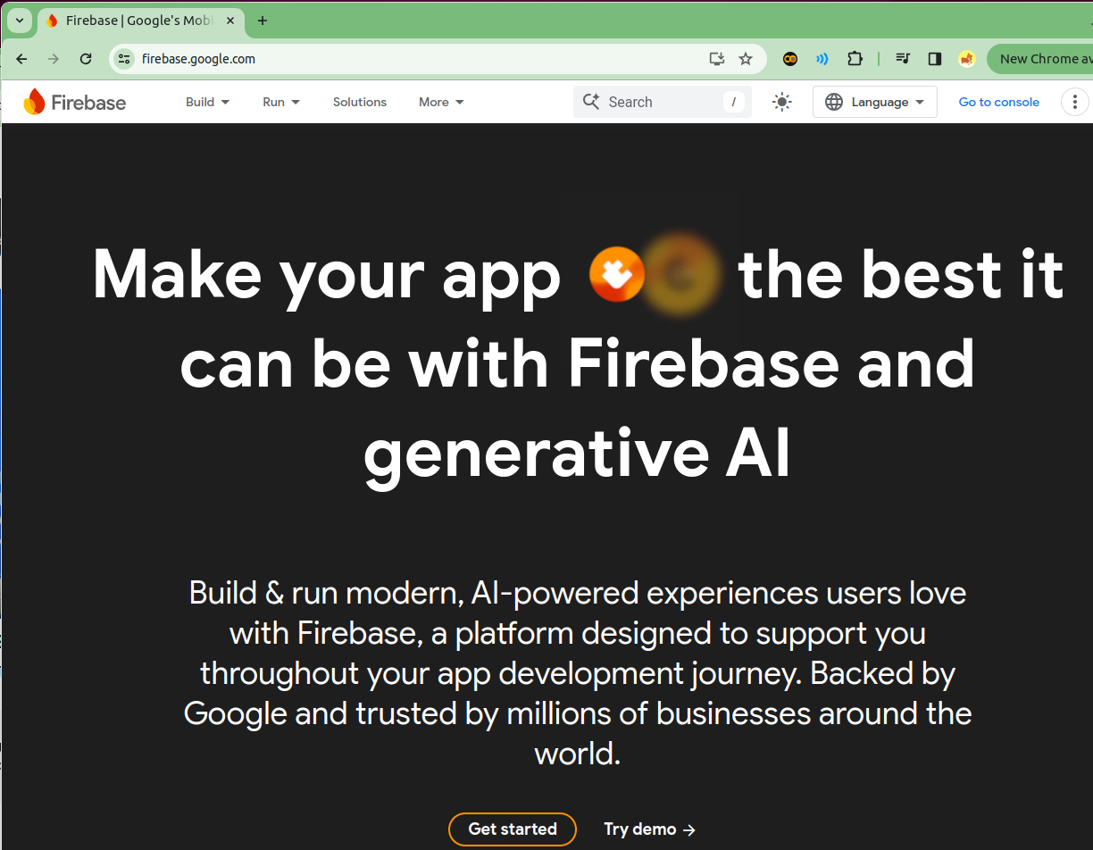
2 Google Free Host Firebase
https://www.youtube.com/watch?v=gtcUIQNhgyQ
Google Free Host Firebase (00:00-00:01/11:36)
We discussed Google Firebase. Google Firebase provide the free static host of Web site. Why do we need free web site?
We start with trial free web site without pressure. We can port into GCP when we start the business.

Slide 3
2 Google Free Host Firebase
https://www.youtube.com/watch?v=gtcUIQNhgyQ
Google Free Host Firebase (00:02-00:03/11:36)
We will what kind of limitation of firebase.
> firebase.google.com

Slide 4
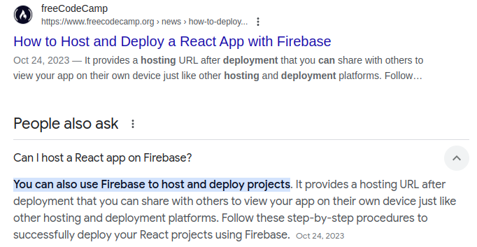
2 Google Free Host Firebase
https://www.youtube.com/watch?v=gtcUIQNhgyQ
Google Free Host Firebase (00:03-00:04/11:36)
Before we start, check “Can firebase host ReactJS”?

Slide 5
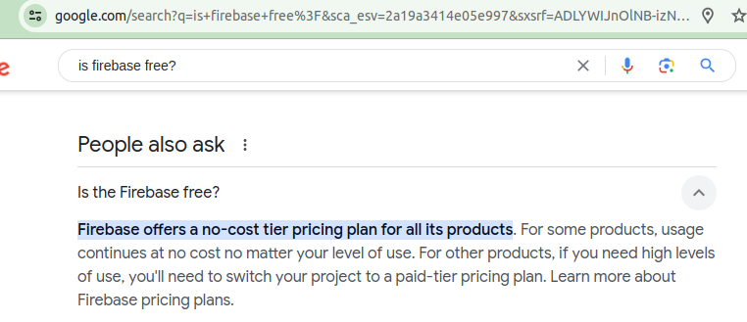
2 Google Free Host Firebase
https://www.youtube.com/watch?v=gtcUIQNhgyQ
Google Free Host Firebase (00:05-00:18/11:36)
Before we start, check “Is Firebase Free?”

Slide 6
2.01 No Cost Limitation

Slide 7
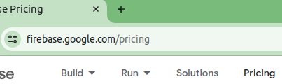
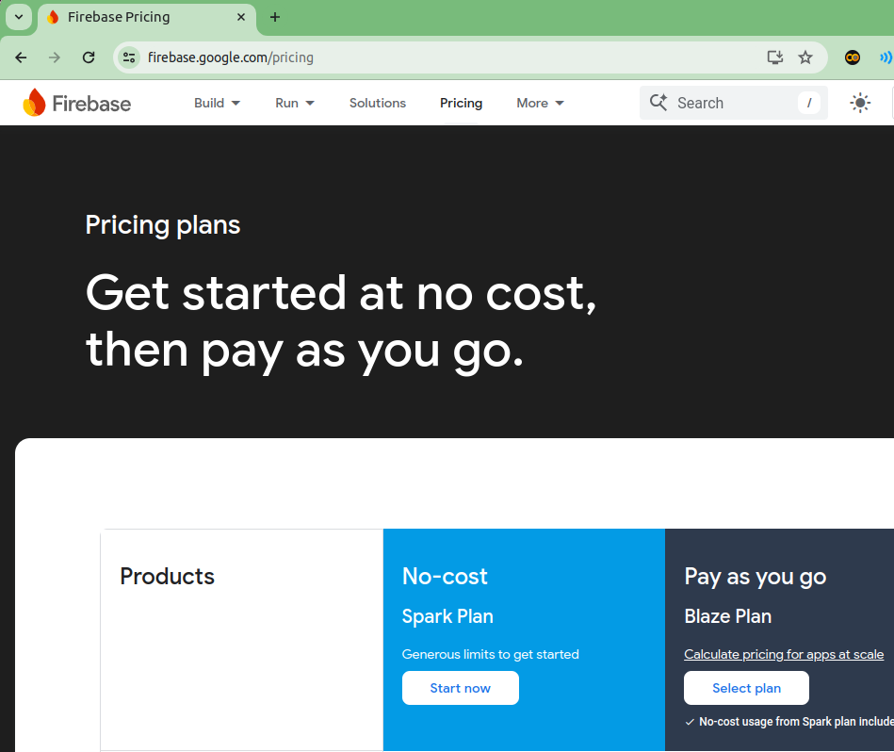
2.01 No Cost Limitation
https://www.youtube.com/watch?v=gtcUIQNhgyQ
No Cost Limitation (00:19-00:20/11:36)
We will look at what kind of limitation of the free version of Firebase.
click the “pricing”.
We Look at the Spark Plan for “No-cost Version”

Slide 8
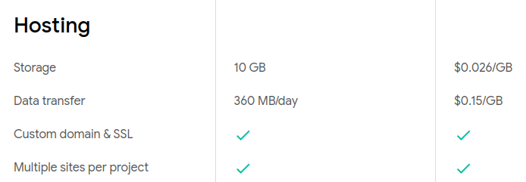
2.01 No Cost Limitation
https://www.youtube.com/watch?v=gtcUIQNhgyQ
No Cost Limitation (00:21-01:05/11:36)
1. Scroll down to “Hosting” section which we are interested. On the left, we see:
2. We have 10 GB free Storage.
3. Data transfer 360 MB per day. If our web site is 1MB which contain a lot of pictures, we can have 360 people go to your website every day. This may not enough for our business web site but it is good for us to try and get started.
4. With web hosting on Google Firebase, we get a custom domain in SSL (Secure Socket Layer) for free and
5. We can have multiple sites per project. So, that is great.
6. We are going to start configuration.

Slide 9
2.02 Start Configuration

Slide 10
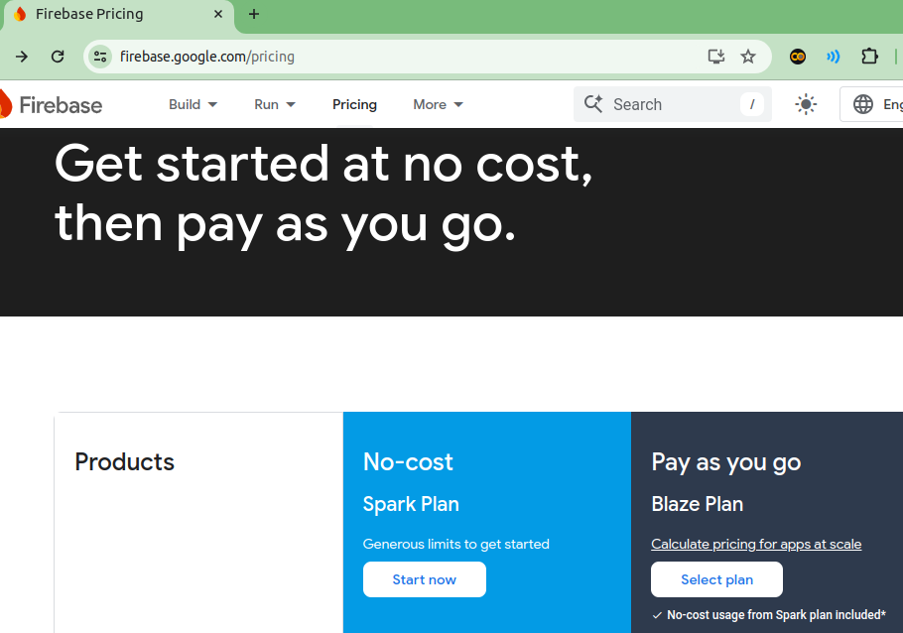
2.02 Start Configuration
https://www.youtube.com/watch?v=gtcUIQNhgyQ
Start Configuration (01:06-01:18/11:36)
We start by configuring our project by click “Start now”.
The Firebase power really come through the command line.

Slide 11
2.03 Create Project

Slide 12
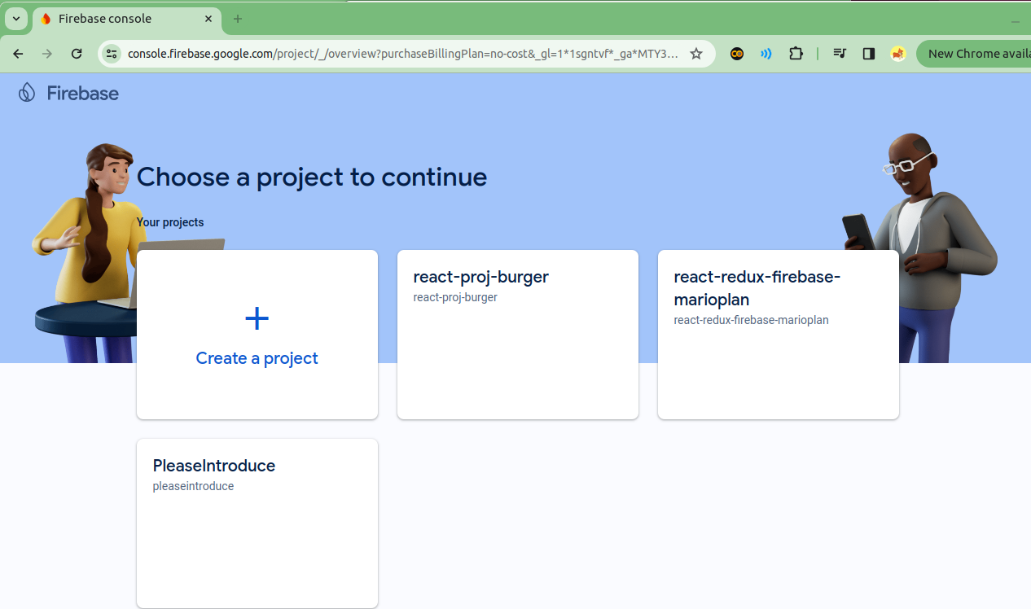
2.03 Create Project
https://www.youtube.com/watch?v=gtcUIQNhgyQ
Create Project (01:19-01:20/11:36)
Click “Create a project”.

Slide 13
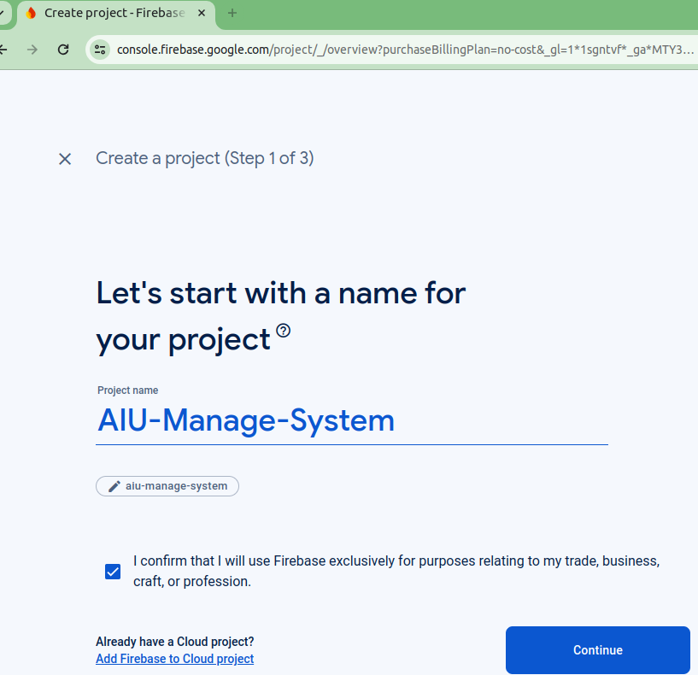
2.03 Create Project
https://www.youtube.com/watch?v=gtcUIQNhgyQ
Create Project (01:21-01:30/11:36)
Project Name: “AIU-Manage-System”.

Slide 14
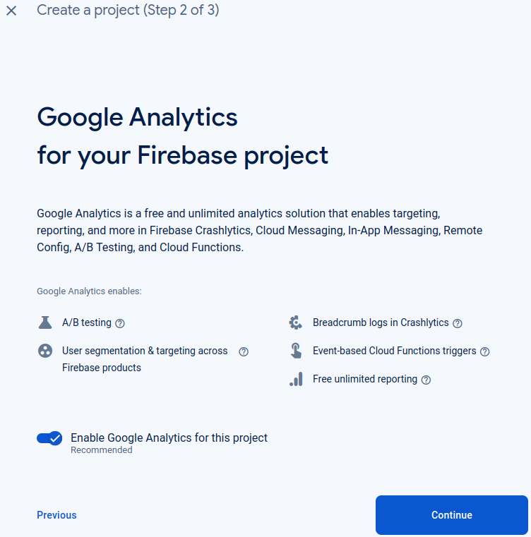
2.03 Create Project
https://www.youtube.com/watch?v=gtcUIQNhgyQ
Create Project (01:31-01:35/11:36)
Here, we disable the “Google Analytics” but we can enable the “Google Analytics” if we want to.

Slide 15
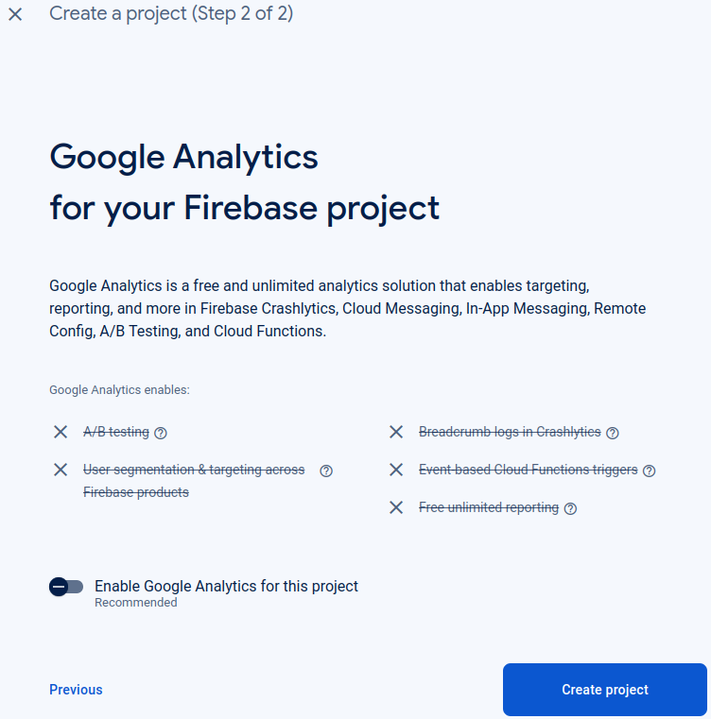
2.03 Create Project
https://www.youtube.com/watch?v=gtcUIQNhgyQ
Create Project (01:36-01:40/11:36)
Click “Create project”.

Slide 16
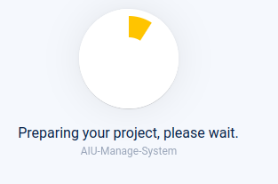
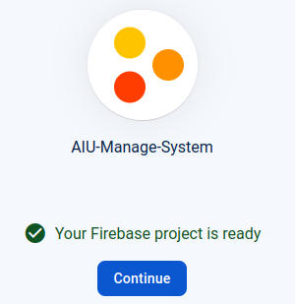
2.03 Create Project
https://www.youtube.com/watch?v=gtcUIQNhgyQ
Create Project (01:41-01:45/11:36)
1. Creating project
2. The project is ready.
3. Click “Continue”
1
2
3

Slide 17
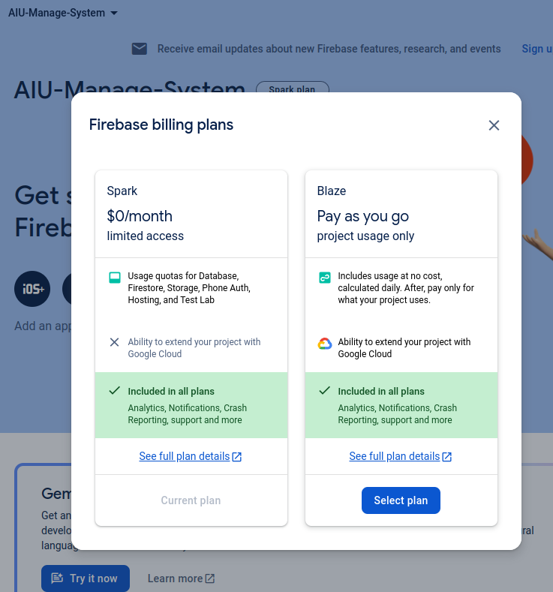
2.03 Create Project
https://www.youtube.com/watch?v=gtcUIQNhgyQ
Create Project (01:46-01:50/11:36)
“Spark” is the current plan.
Click “x” (Close)

Slide 18
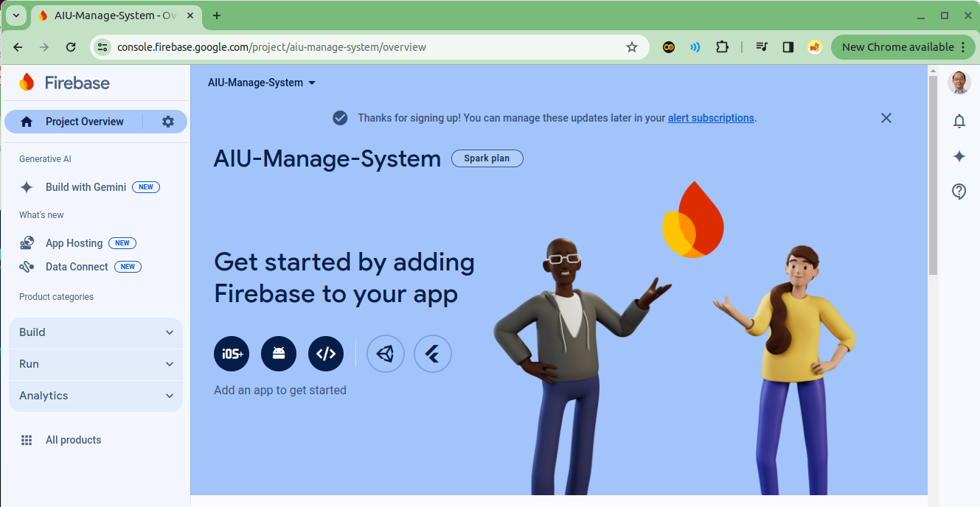

2.03 Create Project
https://www.youtube.com/watch?v=gtcUIQNhgyQ
Create Project (01:51-02:00/11:36)
Click “-” to minimize into Chrome logo.

Slide 19
2.04 Open Linux Terminal

Slide 20
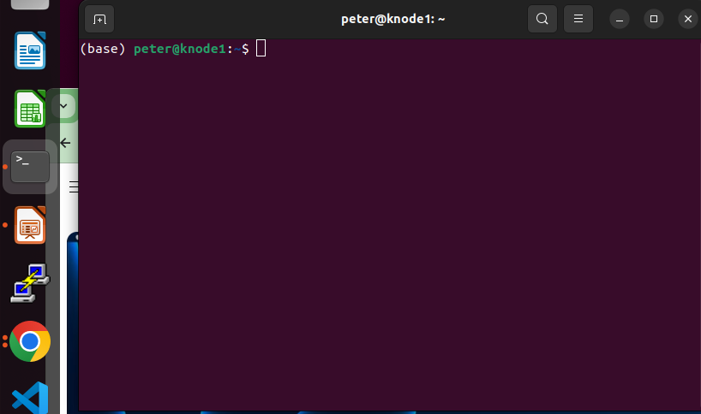
2.04 Create Project
https://www.youtube.com/watch?v=gtcUIQNhgyQ
Create Project (01:51-02:00/11:36)
Click “Terminal” to open Terminal.

Slide 21
2.05 Install Firebase

Slide 22
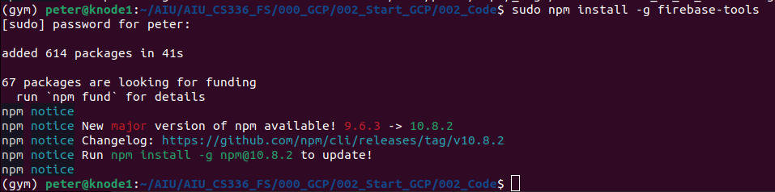
2.05 Install Firebase
https://www.youtube.com/watch?v=gtcUIQNhgyQ
Install Firebase (02:01-02:20/11:36)
User “sudo” (Super user) and npm (Node Package Manager) to install the firebase
> sudo npm install -g firebase-tools

Slide 23
2.06 Start Firebase Login

Slide 24
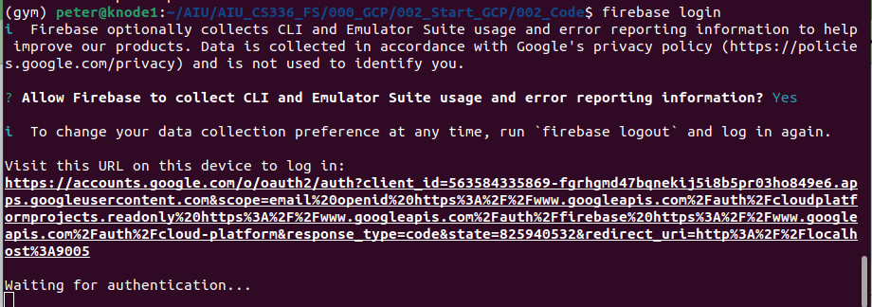
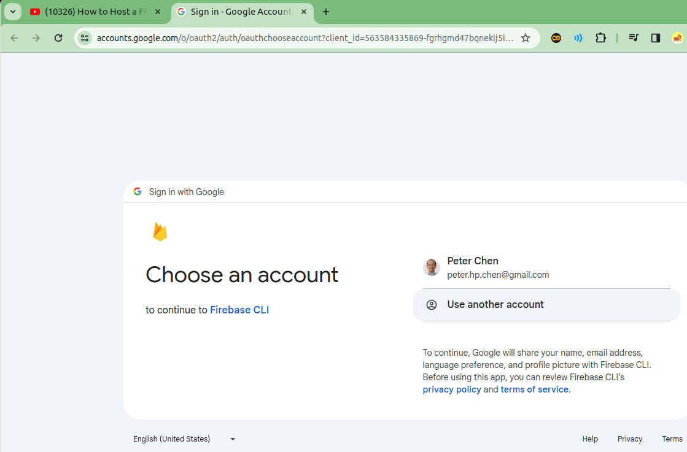
2.06 Start Firebase Login
https://www.youtube.com/watch?v=gtcUIQNhgyQ
Start Firebase Login (02:21-02:50/11:36)
Start firebase
> firebase login
Select email address.

Slide 25
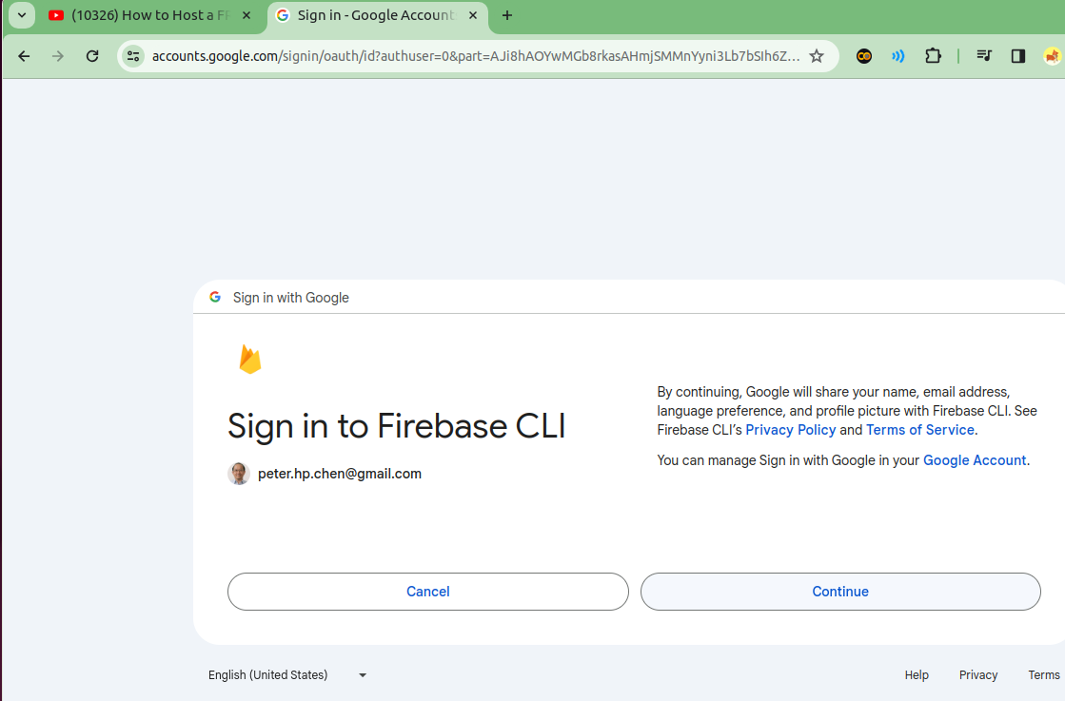
2.06 Start Firebase Login
https://www.youtube.com/watch?v=gtcUIQNhgyQ
Start Firebase Login (02:51-03:00/11:36)
Click “Continue”

Slide 26
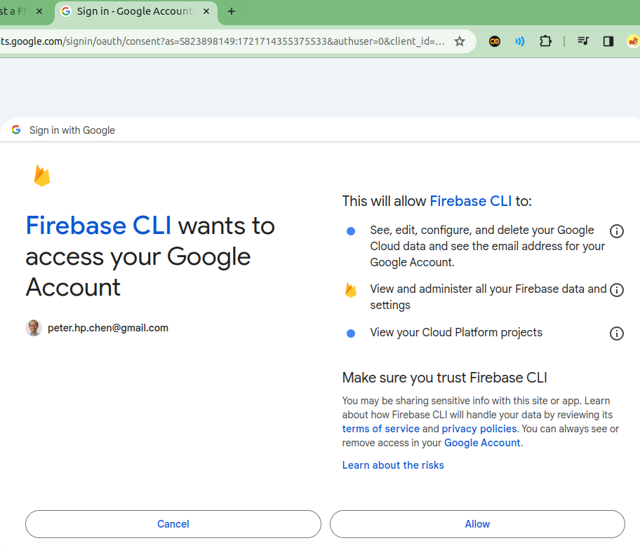
2.06 Start Firebase Login
https://www.youtube.com/watch?v=gtcUIQNhgyQ
Start Firebase Login (03:01-03:05/11:36)
Click “Allow”

Slide 27
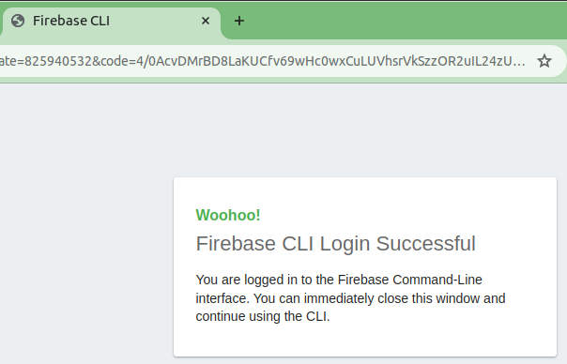
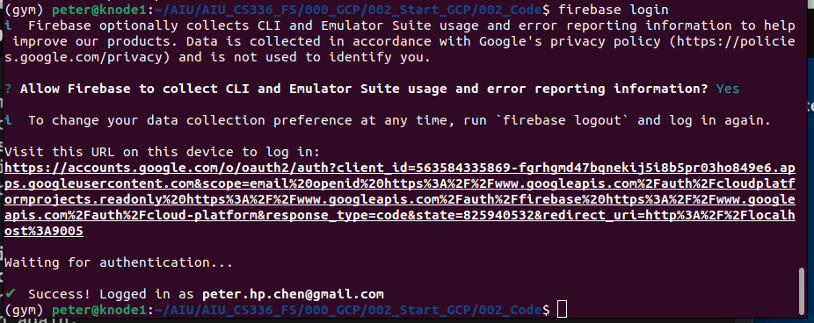
2.06 Start Firebase Login
https://www.youtube.com/watch?v=gtcUIQNhgyQ
Start Firebase Login (03:06-03:15/11:36)
Firebase CLI Login Successful

Slide 28
2.07 Download html-template

Slide 29
2.07 Download html-template
https://www.youtube.com/watch?v=gtcUIQNhgyQ
Download html-template (03:16-03:30/11:36)
Google Search “Free Education html-template” and get the below link.
Unzipped in the code folder.
In the code folder
> ls
>>> html-template like subscribe
https://www.free-css.com/free-css-templates/page291/elearning

Slide 30
2.08 Setup Firebase Hosting

Slide 31
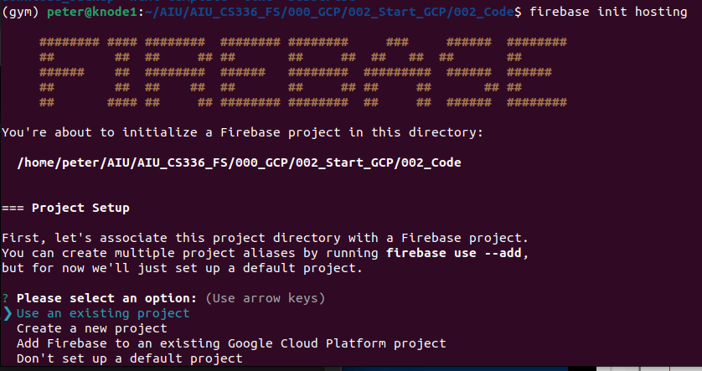
2.08 Setup Firebase Hosting
https://www.youtube.com/watch?v=gtcUIQNhgyQ
Setup Firebase Hosting (03:31-03:4011:36)
> firebase init hosting
This will ask you for the project.
Here, I choose “Use am existing project”

Slide 32
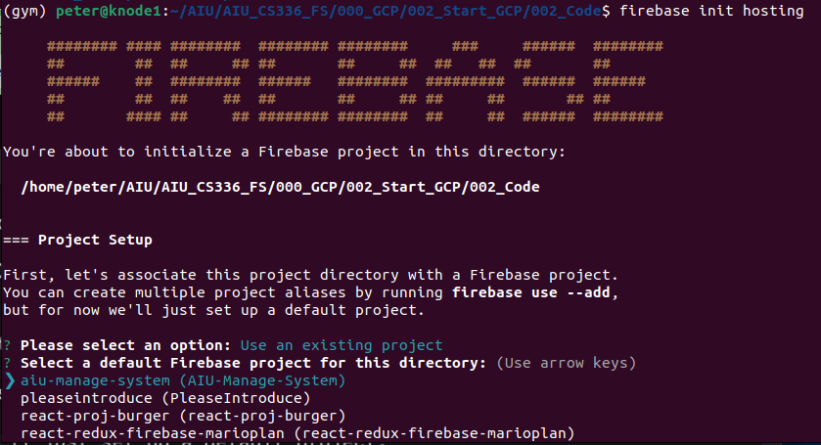
2.08 Setup Firebase Hosting
https://www.youtube.com/watch?v=gtcUIQNhgyQ
Setup Firebase Hosting (03:41-03:50/11:36)
We select “aiu-manage-system (AIU-Manage-System)”

Slide 33
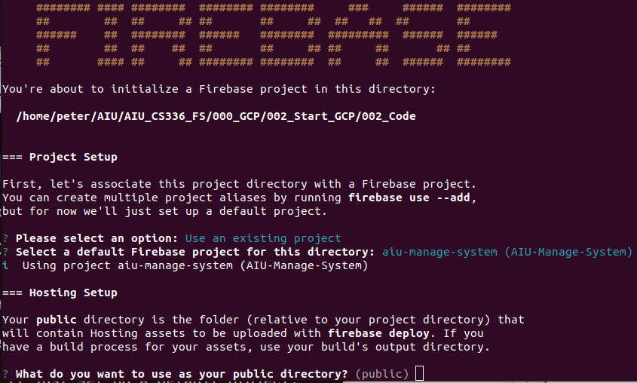
2.08 Setup Firebase Hosting
https://www.youtube.com/watch?v=gtcUIQNhgyQ
Setup Firebase Hosting (03:51-04:00/11:36)
We select “(public)” folder here.

Slide 34
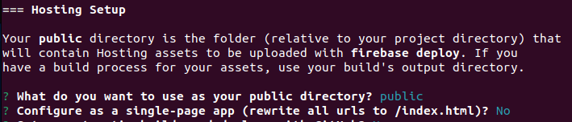
2.08 Setup Firebase Hosting
https://www.youtube.com/watch?v=gtcUIQNhgyQ
Setup Firebase Hosting (04:01-04:11/11:36)
We do not do single-page app “/index.html”: N

Slide 35
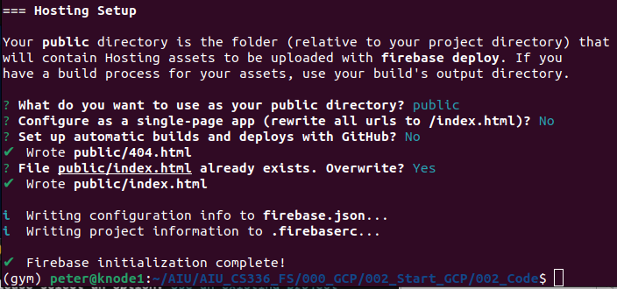
2.08 Setup Firebase Hosting
https://www.youtube.com/watch?v=gtcUIQNhgyQ
Setup Firebase Hosting (04:11-03:20/11:36)
We do not do “GitHub”: N
We have “Firebase initialization complete!”

Slide 36
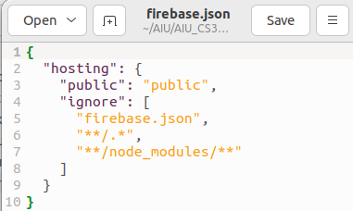
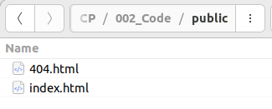
2.08 Setup Firebase Hosting
https://www.youtube.com/watch?v=gtcUIQNhgyQ
Setup Firebase Hosting (04:21-04:40/11:36)
> ls
>> firebase.json public
We can see there are
1. firebase.json and
2. public folder: Contains 404 and index files, both are html files.
created
1
2

Slide 37
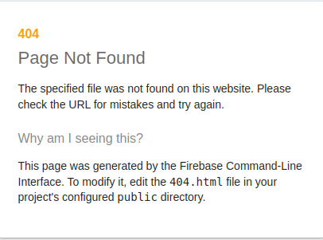
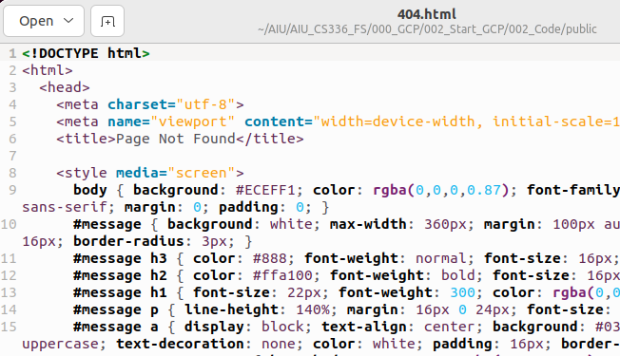
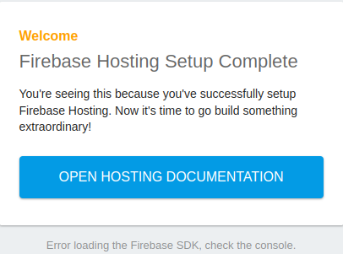
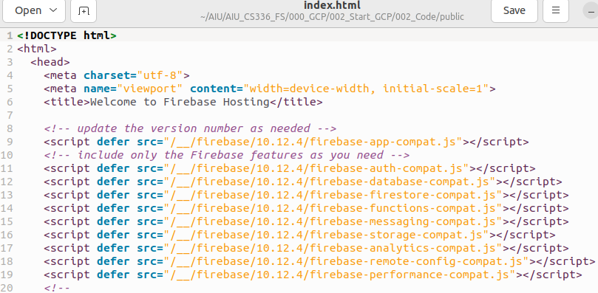
2.08 Setup Firebase Hosting
https://www.youtube.com/watch?v=gtcUIQNhgyQ
Setup Firebase Hosting (04:41-05:00/11:36)
Public folder:
1. 404.html and
2. index.html
1
2

Slide 38
2.09 Firebase Serve

Slide 39
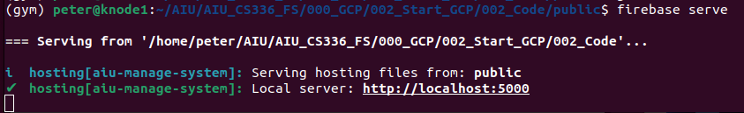
2.09 Firebase Serve
https://www.youtube.com/watch?v=gtcUIQNhgyQ
Firebase Serve (04:41-05:00/11:36)
Start firebase serve
> firebase serve

Slide 40
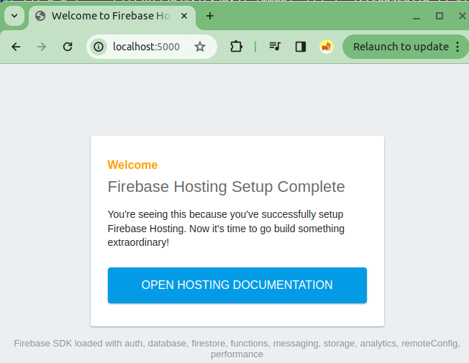
2.09 Firebase Serve
https://www.youtube.com/watch?v=gtcUIQNhgyQ
Firebase Serve (05:01-05:30/11:36)
Open Chrome
> localhost:5000
5000 is the port for localhost to load index.html page.

Slide 41
2.10 Modify index.html

Slide 42
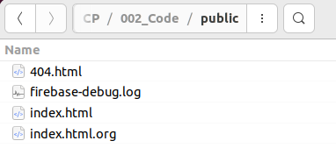
2.10 Modify index.html
https://www.youtube.com/watch?v=gtcUIQNhgyQ
Modify index.html (05:31-05:40/11:36)
We copy index.html to index.html.org
> cp index.html index.html.org
We will start to modify the index.html

Slide 43
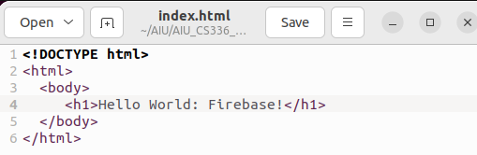
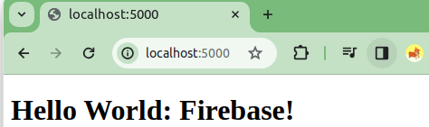
2.10 Modify index.html
https://www.youtube.com/watch?v=gtcUIQNhgyQ
Modify index.html (05:41-06:20/11:36)
1. Modify index.html as below.
2. Click symbol ⟳ (refresh) to reload index.html.
Now, let’s deploy the web page to public now.
1
2

Slide 44
2.11 Stop Firebase Serve

Slide 45
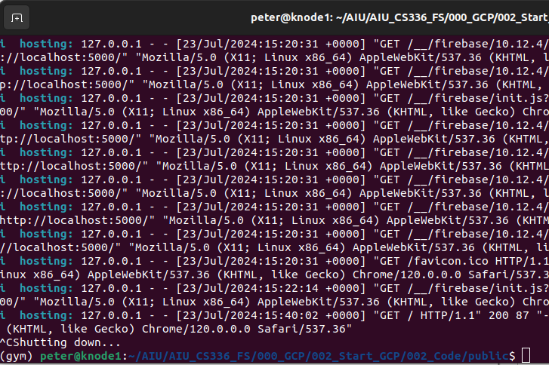
2.10 Stop Firebase Serve
https://www.youtube.com/watch?v=gtcUIQNhgyQ
Stop Firebase Serve (06:21-06:30/11:36)
We control-C to shut down the local server.

Slide 46
2.12 Firebase Deploy

Slide 47
2.12 Firebase Deploy

Slide 48
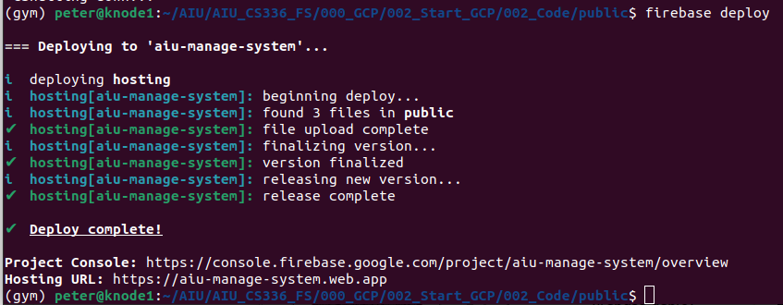
2.12 Firebase Deploy
https://www.youtube.com/watch?v=gtcUIQNhgyQ
Firebase Deploy (06:31-07:20/11:36)
Now, instead of Firebase Serve, we do the Firebase Deploy.
> firebase deploy
The project is deployed at “https://aiu-manage-system.web.app”

Slide 49
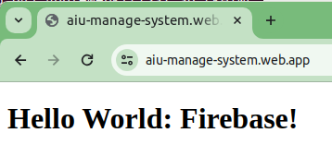
2.12 Firebase Deploy
https://www.youtube.com/watch?v=gtcUIQNhgyQ
Firebase Deploy (06:31-8:30/11:36)
Open Chrome
> https://aiu-manage-system.web.app
We can see the public/index.html is successfully deployed!

Slide 50
2.12 Firebase Deploy
https://www.youtube.com/watch?v=gtcUIQNhgyQ
Firebase Deploy (08:31-09:30/11:36)
This web site public and we do not use “localhost:5000” any more.
Now, we can do whatever modification on index.html and etc. with ReactJS or Angular.

Slide 51
2.13 Sumamry

Slide 52
2.13 Summary
https://www.youtube.com/watch?v=gtcUIQNhgyQ
Summary (09:31-11:36/11:36)
Why do we need the Firebase deploy?
1. Google Firebase is free and very easy to deploy your application. Before we deploy on charged GCP (Google Cloud Platform), developer feel no pressure on using Firebase outside GCP.
2. What does Google Firebase provide?
  2.1 Free storage 10 GB,
  2.2 Data Transfer 360 MB/day,
  2.3 Domain name: user decide the domain name
  2.4 SSL (Secure Socket Layer): User chooses the SSL he wants
  2.5 User can have multiple sites for the same project.
  2.6 Deploy Command: firebase deploy

Slide 53
End

