Slide 1

28 Flask
Peter H. Chen

Slide 2
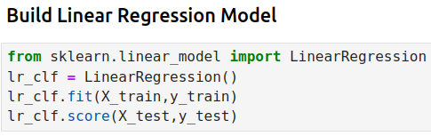
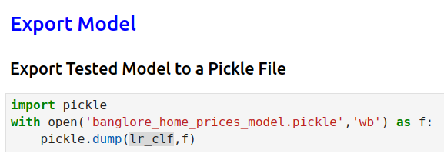
28 Flask
https://www.youtube.com/watch?v=Q5JyawS8f5Q&list=PLeo1K3hjS3uvCeTYTeyfe0-rN5r8zn9rw&index=28
Flask (0:00-0:30/21:12)
In the last discussion,
1. We create the Linear Regression Model and
2. save model in pickle format.
In this discussion, we will write the Python Flask Server which
1. get HTTP requests from frontend UI,
2. route the frontend message to the backend model,
3. The backend Model predict the home price,
4. Flask send back to frontend
5. Frontend UI display result.
1
2

Slide 3
28.1 Conda Environment

Slide 4
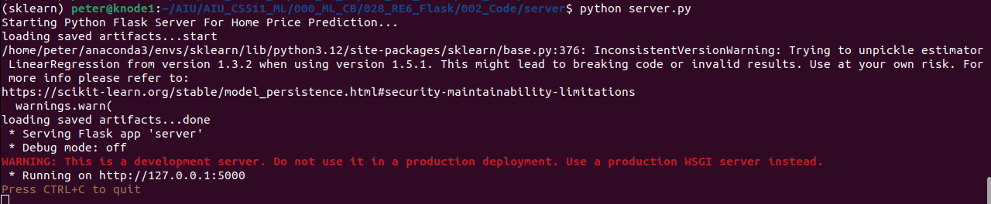
28.1 Conda Environment
https://www.youtube.com/watch?v=Q5JyawS8f5Q&list=PLeo1K3hjS3uvCeTYTeyfe0-rN5r8zn9rw&index=28
Conda Environment (0:31-0:40/21:12)
Here, we use conda environment. We use anaconda python as the the interpreter.
> conda activate sklearn
Below I tested before start.
> python server.py
Note:
If you get the message in pickle.load(): “No module named 'sklearn.linear_model.base'.
Your pickle dump is written in previous version of Pickle file, for example, you download the file from GitHub written by someone else.
Update the pickle file you write and re-start again.

Slide 5
28.2 Install Libraries

Slide 6
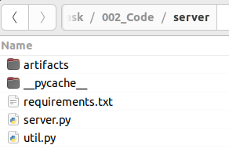
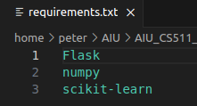
28.2 Install Libraries
https://www.youtube.com/watch?v=Q5JyawS8f5Q&list=PLeo1K3hjS3uvCeTYTeyfe0-rN5r8zn9rw&index=28
Install Libraries (0:41-1:00/21:12)
1. We have requirements.txt
2. Install the libraries:
(base) > pip install -r requirements.txt
1
2

Slide 7
28.3 Folder

Slide 8
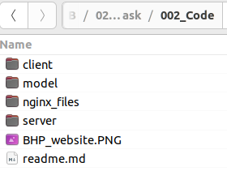
28.3 Folder
https://www.youtube.com/watch?v=Q5JyawS8f5Q&list=PLeo1K3hjS3uvCeTYTeyfe0-rN5r8zn9rw&index=28
Folder (1:01-1:30/21:12)
We have three folder
1. Client: GUI
2. Model: Jupyter Notebook for model
3. server: Flask server.

Slide 9
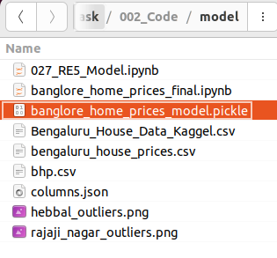
28.3 Folder
https://www.youtube.com/watch?v=Q5JyawS8f5Q&list=PLeo1K3hjS3uvCeTYTeyfe0-rN5r8zn9rw&index=28
Folder (1:31-2:00/21:12)
In the Model folder, we have
1. banglore_home_prices_model.pickle: Model file
2. columns.json: column information.

Slide 10
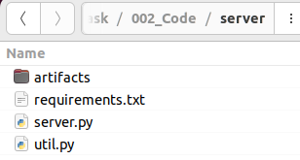
28.3 Folder
https://www.youtube.com/watch?v=Q5JyawS8f5Q&list=PLeo1K3hjS3uvCeTYTeyfe0-rN5r8zn9rw&index=28
Folder (1:31-2:00/21:12)
In the Server folder, we have
1. server.py
2. requirements.txt:

Slide 11
28.4 Server.py

Slide 12
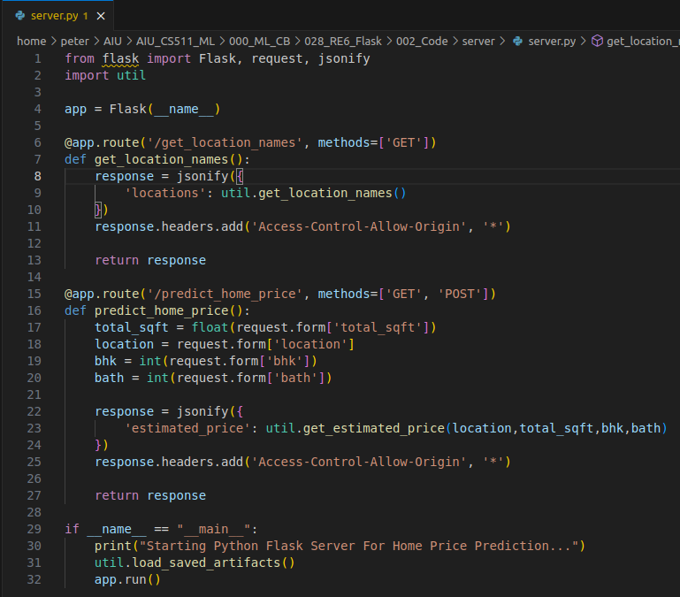
28.4 Server.py
https://www.youtube.com/watch?v=Q5JyawS8f5Q&list=PLeo1K3hjS3uvCeTYTeyfe0-rN5r8zn9rw&index=28
Server.py (2:01-2:30/21:12)
1. In the server folder, we have
2. > code server.py
2

Slide 13
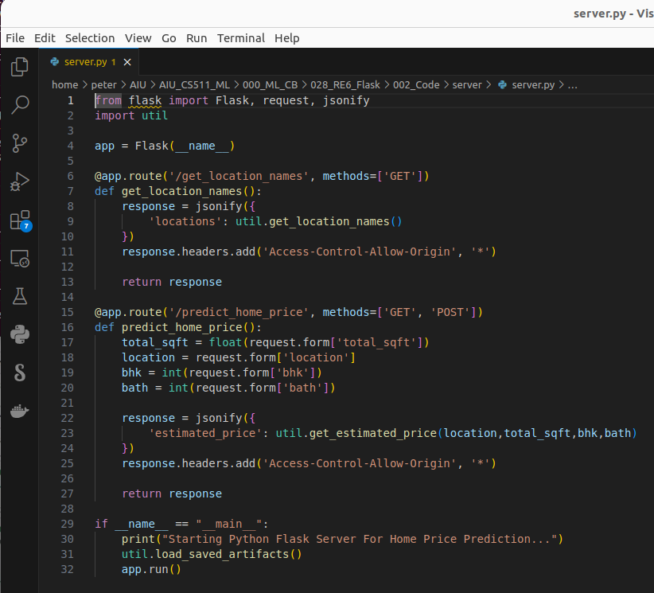
28.1 Conda Environment
https://www.youtube.com/watch?v=Q5JyawS8f5Q&list=PLeo1K3hjS3uvCeTYTeyfe0-rN5r8zn9rw&index=28
Conda Environment (2:31-3:00/21:12)
Here, we use MS code editor [or gedit (GNU Editor)]
> code server.py

Slide 14
28.2 Import Library

Slide 15
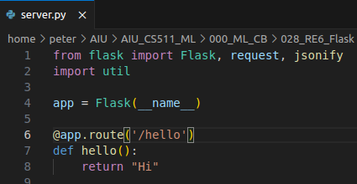
28.2 Import Library
https://www.youtube.com/watch?v=Q5JyawS8f5Q&list=PLeo1K3hjS3uvCeTYTeyfe0-rN5r8zn9rw&index=28
Import Library (3:01-3:05/21:12)
1. Import Flask, request. jsonify library and
2. Import util.py from current folder
1
2

Slide 16
28.3 Create app

Slide 17
28.3 Craete app
https://www.youtube.com/watch?v=Q5JyawS8f5Q&list=PLeo1K3hjS3uvCeTYTeyfe0-rN5r8zn9rw&index=28
Create app (3:06-3:10/21:12)
1. Create app with Flask(__name__).
Here, We passed in “__main__” to app and tell/start the app with function __main__.
1

Slide 18
28.4 Main Program

Slide 19
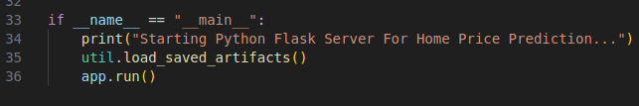
28.4 Main Program
https://www.youtube.com/watch?v=Q5JyawS8f5Q&list=PLeo1K3hjS3uvCeTYTeyfe0-rN5r8zn9rw&index=28
Main Program (3:11-3:20/21:12)
1. Here, we check __name__ = “__main__”. We passed in “__main__” to app and tell/start the app with function __main__.
2. start app.run()
1
2

Slide 20
28.5 Define Route Function hello()

Slide 21
28.5 Define Route Function hello()
https://www.youtube.com/watch?v=Q5JyawS8f5Q&list=PLeo1K3hjS3uvCeTYTeyfe0-rN5r8zn9rw&index=28
Define Route Function hello() (3:21-3:30/21:12)
1. We can run the server now.
1

Slide 22
28.6 Start Main Program

Slide 23
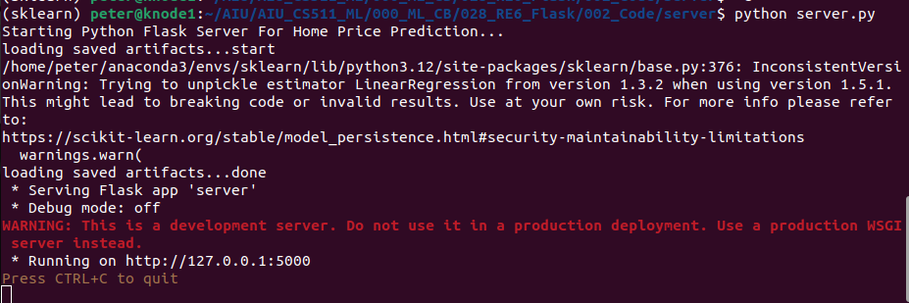
28.6 Start Main Program
https://www.youtube.com/watch?v=Q5JyawS8f5Q&list=PLeo1K3hjS3uvCeTYTeyfe0-rN5r8zn9rw&index=28
Start Main Program (3:31-3:40/21:12)
1. Open the Ubuntu Terminal and start main server program:
> python server.py
2. We can see the server start at “http://127.0.0.1:5000”
The “http://127.0.0.1” is the predefined as “localhost” in Ubuntu.
1
2

Slide 24
28.7 /hello: Request and Response

Slide 25
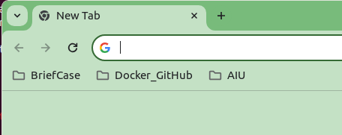
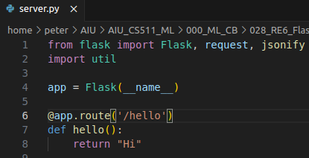
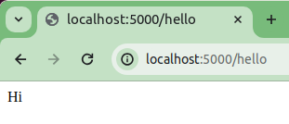
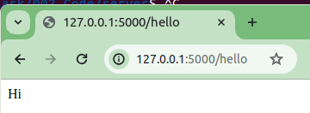
28.7 /hello: Request and Response
https://www.youtube.com/watch?v=Q5JyawS8f5Q&list=PLeo1K3hjS3uvCeTYTeyfe0-rN5r8zn9rw&index=28
1
/hello: Request and Response (3:31-4:00/21:12)
1. Open the google chrome page
2. We already defined the app.route (‘hello’) for function hello().
3. Type
> localhost:5000/hello
Or
4 > http://127.0.0.1:5000/hello
5. Both step 3 and step 4 Google chrome page prompt “Hi”.
2
3
4
5
5

Slide 26
28.8 Copy Model Data

Slide 27
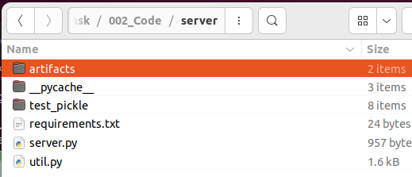
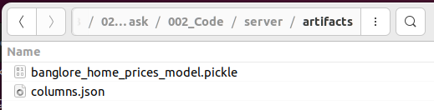
28.8 Copy Model Data
https://www.youtube.com/watch?v=Q5JyawS8f5Q&list=PLeo1K3hjS3uvCeTYTeyfe0-rN5r8zn9rw&index=28
Copt Folder Data (4:01-5:00/21:12)
In the server folder, we
1. Create folder “artifacts”
2. In the artifacts, we copy Model “banglore_home_prices_model.pickle” and columns information “columns.json”
1
2

Slide 28
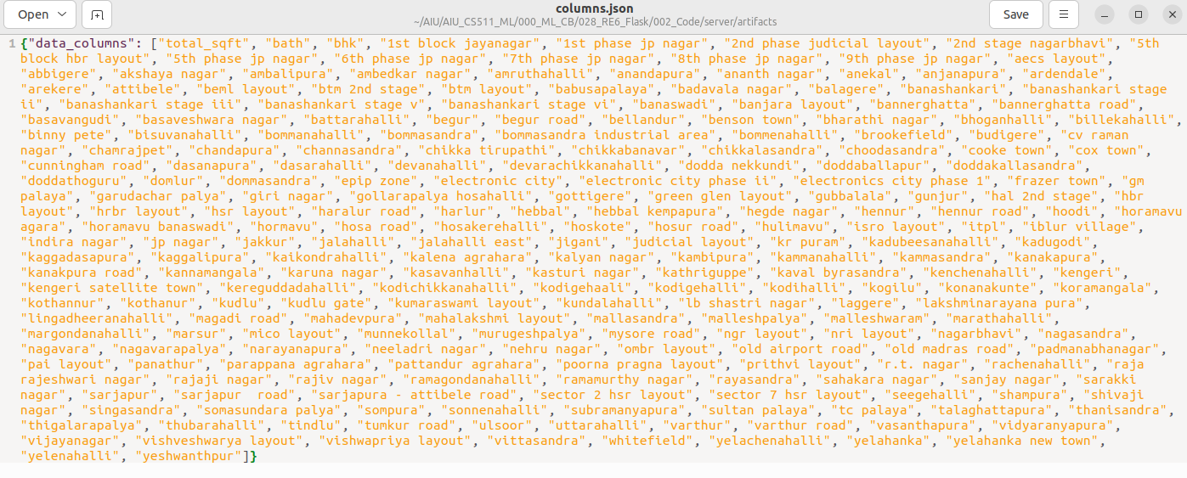
28.8 Copy Model Data
https://www.youtube.com/watch?v=Q5JyawS8f5Q&list=PLeo1K3hjS3uvCeTYTeyfe0-rN5r8zn9rw&index=28
Copt Folder Data (5:01-5:30/21:12)
The json file “columns.json” contains all the locations.

Slide 29
28.9 Define Funcitons

Slide 30
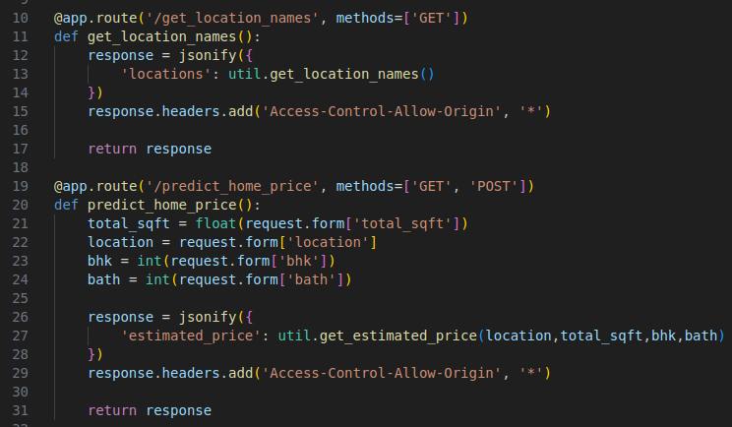
28.9 Define Functions
https://www.youtube.com/watch?v=Q5JyawS8f5Q&list=PLeo1K3hjS3uvCeTYTeyfe0-rN5r8zn9rw&index=28
Function Functions (5:31-9:00/21:12)

Slide 31
28.10 Test get_locaiton_names

Slide 32
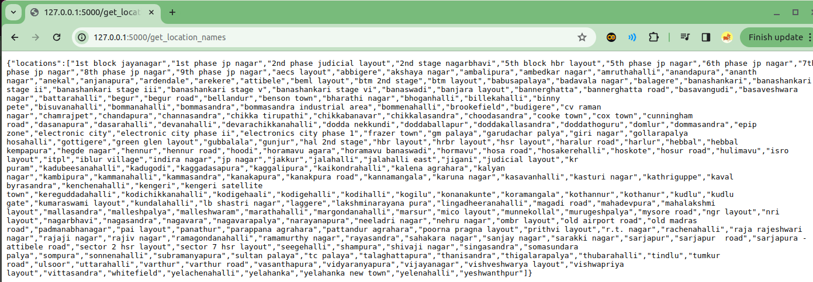
28.10 Test get_locaiton_names
https://www.youtube.com/watch?v=Q5JyawS8f5Q&list=PLeo1K3hjS3uvCeTYTeyfe0-rN5r8zn9rw&index=28
Test get_location_names (5:31-9:00/21:12)
1. Restart server:
> python server.py
2. open google chrome and type
> http://127.0.0.1/get_location_names

Slide 33
28.11 Test Prediction

Slide 34
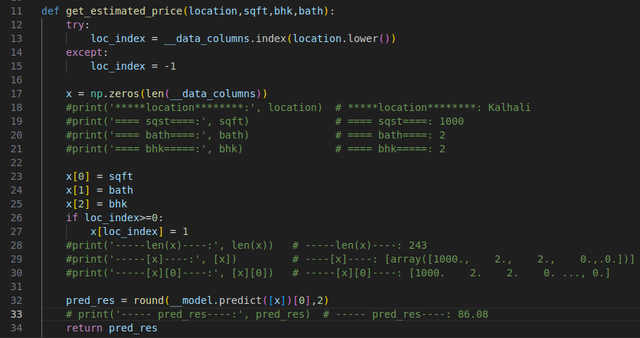
28.11 Test Prediction
https://www.youtube.com/watch?v=Q5JyawS8f5Q&list=PLeo1K3hjS3uvCeTYTeyfe0-rN5r8zn9rw&index=28
Test Prediction (9:01-11:00/21:12)
Warning: UserWarning: X does not have valid feature names, but LinearRegression was fitted with feature names (will be fixed later on)

Slide 35
28.12 Test util.py

Slide 36
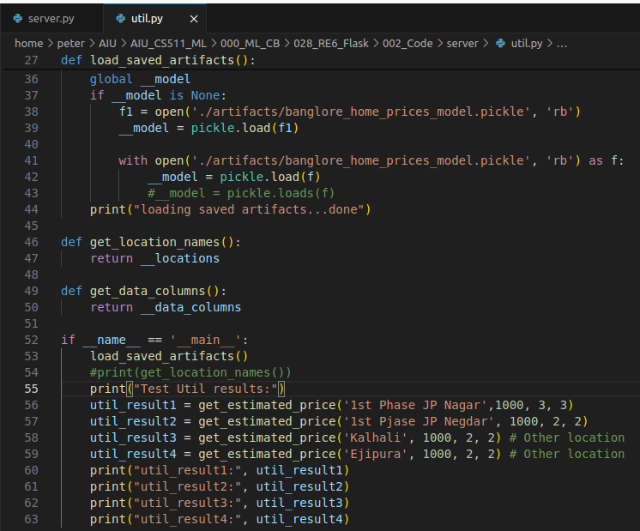
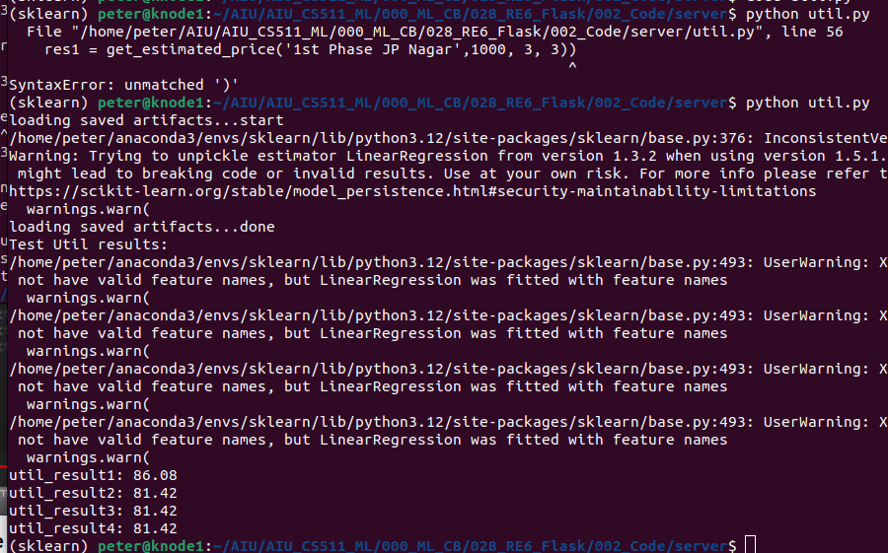
28.12 Test util.py
https://www.youtube.com/watch?v=Q5JyawS8f5Q&list=PLeo1K3hjS3uvCeTYTeyfe0-rN5r8zn9rw&index=28
Test util.py (11:01-13:00/21:12)
1. Add util.py
> python util.py

Slide 37
28.12 Call util from server.py

Slide 38
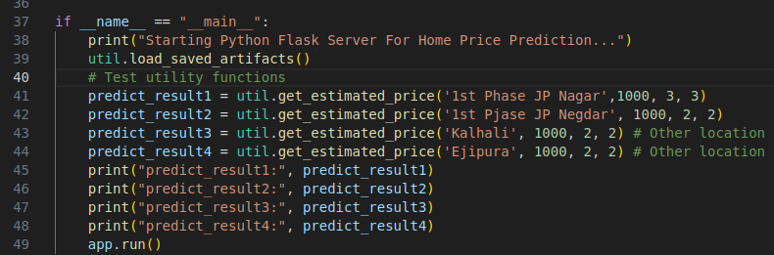
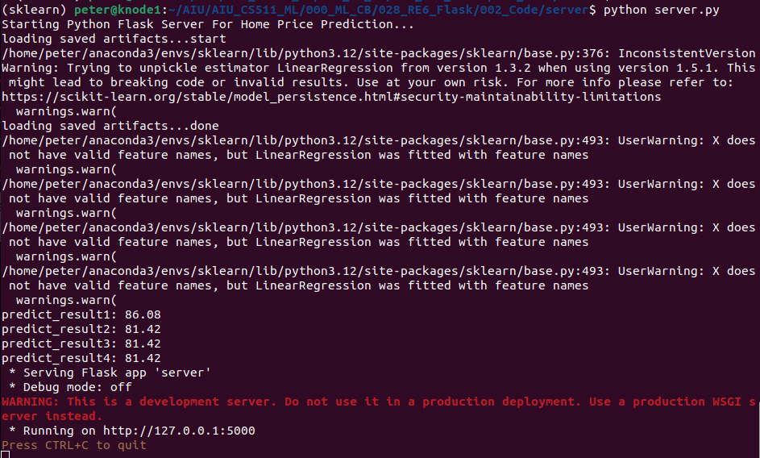
28.12 Call util from server.py
https://www.youtube.com/watch?v=Q5JyawS8f5Q&list=PLeo1K3hjS3uvCeTYTeyfe0-rN5r8zn9rw&index=28
Call util from server.py (13:01-16:00/21:12)
All the util functions are working.

Slide 39
28.13 Download Postman

Slide 40
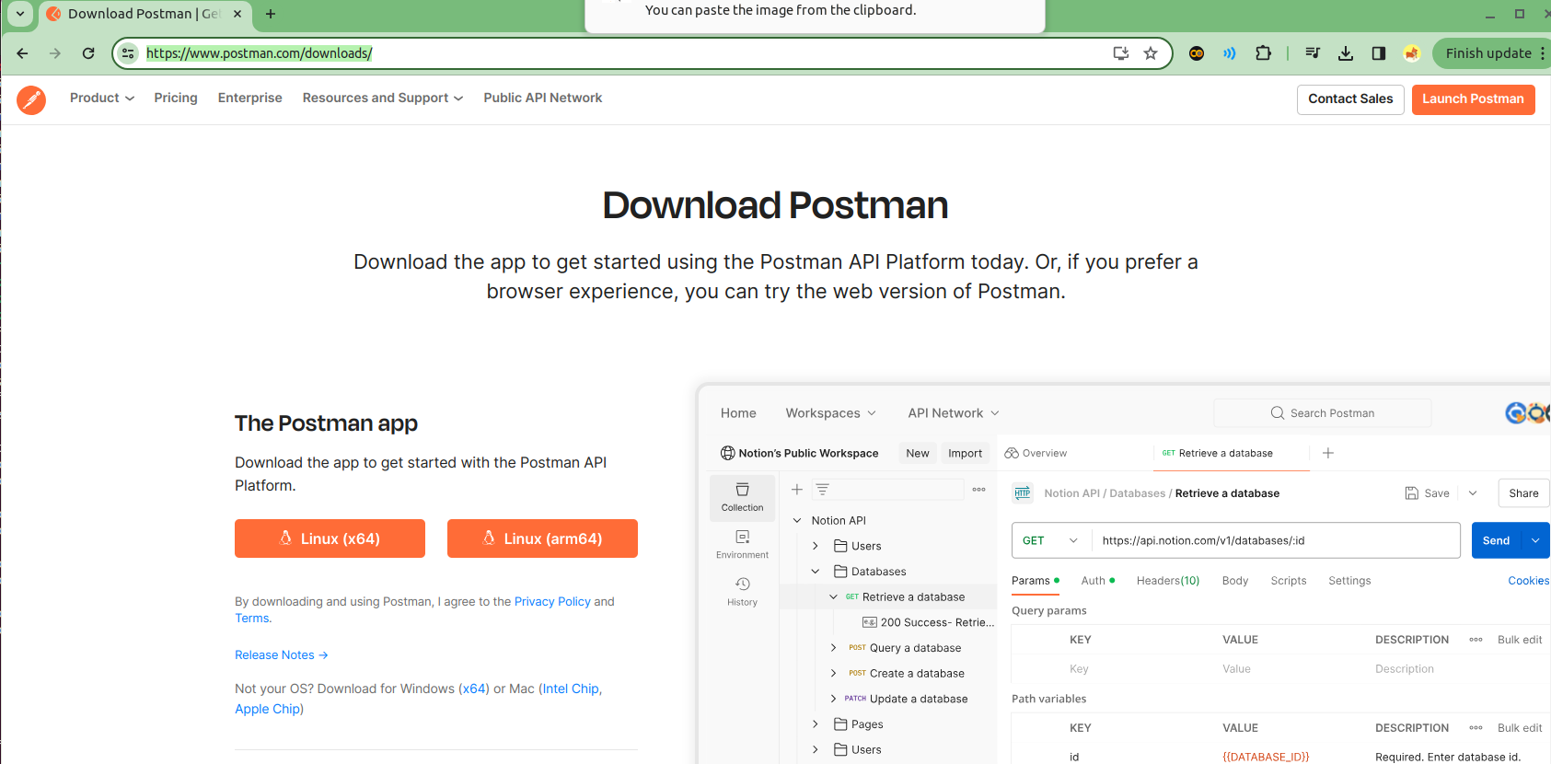
28.13 Download Postman
https://www.youtube.com/watch?v=Q5JyawS8f5Q&list=PLeo1K3hjS3uvCeTYTeyfe0-rN5r8zn9rw&index=28
Download Postman (16:01-17:00/21:12)
We will use POSTMAN to test the HTTP Methods: GET and POST.
The Postman has two type:
1. Postman for server: The web version can be used for public server.
2. Localhost: In our case, we use the localhost (http://127.0.0.01) server, we cannot web version. We need to download localhost version. We google search “localhost postman download”. Click the Linux (x64)
https://www.postman.com/downloads/

Slide 41
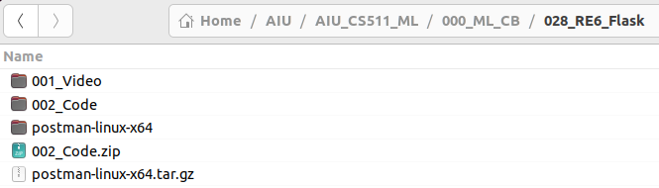
28.13 Download Postman
https://www.youtube.com/watch?v=Q5JyawS8f5Q&list=PLeo1K3hjS3uvCeTYTeyfe0-rN5r8zn9rw&index=28
POSTMAN: GET and POST (16:01-17:00/21:12)
1. We download the “postman-linux-x64.tar.gz”
2. We extract folder: postman-linix-x64

Slide 42
28.14 Start Postman

Slide 43
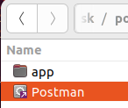
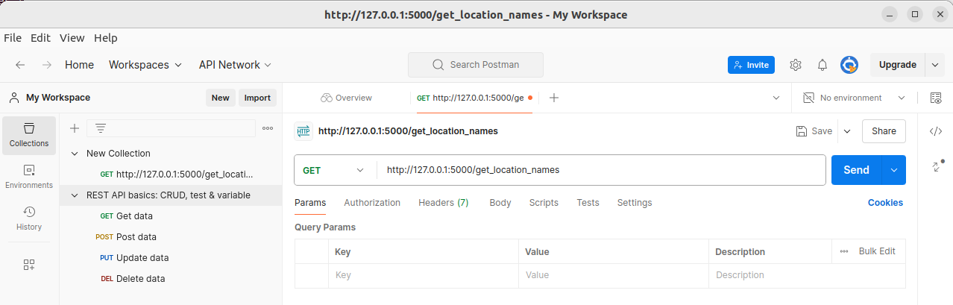
28.14 Start Postman
https://www.youtube.com/watch?v=Q5JyawS8f5Q&list=PLeo1K3hjS3uvCeTYTeyfe0-rN5r8zn9rw&index=28
Start Postman (18:01-18:30/21:12)
In the “postman-linux-64/Postman” folder, double Click “Postman” to start.

Slide 44
28.15 Send GET HTTP/Params

Slide 45
28.15 Send GET HTTP/Params
https://www.youtube.com/watch?v=Q5JyawS8f5Q&list=PLeo1K3hjS3uvCeTYTeyfe0-rN5r8zn9rw&index=28
Send GET HTTP/Params (18:31-19:00/21:12)
We send “GET http://127.0.0.1:5000/get_location_names” as below:
1. Select “GET”
2. Type “http://127.0.0.1:5000/get_location_names
3. Click “Send” button.
1
3
2

Slide 46
28.16 Send POST HTTP/Params

Slide 47
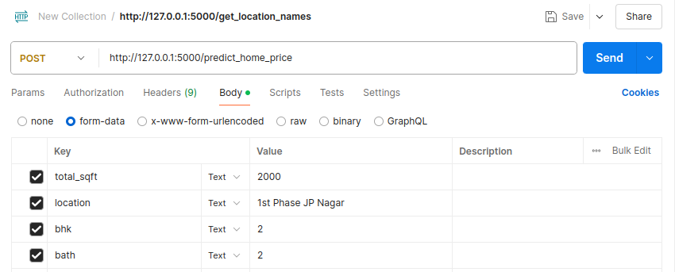
28.16 Send POST HTTP/Params
https://www.youtube.com/watch?v=Q5JyawS8f5Q&list=PLeo1K3hjS3uvCeTYTeyfe0-rN5r8zn9rw&index=28
Send POST HTTP/Params (19:01-19:20/21:12)
1. Select “POST”
2. Type “http://127.0.0.1:5000/Predict_home_price
3. Click Body
4. Select “form-data”
5. POST Parameters: total_sqft: 2000, location: “1st Phase JP Nagar”, bhk: 2, bath: 2
6. Click “Send” button
1
2
6
3
4
5

Slide 48
28.17 POST Response

Slide 49
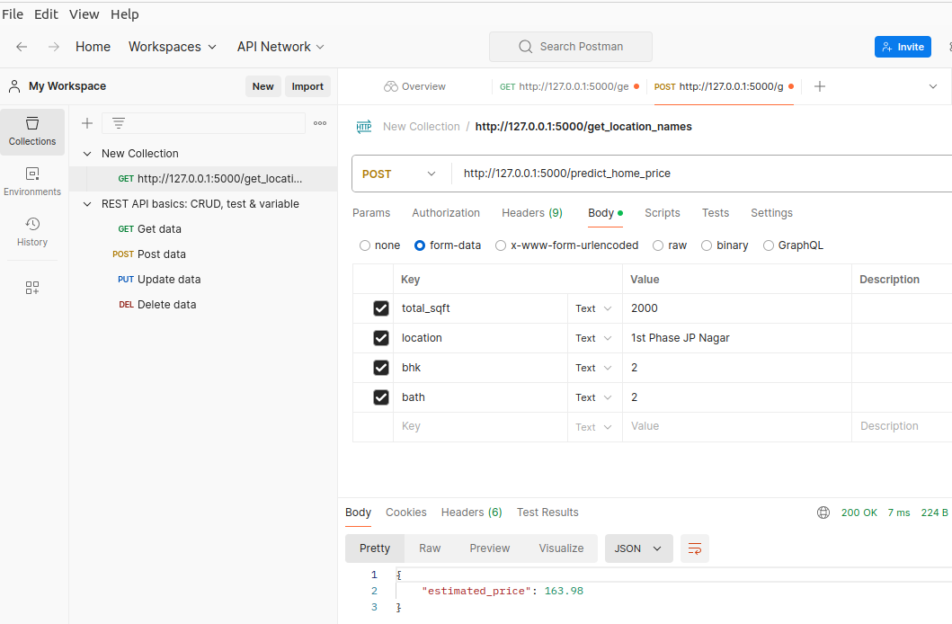
28.17 POST Response
https://www.youtube.com/watch?v=Q5JyawS8f5Q&list=PLeo1K3hjS3uvCeTYTeyfe0-rN5r8zn9rw&index=28
POST Response (19:21-19:50/21:12)
POST response price: 163.98 for location: “1st Phase JP Nagar”, total_sqft: 2000 sq-ft, bhk (bedroom): 2, bath: 2

Slide 50
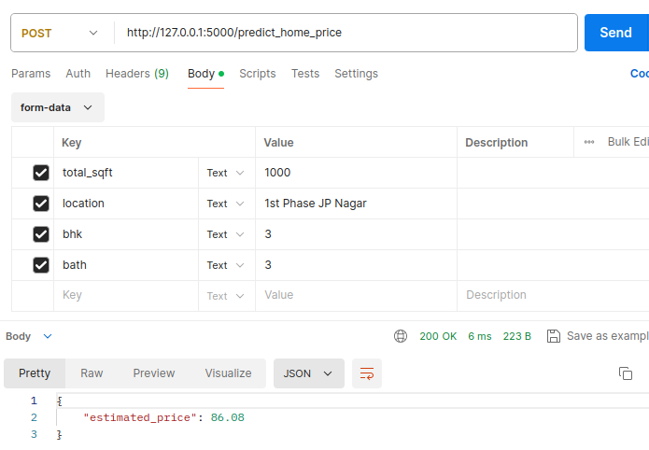
28.17 POST Response
https://www.youtube.com/watch?v=Q5JyawS8f5Q&list=PLeo1K3hjS3uvCeTYTeyfe0-rN5r8zn9rw&index=28
POST Response (19:51-20:00/21:12)
POST response price: 86.88 for location: “1st Phase JP Nagar”, total_sqft: 1000 sq-ft, bhk (bedroom): 3, bath: 3

Slide 51
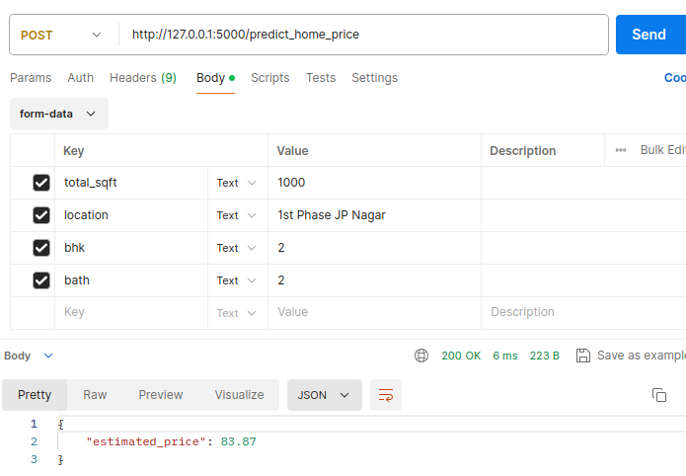
28.17 POST Response
https://www.youtube.com/watch?v=Q5JyawS8f5Q&list=PLeo1K3hjS3uvCeTYTeyfe0-rN5r8zn9rw&index=28
POST Response (20:01-20:20/21:12)
POST response price: 83.87 for location: “1st Phase JP Nagar”, total_sqft: 1000 sq-ft, bhk (bedroom): 2, bath: 2

Slide 52
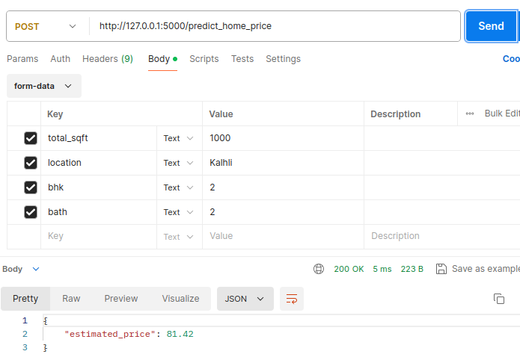
28.17 POST Response
https://www.youtube.com/watch?v=Q5JyawS8f5Q&list=PLeo1K3hjS3uvCeTYTeyfe0-rN5r8zn9rw&index=28
POST Response (20:21-21:00/21:12)
POST response price: 81.42 for location: “Kahali”, total_sqft: 1000 sq-ft, bhk (bedroom): 2, bath: 2

Slide 53
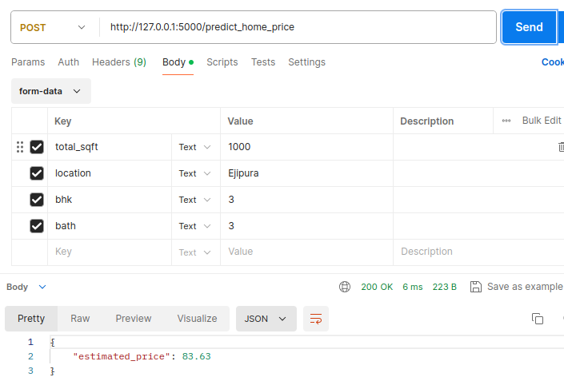
28.17 POST Response
https://www.youtube.com/watch?v=Q5JyawS8f5Q&list=PLeo1K3hjS3uvCeTYTeyfe0-rN5r8zn9rw&index=28
POST Response (21:01-21:12/21:12)
POST response price: 83.63 for location: “Ejipura”, total_sqft: 1000 sq-ft, bhk (bedroom): 2, bath: 2

Slide 54
End

