Slide 1

13 K-Fold Cross Validation
Peter H. Chen

Slide 2
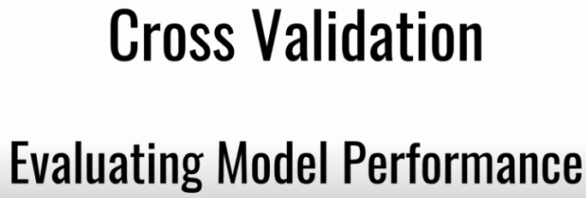
13 K-Fold Cross Validation
https://www.youtube.com/watch?v=gJo0uNL-5Qw&list=PLeo1K3hjS3uvCeTYTeyfe0-rN5r8zn9rw&index=13
K-Fold Cross Validation (0:00-0:30/25:19)
Sometimes we get into the dilemma of which machine learning Model should we use to solve our problem, for example,
When we work on this Iris flower dataset problem, we can classify the Iris flowers by
  SVM,
  Random Forest,
  Logistic Regression,
  Decision Tree, and etc.,
Which model is the best?
Cross Validation is a technique which gives us to answer question. It allows you to evaluate the model performance.

Slide 3
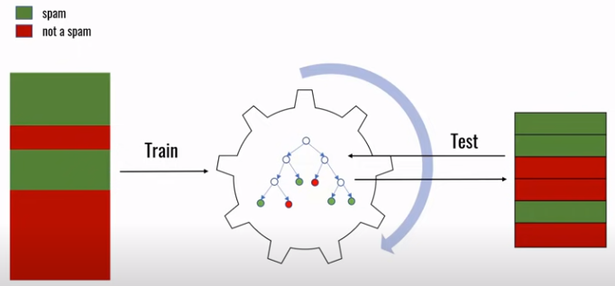
13 K-Fold Cross Validation
https://www.youtube.com/watch?v=gJo0uNL-5Qw&list=PLeo1K3hjS3uvCeTYTeyfe0-rN5r8zn9rw&index=13
K-Fold Cross Validation (0:31-1:05/25:19)
Below example, we have a machine learning model to classify emails as spam or not spam.
The typical procedure is:
1. training the model using the labels dataset that you have.
2. We build a model.
3. We test by a different dataset.
4. Model return results back. You can validate the accuracy of the model.
1
3
2
4
Validate

Slide 4
13.1 Option 1: Same Dataset

Slide 5
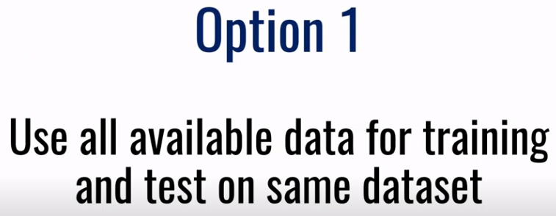
13.1 Option 1: Same Dataset
https://www.youtube.com/watch?v=gJo0uNL-5Qw&list=PLeo1K3hjS3uvCeTYTeyfe0-rN5r8zn9rw&index=13
Option 1: Same Dataset (1:06-1:30/25:19)
There are several ways that we can perform this training step.
The model data and test data are the same, this is not a right way.

Slide 6
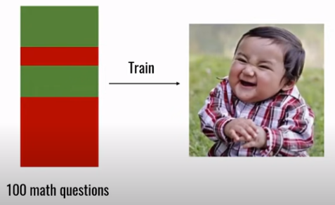
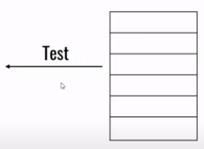
13.1 Option 1: Same Dataset
https://www.youtube.com/watch?v=gJo0uNL-5Qw&list=PLeo1K3hjS3uvCeTYTeyfe0-rN5r8zn9rw&index=13
K-Fold Cross Validation (1:31-2:05/25:19)
We trained 100 math questions to the child and ask a few questions from 100 math questions. The test is a partial set of train data and child always can answer.
Test with a few questions from the 100 math questions that child was trained

Slide 7
13.2 Option 3: Different Dataset

Slide 8
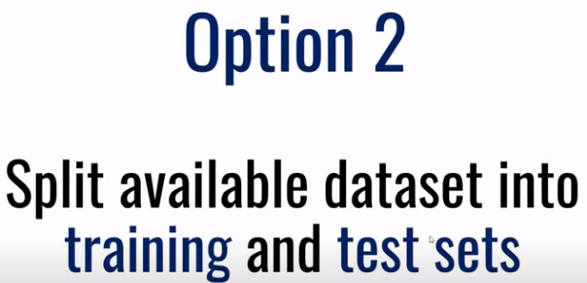
13.2 Option 3: Different Dataset
https://www.youtube.com/watch?v=gJo0uNL-5Qw&list=PLeo1K3hjS3uvCeTYTeyfe0-rN5r8zn9rw&index=13
Option 3: Different Dataset (2:06-2:10/25:19)
We trained and test with different data from dataset.
We split the dataset into train and test.

Slide 9
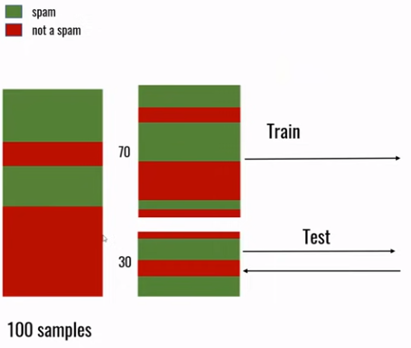

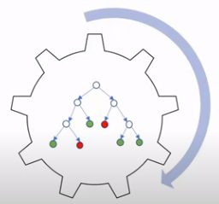
13.2 Option 3: Different Dataset
https://www.youtube.com/watch?v=gJo0uNL-5Qw&list=PLeo1K3hjS3uvCeTYTeyfe0-rN5r8zn9rw&index=13
Option 3: Different Dataset (2:11-2:30/25:19)
We trained and test with different data from dataset.
We split the dataset into train and test.

Slide 10
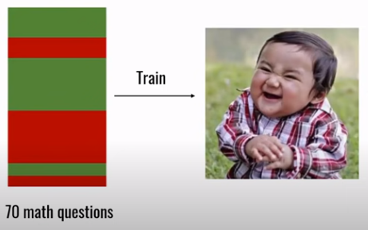
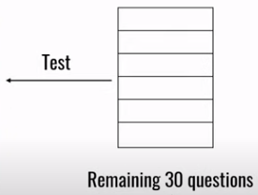
13.2 Option 3: Different Datase
https://www.youtube.com/watch?v=gJo0uNL-5Qw&list=PLeo1K3hjS3uvCeTYTeyfe0-rN5r8zn9rw&index=13
Option 3: Different Dataset (2:31-3:25/25:19)
We trained and test student with different data.
The student might not perform well if they trained subject (Algebra) and test subject (Calculus) are totally different. This method is not good.

Slide 11
13.3 Option 3: K-Fold Cross Validation

Slide 12
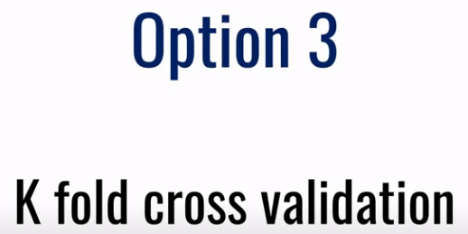
13.3 Option 3: K-Fold Cross Validation
https://www.youtube.com/watch?v=gJo0uNL-5Qw&list=PLeo1K3hjS3uvCeTYTeyfe0-rN5r8zn9rw&index=13
Option 3: K-Fold Cross Validation (3:26-3:50/25:19)
K-Fold is the best method to train and test.

Slide 13
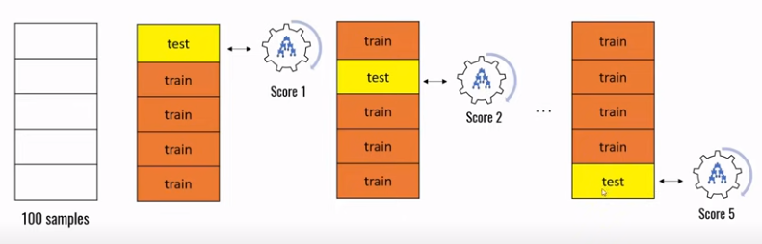
13.3 Option 3: K-Fold Cross Validation
https://www.youtube.com/watch?v=gJo0uNL-5Qw&list=PLeo1K3hjS3uvCeTYTeyfe0-rN5r8zn9rw&index=13
Option 3: K-Fold Cross Validation (3:51-4:25/25:19)
Below, we divide the dataset into 5-fold. Each time we train 4 of the folds and test 1-fold.
Then, we take the average. This method is very good.
Average
Average Score

Slide 14
13.4 Import Library and Read Dataset

Slide 15
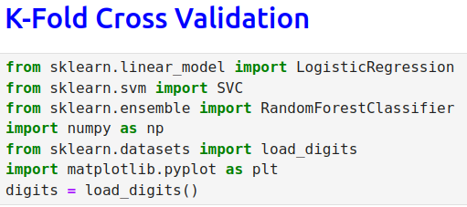
13.4 Import Library and Read Dataset
https://www.youtube.com/watch?v=gJo0uNL-5Qw&list=PLeo1K3hjS3uvCeTYTeyfe0-rN5r8zn9rw&index=13
Import Library and Read Dataset (4:26-4:55/25:19)
We import library
1. sklearn
2. svm
3. random Forest
4. numpy
5. sklearn dataset
6. matplotlib
7. Load dataset

Slide 16
13.4 Import Library and Read Dataset
https://www.youtube.com/watch?v=gJo0uNL-5Qw&list=PLeo1K3hjS3uvCeTYTeyfe0-rN5r8zn9rw&index=13
Import Library and Read Dataset (4:26-4:55/25:19)
Split dataset

Slide 17
13.5 Logistic Regression

Slide 18
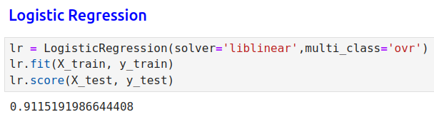
13.5 Logistic Regression
https://www.youtube.com/watch?v=gJo0uNL-5Qw&list=PLeo1K3hjS3uvCeTYTeyfe0-rN5r8zn9rw&index=13
Logistic Regression (4:56-6:30/25:19)
ovr: One over the rest.

Slide 19
13.6 SVM

Slide 20
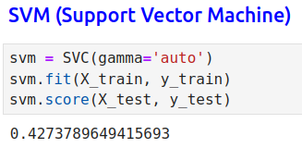
13.6 SVM
https://www.youtube.com/watch?v=gJo0uNL-5Qw&list=PLeo1K3hjS3uvCeTYTeyfe0-rN5r8zn9rw&index=13
SVM (6:31-8:30/25:19)

Slide 21
13.7 Random Forest

Slide 22
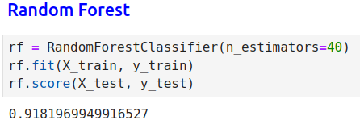
13.7 Random Forest
https://www.youtube.com/watch?v=gJo0uNL-5Qw&list=PLeo1K3hjS3uvCeTYTeyfe0-rN5r8zn9rw&index=13
Random Forest (8:31-10:30/25:19)

Slide 23
13.8 K-Fold Cross Validation

Slide 24
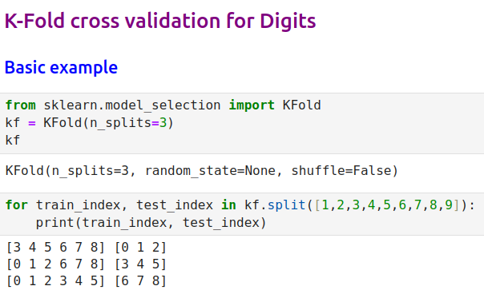
13.8 K-Fold Cross Validation
https://www.youtube.com/watch?v=gJo0uNL-5Qw&list=PLeo1K3hjS3uvCeTYTeyfe0-rN5r8zn9rw&index=13
K-Fold Cross Validation (10:31-12:30/25:19)

Slide 25
13.9 K-Fold for Logistic, SVM, and RF

Slide 26
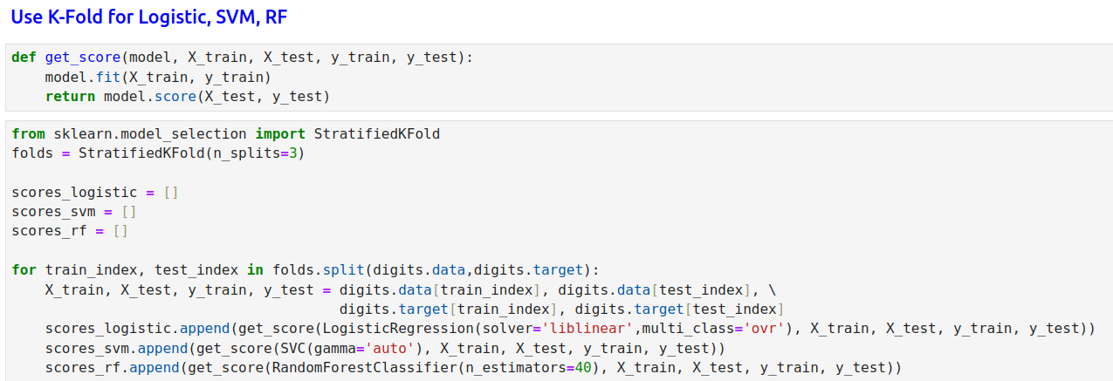
13.9 K-Fold for Logistic, SVM, and RF
https://www.youtube.com/watch?v=gJo0uNL-5Qw&list=PLeo1K3hjS3uvCeTYTeyfe0-rN5r8zn9rw&index=13
K-Fold for Logistic, SVM, and RF (12:31-14:30/25:19)

Slide 27
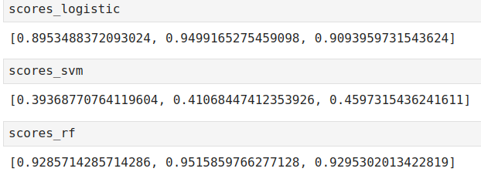
13.9 K-Fold for Logistic, SVM, and RF
https://www.youtube.com/watch?v=gJo0uNL-5Qw&list=PLeo1K3hjS3uvCeTYTeyfe0-rN5r8zn9rw&index=13
K-Fold for Logistic, SVM, and RF (12:31-14:30/25:19)

Slide 28
13.10 cross_val_score Function

Slide 29
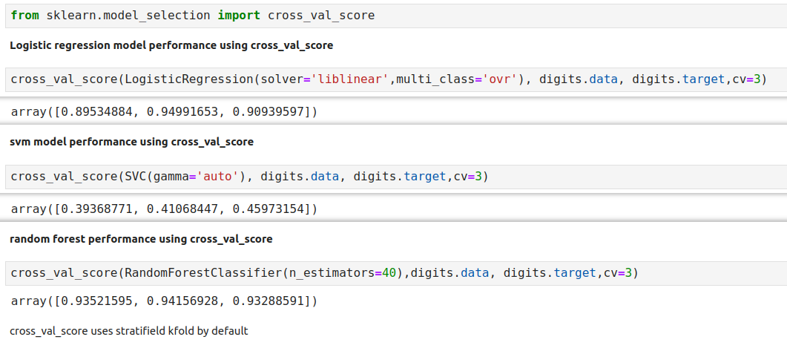
13.10 cross_val_score Function
https://www.youtube.com/watch?v=gJo0uNL-5Qw&list=PLeo1K3hjS3uvCeTYTeyfe0-rN5r8zn9rw&index=13
cross_val_score Function (14:31-16:30/25:19)

Slide 30
13.11 Parameter Tuning

Slide 31
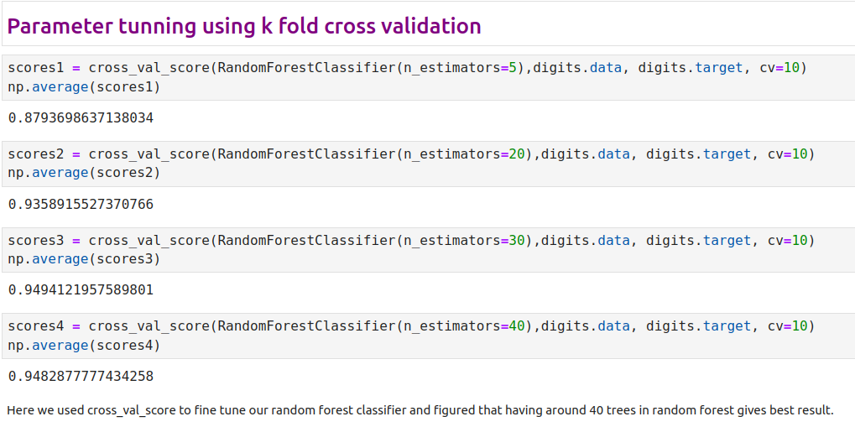
13.11 Parameter Tuning
https://www.youtube.com/watch?v=gJo0uNL-5Qw&list=PLeo1K3hjS3uvCeTYTeyfe0-rN5r8zn9rw&index=13
Parameter Tuning (18:31-23:30/25:19)

Slide 32
13.12 Exercise

Slide 33
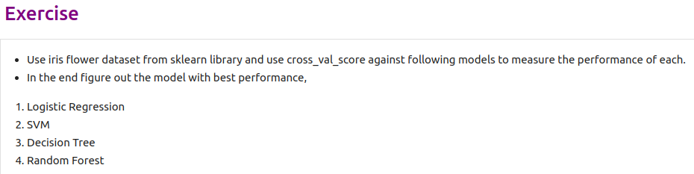
13.12 Exercise
https://www.youtube.com/watch?v=gJo0uNL-5Qw&list=PLeo1K3hjS3uvCeTYTeyfe0-rN5r8zn9rw&index=13
Exercise (24:31-25:19/25:19)

Slide 34
End

