Slide 1

11 SVM Model
Peter H. Chen

Slide 2
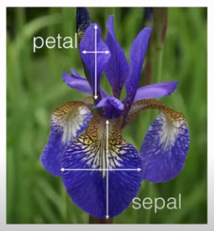
11 SVM Model
https://www.youtube.com/watch?v=FB5EdxAGxQg&list=PLeo1K3hjS3uvCeTYTeyfe0-rN5r8zn9rw&index=11
SVM Model (0:00-0:20/23:21)
We discuss SVM (Support Vector Machine) which is a very popular classification algorithm.
We solve Iris flowers classification problem using SVM.
Based on four features (petal height, petal width, sepal height, sepal width), we can determine the species of Iris flower.

Slide 3
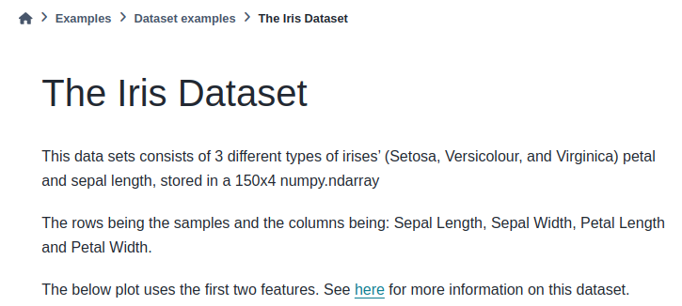
11 SVM Model
https://www.youtube.com/watch?v=FB5EdxAGxQg&list=PLeo1K3hjS3uvCeTYTeyfe0-rN5r8zn9rw&index=11
SVM Model (0:21-0:40/23:21)
There are three species (Setosa, Versicolour, and Virginia) in Iris flower dataset.
The iris dataset is available in scikit- learn as below link.
https://scikit-learn.org/stable/auto_examples/datasets/plot_iris_dataset.html

Slide 4
11.1 Petal Width and Petal Length

Slide 5
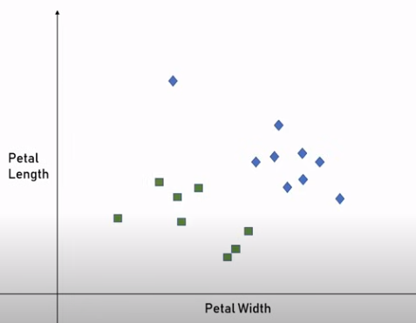
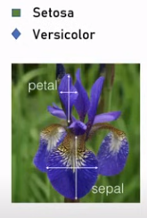
11.1 Petal Width and Petal Length
https://www.youtube.com/watch?v=FB5EdxAGxQg&list=PLeo1K3hjS3uvCeTYTeyfe0-rN5r8zn9rw&index=11
Petal Width and Petal Length (0:41-1:00/23:21)
To make simple, In the below scatter plot, we have two features: petal width and petal length.
Based on the features, we can determine the species is Setosa and Versicolor.

Slide 6
11.2 Boundary

Slide 7
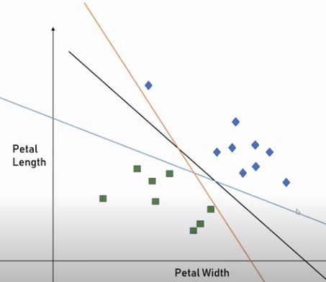
11.2 Boundary
https://www.youtube.com/watch?v=FB5EdxAGxQg&list=PLeo1K3hjS3uvCeTYTeyfe0-rN5r8zn9rw&index=11
Boundary (1:01-1:15/23:21)
Now, We want to draw a classification boundary to separate these two groups.
There are too many ways to draw the boundary. All these three lines below are the boundaries.

Slide 8
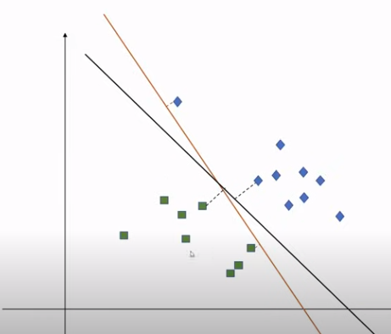
11.2 Boundary
https://www.youtube.com/watch?v=FB5EdxAGxQg&list=PLeo1K3hjS3uvCeTYTeyfe0-rN5r8zn9rw&index=11
Boundary (1:16-2:00/23:21)
How do we decide which line is the best for our classification problem?
One way to determine is: On each line, we can find the near by data data points and we can measure the distance of that line to the data point. Here, we can see the brown line has smaller distance than the black line. The distance is called the margin.
Which line is better? The one with lower margin or the one with higher margin?
If we look and think carefully, we will realize the line with higher margin is better because the line separate the group in a better way.
For example, if we have a point in between these two lines, this point will be misclassified.

Slide 9
11.3 Support Vector Machine

Slide 10
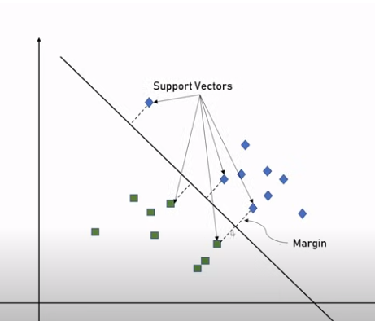
11.3 Support Vector Machine
https://www.youtube.com/watch?v=FB5EdxAGxQg&list=PLeo1K3hjS3uvCeTYTeyfe0-rN5r8zn9rw&index=11
Support Vector Machine (2:01-2:20/23:21)
What is support vector machine?
1. We find the best separate line with the biggest margin between two groups. We try to maximize the margin here between the nearby data points and the line.
2. These data points are called the Support Vectors and this method is called the Support Vector Machine.

Slide 11
11.4 Hyperplane

Slide 12
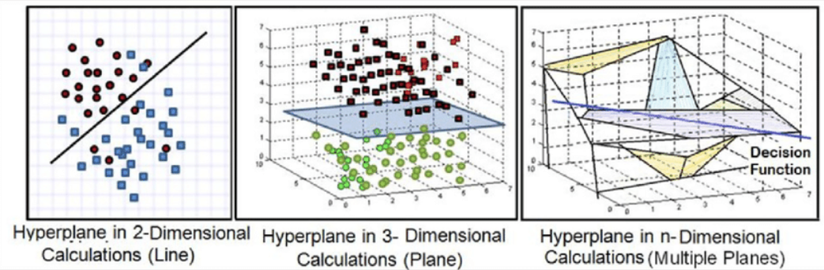
11.4 Hyperplane
https://www.youtube.com/watch?v=FB5EdxAGxQg&list=PLeo1K3hjS3uvCeTYTeyfe0-rN5r8zn9rw&index=11
Hyperplane (2:21-3:00/23:21)
1. In case of 2D space, we have two features, the boundary is a line.
2. In case of 3D space, we have three features, the boundary is a plane.
3. Usually, we have n-D space for n-D features, the boundary is called the hyperplanes. The hyperplane is n-Dimensional. The hyperplanes separate the n-dimensional features. The hyperplanes are impossible to visualize it.
https://www.researchgate.net/figure/e-Support-vector-machine-with-hyperplanes-in-different-dimensions_fig5_350138401
1
2
3

Slide 13
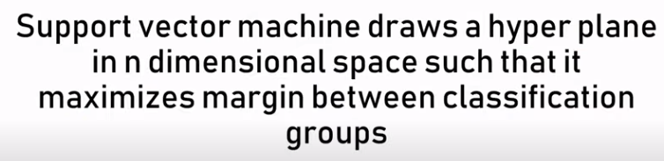
11.4 Hyperplane
https://www.youtube.com/watch?v=FB5EdxAGxQg&list=PLeo1K3hjS3uvCeTYTeyfe0-rN5r8zn9rw&index=11
Hyperplane (3:01-3:20/23:21)
What is hyperplane?
1. SVM draws a hyperplane in n-dimensional space.
2. The hyperplane maximize margin between the classification group.
3. Each hyperplane maximizes the margin between the plane and data points.
This is what support vector machine try to do.

Slide 14
11.5 Gamma Regularization

Slide 15
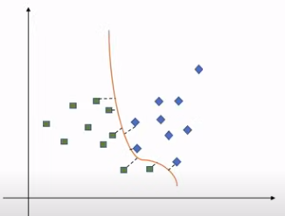
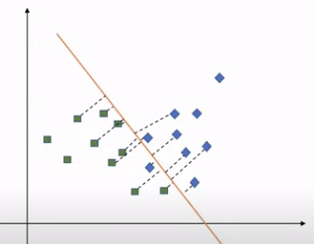
11.5 Gamma Regularization
https://www.youtube.com/watch?v=FB5EdxAGxQg&list=PLeo1K3hjS3uvCeTYTeyfe0-rN5r8zn9rw&index=11
Gamma Regularization (3:21-4:20/23:21)
1. Left below, we have a decision boundary which all the data points around this boundary. Here, we only consider the data points next to the decision boundary.
2. Right below, we use other approach, we consider the far away data points as well.
On the left hand side, we have High Gamma. On the right hand side, we have Low Gamma. Both approaches are valid and right. It depends on our individual situation
1
High Gamma
2
Low Gamma

Slide 16
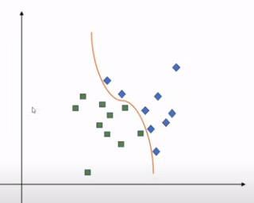
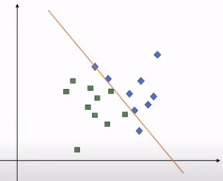
11.5 Gamma Regularization
https://www.youtube.com/watch?v=FB5EdxAGxQg&list=PLeo1K3hjS3uvCeTYTeyfe0-rN5r8zn9rw&index=11
Gamma Regularization (4:21-5:20/23:21)
1. Left below, we have high regularization with higher value of parameter C, C means Constraint for Regularization library.
2. Right below, we have low regularization with lower value of parameter C.
1
2
Low Regularization (C)
High Regularization (C)

Slide 17
11.6 Kernel Transformation

Slide 18
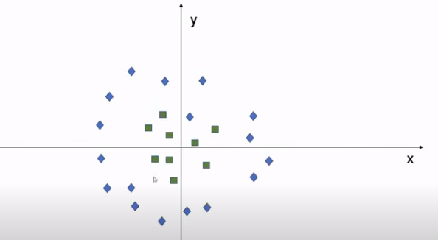
11.6 Kernel Transformation
https://www.youtube.com/watch?v=FB5EdxAGxQg&list=PLeo1K3hjS3uvCeTYTeyfe0-rN5r8zn9rw&index=11
Kernel Transformation(5:21-5:30/23:21)
We may have the complicated dataset like below.
It is not easy to draw the boundary.
One of the approach is to create a third dimension.
We can draw the boundary with circle, which is z = x² + y².

Slide 19
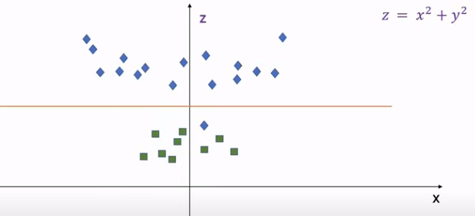
11.6 Kernel Transformation
https://www.youtube.com/watch?v=FB5EdxAGxQg&list=PLeo1K3hjS3uvCeTYTeyfe0-rN5r8zn9rw&index=11
Kernel Transformation (5:31-5:50/23:21)
Below, we create a third dimension z and z = x² + y².
We do some transformation for new feature z.
With this feature, we are able to draw this boundary.
So, y is perpendicular to our screen right now. We are not able to see y.
This transformation is called Kernel.
This transformation is called kernel

Slide 20
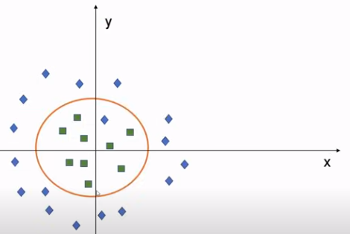
11.6 Kernel Transformation
https://www.youtube.com/watch?v=FB5EdxAGxQg&list=PLeo1K3hjS3uvCeTYTeyfe0-rN5r8zn9rw&index=11
Kernel Transformation (5:31-6:00/23:21)
The kernel create a transformation on our existing features so that we can draw the decision boundary easily.
With the help of Kernel, we can draw the boundary like below.

Slide 21
11.7 Load Dataset

Slide 22
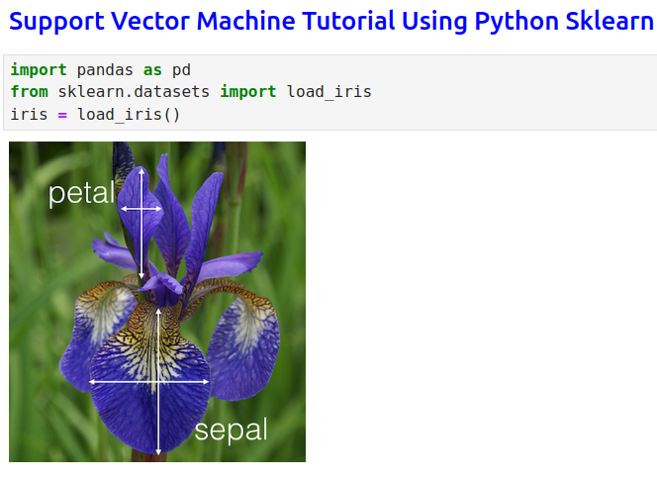
11.7 Load Dataset
https://www.youtube.com/watch?v=FB5EdxAGxQg&list=PLeo1K3hjS3uvCeTYTeyfe0-rN5r8zn9rw&index=11
Load Dataset (6:01-6:30/23:21)

Slide 23
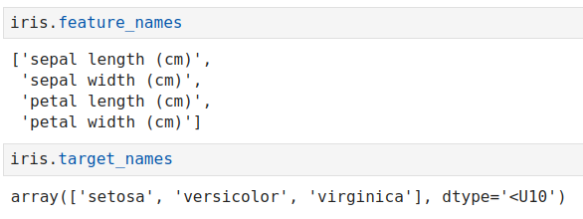
11.7 Load Dataset
https://www.youtube.com/watch?v=FB5EdxAGxQg&list=PLeo1K3hjS3uvCeTYTeyfe0-rN5r8zn9rw&index=11
Load Dataset (6:31-8:30/23:21)
Features and target

Slide 24
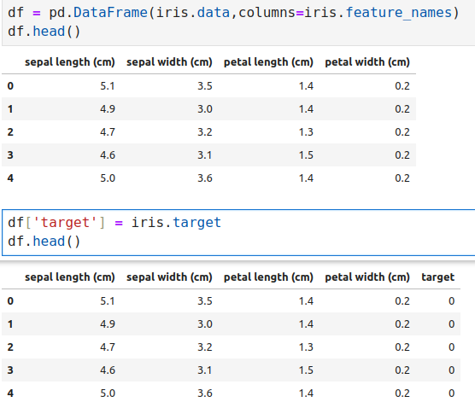
11.7 Load Dataset
https://www.youtube.com/watch?v=FB5EdxAGxQg&list=PLeo1K3hjS3uvCeTYTeyfe0-rN5r8zn9rw&index=11
Load Dataset (8:31-10:30/23:21)

Slide 25
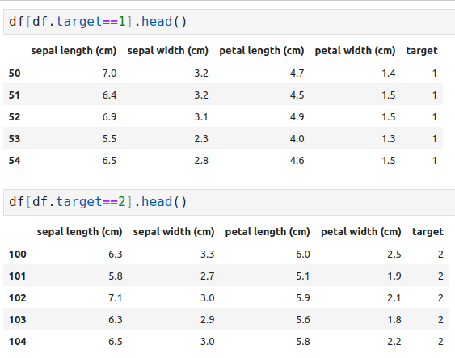
11.7 Load Dataset
https://www.youtube.com/watch?v=FB5EdxAGxQg&list=PLeo1K3hjS3uvCeTYTeyfe0-rN5r8zn9rw&index=11
Load Dataset (10:31-12:30/23:21)

Slide 26
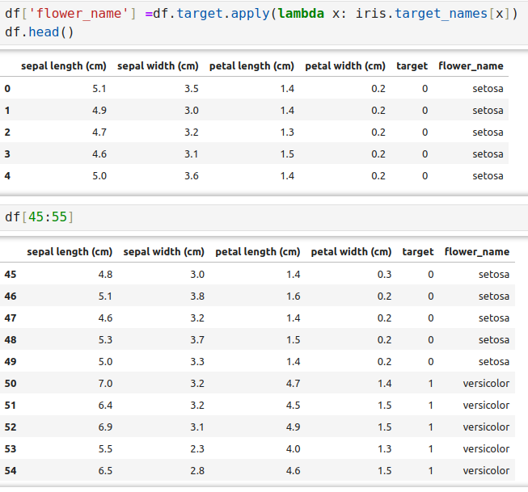
11.7 Load Dataset
https://www.youtube.com/watch?v=FB5EdxAGxQg&list=PLeo1K3hjS3uvCeTYTeyfe0-rN5r8zn9rw&index=11
Load Dataset (12:31-14:30/23:21)

Slide 27
11.8 Separate Plot Data

Slide 28
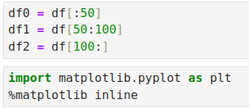
11.8 Separate Plot Data
https://www.youtube.com/watch?v=FB5EdxAGxQg&list=PLeo1K3hjS3uvCeTYTeyfe0-rN5r8zn9rw&index=11
Separate Plot Data (14:31-15:30/23:21)

Slide 29
11.9 Plot Sepal Data

Slide 30
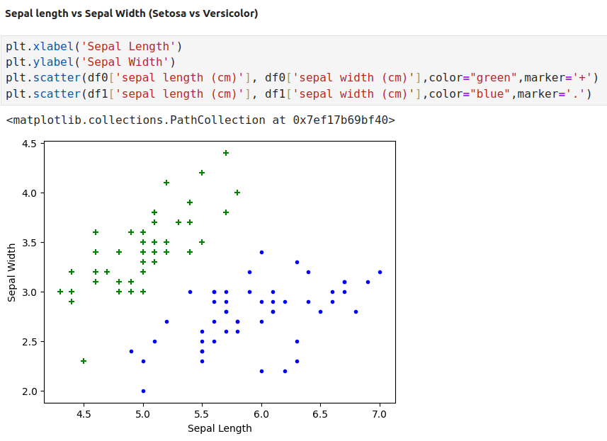
11.9 Plot Sepal Data
https://www.youtube.com/watch?v=FB5EdxAGxQg&list=PLeo1K3hjS3uvCeTYTeyfe0-rN5r8zn9rw&index=11
Plot Sepal Data (15:31-16:30/23:21)

Slide 31
11.10 Plot Petal Data

Slide 32
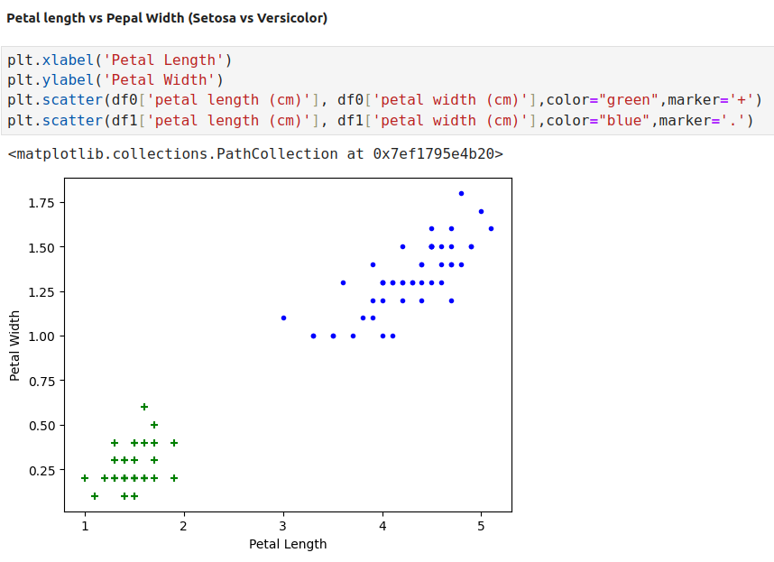
11.10 Plot Petal Data
https://www.youtube.com/watch?v=FB5EdxAGxQg&list=PLeo1K3hjS3uvCeTYTeyfe0-rN5r8zn9rw&index=11
Plot Petal Data (16:31-17:30/23:21)

Slide 33
11.11 Split Data

Slide 34
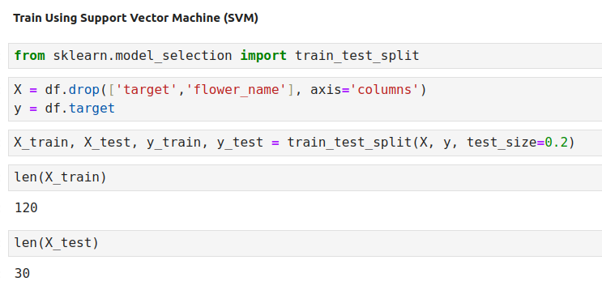
11.11 Split Data
https://www.youtube.com/watch?v=FB5EdxAGxQg&list=PLeo1K3hjS3uvCeTYTeyfe0-rN5r8zn9rw&index=11
Split Data (17:31-18:30/23:21)

Slide 35
11.12 SVM Model

Slide 36
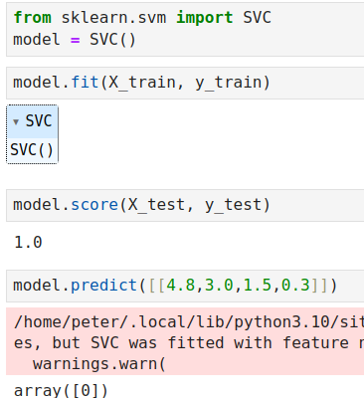
11.12 SVM Model
https://www.youtube.com/watch?v=FB5EdxAGxQg&list=PLeo1K3hjS3uvCeTYTeyfe0-rN5r8zn9rw&index=11
SVM Model (18:31-19:30/23:21)

Slide 37
11.13 Tune Parameter: Regularization

Slide 38
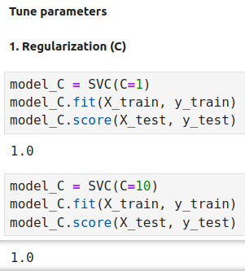
11.13 Tune Parameter: Regularization
https://www.youtube.com/watch?v=FB5EdxAGxQg&list=PLeo1K3hjS3uvCeTYTeyfe0-rN5r8zn9rw&index=11
Tune Parameter: Regularization (19:31-20:30/23:21)

Slide 39
11.14 Tune Parameter: Gamma

Slide 40
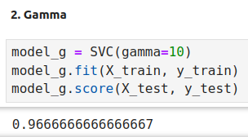
11.14 Tune Parameter: Gamma
https://www.youtube.com/watch?v=FB5EdxAGxQg&list=PLeo1K3hjS3uvCeTYTeyfe0-rN5r8zn9rw&index=11
Tune Parameter: Gamma (20:31-21:30/23:21)

Slide 41
11.15 Tune Parameter: Kernel

Slide 42
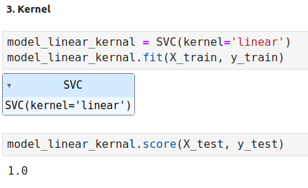
11.15 Tune Parameter: Kernel
https://www.youtube.com/watch?v=FB5EdxAGxQg&list=PLeo1K3hjS3uvCeTYTeyfe0-rN5r8zn9rw&index=11
Tune Parameter: Kernel (21:31-22:30/23:21)

Slide 43
11.16 Exercise

Slide 44
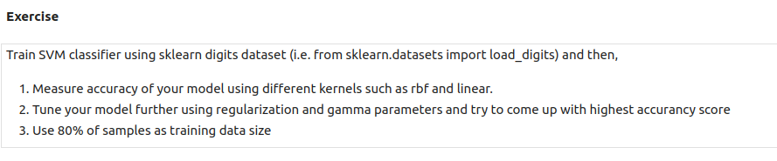
11.16 Exercise
https://www.youtube.com/watch?v=FB5EdxAGxQg&list=PLeo1K3hjS3uvCeTYTeyfe0-rN5r8zn9rw&index=11
Exercise (22:31-23:21/23:21)
Train SVM classifier using sklearn digits dataset (i.e. from sklearn.datasets import load_digits) and then,
1. Measure accuracy of your model using different kernels such as rbf and linear.
2. Tune your model further using regularization and gamma parameters and try to come up with highest accuracy score
3. Use 80% of samples as training data size

Slide 45
End

