Slide 1

2 Linear Regression of Single Var
Peter H. Chen

Slide 2
2 Linear Regression of Single Var
https://www.youtube.com/watch?v=8jazNUpO3lQ&list=PLeo1K3hjS3uvCeTYTeyfe0-rN5r8zn9rw&index=2
Linear Regression for Single Var (0:00-0:10/15:13)
We discuss about linear regression of single variable.
We write the Python Code to predict the home price using the machine learning technique called simple linear regression.

Slide 3
2.1 Home Price Table

Slide 4
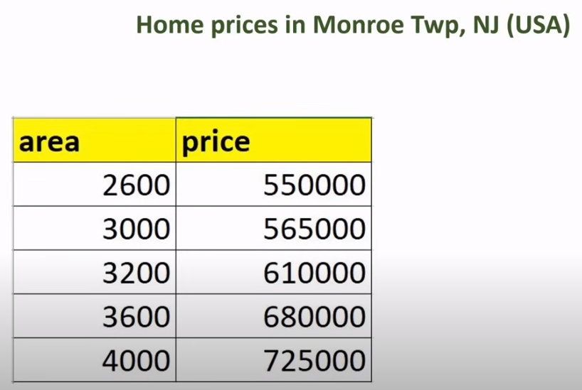
2.1 Home Price Table
https://www.youtube.com/watch?v=8jazNUpO3lQ&list=PLeo1K3hjS3uvCeTYTeyfe0-rN5r8zn9rw&index=2
Home Price Table (0:11-0:20/15:13)
We have the table of area (sq-ft) and prices of home in Monroe Township of New Jersey, USA.

Slide 5
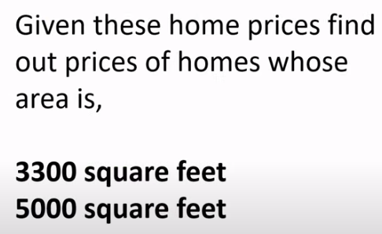
2.1 Home Price Table
https://www.youtube.com/watch?v=8jazNUpO3lQ&list=PLeo1K3hjS3uvCeTYTeyfe0-rN5r8zn9rw&index=2
Home Price Table (0:21-0:30/15:13)
Using these data, we are going to write the machine learning model that can tell me the prices of the homes whose are is 3300 square feet and 5000 square feet.

Slide 6
2.2 Linear Line

Slide 7
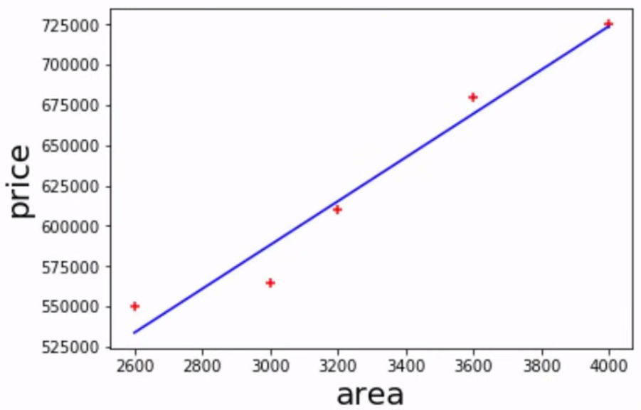
2.2 Linear Line
https://www.youtube.com/watch?v=8jazNUpO3lQ&list=PLeo1K3hjS3uvCeTYTeyfe0-rN5r8zn9rw&index=2
Linear Line (0:31-1:00/15:13)
We can plot available prices vs area in form of scatter plot as below.
The red marker are available data points.
Now, we can draw the blue line which best fits these data points.

Slide 8
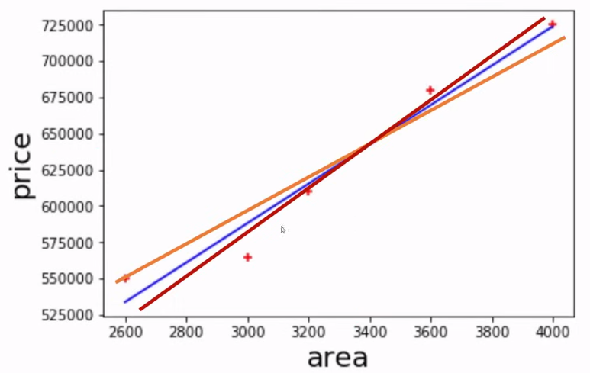
2.2 Linear Line
https://www.youtube.com/watch?v=8jazNUpO3lQ&list=PLeo1K3hjS3uvCeTYTeyfe0-rN5r8zn9rw&index=2
Linear Line (1:01-1:15/15:13)
You might wonder how do we come out with this blue line?
Because this blue line does not go through all the data points, there are number of ways you can draw the lines, such as red and orange lines.

Slide 9
2.3 Square Error

Slide 10
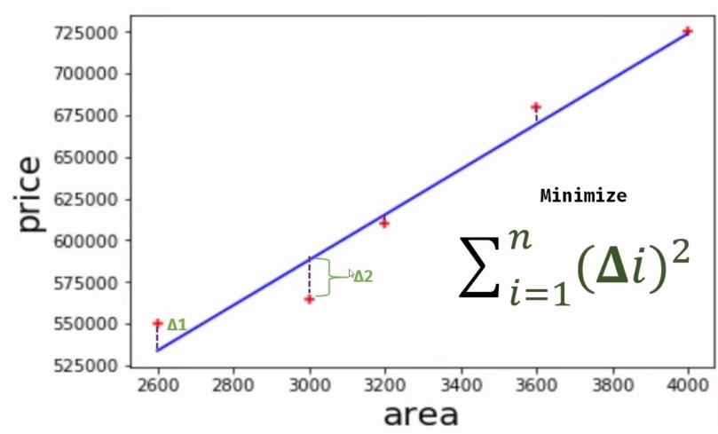
2.3 Square Error
https://www.youtube.com/watch?v=8jazNUpO3lQ&list=PLeo1K3hjS3uvCeTYTeyfe0-rN5r8zn9rw&index=2
Square Error (1:16-1:30/15:13)
So, why do you choose the blue line?
What we do is we calculate the delta which is an error between the actual data point and the predicted data point from our linear equation.
We square the individual errors and we sum them up and we try to minimize those.

Slide 11
2.3 Square Error
https://www.youtube.com/watch?v=8jazNUpO3lQ&list=PLeo1K3hjS3uvCeTYTeyfe0-rN5r8zn9rw&index=2
Square Error (1:31-1:50/15:13)
We minimize the errors of each line for all these lines.
For blue, red, and orange lines, we repeated that sum of errors.
We find the blue line is the best one that give us the minimum error.

Slide 12
2.3 Square Error
https://www.youtube.com/watch?v=8jazNUpO3lQ&list=PLeo1K3hjS3uvCeTYTeyfe0-rN5r8zn9rw&index=2
Square Error (1:51-1:55/15:13)
Therefore, we choose the blue line.

Slide 13
2.4 Linear Equation

Slide 14
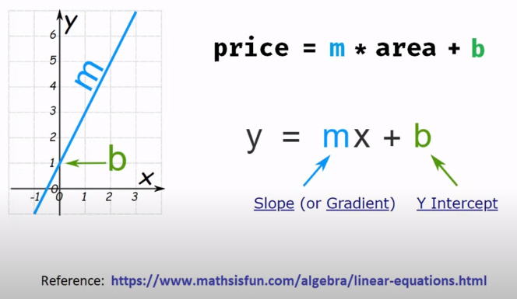
2.4 Linear Equation
https://www.youtube.com/watch?v=8jazNUpO3lQ&list=PLeo1K3hjS3uvCeTYTeyfe0-rN5r8zn9rw&index=2
Linear Equation (1:56-2:20/15:13)
We have the linear equaiton:
y = m * x + b where m is slope and b is the intercept.

Slide 15
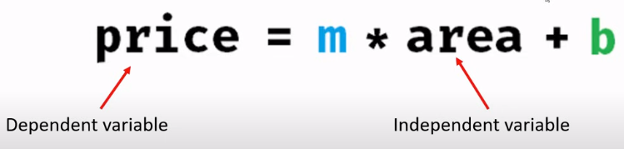
2.4 Linear Equation
https://www.youtube.com/watch?v=8jazNUpO3lQ&list=PLeo1K3hjS3uvCeTYTeyfe0-rN5r8zn9rw&index=2
Linear Equation (2:21-2:30/15:13)
In our case, we have
2. y is home price called dependent variable and
2. x is the area is called independent variable
We calculate the home price based on the area.
We will discuss intercept b later on.

Slide 16
2.5 Import Library

Slide 17
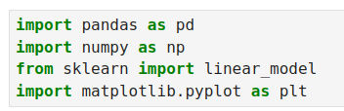
2.5 Import Library
https://www.youtube.com/watch?v=8jazNUpO3lQ&list=PLeo1K3hjS3uvCeTYTeyfe0-rN5r8zn9rw&index=2
Import Library (2:31-2:35/15:13)
We import library
2. pandas: Library for Panel Data frame.
2. numpy: Numerical library for Python
3. from sklearn import linear_model: sci-kit learn library for linear model. This is the most important library.
4. matplotlib: Python plot.

Slide 18

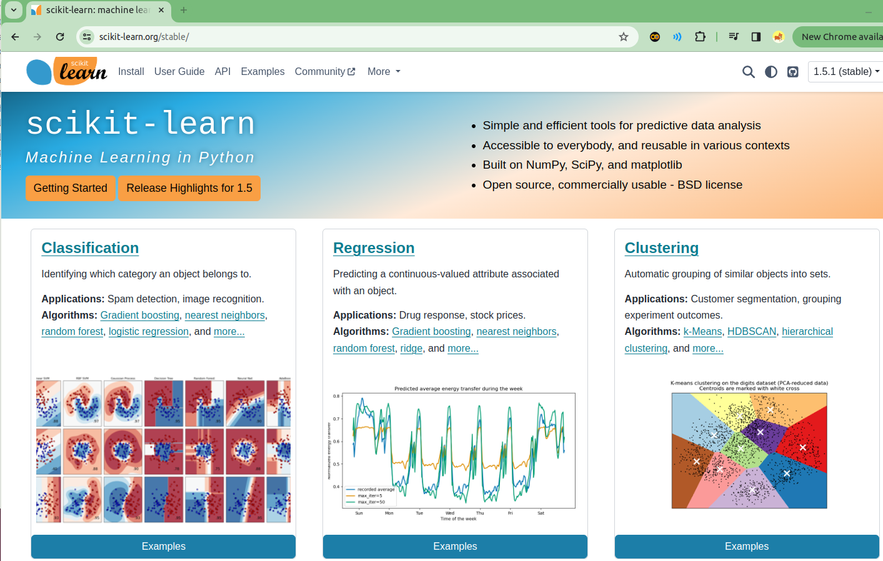
2.5 Import Library
https://www.youtube.com/watch?v=8jazNUpO3lQ&list=PLeo1K3hjS3uvCeTYTeyfe0-rN5r8zn9rw&index=2
Import Library (2:36-3:00/15:13)
Google “scikit learn” and click to see the details.
There are examples for scikit-learn library.
https://scikit-learn.org/stable/

Slide 19
2.6 Pandas Read CSV File

Slide 20
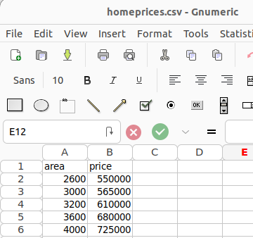
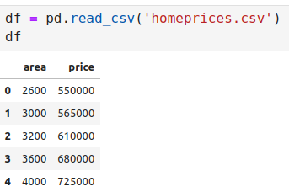
2.6 Pandas Read CSV File
https://www.youtube.com/watch?v=8jazNUpO3lQ&list=PLeo1K3hjS3uvCeTYTeyfe0-rN5r8zn9rw&index=2
Pandas Read CSV File (3:01-4:00/15:13)
We have homeprices.csv in current folder.
We are going to load this file by pandas data frame.
> df = pd.read_csv(“homeprices.csv”)
> df

Slide 21
2.7 Plot Scatter

Slide 22
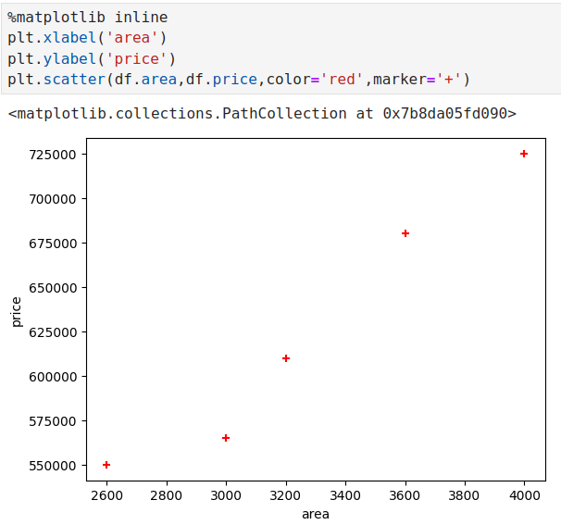
2.7 Plot Scatter
https://www.youtube.com/watch?v=8jazNUpO3lQ&list=PLeo1K3hjS3uvCeTYTeyfe0-rN5r8zn9rw&index=2
Plot Scatter (4:01-5:20/15:13)
Plot scatter and get the idea on distribution of data point.
Put x label, y label, plot with marker and color.

Slide 23
2.9 Linear Regression Model

Slide 24
2.9 Linear Regression Model
https://www.youtube.com/watch?v=8jazNUpO3lQ&list=PLeo1K3hjS3uvCeTYTeyfe0-rN5r8zn9rw&index=2
Plot Scatter (5:21-6:00/15:13)
We have the linear model.
The data point is 2D-array of data frame.

Slide 25
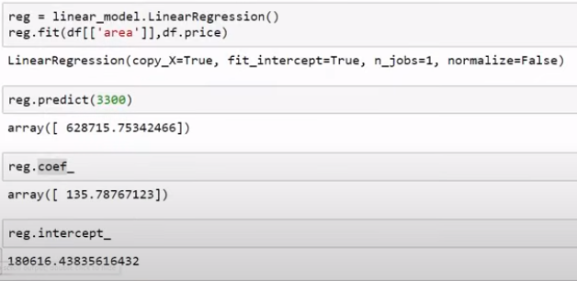
2.9 Linear Regression Model
https://www.youtube.com/watch?v=8jazNUpO3lQ&list=PLeo1K3hjS3uvCeTYTeyfe0-rN5r8zn9rw&index=2
Plot Scatter (5:21-6:00/15:13)
The first argument that we supply the data frame contains area.
The second argument that we supply is data frame contains price.

Slide 26
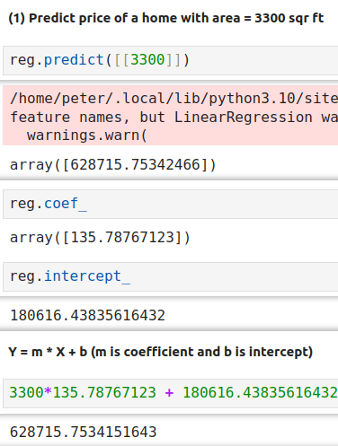
2.9 Linear Regression Model
https://www.youtube.com/watch?v=8jazNUpO3lQ&list=PLeo1K3hjS3uvCeTYTeyfe0-rN5r8zn9rw&index=2
Plot Scatter (7:01-8:00/15:13)
Now, we look at the prediction, slope, and intercept.

Slide 27
2.9 Linear Regression Model
https://www.youtube.com/watch?v=8jazNUpO3lQ&list=PLeo1K3hjS3uvCeTYTeyfe0-rN5r8zn9rw&index=2
Plot Scatter (8:01-9:00/15:13)
We can check the number for the model

Slide 28
2.10 Read Area Data

Slide 29
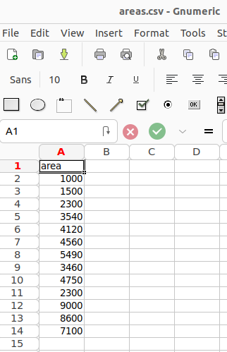
2.10 Read Area Data
https://www.youtube.com/watch?v=8jazNUpO3lQ&list=PLeo1K3hjS3uvCeTYTeyfe0-rN5r8zn9rw&index=2
Read Area Data (9:01-9:00/15:13)
We read the area from file “areas.csv”.

Slide 30
2.11 Predict New Price

Slide 31
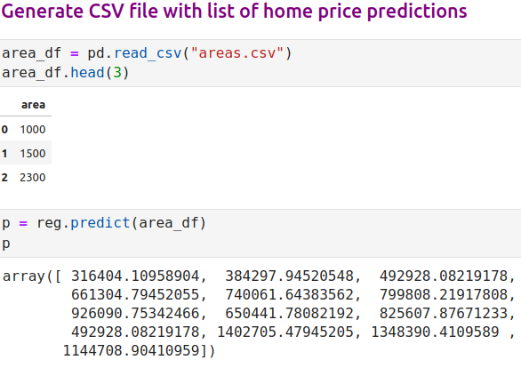
2.11 Predict New Price
https://www.youtube.com/watch?v=8jazNUpO3lQ&list=PLeo1K3hjS3uvCeTYTeyfe0-rN5r8zn9rw&index=2
Predict New Price (9:01-10:00/15:13)
We use new set of area data and use model to predict new set of price.

Slide 32
2.12 Create New Price Column

Slide 33
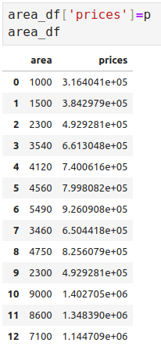
2.12 Create New Price Column
https://www.youtube.com/watch?v=8jazNUpO3lQ&list=PLeo1K3hjS3uvCeTYTeyfe0-rN5r8zn9rw&index=2
Create New Price Column (10:01-11:00/15:13)
We create the new column “price”

Slide 34
2.13 Save Prediction: Area and Price

Slide 35
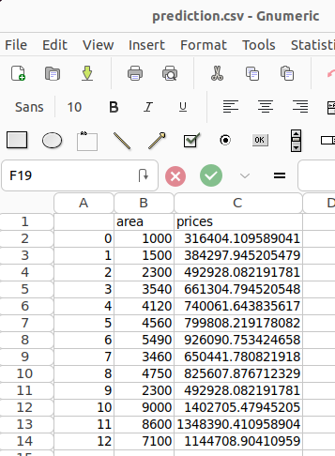

2.13 Save Prediction: Area and Price
https://www.youtube.com/watch?v=8jazNUpO3lQ&list=PLeo1K3hjS3uvCeTYTeyfe0-rN5r8zn9rw&index=2
Save Prediction: Area and Price (11:01-12:00/15:13)
Save the file prediction: Area and Price.
We open file: Prediction. We find we gave the area and predicted prices.

Slide 36
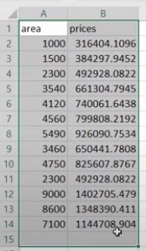

2.13 Save Prediction: Area and Price
https://www.youtube.com/watch?v=8jazNUpO3lQ&list=PLeo1K3hjS3uvCeTYTeyfe0-rN5r8zn9rw&index=2
Save Prediction: Area and Price (11:01-12:00/15:13)
If we do not the index, we can set “index=False”).
Here, we do not see any index.

Slide 37
2.14 Change X and Y Data

Slide 38
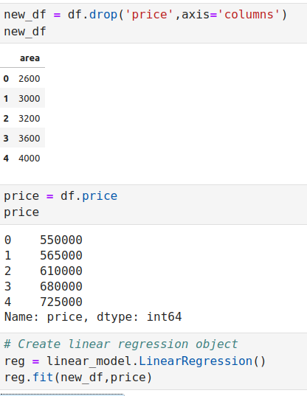
2.14 Change X and Y Data
https://www.youtube.com/watch?v=8jazNUpO3lQ&list=PLeo1K3hjS3uvCeTYTeyfe0-rN5r8zn9rw&index=2
Change X and Y Data (11:01-12:00/15:13)
We use panda to have new X and Y data to do regression again.

Slide 39
2.15 Exercise

Slide 40
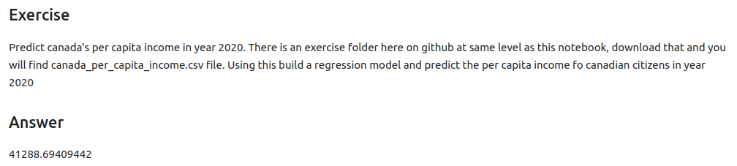
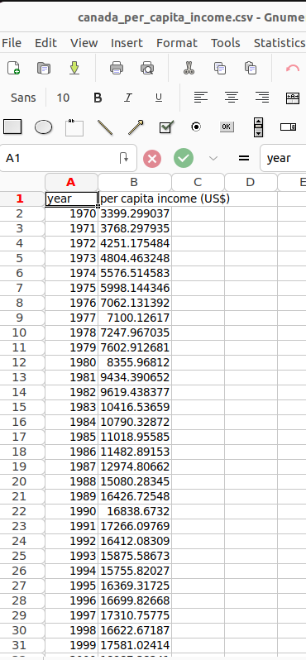
2.15 Exercise
https://www.youtube.com/watch?v=8jazNUpO3lQ&list=PLeo1K3hjS3uvCeTYTeyfe0-rN5r8zn9rw&index=2
Exercise (11:01-12:00/15:13)

Slide 41
End

