Slide 1

3 Multivariate Regression
Peter H. Chen

Slide 2
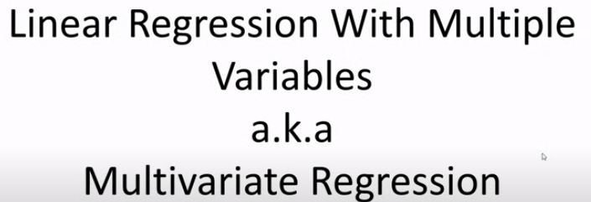
3 Multivariate Regression
https://www.youtube.com/watch?v=J_LnPL3Qg70&list=PLeo1K3hjS3uvCeTYTeyfe0-rN5r8zn9rw&index=3
Multivariate Regression (0:00-0:05/14:07)
We discuss Multivariate Regression (Multi-Regression or Linear Regression of Multiple Variables).

Slide 3
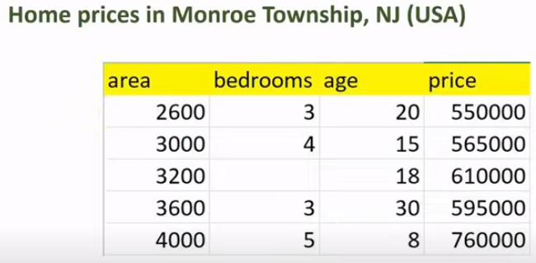
3 Multivariate Regression
https://www.youtube.com/watch?v=J_LnPL3Qg70&list=PLeo1K3hjS3uvCeTYTeyfe0-rN5r8zn9rw&index=3
Multivariate Regression (0:06-0:40/14:07)
Using Multivariate Regression, we are going to predict the Home Prices in Monroe Township, New Jersey.
In the table, we have multiple variables available, such as, area, bedroom, and age, these are the factors that the ultimate price depends on.
In the previous discussion, we looked in the linear regression where the price was dependent only on the area. Now, we make our problem more complicated by adding bedroom and age.
In normal life, the home price depends on multiple factors, not just the square foot of area.

Slide 4
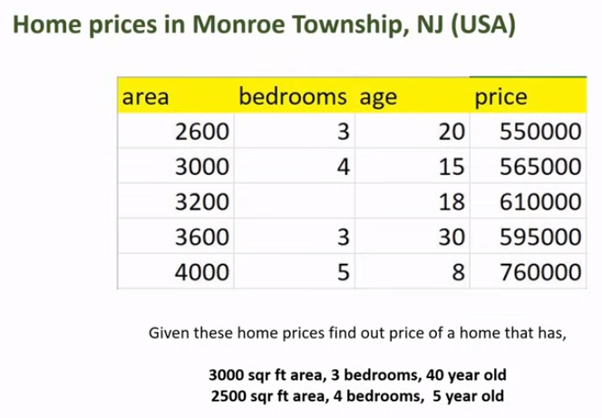
3 Multivariate Regression
https://www.youtube.com/watch?v=J_LnPL3Qg70&list=PLeo1K3hjS3uvCeTYTeyfe0-rN5r8zn9rw&index=3
Multivariate Regression (0:41-1:00/14:07)
After we build a model, we are going to predict the prices of these two homes:
1. 3000 sq ft area, 3 bedroom, 40 year old.
2. 2500 sq ft area, 4 bedroom, 5 year old.

Slide 5
3.1 Missing Data

Slide 6
3.1 Missing Data
https://www.youtube.com/watch?v=J_LnPL3Qg70&list=PLeo1K3hjS3uvCeTYTeyfe0-rN5r8zn9rw&index=3
Missing Data (1:01-1:10/14:07)
Before, we start any machine learning, we need to carefully analyze our dataset or training data.
When we first look at the dataset, there is a data point missing here.
We have to do something to handle this missing data point.

Slide 7
3.2 Input Feature and Output Target Relation

Slide 8
3.2 Input Feature and Output Target Relation
https://www.youtube.com/watch?v=J_LnPL3Qg70&list=PLeo1K3hjS3uvCeTYTeyfe0-rN5r8zn9rw&index=3
Input Feature and Output Target Relation (1:11-1:30/14:07)
Another thing that we notice here is there is a linear relationship between each of this factors and the target variable which is price.
For example, as the home gets older, the price tends go down.
1. Here, we have 3200 sq ft and age 18, price is 61,000.
2. For 3600 sq ft and age 30, the price go down to 59,500.

Slide 9
3.2 Input Feature and Output Target Relation
https://www.youtube.com/watch?v=J_LnPL3Qg70&list=PLeo1K3hjS3uvCeTYTeyfe0-rN5r8zn9rw&index=3
Input Feature and Output Target Relation (1:31-2:00/14:07)
Similarly, the area go up and bedroom go up, the price tends to go up.
Overall, for this dataset, we can use linear regression safely.

Slide 10
3.3 Math Formulation

Slide 11
3.3 Math Formulation
https://www.youtube.com/watch?v=J_LnPL3Qg70&list=PLeo1K3hjS3uvCeTYTeyfe0-rN5r8zn9rw&index=3
Math Formulation (2:01-2:20/14:07)
Our multi-linear-regression will look like this.

Slide 12
3.4 Feature and Target

Slide 13
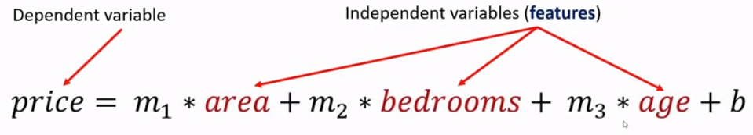
3.4 Feature and Target
https://www.youtube.com/watch?v=J_LnPL3Qg70&list=PLeo1K3hjS3uvCeTYTeyfe0-rN5r8zn9rw&index=3
Feature and Target (2:21-2:30/14:07)
We have feature inputs: area, bedrooms, and age are called independent variables.
Feature is a term we hear often in machine learning. Feature is nothing but the independent variable.
Price is an output which is a dependent variable. In machine learning, we called output is the target.

Slide 14
3.5 Coefficient

Slide 15
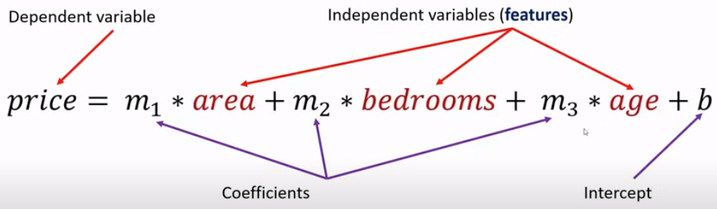
3.5 Coefficient
https://www.youtube.com/watch?v=J_LnPL3Qg70&list=PLeo1K3hjS3uvCeTYTeyfe0-rN5r8zn9rw&index=3
Coefficient (2:31-2:40/14:07)
m1, m2, and m3 are called coefficients and b is the intercept.

Slide 16
3.6 Generalized Equation

Slide 17

3.6 Generalized Equation
https://www.youtube.com/watch?v=J_LnPL3Qg70&list=PLeo1K3hjS3uvCeTYTeyfe0-rN5r8zn9rw&index=3
Generalized Equation (2:41-2:50/14:07)
The generalized equation is as below.
We can have any number of independent variables.

Slide 18
3.7 Topics

Slide 19
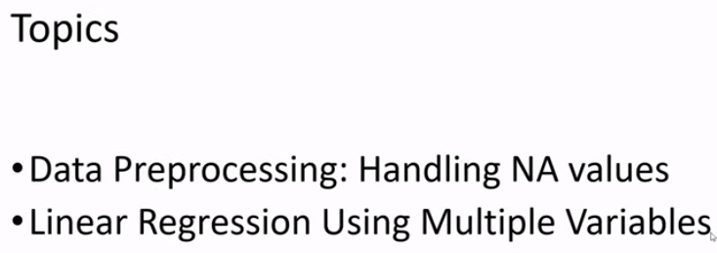
3.7 Topics
https://www.youtube.com/watch?v=J_LnPL3Qg70&list=PLeo1K3hjS3uvCeTYTeyfe0-rN5r8zn9rw&index=3
Topics (2:51-3:05/14:07)
We discuss the
1. Data processing: How to handle missing data point
2. Multi-Regression: We will build a model for multiple variables for linear regression by the Python Code.

Slide 20
3.8 Import Library

Slide 21

3.8 Import Library
https://www.youtube.com/watch?v=J_LnPL3Qg70&list=PLeo1K3hjS3uvCeTYTeyfe0-rN5r8zn9rw&index=3
Import Library (3:06-3:30/14:07)
Import Library
1. pandas: for data frame
2. numpy: Python numerical analysis
3. sciki-learn: linear regression model

Slide 22
3.9 Read CSV Data

Slide 23
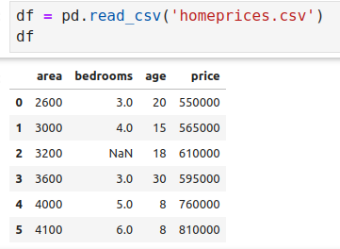
3.9 Read CSV Data
https://www.youtube.com/watch?v=J_LnPL3Qg70&list=PLeo1K3hjS3uvCeTYTeyfe0-rN5r8zn9rw&index=3
Read CSV Data (3:31-3:50/14:07)
Read Home Price data.

Slide 24
3.10 Data Processing

Slide 25
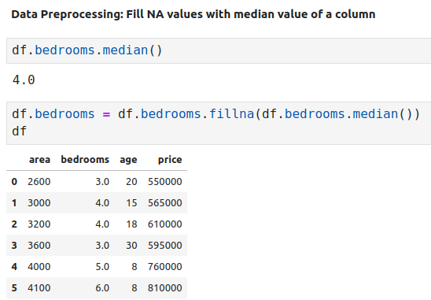
3.10 Data Processing
https://www.youtube.com/watch?v=J_LnPL3Qg70&list=PLeo1K3hjS3uvCeTYTeyfe0-rN5r8zn9rw&index=3
Data Processing (3:51-6:30/14:07)
We can see “NAN” in the bedrooms column.
We will take median of bedrooms column and put here.
Now, the dataset looks good.

Slide 26
3.11 Multiple Regression Model

Slide 27
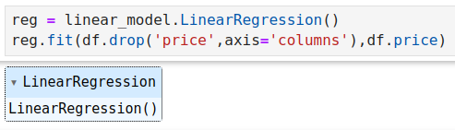
3.11 Multiple Regression Model
https://www.youtube.com/watch?v=J_LnPL3Qg70&list=PLeo1K3hjS3uvCeTYTeyfe0-rN5r8zn9rw&index=3
Multiple Regression Model (6:31-7:40/14:07)
Our independent variables are area, bedrooms, and age.
Our target variable is price.

Slide 28
3.13 Calculate Price

Slide 29
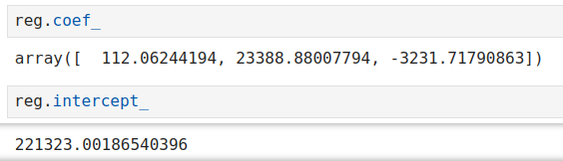
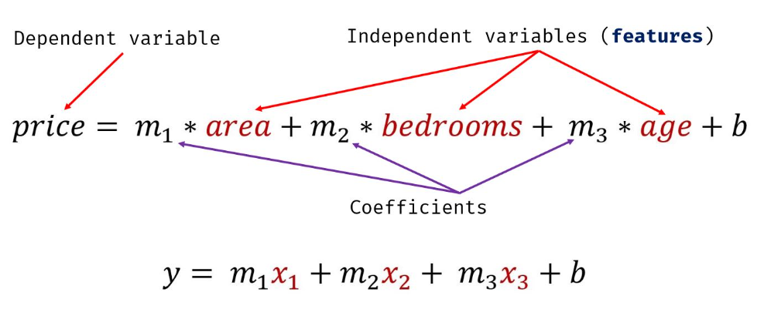
3.12 Coefficient and Intercept
https://www.youtube.com/watch?v=J_LnPL3Qg70&list=PLeo1K3hjS3uvCeTYTeyfe0-rN5r8zn9rw&index=3
Coefficient and Intercept (6:31-8:20/14:07)
Now, we look at the
1. coefficients and
2. intercept = 221323
1
2

Slide 30
3.13 Prediction and Validation

Slide 31
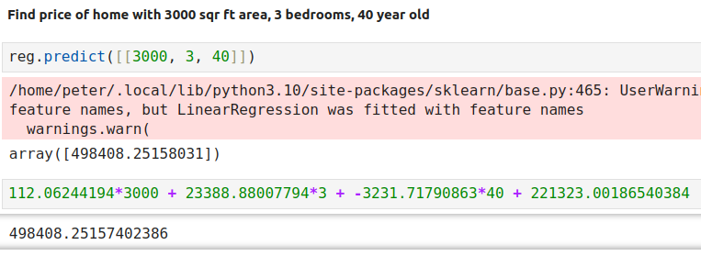
3.13 Prediction and Validation
https://www.youtube.com/watch?v=J_LnPL3Qg70&list=PLeo1K3hjS3uvCeTYTeyfe0-rN5r8zn9rw&index=3
Prediction and Validation (8:21-11:30/14:07)
1. Calculate the price of m1 = 3000 sf ft, m2 = 3 bedrooms, and m3 = 40 years.
2. Calculate with equation: add the intercept = 221323 in equation.
We have same result = 498408
1
2

Slide 32
3.14 Prediction

Slide 33
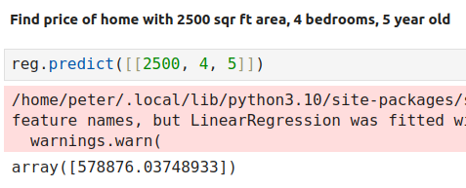
3.14 Prediction
https://www.youtube.com/watch?v=J_LnPL3Qg70&list=PLeo1K3hjS3uvCeTYTeyfe0-rN5r8zn9rw&index=3
Prediction (11:31-12:00/14:07)
Calculate the price of m1 = 2500 sf ft, m2 = 4 bedrooms, and m3 = 5 years.

Slide 34
3.15 Exercise

Slide 35
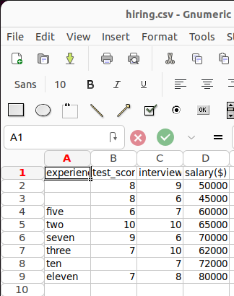
3.15 Exercise
https://www.youtube.com/watch?v=J_LnPL3Qg70&list=PLeo1K3hjS3uvCeTYTeyfe0-rN5r8zn9rw&index=3
Exercise (12:01-12:30/14:07)
1. We have file: hiring.csv. This file contains hiring statistics for a firm such as experience of candidate, his written test score and personal interview score. Based on these 3 factors, HR will decide the salary.
2. Given this data, you need to build a machine learning model for HR department that can help them decide salaries for future candidates.
3. Using this predict salaries for following candidates,
  a. 2 yr experience, 9 test score, 6 interview score
  b. 12 yr experience, 10 test score, 10 interview score

Slide 36
3.15 Exercise
https://www.youtube.com/watch?v=J_LnPL3Qg70&list=PLeo1K3hjS3uvCeTYTeyfe0-rN5r8zn9rw&index=3
Exercise (12:31-14:07/14:07)
We need to
1. Read the data
2. Handle the missing data
3. Convert python word to number.
4. build the multi-regression model
5. Make prediction

Slide 37
End

