Slide 1

23 Introduction to Real Estate Prediction
Peter H. Chen

Slide 2
23 Introduction to Real Estate Prediction
https://www.youtube.com/watch?v=rdfbcdP75KI&list=PLeo1K3hjS3uvCeTYTeyfe0-rN5r8zn9rw&index=23
Introduction to Real Estate Prediction (0:00-0:50/2:11)
We discuss how build a Full Stack Project for Real Estate Prediction for Machine Learning.
This project is for day to day data activity of Data Scientist.
We will build:
1. A Model Projection of home price based on sq-ft, bedroom, lot size, etc.
2. HTML/JavaScript Web Site to host the Model.

Slide 3
23.1 Dataset

Slide 4
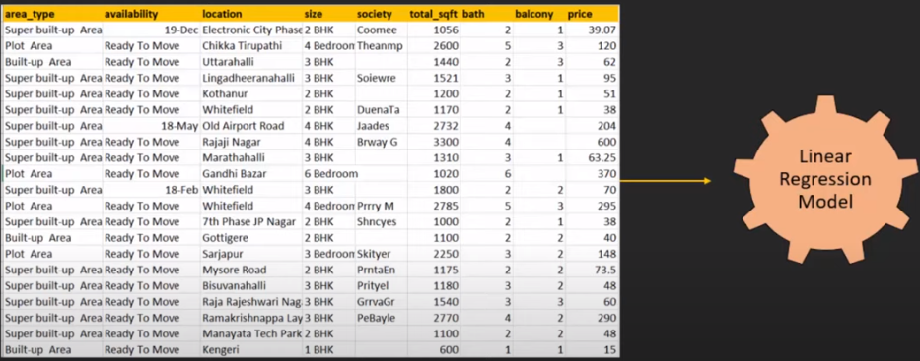
23.1 Dataset
https://www.youtube.com/watch?v=rdfbcdP75KI&list=PLeo1K3hjS3uvCeTYTeyfe0-rN5r8zn9rw&index=23
Dataset (0:51-1:05/2:11)
We
1. Read the csv file with features and target home price.
2. Build the Linear Regression Model.
The csv file of Bangaluru (or Bangalore) house price can be downloaded from the Kaggle as below:
https://www.kaggle.com/datasets/amitabhajoy/bengaluru-house-price-data

Slide 5
23.2 Data Opeartion and Build Model

Slide 6
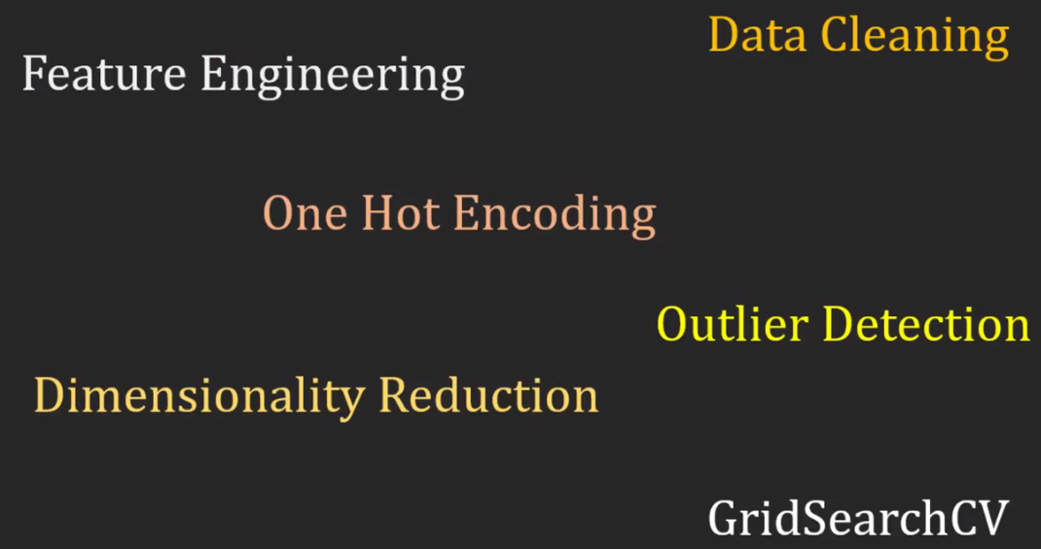
23.2 Data Operation and Build Model
https://www.youtube.com/watch?v=rdfbcdP75KI&list=PLeo1K3hjS3uvCeTYTeyfe0-rN5r8zn9rw&index=23
Data Operation and Build Model (1:06-1:15/2:11)
For the dataset, we need to do:
1. Data Cleaning: Remove N/A data.
2. Feature Engineering: transform data into features and target label.
3. One Hot Encoding: Convert the text string into unique columns for text operation.
4. Outlier Detection: Remove Outliers data from dataset.
5. Dimensionality Reduction: Reduce useless features by PCA (Principal Component Analysis)
6. GridSearchCV: Build Model with Grid Search Cross Validation for hyperparamter tuning and model selection.

Slide 7
23.3 Export Model into Pickle File

Slide 8
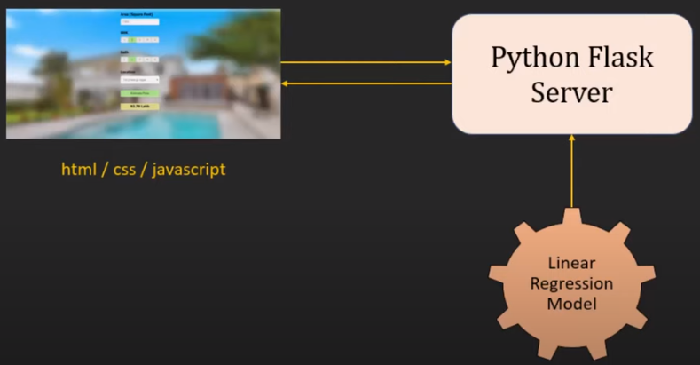
23.3 Export Model into Pickle File
https://www.youtube.com/watch?v=rdfbcdP75KI&list=PLeo1K3hjS3uvCeTYTeyfe0-rN5r8zn9rw&index=23
Export Model into Pickle File (1:16-1:30/2:11)
Once the model is built, we
1. Export the model into Pickle File.
2. Write the frontend HTML/CSS/JavaScript
3. Write the backend Python flask server. Start the flask to read the model from pickle file. Host the model on server
4. Users can make request the server and
5. server will make prediction and return to user.
4
3
5
2
1

Slide 9
23.3 Export Model into Pickle File
https://www.youtube.com/watch?v=rdfbcdP75KI&list=PLeo1K3hjS3uvCeTYTeyfe0-rN5r8zn9rw&index=23
Export Model into Pickle File (1:31-1:30/2:11)
Here,
1. We use pandas for data clearing,
2. We use matplotlib for data visualization
3. We use Sklearn (scikit-learn) for model building.
4. Pickle to read the export Model
5. For backend server, we use Python Flask (or fastAPI).
6. For frontend GUI: we use HTML for GUI Layout, CSS (Cascade Styling Sheet) for color/style, and JavaScript for logic control/looping.
Frontend:
HTML, CSS, JavaScript
request
Backend:
Flask Server
6
5
1-3
response
4
Pickle
Panda
Matplotlib
Sklearn
Model

Slide 10
End

