Slide 1

5 Save Model
Peter H. Chen

Slide 2
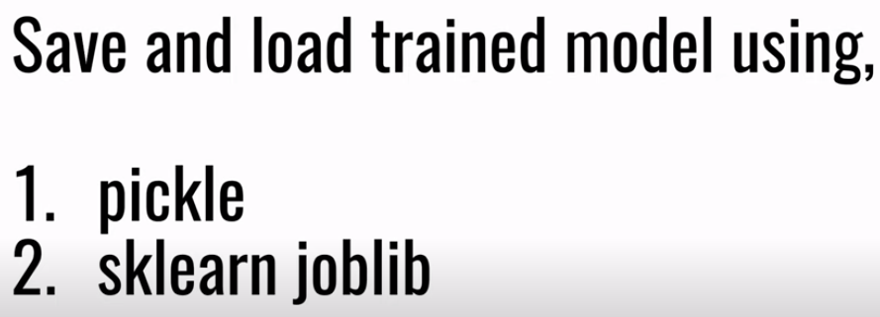
5 Save Model
https://www.youtube.com/watch?v=KfnhNlD8WZI&list=PLeo1K3hjS3uvCeTYTeyfe0-rN5r8zn9rw&index=5
Save Model (0:00-0:15/8:21)
We discuss Save Model using
1. Python Pickle: Pickle is a Python Library for Serializing and deserialize a Python object structure.
2. Scikit-Learn Joblib: Joblib is a Python Library. Joblib build on top of Python Pickle and add several layers in optimization and polish.\
Pickle and sklearn Joblib are two different approaches to save a trained model into a file.
Later on, we can load model into memory and use model from a file and make the prediction.

Slide 3
5.1 Train and Prediction

Slide 4
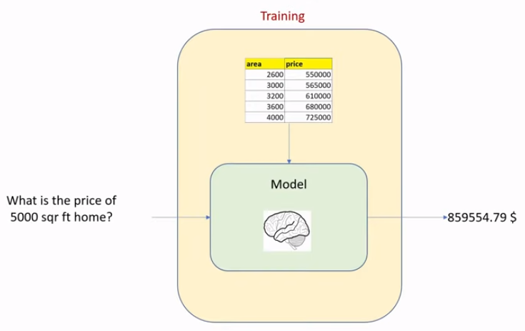
5.1 Train and Prediction
https://www.youtube.com/watch?v=KfnhNlD8WZI&list=PLeo1K3hjS3uvCeTYTeyfe0-rN5r8zn9rw&index=5
Train and Prediction (0:16-1:00/8:21)
Solving the Machine Learning problem consists of two steps:
1. Training: train model using the training dataset.
2. Prediction: Ask questions to the the trained model. The trained model is like a human brain and that will give you the answer.
1
2

Slide 5
5.1 Train and Prediction
https://www.youtube.com/watch?v=KfnhNlD8WZI&list=PLeo1K3hjS3uvCeTYTeyfe0-rN5r8zn9rw&index=5
Train and Prediction (1:01-1:20/8:21)
Normally, the training dataset is very huge. The larger dataset will have more accurate model. For example, you are trained in football. As you train more and more, you will become better and better in football game.
The dataset can be GB size, the training step become more time consuming.
We save the model into a file. We can use the same model later on for prediction. We don’t have to train every time.

Slide 6
5.2 Save/Load Model

Slide 7
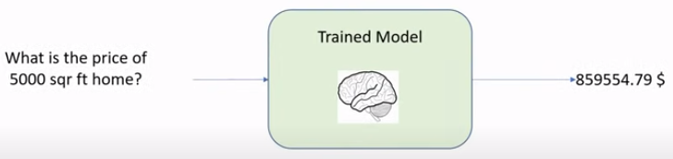
5.2 Save/Load Model
https://www.youtube.com/watch?v=KfnhNlD8WZI&list=PLeo1K3hjS3uvCeTYTeyfe0-rN5r8zn9rw&index=5
Save/Load Model (1:21-1:30/8:21)
If we save the model into a file, we don’t need to train again. We can load the model directly and ask the question.
We are going to write a Python Code to save and load model and make the prediction.

Slide 8
5.3 Dataset

Slide 9
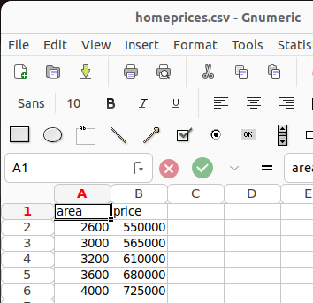
5.3 Dataset
https://www.youtube.com/watch?v=KfnhNlD8WZI&list=PLeo1K3hjS3uvCeTYTeyfe0-rN5r8zn9rw&index=5
Dataset (1:31-1:35/8:21)
Below is dataset “homeprices.csv”.

Slide 10
5.4 Load Dataset

Slide 11
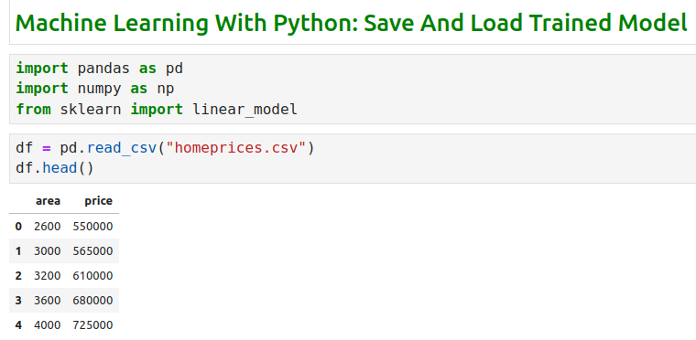
5.4 Load Dataset
https://www.youtube.com/watch?v=KfnhNlD8WZI&list=PLeo1K3hjS3uvCeTYTeyfe0-rN5r8zn9rw&index=5
Load Dataset (1:36-1:50/8:21)
We load dataset from “homeprices.csv” file.

Slide 12
5.5 Create Model and Make Prediction

Slide 13
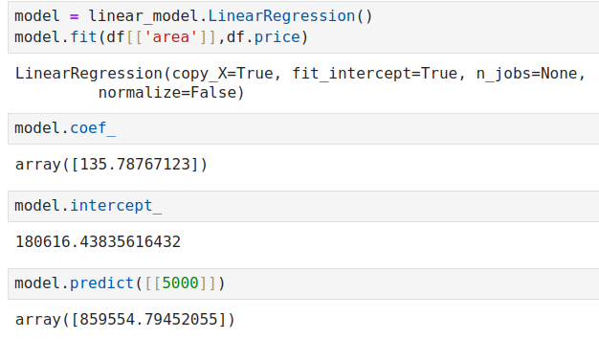
5.5 Create Model and Make Prediction
https://www.youtube.com/watch?v=KfnhNlD8WZI&list=PLeo1K3hjS3uvCeTYTeyfe0-rN5r8zn9rw&index=5
Create Model and Make Prediction (1:51-2:10/8:21)
1. Create Linear Regression Model.
2. Train Model
3. Make price prediction ($859K) for 5000 sq-ft home
1
2
3

Slide 14
5.6 Pickle and Save Model

Slide 15
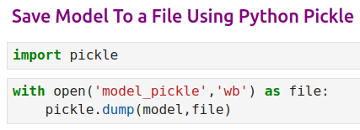
5.6 Pickle and Save Model
https://www.youtube.com/watch?v=KfnhNlD8WZI&list=PLeo1K3hjS3uvCeTYTeyfe0-rN5r8zn9rw&index=5
Pickle and Save Model (2:11-3:40/8:21)
We use Pickle to serialized the Python Object Model and save into file.
1. Import Pickle
2. Open file
3. Dump into a file. It is a binary file we cannot see well.

Slide 16
5.7 Pickle and Load Model

Slide 17
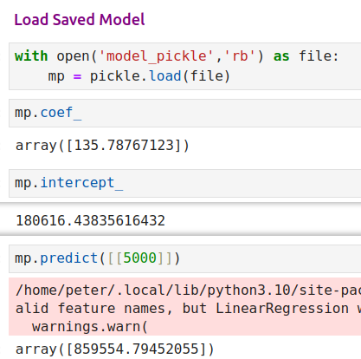
5.7 Pickle Load Model
https://www.youtube.com/watch?v=KfnhNlD8WZI&list=PLeo1K3hjS3uvCeTYTeyfe0-rN5r8zn9rw&index=5
Pickle Load Model (3:41-5:00/8:21)
1. We can load the model
2. Print m and b.
3. Make prediction: we have 5000 sq ft home and price is $859K.
1
2
3

Slide 18
5.8 Joblib and Save Model

Slide 19
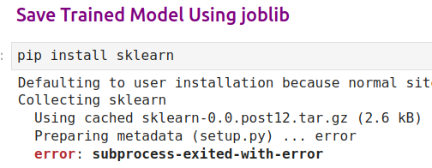
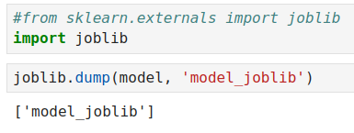
5.8 Joblib and Save Model
https://www.youtube.com/watch?v=KfnhNlD8WZI&list=PLeo1K3hjS3uvCeTYTeyfe0-rN5r8zn9rw&index=5
Joblib and Save Model (5:01-7:00/8:21)
1. Install Joblib
2. Save the Model by Joblib.
1
2

Slide 20
5.9 Joblib and Load Model

Slide 21
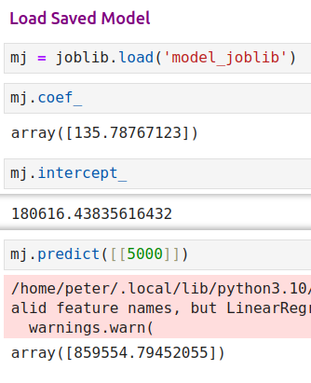
5.8 Joblib Load Model
https://www.youtube.com/watch?v=KfnhNlD8WZI&list=PLeo1K3hjS3uvCeTYTeyfe0-rN5r8zn9rw&index=5
Joblib Load Model (7:01-8:21/8:21)
1. We can load the model using Joblib
2. Print m and b.
3. Make prediction: we have 5000 sq ft home and price is $859K.
1
2
3

Slide 22
End

