Slide 1

21 Bias and Variance
Peter H. Chen

Slide 2
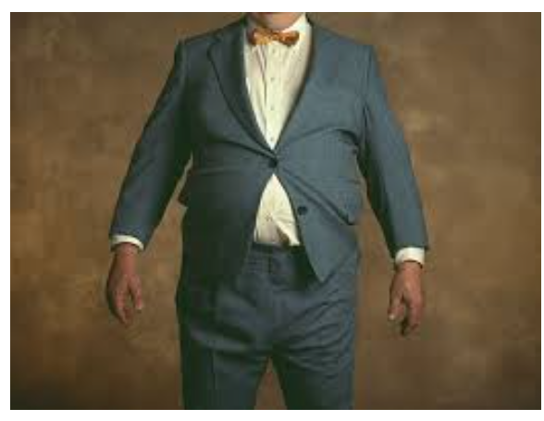
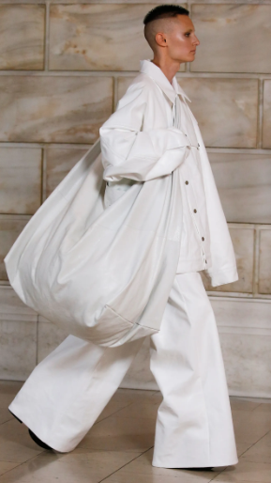
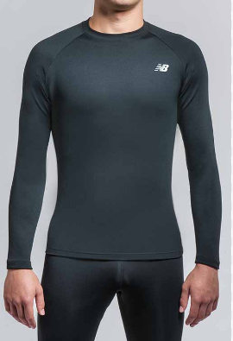
21 Bias and Variance
https://www.youtube.com/watch?v=B01qMFMAgUQ&list=PLeo1K3hjS3uvCeTYTeyfe0-rN5r8zn9rw&index=21
Bias and Variance (0:00-0:50/10:49)
People wear clothes in Overfit (too tight), Underfit (too loose), and Balanced Fit (About right).
Overfit
Underfit
Balanced fit

Slide 3
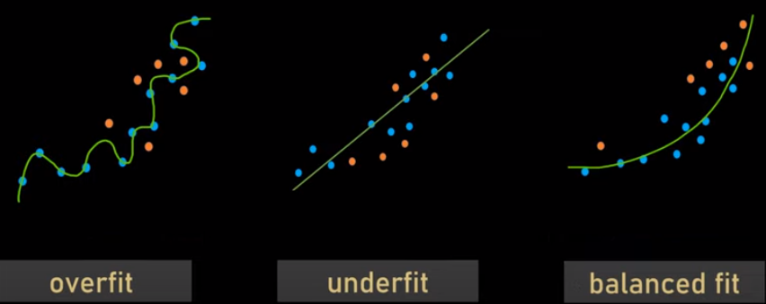
21 Bias and Variance
https://www.youtube.com/watch?v=B01qMFMAgUQ&list=PLeo1K3hjS3uvCeTYTeyfe0-rN5r8zn9rw&index=21
Bias and Variance (0:51-1:00/10:49)
Same concept in Machine Learning, out model can be overfit, underfit, and balanced fit for data.

Slide 4
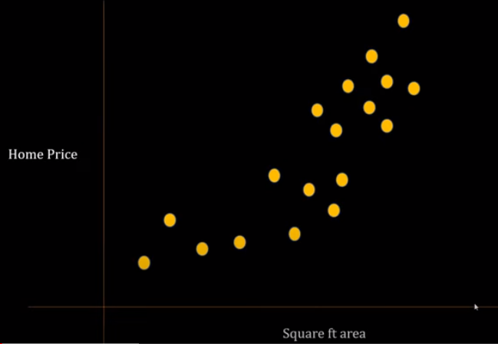
21 Bias and Variance
https://www.youtube.com/watch?v=B01qMFMAgUQ&list=PLeo1K3hjS3uvCeTYTeyfe0-rN5r8zn9rw&index=21
Bias and Variance (1:01-1:40/10:49)
We have scatter plot of home price vs. area (sq-ft).
We split the dataset into train and test sample.

Slide 5
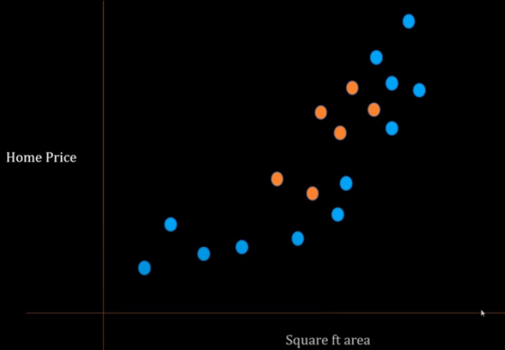
21 Bias and Variance
https://www.youtube.com/watch?v=B01qMFMAgUQ&list=PLeo1K3hjS3uvCeTYTeyfe0-rN5r8zn9rw&index=21
Bias and Variance (1:41-1:50/10:49)
Assume the blue are train samples and orange is test samples.
We can train the model which fit these blue dots.

Slide 6
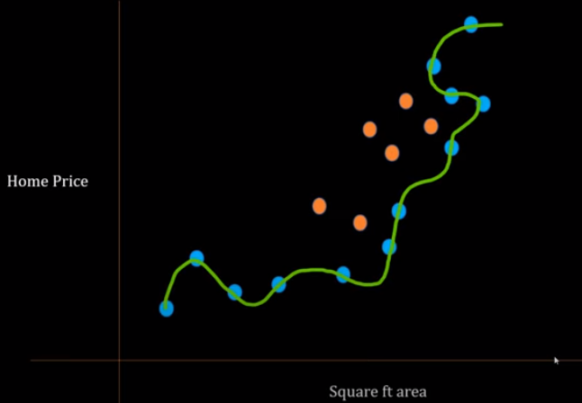

21 Bias and Variance
https://www.youtube.com/watch?v=B01qMFMAgUQ&list=PLeo1K3hjS3uvCeTYTeyfe0-rN5r8zn9rw&index=21
Bias and Variance (1:51-2:20/10:49)
Assume we model is overfit. AN overfit model fit exactly to the training data.
In this overfit, we have error = 0 in training dataset.
But the problem is the test error become very high.

Slide 7
21.1 Overfit/High Variance

Slide 8
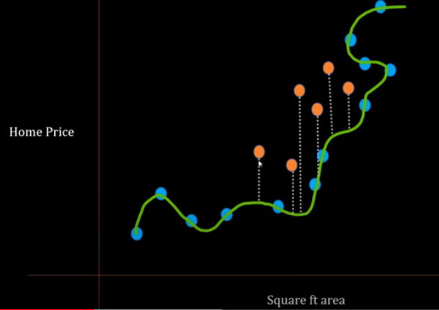

21.1 Overfit/High Variance
https://www.youtube.com/watch?v=B01qMFMAgUQ&list=PLeo1K3hjS3uvCeTYTeyfe0-rN5r8zn9rw&index=21
Overfit/High Variance (2:21-3:00/10:49)
Once we fit the green line to all the blue points.
The error between the green line and orange dot are very big.
Here, we have test dataset error = 100.

Slide 9
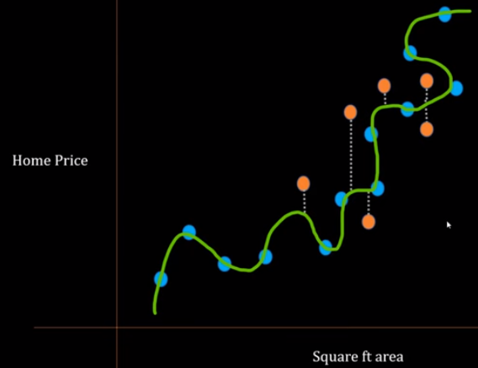

21.1 Overfit/High Variance
https://www.youtube.com/watch?v=B01qMFMAgUQ&list=PLeo1K3hjS3uvCeTYTeyfe0-rN5r8zn9rw&index=21
Overfit/High Variance (3:01-3:40/10:49)
Since we pick the the training samples and test samples in random, another data scientist may pick up different training samples ans test samples.
Different training dataset have train dataset error = 0 but problem here is we have different test dataset error. Here, we have test dataset error = 27.

Slide 10
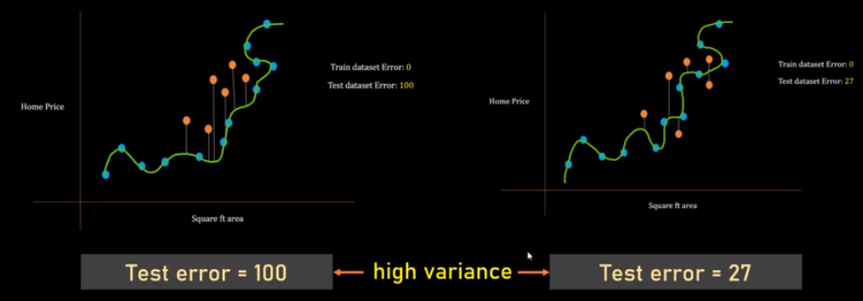
21.1 Overfit/High Variance
https://www.youtube.com/watch?v=B01qMFMAgUQ&list=PLeo1K3hjS3uvCeTYTeyfe0-rN5r8zn9rw&index=21
Overfit/High Variance (3:41-4:10/10:49)
Here, we compare two scenarios side by side. In the first case, we have test error 100. In the second case, we have test error = 27.
In this case, the test errors are varied and related to the different based on selection of training and test data point.
This case is called High Variance because there is high variability in the test error based on what kind of training samples you are selecting.

Slide 11
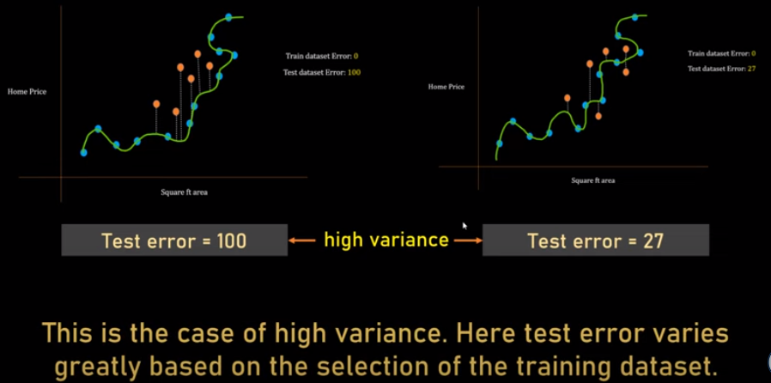
21.1 Overfit/High Variance
https://www.youtube.com/watch?v=B01qMFMAgUQ&list=PLeo1K3hjS3uvCeTYTeyfe0-rN5r8zn9rw&index=21
Overfit/High Variance (4:11-4:40/10:49)
Because the training samples are random selecting, the test error varies randomly which is not good. This is the common issue of overfit model.
High variance, test error varies greatly based on the selection of training data points.
So, remember, when we talk about the high variance, we are talking about the varies in error of different selecting samples.

Slide 12
21.2 Underfit/High Bias

Slide 13
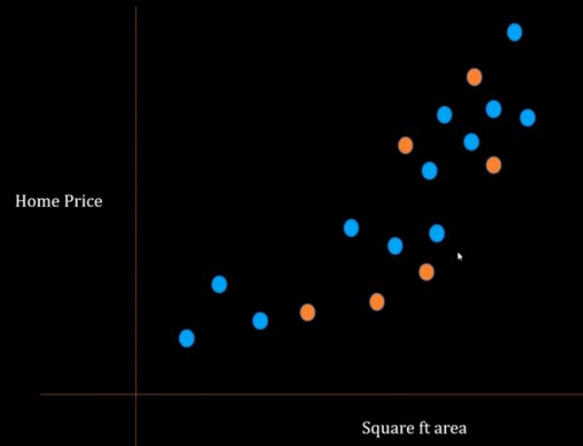
21.2 Underfit/High Bias
https://www.youtube.com/watch?v=B01qMFMAgUQ&list=PLeo1K3hjS3uvCeTYTeyfe0-rN5r8zn9rw&index=21
Underfit/High Bias (4:41-5:00/10:49)
Now, we look at another scenario.

Slide 14
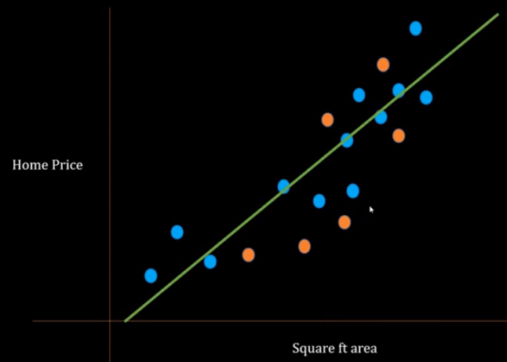
21.2 Underfit/High Bias
https://www.youtube.com/watch?v=B01qMFMAgUQ&list=PLeo1K3hjS3uvCeTYTeyfe0-rN5r8zn9rw&index=21
Underfit/High Bias (5:01-5:20/10:49)
This time, instead of complex model. We use a very simple model, linear regression.
This is a underfit. The straight line cannot pass through all blue dots.

Slide 15
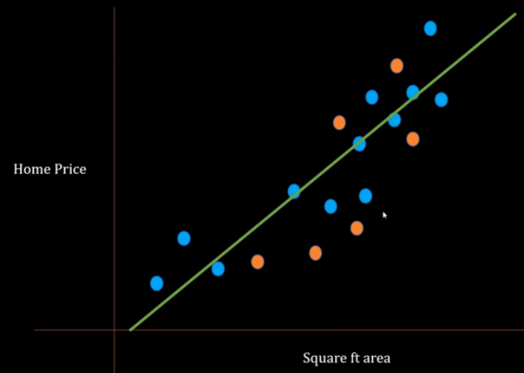

21.2 Underfit/High Bias
https://www.youtube.com/watch?v=B01qMFMAgUQ&list=PLeo1K3hjS3uvCeTYTeyfe0-rN5r8zn9rw&index=21
Underfit/High Bias (5:21-5:40/10:49)
It is a simple model, your training data error is high (= 43).
The test dataset error = 47.

Slide 16
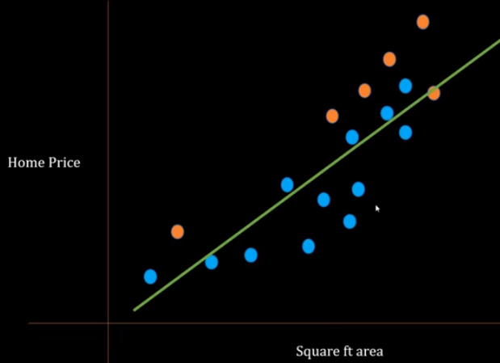

21.2 Underfit/High Bias
https://www.youtube.com/watch?v=B01qMFMAgUQ&list=PLeo1K3hjS3uvCeTYTeyfe0-rN5r8zn9rw&index=21
Underfit/High Bias (5:41-5:50/10:49)
When we select different training dataset. The training dataset error is different (= 41).
But the test dataset error is similar (= 37) which is 47 in previous case.

Slide 17
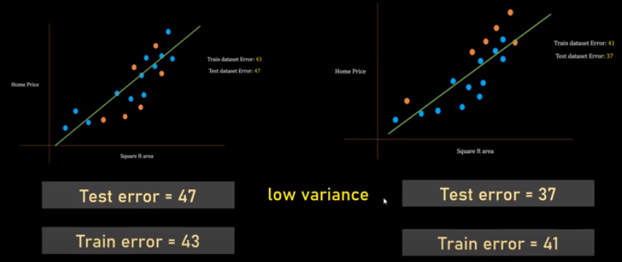
21.2 Underfit/High Bias
https://www.youtube.com/watch?v=B01qMFMAgUQ&list=PLeo1K3hjS3uvCeTYTeyfe0-rN5r8zn9rw&index=21
Underfit/High Bias (5:51-6:40/10:49)
The line is different but the test dataset error is still about the similar (change from 47 to 37).
Because the the test error is similar and test error does not change from training samples and test samples selection, we called this case is Low Variance.

Slide 18
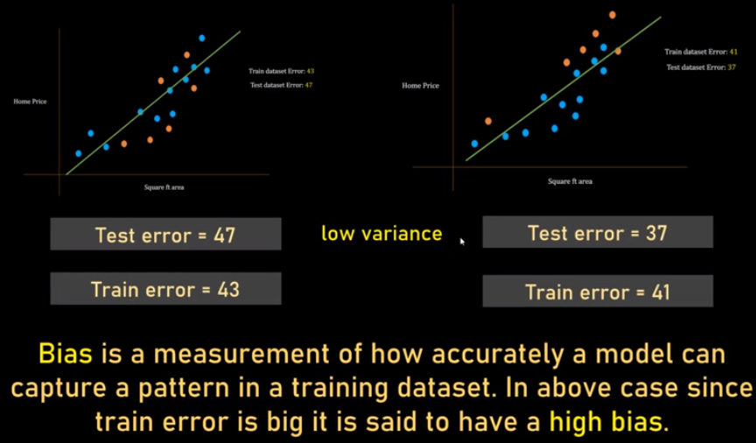
21.2 Underfit/High Bias
https://www.youtube.com/watch?v=B01qMFMAgUQ&list=PLeo1K3hjS3uvCeTYTeyfe0-rN5r8zn9rw&index=21
Underfit/High Bias (6:41-7:20/10:49)
The Low Variance (test error change from 47 to 37) does not change too much like High Variance (test error change from 100 to 27).
In Low variance, the training error is very big (43, and 41). In the previous high variance case, the training error are all 0.
1. In underfit model, we have high bias but low variance. Bias is training error.
2. In overfit model, we have low bias but high variance. Variance is test error.

Slide 19
21.3 Balanced Fit

Slide 20
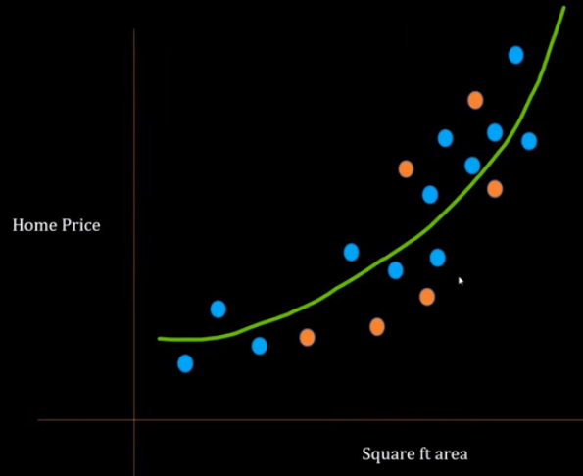

21.3 Balanced Fit
https://www.youtube.com/watch?v=B01qMFMAgUQ&list=PLeo1K3hjS3uvCeTYTeyfe0-rN5r8zn9rw&index=21
Balanced Fit (7:21-7:30/10:49)
Here, we select another training and testing dataset.
In this case, we have both

Slide 21
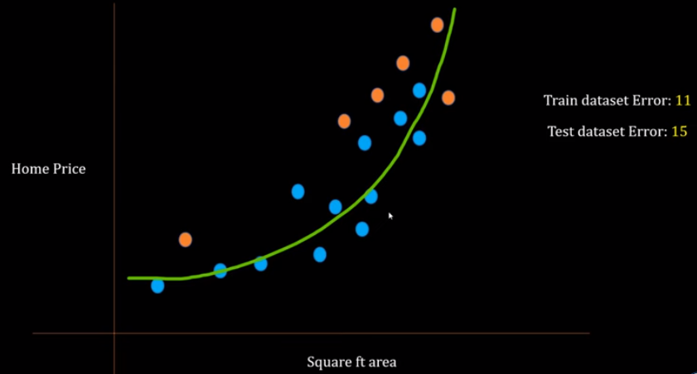
21.3 Balanced Fit
https://www.youtube.com/watch?v=B01qMFMAgUQ&list=PLeo1K3hjS3uvCeTYTeyfe0-rN5r8zn9rw&index=21
Balanced Fit (7:31-7:50/10:49)
Below, we select another training dataset. We have training error = 11 and test error = 15.

Slide 22
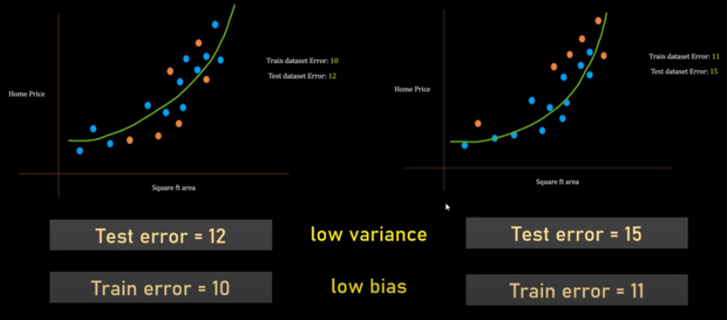
21.3 Balanced Fit
https://www.youtube.com/watch?v=B01qMFMAgUQ&list=PLeo1K3hjS3uvCeTYTeyfe0-rN5r8zn9rw&index=21
Balanced Fit (7:51-8:00/10:49)
Here, our model has both low variance and low bias.
Because the test error does not change too much and both errors are low.
That is why we called low variance and low bias.

Slide 23
21.4 Overfit, Underfit, and Balanced Fit

Slide 24
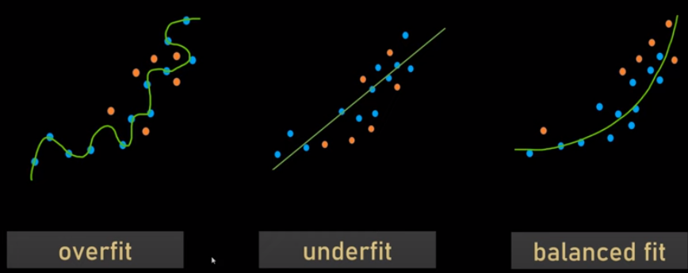
21.4 Overfit, Underfit, and Balanced Fit
https://www.youtube.com/watch?v=B01qMFMAgUQ&list=PLeo1K3hjS3uvCeTYTeyfe0-rN5r8zn9rw&index=21
Over Fit, Underfit, and Balanced Fit (8:01-8:20/10:49)
Overfit: Low Bias, High variance
Underfit: high bias, low variance
Balanced fit: low bias, low variance

Slide 25
21.4 Overfit, Underfit, and Balanced Fit
https://www.youtube.com/watch?v=B01qMFMAgUQ&list=PLeo1K3hjS3uvCeTYTeyfe0-rN5r8zn9rw&index=21
Over Fit, Underfit, and Balanced Fit (8:21-8:35/10:49)
We want to have Balanced Fit in wearing the clothes.
Overfit
Underfit
Balanced fit

Slide 26
21.5 Eye Digram

Slide 27
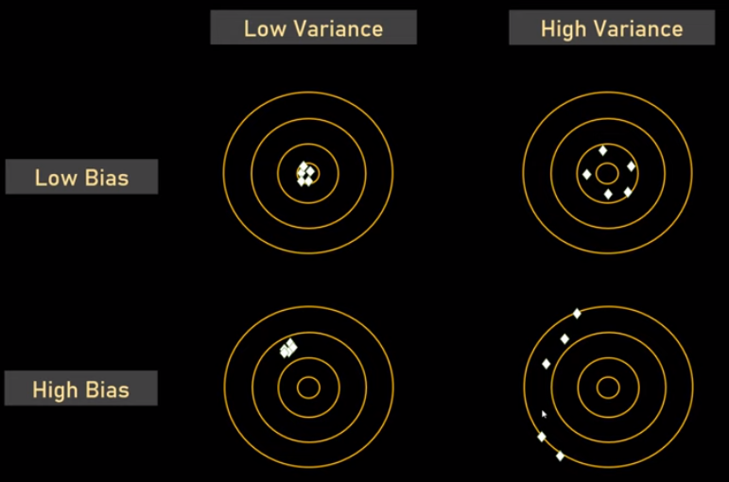
21.5 Eye Diagram
https://www.youtube.com/watch?v=B01qMFMAgUQ&list=PLeo1K3hjS3uvCeTYTeyfe0-rN5r8zn9rw&index=21
Eye Diagram (8:36-10:10/10:49)
Eye diagram for high bias, high bias, low variance, high variance.

Slide 28
21.5 How to Get Balanced Fit Model

Slide 29




21.5 How to Get Balanced Fit Model
https://www.youtube.com/watch?v=B01qMFMAgUQ&list=PLeo1K3hjS3uvCeTYTeyfe0-rN5r8zn9rw&index=21
How to Get Balanced Fit Model (10:11-10:49/10:49)
How to get Balanced Fit Model?
1. Cross Validation: K-Fold Cross validation for hyperparameter and model selection
2. Regularization: L1 (Lasso)/L2 (Ridge)
3. Dimensionality Reduction: Reduce Features
4. Ensemble Techniques: Bagging and Boosting will be discssed.
1
2
3
4

Slide 30
End

