Slide 1

30 Deploy Model to Production on AWS
Peter H. Chen

Slide 2
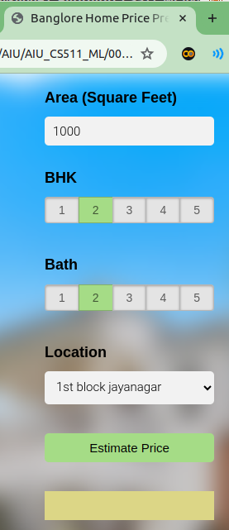
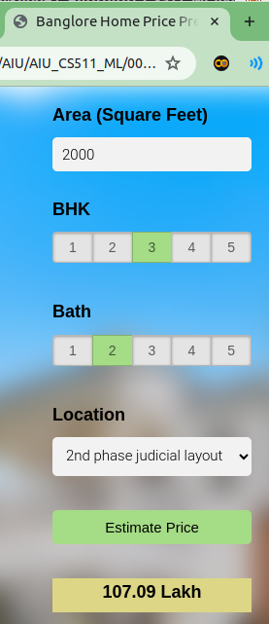
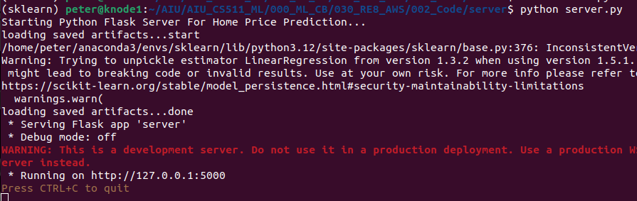
30 Deploy Model to Production on AWS
https://www.youtube.com/watch?v=q8NOmLD5pTU&list=PLeo1K3hjS3uvCeTYTeyfe0-rN5r8zn9rw&index=30
2
3
Deploy Model to Production on AWS (0:00-0:05/28:38)
We are going to deploy our Model to Production on AWS.
In the last discussion
1. Start server: Go to server folder.
> python server.py
2. Start app.html: go to client folder
> google-chrome app.html
3. Select options and click “Estimate Price” button
1

Slide 3
30 Deploy Model to Production on AWS
https://www.youtube.com/watch?v=q8NOmLD5pTU&list=PLeo1K3hjS3uvCeTYTeyfe0-rN5r8zn9rw&index=30
Topics (0:06-0:45/28:38)
We discuss the below topics for Deploy Machine Learning Model to Production on AWS.
To Deploy URL to domain name (such as, abc.com), we need to buy domain name (abc.com) on godaddy.com to map your URL to abc.com. The godaddy.com will load our URL to abc.com.
1. Project Architecture
2. Local Setup nginx Development Environment
3. Chrome JavaScript Debugging
4. Start EC2 Instance on Amazon AWS
5. Connect to EC2 instance using ssh (git bash client)
6. Copy cot to cloud
7. Install nginx on EC2 (Ubuntu)
8. Setup nginx on EC2 (Ubuntu Server)
9. Install Python Package for Flask Server

Slide 4
30.1 Project Archiecture

Slide 5


30.1 Project Architecture
https://www.youtube.com/watch?v=q8NOmLD5pTU&list=PLeo1K3hjS3uvCeTYTeyfe0-rN5r8zn9rw&index=30
Project Architecture (0:46-1:00/28:38)
Below is the the Architecture of our application on Amazon EC2 Instance.
What is used for NGINX?
1. NGINX is open-source web server software used for reverse proxy, load balancing, and caching.
2. NGINX provides HTTPS server capabilities and is mainly designed for maximum performance and stability.
3. NGINX also functions as a proxy server for email communications protocols, such as IMAP, POP3, and SMTP.
App.html
App.css
App.js
Port: 80

Slide 6
30.1 Project Architecture
https://www.youtube.com/watch?v=q8NOmLD5pTU&list=PLeo1K3hjS3uvCeTYTeyfe0-rN5r8zn9rw&index=30
Project Architecture (1:01-1:15/28:38)
Here, the NGINX is our Web Server on port 80 which solve http requests/responses.
When we make request with URL (Uniform Resource Locator) in our web browser (google chrome), the URL will go to EC2 instance and then Web Server (NGINX)
The Web Server NGINX will return the app.html, app.css, and app.js to our browser.
After resources are cached into the NGINX, the NGINX become the proxy for resources.
Now, we have the resources (app.html, app.css, and app.js) in Google-Chrome,
App.html
App.css
App.js
Port: 80

Slide 7
30.1 Project Architecture
https://www.youtube.com/watch?v=q8NOmLD5pTU&list=PLeo1K3hjS3uvCeTYTeyfe0-rN5r8zn9rw&index=30
Project Architecture (1:16-1:30/28:38)
1. When user click on the button to predict the home price from Chrome-Chrome, the Google-Chrome will make http request to NGINX Web Server on Port 80.
2. The NGINX will route the request to the Python Flask Server on Port 5000.
3. The Flask Server is running on EC2 instance will get the predicted price from saved ML Model.
App.html
App.css
App.js
Port: 80
1
App.js
=====
HTTP Post:
/api/predict_home_price
2
Python Flask Server
3
Saved ML Model
Port: 5000

Slide 8
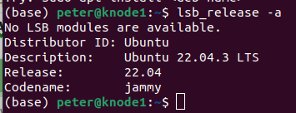
30.02 NGINX
https://www.youtube.com/watch?v=q8NOmLD5pTU&list=PLeo1K3hjS3uvCeTYTeyfe0-rN5r8zn9rw&index=30
NGINX (0:00-0:30/28:38)
We discuss how to install and configure NGINX Web Server in Ubuntu 22.04 to create our own web site on Virtual Host.
> lsb_release -a

Slide 9
30.02.01 Overview

Slide 10
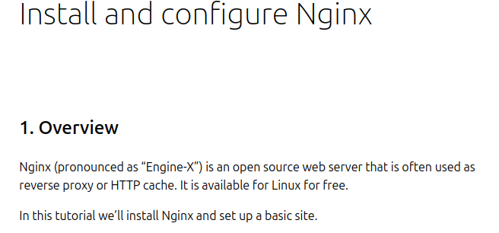
30.02.01 Overview
https://www.youtube.com/watch?v=q8NOmLD5pTU&list=PLeo1K3hjS3uvCeTYTeyfe0-rN5r8zn9rw&index=30
Overview (0:31-0:50/28:38)
Google search “NGINX on Ubuntu as below link.
NGINX (pronounced as “Engine-X”) is an Open Source Web Server that is often used as Reverse Proxy or HTTP Cache. It is available for Linux for free.
”https://ubuntu.com/tutorials/install-and-configure-nginx#1-overview

Slide 11
30.02.02 Install NGINX

Slide 12
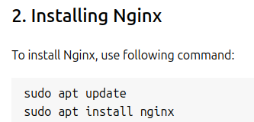
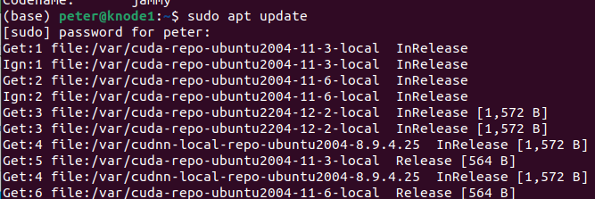
30.02.02 Install NGINX
https://www.youtube.com/watch?v=q8NOmLD5pTU&list=PLeo1K3hjS3uvCeTYTeyfe0-rN5r8zn9rw&index=30
Install NGINX (0:51-1:30/28:38)
Let’s install the NGINX.
First, update the system using command
> sudo apt update
https://ubuntu.com/tutorials/install-and-configure-nginx#2-installing-nginx

Slide 13
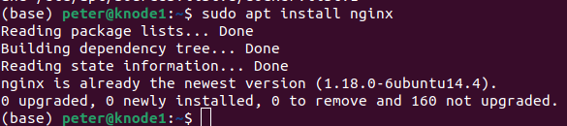
30.02.02 Install NGINX
https://www.youtube.com/watch?v=q8NOmLD5pTU&list=PLeo1K3hjS3uvCeTYTeyfe0-rN5r8zn9rw&index=30
Install NGINX (1:31-2:00/28:38)
Then, we install the NGINX
> sudo apt install nginx
After installed, we have everything we need for NGINX.
https://ubuntu.com/tutorials/install-and-configure-nginx#2-installing-nginx

Slide 14
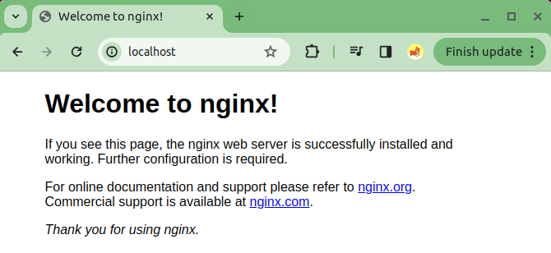
30.02.02 Install NGINX
https://www.youtube.com/watch?v=q8NOmLD5pTU&list=PLeo1K3hjS3uvCeTYTeyfe0-rN5r8zn9rw&index=30
Install NGINX (2:01-2:25/28:38)
Open the Google Chrome Browser and type
> localhost
We can see “Welcome to nginx!”
We have successfully install NGINX on our Web server.
Now, go to the next step.

Slide 15
30.02.03 Create Our Own Web-Site

Slide 16
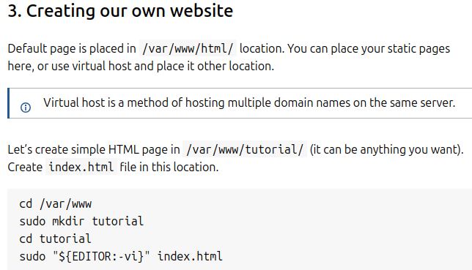
30.02.03 Create Our Own Web-Site
https://www.youtube.com/watch?v=q8NOmLD5pTU&list=PLeo1K3hjS3uvCeTYTeyfe0-rN5r8zn9rw&index=30
Create Our Own Web-Site (2:26-2:50/28:38)
Now, we create our own web-site.
The default page is placed in /var/www/html location. We can place our static pages here, or we can use virtual host and place it in other location.
https://ubuntu.com/tutorials/install-and-configure-nginx#3-creating-our-own-website

Slide 17

30.02.03 Create Our Own Web-Site
https://www.youtube.com/watch?v=q8NOmLD5pTU&list=PLeo1K3hjS3uvCeTYTeyfe0-rN5r8zn9rw&index=30
Create Our Own Web-Site (2:51-3:30/28:38)
Let’s create a simple HTML page in /var/www/tutorial.
The location can be anything we want. The file name is index.html is in this location.
Or anywhere we want to to store.
1. > cd /var/www
2. > ls
3. > sudo mkdir RealEstate,com
4. > cd RealEstate.com
5. > sudo cp -rf ~/AIU/AIU_CS511_ML/000_ML_CB/030_RE8_AWS/002_Code/* .
6. > ls
https://ubuntu.com/tutorials/install-and-configure-nginx#3-creating-our-own-website
5
6

Slide 18
30.02.04 Setup Virtual Host

Slide 19
30.02.04 Setup Virtual Host
https://www.youtube.com/watch?v=q8NOmLD5pTU&list=PLeo1K3hjS3uvCeTYTeyfe0-rN5r8zn9rw&index=30
Setup Virtual Host (5:21-5:30/28:38)
First, we navigate to the below directory:
1. > cd /etc/nginx/sites-enabled
2. > sudo gedit RealEstate
https://ubuntu.com/tutorials/install-and-configure-nginx#4-setting-up-virtual-host

Slide 20
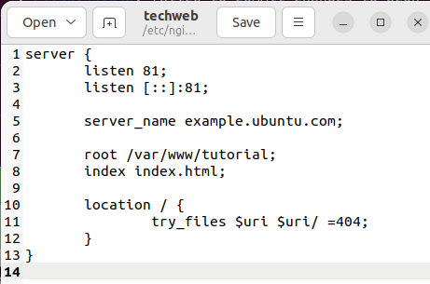
30.02.04 Setup Virtual Host
https://www.youtube.com/watch?v=q8NOmLD5pTU&list=PLeo1K3hjS3uvCeTYTeyfe0-rN5r8zn9rw&index=30
Setup Virtual Host (5:31-5:40/28:38)
Copy and paste below content to file techweb.
https://ubuntu.com/tutorials/install-and-configure-nginx#4-setting-up-virtual-host

Slide 21
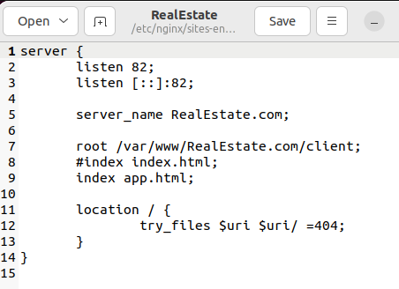
30.02.04 Setup Virtual Host
https://www.youtube.com/watch?v=q8NOmLD5pTU&list=PLeo1K3hjS3uvCeTYTeyfe0-rN5r8zn9rw&index=30
Setup Virtual Host (5:41-7:10/28:38)
Here, we change
1. server_name techweb.com. We can have any domain name because we do not point to any real domain name right now.
2. root directory /var/www/techweb.com which we put our index.html file.
3. Here, our web-site use port number 81, instead of localhost which use port 80.
After this, we activate the virtual host and test result.
https://ubuntu.com/tutorials/install-and-configure-nginx#4-setting-up-virtual-host

Slide 22
30.02.05 Activate Virtual Host and Test

Slide 23
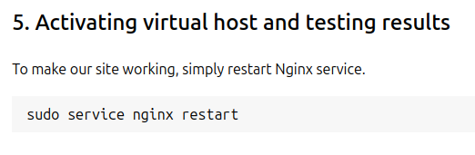
30.02.05 Activate Virtual Host and Test
https://www.youtube.com/watch?v=q8NOmLD5pTU&list=PLeo1K3hjS3uvCeTYTeyfe0-rN5r8zn9rw&index=30
Activate Virtual Host and Test (7:11-7:50/28:38)
To make our site working, simply restart NGINX service.
> sudo service nginx restart
https://ubuntu.com/tutorials/install-and-configure-nginx#5-activating-virtual-host-and-testing-results

Slide 24
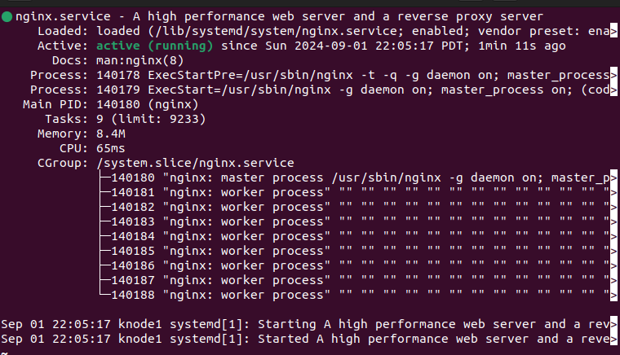
30.02.05 Activate Virtual Host and Test
https://www.youtube.com/watch?v=q8NOmLD5pTU&list=PLeo1K3hjS3uvCeTYTeyfe0-rN5r8zn9rw&index=30
Activate Virtual Host and Test (7:51-7:53/28:38)
Check server status.
> sudo service nginx status
Type q to exit.
https://ubuntu.com/tutorials/install-and-configure-nginx#5-activating-virtual-host-and-testing-results

Slide 25
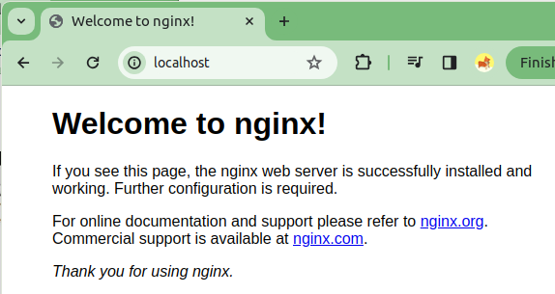
30.02.05 Activate Virtual Host and Test
https://www.youtube.com/watch?v=q8NOmLD5pTU&list=PLeo1K3hjS3uvCeTYTeyfe0-rN5r8zn9rw&index=30
Activate Virtual Host and Test (7:54-7:55/28:38)
Now, open Google chrome
> localhost
https://ubuntu.com/tutorials/install-and-configure-nginx#5-activating-virtual-host-and-testing-results

Slide 26
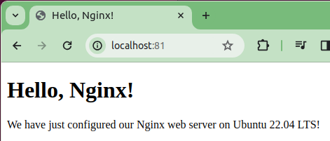
30.02.05 Activate Virtual Host and Test
https://www.youtube.com/watch?v=q8NOmLD5pTU&list=PLeo1K3hjS3uvCeTYTeyfe0-rN5r8zn9rw&index=30
Activate Virtual Host and Test (7:56-7:57/28:38)
Change the port number ‘81’
> localhost:81
That is.
https://ubuntu.com/tutorials/install-and-configure-nginx#5-activating-virtual-host-and-testing-results

Slide 27
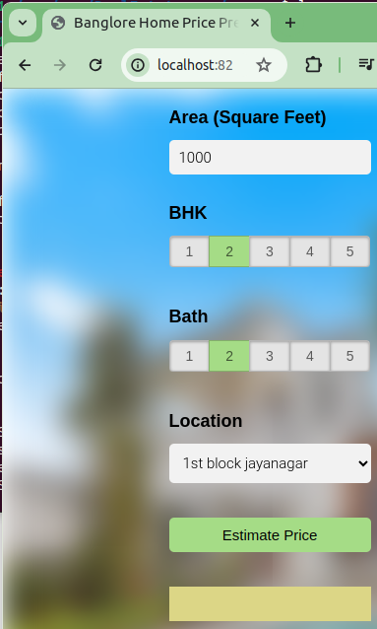
30.02.05 Activate Virtual Host and Test
https://www.youtube.com/watch?v=q8NOmLD5pTU&list=PLeo1K3hjS3uvCeTYTeyfe0-rN5r8zn9rw&index=30
Activate Virtual Host and Test (7:58-7:59/28:38)
Change the port number ‘82’
> localhost:82
That is.
https://ubuntu.com/tutorials/install-and-configure-nginx#5-activating-virtual-host-and-testing-results

Slide 28
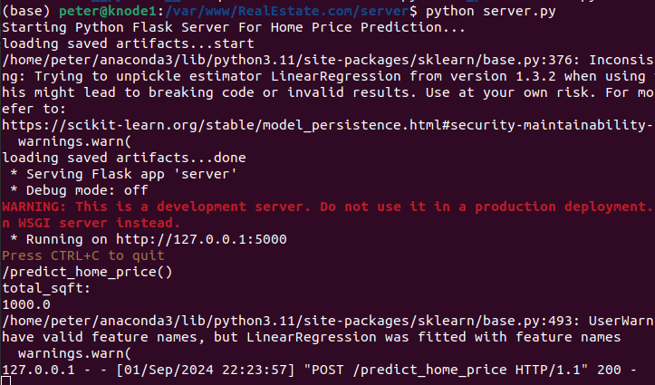
30.02.05 Activate Virtual Host and Test
https://www.youtube.com/watch?v=q8NOmLD5pTU&list=PLeo1K3hjS3uvCeTYTeyfe0-rN5r8zn9rw&index=30
Activate Virtual Host and Test (8:00-8:01/28:38)
Because we need to python server to get the data.
> python server.py
https://ubuntu.com/tutorials/install-and-configure-nginx#5-activating-virtual-host-and-testing-results

Slide 29
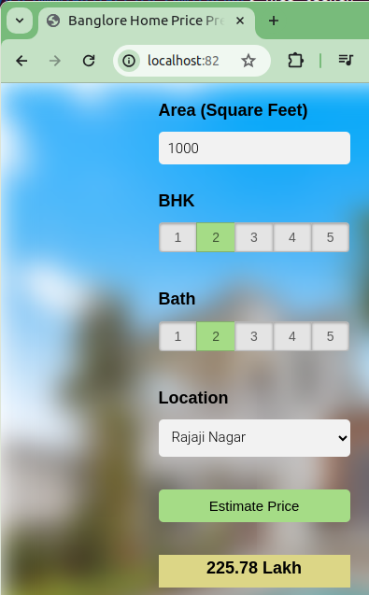
30.02.05 Activate Virtual Host and Test
https://www.youtube.com/watch?v=q8NOmLD5pTU&list=PLeo1K3hjS3uvCeTYTeyfe0-rN5r8zn9rw&index=30
Activate Virtual Host and Test (8:02-8:16/28:38)
Because we need to python server to get the data.
> python server.py
https://ubuntu.com/tutorials/install-and-configure-nginx#5-activating-virtual-host-and-testing-results

Slide 30
End

