Slide 1

30.02 NGINX

Slide 2
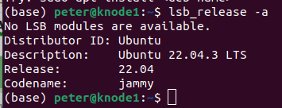
30.02 NGINX
https://www.youtube.com/watch?v=q8NOmLD5pTU&list=PLeo1K3hjS3uvCeTYTeyfe0-rN5r8zn9rw&index=30
NGINX (0:00-0:30/28:28)
We discuss how to install and configure NGINX Web Server in Ubuntu 22.04 to create our own web site on Virtual Host.
> lsb_release -a

Slide 3
30.02.01 Overview

Slide 4
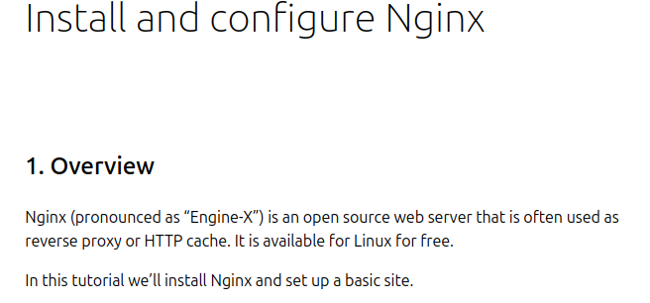
30.02.01 Overview
https://www.youtube.com/watch?v=q8NOmLD5pTU&list=PLeo1K3hjS3uvCeTYTeyfe0-rN5r8zn9rw&index=30
Overview (0:31-0:50/28:28)
Google search “NGINX on Ubuntu as below link.
NGINX (pronounced as “Engine-X”) is an Open Source Web Server that is often used as Reverse Proxy or HTTP Cache. It is available for Linux for free.
”https://ubuntu.com/tutorials/install-and-configure-nginx#1-overview

Slide 5
30.02.02 Install NGINX

Slide 6
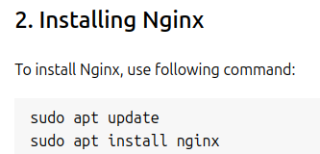
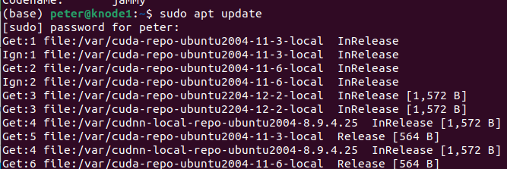
30.02.02 Install NGINX
https://www.youtube.com/watch?v=q8NOmLD5pTU&list=PLeo1K3hjS3uvCeTYTeyfe0-rN5r8zn9rw&index=30
Install NGINX (0:51-1:30/28:28)
Let’s install the NGINX.
First, update the system using command
> sudo apt update
https://ubuntu.com/tutorials/install-and-configure-nginx#2-installing-nginx

Slide 7
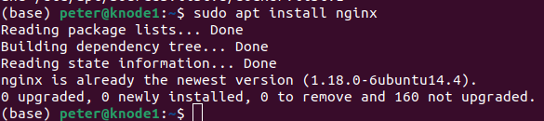
30.02.02 Install NGINX
https://www.youtube.com/watch?v=q8NOmLD5pTU&list=PLeo1K3hjS3uvCeTYTeyfe0-rN5r8zn9rw&index=30
Install NGINX (1:31-2:00/28:28)
Then, we install the NGINX
> sudo apt install nginx
After installed, we have everything we need for NGINX.
https://ubuntu.com/tutorials/install-and-configure-nginx#2-installing-nginx

Slide 8
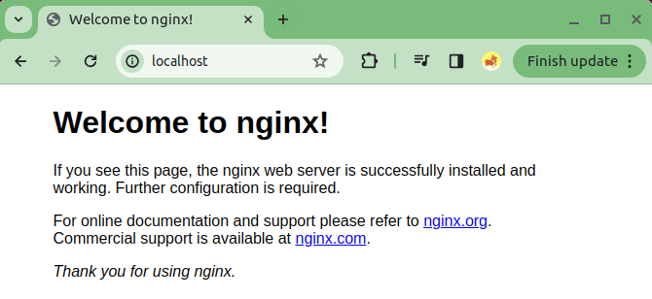
30.02.02 Install NGINX
https://www.youtube.com/watch?v=q8NOmLD5pTU&list=PLeo1K3hjS3uvCeTYTeyfe0-rN5r8zn9rw&index=30
Install NGINX (2:01-2:25/28:28)
Open the Google Chrome Browser and type
> localhost
We can see “Welcome to nginx!”
We have successfully install NGINX on our Web server.
Now, go to the next step.

Slide 9
30.02.03 Create Our Own Web-Site

Slide 10
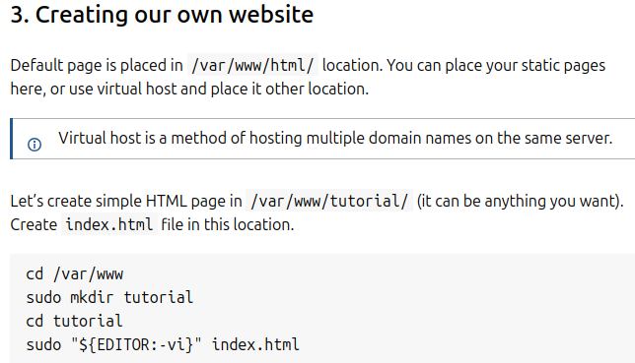
30.02.03 Create Our Own Web-Site
https://www.youtube.com/watch?v=q8NOmLD5pTU&list=PLeo1K3hjS3uvCeTYTeyfe0-rN5r8zn9rw&index=30
Create Our Own Web-Site (2:26-2:50/28:28)
Now, we create our own web-site.
The default page is placed in /var/www/html location. We can place our static pages here, or we can use virtual host and place it in other location.
https://ubuntu.com/tutorials/install-and-configure-nginx#3-creating-our-own-website

Slide 11
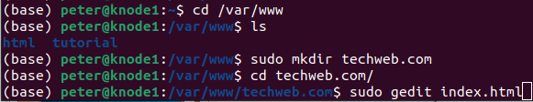
30.02.03 Create Our Own Web-Site
https://www.youtube.com/watch?v=q8NOmLD5pTU&list=PLeo1K3hjS3uvCeTYTeyfe0-rN5r8zn9rw&index=30
Create Our Own Web-Site (2:51-3:30/28:28)
Let’s create a simple HTML page in /var/www/tutorial.
The location can be anything we want. The file name is index.html is in this location.
Or anywhere we want to to store.
1. > cd /var/www
2. > ls
3. > sudo mkdir techweb,com
4. > cd techweb.com
5. > sudo gedit index.html
https://ubuntu.com/tutorials/install-and-configure-nginx#3-creating-our-own-website

Slide 12
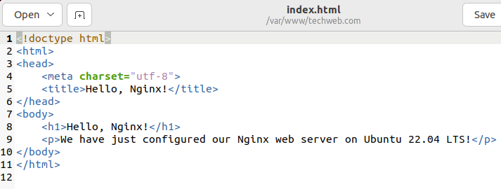
30.02.03 Create Our Own Web-Site
https://www.youtube.com/watch?v=q8NOmLD5pTU&list=PLeo1K3hjS3uvCeTYTeyfe0-rN5r8zn9rw&index=30
Create Our Own Web-Site (3:31-5:20/28:28)
We copy and paste the below html code.
Next step is to setup the virtual host to make NGINX use pages from this location.
https://ubuntu.com/tutorials/install-and-configure-nginx#3-creating-our-own-website

Slide 13
30.02.04 Setup Virtual Host

Slide 14

30.02.04 Setup Virtual Host
https://www.youtube.com/watch?v=q8NOmLD5pTU&list=PLeo1K3hjS3uvCeTYTeyfe0-rN5r8zn9rw&index=30
Setup Virtual Host (5:21-5:30/28:28)
First, we navigate to the below directory:
1. > cd /etc/nginx/sites-enabled
2. > sudo gedit techweb
https://ubuntu.com/tutorials/install-and-configure-nginx#4-setting-up-virtual-host

Slide 15
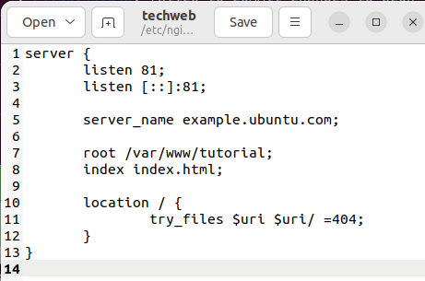
30.02.04 Setup Virtual Host
https://www.youtube.com/watch?v=q8NOmLD5pTU&list=PLeo1K3hjS3uvCeTYTeyfe0-rN5r8zn9rw&index=30
Setup Virtual Host (5:31-5:40/28:28)
Copy and paste below content to file techweb.
https://ubuntu.com/tutorials/install-and-configure-nginx#4-setting-up-virtual-host

Slide 16
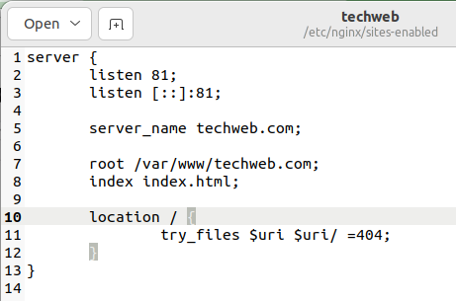
30.02.04 Setup Virtual Host
https://www.youtube.com/watch?v=q8NOmLD5pTU&list=PLeo1K3hjS3uvCeTYTeyfe0-rN5r8zn9rw&index=30
Setup Virtual Host (5:41-7:10/28:28)
Here, we change
1. server_name techweb.com. We can have any domain name because we do not point to any real domain name right now.
2. root directory /var/www/techweb.com which we put our index.html file.
3. Here, our web-site use port number 81, instead of localhost which use port 80.
After this, we activate the virtual host and test result.
https://ubuntu.com/tutorials/install-and-configure-nginx#4-setting-up-virtual-host

Slide 17
30.02.05 Activate Virtual Host and Test

Slide 18
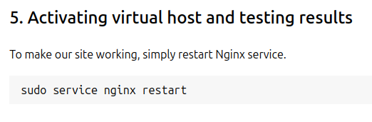
30.02.05 Activate Virtual Host and Test
https://www.youtube.com/watch?v=q8NOmLD5pTU&list=PLeo1K3hjS3uvCeTYTeyfe0-rN5r8zn9rw&index=30
Activate Virtual Host and Test (7:11-7:50/28:28)
To make our site working, simply restart NGINX service.
> sudo service nginx restart
https://ubuntu.com/tutorials/install-and-configure-nginx#5-activating-virtual-host-and-testing-results

Slide 19
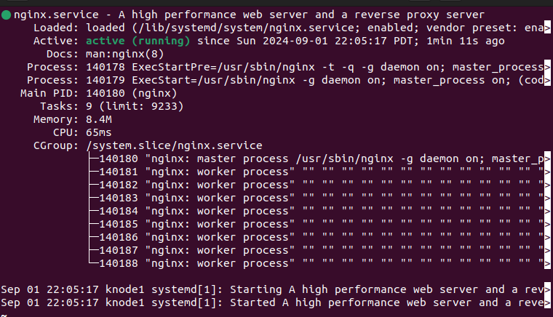
30.02.05 Activate Virtual Host and Test
https://www.youtube.com/watch?v=q8NOmLD5pTU&list=PLeo1K3hjS3uvCeTYTeyfe0-rN5r8zn9rw&index=30
Activate Virtual Host and Test (7:51-7:53/28:28)
Check server status.
> sudo service nginx status
Type q to exit.
https://ubuntu.com/tutorials/install-and-configure-nginx#5-activating-virtual-host-and-testing-results

Slide 20
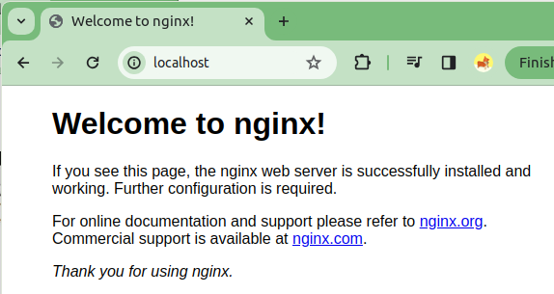
30.02.05 Activate Virtual Host and Test
https://www.youtube.com/watch?v=q8NOmLD5pTU&list=PLeo1K3hjS3uvCeTYTeyfe0-rN5r8zn9rw&index=30
Activate Virtual Host and Test (7:54-8:00/28:28)
Now, open Google chrome
> localhost
https://ubuntu.com/tutorials/install-and-configure-nginx#5-activating-virtual-host-and-testing-results

Slide 21
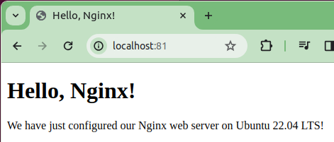
30.02.05 Activate Virtual Host and Test
https://www.youtube.com/watch?v=q8NOmLD5pTU&list=PLeo1K3hjS3uvCeTYTeyfe0-rN5r8zn9rw&index=30
Activate Virtual Host and Test (7:54-8:00/28:28)
Change the port number ‘81’
> localhost:81
That is.
https://ubuntu.com/tutorials/install-and-configure-nginx#5-activating-virtual-host-and-testing-results

Slide 22
End

