Slide 1

30.03 EC2

Slide 2
30.03 EC2
https://www.youtube.com/watch?v=q8NOmLD5pTU&list=PLeo1K3hjS3uvCeTYTeyfe0-rN5r8zn9rw&index=30
EC2 (10:11-10:15/28:38)
We have finished the local test for NGINX.
Now, we will deploy the app into the AWS/EC2.
1. Launch EC2 instance on Amazon AWS.
2. Connect to EC2 instance:
  2.1 On Ubuntu, we use PuTTY to connect AWS/Ubuntu EC2.
  2.2 On Windows, we using SSH (git bash client)
3. File Transfer from local to remote:
  3.1 Copy code to cloud by FileZilla (under Ubuntu) or
  3.2 WinScp (for Windows).
4. Install NGINX on EC2.
5. Setup NGINX on Ubuntu/EC2
6. Install Flask Server.

Slide 3
30.03.01 Launch EC2 on AWS

Slide 4
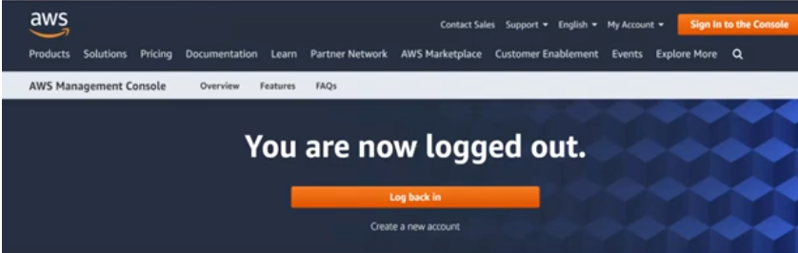
30.03.01 Launch EC2 on AWS
https://www.youtube.com/watch?v=q8NOmLD5pTU&list=PLeo1K3hjS3uvCeTYTeyfe0-rN5r8zn9rw&index=30
Launch EC2 on AWS (10:16-10:17/28:38)
We need AWS cloud server.

Slide 5
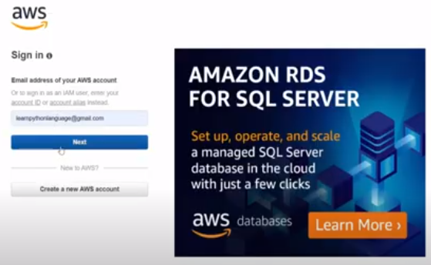
30.03.01 Launch EC2 on AWS
https://www.youtube.com/watch?v=q8NOmLD5pTU&list=PLeo1K3hjS3uvCeTYTeyfe0-rN5r8zn9rw&index=30
Launch EC2 on AWS (10:18-10:30/28:38)
Sign in AWS account. We can create account for free.

Slide 6
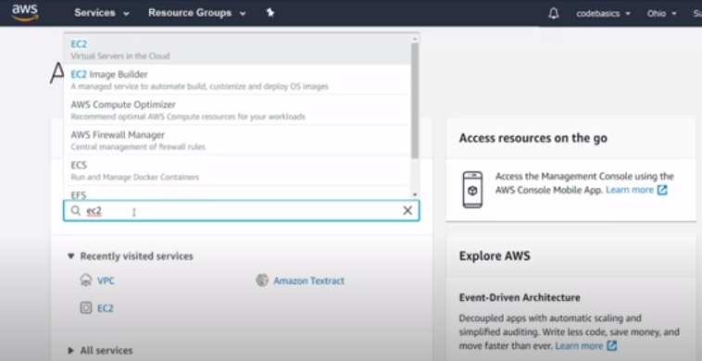
30.03.01 Launch EC2 on AWS
https://www.youtube.com/watch?v=q8NOmLD5pTU&list=PLeo1K3hjS3uvCeTYTeyfe0-rN5r8zn9rw&index=30
Launch EC2 on AWS (10:31-10:45/28:38)
We log into the AWS account. Type
> ec2
AWS provides many services, ec2 is a virtual machine in a cloud. Amazon also have storage service d3, Amazon SageMaker service for machine learning, etc.

Slide 7

30.03.01 Launch EC2 on AWS
https://www.youtube.com/watch?v=q8NOmLD5pTU&list=PLeo1K3hjS3uvCeTYTeyfe0-rN5r8zn9rw&index=30
Launch EC2 on AWS (10:46-10:50/28:38)
Click EC2 to start.

Slide 8
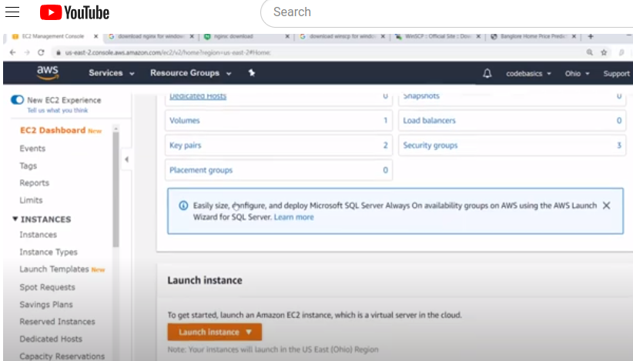
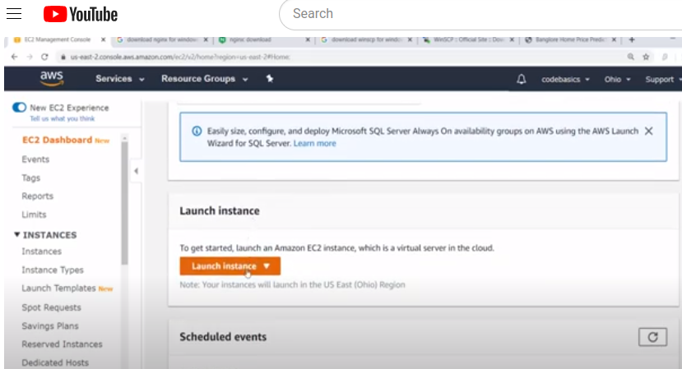
30.03.01 Launch EC2 on AWS
https://www.youtube.com/watch?v=q8NOmLD5pTU&list=PLeo1K3hjS3uvCeTYTeyfe0-rN5r8zn9rw&index=30
Launch EC2 on AWS (10:51-10:57/28:38)
We are creating a virtual machine.
Scroll down to click “Launch instance”

Slide 9
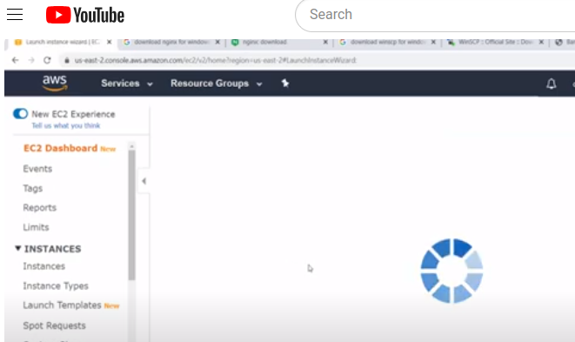
30.03.01 Launch EC2 on AWS
https://www.youtube.com/watch?v=q8NOmLD5pTU&list=PLeo1K3hjS3uvCeTYTeyfe0-rN5r8zn9rw&index=30
Launch EC2 on AWS (10:58-11:00/28:38)
Scroll down to click “Launch instance”.
Launching the EC2 instance.

Slide 10
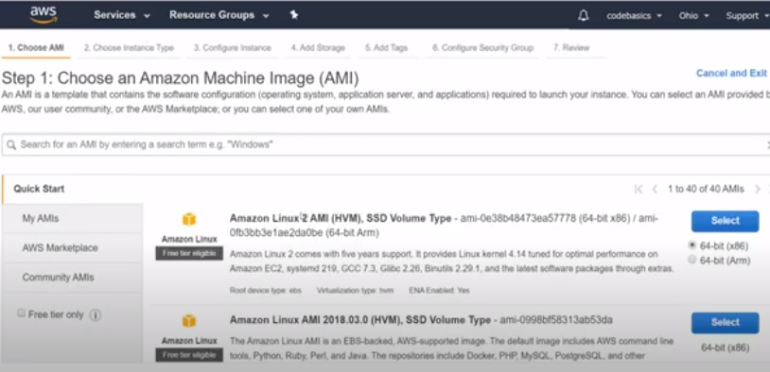
30.03.01 Launch EC2 on AWS
https://www.youtube.com/watch?v=q8NOmLD5pTU&list=PLeo1K3hjS3uvCeTYTeyfe0-rN5r8zn9rw&index=30
Launch EC2 on AWS (11:01-11:10/28:38)
There are several AMI (Amazon Machine Image).

Slide 11
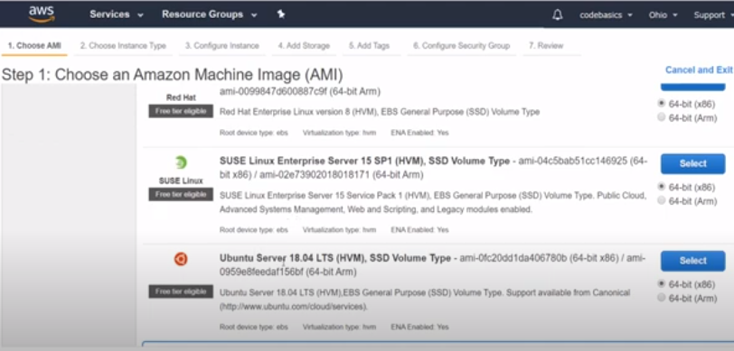
30.03.01 Launch EC2 on AWS
https://www.youtube.com/watch?v=q8NOmLD5pTU&list=PLeo1K3hjS3uvCeTYTeyfe0-rN5r8zn9rw&index=30
Launch EC2 on AWS (11:11-11:14/28:38)
We are going to use Ubuntu server.
Scroll down to “Ubuntu Server” and click “Select” button.

Slide 12
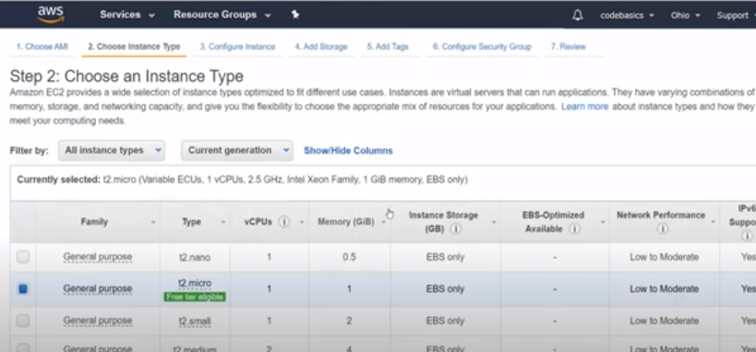
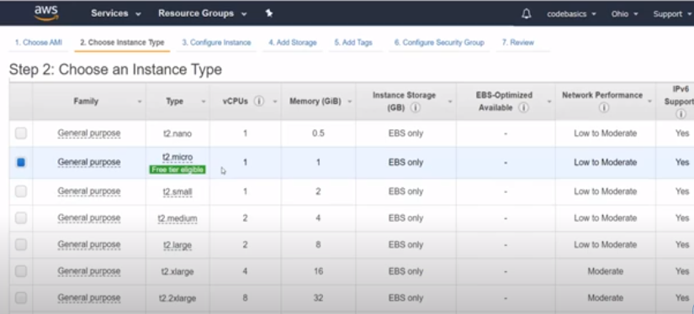
30.03.01 Launch EC2 on AWS
https://www.youtube.com/watch?v=q8NOmLD5pTU&list=PLeo1K3hjS3uvCeTYTeyfe0-rN5r8zn9rw&index=30
Launch EC2 on AWS (11:15-11:35/28:38)
There are several different Instance Types.
Scroll down the page, We can see Amazon will charge you with different instance types.
We use the default free tier.

Slide 13
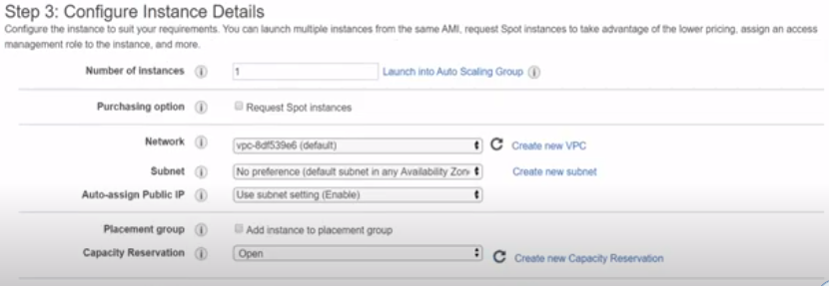
30.03.01 Launch EC2 on AWS
https://www.youtube.com/watch?v=q8NOmLD5pTU&list=PLeo1K3hjS3uvCeTYTeyfe0-rN5r8zn9rw&index=30
Launch EC2 on AWS (11:36-11:40/28:38)
We keep all default configurations.
We will skip through all the configuration setup steps.
The Amazon configurations are all good.

Slide 14
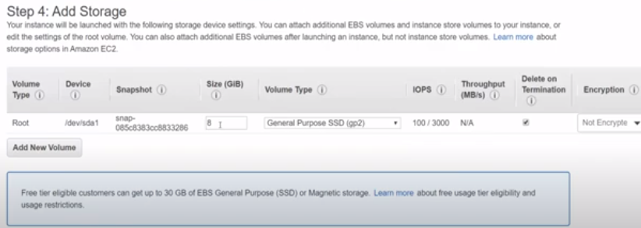
30.03.01 Launch EC2 on AWS
https://www.youtube.com/watch?v=q8NOmLD5pTU&list=PLeo1K3hjS3uvCeTYTeyfe0-rN5r8zn9rw&index=30
Launch EC2 on AWS (11:41-11:48/28:38)
AWS gives up 8 GB storage for my virtual machine.

Slide 15
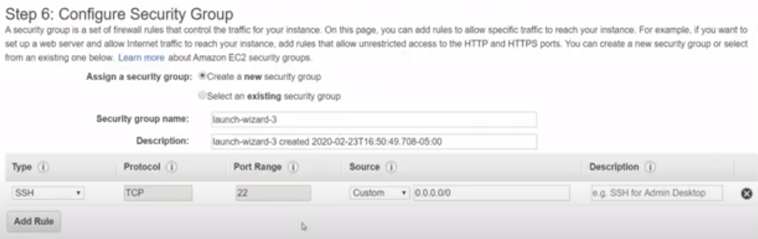
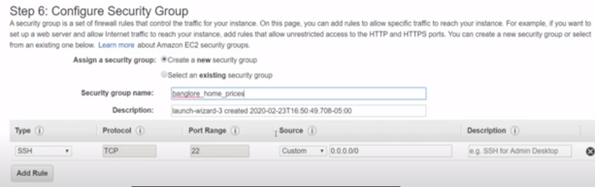
30.03.01 Launch EC2 on AWS
https://www.youtube.com/watch?v=q8NOmLD5pTU&list=PLeo1K3hjS3uvCeTYTeyfe0-rN5r8zn9rw&index=30
Launch EC2 on AWS (11:49-12:03/28:38)
We configure the security step.
We create the security group name: banglore_home_prices

Slide 16
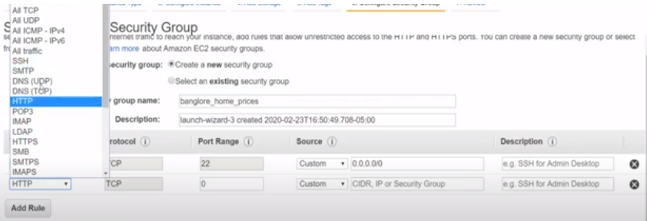
30.03.01 Launch EC2 on AWS
https://www.youtube.com/watch?v=q8NOmLD5pTU&list=PLeo1K3hjS3uvCeTYTeyfe0-rN5r8zn9rw&index=30
Launch EC2 on AWS (12:04-12:08/28:38)
We want to add rule for all HTTP for port 80.
HTTP request is on port 80.

Slide 17
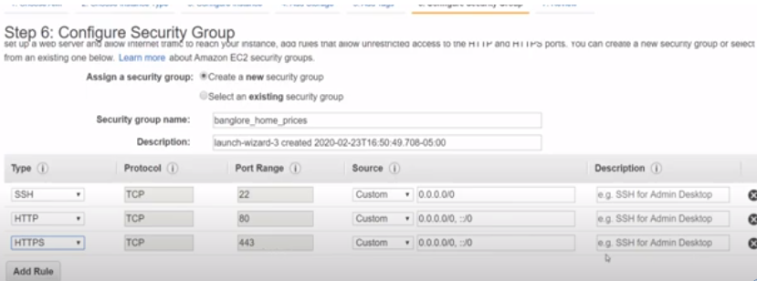
30.03.01 Launch EC2 on AWS
https://www.youtube.com/watch?v=q8NOmLD5pTU&list=PLeo1K3hjS3uvCeTYTeyfe0-rN5r8zn9rw&index=30
Launch EC2 on AWS (12:09-12:40/28:38)
We adds HTTPS for port 443 which is a standard.
Wen add these two ports (80 and 443) for HTTP and HTTPS so that from outside world, anyone can call my web server and make HTTP requests.
We are going to make HTTP request from our local chrome browser.
Therefore, these two rules are required.

Slide 18
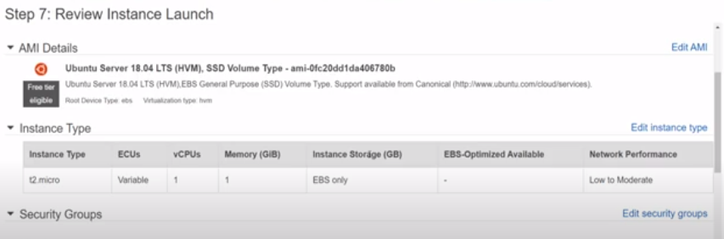
30.03.01 Launch EC2 on AWS
https://www.youtube.com/watch?v=q8NOmLD5pTU&list=PLeo1K3hjS3uvCeTYTeyfe0-rN5r8zn9rw&index=30
Launch EC2 on AWS (12:41-12:45/28:38)
Now, we click button “Review and Launch” on the bottom of page.
Below is the Instance Type.

Slide 19
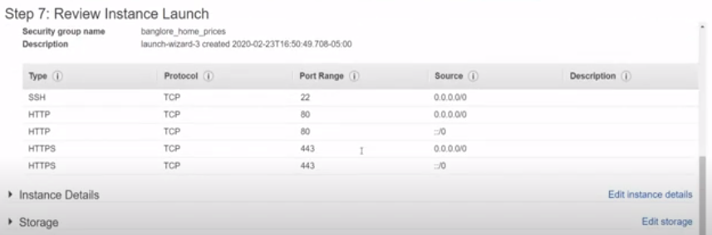
30.03.01 Launch EC2 on AWS
https://www.youtube.com/watch?v=q8NOmLD5pTU&list=PLeo1K3hjS3uvCeTYTeyfe0-rN5r8zn9rw&index=30
Launch EC2 on AWS (12:45-12:48/28:38)
Scroll to review security configuration.

Slide 20
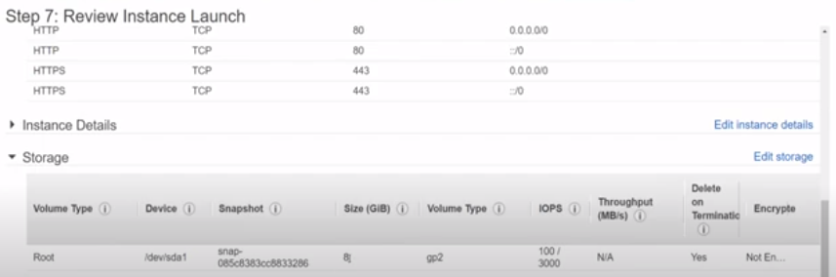
30.03.01 Launch EC2 on AWS
https://www.youtube.com/watch?v=q8NOmLD5pTU&list=PLeo1K3hjS3uvCeTYTeyfe0-rN5r8zn9rw&index=30
Launch EC2 on AWS (12:49-12:50/28:38)
Below is the storage detail.
8GB is very small for virtual machine.

Slide 21
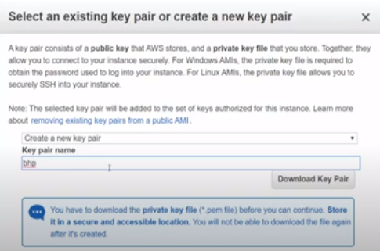
30.03.01 Launch EC2 on AWS
https://www.youtube.com/watch?v=q8NOmLD5pTU&list=PLeo1K3hjS3uvCeTYTeyfe0-rN5r8zn9rw&index=30
Launch EC2 on AWS (12:49-13:52/28:38)
Here, we click “Launch” button on the bottom of page. We see the
1. “Create a new key pair”
2. “Key pair name” bhp
3. Click button “Download Key Pair”
4. We use OpenSSL to generate the PEM file.
5. We load load the PEM (Private Enhanced Mail) file for authentication. When you connect to the AWS EC2 cloud server, we don’t have to specify password. We can specify the PEM file which serves as a password.

Slide 22
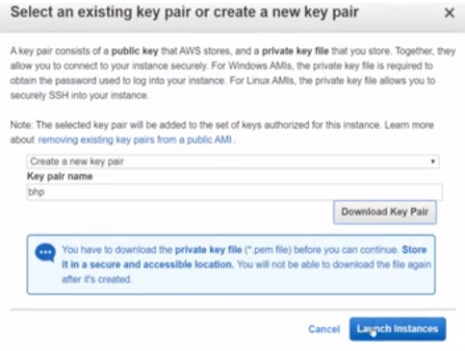
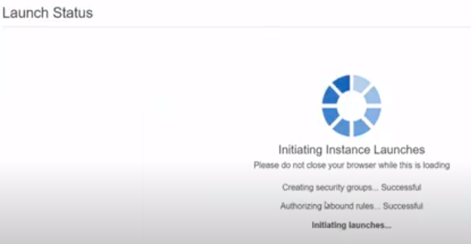
30.03.01 Launch EC2 on AWS
https://www.youtube.com/watch?v=q8NOmLD5pTU&list=PLeo1K3hjS3uvCeTYTeyfe0-rN5r8zn9rw&index=30
Launch EC2 on AWS (13:53-13:56/28:38)
Now, we click button “Launch Instances” at the bottom of page.

Slide 23
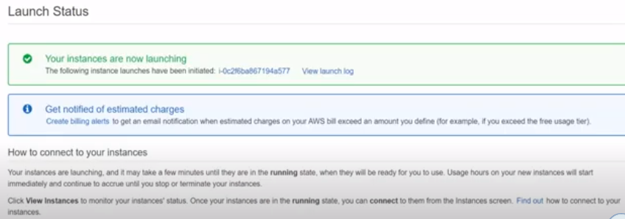
30.03.01 Launch EC2 on AWS
https://www.youtube.com/watch?v=q8NOmLD5pTU&list=PLeo1K3hjS3uvCeTYTeyfe0-rN5r8zn9rw&index=30
Launch EC2 on AWS (13:57-14:00/28:38)
We can see the below information for the launch instances in a few seconds/minutes.

Slide 24
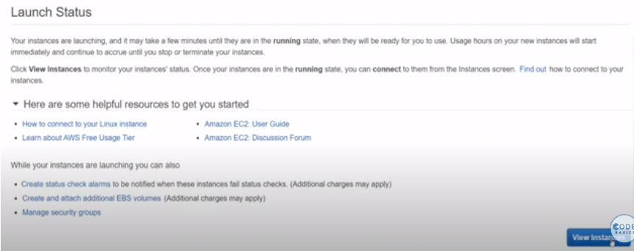
30.03.01 Launch EC2 on AWS
https://www.youtube.com/watch?v=q8NOmLD5pTU&list=PLeo1K3hjS3uvCeTYTeyfe0-rN5r8zn9rw&index=30
Launch EC2 on AWS (14:01-14:08/28:38)
Scroll down to and click button “View Instances”.

Slide 25
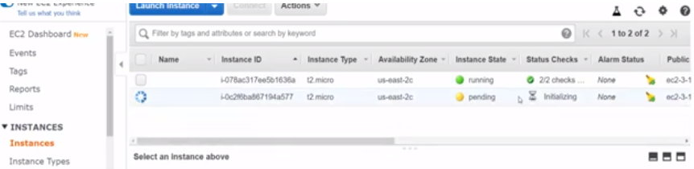
30.03.01 Launch EC2 on AWS
https://www.youtube.com/watch?v=q8NOmLD5pTU&list=PLeo1K3hjS3uvCeTYTeyfe0-rN5r8zn9rw&index=30
Launch EC2 on AWS (14:09-14:10/28:38)
We see all the running instances.
We have the running and pending instances here.

Slide 26
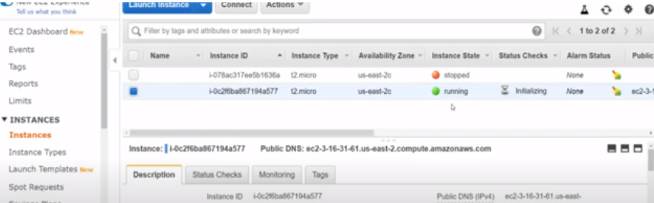
30.03.01 Launch EC2 on AWS
https://www.youtube.com/watch?v=q8NOmLD5pTU&list=PLeo1K3hjS3uvCeTYTeyfe0-rN5r8zn9rw&index=30
Launch EC2 on AWS (14:11-14:25/28:38)
The pending instance is initialized and the pending instance will become the running instance.

Slide 27
End

