Slide 1

30.04 Connect EC2 with PuTTY

Slide 2
30.04 Connect EC2 with PuTTY
https://www.youtube.com/watch?v=q8NOmLD5pTU&list=PLeo1K3hjS3uvCeTYTeyfe0-rN5r8zn9rw&index=30
Connect EC2 with PuTTY (14:26-14:27/28:38)
We have finished the local test for NGINX.
Now, we will deploy the app into the AWS/EC2.
1. Launch EC2 instance on Amazon AWS.
2. Connect to EC2 instance:
  2.1 On Ubuntu, we use PuTTY to connect AWS/Ubuntu EC2.
  2.2 On Windows, we using SSH (git bash client)
3. File Transfer from local to remote:
  3.1 Copy code to cloud by FileZilla (under Ubuntu) or
  3.2 WinScp (for Windows).
4. Install NGINX on EC2.
5. Setup NGINX on Ubuntu/EC2
6. Install Flask Server.

Slide 3
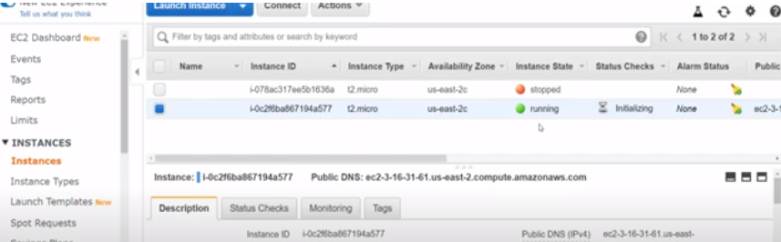
30.04 Connect EC2 with PuTTY
https://www.youtube.com/watch?v=q8NOmLD5pTU&list=PLeo1K3hjS3uvCeTYTeyfe0-rN5r8zn9rw&index=30
Connect EC2 with PuTTY (14:28-14:29/28:38)
Next step is to connect EC2 using SSH client (PuTTY client).
So, what we will do here is from our local machine. We will connect our local machine to EC2 server on cloud by PuTTY client (or Git Bash).

Slide 4
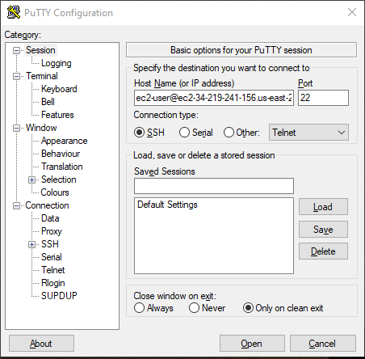
30.04 Connect EC2 with PuTTY
https://www.youtube.com/watch?v=q8NOmLD5pTU&list=PLeo1K3hjS3uvCeTYTeyfe0-rN5r8zn9rw&index=30
Connect EC2 with PuTTY (14:28-15:56/28:38)
We connect the EC2 with PuTTY.

Slide 5
End

