Slide 1

30.06 Install NGINX on EC2

Slide 2
30.06 Install NGINX on EC2
https://www.youtube.com/watch?v=q8NOmLD5pTU&list=PLeo1K3hjS3uvCeTYTeyfe0-rN5r8zn9rw&index=30
Install NGINX on EC2 (18:05-18:06/28:38)
We have finished the local test for NGINX.
Now, we will deploy the app into the AWS/EC2.
1. Launch EC2 instance on Amazon AWS.
2. Connect to EC2 instance:
  2.1 On Ubuntu, we use PuTTY to connect AWS/Ubuntu EC2.
  2.2 On Windows, we using SSH (git bash client)
3. File Transfer from local to remote:
  3.1 Copy code to cloud by FileZilla (under Ubuntu) or SecureFTP
  3.2 WinScp (for Windows).
4. Install NGINX on EC2.
5. Setup NGINX on Ubuntu/EC2
6. Install Flask Server.

Slide 3
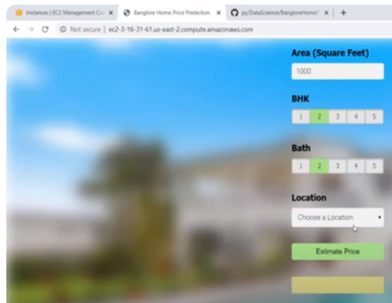
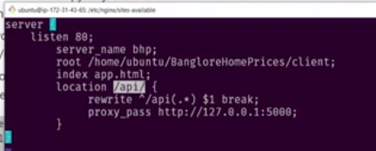
30.06 Install NGINX on EC2
https://www.youtube.com/watch?v=q8NOmLD5pTU&list=PLeo1K3hjS3uvCeTYTeyfe0-rN5r8zn9rw&index=30
Install NGINX on EC2 (18:06-19:29/28:38)
We install NGINX on EC2.
We configure the port number and home page location.
1. We start the PuTTY to connect the EC2 server.
2. We can use browse the server home page through the port number.
Because we do not have Flask server yet. The backend still not working yet.
https://medium.com/@mertcal/install-nginx-on-ec2-instance-in-30-seconds-e714d427b01b

Slide 4
End

