Slide 1

30.07 Flask Server on EC2

Slide 2
30.07 Flask Server on EC2
https://www.youtube.com/watch?v=q8NOmLD5pTU&list=PLeo1K3hjS3uvCeTYTeyfe0-rN5r8zn9rw&index=30
Flask Server on EC2 (25:49-25:50/28:38)
We have finished the local test for NGINX.
Now, we will deploy the app into the AWS/EC2.
1. Launch EC2 instance on Amazon AWS.
2. Connect to EC2 instance:
  2.1 On Ubuntu, we use PuTTY to connect AWS/Ubuntu EC2.
  2.2 On Windows, we using SSH (git bash client)
3. File Transfer from local to remote:
  3.1 Copy code to cloud by FileZilla (under Ubuntu) or SecureFTP
  3.2 WinScp (for Windows).
4. Install NGINX on EC2.
5. Setup NGINX on Ubuntu/EC2
6. Install Flask Server.

Slide 3
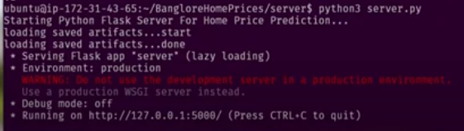
30.07 Flask Server on EC2
https://www.youtube.com/watch?v=q8NOmLD5pTU&list=PLeo1K3hjS3uvCeTYTeyfe0-rN5r8zn9rw&index=30
Flask Server on EC2 (25:51-27:30/28:38)
Install Flask Server on EC2.
1. > sudo apt install python3-pip
2. > sudo pip3 install -r requirements.txt
3. start the server.
> python3 server.py
https://aws.plainenglish.io/deploying-a-flask-application-on-ec2-54cfeb396fa1

Slide 4
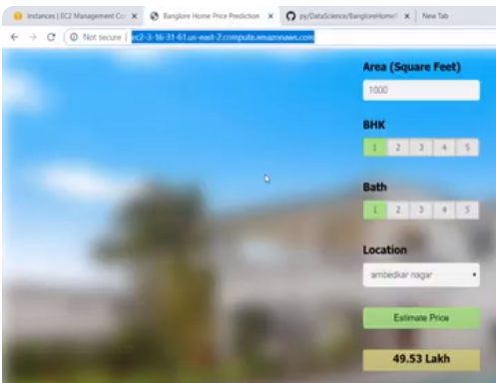
30.07 Flask Server on EC2
https://www.youtube.com/watch?v=q8NOmLD5pTU&list=PLeo1K3hjS3uvCeTYTeyfe0-rN5r8zn9rw&index=30
Flask Server on EC2 (27:31-28:38/28:38)
1. Using the PuTTY to connect the EC2 Server
2. Open Chrome
> http://127.0.0.1:5000
https://aws.plainenglish.io/deploying-a-flask-application-on-ec2-54cfeb396fa1

Slide 5
End

