Slide 1

17 Tune Hyperparamter
Peter H. Chen

Slide 2
17 Tune Hyperparamter
https://www.youtube.com/watch?v=HdlDYng8g9s&list=PLeo1K3hjS3uvCeTYTeyfe0-rN5r8zn9rw&index=17
Tune Hyperparamter (0:00-0:10/16:29)
We discuss
1. How to choose the best model for your machine learning problem and
2. How to do the best hyperparameter tuning
Below is a list of topics we will discussed.
Topics:
1. train_test_split to split training data
2. K-Fold Cross Validation
3. GridSearchCV for Hyperparamter Tuning
4. RandomizedSearchCV
5. Choose Best Model
6. Exercise

Slide 3
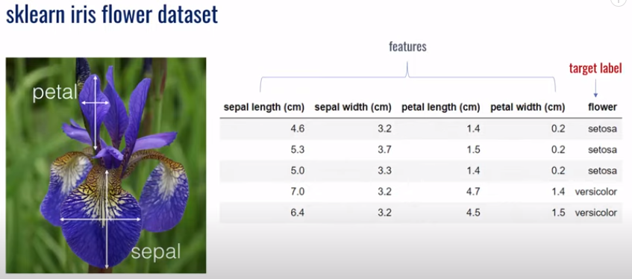
17 Tune Hyperparamter
https://www.youtube.com/watch?v=HdlDYng8g9s&list=PLeo1K3hjS3uvCeTYTeyfe0-rN5r8zn9rw&index=17
Tune Hyperparamter (0:11-0:20/16:29)
We have sklearn Iris Dataset as below.
We try to classify the flower with sklearn model.
With sepal and petal length and width, we try to predict what type of Irish Flower.

Slide 4
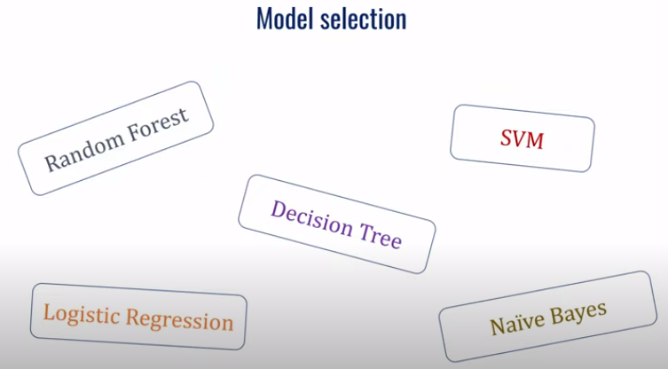
17 Tune Hyperparamter
https://www.youtube.com/watch?v=HdlDYng8g9s&list=PLeo1K3hjS3uvCeTYTeyfe0-rN5r8zn9rw&index=17
Tune Hyperparamter (0:21-0:25/16:29)
The first quesiton we have is which model should we use?
There are so many model. Which model should we choose from?

Slide 5
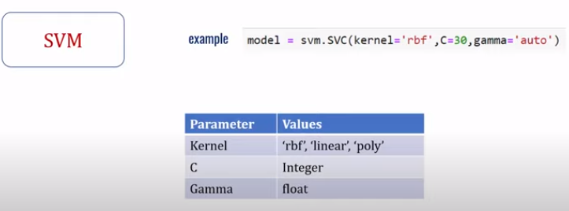
17 Tune Hyperparamter
https://www.youtube.com/watch?v=HdlDYng8g9s&list=PLeo1K3hjS3uvCeTYTeyfe0-rN5r8zn9rw&index=17
Tune Hyperparamter (0:26-0:27/16:29)
If we choose model SVM. The problem is not solved yet.

Slide 6
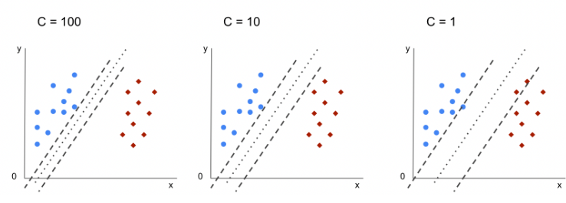
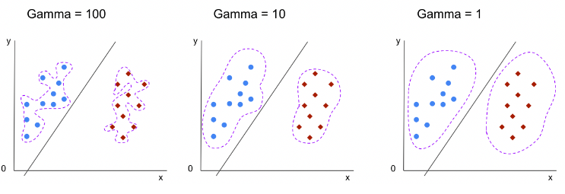
17 Tune Hyperparamter
https://www.youtube.com/watch?v=HdlDYng8g9s&list=PLeo1K3hjS3uvCeTYTeyfe0-rN5r8zn9rw&index=17
Tune Hyperparamter (0:28-0:30/16:29)
Different values of hyperparameters will impact different results.
  1. What kind of kernel: rbf (Radial Basis Function), linear, poly (polynomial),
  2. C (Margin width of SVM), and
  3. Gamma (High Gamma: Higher Order of fitting, Low Gamma: Linear)

Slide 7
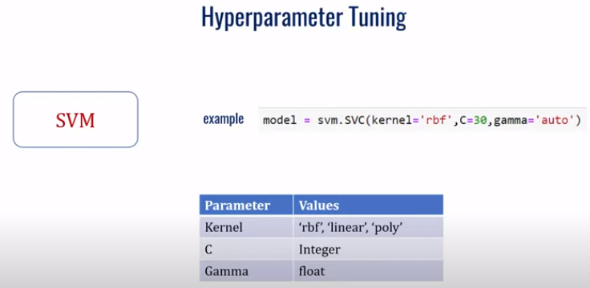
17 Tune Hyperparamter
https://www.youtube.com/watch?v=HdlDYng8g9s&list=PLeo1K3hjS3uvCeTYTeyfe0-rN5r8zn9rw&index=17
Tune Hyperparamter (0:31-0:45/16:29)
The process of choosing the optimal parameter is called hyperparamter tuning.

Slide 8
17.1 Import Library and Read Dataset

Slide 9
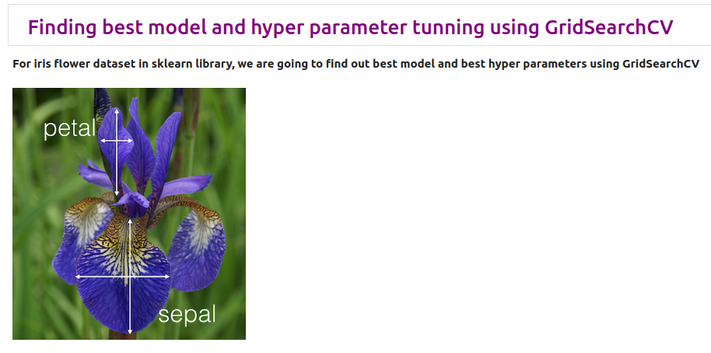
17.1 Import Library and Read Dataset
https://www.youtube.com/watch?v=HdlDYng8g9s&list=PLeo1K3hjS3uvCeTYTeyfe0-rN5r8zn9rw&index=17
Import Library and Read Dataset (0:46-0:47/16:29)

Slide 10
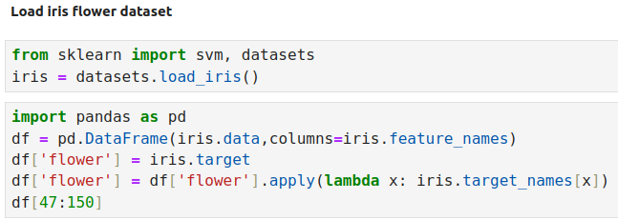
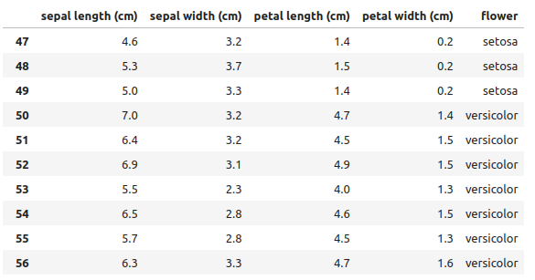
17.1 Import Library and Read Dataset
https://www.youtube.com/watch?v=HdlDYng8g9s&list=PLeo1K3hjS3uvCeTYTeyfe0-rN5r8zn9rw&index=17
Import Library and Read Dataset (0:48-1:20/16:29)

Slide 11
17.2 Approach 1: Try and Error

Slide 12
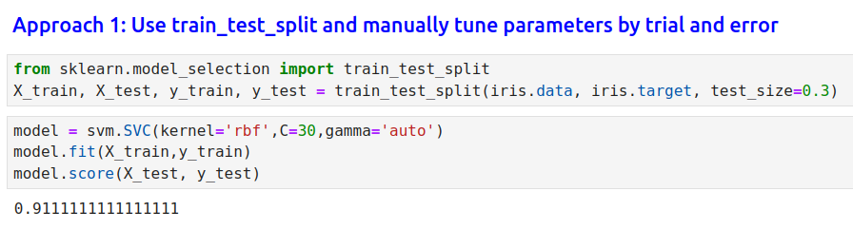
17.2 Approach 1: Try and Error
https://www.youtube.com/watch?v=HdlDYng8g9s&list=PLeo1K3hjS3uvCeTYTeyfe0-rN5r8zn9rw&index=17
Approach 1: Try and Error (1:21-1:35/16:29)

Slide 13
17.3 Approach 2: K-Fold Validation

Slide 14
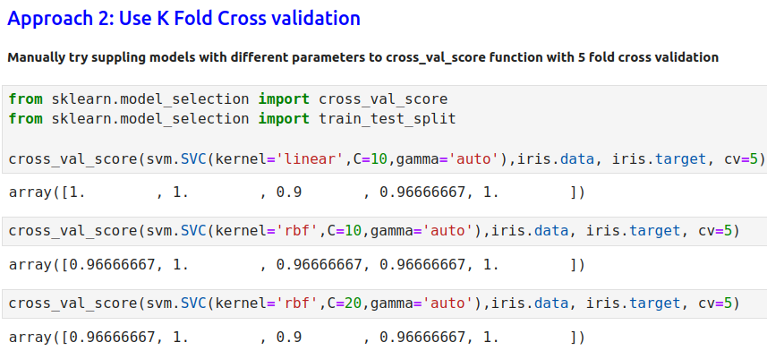
17.3 Approach 2: K-Fold Validation
https://www.youtube.com/watch?v=HdlDYng8g9s&list=PLeo1K3hjS3uvCeTYTeyfe0-rN5r8zn9rw&index=17
Approach 2: K-Fold Validation (1:36-2:30/16:29)

Slide 15
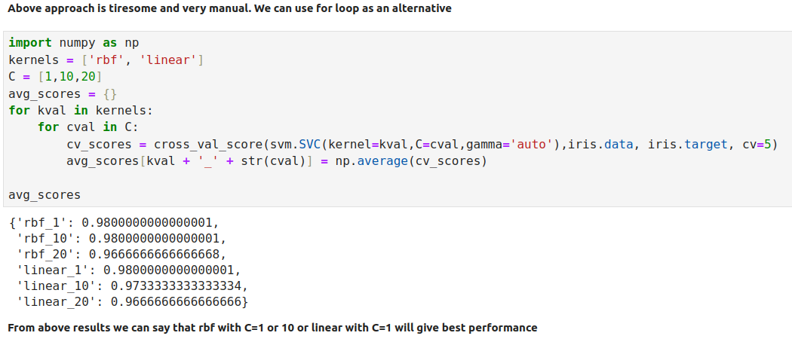
17.3 Approach 2: K-Fold Validation
https://www.youtube.com/watch?v=HdlDYng8g9s&list=PLeo1K3hjS3uvCeTYTeyfe0-rN5r8zn9rw&index=17
Approach 2: K-Fold Validation (2:31-4:40/16:29)

Slide 16
17.4 Approach 3: Use GridSearchCV

Slide 17
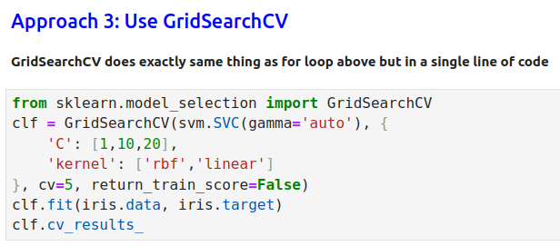
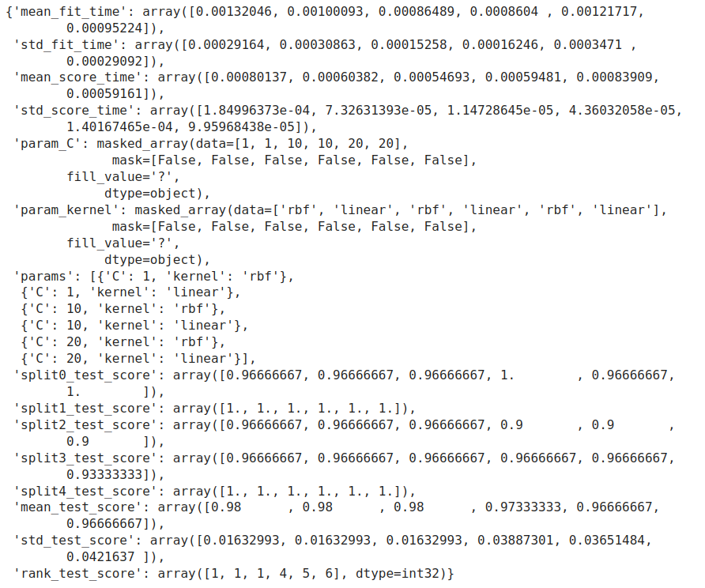
7.4 Approach 3: Use GridSearchCV
https://www.youtube.com/watch?v=HdlDYng8g9s&list=PLeo1K3hjS3uvCeTYTeyfe0-rN5r8zn9rw&index=17
Approach 3: Use GridSearchCV (4:41-5:30/16:29)

Slide 18
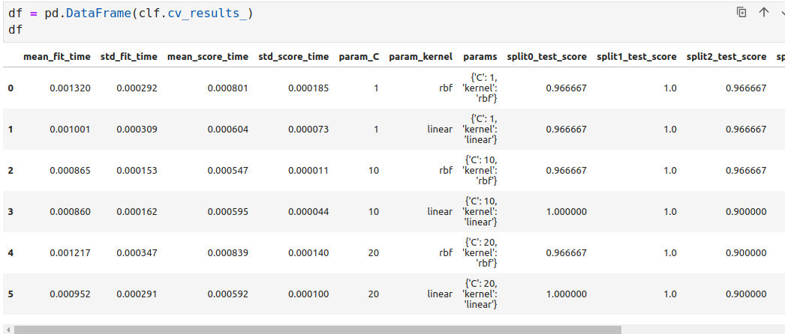
7.4 Approach 3: Use GridSearchCV
https://www.youtube.com/watch?v=HdlDYng8g9s&list=PLeo1K3hjS3uvCeTYTeyfe0-rN5r8zn9rw&index=17
Approach 3: Use GridSearchCV (5:31-6:30/16:29)

Slide 19
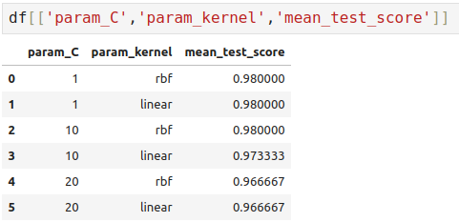
7.4 Approach 3: Use GridSearchCV
https://www.youtube.com/watch?v=HdlDYng8g9s&list=PLeo1K3hjS3uvCeTYTeyfe0-rN5r8zn9rw&index=17
Approach 3: Use GridSearchCV (6:31-8:30/16:29)

Slide 20
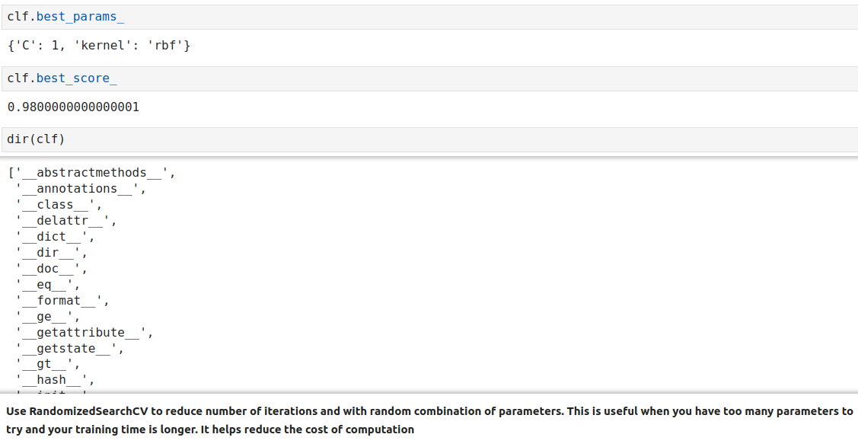
7.4 Approach 3: Use GridSearchCV
https://www.youtube.com/watch?v=HdlDYng8g9s&list=PLeo1K3hjS3uvCeTYTeyfe0-rN5r8zn9rw&index=17
Approach 3: Use GridSearchCV (8:31-10:15/16:29)

Slide 21
17.5 Approach 4: Use RandomizedSearchCV

Slide 22
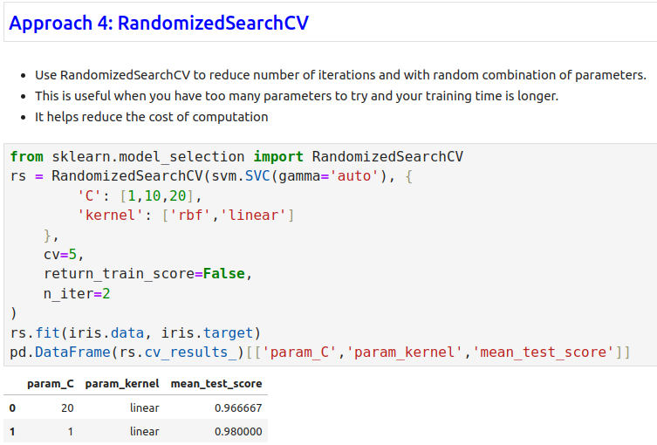
17.5 Approach 4: Use RandomizedSearchCV
https://www.youtube.com/watch?v=HdlDYng8g9s&list=PLeo1K3hjS3uvCeTYTeyfe0-rN5r8zn9rw&index=17
Approach 4: Use RandomizedSearchCV (10:16-12:30/16:29)

Slide 23
17.6 Approach 3: Use RandomizedSearchCV

Slide 24
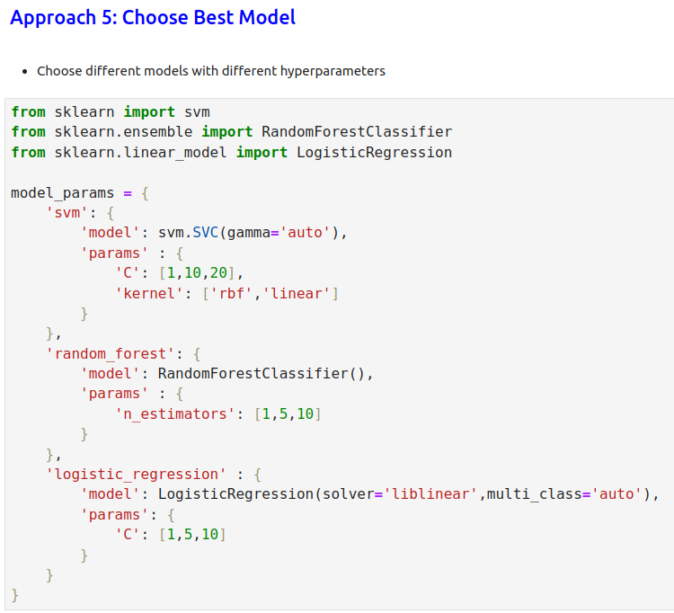
17.6 Approach 5: Choose Best Model
https://www.youtube.com/watch?v=HdlDYng8g9s&list=PLeo1K3hjS3uvCeTYTeyfe0-rN5r8zn9rw&index=17
Approach 5: Choose Best Model (12:31-13:30/16:29)

Slide 25
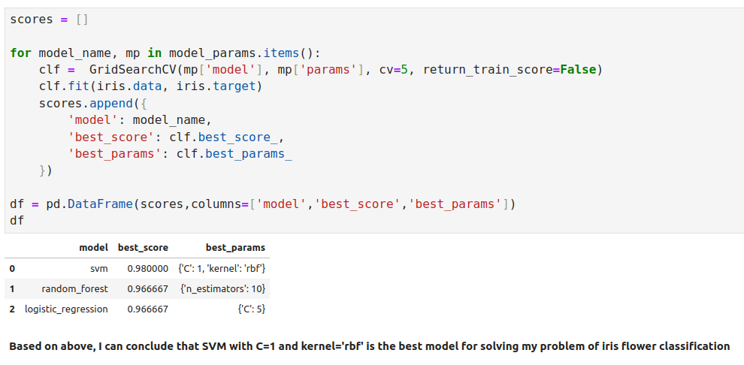
17.6 Approach 5: Choose Best Model
https://www.youtube.com/watch?v=HdlDYng8g9s&list=PLeo1K3hjS3uvCeTYTeyfe0-rN5r8zn9rw&index=17
Approach 5: Choose Best Model (13:31-15:20/16:29)

Slide 26
17.7 Exercise

Slide 27
17.7 Exercise
https://www.youtube.com/watch?v=HdlDYng8g9s&list=PLeo1K3hjS3uvCeTYTeyfe0-rN5r8zn9rw&index=17
Exercise (15:21-15:50/16:29)
Machine Learning: Finding Optimal Model and Hyperparameters
1. Download the digits dataset in sklearn.dataset, please try following classifiers and find out the one that gives best performance.
2. Find the optimal parameters for that classifier.
3. Import the below library
> from sklearn import svm
> from sklearn.ensemble import RandomForestClassifier
> from sklearn.linear_model import LogisticRegression
> from sklearn.naive_bayes import GaussianNB
> from sklearn.naive_bayes import MultinomialNB
> from sklearn.tree import DecisionTreeClassifier

Slide 28
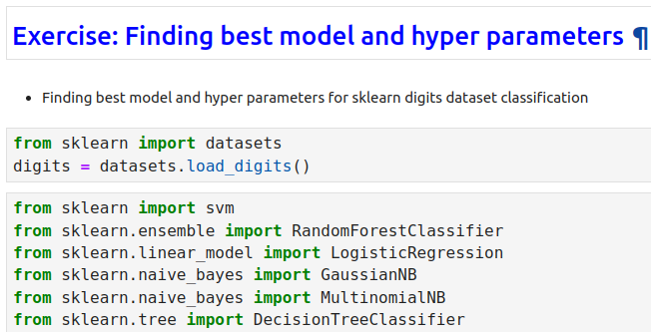
17.7 Exercise
https://www.youtube.com/watch?v=HdlDYng8g9s&list=PLeo1K3hjS3uvCeTYTeyfe0-rN5r8zn9rw&index=17
Exercise (15:51-16:00/16:29)

Slide 29
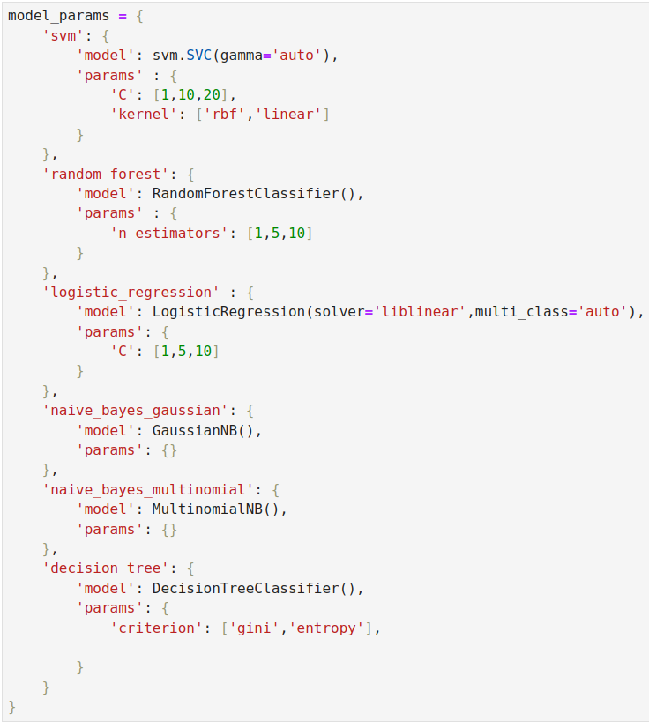
17.7 Exercise
https://www.youtube.com/watch?v=HdlDYng8g9s&list=PLeo1K3hjS3uvCeTYTeyfe0-rN5r8zn9rw&index=17
Exercise (16:01-16:10/16:29)

Slide 30
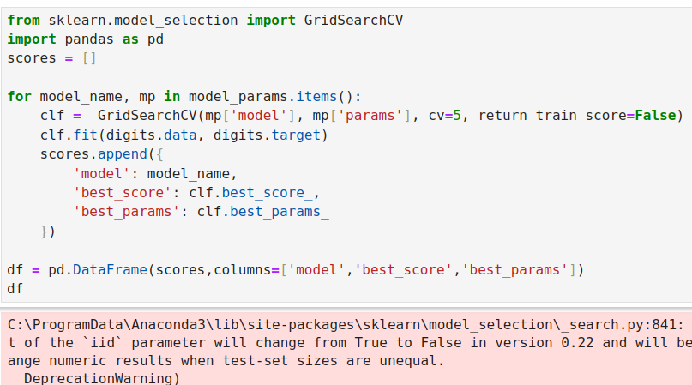
17.7 Exercise
https://www.youtube.com/watch?v=HdlDYng8g9s&list=PLeo1K3hjS3uvCeTYTeyfe0-rN5r8zn9rw&index=17
Exercise (16:01-16:10/16:29)

Slide 31
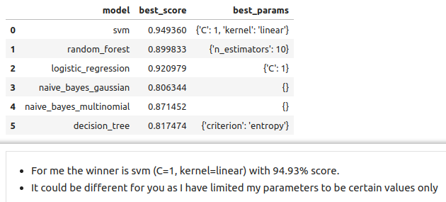
17.7 Exercise
https://www.youtube.com/watch?v=HdlDYng8g9s&list=PLeo1K3hjS3uvCeTYTeyfe0-rN5r8zn9rw&index=17
Exercise (16:11-16:29/16:29)
Best Model SVM, Best Parameter: C = 1. Kernel = Linear.

Slide 32
End

