Slide 1

15 Naive Bayes Classifier Algorithm: P1
Peter H. Chen

Slide 2
15 Naive Bayes Classifier Algorithm: P1
https://www.youtube.com/watch?v=EItlUEPCIzM&list=PLeo1K3hjS3uvCeTYTeyfe0-rN5r8zn9rw&index=14
Naive Bayes Classifier Algorithm (0:00-0:10/13:37)
We discuss the Naive Bayes Classifier Algorithm with two parts as below.
The first part is theory and then predict the Titanic survival rate
The second part is the spam detector by Naive Bayes.
Naive Bayes Classifier Algorithm:
Part 1:
  1. Theory of Naive Bayes Classifier Algorithm
  2. Use Naive Bayes Classifier Algorithm to Predict Titanic Survival
Part 2:
  Use Naive Bayes Classifier Algorithm to Build Email Spam Detector

Slide 3
15 Naive Bayes Classifier Algorithm: P1
https://www.youtube.com/watch?v=EItlUEPCIzM&list=PLeo1K3hjS3uvCeTYTeyfe0-rN5r8zn9rw&index=14
Naive Bayes Classifier Algorithm (0:11-0:20/13:37)
In this discussion, below is the topics we want to discuss:
Topics:
1. Basic Probability Theory
2. Conditional Probability
3. Bayes Theorem
4. Coding: Titanic Crash Survival
5. GaussianNB Classifier

Slide 4
15.1 Basic Probability Theory

Slide 5
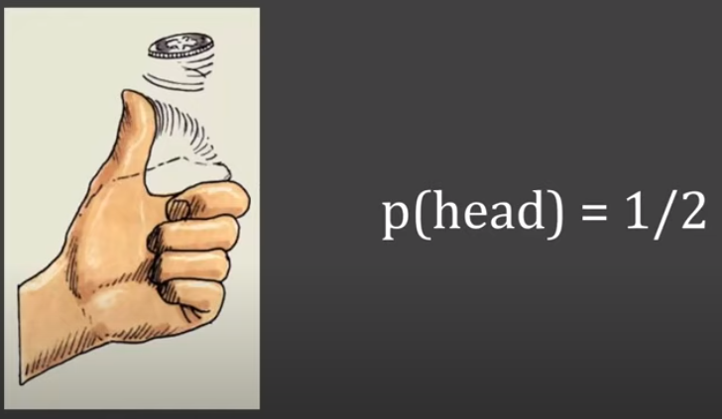
15.1 Basic Probability Theory
https://www.youtube.com/watch?v=EItlUEPCIzM&list=PLeo1K3hjS3uvCeTYTeyfe0-rN5r8zn9rw&index=14
Basic Probability Theory (0:21-0:35/13:37)
We start with some basic probability theory.
When we flip some coin, the probability to get head or tail is p (head) = 1/2 because there are two possible outcomes and the chance of getting head or tail is 50%.

Slide 6
15.2 Conditional Probability

Slide 7
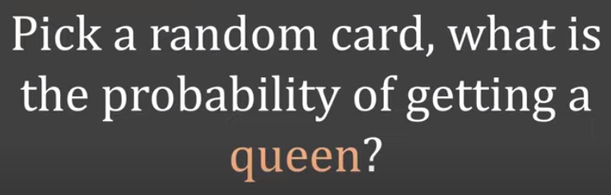
15.2 Conditional Probability
https://www.youtube.com/watch?v=EItlUEPCIzM&list=PLeo1K3hjS3uvCeTYTeyfe0-rN5r8zn9rw&index=14
Conditional Probability (0:36-0:30/13:37)
Similarly, when we pick a random card, how much the probability of getting a queen?

Slide 8
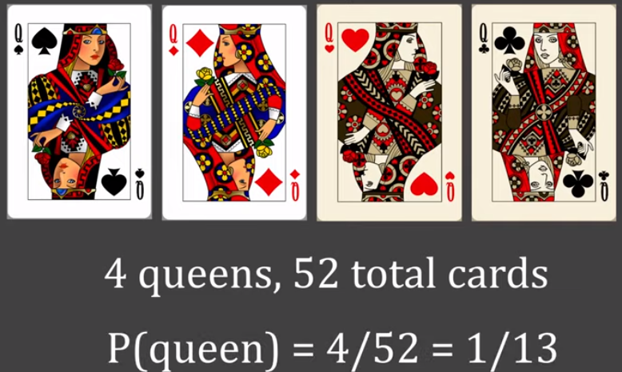
15.2 Conditional Probability
https://www.youtube.com/watch?v=EItlUEPCIzM&list=PLeo1K3hjS3uvCeTYTeyfe0-rN5r8zn9rw&index=14
Conditional Probability (0:36-0:55/13:37)
Assume there are 4 queens and 52 cards (= 13 x 4 without Joke).
The probability of getting queen is: p(queen) = 4/52 = 1/13.

Slide 9
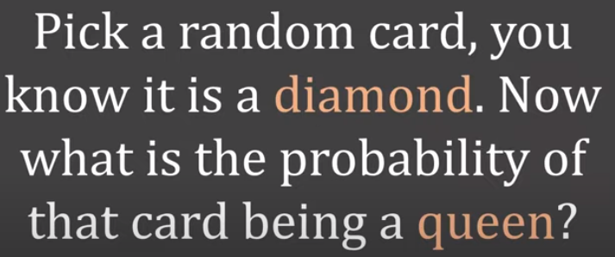
15.2 Conditional Probability
https://www.youtube.com/watch?v=EItlUEPCIzM&list=PLeo1K3hjS3uvCeTYTeyfe0-rN5r8zn9rw&index=14
Conditional Probability (0:56-1:30/13:37)
If you know your card is diamond, what is the probability to pick a card is queen?
This is a conditional probability: You know something A that is occurred and then predict the probability of B.

Slide 10
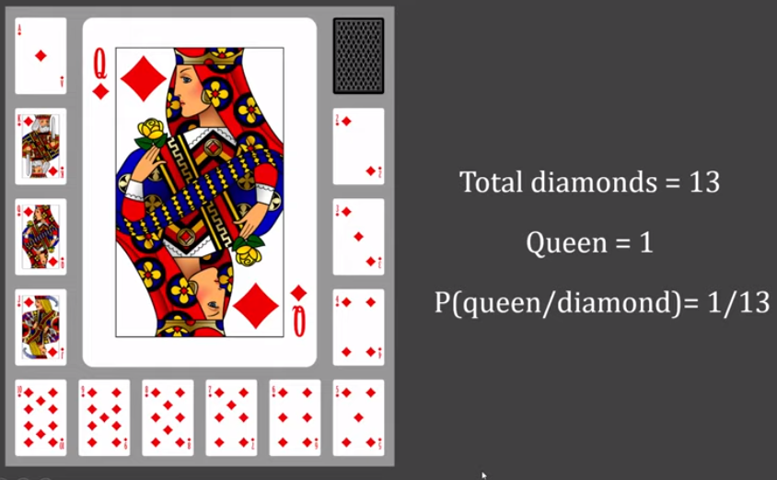
15.2 Conditional Probability
https://www.youtube.com/watch?v=EItlUEPCIzM&list=PLeo1K3hjS3uvCeTYTeyfe0-rN5r8zn9rw&index=14
Conditional Probability (0:56-1:30/13:37)
Here, we have total Diamonds = 13 and Queen is 1.
We present in the conditional probability: P (queen/Diamond) = 1/13

Slide 11
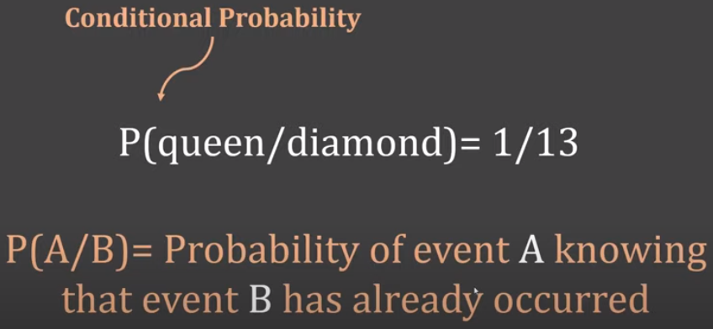
15.2 Conditional Probability
https://www.youtube.com/watch?v=EItlUEPCIzM&list=PLeo1K3hjS3uvCeTYTeyfe0-rN5r8zn9rw&index=14
Conditional Probability (1:31-1:40/13:37)
We have conditional probability: P (Queen/Diamond) = 1/13 where we know the diamond event has already occurred and the probability of getting a queen is conditional Probability.
P(A/B) is the way of presenting conditional probability
  where B is the event occurred already that we know that card is diamond and
  we are trying to find the probability of event A which is whether the card is Queen or not.

Slide 12
15.3 Bayes Theorem

Slide 13
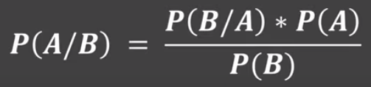
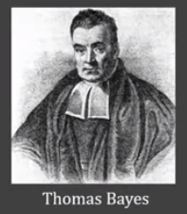
15.3 Bayes Theorem
https://www.youtube.com/watch?v=EItlUEPCIzM&list=PLeo1K3hjS3uvCeTYTeyfe0-rN5r8zn9rw&index=14
Bayes Theorem (1:51-2:15/13:37)
Thomas Bayes gave us the famous equation of finding the conditional probability.
We can find the probability of A given the event B has occurred.
By knowing some parameter which is individual probability of A and probability of B.
We can calculate the probability of A given B: P(A | B).

Slide 14
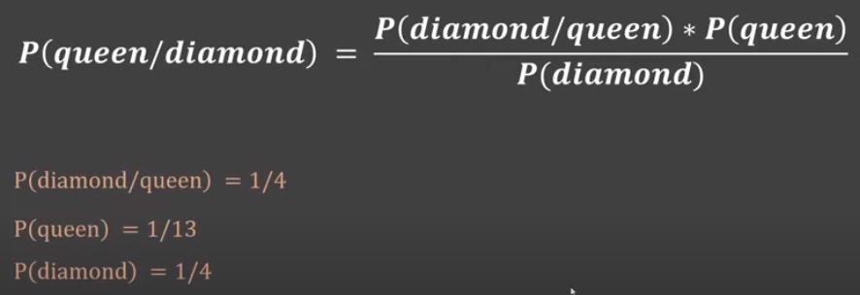
15.3 Bayes Theorem
https://www.youtube.com/watch?v=EItlUEPCIzM&list=PLeo1K3hjS3uvCeTYTeyfe0-rN5r8zn9rw&index=14
Bayes Theorem (2:16-2:20/13:37)
Let us look at in the context (语境) of Queen and Diamond problem.
Below, is the equation we represented for individual probability for this problem.

Slide 15
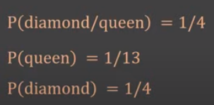
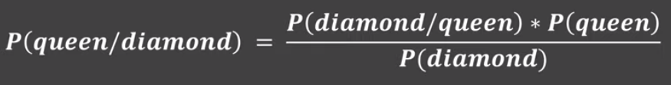
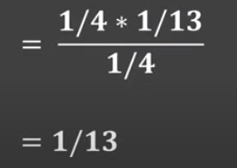
15.3 Bayes Theorem
https://www.youtube.com/watch?v=EItlUEPCIzM&list=PLeo1K3hjS3uvCeTYTeyfe0-rN5r8zn9rw&index=14
Bayes Theorem (2:21-2:45/13:37)
We put the number into equation.
Bayes theorem is a very powerful theorem
  Where you know probability of certain event
  But you don’t know the probability of some other events.
From those known certain events, you can find other probabilities.

Slide 16
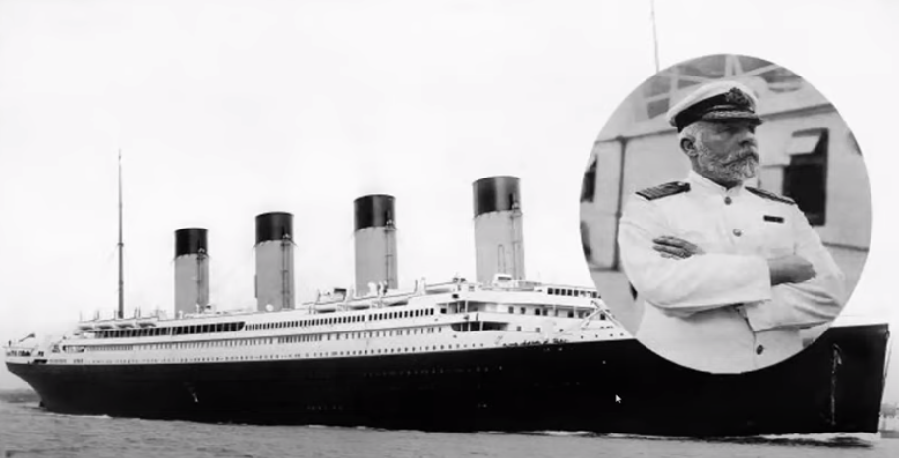
15.3 Bayes Theorem
https://www.youtube.com/watch?v=EItlUEPCIzM&list=PLeo1K3hjS3uvCeTYTeyfe0-rN5r8zn9rw&index=14
Bayes Theorem (2:46-2:55/13:37)
We know about the Titanic ocean liner (远洋客轮).
There is movie describe how the event occurred. There are many people died in that event.

Slide 17
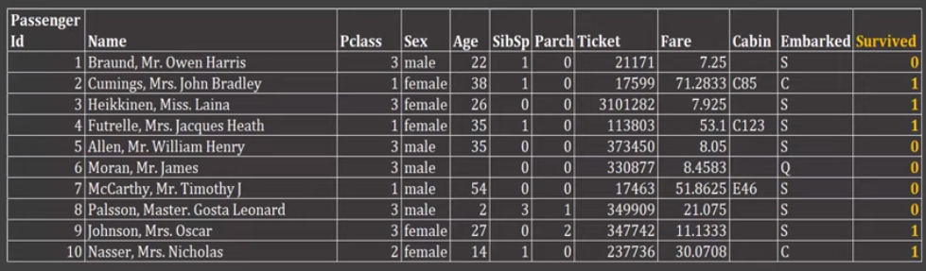
15.3 Bayes Theorem
https://www.youtube.com/watch?v=EItlUEPCIzM&list=PLeo1K3hjS3uvCeTYTeyfe0-rN5r8zn9rw&index=14
Bayes Theorem (2:56-3:10/13:37)
We have dataset “titanic.csv” for crash of Titanic Ocean Liner.
There are name of the people along with certain features which include fare, ticket, cabin, etc.
Based on the features, we try to find out the survival rate.
https://www.kaggle.com/c/titanic/data

Slide 18
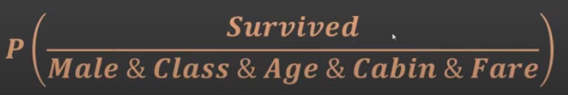
15.3 Bayes Theorem
https://www.youtube.com/watch?v=EItlUEPCIzM&list=PLeo1K3hjS3uvCeTYTeyfe0-rN5r8zn9rw&index=14
Bayes Theorem (3:11-3:25/13:37)
Here, we can use Bayes Theorem. We try to find the probability of survival based on the features, such as, if the person is male, class, age, cabin, fare, etc.
https://www.kaggle.com/c/titanic/data

Slide 19
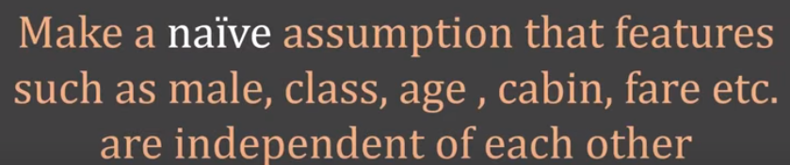
15.3 Bayes Theorem
https://www.youtube.com/watch?v=EItlUEPCIzM&list=PLeo1K3hjS3uvCeTYTeyfe0-rN5r8zn9rw&index=14
Bayes Theorem (3:26-3:50/13:37)
The reason that we called Naive Bayes is because we make a naive assumption that the features which is male class, age, cabin, etc. are independent of each other.
In reality, some of the events maybe dependent, such as, frae and cabin are related. For simplicity, we assume these events are not related.
Therefore, Naive Bayes is a simple assumption which reduces our calculation and makes the algorithm simple and effective.
Luis Serrano has

Slide 20
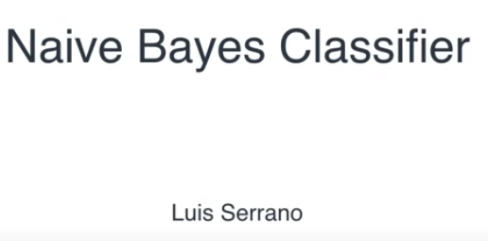
15.3 Bayes Theorem
https://www.youtube.com/watch?v=EItlUEPCIzM&list=PLeo1K3hjS3uvCeTYTeyfe0-rN5r8zn9rw&index=14
Bayes Theorem (3:51-4:20/13:37)
Luis Serrano has “Naive Bayes Classifier” in the below link for details.
https://www.youtube.com/watch?v=Q8l0Vip5YUw

Slide 21

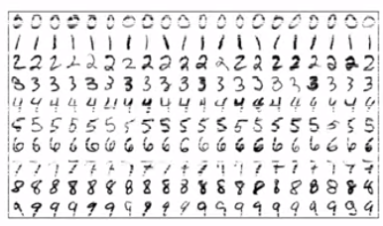

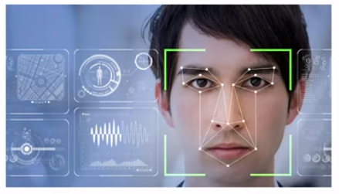

15.3 Bayes Theorem
https://www.youtube.com/watch?v=EItlUEPCIzM&list=PLeo1K3hjS3uvCeTYTeyfe0-rN5r8zn9rw&index=14
Bayes Theorem (3:51-4:30/13:37)
Naive Bayes is used in email SPAM Detection, Hand Written character recognition, weather prediction, face prediction, news article categorization, etc.

Slide 22
15.4 Import Library and Load Dataset

Slide 23
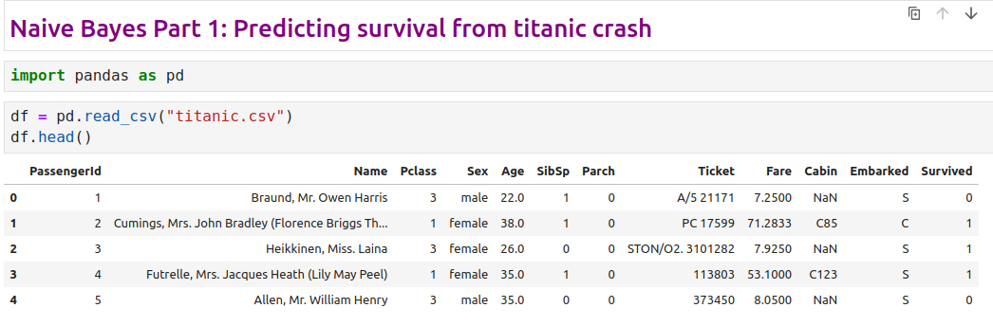
15.4 Import Library and Load Dataset
https://www.youtube.com/watch?v=EItlUEPCIzM&list=PLeo1K3hjS3uvCeTYTeyfe0-rN5r8zn9rw&index=14
Import Library and Load Dataset (4:31-5:30/13:37)

Slide 24
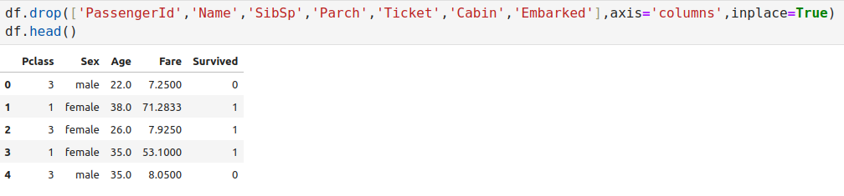

15.4 Import Library and Load Dataset
https://www.youtube.com/watch?v=EItlUEPCIzM&list=PLeo1K3hjS3uvCeTYTeyfe0-rN5r8zn9rw&index=14
Import Library and Load Dataset (5:31-6:30/13:37)

Slide 25
15.5 One Hot Encoding

Slide 26
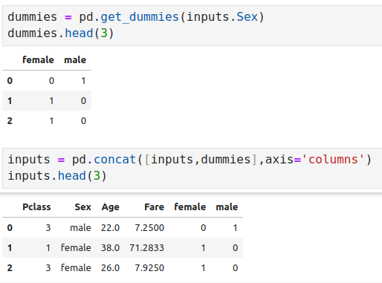
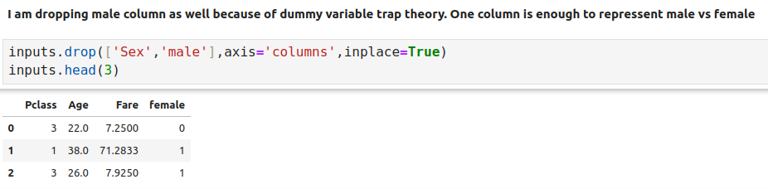
15.5 One Hot Encoding
https://www.youtube.com/watch?v=EItlUEPCIzM&list=PLeo1K3hjS3uvCeTYTeyfe0-rN5r8zn9rw&index=14
One Hot Encoding (6:31-7:30/13:37)

Slide 27
15.6 Cleanup Data

Slide 28
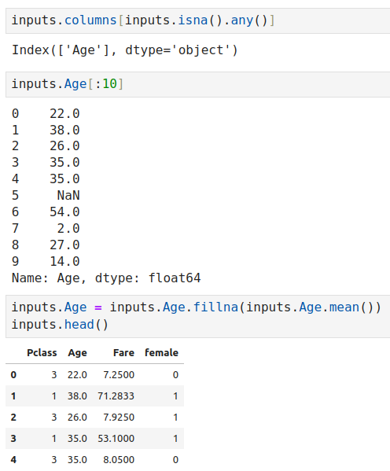
15.6 Cleanup Data
https://www.youtube.com/watch?v=EItlUEPCIzM&list=PLeo1K3hjS3uvCeTYTeyfe0-rN5r8zn9rw&index=14
Cleanup Data (7:31-9:50/13:37)

Slide 29
15.7 Split and Train GaussianNB Model

Slide 30
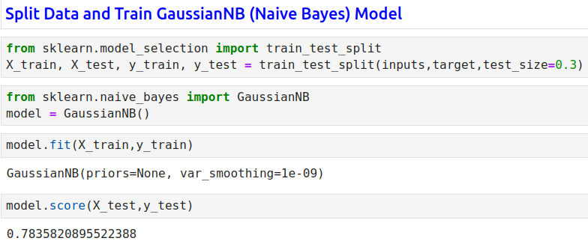
15.7 Split and Train GaussianNB Model
https://www.youtube.com/watch?v=EItlUEPCIzM&list=PLeo1K3hjS3uvCeTYTeyfe0-rN5r8zn9rw&index=14
Split Data and Train GaussianNB Model (09:51-11:30/13:37)

Slide 31
15.8 Naive Bayes Model Prediction

Slide 32
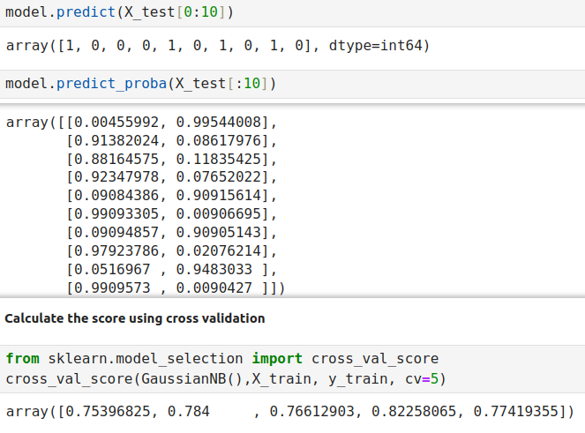
15.8 Naive Bayes Model Prediction
https://www.youtube.com/watch?v=EItlUEPCIzM&list=PLeo1K3hjS3uvCeTYTeyfe0-rN5r8zn9rw&index=14
Naive Bayes Model Prediction (11:31-13:37/13:37)

Slide 33
End

