Slide 1

26 Outlier
Peter H. Chen

Slide 2
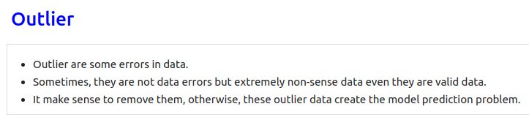
26 Outlier
https://www.youtube.com/watch?v=cbqZa_1vzcg&list=PLeo1K3hjS3uvCeTYTeyfe0-rN5r8zn9rw&index=26
Remove Outlier (0:00-0:30/19:30)
We discuss the Remove Outlier in the Real Estate Prediction of Full Stack development project.
Outlier are some errors in data.
Sometimes, they are not data errors but extremely non-sense data even they are valid data.
It make sense to remove them, otherwise, these outlier data create the model prediction problem.
Here, we apply some technique to detect the outliers and remove them. These techniques we used here are
1. Remove Outlier by Domain Knowledge
2. Remove Outlier by Standard deviation

Slide 3
26.1 Remove Outlier by Domain Knowledge

Slide 4
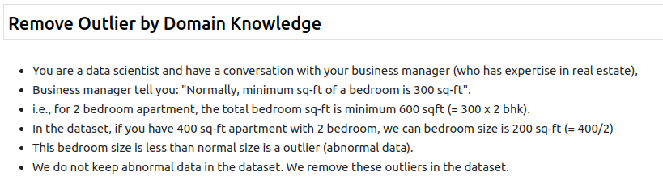
26.1 Remove Outlier by Domain Knowledge
https://www.youtube.com/watch?v=cbqZa_1vzcg&list=PLeo1K3hjS3uvCeTYTeyfe0-rN5r8zn9rw&index=26
Remove Outlier by Domain Knowledge (0:31-1:30/19:30)
In real estate domain, we have minimum sq-ft 300 sq-ft for bedroom size, if the bedroom size is less than 300 sq-ft, they are outlier data and should be removed.

Slide 5
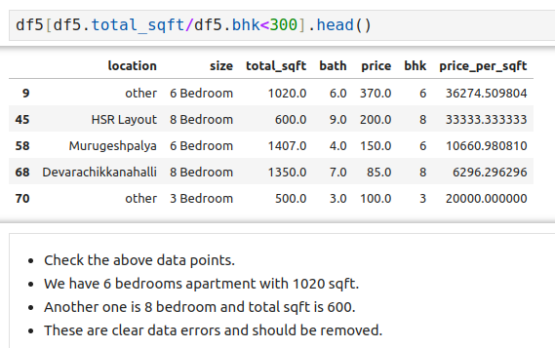
26.1 Remove Outlier by Domain Knowledge
https://www.youtube.com/watch?v=cbqZa_1vzcg&list=PLeo1K3hjS3uvCeTYTeyfe0-rN5r8zn9rw&index=26
Remove Outlier by Domain Knowledge (1:31-2:30/19:30)
Check the outlier data

Slide 6
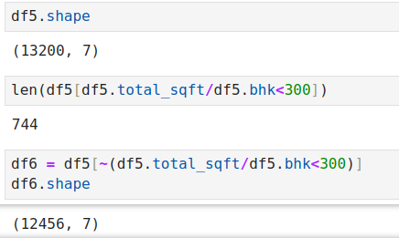
26.1 Remove Outlier by Domain Knowledge
https://www.youtube.com/watch?v=cbqZa_1vzcg&list=PLeo1K3hjS3uvCeTYTeyfe0-rN5r8zn9rw&index=26
Remove Outlier by Domain Knowledge (2:31-3:30/19:30)
Original data szie = 13200
Outlier size is 744.
After outlier is remove, we have 12456 (= 13200 - 744)

Slide 7
26.2 Keep Data between (Mean +/- Std)

Slide 8
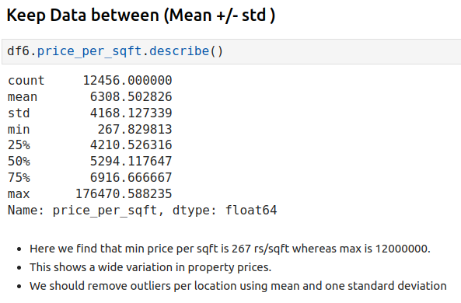
26.2 Keep Data between (Mean +/- Std)
https://www.youtube.com/watch?v=cbqZa_1vzcg&list=PLeo1K3hjS3uvCeTYTeyfe0-rN5r8zn9rw&index=26
Keep Data Between (Mean +/- Std) (3:31-4:30/19:30)

Slide 9
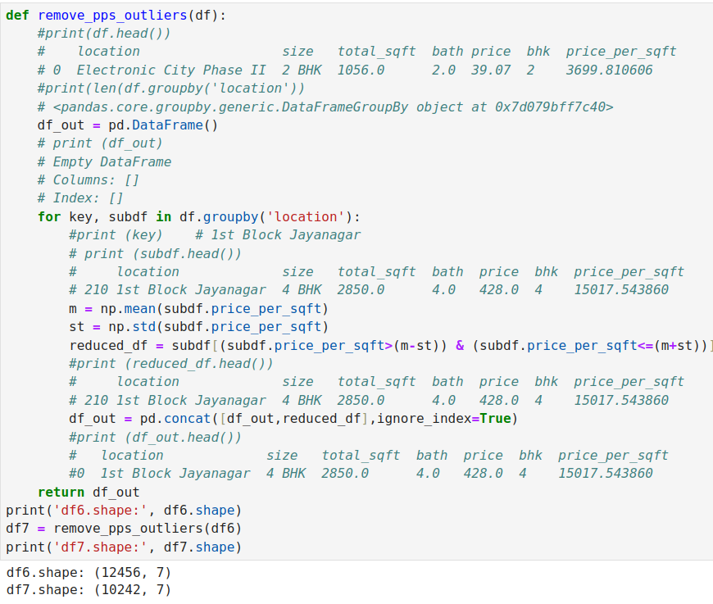
26.2 Keep Data between (Mean +/- Std)
https://www.youtube.com/watch?v=cbqZa_1vzcg&list=PLeo1K3hjS3uvCeTYTeyfe0-rN5r8zn9rw&index=26
Keep Data Between (Mean +/- Std) (4:31-5:30/19:30)

Slide 10
26.3 Plot Bedroom Size vs. Price

Slide 11
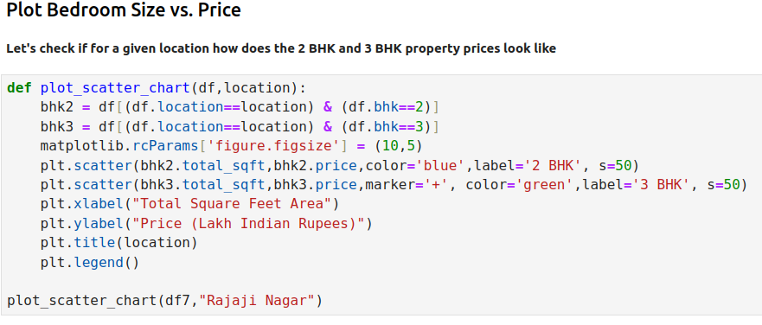
26.3 Plot Bedroom Size vs. Price
https://www.youtube.com/watch?v=cbqZa_1vzcg&list=PLeo1K3hjS3uvCeTYTeyfe0-rN5r8zn9rw&index=26
Plot Bedroom Size vs. Price (5:31-6:30/19:30)

Slide 12
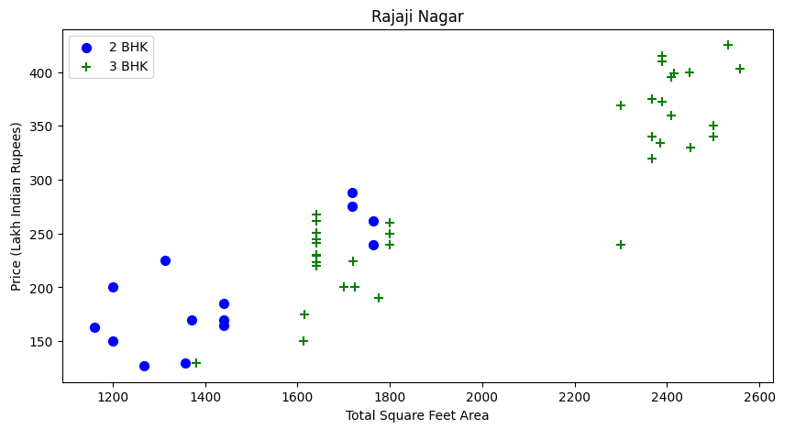
26.3 Plot Bedroom Size vs. Price
https://www.youtube.com/watch?v=cbqZa_1vzcg&list=PLeo1K3hjS3uvCeTYTeyfe0-rN5r8zn9rw&index=26
Plot Bedroom Size vs. Price (6:31-7:30/19:30)

Slide 13
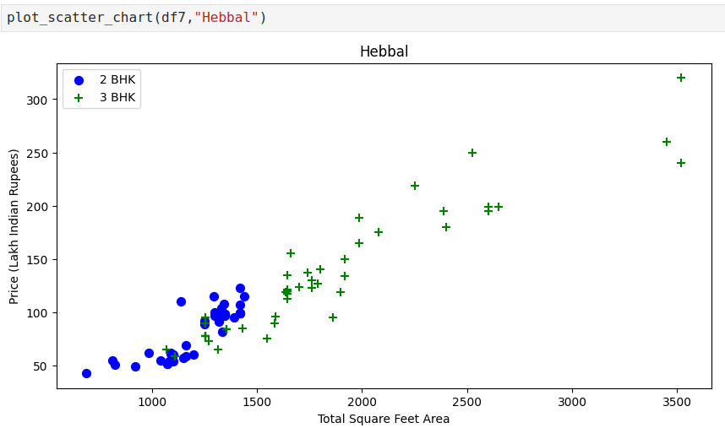
26.3 Plot Bedroom Size vs. Price
https://www.youtube.com/watch?v=cbqZa_1vzcg&list=PLeo1K3hjS3uvCeTYTeyfe0-rN5r8zn9rw&index=26
Plot Bedroom Size vs. Price (7:31-8:30/19:30)

Slide 14
26.4 Remove More Bedroom/sq-ft but Less Price

Slide 15
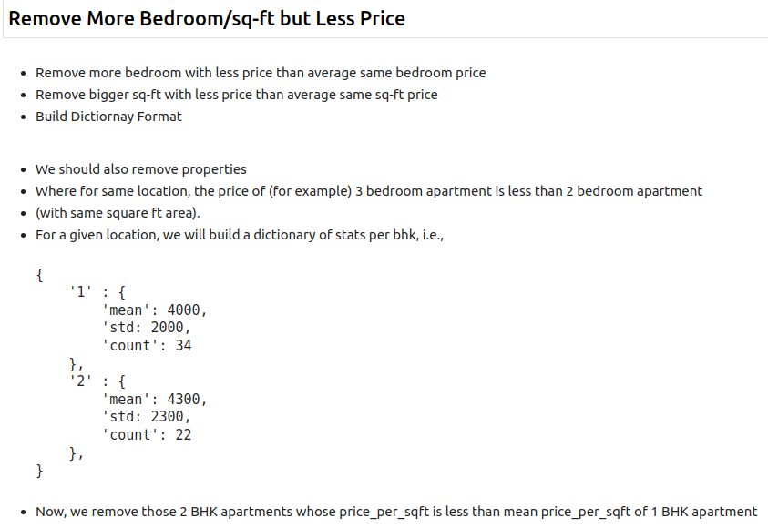
26.4 Remove More Bedroom/sq-ft but Less Price
https://www.youtube.com/watch?v=cbqZa_1vzcg&list=PLeo1K3hjS3uvCeTYTeyfe0-rN5r8zn9rw&index=26
Remove More Bedroom/sq-ft but Less Price (8:31-9:30/19:30)

Slide 16
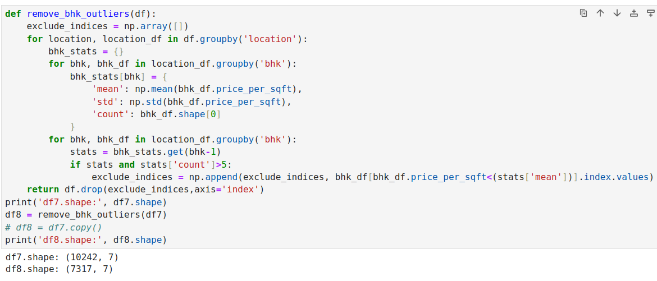
26.4 Remove More Bedroom/sq-ft but Less Price
https://www.youtube.com/watch?v=cbqZa_1vzcg&list=PLeo1K3hjS3uvCeTYTeyfe0-rN5r8zn9rw&index=26
Remove More Bedroom/sq-ft but Less Price (9:31-10:30/19:30)

Slide 17
26.5 Plot Bedroom vs. Price

Slide 18
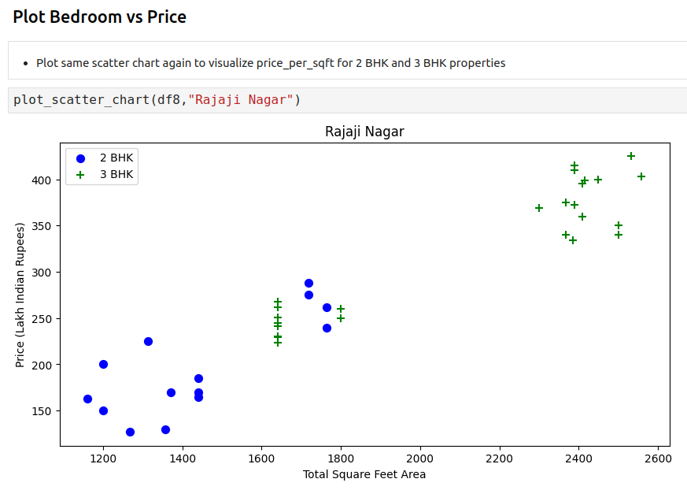
26.5 Plot Bedroom vs. Price
https://www.youtube.com/watch?v=cbqZa_1vzcg&list=PLeo1K3hjS3uvCeTYTeyfe0-rN5r8zn9rw&index=26
Plot Bedroom vs. Price (10:31-11:30/19:30)

Slide 19
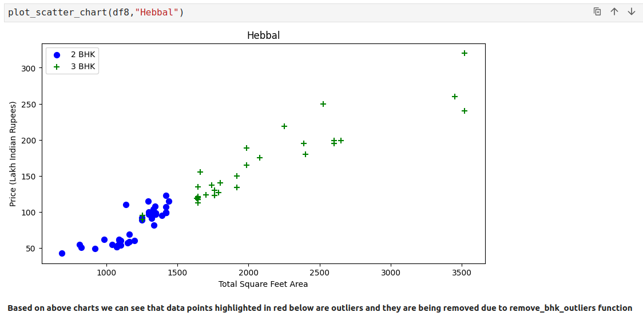
26.5 Plot Bedroom vs. Price
https://www.youtube.com/watch?v=cbqZa_1vzcg&list=PLeo1K3hjS3uvCeTYTeyfe0-rN5r8zn9rw&index=26
Plot Bedroom vs. Price (10:31-11:30/19:30)

Slide 20
26.6 Before and After Outlier Removed

Slide 21
26.6 Before and After Outlier Removed
https://www.youtube.com/watch?v=cbqZa_1vzcg&list=PLeo1K3hjS3uvCeTYTeyfe0-rN5r8zn9rw&index=26
Before and After Outlier Removed (11:31-12:30/19:30)
We can see some of the outlier data are removed for location “Rajaji Nagar”.

Slide 22
26.6 Before and After Outlier Removed
https://www.youtube.com/watch?v=cbqZa_1vzcg&list=PLeo1K3hjS3uvCeTYTeyfe0-rN5r8zn9rw&index=26
Before and After Outlier Removed (12:31-13:30/19:30)
We can see some of the outlier data are removed for location “Hebbal”.

Slide 23
26.7 Plot Price Per Sq-ft Histogram

Slide 24
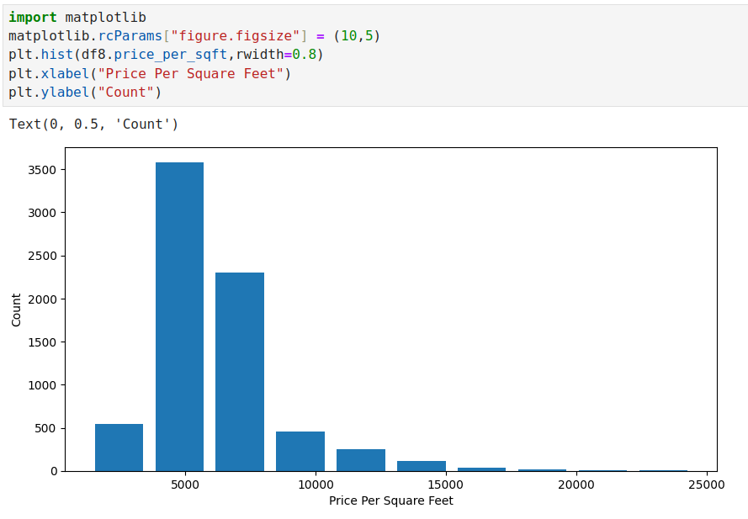
26.7 Plot Price Per Sq-ft Histogram
https://www.youtube.com/watch?v=cbqZa_1vzcg&list=PLeo1K3hjS3uvCeTYTeyfe0-rN5r8zn9rw&index=26
Plot Price Per Sq-ft Histogram (13:31-14:30/19:30)
Plot the histogram of price per sq-ft.

Slide 25
26.8 Remove Bathroom Outlier

Slide 26
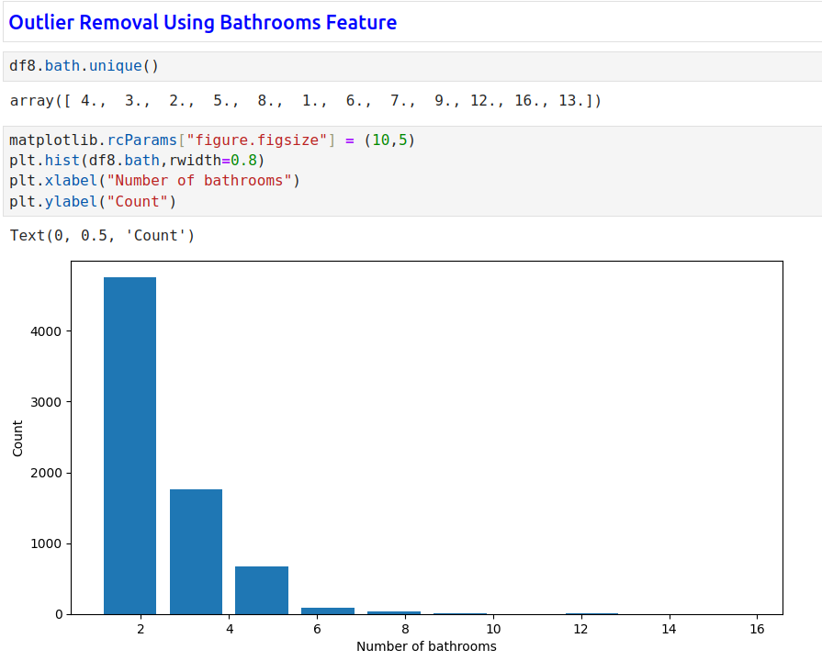
26.8 Remove Bathroom Outlier
https://www.youtube.com/watch?v=cbqZa_1vzcg&list=PLeo1K3hjS3uvCeTYTeyfe0-rN5r8zn9rw&index=26
Remove Bathroom Outlier (14:31-15:30/19:30)
Plot histogram of bathroom.

Slide 27
26.9 Remove Bathroom > Bedroom + 2

Slide 28
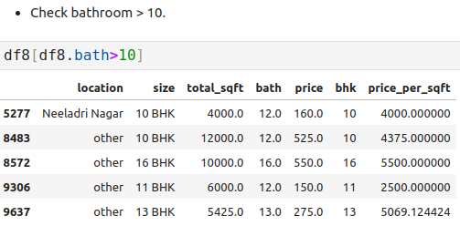
26.9 Remove Bathroom > Bedroom + 2
https://www.youtube.com/watch?v=cbqZa_1vzcg&list=PLeo1K3hjS3uvCeTYTeyfe0-rN5r8zn9rw&index=26
Remove Bathroom > Bedroom + 2 (15:31-16:30/19:30)
Check Bathroom > 10.

Slide 29
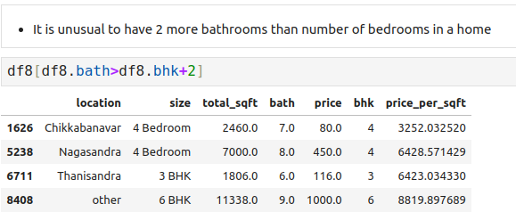
26.9 Remove Bathroom > Bedroom + 2
https://www.youtube.com/watch?v=cbqZa_1vzcg&list=PLeo1K3hjS3uvCeTYTeyfe0-rN5r8zn9rw&index=26
Remove Bathroom > Bedroom + 2 (16:31-17:30/19:30)
It is unusual to have 2 more bathrooms than number of bedroom.

Slide 30
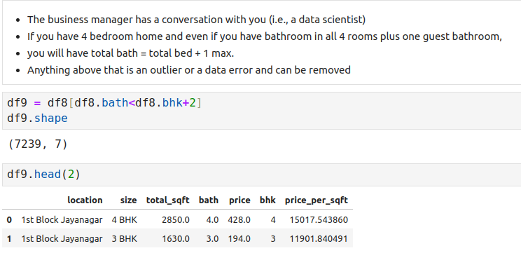
26.9 Remove Bathroom > Bedroom + 2
https://www.youtube.com/watch?v=cbqZa_1vzcg&list=PLeo1K3hjS3uvCeTYTeyfe0-rN5r8zn9rw&index=26
Remove Bathroom > Bedroom + 2 (17:31-18:30/19:30)

Slide 31
26.10 Cleanup Final Dataset

Slide 32
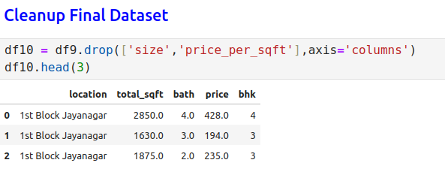
26.10 Cleanup Final Dataset
https://www.youtube.com/watch?v=cbqZa_1vzcg&list=PLeo1K3hjS3uvCeTYTeyfe0-rN5r8zn9rw&index=26
Cleanup Final Dataset (18:31-19:30/19:30)

Slide 33
End

