Slide 1

24 Data Cleaning and Feature Engineering
Peter H. Chen

Slide 2
24 Data Cleaning and Feature Engineering
https://www.youtube.com/watch?v=_drqJ9SFCgU&list=PLeo1K3hjS3uvCeTYTeyfe0-rN5r8zn9rw&index=24
Data Cleaning and Feature Engineering (0:00-0:05/15:20)
We discuss the data cleaning in the Real Estate Prediction of Full Stack development project.

Slide 3
24.1 Dataset

Slide 4
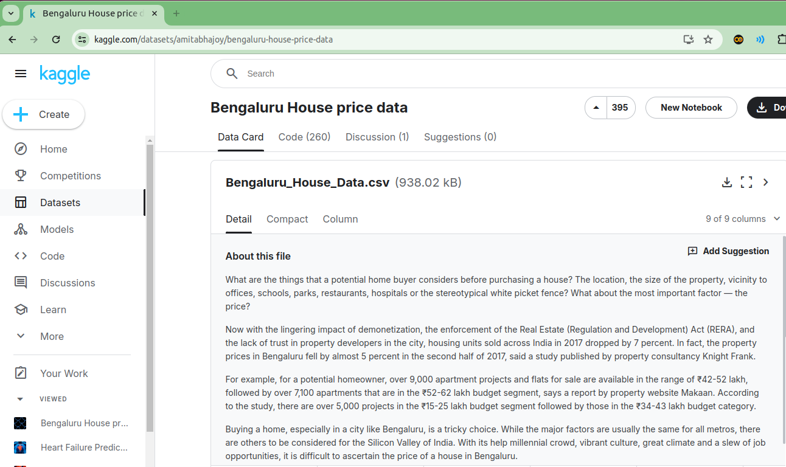
24.1 Dataset
https://www.youtube.com/watch?v=_drqJ9SFCgU&list=PLeo1K3hjS3uvCeTYTeyfe0-rN5r8zn9rw&index=24
Dataset (0:06-0:30/15:20)
We download the Bangaluru (or Bangalore) dataset from the below link.
https://www.kaggle.com/datasets/amitabhajoy/bengaluru-house-price-data

Slide 5
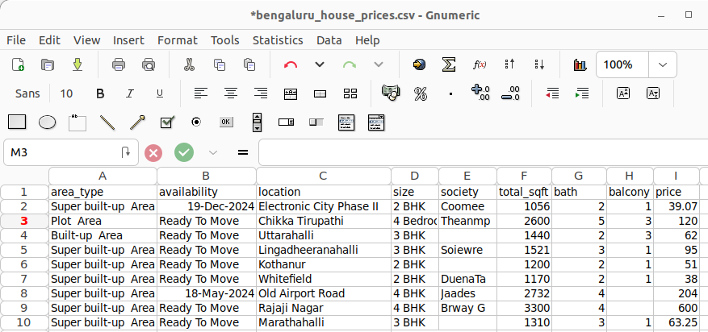
24.1 Dataset
https://www.youtube.com/watch?v=_drqJ9SFCgU&list=PLeo1K3hjS3uvCeTYTeyfe0-rN5r8zn9rw&index=24
Bangaluru House Price Dataset (0:31-1:20/15:20)
Open the Bangaluru (or Bangalore) csv. It looks like below.
We have independent feature variables: area type, availability, location, size (BHK: Bedroom, hallway, kitchen), society, bath, balcony.
The target variable price is a dependent variable depends on the above independent features. The price unit is defined in 1 lakh (1E+5) Rupee, i.e., 1E+5 Rupee.
Here, we use supervised learning. In supervised learning, we have label the output. Here, we have the target label “price” for all the output.

Slide 6
24.2 Import Library

Slide 7
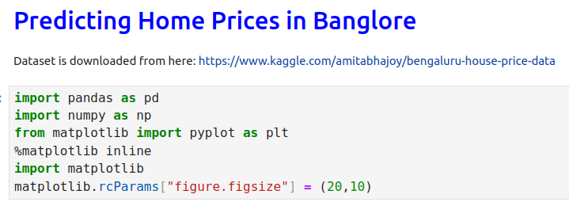
24.2 Import Library
https://www.youtube.com/watch?v=_drqJ9SFCgU&list=PLeo1K3hjS3uvCeTYTeyfe0-rN5r8zn9rw&index=24
Import Library (0:31-1:40/15:20)
We import several basic libraries.

Slide 8
24.3 Load Dataset

Slide 9
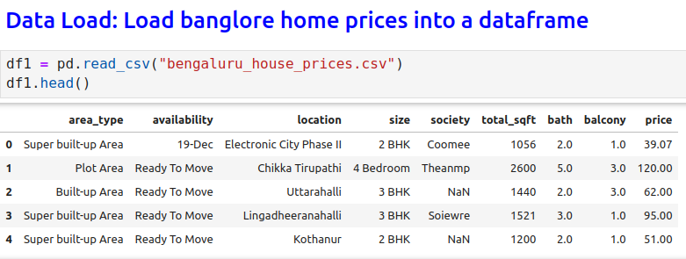
24.3 Load Dataset
https://www.youtube.com/watch?v=_drqJ9SFCgU&list=PLeo1K3hjS3uvCeTYTeyfe0-rN5r8zn9rw&index=24
Load Dataset (1:41-1:50/15:20)
We load the csv Dataset into the Pandas Data Frame.

Slide 10

24.3 Load Dataset
https://www.youtube.com/watch?v=_drqJ9SFCgU&list=PLeo1K3hjS3uvCeTYTeyfe0-rN5r8zn9rw&index=24
Load Dataset (1:51-2:10/15:20)
We have load all the data.
We can see the number of row = 13320 and number of column = 9.

Slide 11
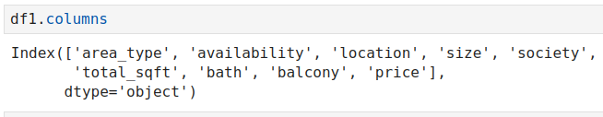
24.3 Load Dataset
https://www.youtube.com/watch?v=_drqJ9SFCgU&list=PLeo1K3hjS3uvCeTYTeyfe0-rN5r8zn9rw&index=24
Load Dataset (2:11-2:15/15:20)
Here, we check how many columns with 8 features and one target label price.

Slide 12
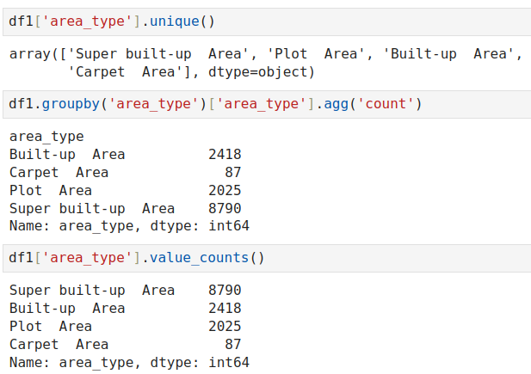
24.3 Load Dataset
https://www.youtube.com/watch?v=_drqJ9SFCgU&list=PLeo1K3hjS3uvCeTYTeyfe0-rN5r8zn9rw&index=24
Load Dataset (2:16-2:50/15:20)
We count how many types in ‘area_type’.

Slide 13
24.4 Drop Features

Slide 14
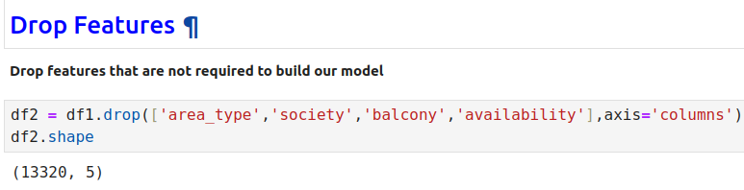
24.4 Drop Features
https://www.youtube.com/watch?v=_drqJ9SFCgU&list=PLeo1K3hjS3uvCeTYTeyfe0-rN5r8zn9rw&index=24
Drop Features (2:51-3:00/15:20)
We drop some of the columns in the dataset.
Now, we have 13320 rows x 5 columns. We drop 4 columns out of 9 columns.

Slide 15
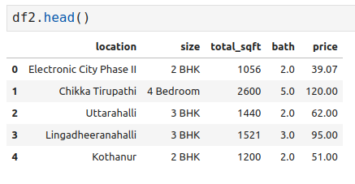
24.4 Drop Features
https://www.youtube.com/watch?v=_drqJ9SFCgU&list=PLeo1K3hjS3uvCeTYTeyfe0-rN5r8zn9rw&index=24
Drop Features (3:11-3:25/15:20)
We check the df2.head()
After we drop 5 columns, we have 5 columns remains.
The columns are: location, size’, total_sqft’, bath, and price.

Slide 16
24.4 Data Clean

Slide 17
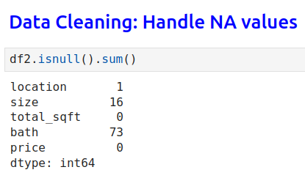
24.4 Data Clean
https://www.youtube.com/watch?v=_drqJ9SFCgU&list=PLeo1K3hjS3uvCeTYTeyfe0-rN5r8zn9rw&index=24
Data Clean (3:26-3:50/15:20)
After we drop the columns, we do the data cleaning.
We use isnul() function to check whether there is null data in each columns.

Slide 18
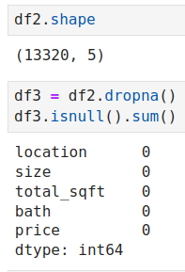
24.4 Data Clean
https://www.youtube.com/watch?v=_drqJ9SFCgU&list=PLeo1K3hjS3uvCeTYTeyfe0-rN5r8zn9rw&index=24
Data Clean (3:50-4:30/15:20)
We can drop all null() rows.
If we do not want to drop null. For example, if we don’t want to drop the bathroom, we can take median and replace the empty data.
1. Since have 13320 rows of data in dataframe, we have a lot of data, we can drop some of them.
2. We use
> df3 = df2. dropna()
to drop the rows with NA.
3. We can check how many NA remain.
> df3.isnull.sum()
We can see there no NA in the dataframe.
1
2
3

Slide 19
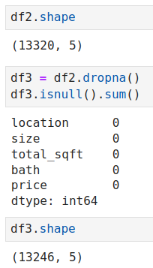
24.4 Data Clean
https://www.youtube.com/watch?v=_drqJ9SFCgU&list=PLeo1K3hjS3uvCeTYTeyfe0-rN5r8zn9rw&index=24
Data Clean (4:31-4:40/15:20)
1. before drop NA, we have 13320 rows x 5.
2. Now, we check the dataframe again.
> df3.shape()
We have 13246 rows x 5 columns remains. About 76 (= 13320 – 13246) rows are dropped.
1
2

Slide 20
24.5 Check Unqiue Value in Column

Slide 21
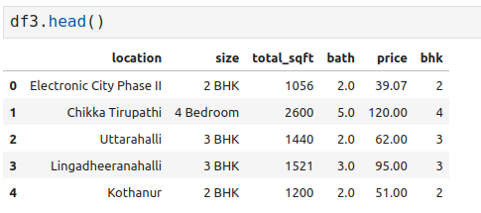
24.5 Check Unqiue Value in Column
https://www.youtube.com/watch?v=_drqJ9SFCgU&list=PLeo1K3hjS3uvCeTYTeyfe0-rN5r8zn9rw&index=24
Check Unique Value in Column (4:41-5:00/15:20)
We check the content of column size.
> df3.head()
We can see some size are 2 BHK (Bedroom Hall Kitchen). Some size are 4 bedroom.
What is going on inside the size column.

Slide 22
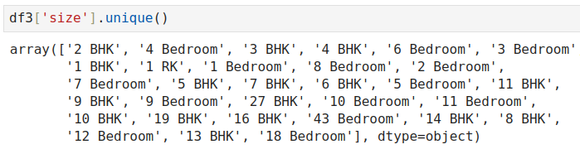
24.5 Check Unqiue Value in Column
https://www.youtube.com/watch?v=_drqJ9SFCgU&list=PLeo1K3hjS3uvCeTYTeyfe0-rN5r8zn9rw&index=24
Check Unique Value in Column (5:01-5:30/15:20)
We want to see what is really inside
> df3[‘size’].unique()
>> ‘2 BHK’, ‘4 bedroom’, …, ‘18 bedroom’

Slide 23
24.6 Add New Feature bhk

Slide 24
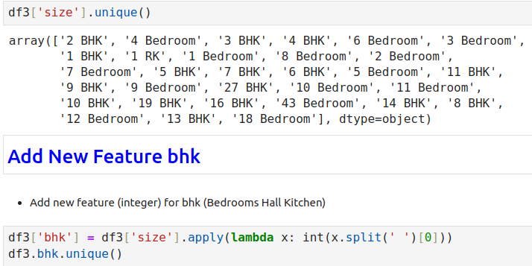
24.6 Add New Feature bhk
https://www.youtube.com/watch?v=_drqJ9SFCgU&list=PLeo1K3hjS3uvCeTYTeyfe0-rN5r8zn9rw&index=24
Add New Feature bhk (5:31-5:50/15:20)
Now, we want to convert the ‘2 BHK’, ‘4 Bedroom’, ‘3 BHK’, … into unique number.
1. We use apply () to apply some function.
2. We use python lambda function.
3. We pass in the X value on by one.
4. We want to do some transformation, x = ‘2 BHK’,
5. How to split into 2 token? x.split(‘ ‘)
6. How do we pick up the first token? x.split(‘ ‘)[0]
7. Convert into integer: lambda x: int (x.split(‘ ‘)[0]

Slide 25
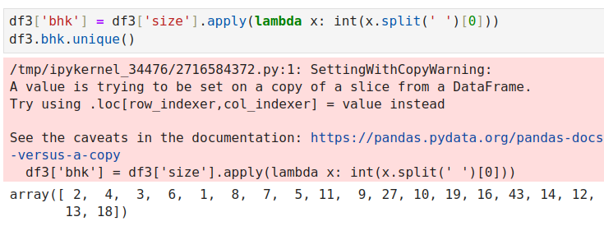
24.6 Add New Feature bhk
https://www.youtube.com/watch?v=_drqJ9SFCgU&list=PLeo1K3hjS3uvCeTYTeyfe0-rN5r8zn9rw&index=24
Add New Feature bhk (5:51-6:30/15:20)
Apply Lambda Function.
> df3 [‘bhk’] = df3[‘size’].apply(lambda x: int (x.split(‘ ‘)[0]))
1. We pass into the x and return x.split(‘ ‘)[0] (= 2, 4, 3, …)
2. We create a new column ‘bhk’ to store the data.

Slide 26
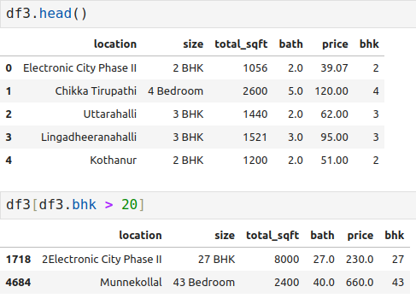
24.6 Add New Feature bhk
https://www.youtube.com/watch?v=_drqJ9SFCgU&list=PLeo1K3hjS3uvCeTYTeyfe0-rN5r8zn9rw&index=24
Add New Feature bhk (8:01-8:30/15:20)
1. Now, we can see new column of bhk
2. We want to see bhk > 20
> df3 [df3.bhk > 20]
1
2

Slide 27
24.7 Explore total_sqft Feature

Slide 28
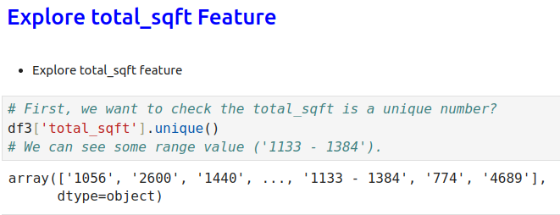
24.7 Explore total_sqft Feature
https://www.youtube.com/watch?v=_drqJ9SFCgU&list=PLeo1K3hjS3uvCeTYTeyfe0-rN5r8zn9rw&index=24
Explore total_sqft Feature (6:31-9:00/15:20)
First, we want to make sure total_sqft is an unique value.
> df3[‘total_sqft’].unique()
>> [‘1056’, …, ‘1113 – 1384’, …
We see some range value (‘1113 – 1384’). It is not a single value. We want to convert the range into a single number. We can take the average of this number.

Slide 29
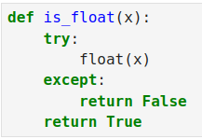
24.7 Explore total_sqft Feature
https://www.youtube.com/watch?v=_drqJ9SFCgU&list=PLeo1K3hjS3uvCeTYTeyfe0-rN5r8zn9rw&index=24
Explore total_sqft Feature (9:01-9:30/15:20)
We define is_float ().

Slide 30
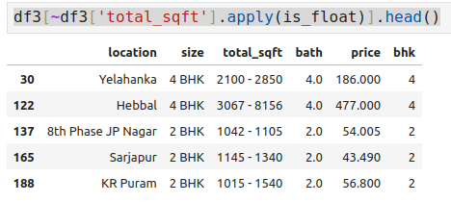
24.7 Explore total_sqft Feature
https://www.youtube.com/watch?v=_drqJ9SFCgU&list=PLeo1K3hjS3uvCeTYTeyfe0-rN5r8zn9rw&index=24
Explore total_sqft Feature (9:01-9:30/15:20)
We use apply () for lambda function is_float(), it return false when there is a range (‘1113 - 1384’) existed.
We pass in every data in the feature ‘total_sqft’: ~df[‘total_sqft’].apply(is_float). If is is not float (range), then we list them with head() function.
We can see there are a lot of range in ‘total_sqft’.

Slide 31
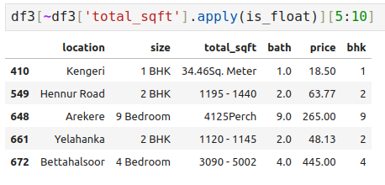
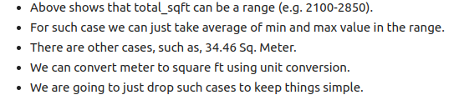
24.7 Explore total_sqft Feature
https://www.youtube.com/watch?v=_drqJ9SFCgU&list=PLeo1K3hjS3uvCeTYTeyfe0-rN5r8zn9rw&index=24
Explore total_sqft Feature (9:31-10:30/15:20)
There are other cases, such as, 34.46Sq. Meter.
We can convert meter to square ft using unit conversion.
We are going to just drop such cases to keep things simple.
The dataset have all kinds of error. We need to clean up. Here, we only take the range by average and just ignore other errors.

Slide 32
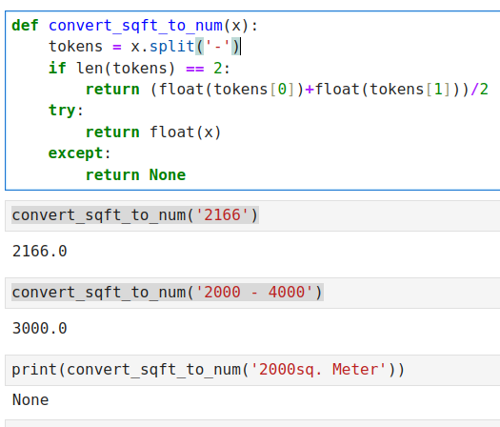
24.7 Explore total_sqft Feature
https://www.youtube.com/watch?v=_drqJ9SFCgU&list=PLeo1K3hjS3uvCeTYTeyfe0-rN5r8zn9rw&index=24
Explore total_sqft Feature (10:31-14:10/15:20)
Define convert_dqft_to_num(x)
1. Convert the float
2. Convert range into average of token[0] and token[1].
3. Convert (‘ … sq Meter’) are exception and return None.

Slide 33
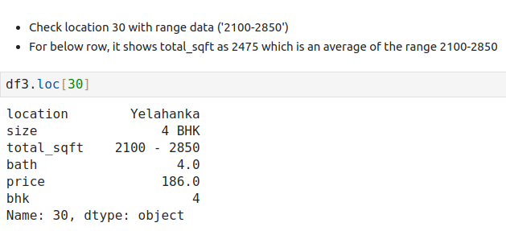
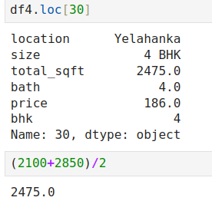
24.7 Explore total_sqft Feature
https://www.youtube.com/watch?v=_drqJ9SFCgU&list=PLeo1K3hjS3uvCeTYTeyfe0-rN5r8zn9rw&index=24
Explore total_sqft Feature (14:11-15:00/15:20)
Now, we clean up the total_sqft Feature.

Slide 34
24.8 Summary

Slide 35
24.8 Summary
https://www.youtube.com/watch?v=_drqJ9SFCgU&list=PLeo1K3hjS3uvCeTYTeyfe0-rN5r8zn9rw&index=24
Summary (15:01-15:20/15:20)
Now, we clean up the Dataset as below:
1. size: contains different format, we use lambda function to split them and take the first data to create new column bhk (bedroom, hallway, kitchen)
2. total_sqft Feature: We take average for range format, other error format convert into ‘None”. We drop the rows contain “None’.

Slide 36
End

