Slide 1

25 Feature Engineering
Peter H. Chen

Slide 2
25 Feature Engineering
https://www.youtube.com/watch?v=gMoJIH0prL4&list=PLeo1K3hjS3uvCeTYTeyfe0-rN5r8zn9rw&index=25
Feature Engineering (0:00-0:30/15:20)
We discuss the Feature Engineering in the Real Estate Prediction of Full Stack development project.

Slide 3
25.1 Add price_per_sqft

Slide 4
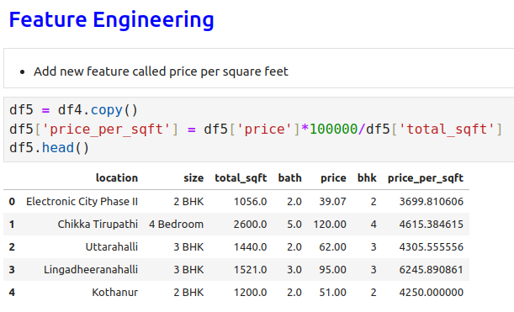
25.1 Add price_per_sqft
https://www.youtube.com/watch?v=gMoJIH0prL4&list=PLeo1K3hjS3uvCeTYTeyfe0-rN5r8zn9rw&index=25
Add price_per_sqft (0:31-2:50/15:20)
1. We make deep copy from df4 to df5.
2. Convert the price (lakh) into price (Rupee)/per sq-ft.
Price unit is lakh = 100,000 rupee.
Price (rupee)/(total-sqft) = Price (lakh) * 10,000 (rupee/lakh)/(total-sqft)

Slide 5
25.2 Unique in location Feature

Slide 6
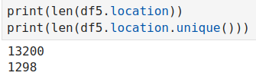
25.2 Unique in location Feature
https://www.youtube.com/watch?v=gMoJIH0prL4&list=PLeo1K3hjS3uvCeTYTeyfe0-rN5r8zn9rw&index=25
Unique in location Feature (0:31-2:50/15:20)
Look at how many unique feature.

Slide 7
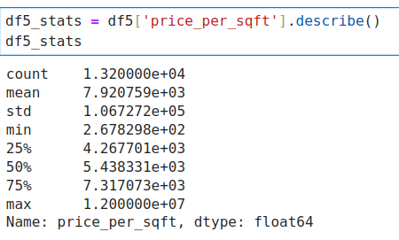
25.2 Unique in location Feature
https://www.youtube.com/watch?v=gMoJIH0prL4&list=PLeo1K3hjS3uvCeTYTeyfe0-rN5r8zn9rw&index=25
Unique in location Feature (0:31-2:50/15:20)
Look at what function in df5.

Slide 8
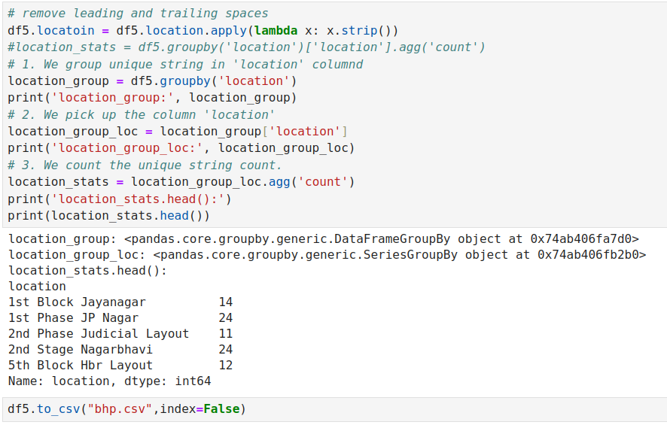
25.2 Unique in location Feature
https://www.youtube.com/watch?v=gMoJIH0prL4&list=PLeo1K3hjS3uvCeTYTeyfe0-rN5r8zn9rw&index=25
Unique in location Feature (0:31-2:50/15:20)
Count unique rows in column ‘location’.

Slide 9
25.2 Examine Categorical Variable

Slide 10
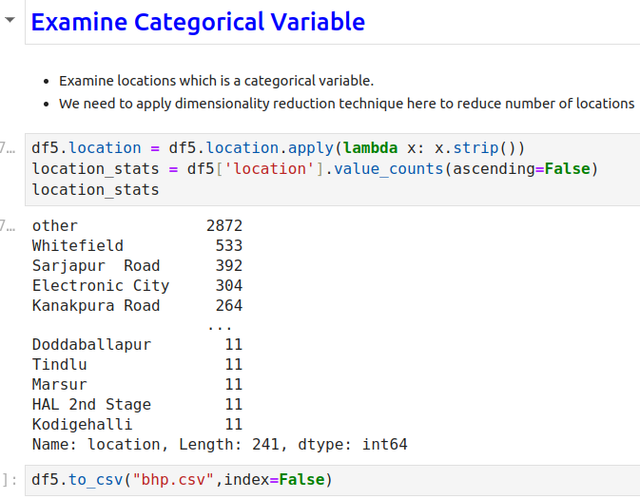
25.2 Examine Categorical Variable
https://www.youtube.com/watch?v=gMoJIH0prL4&list=PLeo1K3hjS3uvCeTYTeyfe0-rN5r8zn9rw&index=25
Examine Categorical Variable (2:51-5:00/15:20)

Slide 11
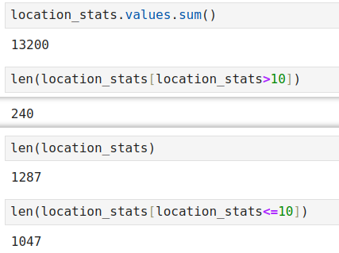
25.2 Examine Categorical Variable
https://www.youtube.com/watch?v=gMoJIH0prL4&list=PLeo1K3hjS3uvCeTYTeyfe0-rN5r8zn9rw&index=25
Examine Categorical Variable (5:01-8:00/15:20)
We want to see how many unique count is less than 10.

Slide 12
25.3 Dimensionality Reduction

Slide 13
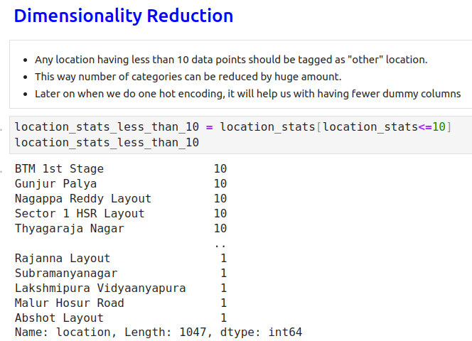
25.3 Dimensionality Reduction
https://www.youtube.com/watch?v=gMoJIH0prL4&list=PLeo1K3hjS3uvCeTYTeyfe0-rN5r8zn9rw&index=25
Dimensionality Reduction (8:01-11:00/15:20)
We want to reduce the dimension for unique sting name <= 10 group into “others”.

Slide 14
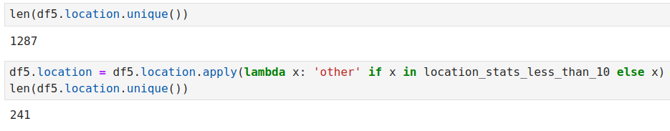
25.3 Dimensionality Reduction
https://www.youtube.com/watch?v=gMoJIH0prL4&list=PLeo1K3hjS3uvCeTYTeyfe0-rN5r8zn9rw&index=25
Dimensionality Reduction (11:01-14:00/15:20)
We reduce the rows from 1287 into 241 (others contains all unique count <= 10).

Slide 15
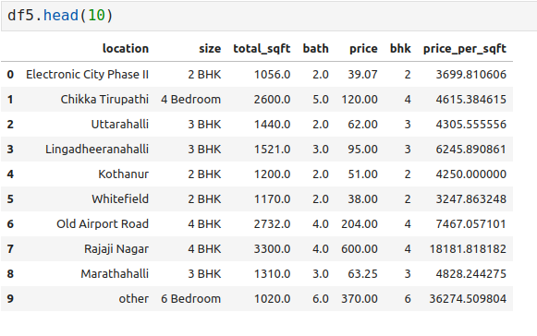
25.3 Dimensionality Reduction
https://www.youtube.com/watch?v=gMoJIH0prL4&list=PLeo1K3hjS3uvCeTYTeyfe0-rN5r8zn9rw&index=25
Dimensionality Reduction (14:01-15:20/15:20)
Examine the final Dimensionality Reduction.

Slide 16
End

