Slide 1

29 GUI
Peter H. Chen

Slide 2
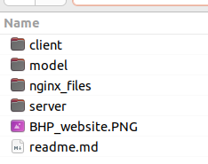
29 GUI
https://www.youtube.com/watch?v=rD2xumR98w8&list=PLeo1K3hjS3uvCeTYTeyfe0-rN5r8zn9rw&index=29
GUI (0:00-0:20/13:20)
In the last discussion,
1. In the model folder, we have Jupyter notebook build for model and save the model.
2. In the server folder, we build a Python Flask Server to read the model and perform the prediction with model.
Now, we are going to build the client folder.

Slide 3
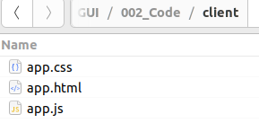
29 GUI
https://www.youtube.com/watch?v=rD2xumR98w8&list=PLeo1K3hjS3uvCeTYTeyfe0-rN5r8zn9rw&index=29
GUI (0:21-2:30/13:20)
We will have simple app.html, app.css, app.js for GUI.
We can replace JavaScript app.js into ReactJS for more efficient in-memory operation.
1. html: contains the structure of our GUI.
2. css: is a cascaded style-sheet. It contains the color and look-and-feel of GUI.
3. JavaScript: contains Logic control and Dynamic Code which make the HTTP calls to the backend to retrieve data. JavaScript is a server communicator. JavaScript communicate with server, get the data, and run dynamic code.
These are three basic concepts. We use MS-code to edit the code.

Slide 4
29.1 app.html

Slide 5
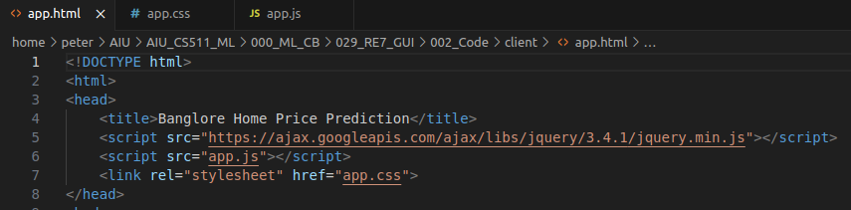
29.1 app.html
https://www.youtube.com/watch?v=rD2xumR98w8&list=PLeo1K3hjS3uvCeTYTeyfe0-rN5r8zn9rw&index=29
app.html (2:31-3:00/13:20)
<head>
  <title>
  Load library<jquery.min.js>
  Include <app.js>
  Include <app.css>
</head>

Slide 6
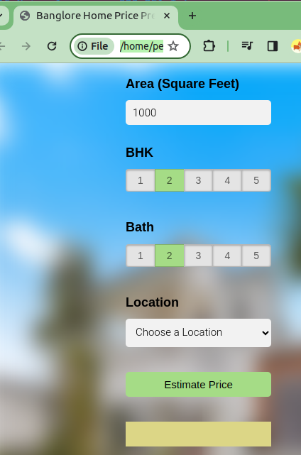
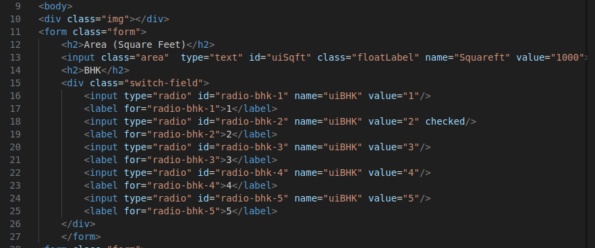
29.1 app.html
https://www.youtube.com/watch?v=rD2xumR98w8&list=PLeo1K3hjS3uvCeTYTeyfe0-rN5r8zn9rw&index=29
app.html (3:01-3:30/13:20)
1. <h2>Area (Square feet)</h2>, Text field: value=”1000”
2. <h2>BHK</h2>, radio buttons 1-5, default button 2. <h2>Location</h2>, option: Electronic City, Rajaji Nagar

Slide 7
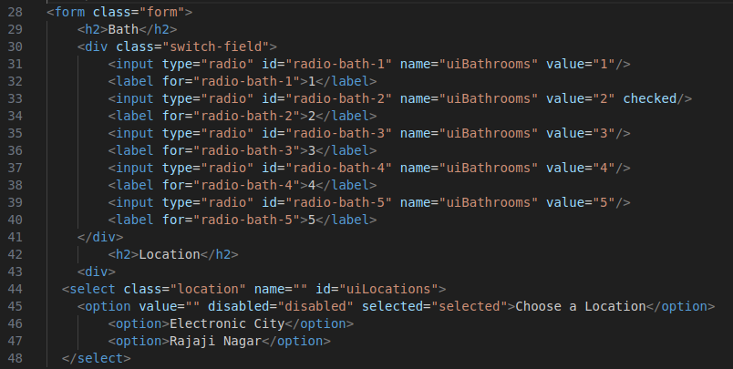
29.1 app.html
https://www.youtube.com/watch?v=rD2xumR98w8&list=PLeo1K3hjS3uvCeTYTeyfe0-rN5r8zn9rw&index=29
app.html (3:31-4:00/13:20)
1. <h2>Bath</h2>, Radio button 1-5, default button
2. <h2>BHK</h2>, radio 1-5, check button 2.

Slide 8
29.2 app.css

Slide 9
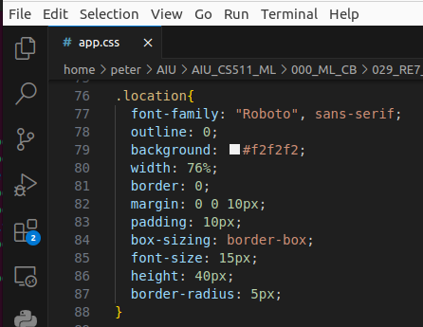
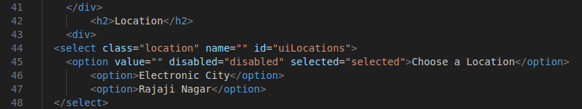
29.2 app.css
https://www.youtube.com/watch?v=rD2xumR98w8&list=PLeo1K3hjS3uvCeTYTeyfe0-rN5r8zn9rw&index=29
app.css (4:01-4:20/13:20)
The css need separated detail discussion.
Here, we just look at the definition of class .location. In CSS, the class is defined as “.class-name”, in this example, “.location”

Slide 10
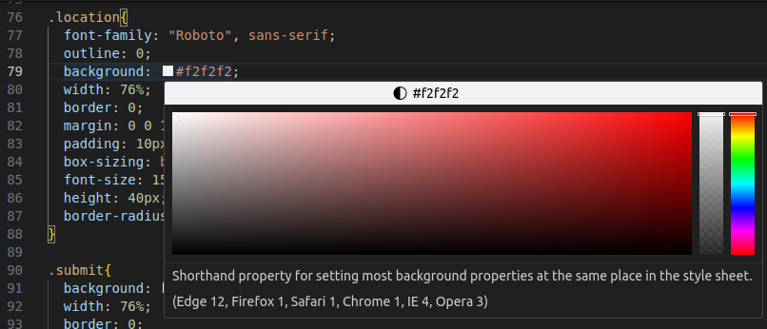
29.2 app.css
https://www.youtube.com/watch?v=rD2xumR98w8&list=PLeo1K3hjS3uvCeTYTeyfe0-rN5r8zn9rw&index=29
app.css (4:21-4:30/13:20)
We move the mouse. Popup the color selection, we can select the color we want.

Slide 11
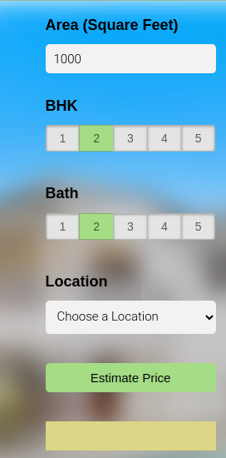
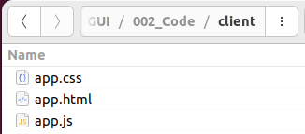
29.2 app.css
https://www.youtube.com/watch?v=rD2xumR98w8&list=PLeo1K3hjS3uvCeTYTeyfe0-rN5r8zn9rw&index=29
app.css (4:31-5:00/13:20)
Now, we click “app.html”, we get the location color “#f2f2f2”.

Slide 12
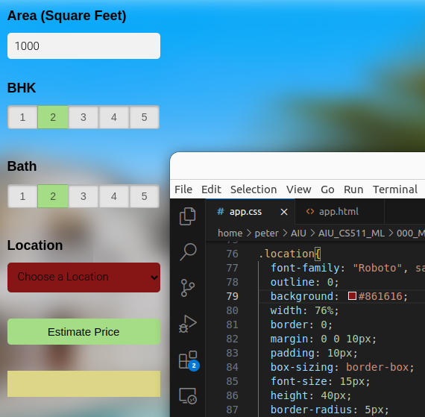
29.2 app.css
https://www.youtube.com/watch?v=rD2xumR98w8&list=PLeo1K3hjS3uvCeTYTeyfe0-rN5r8zn9rw&index=29
app.css (5:01-5:30/13:20)
We can select different color for background color “#861616” of location.
Save app.css and refresh the app.html, we will have different color as below.

Slide 13
29.3 app.js

Slide 14
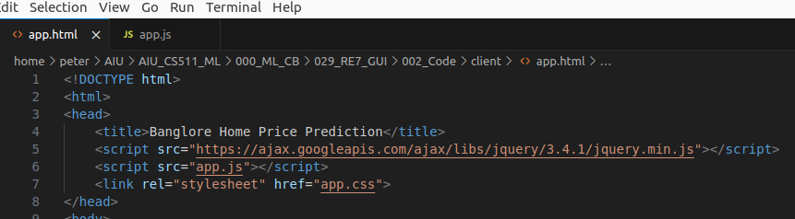
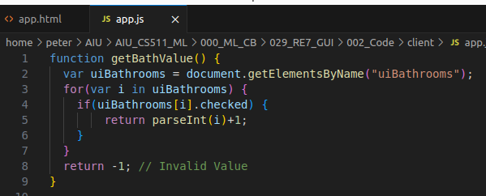
29.3 app.js
https://www.youtube.com/watch?v=rD2xumR98w8&list=PLeo1K3hjS3uvCeTYTeyfe0-rN5r8zn9rw&index=29
app.css (5:31-6:00/13:20)
We include the “app.js” in the app.html as below.
Now, we look at the app.js file.

Slide 15
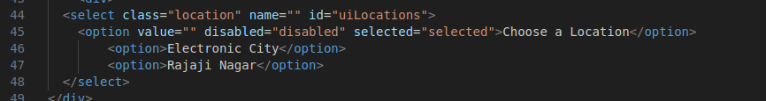
29.3 app.js
https://www.youtube.com/watch?v=rD2xumR98w8&list=PLeo1K3hjS3uvCeTYTeyfe0-rN5r8zn9rw&index=29
app.css (6:01-6:30/13:20)
In app.html, we hard code the two options.

Slide 16
29.4 window.onload

Slide 17
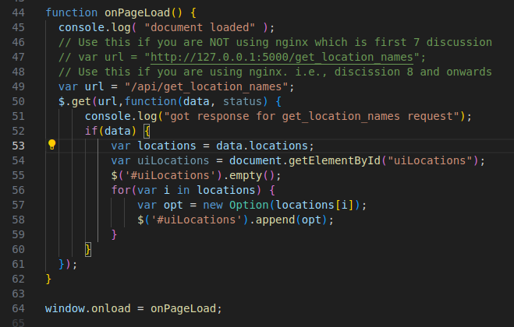
29.4 window.onload
https://www.youtube.com/watch?v=rD2xumR98w8&list=PLeo1K3hjS3uvCeTYTeyfe0-rN5r8zn9rw&index=29
Window.onload (6:31-7:00/13:20)
In app.js,
1. The “window.onload” is first called when html page is loaded. Here, function onPageLoad() is called first.
2. We can get data from Flask sever data.
3. We use $(‘#uilocations’) to get the html component “location” and display new server data.

Slide 18
29.5 OnClick Callback

Slide 19
29.5 OnClick Callback
https://www.youtube.com/watch?v=rD2xumR98w8&list=PLeo1K3hjS3uvCeTYTeyfe0-rN5r8zn9rw&index=29
OnClick Callback (7:01-8:00/13:20)
When we click the Estimate Price button, the function onClickEstiamtePrice() will be called.

Slide 20
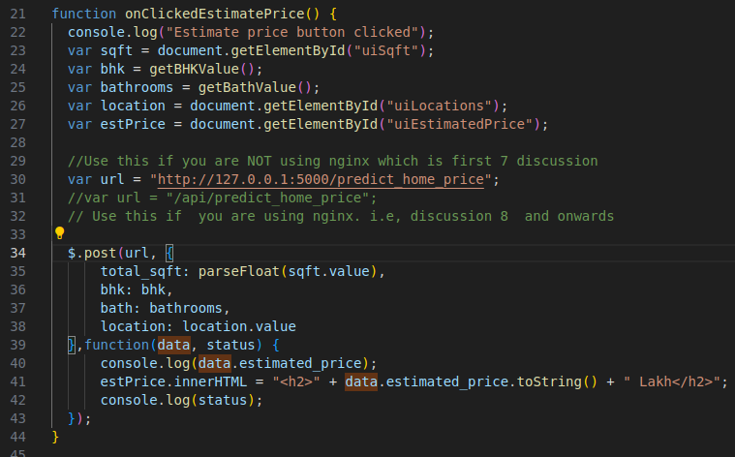
29.5 OnClick Callback
https://www.youtube.com/watch?v=rD2xumR98w8&list=PLeo1K3hjS3uvCeTYTeyfe0-rN5r8zn9rw&index=29
OnClick Callback (8:01-9:00/13:20)
If we do not use nginx, our url endpoint is “http://127.0.0.1:500/predict_home_price”
If we use postman nginx, then our url endpoint is “/api/predict_home_price” will be called.

Slide 21
29.6 Start Server

Slide 22
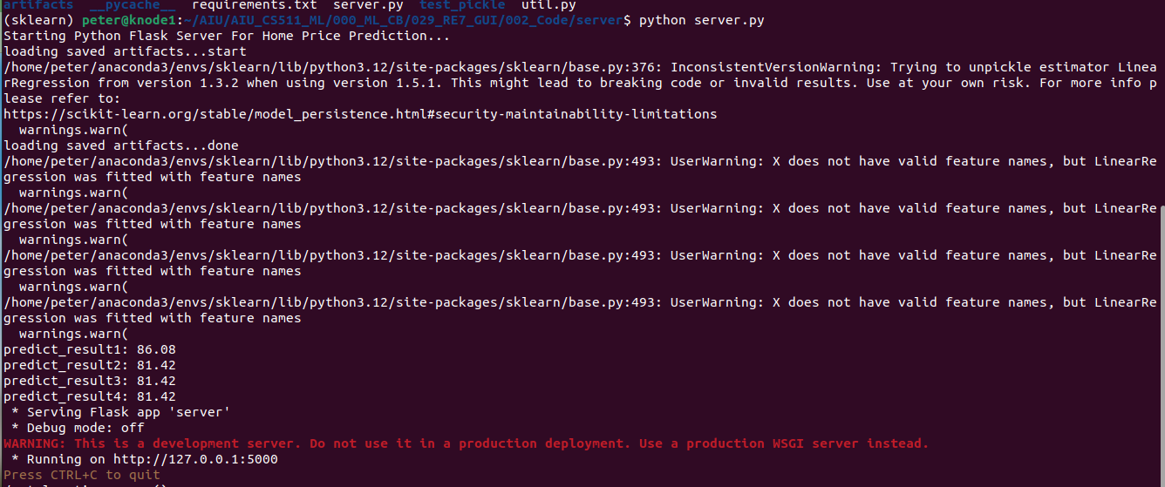
29.6 Start Server
https://www.youtube.com/watch?v=rD2xumR98w8&list=PLeo1K3hjS3uvCeTYTeyfe0-rN5r8zn9rw&index=29
Start Server (8:01-9:00/13:20)
We use local host without nginx.
> python server.py

Slide 23
29.7 Start app.html

Slide 24
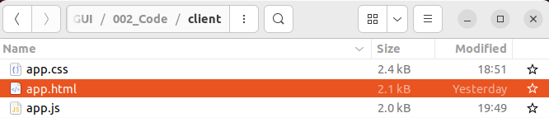
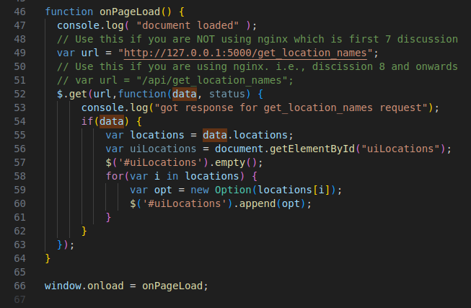
29.7 Start app.html
https://www.youtube.com/watch?v=rD2xumR98w8&list=PLeo1K3hjS3uvCeTYTeyfe0-rN5r8zn9rw&index=29
Start app.html (9:01-10:00/13:20)
1. Double click “app.html” to start web page.
2. The window.onload = onPageLoad() is called first and page is refreshed.
1
2

Slide 25
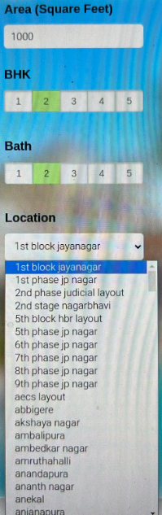
29.7 Start app.html
https://www.youtube.com/watch?v=rD2xumR98w8&list=PLeo1K3hjS3uvCeTYTeyfe0-rN5r8zn9rw&index=29
Start app.html (9:01-10:00/13:20)
Originally, we only have two hard-coded options from app.html.
Now, we can see more “options” are updated from server.py

Slide 26
29.8 Test Prediction

Slide 27
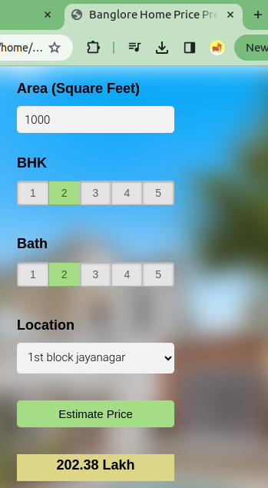
29.8 Test Prediction
https://www.youtube.com/watch?v=rD2xumR98w8&list=PLeo1K3hjS3uvCeTYTeyfe0-rN5r8zn9rw&index=29
Test Prediction (10:01-12:00/13:20)
1. Click “Estimate Price” button.
2. Get the price “202.38 Lakh”
1
2

Slide 28
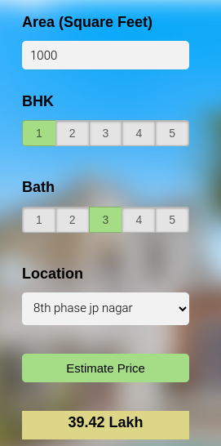
29.8 Test Prediction
https://www.youtube.com/watch?v=rD2xumR98w8&list=PLeo1K3hjS3uvCeTYTeyfe0-rN5r8zn9rw&index=29
Test Prediction (12:01-13:00/13:20)
1. We select some other options
2. Click “Estimate Price”
3. We have predicted result.
1
2
3

Slide 29
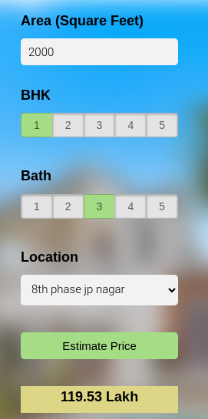
29.8 Test Prediction
https://www.youtube.com/watch?v=rD2xumR98w8&list=PLeo1K3hjS3uvCeTYTeyfe0-rN5r8zn9rw&index=29
Test Prediction (13:01-13:20/13:20)
1. Change sq-ft to “2000”
2. Click “Estimate Price”
3. We have predicted result.
1
2
3

Slide 30
End

