Slide 1

20 PCA
Peter H. Chen

Slide 2
20 PCA
https://www.youtube.com/watch?v=8klqIM9UvAc&list=PLeo1K3hjS3uvCeTYTeyfe0-rN5r8zn9rw&index=20
PCA (0:00-0:10/24:08)
PCA (Principal Component Analysis) is a technique to reduce dimension.
We will discuss Theory of PCA, Python Coding, and Exercise.

Slide 3
20.1 House Price Dataset

Slide 4
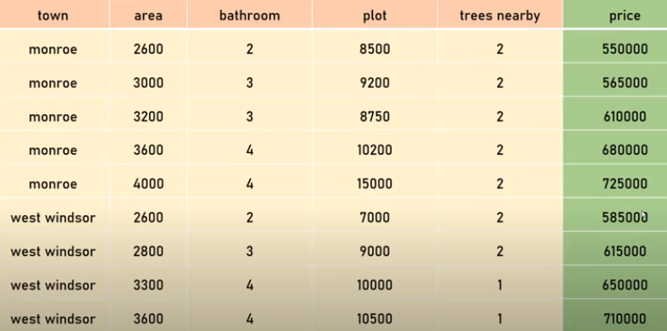
20.1 House Price Dataset
https://www.youtube.com/watch?v=8klqIM9UvAc&list=PLeo1K3hjS3uvCeTYTeyfe0-rN5r8zn9rw&index=20
House Price Dataset (0:11-0:20/24:08)
Below is the home price dataset of Monroe, West Windsor in New Jersey State. We use it to build the model for machine learning.
The red columns are features which are town, area (sq-ft), bathroom, plot (parcel lot size in sq-ft), and trees nearby.
The green column is target variable which is price.

Slide 5
20.1 House Price Dataset
https://www.youtube.com/watch?v=8klqIM9UvAc&list=PLeo1K3hjS3uvCeTYTeyfe0-rN5r8zn9rw&index=20
House Price Dataset (0:21-1:30/24:08)
The home price is mainly determined by town, house sq-ft, lot size, etc.
The number of bathroom may not impact the home price too much. The bathroom number will not cause too much difference in price. But the home price of 3000 sq-ft and 2600 sq-ft are significant different. The plot (Parcel or Lot size) also plays more important role in determining the home price
The trees nearby do not impact the home price at all.

Slide 6
20.1 House Price Dataset
https://www.youtube.com/watch?v=8klqIM9UvAc&list=PLeo1K3hjS3uvCeTYTeyfe0-rN5r8zn9rw&index=20
House Price Dataset (1:31-1:40/24:08)
When we solve the machine learning problem, we may have 1000, 2000 columns or features.
Reduce the features is very important in Machine Learning or Deep Learning.
We need to remove the unnecessary feature for modeling.

Slide 7
20.2 Handwritten Digit Dataset

Slide 8
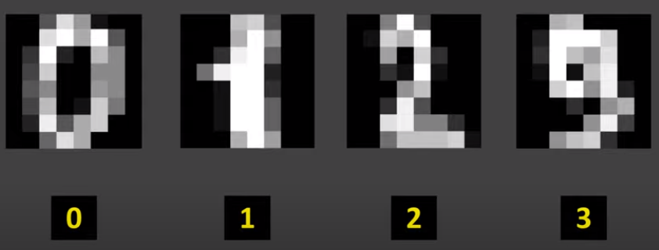
20.2 Handwritten Digit Dataset
https://www.youtube.com/watch?v=8klqIM9UvAc&list=PLeo1K3hjS3uvCeTYTeyfe0-rN5r8zn9rw&index=20
Handwritten Digit Dataset (1:41-1:50/24:08)
When we work on handwritten classification.
We want to classify the one of the number from 0 to 9.

Slide 9
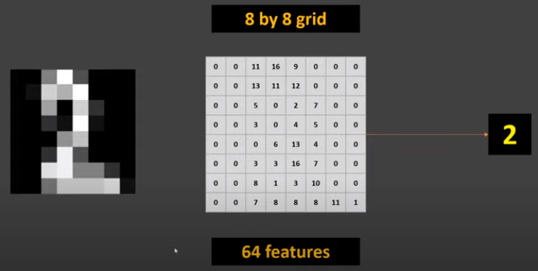
20.2 Handwritten Digit Dataset
https://www.youtube.com/watch?v=8klqIM9UvAc&list=PLeo1K3hjS3uvCeTYTeyfe0-rN5r8zn9rw&index=20
Handwritten Digit Dataset (1:51-2:20/24:08)
Here, the image is represented as pixel. The grid is 8 x 8 and every number represents the color. 0 means blacks, 16 means white.
Since this is the 8x8 grids, there are totally 64 pixels or numbers which are used to determine the number. This 64 pixels are called features.

Slide 10

20.2 Handwritten Digit Dataset
https://www.youtube.com/watch?v=8klqIM9UvAc&list=PLeo1K3hjS3uvCeTYTeyfe0-rN5r8zn9rw&index=20
Handwritten Digit Dataset (2:21-3:00/24:08)
Below, if we look at these two pixels of last column, we can find out there is no use for digit identification. No matter what digits, the last column should be black.
So, the pixels at the last column are not important features.

Slide 11

20.2 Handwritten Digit Dataset
https://www.youtube.com/watch?v=8klqIM9UvAc&list=PLeo1K3hjS3uvCeTYTeyfe0-rN5r8zn9rw&index=20
Handwritten Digit Dataset (3:01-3:20/24:08)
What if we get rid of these non-important features?
We get two benefits to get rid of this features (last columns of the image).
1. Faster training and inference
2. Data Visualization becomes easier

Slide 12
20.2 Handwritten Digit Dataset
https://www.youtube.com/watch?v=8klqIM9UvAc&list=PLeo1K3hjS3uvCeTYTeyfe0-rN5r8zn9rw&index=20
Handwritten Digit Dataset (3:21-3:45/24:08)
After features are reduced, we can have:
1. Faster training and inference: Machine learning takes a lot of time, a lot of computing resources, and the inference is faster.
2. Data Visualization becomes easier: if we have 100 features and we reduce to 2 or 3 features, then we can easily plot 2-D and 3-D and visualize them. Data visualization helps us a lot of what kind of model we want to build.

Slide 13
20.3 PCA (Principal Component Analysis)

Slide 14
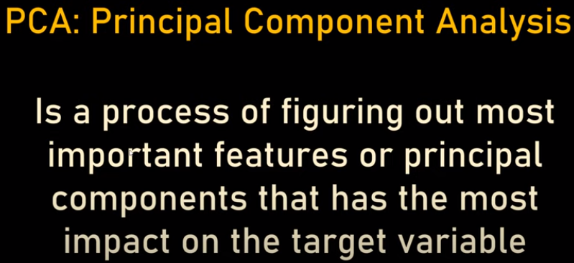
20.3 PCA (Principal Component Analysis)
https://www.youtube.com/watch?v=8klqIM9UvAc&list=PLeo1K3hjS3uvCeTYTeyfe0-rN5r8zn9rw&index=20
PCA (Principal Component Analysis) (3:46-4:00/24:08)
PCA is a process of figuring out the the most important features for the target variable.
We keep the most important features and remove the less/irrelevant important features.

Slide 15
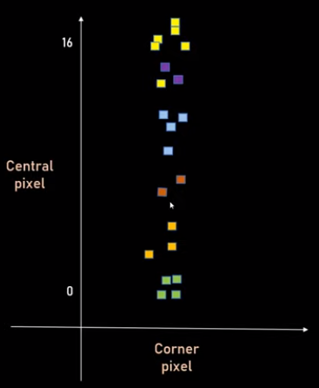

20.3 PCA (Principal Component Analysis)
https://www.youtube.com/watch?v=8klqIM9UvAc&list=PLeo1K3hjS3uvCeTYTeyfe0-rN5r8zn9rw&index=20
PCA (Principal Component Analysis) (4:01-4:30/24:08)
PCA will create the most Important features, called PC (Principal Component), such as, PC1, PC2, etc. Below digits example, we have 64 pixels digits. We only plot two features, corner pixel and central pixel.
The different colors (green, orange, red, blue, purple, yellow) represent different digits (9, 1, 2, 3, 4, 5), respectively.
Here, the same corner pixel can have different different digits.
The central pixel has difference variance map to different digits.

Slide 16
20.4 Dimension Reduction from 2D to 1D

Slide 17

20.4 Dimension Reduction from 2D to 1D
https://www.youtube.com/watch?v=8klqIM9UvAc&list=PLeo1K3hjS3uvCeTYTeyfe0-rN5r8zn9rw&index=20
Dimension Reduction from 2D to 1D (4:31-4:50/24:08)
Dimension Reduction from 2-D into 1-D:
Therefore, we can remove the feature of corner pixel. We reduce two dimensions into one dimension.

Slide 18
20.5 PC1 and PC2

Slide 19
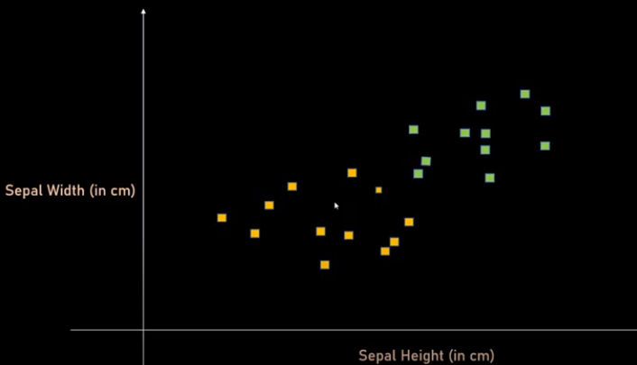
20.5 PC1 and PC2
https://www.youtube.com/watch?v=8klqIM9UvAc&list=PLeo1K3hjS3uvCeTYTeyfe0-rN5r8zn9rw&index=20
PC1 and PC2 (4:51-5:10/24:08)
Let’s look at the Irish Dataset where sepal width and sepal length determine what types (Setosa or Veriscolor) of Irish flower.
Setosa
Veriscolor

Slide 20
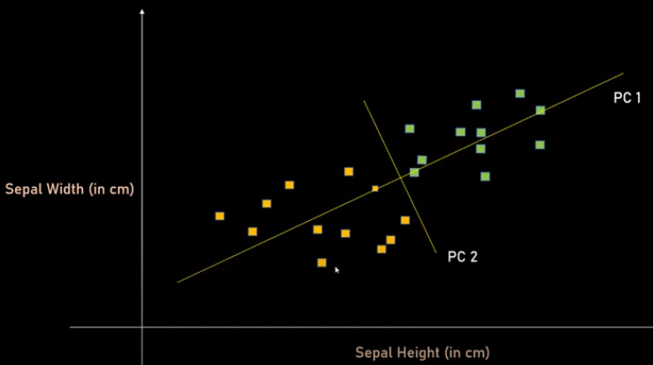
20.5 PC1 and PC2
https://www.youtube.com/watch?v=8klqIM9UvAc&list=PLeo1K3hjS3uvCeTYTeyfe0-rN5r8zn9rw&index=20
PC1 and PC2 (5:11-5:40/24:08)
If we have the scatter plot like this, we can draw a line which cover this maximum variance in terms of feature. We can draw the perpendicular line which cover the second most variance. These two lines are called the PCs (Principal Components).
Here, we see axis PC1 covert the most variance and axis PC2 covers the second most variance.
Setosa
Veriscolor

Slide 21
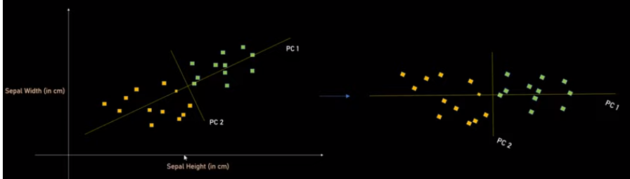
20.5 PC1 and PC2
https://www.youtube.com/watch?v=8klqIM9UvAc&list=PLeo1K3hjS3uvCeTYTeyfe0-rN5r8zn9rw&index=20
PC1 and PC2 (5:41-6:10/24:08)
Here, we only reduce two features into two PCs (Principal Components).
If we have 100 features, we can create 100 PCs (Principal Components) in the descending order. We then can pick up 1-3 principal components and ignore the rest components.
This will greatly simplify the analysis and plot.

Slide 22
20.6 Reduce 64 Digits Features

Slide 23

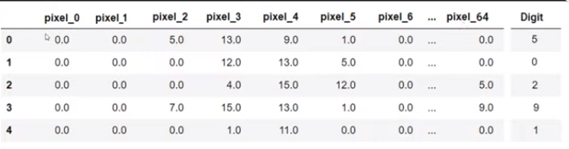
20.6 Reduce 64 Digits Features
https://www.youtube.com/watch?v=8klqIM9UvAc&list=PLeo1K3hjS3uvCeTYTeyfe0-rN5r8zn9rw&index=20
Reduce 64 Digits Features (6:11-6:30/24:08)
For the below digits, we load the data frame for all the data points.
We see pixel 0 and 1 are always 0. There are no important for the target variable “Digit”.
pixel_63

Slide 24
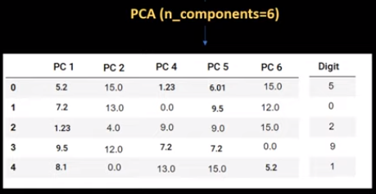
20.6 Reduce 64 Digits Features
https://www.youtube.com/watch?v=8klqIM9UvAc&list=PLeo1K3hjS3uvCeTYTeyfe0-rN5r8zn9rw&index=20
Reduce 64 Digits Features(6:31-7:40/24:08)
When we use sklearn library and use PCA method to pick up the 6 most important components for us.
PC1 is the most important feature, PC2 is the second important feature, etc.
We can try and error for with different parameters 2, 3, 4, 5 for the important features.
We also can set 95% of variance in terms of number of features.
pixel_63

Slide 25
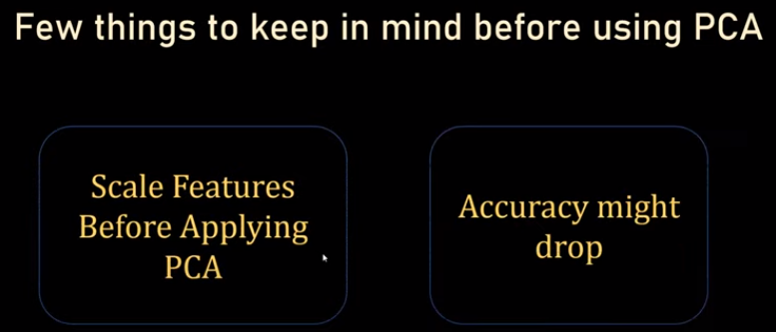
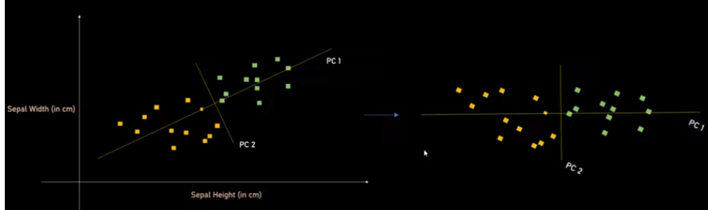
20.3 PCA (Principal Component Analysis)
https://www.youtube.com/watch?v=8klqIM9UvAc&list=PLeo1K3hjS3uvCeTYTeyfe0-rN5r8zn9rw&index=20
Reduce 64 Digits Features (7:51-8:20/24:08)
Keep in mind, before using PCA.
1. Scale features before applying PCA: If you don’t scale, the PCA will not work. Below is a chart. The graph maybe skewed and PCA will not work well.
2. Accuracy may be dropped a little bit: You have 100 features for the target variable. Now, we only keep major components to represent the target variable. We lose a lot of information.
1
2

Slide 26
20.7 Dimenstionality Curse

Slide 27
20.7 Dimenstionality Curse
https://www.youtube.com/watch?v=8klqIM9UvAc&list=PLeo1K3hjS3uvCeTYTeyfe0-rN5r8zn9rw&index=20
Dimensionality Curse (8:21-8:40/24:08)
We already seen here that we reduce 64 dimensions into 6 dimensions.
When we have less columns, our computation time become faster.
pixel_63

Slide 28
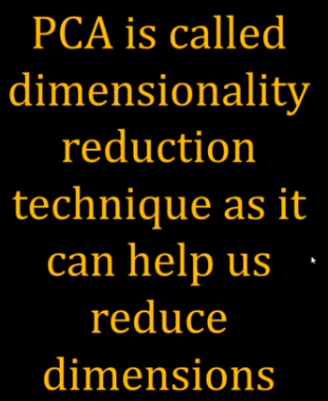
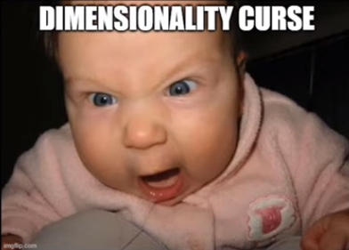
20.7 Dimenstionality Curse
https://www.youtube.com/watch?v=8klqIM9UvAc&list=PLeo1K3hjS3uvCeTYTeyfe0-rN5r8zn9rw&index=20
Dimensionality Curse (8:41-9:00/24:08)
We have so many features (columns) in data science, 100 columns, 1000 columns or more called Dimensionality Curse.
PCA is called the Dimensionality Reduction Technique.
PCA helps us the reduce the dimensions.

Slide 29
20.8 Import Library and Read Dataset

Slide 30
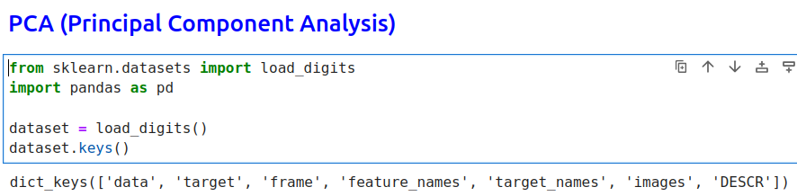
20.8 Import Library and Read Dataset
https://www.youtube.com/watch?v=8klqIM9UvAc&list=PLeo1K3hjS3uvCeTYTeyfe0-rN5r8zn9rw&index=20
Import Library and Read Dataset (9:01-10:00/24:08)

Slide 31
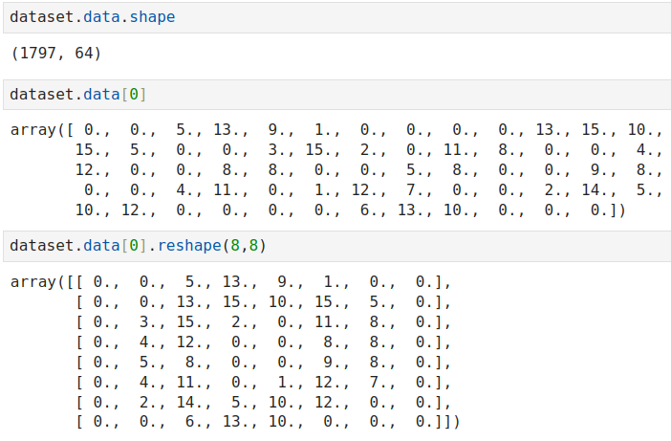
20.8 Import Library and Read Dataset
https://www.youtube.com/watch?v=8klqIM9UvAc&list=PLeo1K3hjS3uvCeTYTeyfe0-rN5r8zn9rw&index=20
Import Library and Read Dataset (10:01-11:00/24:08)

Slide 32
20.9 Plot Data

Slide 33
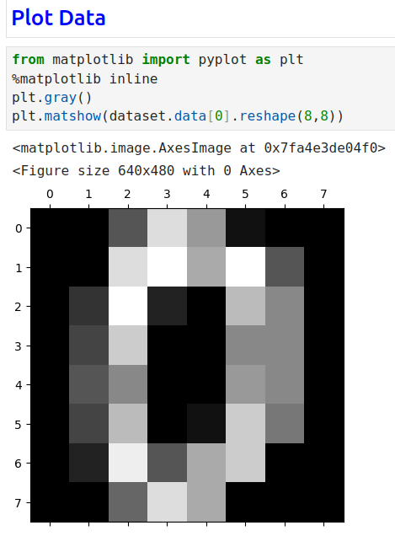
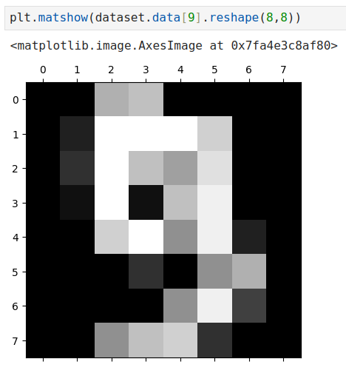
20.9 Plot Data
https://www.youtube.com/watch?v=8klqIM9UvAc&list=PLeo1K3hjS3uvCeTYTeyfe0-rN5r8zn9rw&index=20
Plot Data (11:01-12:00/24:08)

Slide 34
20.10 Check Data Dimension

Slide 35
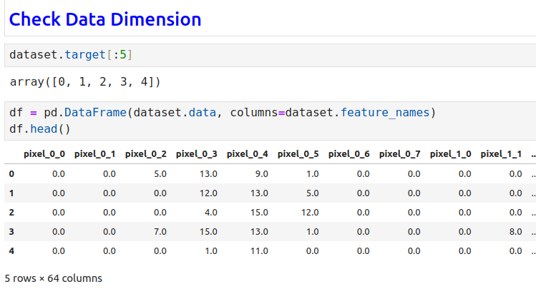
20.10 Check Data Dimension
https://www.youtube.com/watch?v=8klqIM9UvAc&list=PLeo1K3hjS3uvCeTYTeyfe0-rN5r8zn9rw&index=20
Check Data Dimension (12:01-13:00/24:08)

Slide 36
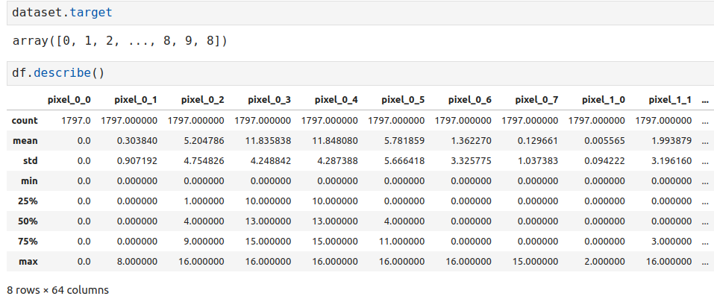
20.10 Check Data Dimension
https://www.youtube.com/watch?v=8klqIM9UvAc&list=PLeo1K3hjS3uvCeTYTeyfe0-rN5r8zn9rw&index=20
Check Data Dimension (13:01-14:00/24:08)

Slide 37
20.11 Scale Data

Slide 38
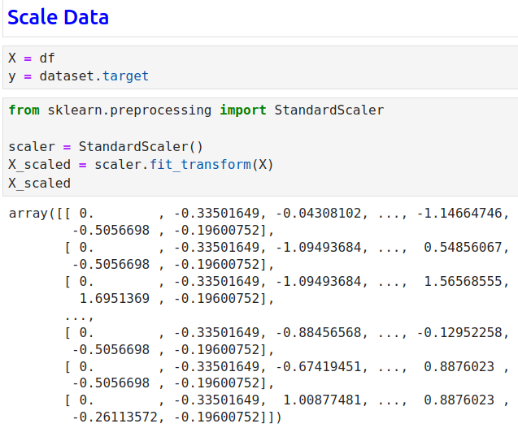
20.11 Scale Data
https://www.youtube.com/watch?v=8klqIM9UvAc&list=PLeo1K3hjS3uvCeTYTeyfe0-rN5r8zn9rw&index=20
Scale Data (13:01-14:00/24:08)

Slide 39
20.12 Split Data and Logistic Regression

Slide 40
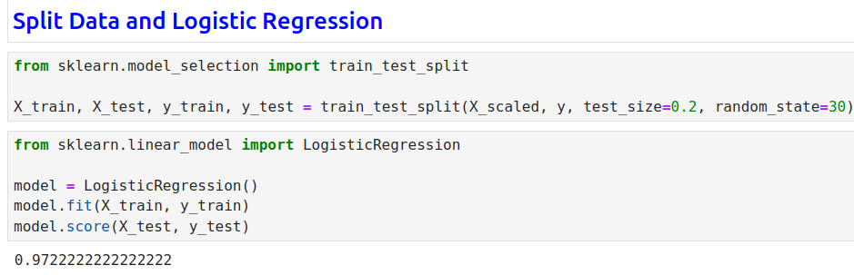
20.12 Split Data and Logistic Regression
https://www.youtube.com/watch?v=8klqIM9UvAc&list=PLeo1K3hjS3uvCeTYTeyfe0-rN5r8zn9rw&index=20
Split Data and Logistic Regression (14:01-15:00/24:08)

Slide 41
20.13 PCA with Percentage

Slide 42
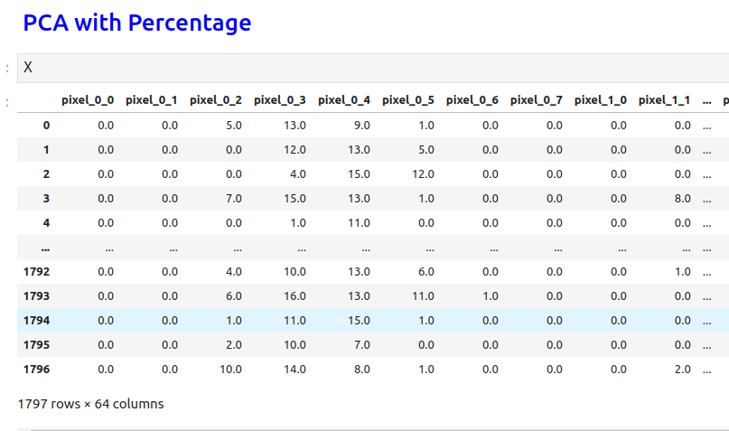
20.13 PCA with Percentage
https://www.youtube.com/watch?v=8klqIM9UvAc&list=PLeo1K3hjS3uvCeTYTeyfe0-rN5r8zn9rw&index=20
PCA with Percentage (15:01-16:00/24:08)

Slide 43
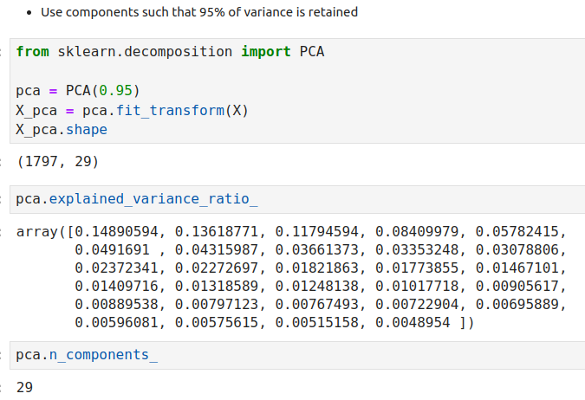
20.13 PCA with Percentage
https://www.youtube.com/watch?v=8klqIM9UvAc&list=PLeo1K3hjS3uvCeTYTeyfe0-rN5r8zn9rw&index=20
PCA with Percentage ( (16:01-17:00/24:08)

Slide 44
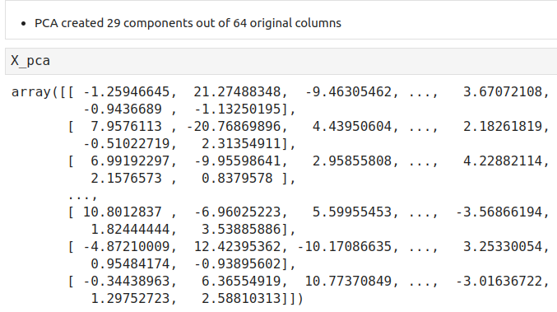
20.13 PCA with Percentage
https://www.youtube.com/watch?v=8klqIM9UvAc&list=PLeo1K3hjS3uvCeTYTeyfe0-rN5r8zn9rw&index=20
PCA with Percentage (17:01-18:00/24:08)

Slide 45
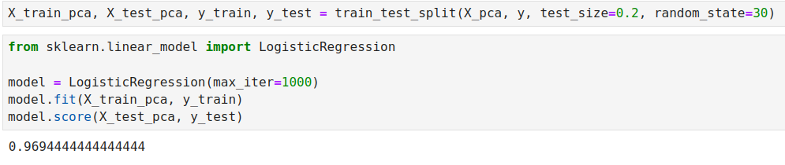
20.13 PCA with Percentage
https://www.youtube.com/watch?v=8klqIM9UvAc&list=PLeo1K3hjS3uvCeTYTeyfe0-rN5r8zn9rw&index=20
PCA with Percentage (19:01-20:00/24:08)

Slide 46
20.14 PCA with 2 Components

Slide 47
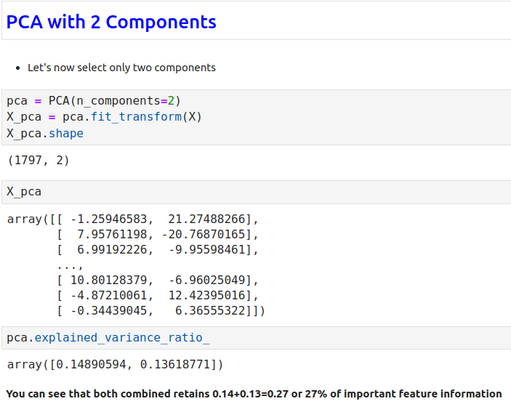
20.14 PCA with 2 Components
https://www.youtube.com/watch?v=8klqIM9UvAc&list=PLeo1K3hjS3uvCeTYTeyfe0-rN5r8zn9rw&index=20
PCA with 2 Components (20:01-21:00/24:08)

Slide 48
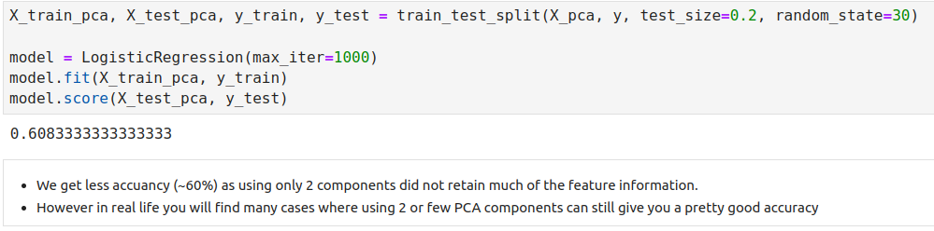
20.14 PCA with 2 Components
https://www.youtube.com/watch?v=8klqIM9UvAc&list=PLeo1K3hjS3uvCeTYTeyfe0-rN5r8zn9rw&index=20
PCA with 2 Components (21:01-22:00/24:08)

Slide 49
20.15 Exercise

Slide 50
20.15 Exercise
https://www.youtube.com/watch?v=8klqIM9UvAc&list=PLeo1K3hjS3uvCeTYTeyfe0-rN5r8zn9rw&index=20
Exercise (22:01-22:10/24:08)
Download heart disease dataset heart.csv as below kaggle link
1. Load heart disease dataset in pandas dataframe
2. Remove outliers using Z score.
  Usual guideline is to remove anything that has Z score > 3 or Z score < -3
  Here, Z-score Formula: z = (x – mean)/std
  We remove outlier, i.e., x > mean + 3 * std or x < mean – 3 * std
3. Convert text columns to numbers using label encoding and one hot encoding
4. Apply scaling
5. Build a classification model using various methods (SVM, logistic regression, random forest) and check which model gives you the best accuracy
6. Now use PCA to reduce dimensions, retrain your model and see what impact it has on your model in terms of accuracy.
  Keep in mind that many times doing PCA reduces the accuracy but computation is much lighter and that's the trade off you need to consider while building models in real life
https://www.kaggle.com/datasets/arezaei81/heartcsv

Slide 51
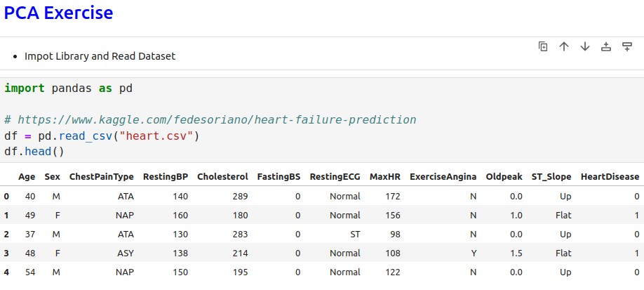
20.15 Exercise
https://www.youtube.com/watch?v=8klqIM9UvAc&list=PLeo1K3hjS3uvCeTYTeyfe0-rN5r8zn9rw&index=20
Exercise (22:11-22:20/24:08)

Slide 52
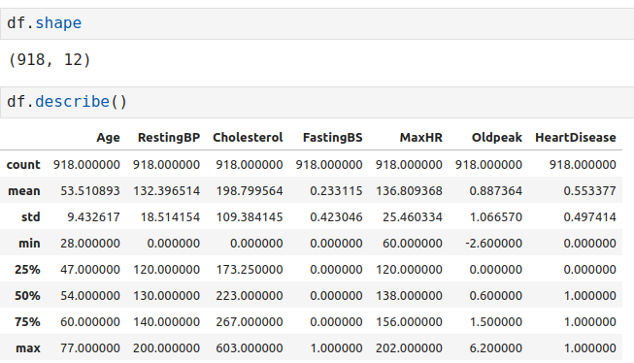
20.15 Exercise
https://www.youtube.com/watch?v=8klqIM9UvAc&list=PLeo1K3hjS3uvCeTYTeyfe0-rN5r8zn9rw&index=20
Exercise (22:21-22:30/24:08)

Slide 53
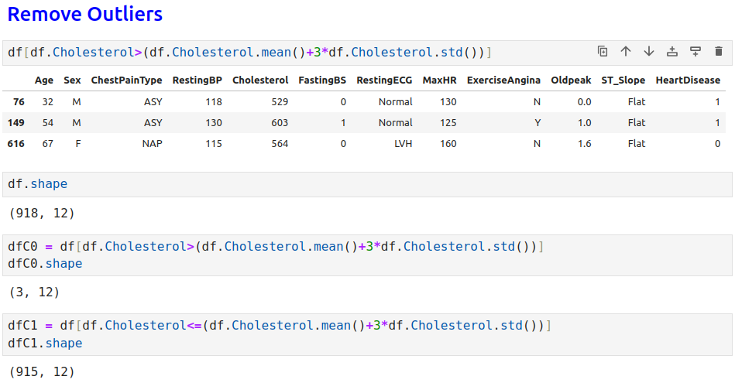
20.15 Exercise
https://www.youtube.com/watch?v=8klqIM9UvAc&list=PLeo1K3hjS3uvCeTYTeyfe0-rN5r8zn9rw&index=20
Exercise (22:31-22:40/24:08)

Slide 54
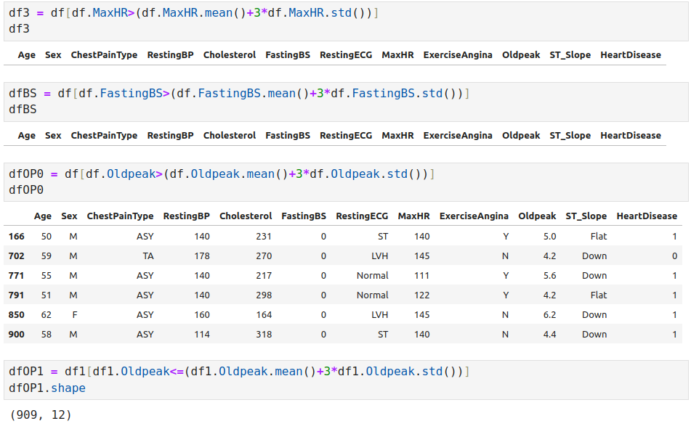
20.15 Exercise
https://www.youtube.com/watch?v=8klqIM9UvAc&list=PLeo1K3hjS3uvCeTYTeyfe0-rN5r8zn9rw&index=20
Exercise (22:41-22:50/24:08)

Slide 55
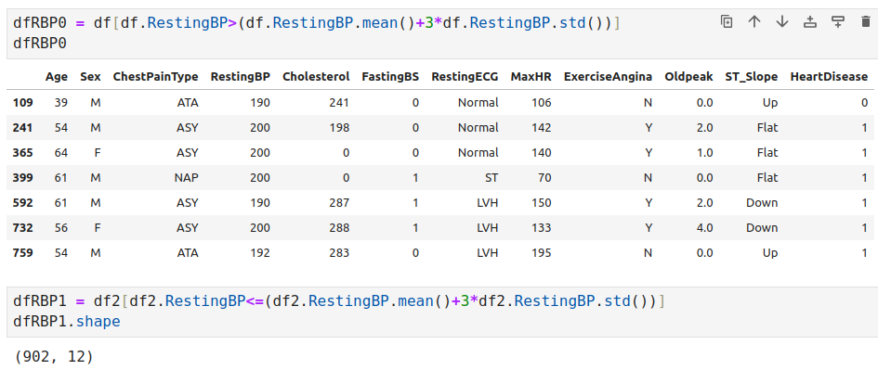
20.15 Exercise
https://www.youtube.com/watch?v=8klqIM9UvAc&list=PLeo1K3hjS3uvCeTYTeyfe0-rN5r8zn9rw&index=20
Exercise (22:51-23:00/24:08)

Slide 56
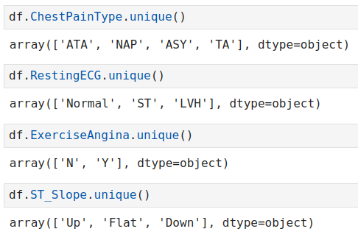
20.15 Exercise
https://www.youtube.com/watch?v=8klqIM9UvAc&list=PLeo1K3hjS3uvCeTYTeyfe0-rN5r8zn9rw&index=20
Exercise (23:01-23:10/24:08)

Slide 57
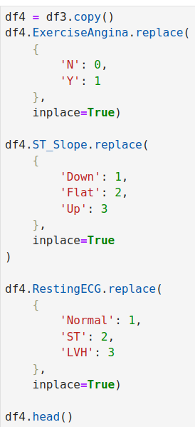
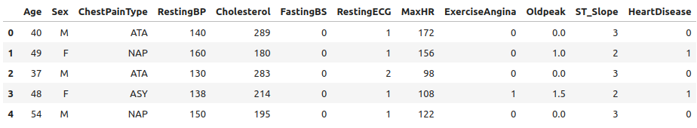
20.15 Exercise
https://www.youtube.com/watch?v=8klqIM9UvAc&list=PLeo1K3hjS3uvCeTYTeyfe0-rN5r8zn9rw&index=20
Exercise (23:11-23:20/24:08)

Slide 58
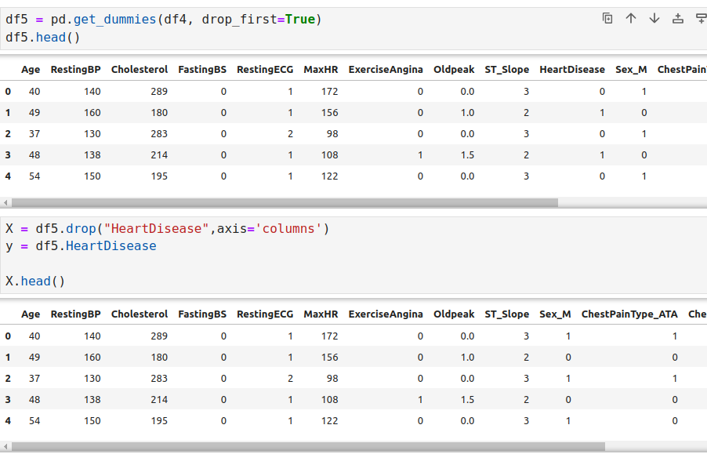
20.15 Exercise
https://www.youtube.com/watch?v=8klqIM9UvAc&list=PLeo1K3hjS3uvCeTYTeyfe0-rN5r8zn9rw&index=20
Exercise (23:21-23:30/24:08)

Slide 59
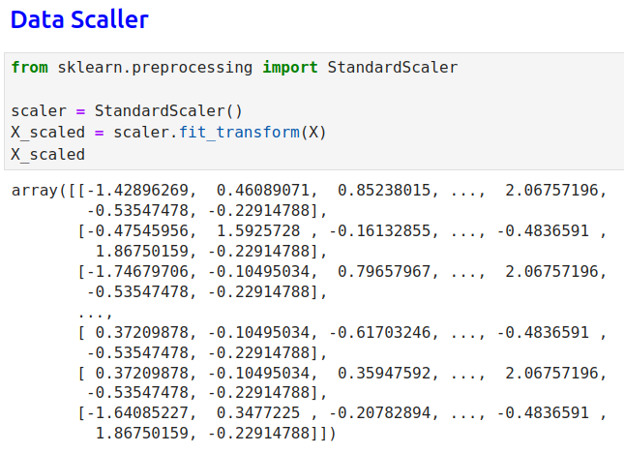
20.15 Exercise
https://www.youtube.com/watch?v=8klqIM9UvAc&list=PLeo1K3hjS3uvCeTYTeyfe0-rN5r8zn9rw&index=20
Exercise (23:31-23:40/24:08)

Slide 60
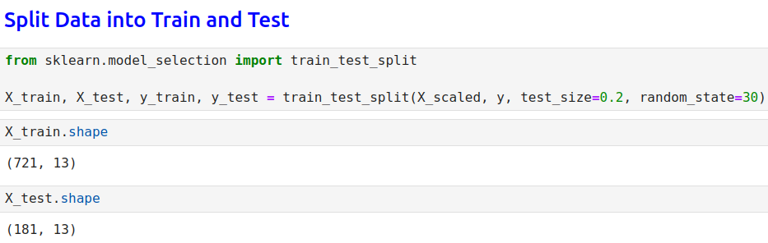
20.15 Exercise
https://www.youtube.com/watch?v=8klqIM9UvAc&list=PLeo1K3hjS3uvCeTYTeyfe0-rN5r8zn9rw&index=20
Exercise (23:41-23:50/24:08)

Slide 61
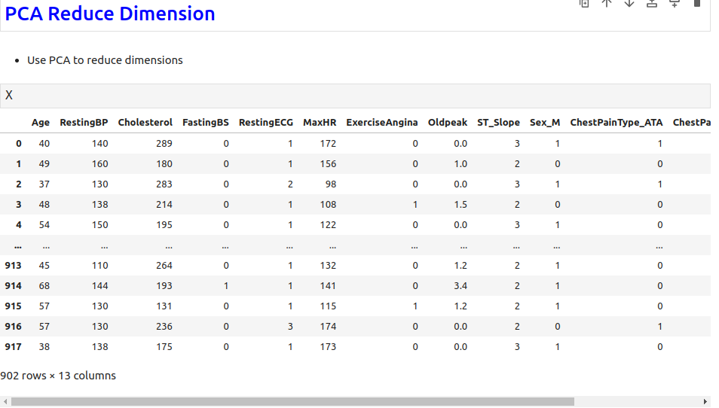
20.15 Exercise
https://www.youtube.com/watch?v=8klqIM9UvAc&list=PLeo1K3hjS3uvCeTYTeyfe0-rN5r8zn9rw&index=20
Exercise (23:51-24:00/24:08)

Slide 62
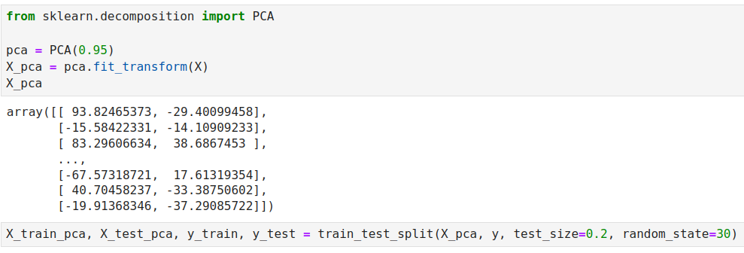
20.15 Exercise
https://www.youtube.com/watch?v=8klqIM9UvAc&list=PLeo1K3hjS3uvCeTYTeyfe0-rN5r8zn9rw&index=20
Exercise (24:01-24:05/24:08)

Slide 63
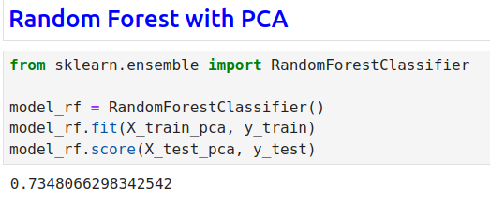
20.15 Exercise
https://www.youtube.com/watch?v=8klqIM9UvAc&list=PLeo1K3hjS3uvCeTYTeyfe0-rN5r8zn9rw&index=20
Exercise (24:06-24:08/24:08)

Slide 64
End

