Slide 1

12 Random Forest Model
Peter H. Chen

Slide 2
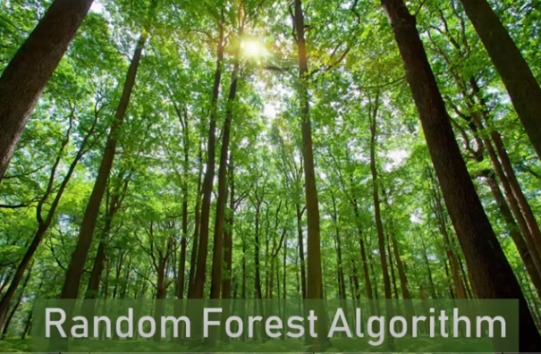
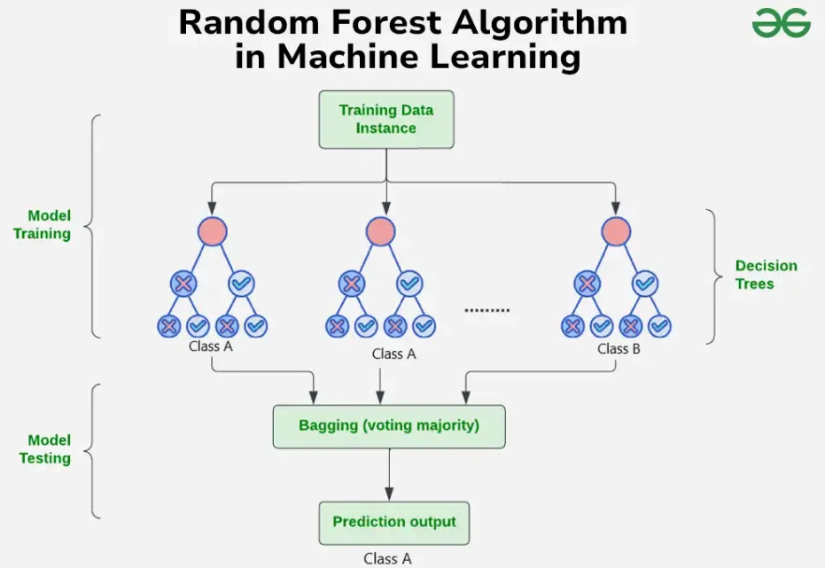
12 Random Forest Model
https://www.youtube.com/watch?v=ok2s1vV9XW0&list=PLeo1K3hjS3uvCeTYTeyfe0-rN5r8zn9rw&index=12
Random Forest Model (0:00-0:20/12:48)
Random Forest is another popular machine learning technique used in both regression and classification.
Why do we call random forest? The forest has trees and tree in machine learning world means a decision tree which we have discussed the decision tree.
https://www.geeksforgeeks.org/random-forest-algorithm-in-machine-learning/

Slide 3
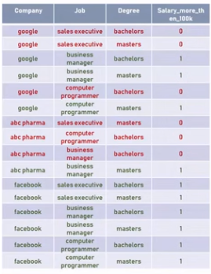
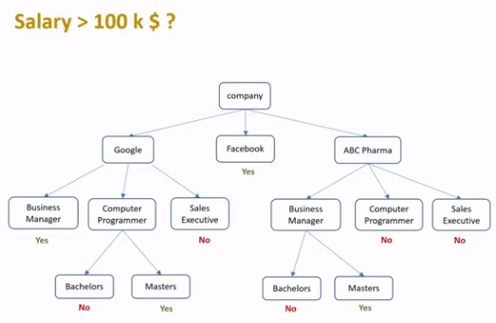
12 Random Forest Model
https://www.youtube.com/watch?v=ok2s1vV9XW0&list=PLeo1K3hjS3uvCeTYTeyfe0-rN5r8zn9rw&index=12
Random Forest Model (0:21-0:40/12:48)
In the decision tree discussion, we build the decision tree with three features (company, job title, and degree) to predict the employee salary.
This decision tree is too complicated to present for random forest.

Slide 4
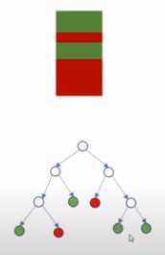
12 Random Forest Model
https://www.youtube.com/watch?v=ok2s1vV9XW0&list=PLeo1K3hjS3uvCeTYTeyfe0-rN5r8zn9rw&index=12
Random Forest Model (0:41-0:50/12:48)
Below, we use the simpler example for discussion.
We have red sample and green sample in the dataset. Based on the dataset, we represent the data into the tree.

Slide 5
12.1 Build Multiple Decision Tree

Slide 6
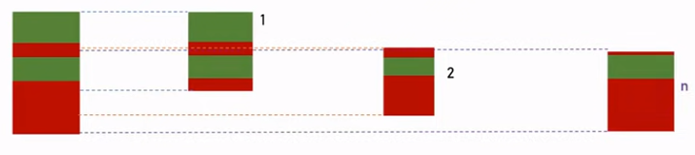
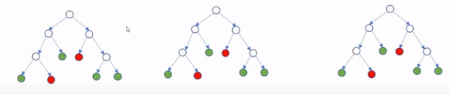
12.1 Build Multiple Decision Tree
https://www.youtube.com/watch?v=ok2s1vV9XW0&list=PLeo1K3hjS3uvCeTYTeyfe0-rN5r8zn9rw&index=12
Build Multiple Decision Tree (1:01-1:20/12:48)
How do we build multiple decision tree based on the dataset?
We take the dataset, then we divide the dataset into batch of random dataset.
Then, we build decision tree for each batch of random dataset.
Since we did random sampling, here we called random forest.
Now, we have multiple trees, we see the forest formed below.

Slide 7
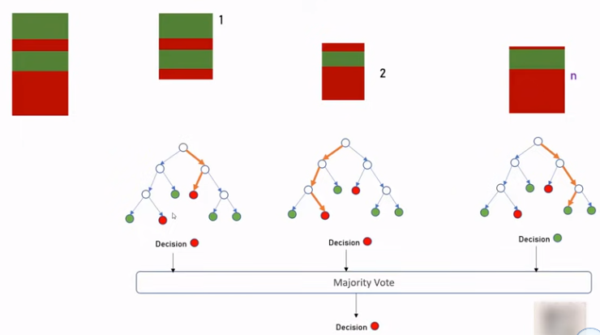

12.1 Build Multiple Decision Tree
https://www.youtube.com/watch?v=ok2s1vV9XW0&list=PLeo1K3hjS3uvCeTYTeyfe0-rN5r8zn9rw&index=12
Build Multiple Decision Tree (1:21-1:45/12:48)
When the random forest is trained, we want to predict and they will all come up with different decision.
We just take the majority out of it. This is the basic idea behind the random forest algorithm.

Slide 8
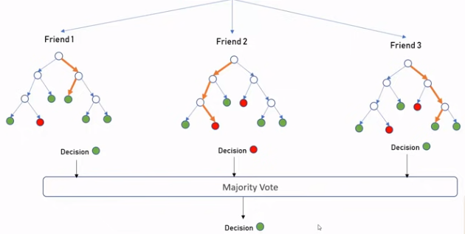
12.1 Build Multiple Decision Tree
https://www.youtube.com/watch?v=ok2s1vV9XW0&list=PLeo1K3hjS3uvCeTYTeyfe0-rN5r8zn9rw&index=12
Build Multiple Decision Tree (1:46-2:30/12:48)
When we install gas water heaters or electrical water heaters, we can call several friends to give us suggestions.
Then, we make decision to make decision and brand.
Ask friends how to buy a Nest Thermostat

Slide 9
12.2 Hand Written Digit Recognition

Slide 10

12.2 Hand Written Digit Recognition
https://www.youtube.com/watch?v=ok2s1vV9XW0&list=PLeo1K3hjS3uvCeTYTeyfe0-rN5r8zn9rw&index=12
Hand Written Digit Recognition (2:31-2:40/12:48)
We want to classify the 10 categories from 0 to 9.
Identify Hand Written Digits Recognition
0
1
2
3
4
5
6
7
8
9

Slide 11

12.2 Hand Written Digit Recognition
https://www.youtube.com/watch?v=ok2s1vV9XW0&list=PLeo1K3hjS3uvCeTYTeyfe0-rN5r8zn9rw&index=12
Hand Written Digit Recognition (2:41-2:50/12:48)
We use the sciki-learn digits dataset to make classification using random forest.
The dataset contain the image of handwritten digits and label.
Identify Hand Written Digits Recognition
0
1
2
3
4
5
6
7
8
9

Slide 12
12.3 Import Library and Load Data

Slide 13
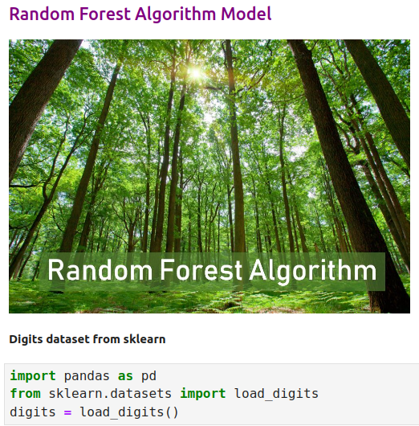
12.3 Import Library and Load Data
https://www.youtube.com/watch?v=ok2s1vV9XW0&list=PLeo1K3hjS3uvCeTYTeyfe0-rN5r8zn9rw&index=12
Import Library and Load Data (2:51-3:30/12:48)

Slide 14
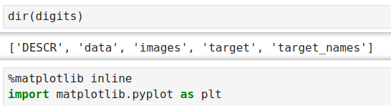
12.3 Import Library and Load Data
https://www.youtube.com/watch?v=ok2s1vV9XW0&list=PLeo1K3hjS3uvCeTYTeyfe0-rN5r8zn9rw&index=12
Import Library and Load Data (3:31-4:30/12:48)

Slide 15
12.4 Plot Data

Slide 16
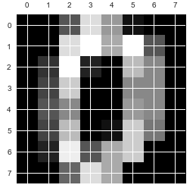
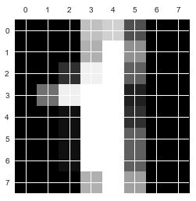

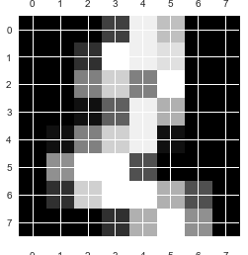
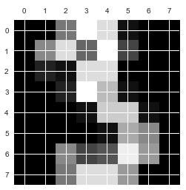
12.4 Plot Data
https://www.youtube.com/watch?v=ok2s1vV9XW0&list=PLeo1K3hjS3uvCeTYTeyfe0-rN5r8zn9rw&index=12
Plot Data (4:31-5:30/12:48)
Plot digits ‘0’, ‘1’, ‘2’, ‘3’.

Slide 17
12.5 View Data Frame

Slide 18
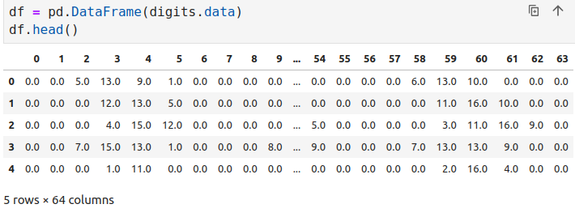
12.5 View Data Frame
https://www.youtube.com/watch?v=ok2s1vV9XW0&list=PLeo1K3hjS3uvCeTYTeyfe0-rN5r8zn9rw&index=12
View Data Frame (5:31-6:30/12:48)

Slide 19
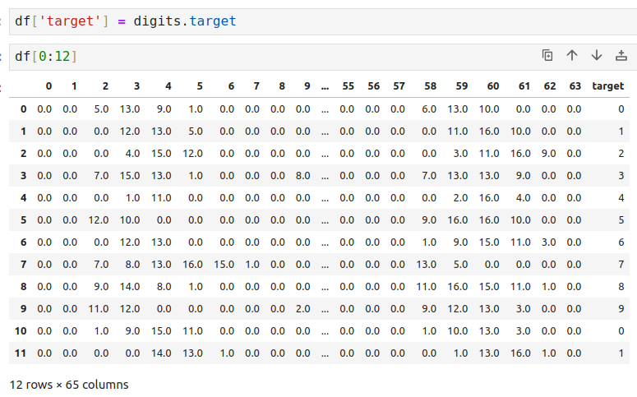
12.5 View Data Frame
https://www.youtube.com/watch?v=ok2s1vV9XW0&list=PLeo1K3hjS3uvCeTYTeyfe0-rN5r8zn9rw&index=12
View Data Frame (6:31-7:30/12:48)

Slide 20
12.6 Train Model

Slide 21
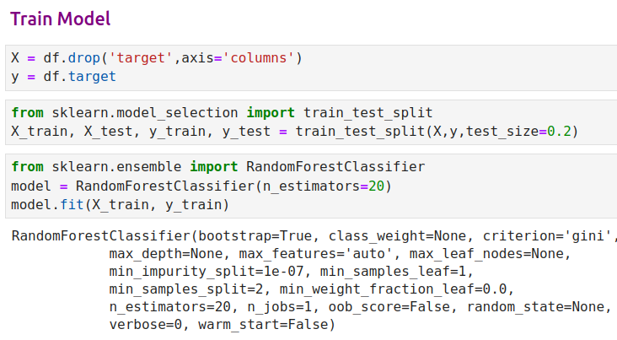
12.6 Train Model
https://www.youtube.com/watch?v=ok2s1vV9XW0&list=PLeo1K3hjS3uvCeTYTeyfe0-rN5r8zn9rw&index=12
Train Model (7:31-8:30/12:48)

Slide 22
12.7 Model Prediction

Slide 23
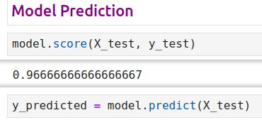
12.7 Model Prediction
https://www.youtube.com/watch?v=ok2s1vV9XW0&list=PLeo1K3hjS3uvCeTYTeyfe0-rN5r8zn9rw&index=12
Model Prediction (9:31-9:30/12:48)

Slide 24
12.8 Confusion Matrix

Slide 25
12.8 Confusion Matrix
https://www.youtube.com/watch?v=ok2s1vV9XW0&list=PLeo1K3hjS3uvCeTYTeyfe0-rN5r8zn9rw&index=12
Confusion Matrix (9:31-10:30/12:48)

Slide 26
12.9 Seaborn Plot

Slide 27
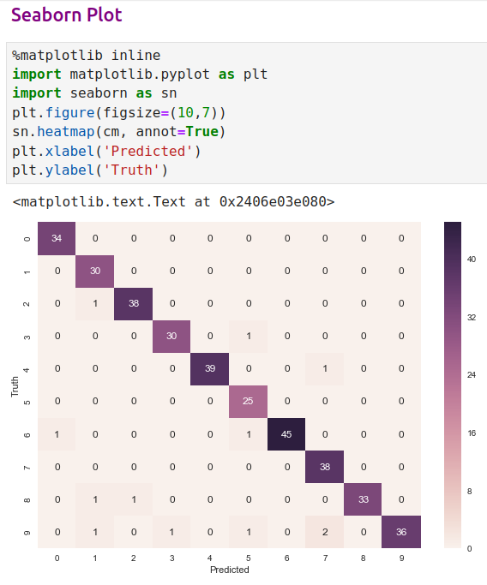
12.9 Seaborn Plot
https://www.youtube.com/watch?v=ok2s1vV9XW0&list=PLeo1K3hjS3uvCeTYTeyfe0-rN5r8zn9rw&index=12
Seaborn Plot (10:31-11:30/12:48)

Slide 28
12.9 Seaborn Plot

Slide 29
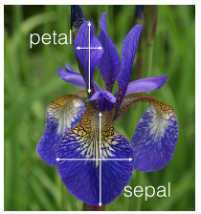
12.10 Exercise
https://www.youtube.com/watch?v=ok2s1vV9XW0&list=PLeo1K3hjS3uvCeTYTeyfe0-rN5r8zn9rw&index=12
Exercise (11:31-12:48/12:48)
Download iris flower dataset from sklearn datasets as below link to predict flower species using random forest classifier.
1. Measure prediction score using default n_estimators (10)
2. Now, fine tune your model by changing number of trees in your classier
3. Tell me what best score you can get using how many trees
https://scikit-learn.org/stable/auto_examples/datasets/plot_iris_dataset.html

Slide 30
End

