Slide 1

16 Naive Bayes Classifier Algorithm: P2
Peter H. Chen

Slide 2
16 Naive Bayes Classifier Algorithm: P2
https://www.youtube.com/watch?v=nHIUYwN-5rM&list=PLeo1K3hjS3uvCeTYTeyfe0-rN5r8zn9rw&index=16
Naive Bayes Classifier Algorithm (0:00-0:05/11:27)
We discuss the Second Part of Naive Bayes Classifier Algorithm.
Here is a list of topics we will discuss.
Topics:
1. Explore SPAM Email Dataset
2. Sklearn CountVectorizer
3. types of Naive Bayes Classifier
4. Sklearn MultinominalNB Classifier
5. Sklearn Pipeline
6. Exercise

Slide 3
16.1 SPAM Dataset

Slide 4
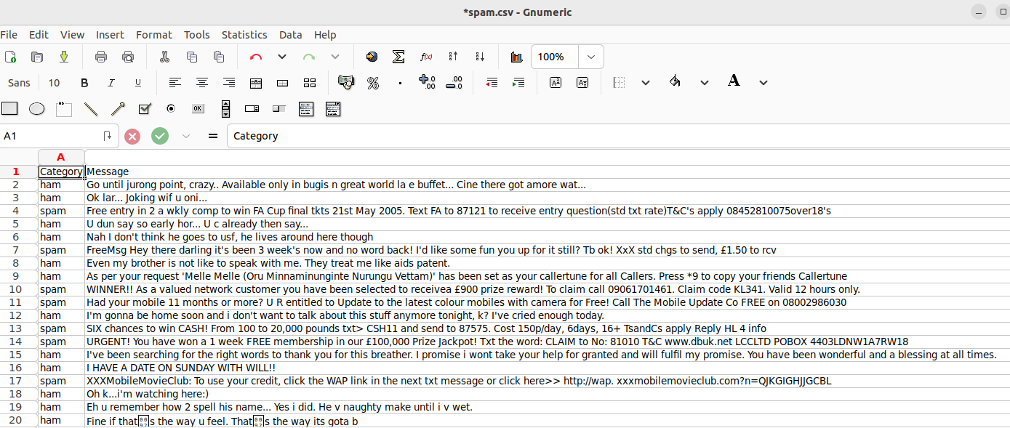
16.1 SPAM Dataset
https://www.youtube.com/watch?v=nHIUYwN-5rM&list=PLeo1K3hjS3uvCeTYTeyfe0-rN5r8zn9rw&index=16
SPAM Dataset (0:06-0:40/11:27)
Here is the SPAM dataset “spam.csv”.
We can download from Keggle.com.
Ham: Good email, Spam: Bad email.
https://www.kaggle.com/datasets/uciml/sms-spam-collection-dataset

Slide 5
16.2 Import Library and Load Dataset

Slide 6
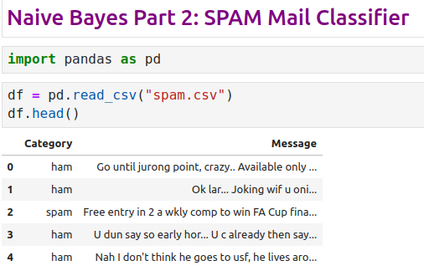
16.2 Import Library and Load Dataset
https://www.youtube.com/watch?v=nHIUYwN-5rM&list=PLeo1K3hjS3uvCeTYTeyfe0-rN5r8zn9rw&index=16
Import Library and Load Dataset (0:41-0:50/11:27)

Slide 7
16.3 Group Feature “Category”

Slide 8
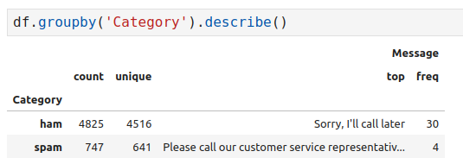
16.3 Group Feature “Category”
https://www.youtube.com/watch?v=nHIUYwN-5rM&list=PLeo1K3hjS3uvCeTYTeyfe0-rN5r8zn9rw&index=16
Group Feature “Category” (0:41-1:30/11:27)

Slide 9
16.4 Convert Ham/Spam into 0/1

Slide 10
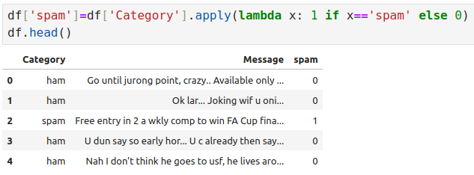
16.4 Convert Ham/Spam into 0/1
https://www.youtube.com/watch?v=nHIUYwN-5rM&list=PLeo1K3hjS3uvCeTYTeyfe0-rN5r8zn9rw&index=16
Convert Ham/Spam into 0/1 (1:31-2:00/11:27)

Slide 11
16.5 Split Data into Train/Test

Slide 12
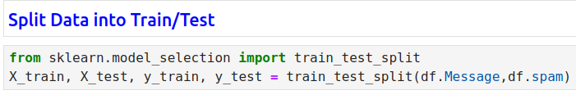
16.5 Split Data into Train/Test
https://www.youtube.com/watch?v=nHIUYwN-5rM&list=PLeo1K3hjS3uvCeTYTeyfe0-rN5r8zn9rw&index=16
Split Data into Train/Test (2:01-3:30/11:27)

Slide 13
16.6 Transform Text into Vector

Slide 14
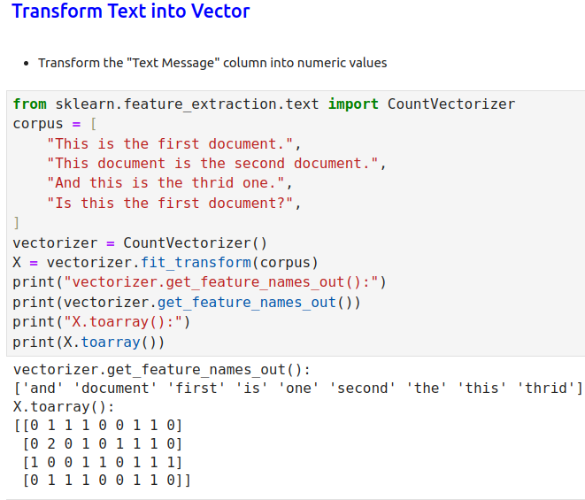
16.6 Transform Text into Vector
https://www.youtube.com/watch?v=nHIUYwN-5rM&list=PLeo1K3hjS3uvCeTYTeyfe0-rN5r8zn9rw&index=16
Transform Text into Vector (2:01-3:30/11:27)

Slide 15
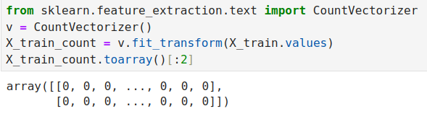
16.6 Transform Text into Vector
https://www.youtube.com/watch?v=nHIUYwN-5rM&list=PLeo1K3hjS3uvCeTYTeyfe0-rN5r8zn9rw&index=16
Transform Text into Vector (3:31-4:30/11:27)

Slide 16
16.7 Naive Bayes Model

Slide 17
16.7 Naive Bayes Model
https://www.youtube.com/watch?v=nHIUYwN-5rM&list=PLeo1K3hjS3uvCeTYTeyfe0-rN5r8zn9rw&index=16
Naive Bayes Model (4:31-5:30/11:27)
Three kinds of Naive Bayes Model:
1. Bernoulli Naive Bayes is good at handling boolean/binary attributes,
2. Multinomial Naive Bayes is good at handling discrete values.
3. Gaussian Naive Bayes is good at handling continuous values.
We are going to use Multinomial Naive Bayes.
https://stackoverflow.com/questions/48580762/difference-of-three-naive-bayes-classifiers#:~:text=Bernoulli%20Naive%20bayes%20is%20good,good%20at%20handling%20continuous%20values.

Slide 18
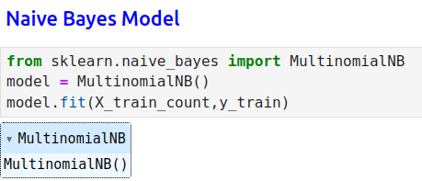
16.7 Naive Bayes Model
https://www.youtube.com/watch?v=nHIUYwN-5rM&list=PLeo1K3hjS3uvCeTYTeyfe0-rN5r8zn9rw&index=16
Naive Bayes Model (4:31-6:00/11:27)

Slide 19
16.8 Test Email

Slide 20
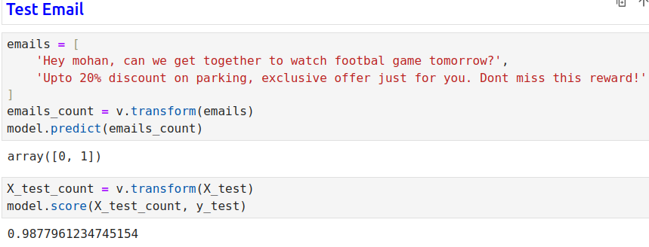
16.8 Test Email
https://www.youtube.com/watch?v=nHIUYwN-5rM&list=PLeo1K3hjS3uvCeTYTeyfe0-rN5r8zn9rw&index=16
Test Email (6:01-7:00/11:27)
1. Transform the text message into numeric.

Slide 21
16.9 Sklearn Pipeline

Slide 22
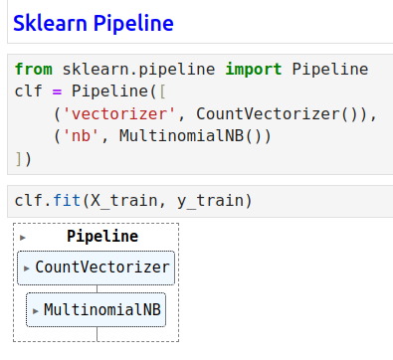
16.9 Sklearn Pipeline
https://www.youtube.com/watch?v=nHIUYwN-5rM&list=PLeo1K3hjS3uvCeTYTeyfe0-rN5r8zn9rw&index=16
Sklearn Pipeline (7:01-9:00/11:27)
1. Create Pipeline
2. Tran Model with Pipeline.

Slide 23
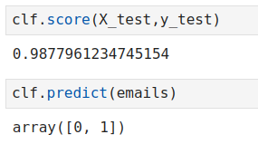
16.9 Sklearn Pipeline
https://www.youtube.com/watch?v=nHIUYwN-5rM&list=PLeo1K3hjS3uvCeTYTeyfe0-rN5r8zn9rw&index=16
Sklearn Pipeline (9:01-9:40/11:27)
Test Score

Slide 24
16.10 Exercise

Slide 25
16.10 Exercise
https://www.youtube.com/watch?v=nHIUYwN-5rM&list=PLeo1K3hjS3uvCeTYTeyfe0-rN5r8zn9rw&index=16
Exercise (9:41-10:00/11:27)
Naive Bayes 2: Exercise
Use wine dataset from sklearn.datasets to classify wines into 3 categories.
1. Load the dataset and split it into test and train.
2. After that train the model using Gaussian and Multi-nominal classifier and post which model performs better.
3. Use the trained model to perform some predictions on test data.
https://www.kaggle.com/code/cristianlapenta/wine-dataset-sklearn-machine-learning-project

Slide 26
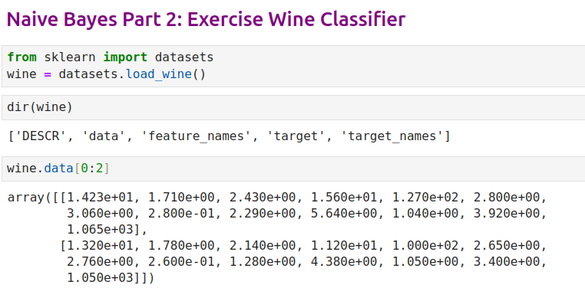
16.10 Exercise
https://www.youtube.com/watch?v=nHIUYwN-5rM&list=PLeo1K3hjS3uvCeTYTeyfe0-rN5r8zn9rw&index=16
Exercise (10:01-10:20/11:27)

Slide 27
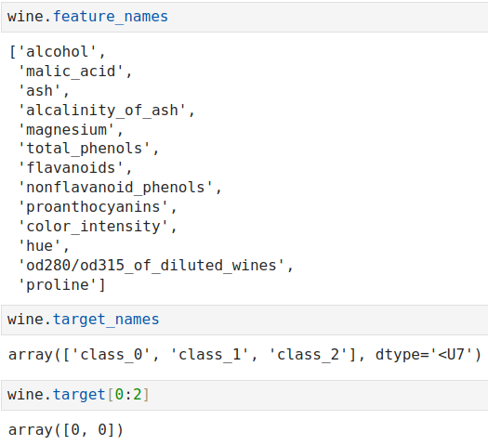
16.10 Exercise
https://www.youtube.com/watch?v=nHIUYwN-5rM&list=PLeo1K3hjS3uvCeTYTeyfe0-rN5r8zn9rw&index=16
Exercise (10:21-10:30/11:27)

Slide 28
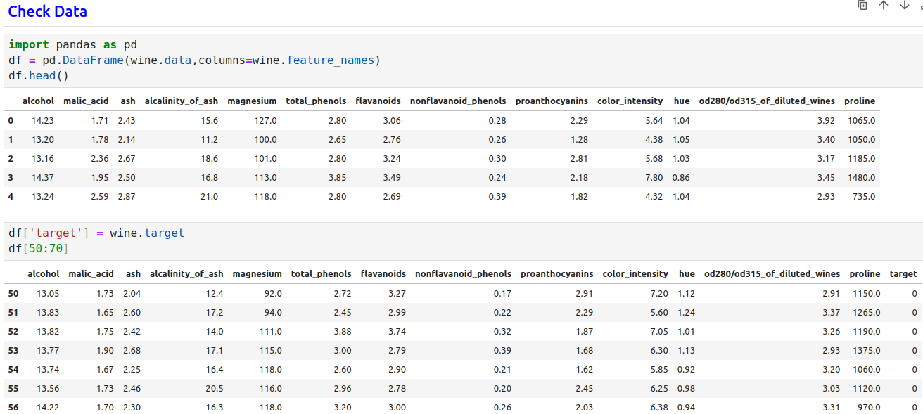
16.10 Exercise
https://www.youtube.com/watch?v=nHIUYwN-5rM&list=PLeo1K3hjS3uvCeTYTeyfe0-rN5r8zn9rw&index=16
Exercise (10:31-10:40/11:27)

Slide 29
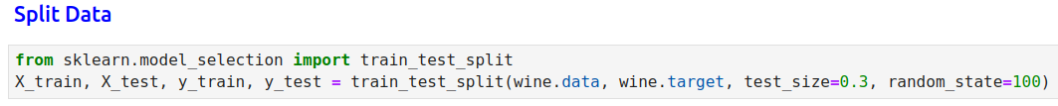
16.10 Exercise
https://www.youtube.com/watch?v=nHIUYwN-5rM&list=PLeo1K3hjS3uvCeTYTeyfe0-rN5r8zn9rw&index=16
Exercise (10:41-11:00/11:27)

Slide 30
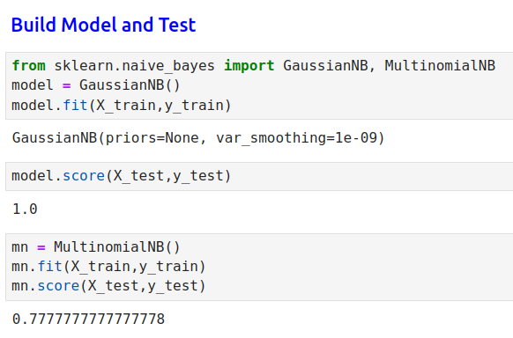
16.10 Exercise
https://www.youtube.com/watch?v=nHIUYwN-5rM&list=PLeo1K3hjS3uvCeTYTeyfe0-rN5r8zn9rw&index=16
Exercise (11:01-11:27/11:27)

Slide 31
End

