Slide 1

27 Build Model
Peter H. Chen

Slide 2
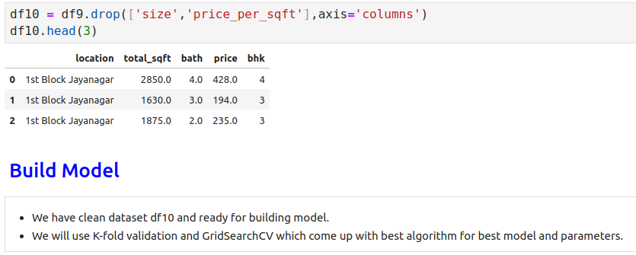
27 Build Model
https://www.youtube.com/watch?v=oCiRv94GMEc&list=PLeo1K3hjS3uvCeTYTeyfe0-rN5r8zn9rw&index=27
Build Model (0:00-0:20/19:11)
In the last discussion, we clean up dataset, prepare features, and ready for building the model.
In this discussion, we will build the machine learning model, then we will use K-fold validation and GridSearchCV which come up with best algorithm for best model and parameters.

Slide 3
27.1 One Hot Encoding

Slide 4
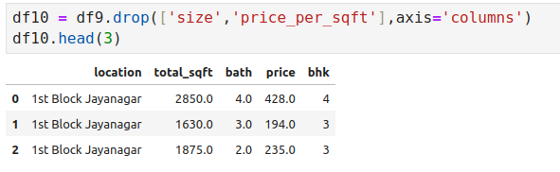
27.1 One Hot Encoding
https://www.youtube.com/watch?v=oCiRv94GMEc&list=PLeo1K3hjS3uvCeTYTeyfe0-rN5r8zn9rw&index=27
One Hot Encoding (0:21-1:30/19:11)
The column contains the text string. Since the computer cannot understand the text string, we have to convert into the numeric by One Hot Encoding.

Slide 5
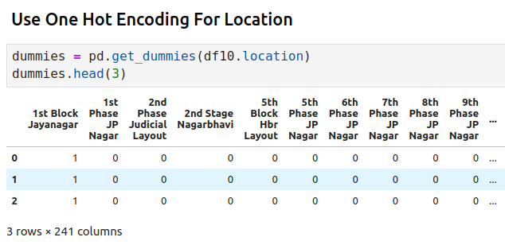
27.1 One Hot Encoding
https://www.youtube.com/watch?v=oCiRv94GMEc&list=PLeo1K3hjS3uvCeTYTeyfe0-rN5r8zn9rw&index=27
One Hot Encoding (1:31-2:30/19:11)
Here, we use sklearn get_dummies() to convert the ‘location’ column text into numeric number.

Slide 6
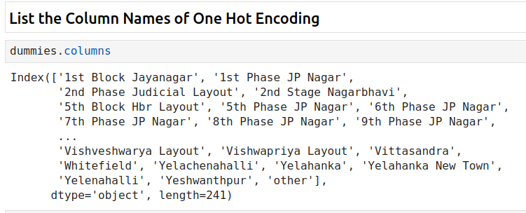
27.1 One Hot Encoding
https://www.youtube.com/watch?v=oCiRv94GMEc&list=PLeo1K3hjS3uvCeTYTeyfe0-rN5r8zn9rw&index=27
One Hot Encoding (2:31-3:30/19:11)
We list all the column names of One Hot Encoding.

Slide 7
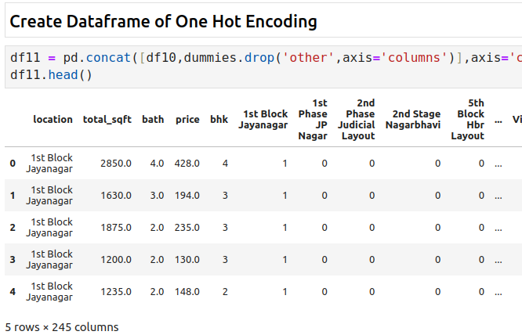
27.1 One Hot Encoding
https://www.youtube.com/watch?v=oCiRv94GMEc&list=PLeo1K3hjS3uvCeTYTeyfe0-rN5r8zn9rw&index=27
One Hot Encoding (3:31-4:30/19:11)
1. Drop the ‘other’ column from dummies (One Hot Encoding)
2. contact dataframe with dummies (One Hot Encoding)

Slide 8
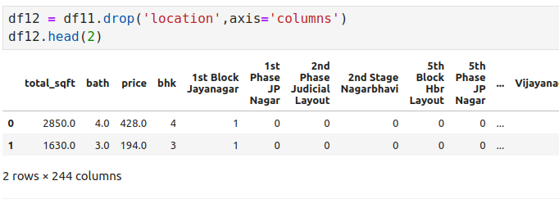
27.1 One Hot Encoding
https://www.youtube.com/watch?v=oCiRv94GMEc&list=PLeo1K3hjS3uvCeTYTeyfe0-rN5r8zn9rw&index=27
One Hot Encoding (4:31-5:30/19:11)
Drop the ‘location’ column from Dataframe.

Slide 9
27.2 Build Model

Slide 10
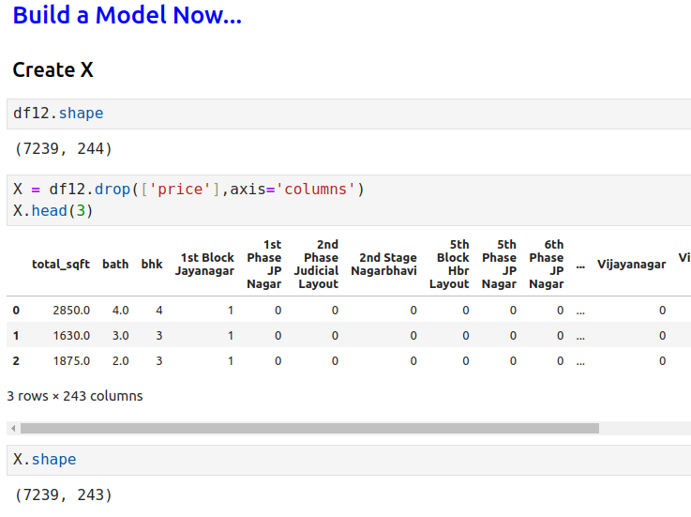
27.2 Build Model
https://www.youtube.com/watch?v=oCiRv94GMEc&list=PLeo1K3hjS3uvCeTYTeyfe0-rN5r8zn9rw&index=27
Build Model (5:31-6:30/19:11)
Create X

Slide 11
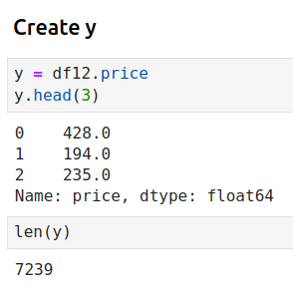
27.2 Build Model
https://www.youtube.com/watch?v=oCiRv94GMEc&list=PLeo1K3hjS3uvCeTYTeyfe0-rN5r8zn9rw&index=27
Build Model (6:31-7:30/19:11)
Create y.

Slide 12
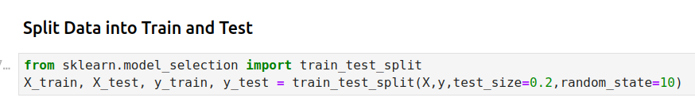
27.2 Build Model
https://www.youtube.com/watch?v=oCiRv94GMEc&list=PLeo1K3hjS3uvCeTYTeyfe0-rN5r8zn9rw&index=27
Build Model (7:31-8:30/19:11)
Split Data into Train and Test.

Slide 13
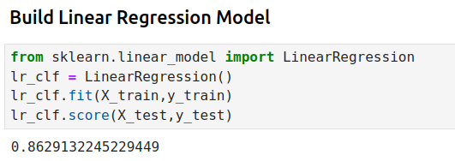
27.2 Build Model
https://www.youtube.com/watch?v=oCiRv94GMEc&list=PLeo1K3hjS3uvCeTYTeyfe0-rN5r8zn9rw&index=27
Build Model (8:31-9:30/19:11)
Build Regression, train, and score.

Slide 14
27.3 K-Fold Cross Validaiton

Slide 15
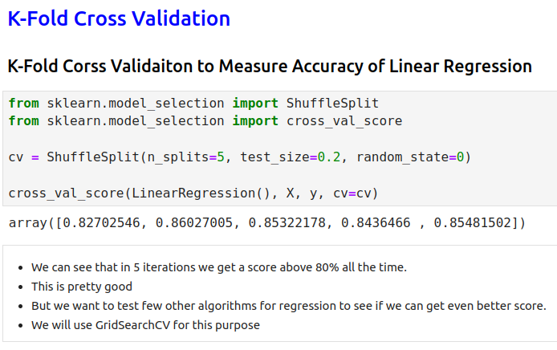
27.3 K-Fold Cross Validation
https://www.youtube.com/watch?v=oCiRv94GMEc&list=PLeo1K3hjS3uvCeTYTeyfe0-rN5r8zn9rw&index=27
K-Fold Cross Validation (9:31-10:30/19:11)

Slide 16
27.4 Find Best Model by GridSearchCV

Slide 17
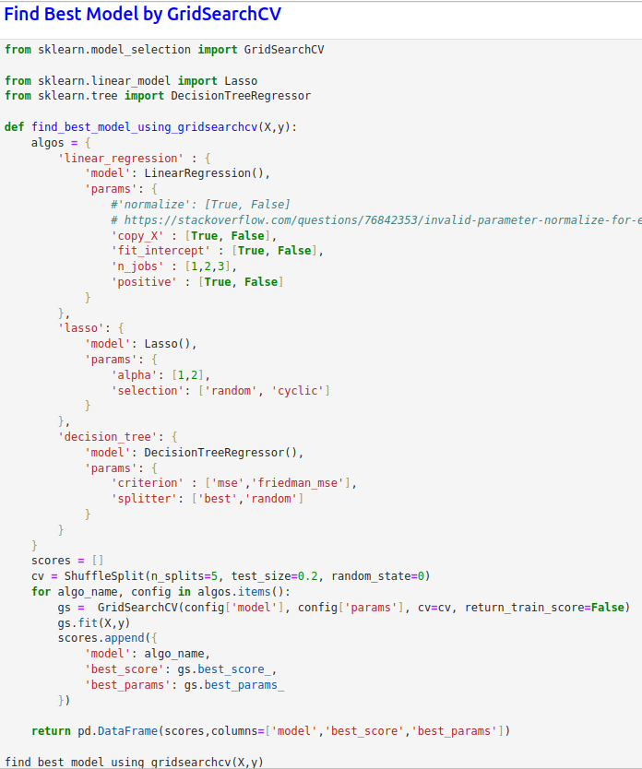
27.4 Find Best Model by GridSearchCV
https://www.youtube.com/watch?v=oCiRv94GMEc&list=PLeo1K3hjS3uvCeTYTeyfe0-rN5r8zn9rw&index=27
Find Best Model by GridSearchCV (10:31-11:30/19:11)
We test for 3 different model:
1. Linear Regression
2. Lasso
3. Decision Tree

Slide 18
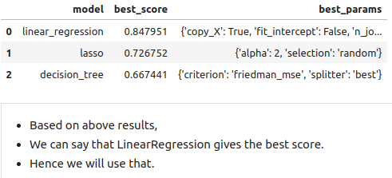
27.4 Find Best Model by GridSearchCV
https://www.youtube.com/watch?v=oCiRv94GMEc&list=PLeo1K3hjS3uvCeTYTeyfe0-rN5r8zn9rw&index=27
Find Best Model by GridSearchCV (11:31-13:30/19:11)
We found the Linear Regression has the best Accuracy.

Slide 19
27.5 Test Model for Few Properties

Slide 20
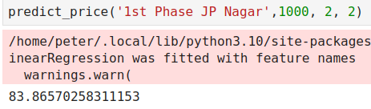
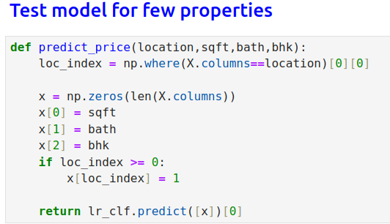
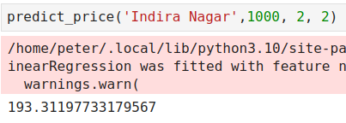
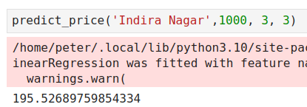
27.5 Test Model for Few Properties
https://www.youtube.com/watch?v=oCiRv94GMEc&list=PLeo1K3hjS3uvCeTYTeyfe0-rN5r8zn9rw&index=27
Test Model for Few Properties (13:31-15:30/19:11)

Slide 21
27.6 Export Model

Slide 22
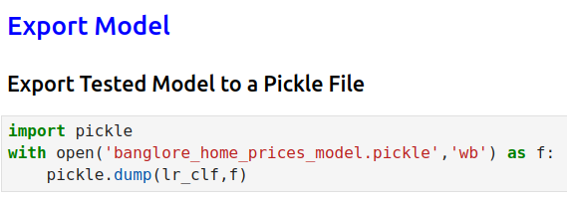
27.6 Export Model
https://www.youtube.com/watch?v=oCiRv94GMEc&list=PLeo1K3hjS3uvCeTYTeyfe0-rN5r8zn9rw&index=27
Export Model (15:31-17:30/19:11)

Slide 23
27.7 Export Column Information

Slide 24
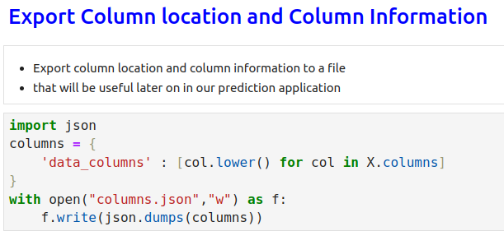
27.7 Export Column Information
https://www.youtube.com/watch?v=oCiRv94GMEc&list=PLeo1K3hjS3uvCeTYTeyfe0-rN5r8zn9rw&index=27
Export Column Information (17:31-19:11/19:11)

Slide 25
End

