Slide 1

18 Regularization: L1(Lasso)/L2(Ridge)
Peter H. Chen

Slide 2
18 Regularization: L1(Lasso)/L2(Ridge)
https://www.youtube.com/watch?v=VqKq78PVO9g&list=PLeo1K3hjS3uvCeTYTeyfe0-rN5r8zn9rw&index=18
Regularization: L1(Lasso)/L2 (Ridge) (0:00-0:50/19:20)
Overfitting is common problem in machine learning.
L1 (Lasso) and L2 (Ridge) Regularization are common techniques that can be used to solve the overfitting problem.
We will discuss
  1. Theory of L1 and L2 regularization and
  2. Build the model of the house price in Melbourne by simple linear regression
  3. Build the overfit model and use L1/L2 regularization to improve the score of test set

Slide 3
18.1 Introduction to Regularization

Slide 4
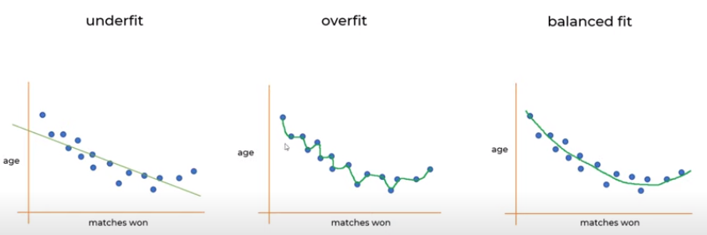
18.1 Introduction to Regularization
https://www.youtube.com/watch?v=VqKq78PVO9g&list=PLeo1K3hjS3uvCeTYTeyfe0-rN5r8zn9rw&index=18
Introduction to Regularization(0:51-3:50/19:20)
We predict sports won based on age.
1. We have linear regression for match won and age. It is underfit.
  Match won = θ0 + θ1 * age
2. We can have anther equation with higher order of polynomial. It is overfit.
  Match won = θ0 + θ1 * age + θ2 * age² + θ3 * age³ + θ4 * age⁴
3. If we reduce the order, we have better fit. It about right
  Match won = θ0 + θ1 * age + θ2 * age²
1
2
3
Match won = θ0 + θ1 * age
Match won = θ0 + θ1 * age
+ θ2 * age² + θ3 * age³
+ θ4 * age⁴
Match won = θ0 + θ1 * age
+ θ2 * age²

Slide 5
18.2 How to Reduce Overfit?

Slide 6
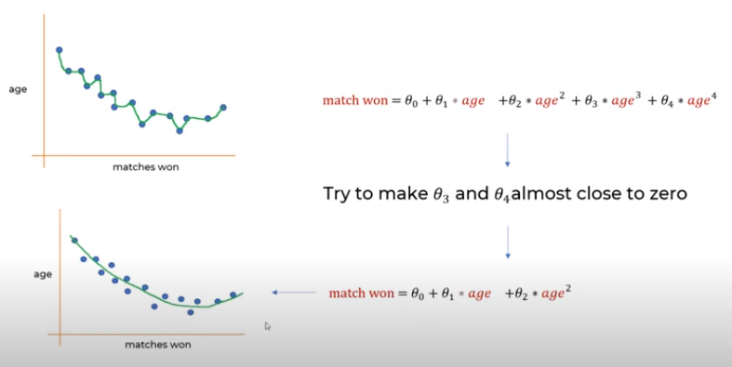
18.2 How to Reduce Overfit?
https://www.youtube.com/watch?v=VqKq78PVO9g&list=PLeo1K3hjS3uvCeTYTeyfe0-rN5r8zn9rw&index=18
How to Reduce Overfit? (3:51-4:40/19:20)
We have an overfit equation:
  Match won = θ0 + θ1 * age + θ2 * age² + θ3 * age³ + θ4 * age⁴
If θ3 and θ4 almost close to zero, then we can shrink these parameters and get the better regression equation:
  Match won = θ0 + θ1 * age + θ2 * age²

Slide 7
18.3 Mean Square Error

Slide 8
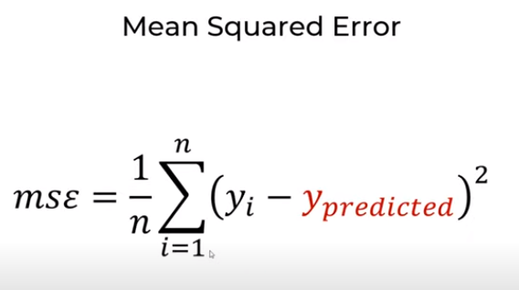
18.3 Mean Square Error
https://www.youtube.com/watch?v=VqKq78PVO9g&list=PLeo1K3hjS3uvCeTYTeyfe0-rN5r8zn9rw&index=18
Mean Square Error (4:41-5:10/19:20)
Now, how do we remove the parameters and get better equation?
We subtract the points and predicted value and take sum square of them.
We have MSE (Mean Square Error).

Slide 9
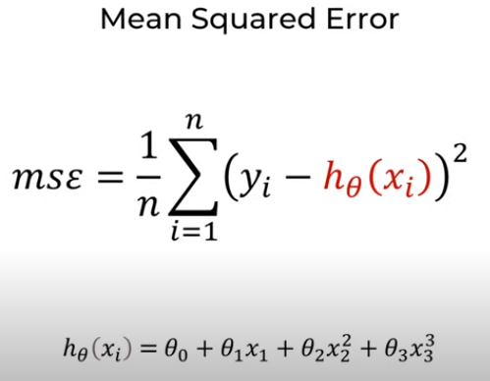
18.3 Mean Square Error
https://www.youtube.com/watch?v=VqKq78PVO9g&list=PLeo1K3hjS3uvCeTYTeyfe0-rN5r8zn9rw&index=18
Mean Square Error (5:11-6:50/19:20)
Here, we substitute the regression equation into MSE.

Slide 10
18.4 L2 Regularization

Slide 11
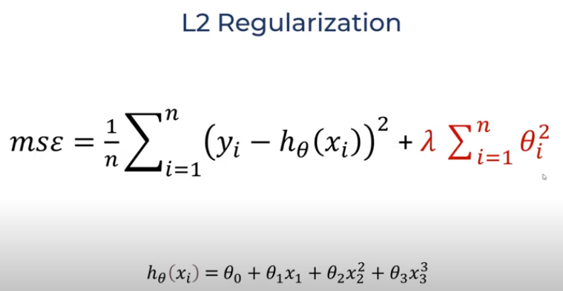
18.4 L2 Regularization
https://www.youtube.com/watch?v=VqKq78PVO9g&list=PLeo1K3hjS3uvCeTYTeyfe0-rN5r8zn9rw&index=18
L2 Regularization (5:51-7:00/19:20)
In the MSE, we add the square of coefficient terms.
This equation penalize the big values of coefficients.

Slide 12
18.5 L1 Regularization

Slide 13
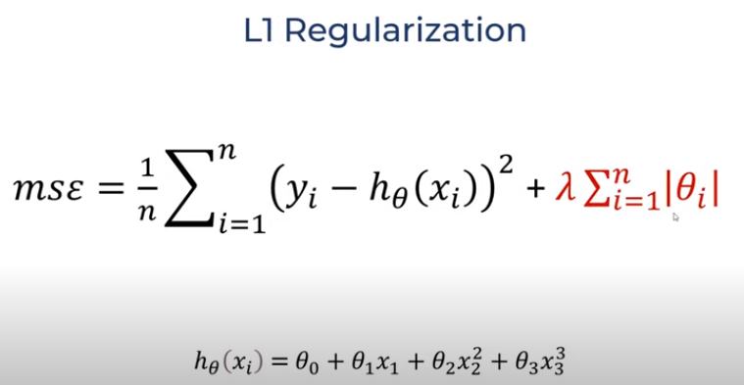
18.5 L1 Regularization
https://www.youtube.com/watch?v=VqKq78PVO9g&list=PLeo1K3hjS3uvCeTYTeyfe0-rN5r8zn9rw&index=18
L1 Regularization (7:01-7:20/19:20)
In L1, Instead of square the coefficients, we use absolute value instead.

Slide 14
18.6 Reduce to Simpler Equation

Slide 15
18.6 Reduce to Simpler Equation
https://www.youtube.com/watch?v=VqKq78PVO9g&list=PLeo1K3hjS3uvCeTYTeyfe0-rN5r8zn9rw&index=18
Reduce to Simpler Equation (7:21-7:40/19:20)
After we use L1 and L2 Regularization, we get the simpler equation.
Do no make the regression equation too complicated and overfit.
Simpler equation are the best for test data.

Slide 16
18.7 Dataset

Slide 17
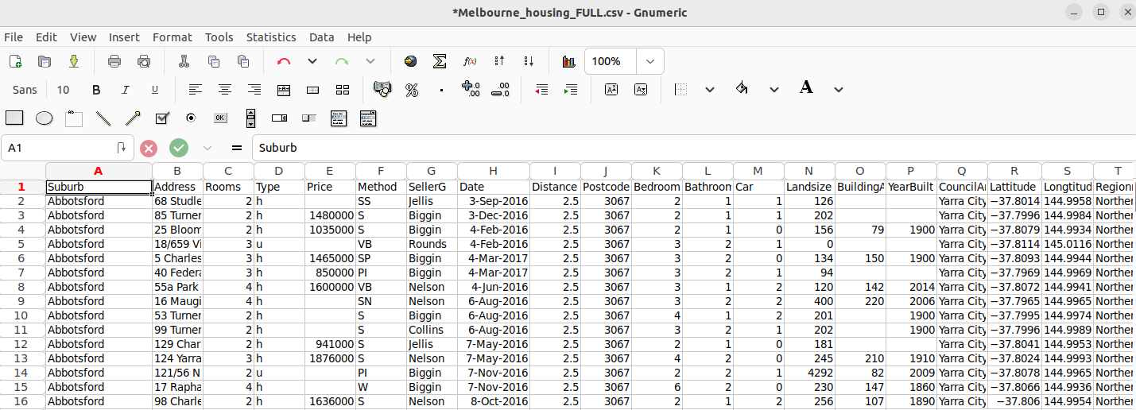
18.7 Dataset
https://www.youtube.com/watch?v=VqKq78PVO9g&list=PLeo1K3hjS3uvCeTYTeyfe0-rN5r8zn9rw&index=18
Dataset (7:41-8:00/19:20)
We download the Melbourne house price dataset from Keggle.
https://www.kaggle.com/datasets/anthonypino/melbourne-housing-market

Slide 18
18.8 Import Library and Read Dataset

Slide 19
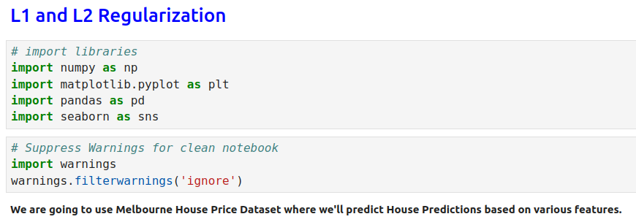
18.8 Import Library and Read Dataset
https://www.youtube.com/watch?v=VqKq78PVO9g&list=PLeo1K3hjS3uvCeTYTeyfe0-rN5r8zn9rw&index=18
Import Library and Read Dataset (8:01-8:30/19:20)

Slide 20
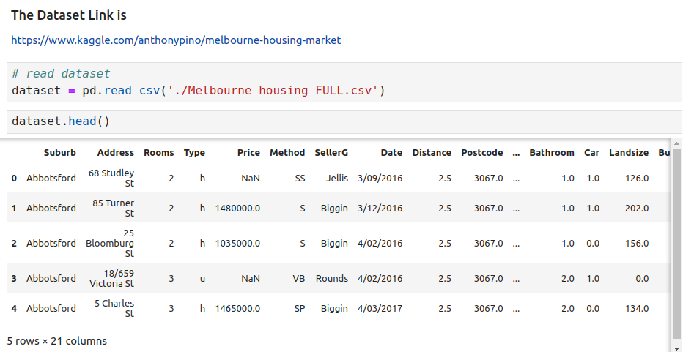
18.8 Import Library and Read Dataset
https://www.youtube.com/watch?v=VqKq78PVO9g&list=PLeo1K3hjS3uvCeTYTeyfe0-rN5r8zn9rw&index=18
Import Library and Read Dataset (8:31-9:00/19:20)

Slide 21
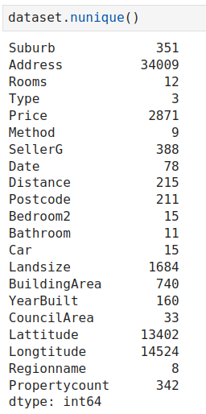
18.8 Import Library and Read Dataset
https://www.youtube.com/watch?v=VqKq78PVO9g&list=PLeo1K3hjS3uvCeTYTeyfe0-rN5r8zn9rw&index=18
Import Library and Read Dataset (9:01-10:00/19:20)

Slide 22
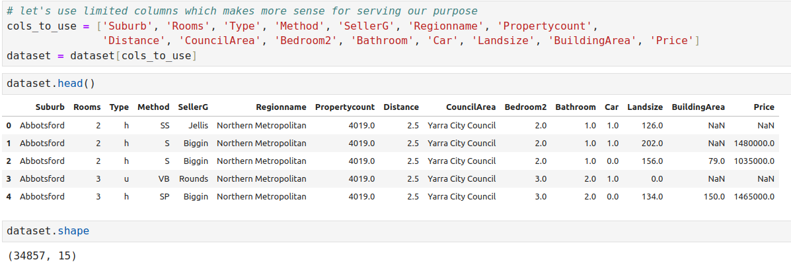
18.8 Import Library and Read Dataset
https://www.youtube.com/watch?v=VqKq78PVO9g&list=PLeo1K3hjS3uvCeTYTeyfe0-rN5r8zn9rw&index=18
Import Library and Read Dataset (10:01-11:00/19:20)

Slide 23
18.9 Check NaN Values

Slide 24
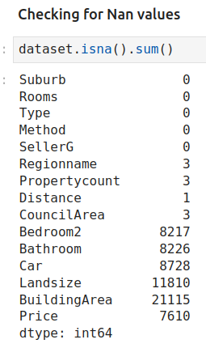
18.9 Check NaN Values
https://www.youtube.com/watch?v=VqKq78PVO9g&list=PLeo1K3hjS3uvCeTYTeyfe0-rN5r8zn9rw&index=18
Check NaN Values (11:01-12:00/19:20)

Slide 25
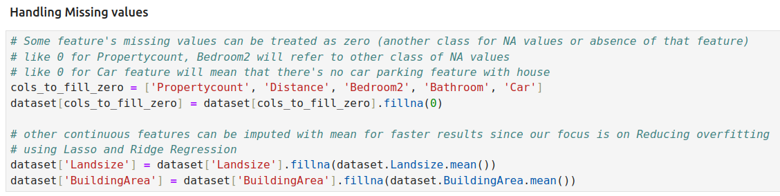
18.9 Check NaN Values
https://www.youtube.com/watch?v=VqKq78PVO9g&list=PLeo1K3hjS3uvCeTYTeyfe0-rN5r8zn9rw&index=18
Check NaN Values (12:01-13:00/19:20)

Slide 26
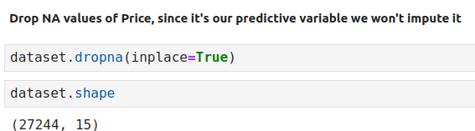
18.9 Check NaN Values
https://www.youtube.com/watch?v=VqKq78PVO9g&list=PLeo1K3hjS3uvCeTYTeyfe0-rN5r8zn9rw&index=18
Check NaN Values (13:01-14:00/19:20)

Slide 27
18.10 On Hot Encoding

Slide 28
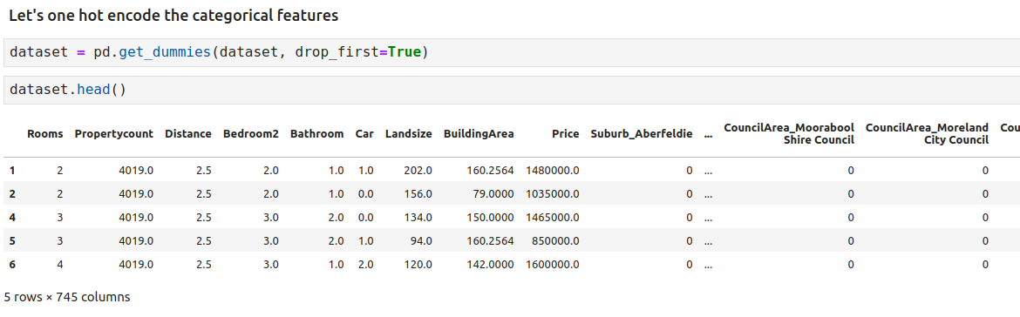
18.10 On Hot Encoding
https://www.youtube.com/watch?v=VqKq78PVO9g&list=PLeo1K3hjS3uvCeTYTeyfe0-rN5r8zn9rw&index=18
One Hot Encoding (14:01-15:00/19:20)

Slide 29
18.11 Split Data into Train and Test

Slide 30
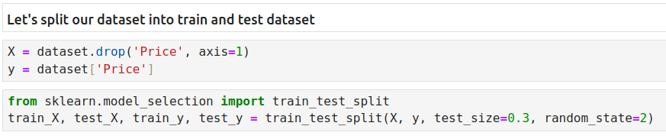
18.11 Split Data into Train and Test
https://www.youtube.com/watch?v=VqKq78PVO9g&list=PLeo1K3hjS3uvCeTYTeyfe0-rN5r8zn9rw&index=18
Split Data into Train and Test (15:01-16:00/19:20)

Slide 31
18.12 Train Model

Slide 32
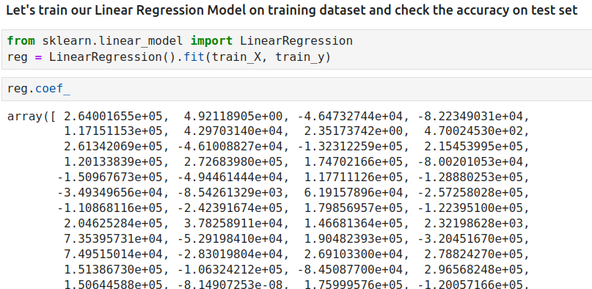
18.12 Train Model
https://www.youtube.com/watch?v=VqKq78PVO9g&list=PLeo1K3hjS3uvCeTYTeyfe0-rN5r8zn9rw&index=18
Train Model (16:01-16:30/19:20)
We can see sklearn automatically insert many coefficient in the linear equation model.

Slide 33
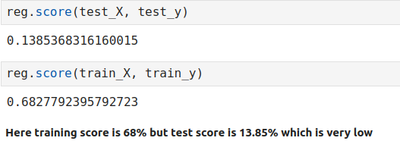
18.12 Train Model
https://www.youtube.com/watch?v=VqKq78PVO9g&list=PLeo1K3hjS3uvCeTYTeyfe0-rN5r8zn9rw&index=18
Train Model (16:31-17:00/19:20)
We have high accuracy in training data but very low accuracy in testing data.
From the train and test result, we know that model is overfit.

Slide 34
18.13 L1 Regularization

Slide 35
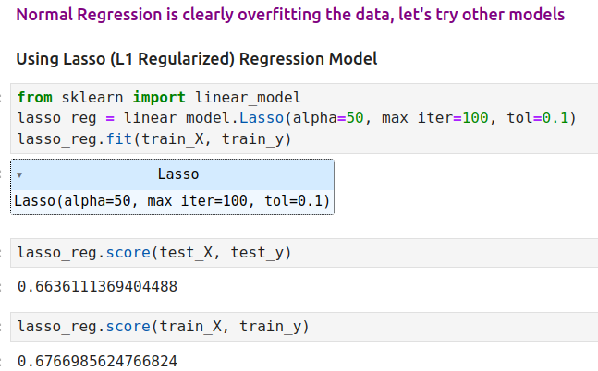
18.13 L1 Regularization
https://www.youtube.com/watch?v=VqKq78PVO9g&list=PLeo1K3hjS3uvCeTYTeyfe0-rN5r8zn9rw&index=18
L1 Regularization (17:01-18:00/19:20)

Slide 36
18.14 L2 Regularization

Slide 37
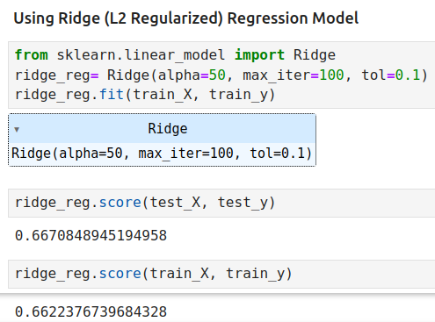
18.14 L2 Regularization
https://www.youtube.com/watch?v=VqKq78PVO9g&list=PLeo1K3hjS3uvCeTYTeyfe0-rN5r8zn9rw&index=18
L2 Regularization (18:01-19:00/19:20)

Slide 38
18.15 Summary

Slide 39
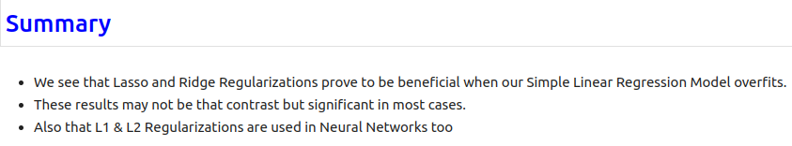
18.15 Summary
https://www.youtube.com/watch?v=VqKq78PVO9g&list=PLeo1K3hjS3uvCeTYTeyfe0-rN5r8zn9rw&index=18
Summary (19:01-19:20/19:20)

Slide 40
End

