Slide 1

6 One Hot Encoding
Peter H. Chen

Slide 2
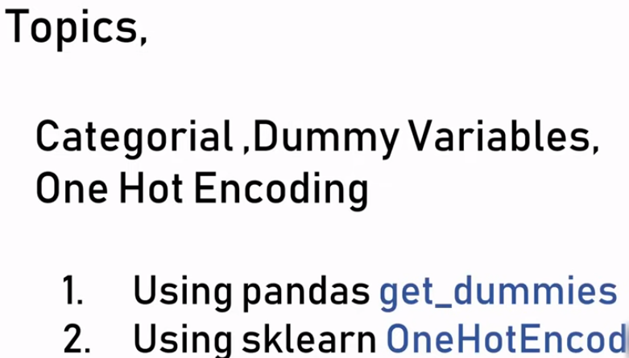
6 One Hot Encoding
https://www.youtube.com/watch?v=9yl6-HEY7_s&list=PLeo1K3hjS3uvCeTYTeyfe0-rN5r8zn9rw&index=6
One Hot Encoding (0:00-0:10/21:34)
We discuss the dataset contains the text string. For one-hot-encoding, data category “town” is expanded into several unique columns called Dummy Variables.
Topics:
Categorical, Dummy Variables, and One Hot Encoding using
1. Pandas get_dummies
2. sklearn OneHotEncod

Slide 3
6.1 Dataset Contains String

Slide 4
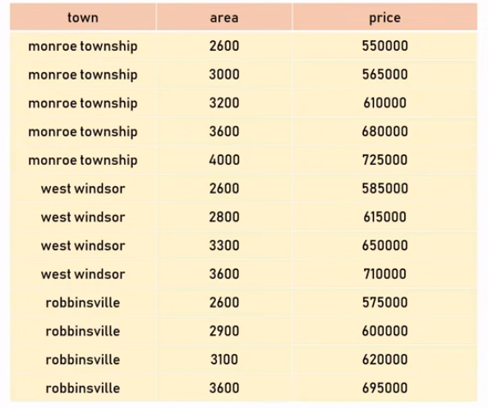
6.1 Dataset Contains String
https://www.youtube.com/watch?v=9yl6-HEY7_s&list=PLeo1K3hjS3uvCeTYTeyfe0-rN5r8zn9rw&index=6
Dataset Contains String (0:11-0:30/21:34)
Below, we have home price dataset of New Jersey State which includes town, area (sq ft), and price.
We want to predict the monroe township and nearby town.
In this dataset, we have “text data” which we never see before.

Slide 5
6.2 Build Model Contains String

Slide 6
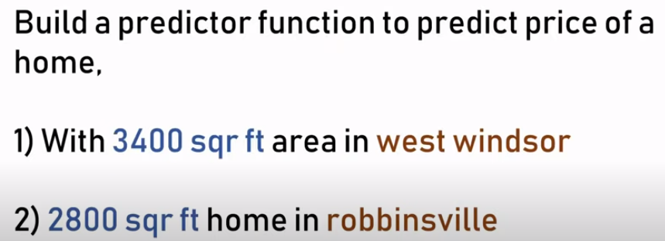
6.2 Build Model Contains String
https://www.youtube.com/watch?v=9yl6-HEY7_s&list=PLeo1K3hjS3uvCeTYTeyfe0-rN5r8zn9rw&index=6
Build Model Contains String (0:31-0:40/21:34)
Given this data, build a predictor function to predict price of a home.
1. 3400 sq ft area in West Windsor.
2. 2800 sq ft home in robbinsville.

Slide 7
6.3 Handle Dataset Contains String

Slide 8
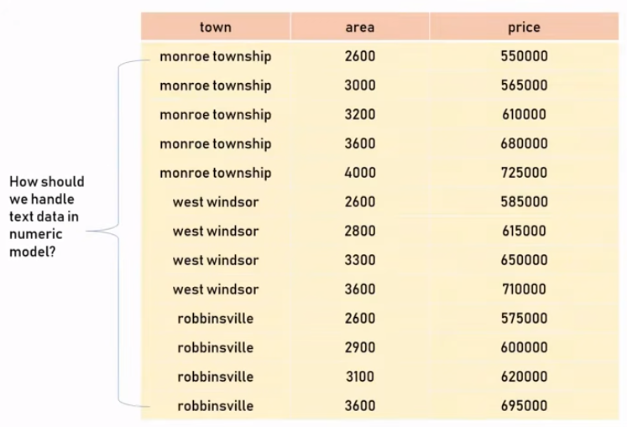
6.3 Handle Dataset with String
https://www.youtube.com/watch?v=9yl6-HEY7_s&list=PLeo1K3hjS3uvCeTYTeyfe0-rN5r8zn9rw&index=6
Handle Dataset with String (0:41-0:50/21:34)
When we look at the dataset, we can see the text data in the dataset.
Because the machine learning model can handle the numeric data, how do we handle the text data?

Slide 9
6.4 String to Number

Slide 10
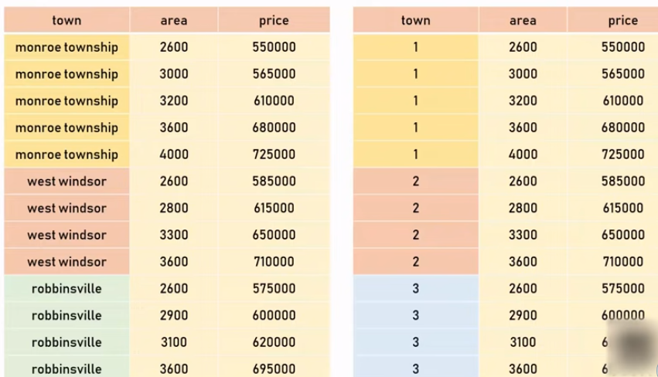

6.4 String to Number
https://www.youtube.com/watch?v=9yl6-HEY7_s&list=PLeo1K3hjS3uvCeTYTeyfe0-rN5r8zn9rw&index=6
String to Number (0:51-1:20/21:34)
One way to do that is to convert the string into a integer.

Slide 11
6.5 String Order and Operation

Slide 12
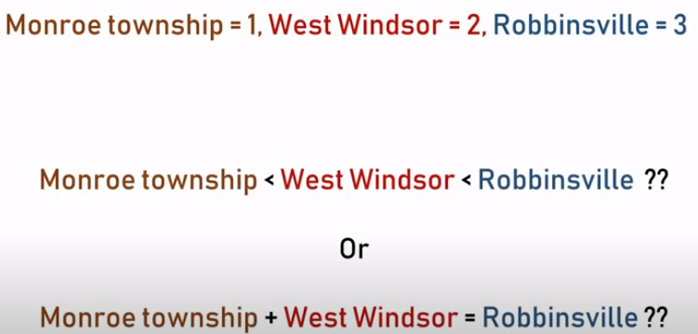
6.5 String Order and Operation
https://www.youtube.com/watch?v=9yl6-HEY7_s&list=PLeo1K3hjS3uvCeTYTeyfe0-rN5r8zn9rw&index=6
String Order and Operation (1:21-1:35/21:34)
When we convert the string (Monroe, West Windsor, Robbinsville) into integer (1, 2 ,3), there existed two issues.
1. Order: It does not make sense that the string has order.
2. Addition: When we add String 1 + String 2 = String 3.

Slide 13
6.6 Categorical Variable

Slide 14
6.6 Categorical Variable
https://www.youtube.com/watch?v=9yl6-HEY7_s&list=PLeo1K3hjS3uvCeTYTeyfe0-rN5r8zn9rw&index=6
Categorical Variable (1:36-2:50/21:34)
There are two types of categorical variables: Nominal and Ordinal
1. Nominal: Nominal does not have any numeric order in between them, for example,
  Township: Monroe, West Windsor, or Robbinsville,
  Gender: male or female, or
  Colors: Green, Red, or blue.
2. Ordinal: Ordinal has numerical order in between them, for example,
  Customer service order: Dissatisfied < Neural < Satisfied,
  College Degree: BS <MS < PhD,
  Size: Low < Medium < High.
Categorical Variables (分類變數)
Nominal (名義上的)
Ordinal (序數)
Monroe Township
West Windsor
Robbinsville
Satisfied
Neural
Dissatisfied
Male
Female
Green Red
Blue
BS
MS
PhD
High
Medium
Low

Slide 15
6.7 One-Hot-Encoding

Slide 16



6.7 One-Hot-Encoding
https://www.youtube.com/watch?v=9yl6-HEY7_s&list=PLeo1K3hjS3uvCeTYTeyfe0-rN5r8zn9rw&index=6
One-Hot-Encoding (2:51-3:30/21:34)
For Nominal Variables, there is no order embedded in the string. The simple integer encoding is not working.
Therefore, we need a technique called “One Hot Encoding”.

Slide 17
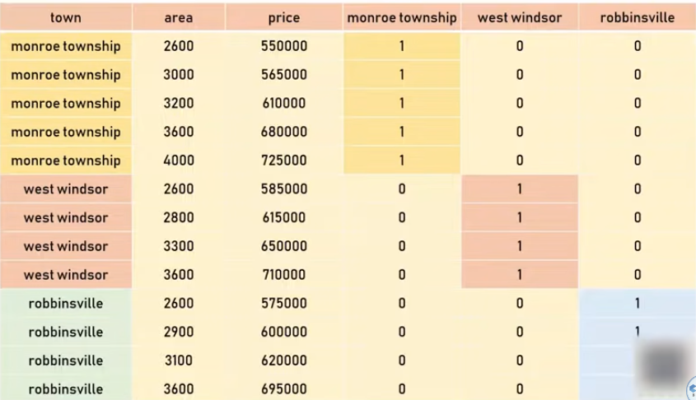
6.7 One-Hot-Encoding
https://www.youtube.com/watch?v=9yl6-HEY7_s&list=PLeo1K3hjS3uvCeTYTeyfe0-rN5r8zn9rw&index=6
One-Hot-Encoding (2:51-3:00/21:34)
For Nominal Variables, there is no order embedded in the string. The simple integer encoding is not working.
1. We use technique called One-Hot-Encoding.
2. Each string is represented by a unique binary number.
3. Each bit represent an attribute with unique meaning.
4. We can have the set operation for each bit attribute.
5. These One-Hot-Encoding variables are also called “Dummy Variables”
1
1
1
1

Slide 18
6.8 CSV File

Slide 19
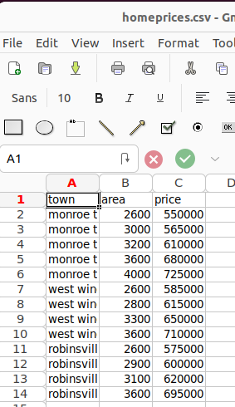
6.8 CSV File
https://www.youtube.com/watch?v=9yl6-HEY7_s&list=PLeo1K3hjS3uvCeTYTeyfe0-rN5r8zn9rw&index=6
CSV File (3:01-3:30/21:34)
Read CSV file.

Slide 20
6.9 Pandas Read CSV

Slide 21
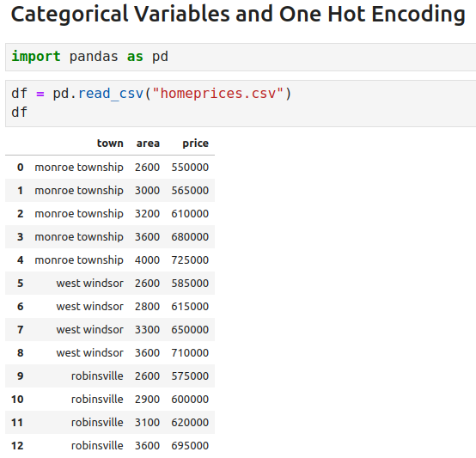
6.9 Pandas Read CSV
https://www.youtube.com/watch?v=9yl6-HEY7_s&list=PLeo1K3hjS3uvCeTYTeyfe0-rN5r8zn9rw&index=6
Pandas Read CSV (3:31-3:50/21:34)
Read CSV file.

Slide 22
6.10 Pandas Create Dummies

Slide 23
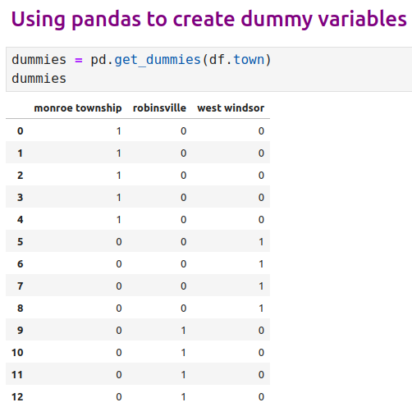
6.10 Pandas Create Dummies
https://www.youtube.com/watch?v=9yl6-HEY7_s&list=PLeo1K3hjS3uvCeTYTeyfe0-rN5r8zn9rw&index=6
Pandas Create Dummies (3:51-4:35/21:34)
Pandas has function get_dummies () which return the dummy variable columns.
Data category is “town” is expanded into three columns “monroe township”, “robinsville”, and “west windsor”.
If we have 10 township names, it will expanded into 10 unique columns.

Slide 24
6.11 Merge Dataset and Dummies

Slide 25
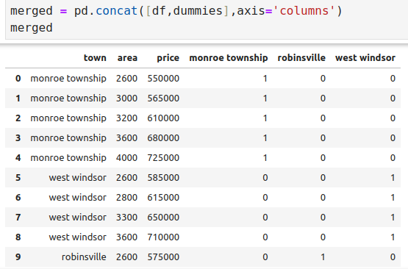
6.11 Merge Dataset and Dummies
https://www.youtube.com/watch?v=9yl6-HEY7_s&list=PLeo1K3hjS3uvCeTYTeyfe0-rN5r8zn9rw&index=6
Merge Dataset and Dummies (4:46-5:20/21:34)
We merge the dummies with original dataset.
The dataset is called merged.

Slide 26
6.12 Final Dataset

Slide 27
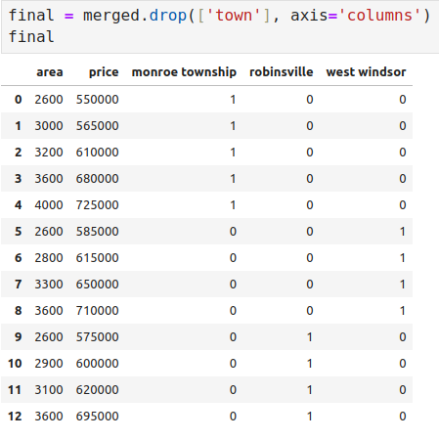
6.12 Final Dataset
https://www.youtube.com/watch?v=9yl6-HEY7_s&list=PLeo1K3hjS3uvCeTYTeyfe0-rN5r8zn9rw&index=6
Final Dataset (5:21-6:00/21:34)
Now, we need to drop the original “town” column. Because we already have the unique dummy columns, we don’t need the the original column “town”. This “town” column contains text strings will not work for linear regression model.
We have the final dataset named “final”.

Slide 28
6.13 Pandas: Drop Colinear Column

Slide 29
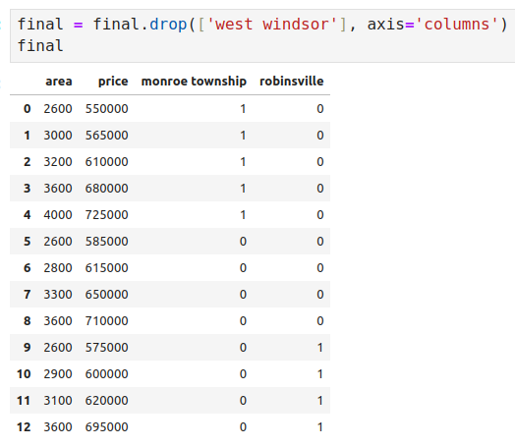
6.13 Pandas: Drop Colinear Column
https://www.youtube.com/watch?v=9yl6-HEY7_s&list=PLeo1K3hjS3uvCeTYTeyfe0-rN5r8zn9rw&index=6
Pandas: Drop Colinear Column (6:01-7:00/21:34)
When you can derive one variable from other variables, they are known to be multi-colinear.
For example, If we have three states: California, Georgia, and New Jersey, then we can know new jersey state by california = 0 and georgia = 0. These state variables are called to be multi-colinear.
For linear regression, the extra column does not work as expected.
Hence, we need to drop one column. For example, if you have five columns of dummy variables, you can drop one of the columns. The columns change from five columns into four columns.
NOTE:
sklearn library takes care of dummy variable trap.
Hence, even if you don't drop one of the state columns it is going to work.
Here, we take care of dummy variable trap ourselves in case library does not handle for us

Slide 30
6.14 Pandas: Linear Regression

Slide 31
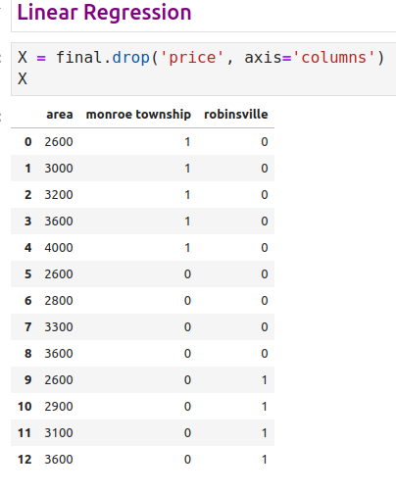
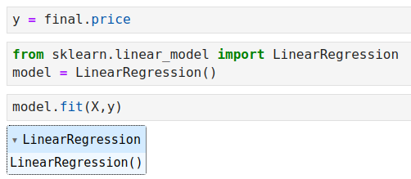
6.14 Pandas: Linear Regression
https://www.youtube.com/watch?v=9yl6-HEY7_s&list=PLeo1K3hjS3uvCeTYTeyfe0-rN5r8zn9rw&index=6
Linear Regression (7:01-11:10/21:34)
Now, we do linear regression model.

Slide 32
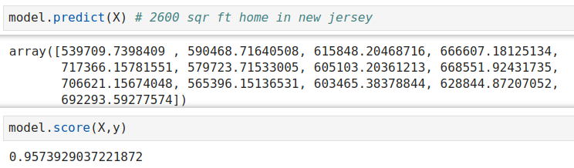
6.14 Pandas: Linear Regression
https://www.youtube.com/watch?v=9yl6-HEY7_s&list=PLeo1K3hjS3uvCeTYTeyfe0-rN5r8zn9rw&index=6
Linear Regression (11:11-12:00/21:34)
Check Model Accuracy for X and y. Accuracy is 95%.

Slide 33
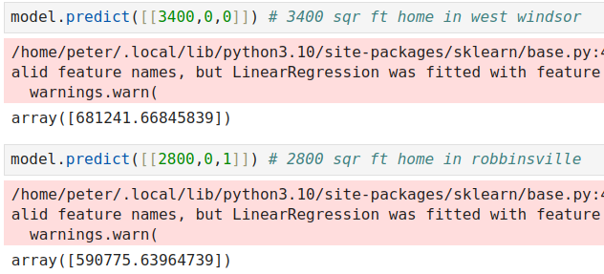
6.14 Pandas: Linear Regression
https://www.youtube.com/watch?v=9yl6-HEY7_s&list=PLeo1K3hjS3uvCeTYTeyfe0-rN5r8zn9rw&index=6
Linear Regression (12:01-12:40/21:34)
1. Predict area = 3400 sq ft, “west windsor” = [0, 0] (“west windsor” is the Drop Colinear column)
2. Predict area = 2800 sq ft, “robbinsville” = [0, 1]

Slide 34
6.15 Sklearn Label: Text into Number

Slide 35
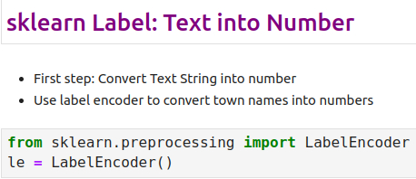
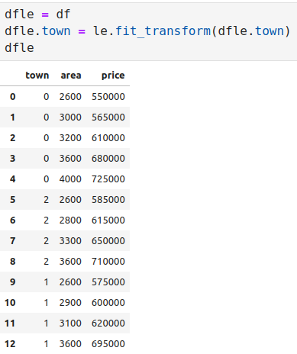
6.15 Sklearn Label: Text into Number
https://www.youtube.com/watch?v=9yl6-HEY7_s&list=PLeo1K3hjS3uvCeTYTeyfe0-rN5r8zn9rw&index=6
Sklearn Label: Text into Number (12:41-13:00/21:34)
Now, we use scikit-learn library for One-Hot-Encoding.
First Step: We convert the text string into integer first.

Slide 36
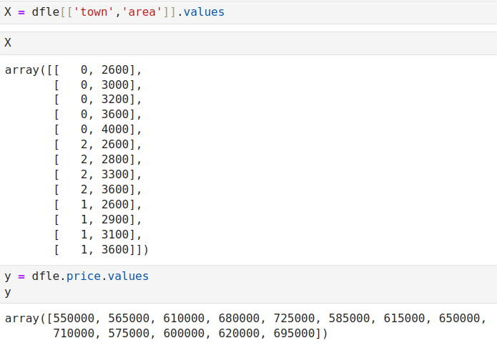
6.15 Sklearn Label: Text into Number
https://www.youtube.com/watch?v=9yl6-HEY7_s&list=PLeo1K3hjS3uvCeTYTeyfe0-rN5r8zn9rw&index=6
Sklearn Label: Text into Number (13:01-15:20/21:34)
Split data into X and y.

Slide 37
6.15 Sklearn OneHotEncoder

Slide 38
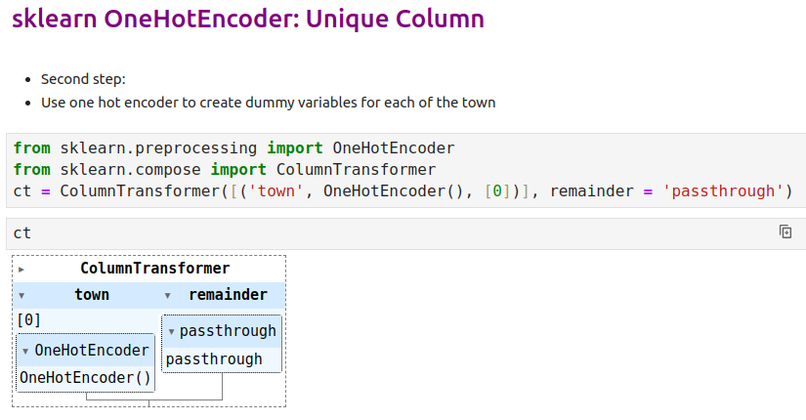
6.15 Sklearn OneHotEncoder
https://www.youtube.com/watch?v=9yl6-HEY7_s&list=PLeo1K3hjS3uvCeTYTeyfe0-rN5r8zn9rw&index=6
Sklearn OneHotEncoder (15:21-16:00/21:34)
We do the One-Hot-Encoding for the first column [0] “town” and keep all other columns (passthrough).
https://scikit-learn.org/stable/modules/generated/sklearn.compose.ColumnTransformer.html

Slide 39
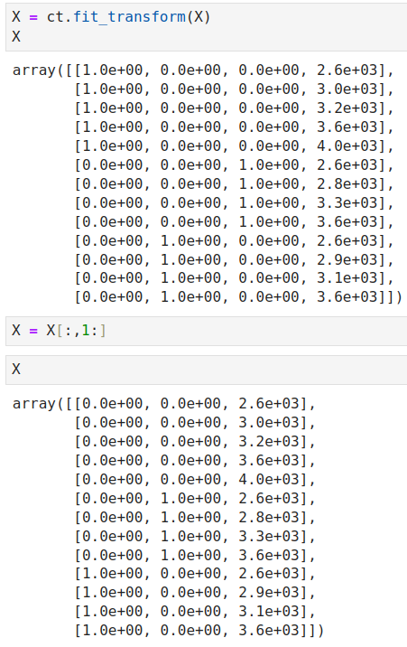
6.15 Sklearn OneHotEncoder
https://www.youtube.com/watch?v=9yl6-HEY7_s&list=PLeo1K3hjS3uvCeTYTeyfe0-rN5r8zn9rw&index=6
Sklearn OneHotEncoder (15:21-16:00/21:34)
One-Hot-Encoding for unique column name and the first column [0] and keep the column from one to the last column, i.e., [1:], because of multi-colinear.

Slide 40
6.16 Sklearn: Model Fit

Slide 41
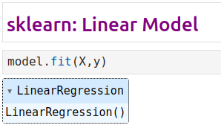
6.16 Sklearn: Model Fit
https://www.youtube.com/watch?v=9yl6-HEY7_s&list=PLeo1K3hjS3uvCeTYTeyfe0-rN5r8zn9rw&index=6
Sklearn: Model Fit (16:01-18:20/21:34)

Slide 42
6.17 Sklearn: Prediction

Slide 43
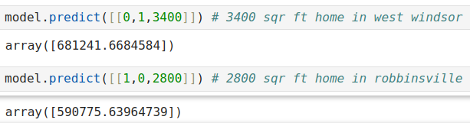
6.17 Sklearn: Prediction
https://www.youtube.com/watch?v=9yl6-HEY7_s&list=PLeo1K3hjS3uvCeTYTeyfe0-rN5r8zn9rw&index=6
Sklearn: Prediction (18:21-20:00/21:34)
We have finished One Hot Encoding for both Pandas and Sklearn

Slide 44
6.18 Exercise

Slide 45
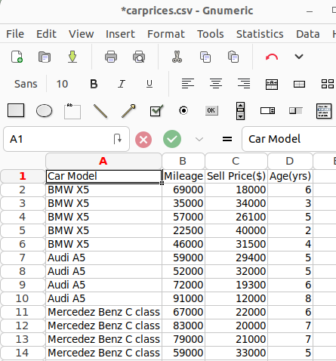
6.18 Exercise
https://www.youtube.com/watch?v=9yl6-HEY7_s&list=PLeo1K3hjS3uvCeTYTeyfe0-rN5r8zn9rw&index=6
Exercise (20:01-21:34/21:34)
We have file "carprices.csv" that contains 3 different car models.
First plot data points on a scatter plot chart to see if linear regression model can be applied.
If yes, then build a model,
Predict price of a mercedez benz that is 4 yr old with mileage 45000
Predict price of a BMW X5 that is 7 yr old with mileage 86000
Score the model, i.e., accuracy. (Hint: use LinearRegression().score())

Slide 46
End

