Slide 1

7 Train and Test
Peter H. Chen

Slide 2
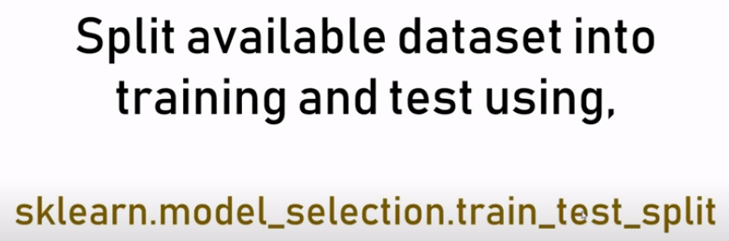
7 Train and Test
https://www.youtube.com/watch?v=fwY9Qv96DJY&list=PLeo1K3hjS3uvCeTYTeyfe0-rN5r8zn9rw&index=7
Train and Test (0:00-0:10/6:33)
We discuss:
1. How to split of the Dataset into several batches for training and testing.
2. The scikit-learn method train_test_split() to split the dataset into several batches for train and test.

Slide 3
7.1 Split Train and Test

Slide 4
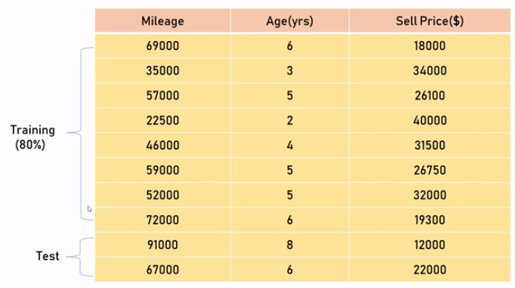
7.1 Split Train and Test
https://www.youtube.com/watch?v=fwY9Qv96DJY&list=PLeo1K3hjS3uvCeTYTeyfe0-rN5r8zn9rw&index=7
Split Train and Test (0:11-0:50/6:33)
We have dataset as below. This is a very tiny dataset.
In machine learning, the dataset is are very huge and very time consuming to train.
Therefore, it is not a good strategy to use the entire dataset for training.
We split into 80% train and 20% test.

Slide 5
7.2 Read CSV and Plot

Slide 6
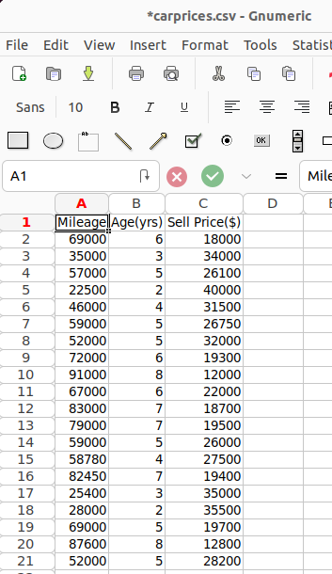
7.2 Read CSV and Plot
https://www.youtube.com/watch?v=fwY9Qv96DJY&list=PLeo1K3hjS3uvCeTYTeyfe0-rN5r8zn9rw&index=7
Read CSV and Plot (0:00-0:10/6:33)
We have carprices.csv with Mileage, Age in years), and Sell Prices in $.

Slide 7
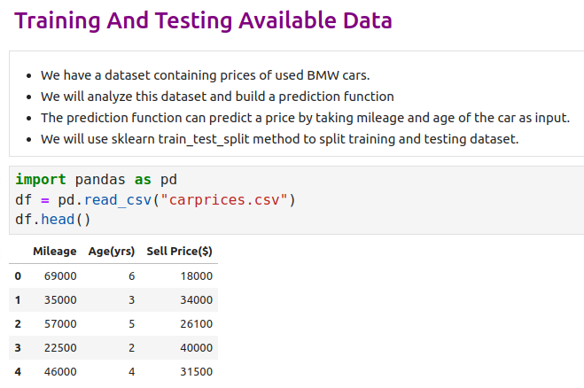
7.2 Read CSV and Plot
https://www.youtube.com/watch?v=fwY9Qv96DJY&list=PLeo1K3hjS3uvCeTYTeyfe0-rN5r8zn9rw&index=7
Read CSV and Plot (0:00-1:00/6:33)
We have a dataset containing prices of used BMW cars.
We will analyze this dataset and build a prediction function
The prediction function can predict a price by taking mileage and age of the car as input.
We will use sklearn train_test_split method to split training and testing dataset.

Slide 8
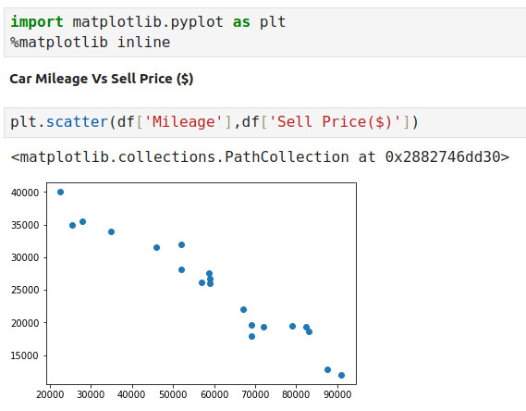
7.2 Read CSV and Plot
https://www.youtube.com/watch?v=fwY9Qv96DJY&list=PLeo1K3hjS3uvCeTYTeyfe0-rN5r8zn9rw&index=7
Read CSV and Plot (1:11-1:30/6:33)
We plot the mileage and sell price.

Slide 9
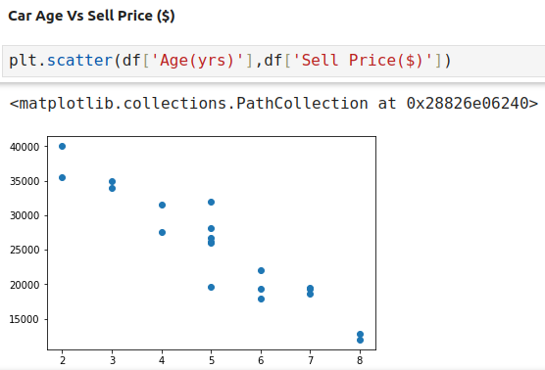
7.2 Read CSV and Plot
https://www.youtube.com/watch?v=fwY9Qv96DJY&list=PLeo1K3hjS3uvCeTYTeyfe0-rN5r8zn9rw&index=7
Read CSV and Plot (1:11-2:00/6:33)
We plot the Age and sell price.
Look at above two scatter plots, using linear regression model makes sense
We can see there is a linear relationship between dependent,
i.e., Sell Price, and independent variables, i.e., car age and car mileage

Slide 10
7.3 Separate Data into Train and Test

Slide 11
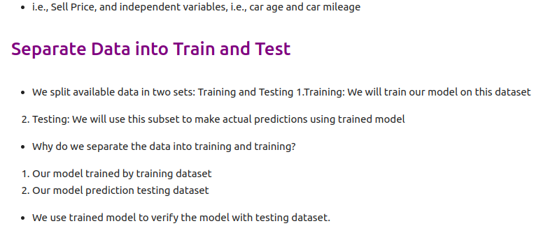
7.3 Separate Data into Train and Test
https://www.youtube.com/watch?v=fwY9Qv96DJY&list=PLeo1K3hjS3uvCeTYTeyfe0-rN5r8zn9rw&index=7
Separate Data into Train and Test (2:01-2:10/6:33)
We split available data in two sets: Training and Testing
  1.Training: We will train our model on this dataset
  2. Testing: We will use this subset to make actual predictions using trained model
Why do we separate the data into training and training?
  1. Our model trained by training dataset
  2. Our model prediction testing dataset
We use trained model to verify the model with testing dataset.

Slide 12
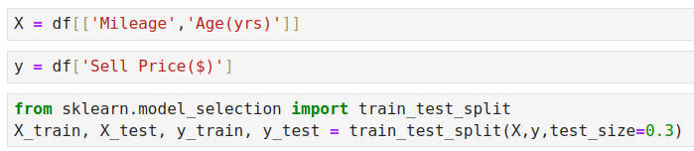
7.3 Separate Data into Train and Test
https://www.youtube.com/watch?v=fwY9Qv96DJY&list=PLeo1K3hjS3uvCeTYTeyfe0-rN5r8zn9rw&index=7
Separate Data into Train and Test (2:11-2:30/6:33)

Slide 13
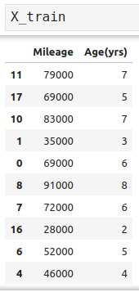
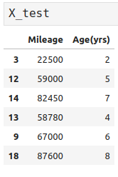
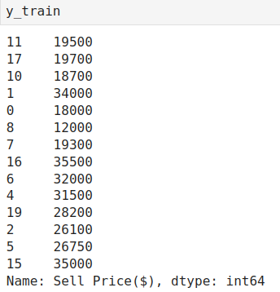
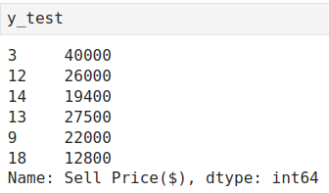
7.3 Separate Data into Train and Test
https://www.youtube.com/watch?v=fwY9Qv96DJY&list=PLeo1K3hjS3uvCeTYTeyfe0-rN5r8zn9rw&index=7
Separate Data into Train and Test (2:31-4:00/6:33)
Split dataset into X_train, X_test, y_train, and y_test

Slide 14
7.4 Train Model

Slide 15
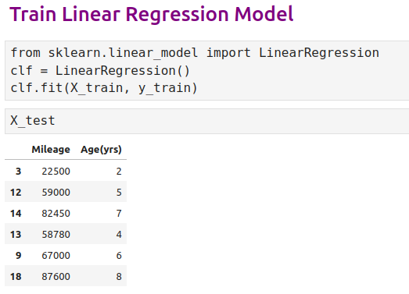
7.4 Train Model
https://www.youtube.com/watch?v=fwY9Qv96DJY&list=PLeo1K3hjS3uvCeTYTeyfe0-rN5r8zn9rw&index=7
Train Model (4:01-5:00/6:33)

Slide 16
7.5 Prediction

Slide 17
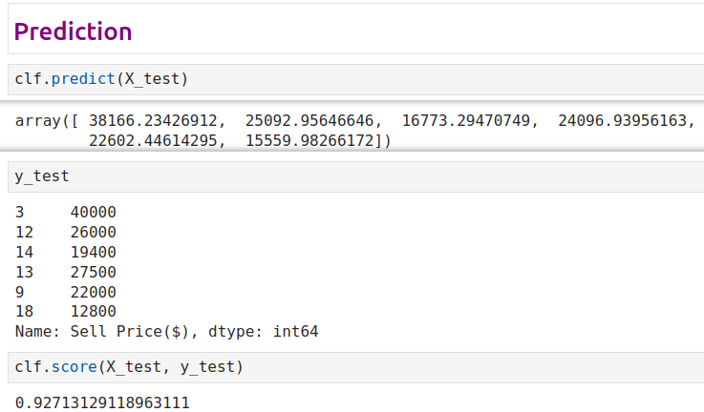
7.5 Prediction
https://www.youtube.com/watch?v=fwY9Qv96DJY&list=PLeo1K3hjS3uvCeTYTeyfe0-rN5r8zn9rw&index=7
Train Model (5:01-6:00/6:33)

Slide 18
7.6 Random State Argument

Slide 19
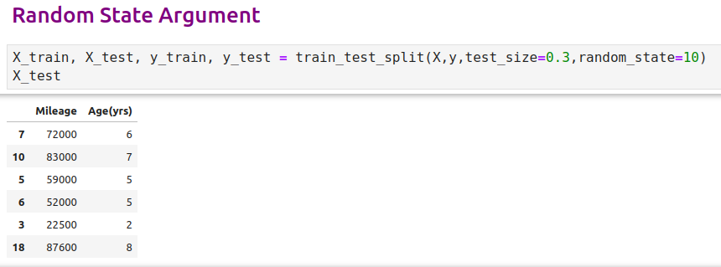
7.6 Random State Argument
https://www.youtube.com/watch?v=fwY9Qv96DJY&list=PLeo1K3hjS3uvCeTYTeyfe0-rN5r8zn9rw&index=7
Random State Argument (5:01-6:00/6:33)
Use random_state argument to test the X and y.

Slide 20
End

