Slide 1

10 Decision Tree Model
Peter H. Chen

Slide 2
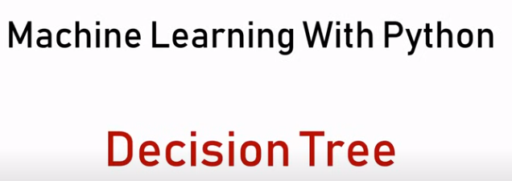
10 Decision Tree Model
https://www.youtube.com/watch?v=PHxYNGo8NcI&list=PLeo1K3hjS3uvCeTYTeyfe0-rN5r8zn9rw&index=10
Decision Tree Model (0:00-0:04/14:45)
We discuss how to solve a classification problem with Decision Tree algorithm.
We will build Decision Tree Model by Scikit-Learn Python Library.

Slide 3
10.1 Data Boundary

Slide 4
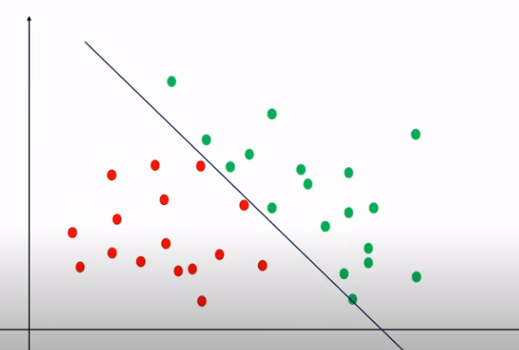
10.1 Data Boundary
https://www.youtube.com/watch?v=PHxYNGo8NcI&list=PLeo1K3hjS3uvCeTYTeyfe0-rN5r8zn9rw&index=10
Data Boundary (0:05-0:10/14:45)
Here, we have a red and blue data.
It is easy to draw the decision boundary using logistic regression.

Slide 5
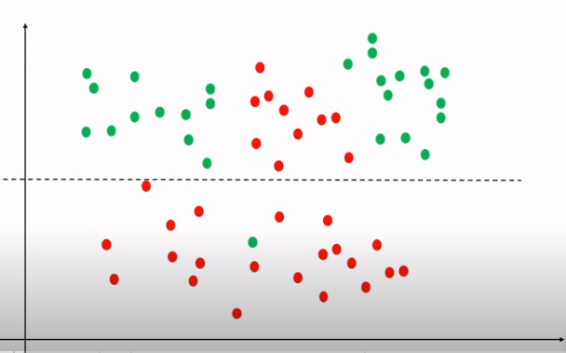
10.1 Data Boundary
https://www.youtube.com/watch?v=PHxYNGo8NcI&list=PLeo1K3hjS3uvCeTYTeyfe0-rN5r8zn9rw&index=10
Data Boundary (0:11-0:15/14:45)
Below, we have complicated data pattern.
It is hard to draw a line for data boundary.

Slide 6
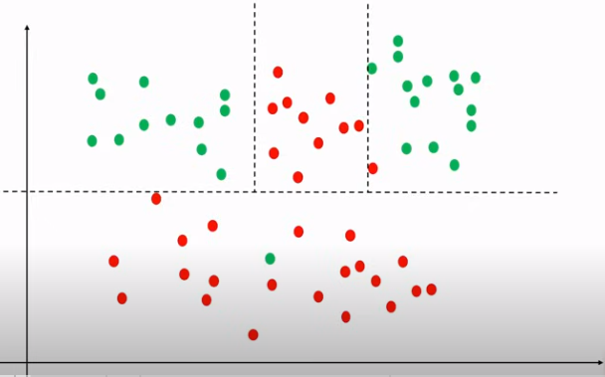
10.1 Data Boundary
https://www.youtube.com/watch?v=PHxYNGo8NcI&list=PLeo1K3hjS3uvCeTYTeyfe0-rN5r8zn9rw&index=10
Data Boundary (0:16-0:20/14:45)
We might have to draw the dat boundary again and again like below.
This is what the decision tree algorithm do.

Slide 7
10.2 Dataset

Slide 8
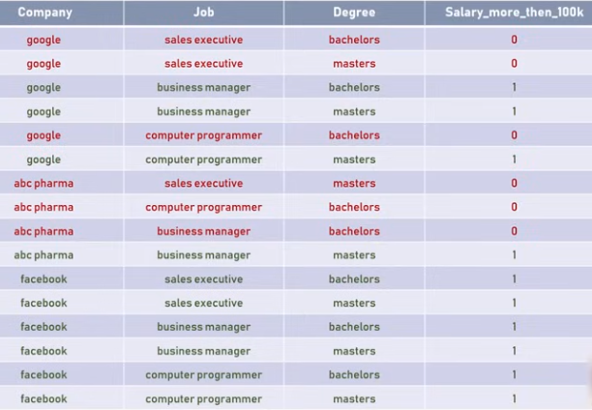
10.2 Dataset
https://www.youtube.com/watch?v=PHxYNGo8NcI&list=PLeo1K3hjS3uvCeTYTeyfe0-rN5r8zn9rw&index=10
Dataset (0:21-0:50/14:45)
Below is “salaries.csv” dataset of company employee salary based on job title and degree.
We try to solve problem with decision tree by our brain.

Slide 9
10.3 Decision Tree Classification Example

Slide 10
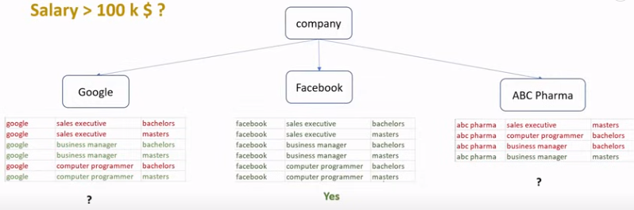
10.3 Decision Tree Classification Example
https://www.youtube.com/watch?v=PHxYNGo8NcI&list=PLeo1K3hjS3uvCeTYTeyfe0-rN5r8zn9rw&index=10
Decision Tree Classification Example (0:21-1:20/14:45)
Below, we use decision tree algorithm in our brain to separate the dataset.
First, we use the company name to separate the dataset.
Here, we can see the answer of Meta/facebook (“salary > 100K” all yes). No matter the job title and degree, Meta/Facebook is always pay higher salary (due to Meta/Facebook stock is good).
In other two companies, we have mixed samples.

Slide 11
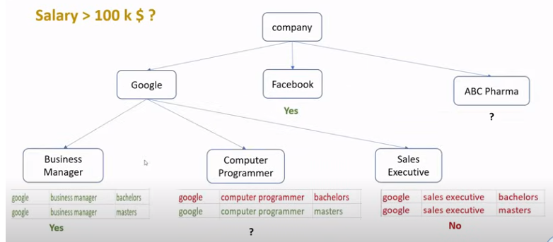
10.3 Decision Tree Classification Example
https://www.youtube.com/watch?v=PHxYNGo8NcI&list=PLeo1K3hjS3uvCeTYTeyfe0-rN5r8zn9rw&index=10
Decision Tree Classification Example (1:21-1:40/14:45)
How do we resolve two other companies?
Below diagram, we look at Google of job title, such as, business manager, computer programmer, and sales executive, we have yes and no for Business manger and sales executive, respectively.

Slide 12
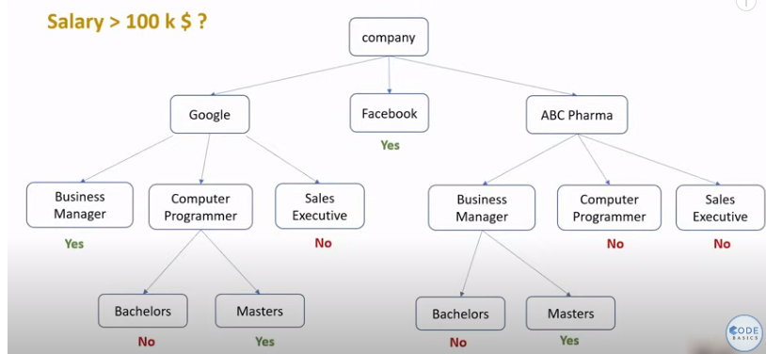

10.3 Decision Tree Classification Example
https://www.youtube.com/watch?v=PHxYNGo8NcI&list=PLeo1K3hjS3uvCeTYTeyfe0-rN5r8zn9rw&index=10
Decision Tree Classification Example (1:21-2:05/14:45)
We continue to iterate the classification and we have the complete decision tree as below diagram.
In the diagram, we classify by company names, job title, and degree.
Different order of feature selection will have have different diagrams and different algorithm performances.

Slide 13
10.4 Order of Features

Slide 14
10.4 Order of Features
https://www.youtube.com/watch?v=PHxYNGo8NcI&list=PLeo1K3hjS3uvCeTYTeyfe0-rN5r8zn9rw&index=10
Order of Features (2:06-2:15/14:45)
Question: How do we select the order of these features?
How Do We Select the Order of These Features?

Slide 15
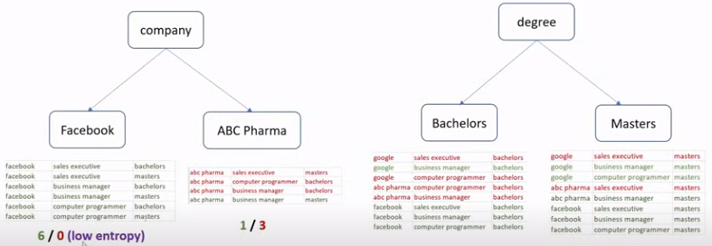
10.4 Order of Features
https://www.youtube.com/watch?v=PHxYNGo8NcI&list=PLeo1K3hjS3uvCeTYTeyfe0-rN5r8zn9rw&index=10
Order of Features (2:16-3:05/14:45)
Left below, we use the company as the first feature.
Right below, we use the degree as the first feature.
On the left, we are getting a purer subset.
In the pure subset means, all of the samples are same color (green). The entropy measure the randomness of our sample.
On the left below, in the company Facebook, there is no randomness. Every selected components are green. 6 green and 0 red. It is zero entropy.
Left below ABC Pharma has 1 green and 3 red. The majority samples are red. There is some entropy in ABC Pharma.

Slide 16
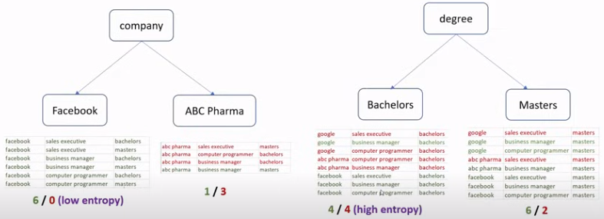
10.4 Order of Features
https://www.youtube.com/watch?v=PHxYNGo8NcI&list=PLeo1K3hjS3uvCeTYTeyfe0-rN5r8zn9rw&index=10
Order of Features (3:06-3:30/14:45)
On the right below.
1. Degree BS is 4 greens/4 reds: entropy = 1.
2. Degree MS is 6 greens / 2 reds.

Slide 17
10.4 Order of Features
https://www.youtube.com/watch?v=PHxYNGo8NcI&list=PLeo1K3hjS3uvCeTYTeyfe0-rN5r8zn9rw&index=10
Order of Features (3:31-3:50/14:45)
On the left hand side, we choose the company for low entropy with high information gain.
On the right hand side, we have low information gain.
We should use the approach which give us the high information gain at every split.
So, In the first split, we choose “company” as the first attribute
In the next split, we also choose the high information gain for the criteria to divide.
High Information Gain
Low Information Gain

Slide 18
10.5 Gini Impurity

Slide 19
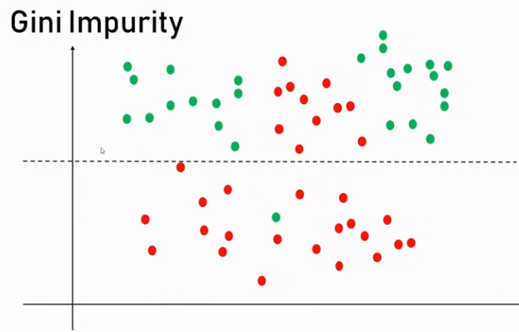
10.5 Gini Impurity
https://www.youtube.com/watch?v=PHxYNGo8NcI&list=PLeo1K3hjS3uvCeTYTeyfe0-rN5r8zn9rw&index=10
Gini Impurity (3:51-4:25/14:45)
What is Gini Impurity?
When we split into upper and bottom, most samples in the bottom are red, however, there is one green in the bottom. The green is called the “impurity”.

Slide 20
10.6 Read Dataset

Slide 21
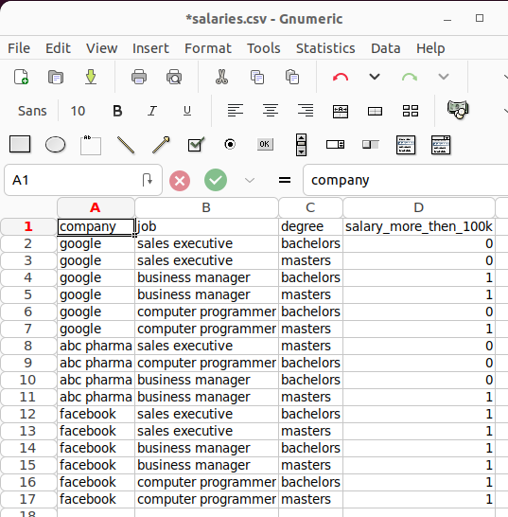
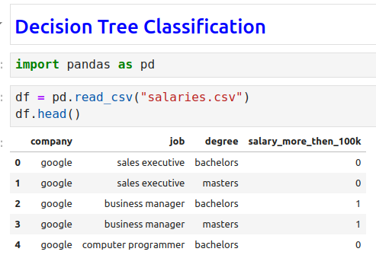
10.6 Read Dataset
https://www.youtube.com/watch?v=PHxYNGo8NcI&list=PLeo1K3hjS3uvCeTYTeyfe0-rN5r8zn9rw&index=10
Read Dataset (4:26-4:40/14:45)
Here,
1. We have dataset “salaries.csv”
2. We import pandas
3. read dataset “salaries.csv”
1
2
3

Slide 22
10.7 Input Feature and Output Target

Slide 23

10.7 Input Feature and Output Target
https://www.youtube.com/watch?v=PHxYNGo8NcI&list=PLeo1K3hjS3uvCeTYTeyfe0-rN5r8zn9rw&index=10
Input Feature and Output Target (4:41-5:30/14:45)
1. Inputs Features: Drop Target column. Keep company, job, and degree columns for input features.
2. Target: Salary column.

Slide 24
10.8 On Hot Encoding

Slide 25
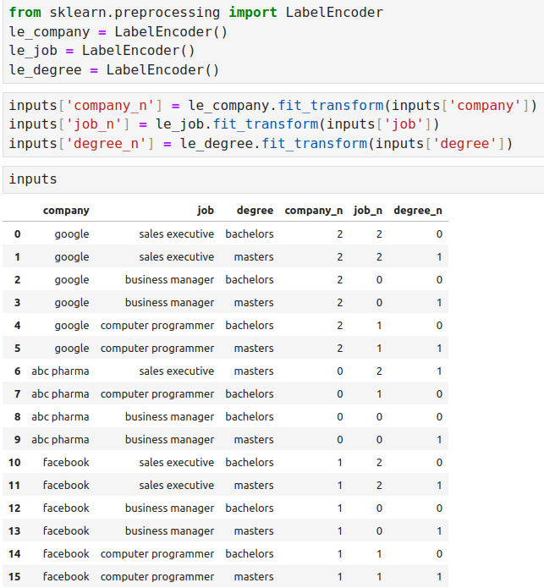
10.8 One Hot Encoding
https://www.youtube.com/watch?v=PHxYNGo8NcI&list=PLeo1K3hjS3uvCeTYTeyfe0-rN5r8zn9rw&index=10
One Hot Encoding (7:21-8:10/14:45)
On Hot Encoding (Label encoding) for company, job, and degree column.

Slide 26
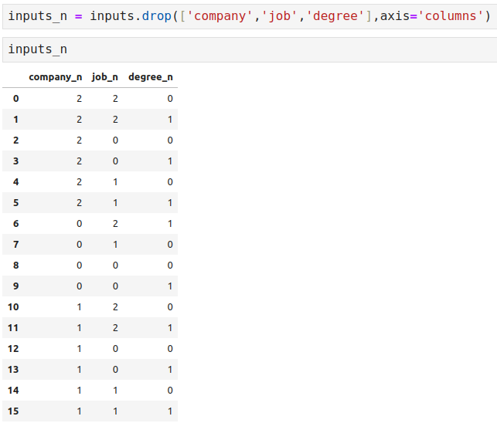
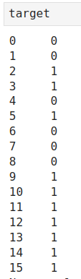
10.8 One Hot Encoding
https://www.youtube.com/watch?v=PHxYNGo8NcI&list=PLeo1K3hjS3uvCeTYTeyfe0-rN5r8zn9rw&index=10
One Hot Encoding (8:11-9:00/14:45)
Remove the original label, use one-hot encoding instead.

Slide 27
10.9 Decision Tree Model

Slide 28
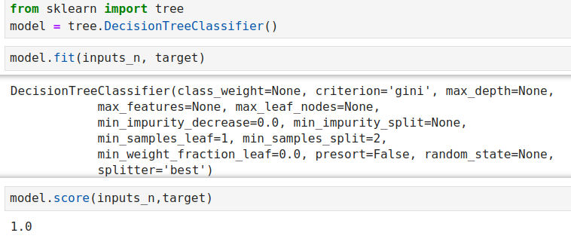
10.9 Decision Tree Model
https://www.youtube.com/watch?v=PHxYNGo8NcI&list=PLeo1K3hjS3uvCeTYTeyfe0-rN5r8zn9rw&index=10
Decision Tree Model (9:01-11:30/14:45)
1. Build Decision Tree Model and
2. Train Model.
3. Model Accuracy
1
2
3

Slide 29
10.10 Prediction

Slide 30
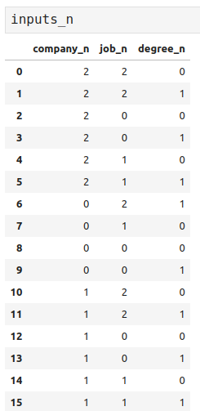
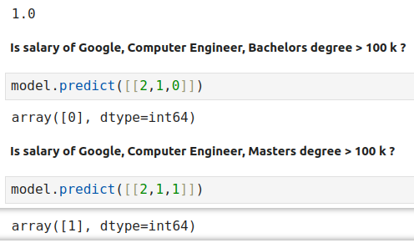
10.10 Prediction
https://www.youtube.com/watch?v=PHxYNGo8NcI&list=PLeo1K3hjS3uvCeTYTeyfe0-rN5r8zn9rw&index=10
Prediction (11:31-14:00/14:45)

Slide 31
10.11 Exercise

Slide 32
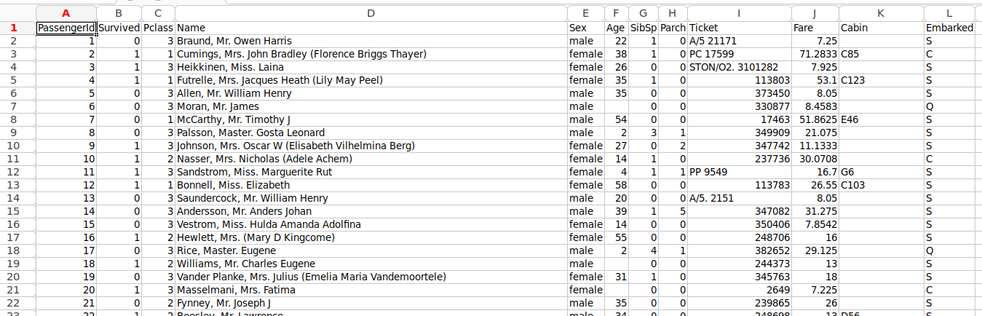
10.11 Exercise
https://www.youtube.com/watch?v=PHxYNGo8NcI&list=PLeo1K3hjS3uvCeTYTeyfe0-rN5r8zn9rw&index=10
Exercise (14:01-14:30/14:45)
Download the Titanic CSV from below link:
https://github.com/codebasics/py/blob/master/ML/9_decision_tree/Exercise/titanic.csv

Slide 33
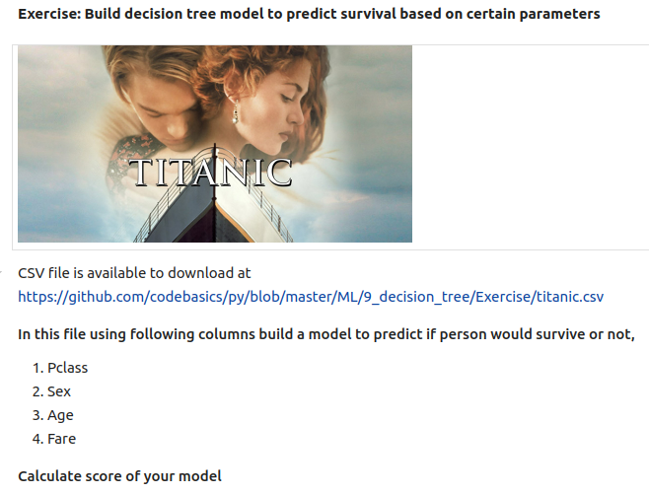
10.11 Exercise
https://www.youtube.com/watch?v=PHxYNGo8NcI&list=PLeo1K3hjS3uvCeTYTeyfe0-rN5r8zn9rw&index=10
Exercise (14:31-14:45/14:45)
In this file using following columns build a model to predict if person would survive or not.
Input features:
1. Pclass: Passenger class
2. Sex: Male/Female
3. Age
4. Fare: Pay amount
5. survived: no (0)/yes(1)
6. Build Decision Tree Model
7. Calculate score of your model¶

Slide 34
End

