Slide 1

19 KNN Classification
Peter H. Chen

Slide 2
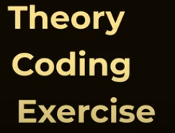
19 KNN Classification
https://www.youtube.com/watch?v=CQveSaMyEwM&list=PLeo1K3hjS3uvCeTYTeyfe0-rN5r8zn9rw&index=19
KNN Classification (0:00-0:10/15:41)
We discuss what is KNN (K Nearest Neighbor) Classification
We will talk Theory, Coding, and Exercise.

Slide 3
19.1 Introduction to KNN Calssification

Slide 4
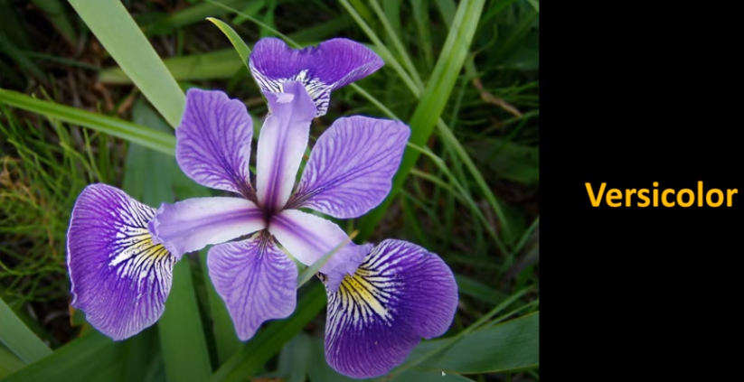
19.1 Introduction to KNN Calssification
https://www.youtube.com/watch?v=CQveSaMyEwM&list=PLeo1K3hjS3uvCeTYTeyfe0-rN5r8zn9rw&index=19
Introduction to KNN Classification (0:11-0:25/15:41)
Here, we do the classification for Iris flower.
We have Sepal width and length to figure out this is the Versicolor.

Slide 5
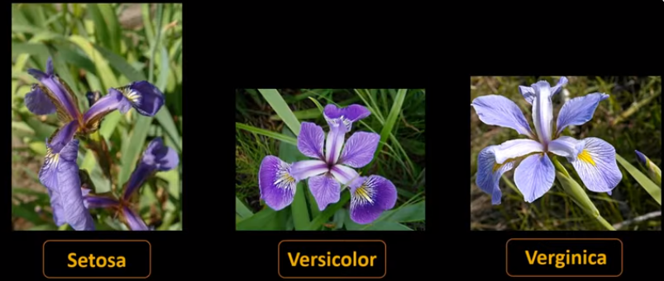
19.1 Introduction to KNN Calssification
https://www.youtube.com/watch?v=CQveSaMyEwM&list=PLeo1K3hjS3uvCeTYTeyfe0-rN5r8zn9rw&index=19
Introduction to KNN Classification (0:26-0:40/15:41)
Here, we have three types of Irish flowers: Setosa, Versicolor, and Verginica.

Slide 6
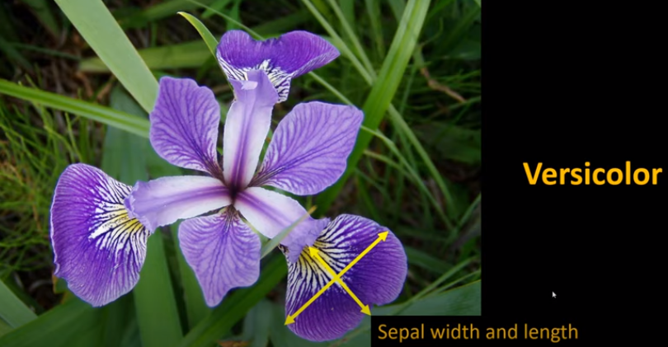
19.1 Introduction to KNN Calssification
https://www.youtube.com/watch?v=CQveSaMyEwM&list=PLeo1K3hjS3uvCeTYTeyfe0-rN5r8zn9rw&index=19
Introduction to KNN Classification (0:41-0:42/15:41)
We can figure the Versicolor flower based on Sepal width and height.

Slide 7
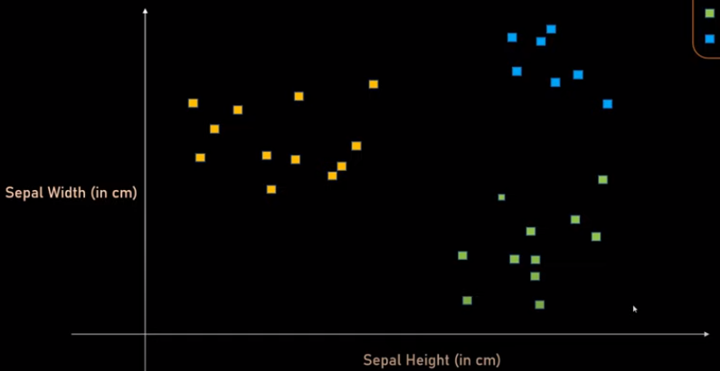

19.1 Introduction to KNN Calssification
https://www.youtube.com/watch?v=CQveSaMyEwM&list=PLeo1K3hjS3uvCeTYTeyfe0-rN5r8zn9rw&index=19
Introduction to KNN Classification (0:41-1:00/15:41)
We can plot sepal with and height in 2D scatter plot with known classes: Setosa, Veriscolor, and Verginica.

Slide 8
19.1 Introduction to KNN Calssification
https://www.youtube.com/watch?v=CQveSaMyEwM&list=PLeo1K3hjS3uvCeTYTeyfe0-rN5r8zn9rw&index=19
Introduction to KNN Classification (1:01-1:20/15:41)
Now, assume we have built the model. We have new yellow circle point.
We don’t know what class the yellow circle belong to. Using CNN, we want to figure out. By looking at the graph itself, we can immediate intuition that yellow circle belongs to the blue square which is Virginica. Because the yellow circle is near to the blur square cluster.
In KNN, first, we figure out what is the value of K by trial and error. There is no rule to specify the K value. Usually, K = 5. Here, we use the K = 3.

Slide 9
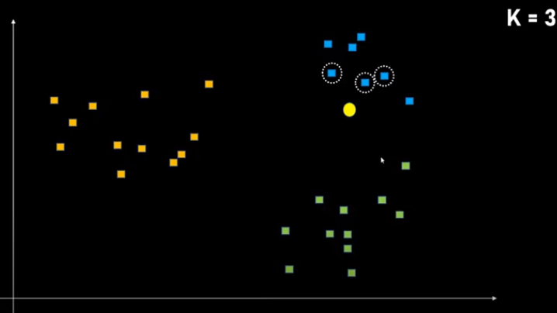
19.1 Introduction to KNN Calssification
https://www.youtube.com/watch?v=CQveSaMyEwM&list=PLeo1K3hjS3uvCeTYTeyfe0-rN5r8zn9rw&index=19
Introduction to KNN Classification (1:21-1:30/15:41)
Here, K =3, means that we need to figure out by the most nearby 3 data point.

Slide 10
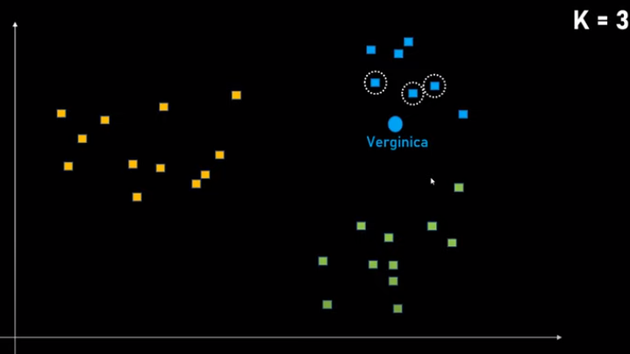
19.1 Introduction to KNN Calssification
https://www.youtube.com/watch?v=CQveSaMyEwM&list=PLeo1K3hjS3uvCeTYTeyfe0-rN5r8zn9rw&index=19
Introduction to KNN Classification (1:31-2:10/15:41)
These nearby three points are Virginica.
Since our data data is in the blue square category, therefore, this circle is Virginica which is blue category.

Slide 11
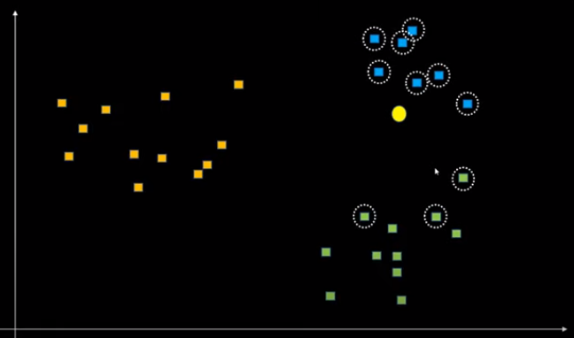


19.1 Introduction to KNN Calssification
https://www.youtube.com/watch?v=CQveSaMyEwM&list=PLeo1K3hjS3uvCeTYTeyfe0-rN5r8zn9rw&index=19
Introduction to KNN Classification (2:11-2:20/15:41)
Now, if we have K = 10. We figure it out by most nearby 10 data points.

Slide 12


19.1 Introduction to KNN Calssification
https://www.youtube.com/watch?v=CQveSaMyEwM&list=PLeo1K3hjS3uvCeTYTeyfe0-rN5r8zn9rw&index=19
Introduction to KNN Classification (2:21-2:30/15:41)
Here, we have Virginica = 7 and Versicolor = 3.
We take the highest number which is Verginica.

Slide 13
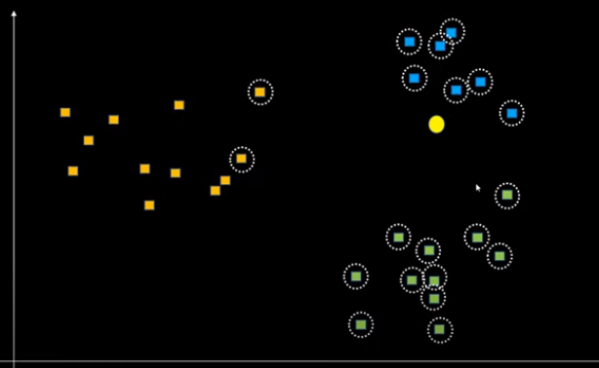

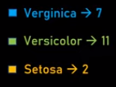
19.1 Introduction to KNN Calssification
https://www.youtube.com/watch?v=CQveSaMyEwM&list=PLeo1K3hjS3uvCeTYTeyfe0-rN5r8zn9rw&index=19
Introduction to KNN Classification (2:31-3:20/15:41)
If we take K = 20. We have the problem because we have Veriscolor = 12. We pick up the wrong category Veriscolor.

Slide 14

19.1 Introduction to KNN Calssification
https://www.youtube.com/watch?v=CQveSaMyEwM&list=PLeo1K3hjS3uvCeTYTeyfe0-rN5r8zn9rw&index=19
Introduction to KNN Classification (3:21-3:30/15:41)
We have to be carefully because the K should not be very small or very high.
We need to trial and error depends on the situation.
In this case, we need to calculate the distance of points and determine which cluster is belong to.

Slide 15
19.2 Import Library and Read Dataset

Slide 16
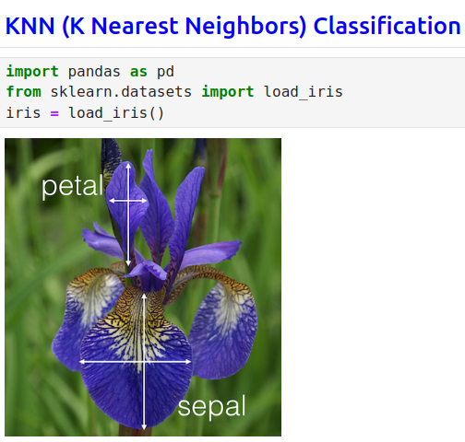
19.2 Import Library and Read Dataset
https://www.youtube.com/watch?v=CQveSaMyEwM&list=PLeo1K3hjS3uvCeTYTeyfe0-rN5r8zn9rw&index=19
Import Library and Read Dataset (3:31-4:00/15:41)

Slide 17
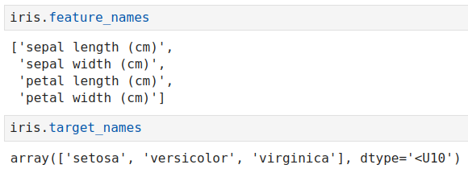
19.2 Import Library and Read Dataset
https://www.youtube.com/watch?v=CQveSaMyEwM&list=PLeo1K3hjS3uvCeTYTeyfe0-rN5r8zn9rw&index=19
Import Library and Read Dataset (4:01-4:30/15:41)

Slide 18
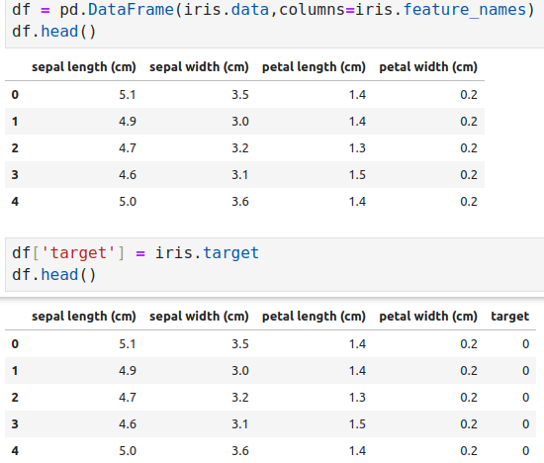
19.2 Import Library and Read Dataset
https://www.youtube.com/watch?v=CQveSaMyEwM&list=PLeo1K3hjS3uvCeTYTeyfe0-rN5r8zn9rw&index=19
Import Library and Read Dataset (4:31-5:00/15:41)

Slide 19
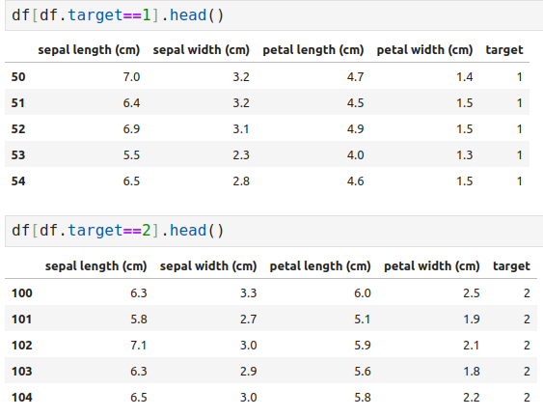
19.2 Import Library and Read Dataset
https://www.youtube.com/watch?v=CQveSaMyEwM&list=PLeo1K3hjS3uvCeTYTeyfe0-rN5r8zn9rw&index=19
Import Library and Read Dataset (5:01-5:30/15:41)

Slide 20
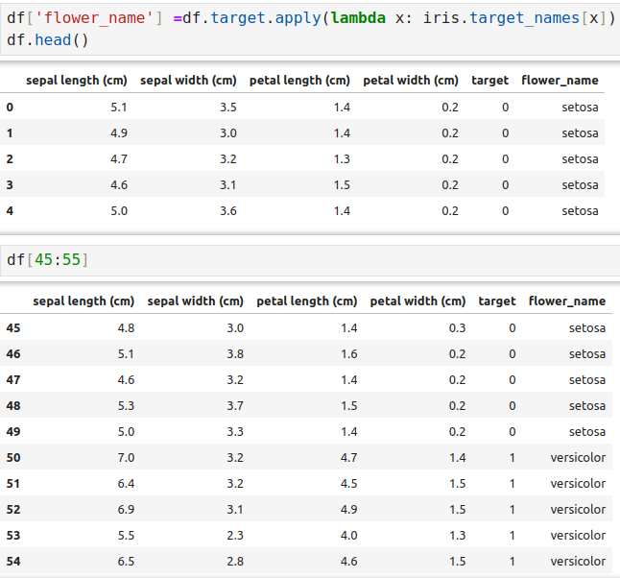
19.2 Import Library and Read Dataset
https://www.youtube.com/watch?v=CQveSaMyEwM&list=PLeo1K3hjS3uvCeTYTeyfe0-rN5r8zn9rw&index=19
Import Library and Read Dataset (5:31-6:30/15:41)

Slide 21

19.2 Import Library and Read Dataset
https://www.youtube.com/watch?v=CQveSaMyEwM&list=PLeo1K3hjS3uvCeTYTeyfe0-rN5r8zn9rw&index=19
Import Library and Read Dataset (6:31-7:30/15:41)

Slide 22
19.3 Plot Data

Slide 23
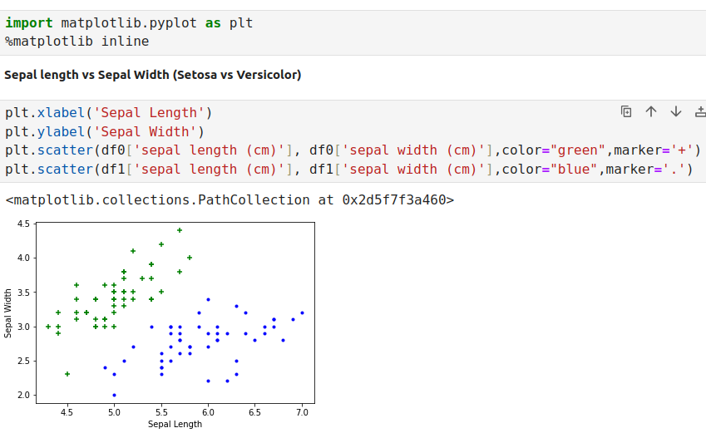
19.3 Plot Data
https://www.youtube.com/watch?v=CQveSaMyEwM&list=PLeo1K3hjS3uvCeTYTeyfe0-rN5r8zn9rw&index=19
Plot Data (7:31-8:30/15:41)

Slide 24
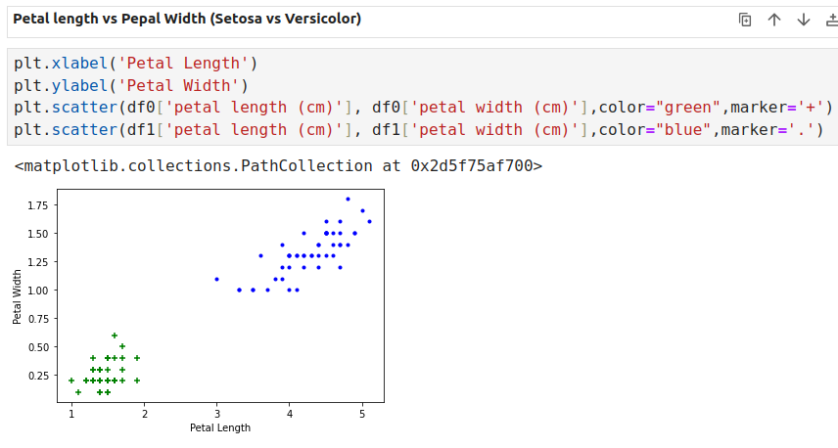
19.3 Plot Data
https://www.youtube.com/watch?v=CQveSaMyEwM&list=PLeo1K3hjS3uvCeTYTeyfe0-rN5r8zn9rw&index=19
Plot Data (8:31-9:30/15:41)

Slide 25
19.4 Split Data into Train and Test

Slide 26
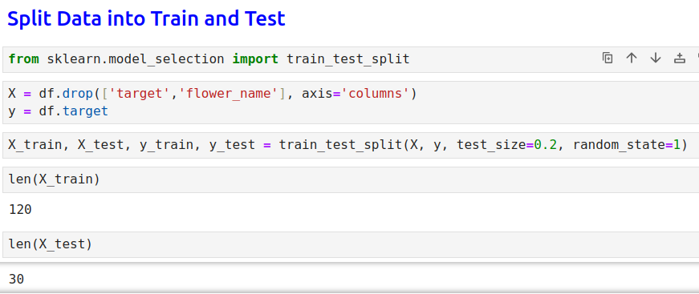
19.4 Split Data into Train and Test
https://www.youtube.com/watch?v=CQveSaMyEwM&list=PLeo1K3hjS3uvCeTYTeyfe0-rN5r8zn9rw&index=19
Split Data into Train and Test (9:31-10:30/15:41)

Slide 27
19.5 Create CNN

Slide 28
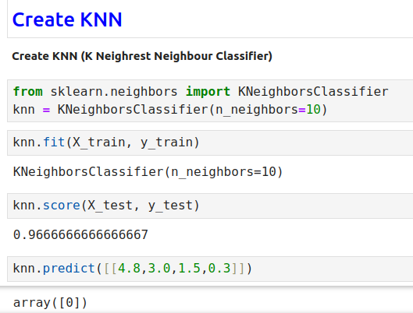
19.5 Create CNN
https://www.youtube.com/watch?v=CQveSaMyEwM&list=PLeo1K3hjS3uvCeTYTeyfe0-rN5r8zn9rw&index=19
Create CNN (10:31-11:30/15:41)

Slide 29
19.6 Plot Confusion Matrix

Slide 30
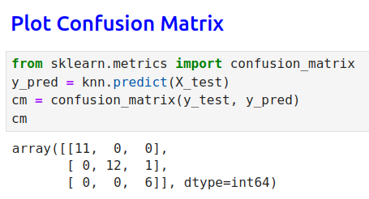
19.6 Plot Confusion Matrix
https://www.youtube.com/watch?v=CQveSaMyEwM&list=PLeo1K3hjS3uvCeTYTeyfe0-rN5r8zn9rw&index=19
Plot Confusion Matrix (11:31-12:30/15:41)

Slide 31
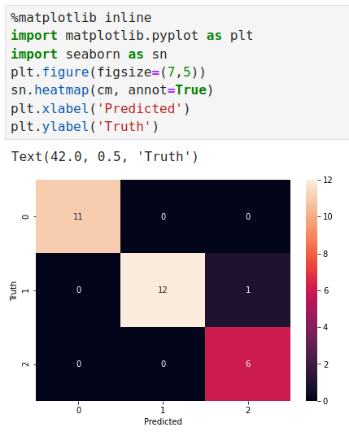
19.6 Plot Confusion Matrix
https://www.youtube.com/watch?v=CQveSaMyEwM&list=PLeo1K3hjS3uvCeTYTeyfe0-rN5r8zn9rw&index=19
Plot Confusion Matrix (12:31-13:30/15:41)

Slide 32
19.7 Print Classificaiton Report

Slide 33
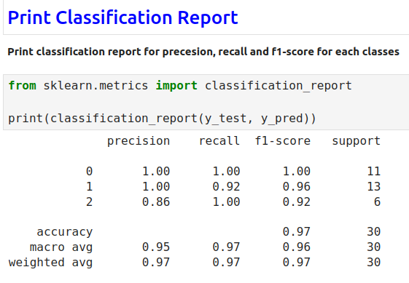
19.7 Print Classificaiton Report
https://www.youtube.com/watch?v=CQveSaMyEwM&list=PLeo1K3hjS3uvCeTYTeyfe0-rN5r8zn9rw&index=19
Print Classification Report (13:31-14:30/15:41)

Slide 34
19.8 Exercise

Slide 35
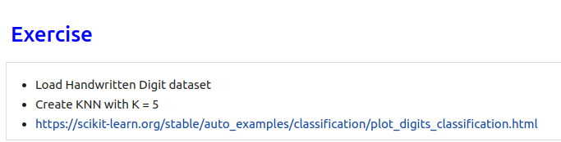
19.8 Exercise
https://www.youtube.com/watch?v=CQveSaMyEwM&list=PLeo1K3hjS3uvCeTYTeyfe0-rN5r8zn9rw&index=19
Exercise (14:31-15:40/15:41)
KNN with K = 5 by trial and error is the best answer.

Slide 36
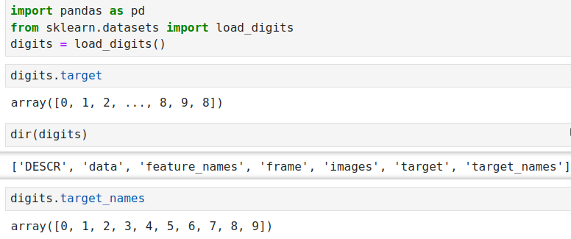
19.8 Exercise
https://www.youtube.com/watch?v=CQveSaMyEwM&list=PLeo1K3hjS3uvCeTYTeyfe0-rN5r8zn9rw&index=19
Exercise (14:41-14:50/15:41)

Slide 37
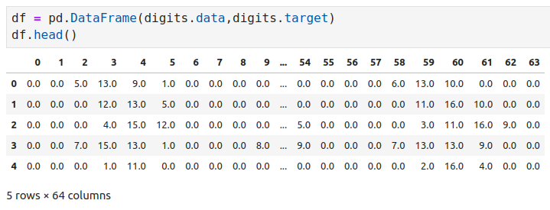
19.8 Exercise
https://www.youtube.com/watch?v=CQveSaMyEwM&list=PLeo1K3hjS3uvCeTYTeyfe0-rN5r8zn9rw&index=19
Exercise (14:51-15:00/15:41)

Slide 38
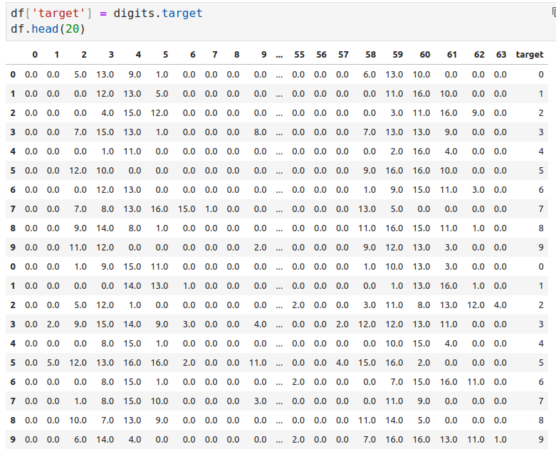
19.8 Exercise
https://www.youtube.com/watch?v=CQveSaMyEwM&list=PLeo1K3hjS3uvCeTYTeyfe0-rN5r8zn9rw&index=19
Exercise (15:01-15:10/15:41)

Slide 39
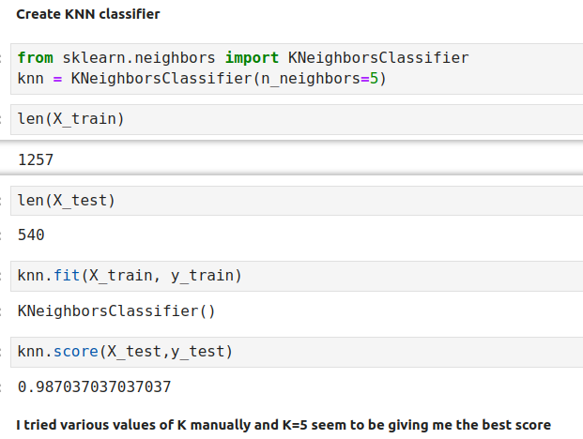
19.8 Exercise
https://www.youtube.com/watch?v=CQveSaMyEwM&list=PLeo1K3hjS3uvCeTYTeyfe0-rN5r8zn9rw&index=19
Exercise (15:11-15:20/15:41)

Slide 40
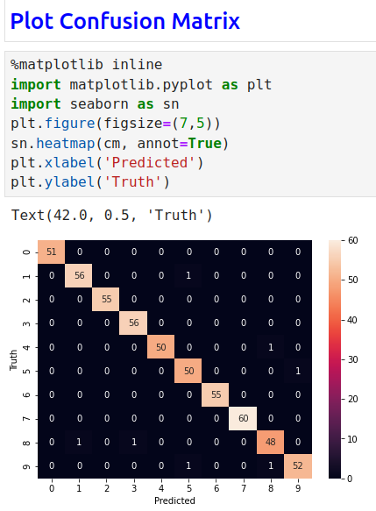
19.8 Exercise
https://www.youtube.com/watch?v=CQveSaMyEwM&list=PLeo1K3hjS3uvCeTYTeyfe0-rN5r8zn9rw&index=19
Exercise (15:21-15:30/15:41)

Slide 41
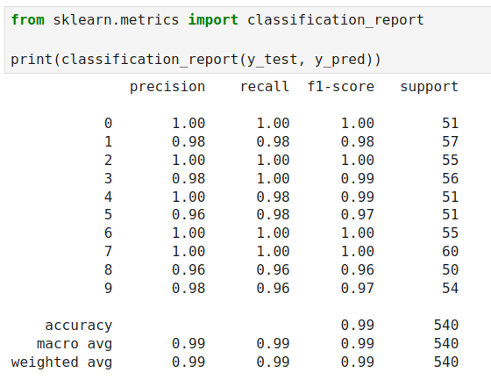
19.8 Exercise
https://www.youtube.com/watch?v=CQveSaMyEwM&list=PLeo1K3hjS3uvCeTYTeyfe0-rN5r8zn9rw&index=19
Exercise (15:31-15:41/15:41)
Print confusion matrix.

Slide 42
End

