Slide 1

9 Logic Regression: Multi-Class
Peter H. Chen

Slide 2
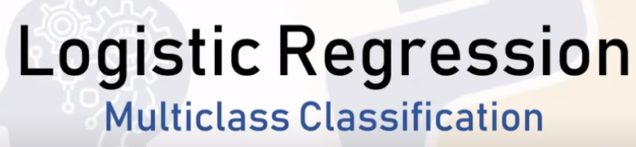
9 Logic Regression: Multi-Class Classification
https://www.youtube.com/watch?v=J5bXOOmkopc&list=PLeo1K3hjS3uvCeTYTeyfe0-rN5r8zn9rw&index=9
Logic Regression: Multi-Class Classification (0:00-0:05/15:42)
We discuss how to solve a Simple Classification problem using Logic Regression.

Slide 3
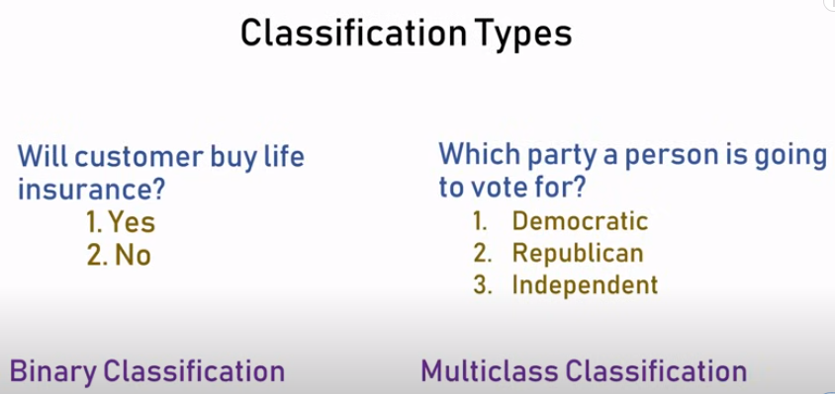
9 Logic Regression: Multi-Class Classification
https://www.youtube.com/watch?v=J5bXOOmkopc&list=PLeo1K3hjS3uvCeTYTeyfe0-rN5r8zn9rw&index=9
Logic Regression: Multi-Class Classification (0:05-0:30/15:42)
In the previous discussion, we discussed the Binary Classification in which the category is yes or no.
In this discussion, we will discuss the multi-class classification in which person has three choices: democratic, republican, and independent.

Slide 4

9 Logic Regression: Multi-Class Classification
https://www.youtube.com/watch?v=J5bXOOmkopc&list=PLeo1K3hjS3uvCeTYTeyfe0-rN5r8zn9rw&index=9
Logic Regression: Multi-Class Classification (0:31-0:40/15:42)
The identification of handwritten digit is a standard example for multi-class classification.
Below, the images maps to one of the output categories which is digit 0 to 9.
Identify Hand Written Digits Recognition
0
1
2
3
4
5
6
7
8
9

Slide 5

9 Logic Regression: Multi-Class Classification
https://www.youtube.com/watch?v=J5bXOOmkopc&list=PLeo1K3hjS3uvCeTYTeyfe0-rN5r8zn9rw&index=9
Logic Regression: Multi-Class Classification (0:41-0:50/15:42)
Similarly, below image maps to the output category digit 4.
We use a training set with a lot of target label character images and build a model using a logistic regression.
Identify Hand Written Digits Recognition
0
1
2
3
4
5
6
7
8
9

Slide 6
9.1 Import Library

Slide 7
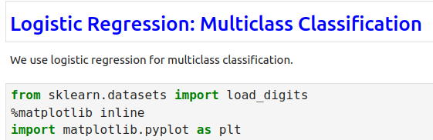
9.1 Import Library
https://www.youtube.com/watch?v=J5bXOOmkopc&list=PLeo1K3hjS3uvCeTYTeyfe0-rN5r8zn9rw&index=9
Import Library (0:51-1:00/15:42)
We import the below framework/library:
1. Import scikit-learn framework
2. Magic command to store graph
3. import matplotlib
https://scikit-learn.org/stable/auto_examples/datasets/plot_digits_last_image.html

Slide 8
9.2 Load Digit Dataset

Slide 9
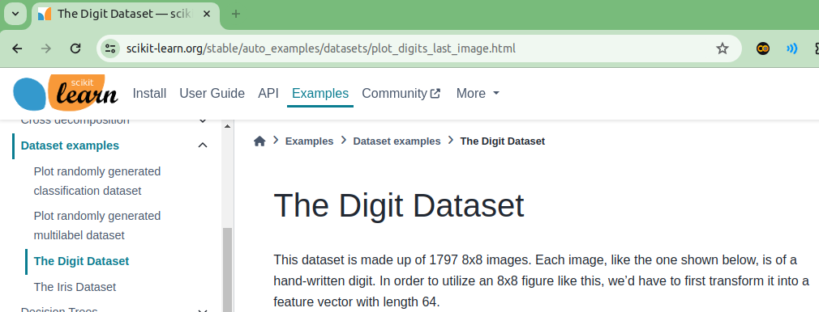
9.2 Load Digit Dataset
https://www.youtube.com/watch?v=J5bXOOmkopc&list=PLeo1K3hjS3uvCeTYTeyfe0-rN5r8zn9rw&index=9
Load Digit Dataset (1:01-1:20/15:42)
The hand written dataset is 1797 images. They are hand written digits. Each image is 8x8 pixels.
The scikit-learn provides api function load_digits() to load the dataset of all 1797 images.
https://scikit-learn.org/stable/auto_examples/datasets/plot_digits_last_image.html

Slide 10
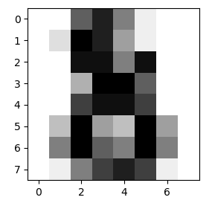
9.2 Load Digit Dataset
https://www.youtube.com/watch?v=J5bXOOmkopc&list=PLeo1K3hjS3uvCeTYTeyfe0-rN5r8zn9rw&index=9
Load Digit Dataset (1:21-1:35/15:42)
The image looks something as below.
https://scikit-learn.org/stable/auto_examples/datasets/plot_digits_last_image.html

Slide 11
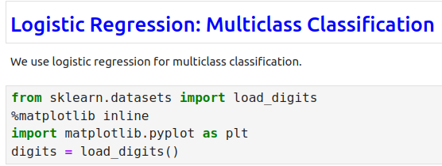
9.2 Load Digit Dataset
https://www.youtube.com/watch?v=J5bXOOmkopc&list=PLeo1K3hjS3uvCeTYTeyfe0-rN5r8zn9rw&index=9
Load Digit Dataset (1:21-1:35/15:42)
The image looks something as below.
https://scikit-learn.org/stable/auto_examples/datasets/plot_digits_last_image.html

Slide 12
9.3 Plot Digit Images

Slide 13
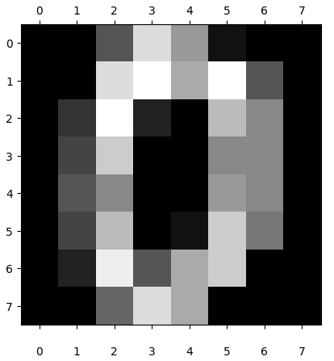
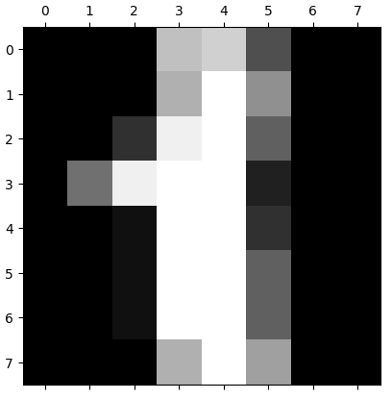

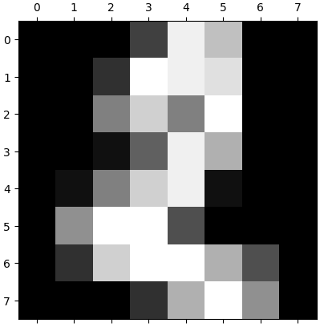
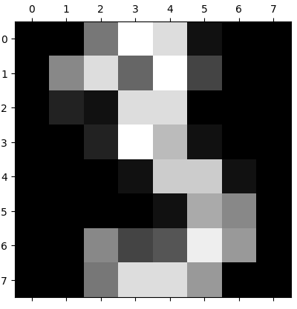
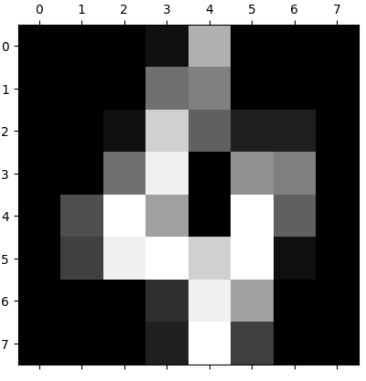
9.3 Plot Digit Images
1
2
https://www.youtube.com/watch?v=J5bXOOmkopc&list=PLeo1K3hjS3uvCeTYTeyfe0-rN5r8zn9rw&index=9
Plot Digit Images (1:36-2:00/15:42)
We plot 5 digit images from digit dataset.
3
3
4
4
5
5

Slide 14
9.4 Check Content of Data

Slide 15

9.4 Check Content of Data
https://www.youtube.com/watch?v=J5bXOOmkopc&list=PLeo1K3hjS3uvCeTYTeyfe0-rN5r8zn9rw&index=9
Check Content of Data (2:01-2:15/15:42)
We check the content of Data.

Slide 16
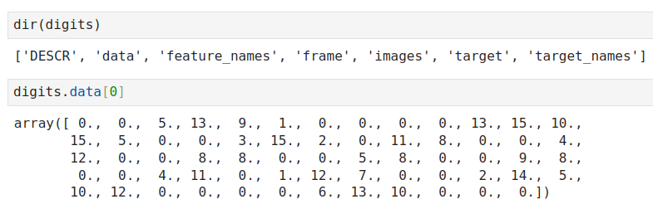
9.4 Check Content of Data
https://www.youtube.com/watch?v=J5bXOOmkopc&list=PLeo1K3hjS3uvCeTYTeyfe0-rN5r8zn9rw&index=9
Check Content of Data (2:16-4:30/15:42)
We check the first image zero, data[0].

Slide 17

9.4 Check Content of Data
1
2
https://www.youtube.com/watch?v=J5bXOOmkopc&list=PLeo1K3hjS3uvCeTYTeyfe0-rN5r8zn9rw&index=9
Check Content of Data (2:16-5:00/15:42)
Check targets
digits.target[0:5]
> [0, 1, 2, 3, 4]
3
4
5

Slide 18
9.5 Create Logistic Regression Model

Slide 19
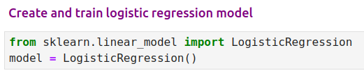
9.5 Create Logistic Regression Model
https://www.youtube.com/watch?v=J5bXOOmkopc&list=PLeo1K3hjS3uvCeTYTeyfe0-rN5r8zn9rw&index=9
Create Logistic Regressional Model (5:01-5:15/15:42)

Slide 20
9.6 Split Dataset

Slide 21
9.6 Split Dataset
https://www.youtube.com/watch?v=J5bXOOmkopc&list=PLeo1K3hjS3uvCeTYTeyfe0-rN5r8zn9rw&index=9
Split Dataset (5:16-6:50/15:42)

Slide 22
9.7 Train Logistic Regression Model

Slide 23
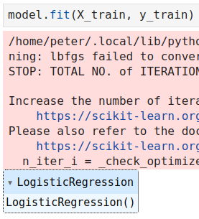
9.7 Train Logistic Regression Model
https://www.youtube.com/watch?v=J5bXOOmkopc&list=PLeo1K3hjS3uvCeTYTeyfe0-rN5r8zn9rw&index=9
Train Logistic Regression Model (6:51-7:30/15:42)

Slide 24
9.8 Test Data

Slide 25
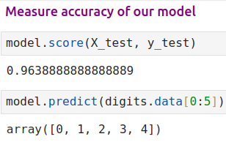
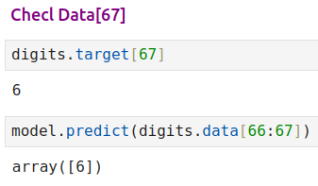
9.8 Test Data
https://www.youtube.com/watch?v=J5bXOOmkopc&list=PLeo1K3hjS3uvCeTYTeyfe0-rN5r8zn9rw&index=9
Test Data (7:31-8:30/15:42)

Slide 26
9.9 Model Accuracy

Slide 27
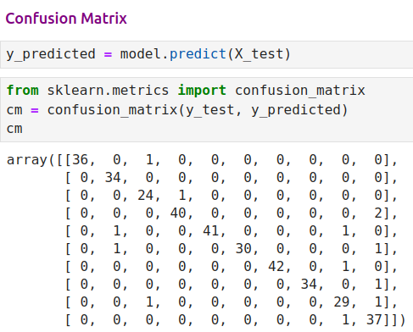
9.9 Model Accuracy
https://www.youtube.com/watch?v=J5bXOOmkopc&list=PLeo1K3hjS3uvCeTYTeyfe0-rN5r8zn9rw&index=9
Model Accuracy (8:31-10:30/15:42)

Slide 28
9.10 Seaborn Plot for Confusion Matrix

Slide 29
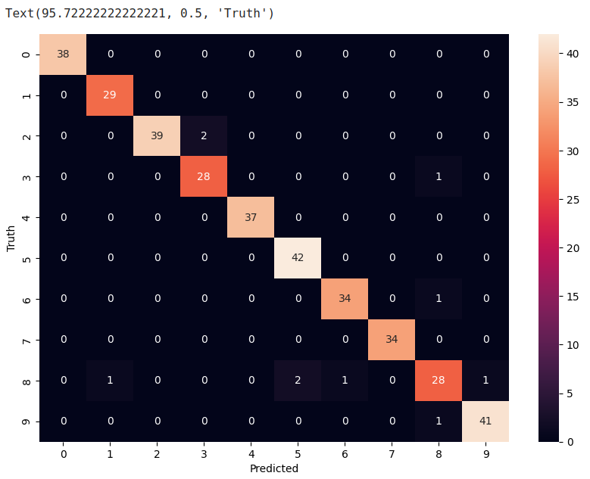
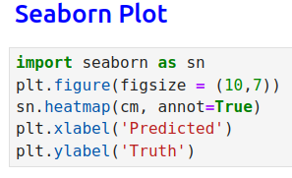
9.10 Seaborn Plot for Confusion Matrix
https://www.youtube.com/watch?v=J5bXOOmkopc&list=PLeo1K3hjS3uvCeTYTeyfe0-rN5r8zn9rw&index=9
Seaborn Plot for Confusion Matrix (11:31-14:00/15:42)

Slide 30
9.11 Exercise

Slide 31
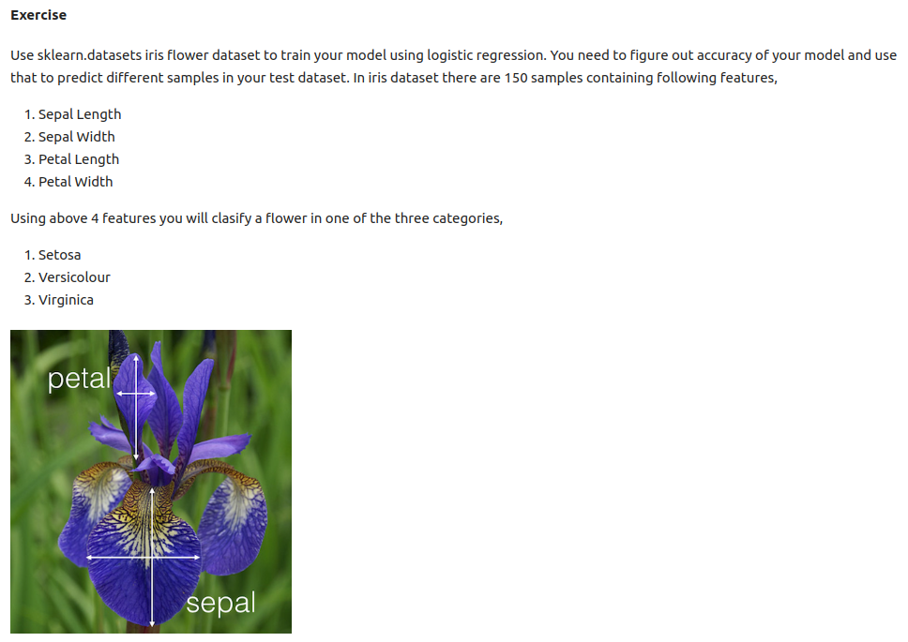
9.11 Exercise
https://www.youtube.com/watch?v=J5bXOOmkopc&list=PLeo1K3hjS3uvCeTYTeyfe0-rN5r8zn9rw&index=9
Exercise (14:01-15:42/15:42)
We have Irish flower with different sepal and petal length and width
We want to predict different Irish Flower: Setosa, Versicolor, and Virginica.

Slide 32
End

