Slide 1

8 Logic Regression: Binary Classification
Peter H. Chen

Slide 2
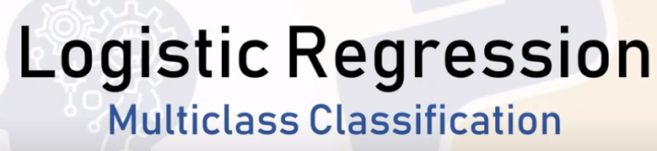
8 Logic Regression: Binary Classification
https://www.youtube.com/watch?v=zM4VZR0px8E&list=PLeo1K3hjS3uvCeTYTeyfe0-rN5r8zn9rw&index=8
Logic Regression: Binary Classification (0:00-0:05/19:18)
We discuss how to solve a simple Binary-Class Classification problem using Logic Regression.
Binary-Class Classification

Slide 3
8.1 Linear Regression vs Classification

Slide 4
8.1 Linear Regression vs Classification
https://www.youtube.com/watch?v=zM4VZR0px8E&list=PLeo1K3hjS3uvCeTYTeyfe0-rN5r8zn9rw&index=8
Linear Regression vs Classification (0:05-1:00/19:18)
We have two types of prediction problems:
1. The first type of problem is called Linear Regression. We build the linear regression model. This linear model can be used to predict home prices, weather, stock price, etc. All these examples have continuous prediction value. This kind of problem is called “Linear Regression”.
1. Linear Regression
2. Classification
1. Home Prices
2. Weather
3. Stock Price
Predicted value is continuous
1. Email is Spam or not
2. Will customer buy life insurance?
3. Which party that a person will vote for?
a. Democratic
b. Republican
c. Independent
Prediction value is Categorical

Slide 5
8.1 Linear Regression vs Classification
https://www.youtube.com/watch?v=zM4VZR0px8E&list=PLeo1K3hjS3uvCeTYTeyfe0-rN5r8zn9rw&index=8
Linear Regression vs Classification (1:01-1:20/19:18)
2. The second type of problem is called “Classification” problem, such as, Model predicts the email is spam or not? Model predicts customer will buy life insurance product? Model predict which party that a person will vote for? For all these problems, the prediction value is categorical. We try to predict is one of the three parties.
In Linear Regression, the model predicts number is any continuous number. In classification, the model predict the discrete categories.
1. Linear Regression
2. Classification
1. Home Prices
2. Weather
3. Stock Price
Predicted value is continuous
1. Email is Spam or not
2. Will customer buy life insurance?
3. Which party that a person will vote for?
a. Democratic
b. Republican
c. Independent
Prediction value is Categorical

Slide 6
8.2 Logic Regression

Slide 7

8.2 Logic Regression
https://www.youtube.com/watch?v=zM4VZR0px8E&list=PLeo1K3hjS3uvCeTYTeyfe0-rN5r8zn9rw&index=8
Logic Regression (1:21-1:25/19:18)
Logic Regression is one of the techniques used to solve the classification problems.

Slide 8
8.3 Classification Type

Slide 9
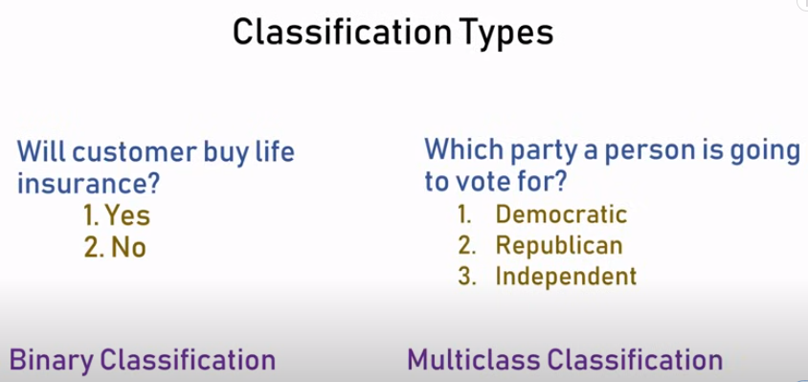
8.3 Classification Type
https://www.youtube.com/watch?v=zM4VZR0px8E&list=PLeo1K3hjS3uvCeTYTeyfe0-rN5r8zn9rw&index=8
Classification Type (1:26-1:50/19:18)
There are two types in the classification.
1. Binary Classification: There are binary classes, for example, yes or no
2. Multi-class Classification: There are multiple classes, such as, Democratic, Republican, or Independent.

Slide 10
8.4 Binary Classification

Slide 11
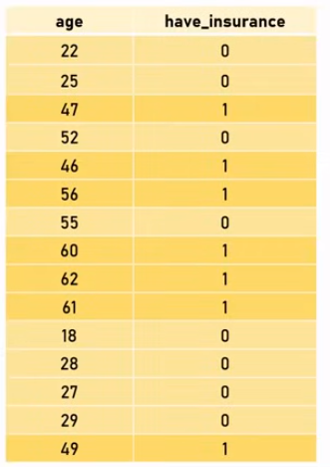
8.4 Binary Classification
https://www.youtube.com/watch?v=zM4VZR0px8E&list=PLeo1K3hjS3uvCeTYTeyfe0-rN5r8zn9rw&index=8
Binary Classification (1:51-2:55/19:18)
We have below dataset to predict the person will buy the life insurance or not based on their age. You can see
1. The young person is more likely not to buy the life insurance.
2. The older person is more likely to buy the life insurance.
The age increases is more likely to buy insurance. There is a linear relationship between age and buy insurance.
We want to build a machine learning model that can do the prediction based on the potential customer.

Slide 12
8.5 Age vs Insurance Plot

Slide 13
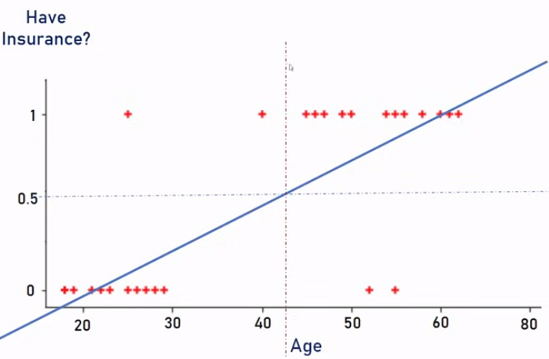
8.5 Age vs Insurance Plot
https://www.youtube.com/watch?v=zM4VZR0px8E&list=PLeo1K3hjS3uvCeTYTeyfe0-rN5r8zn9rw&index=8
Age vs. Insurance Plot (2:56-4:00/19:18)
Below, we have scatter plot and linear regression line for age vs “Have Insurance”.
We can predict the value with linear regression line. We can use 0.5 threshold to predict buy or not buy the insurance. On the right hand side, is “yes”. On the left hand side is “no”. There is some outlier, we don’t care too much because 90% of cases of linear regression are working well.

Slide 14
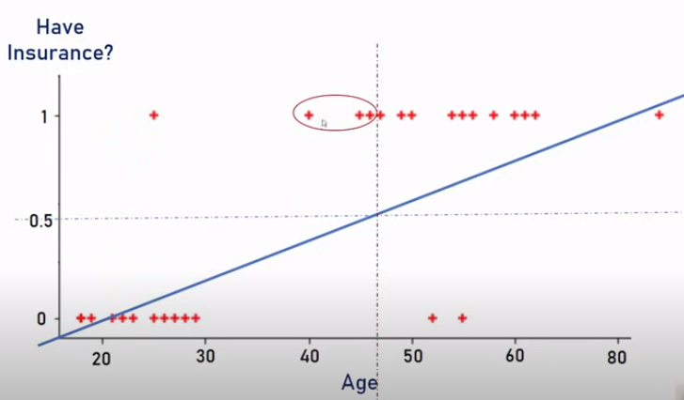
8.5 Age vs Insurance Plot
https://www.youtube.com/watch?v=zM4VZR0px8E&list=PLeo1K3hjS3uvCeTYTeyfe0-rN5r8zn9rw&index=8
Age vs. Insurance Plot (2:56-5:05/19:18)
Now, if one person age is more than 80, then the slope of linear regression is changed. The age threshold is change as well.
Here, we can see the problems in the data points. These age was shifted from buy insurance “yes” into “no”. This is pretty bad.

Slide 15
8.6 Binary Categorical Curve

Slide 16
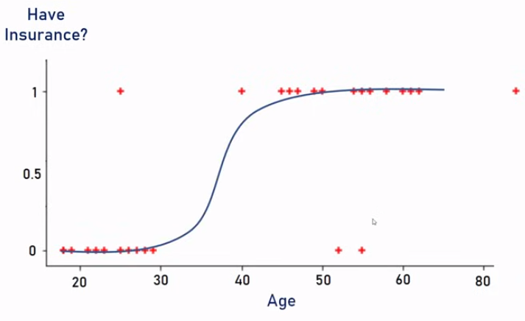
8.6 Binary Categorical Curve
https://www.youtube.com/watch?v=zM4VZR0px8E&list=PLeo1K3hjS3uvCeTYTeyfe0-rN5r8zn9rw&index=8
Binary Categorical Curve (5:06-5:20/19:18)
In Binary Classification, we draw a categorical curve as below.
This is binary classification curve is much better fit than the linear regression model we had before.

Slide 17
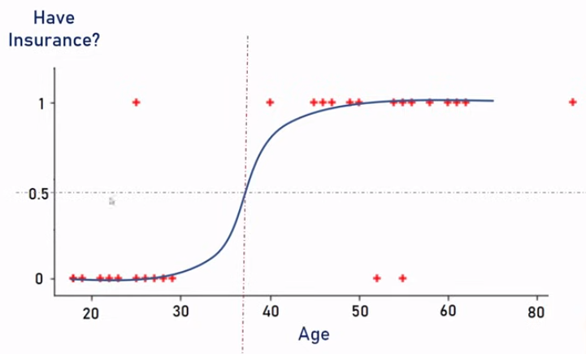
8.6 Binary Categorical Curve
https://www.youtube.com/watch?v=zM4VZR0px8E&list=PLeo1K3hjS3uvCeTYTeyfe0-rN5r8zn9rw&index=8
Binary Categorical Curve (5:21-5:40/19:18)
Here, we can much easily draw the 50% than the linear regression.
The quesiton comes up now is how to get the curve.

Slide 18
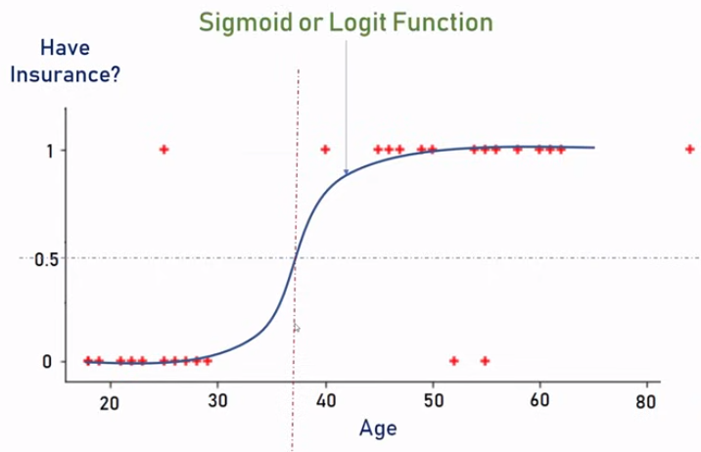
8.6 Binary Categorical Curve
https://www.youtube.com/watch?v=zM4VZR0px8E&list=PLeo1K3hjS3uvCeTYTeyfe0-rN5r8zn9rw&index=8
Binary Categorical Curve (5:41-6:05/19:18)
Here, we called this curve is the sigmoid or logit function.
We can google “sigmoid” and read about sigmoid or logit function.

Slide 19
8.7 Sigmoid/Logit Function

Slide 20
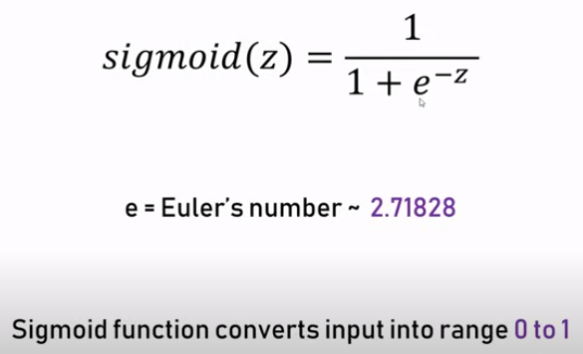
8.7 Sigmoid/Logit Function
https://www.youtube.com/watch?v=zM4VZR0px8E&list=PLeo1K3hjS3uvCeTYTeyfe0-rN5r8zn9rw&index=8
Sigmoid/Logit Function (6:06-7:10/19:18)
What is Sigmoid/Logit Function?
1. Sigmoid/Logit function (z) = 1/[1 + e^(-z)]
2. Where e is mathematical constant is called Euler’s number with the value ≈ 2.71828.
3. When we divided 1 by [1 + e^(-z)], the outcome will be always less than 1.
The sigmoid convert the input number into range between 0 and 1.
The shape looks like a s-shape

Slide 21
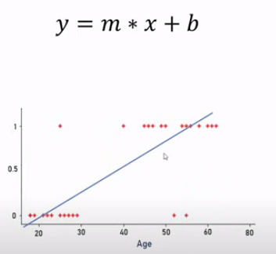
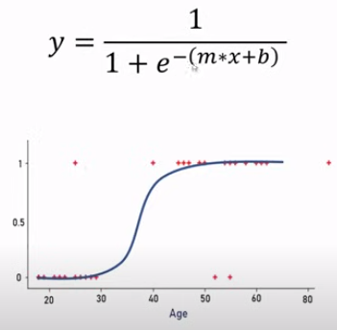
8.7 Sigmoid/Logit Function
https://www.youtube.com/watch?v=zM4VZR0px8E&list=PLeo1K3hjS3uvCeTYTeyfe0-rN5r8zn9rw&index=8
Sigmoid/Logit Function (7:11-8:20/19:18)
Here, we have a straight line in linear regression: y = m * x + b.
Now, we convert the linear line into a s-shape as right below.
The original data point remain the same, we just change the straight line into the s-shape.

Slide 22
8.8 Insurance Dataset

Slide 23
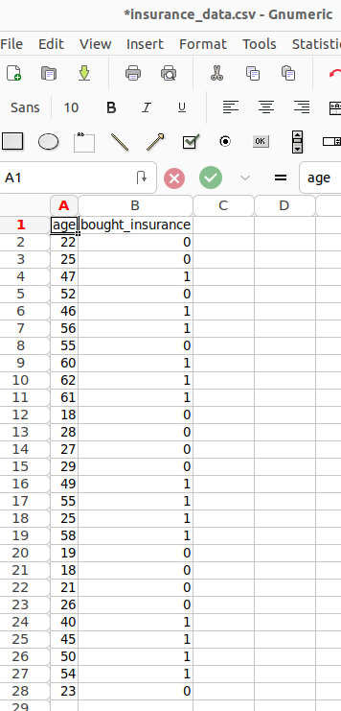
8.8 Insurance Dataset
https://www.youtube.com/watch?v=zM4VZR0px8E&list=PLeo1K3hjS3uvCeTYTeyfe0-rN5r8zn9rw&index=8
Insurance Dataset (8:21-8:30/19:18)
We have csv file that contains the insurance data.
You can see the data are two columns with
1. age and
2. whether the person bough the insurance or not.

Slide 24
8.9 Import Library

Slide 25
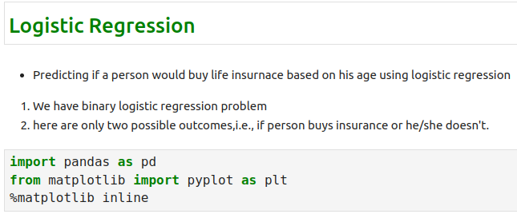
8.9 Import Library
https://www.youtube.com/watch?v=zM4VZR0px8E&list=PLeo1K3hjS3uvCeTYTeyfe0-rN5r8zn9rw&index=8
Import Library (8:21-8:40/19:18)
We import the
1. panda library for data frame
2. matplotlib for plot.
3. “%matplotlib inline” is a magic command to restore plot inside jupyter notebook.

Slide 26
8.10 Read CSV

Slide 27
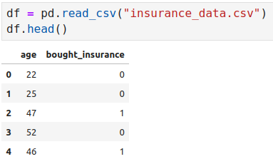
8.10 Read CSV
https://www.youtube.com/watch?v=zM4VZR0px8E&list=PLeo1K3hjS3uvCeTYTeyfe0-rN5r8zn9rw&index=8
Read CSV (8:41-8:50/19:18)
We read the CSV file.

Slide 28
8.11 Plot Scatter Data

Slide 29
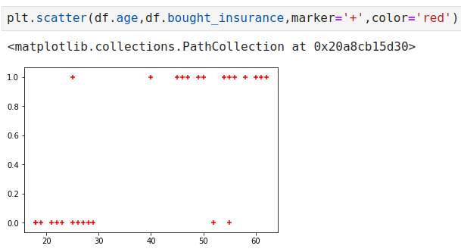
8.11 Plot Scatter Data
https://www.youtube.com/watch?v=zM4VZR0px8E&list=PLeo1K3hjS3uvCeTYTeyfe0-rN5r8zn9rw&index=8
Plot Scatter Data (8:51-9:10/19:18)

Slide 30
8.12 Split Dataset int Train and Test

Slide 31
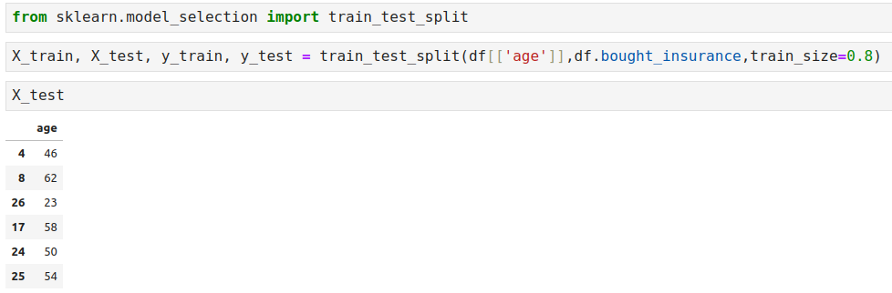
8.12 Split Dataset int Train and Test
https://www.youtube.com/watch?v=zM4VZR0px8E&list=PLeo1K3hjS3uvCeTYTeyfe0-rN5r8zn9rw&index=8
Split Dataset into Train and Test (9:11-12:30/19:18)

Slide 32
8.13 Train Logistic Regression Model

Slide 33
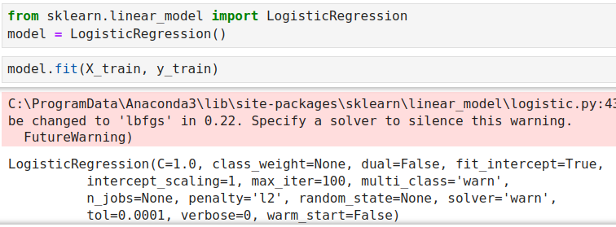
8.13 Train Logistic Regression Model
https://www.youtube.com/watch?v=zM4VZR0px8E&list=PLeo1K3hjS3uvCeTYTeyfe0-rN5r8zn9rw&index=8
Train Logistic Regression Model (12:31-14:00/19:18)

Slide 34
8.14 Logistic Regression Model Prediction

Slide 35
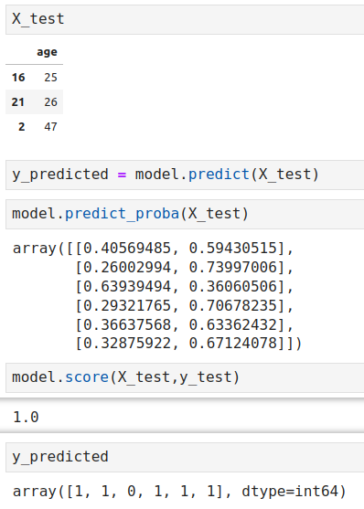
8.14 Logistic Regression Model Prediction
https://www.youtube.com/watch?v=zM4VZR0px8E&list=PLeo1K3hjS3uvCeTYTeyfe0-rN5r8zn9rw&index=8
Logistic Regression Model Prediction (14:01-14:30/19:18)

Slide 36
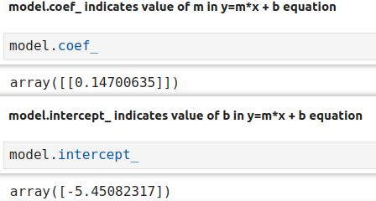
8.14 Logistic Regression Model Prediction
https://www.youtube.com/watch?v=zM4VZR0px8E&list=PLeo1K3hjS3uvCeTYTeyfe0-rN5r8zn9rw&index=8
Logistic Regression Model Prediction (14:31-15:00/19:18)
Check coefficient and intercept.

Slide 37
8.15 Define Your Own Sigmoid Function

Slide 38
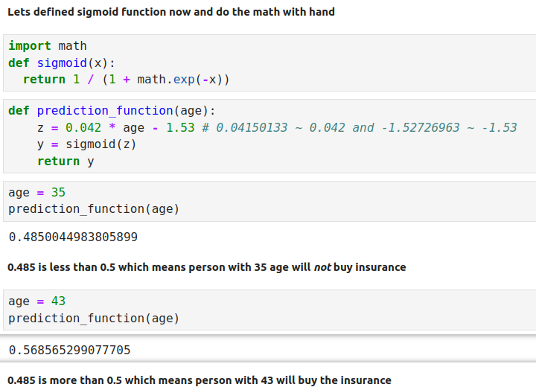
8.15 Define Your Own Sigmoid Function
https://www.youtube.com/watch?v=zM4VZR0px8E&list=PLeo1K3hjS3uvCeTYTeyfe0-rN5r8zn9rw&index=8
Define Your Own Sigmoid Function (14:31-16:00/19:18)

Slide 39
8.16 Exercise

Slide 40
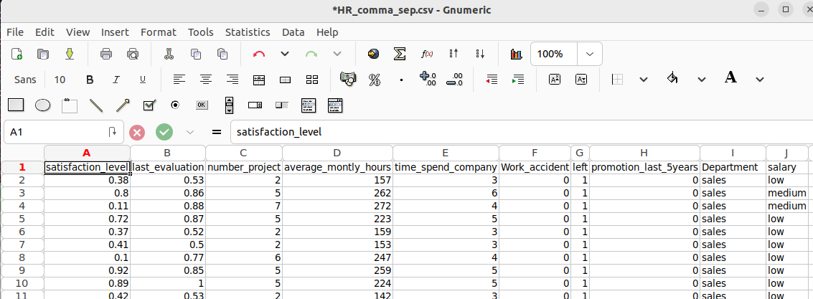
8.16 Exercise
https://www.youtube.com/watch?v=zM4VZR0px8E&list=PLeo1K3hjS3uvCeTYTeyfe0-rN5r8zn9rw&index=8
Exercise (16:01-16:30/19:18)
Download employee retention dataset (HR_comma_sep.csv) as below from here: https://www.kaggle.com/giripujar/hr-analytics

Slide 41
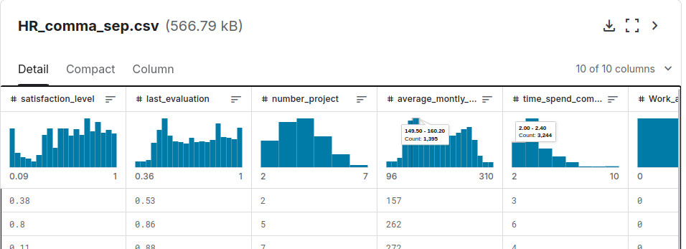
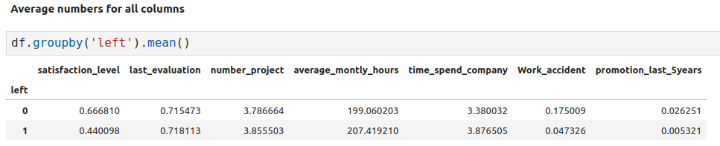
8.16 Exercise
https://www.youtube.com/watch?v=zM4VZR0px8E&list=PLeo1K3hjS3uvCeTYTeyfe0-rN5r8zn9rw&index=8
Exercise (16:31-17:00/19:18)
1. Now, do some exploratory data analysis to figure out which variables have direct and clear impact on employee retention, i.e., whether they leave the company or continue to work.

Slide 42
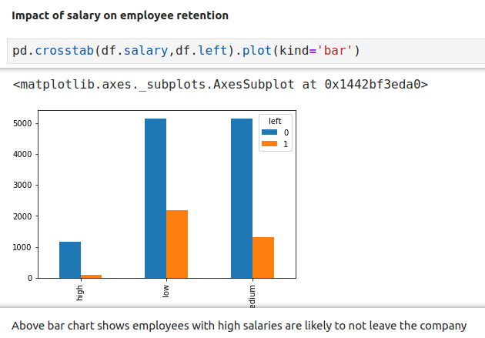
8.16 Exercise
https://www.youtube.com/watch?v=zM4VZR0px8E&list=PLeo1K3hjS3uvCeTYTeyfe0-rN5r8zn9rw&index=8
Exercise (17:01-17:30/19:18)
2. Plot bar charts showing impact of employee salaries on retention

Slide 43
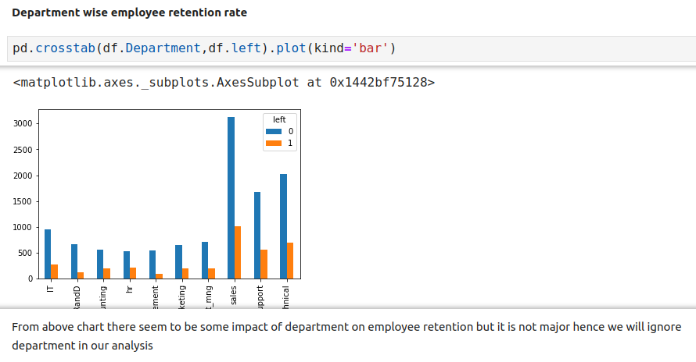
8.16 Exercise
https://www.youtube.com/watch?v=zM4VZR0px8E&list=PLeo1K3hjS3uvCeTYTeyfe0-rN5r8zn9rw&index=8
Exercise (17:31-18:00/19:18)
3. Plot bar charts showing corelation between department and employee retention

Slide 44
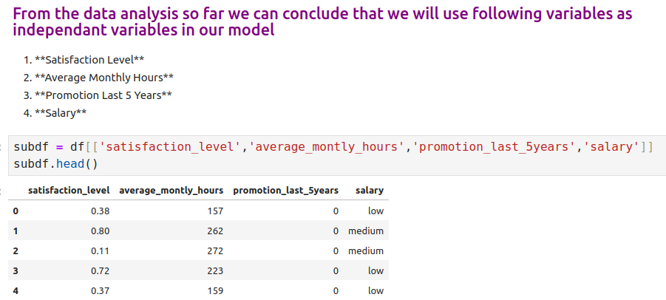
8.16 Exercise
https://www.youtube.com/watch?v=zM4VZR0px8E&list=PLeo1K3hjS3uvCeTYTeyfe0-rN5r8zn9rw&index=8
Exercise (18:01-18:30/19:18)
4. Now build logistic regression model using variables that were narrowed down in step 1.

Slide 45
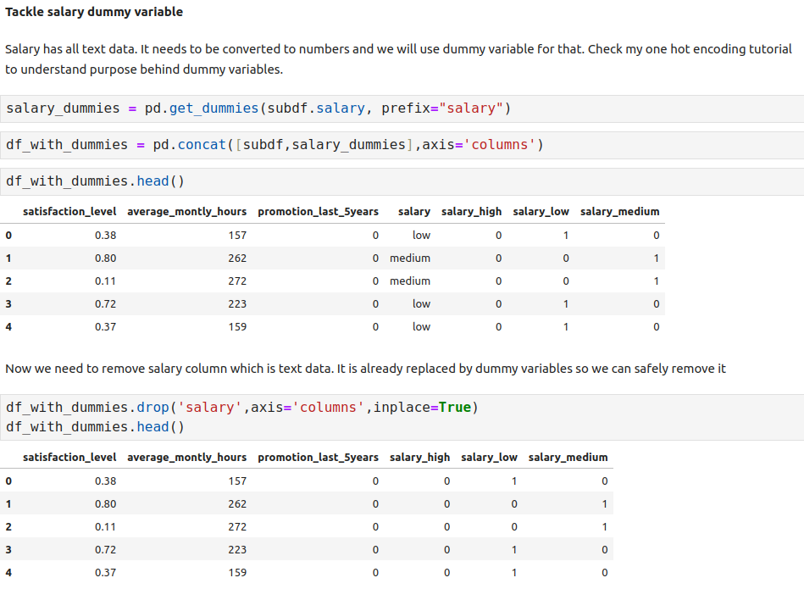
8.16 Exercise
https://www.youtube.com/watch?v=zM4VZR0px8E&list=PLeo1K3hjS3uvCeTYTeyfe0-rN5r8zn9rw&index=8
Exercise (18:31-19:00/19:18)
4. Now build logistic regression model using variables that were narrowed down in step 1.

Slide 46
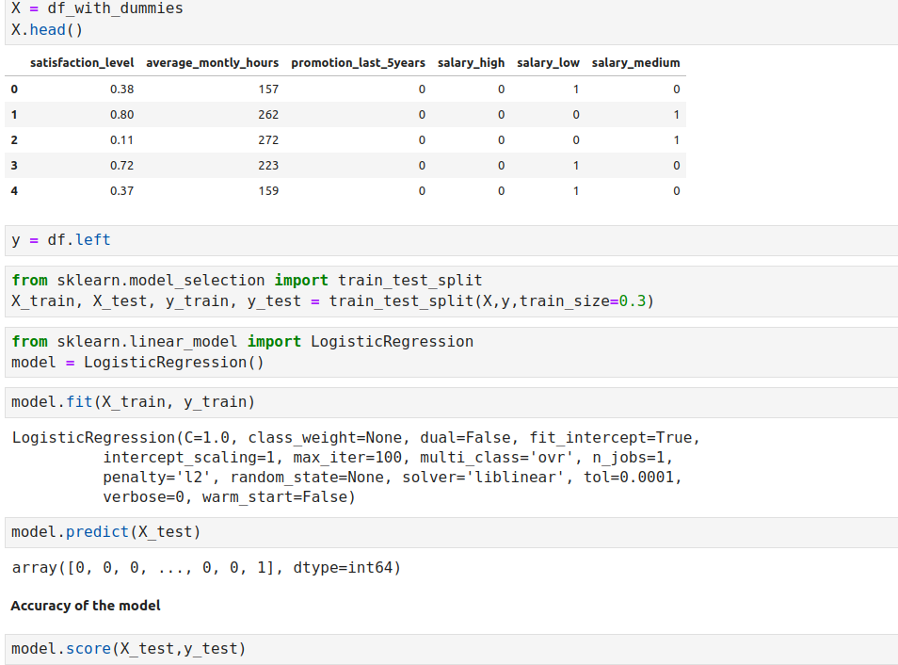
8.16 Exercise
https://www.youtube.com/watch?v=zM4VZR0px8E&list=PLeo1K3hjS3uvCeTYTeyfe0-rN5r8zn9rw&index=8
Exercise (19:01-19:18/19:18)
5. Measure the accuracy of the model.

Slide 47
End

