Slide 1

14 K-Mean Cluster Algorithm
Peter H. Chen

Slide 2
14 K-Mean Cluster Algorithm
https://www.youtube.com/watch?v=EItlUEPCIzM&list=PLeo1K3hjS3uvCeTYTeyfe0-rN5r8zn9rw&index=14
K-Mean Cluster Algorithm (0:00-0:30/25:14)
Machine learning algorithm are classified into three main categories.
1. Supervised learning
2. Unsupervised learning
3. Reinforcement learning
Up to now, we have already seen the Supervised Learning. In supervised learning, the dataset contains the features and labeled target variable/label or class variable/label.
In unsupervised learning, we only have the features, we do not have labeled target variable (or class label). Using this unsupervised dataset, we try to understand the underlying structure in the data or sometimes, we try to find the clusters in the data. After unsupervised learning, we can make useful prediction out of it.
In this discussion, we discuss K-Mean clustering algorithm which is a very popular algorithm.

Slide 3
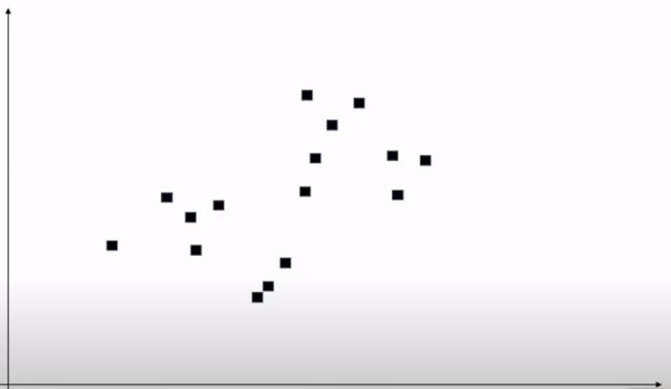
14 K-Mean Cluster Algorithm
https://www.youtube.com/watch?v=EItlUEPCIzM&list=PLeo1K3hjS3uvCeTYTeyfe0-rN5r8zn9rw&index=14
K-Mean Cluster Algorithm (0:31-1:00/25:14)
We have below dataset. The x and y represent two different features.
Note that we do not have labeled target variable. We want to identify this dataset.

Slide 4
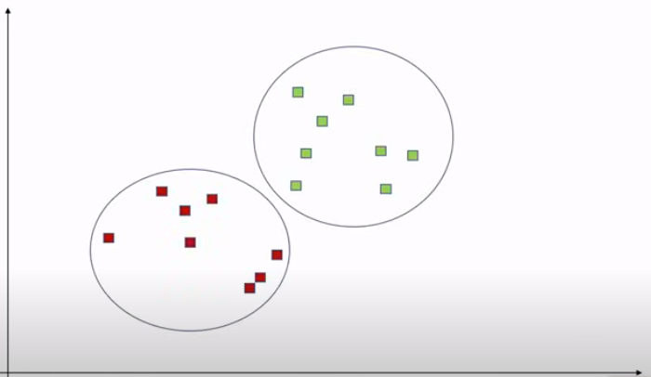
14.1 What is K-Mean Clustering Algorithm?
https://www.youtube.com/watch?v=EItlUEPCIzM&list=PLeo1K3hjS3uvCeTYTeyfe0-rN5r8zn9rw&index=14
K-Mean Cluster Algorithm (1:01-1:40/25:14)
Since the dataset is given to us, we don’t have any information the target variable. All we are tying to do is identify some structure in the data.
Below, one way we looking into it is divide data into two clusters. K-Means helps us identify these clusters. Now, K in K-means is a parameter. Before you start the algorithm, the value of K that you are looking for. Here K = 2.

Slide 5
14.1 Step 1: Random Select K-Points

Slide 6
14.1 Step 1: Random Select K-Points
https://www.youtube.com/watch?v=EItlUEPCIzM&list=PLeo1K3hjS3uvCeTYTeyfe0-rN5r8zn9rw&index=14
Step 1: Random Select K-Points (1:41-1:50/25:14)
Below is the data of dataset. We start with K = 2.
The first step is to identify two random points which we consider the center of those clusters. We called these center points as centroids.

Slide 7
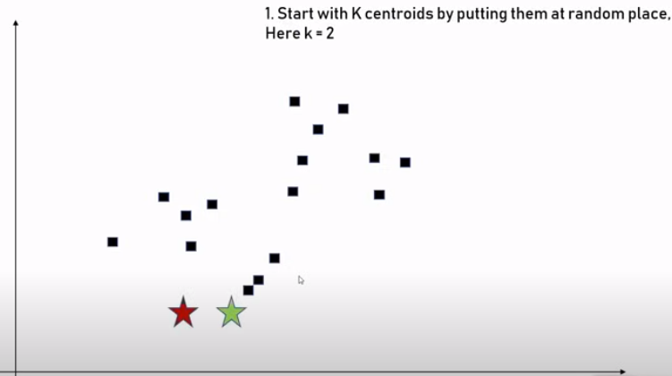
14.1 Step 1: Random Select K-Points
https://www.youtube.com/watch?v=EItlUEPCIzM&list=PLeo1K3hjS3uvCeTYTeyfe0-rN5r8zn9rw&index=14
Step 1: Random Select K-Points (1:51-2:00/25:14)
Here, we just put two random points, i.e., K =2. These points are called centroids.
If we have K = 3, we have three random points. The selected random points can be placed anywhere in this 2D place. It does not matter which K-points are selected.

Slide 8
14.2 Step 2: Determine Centroid

Slide 9
14.2 Step 2: Determine Cluster Centroid
https://www.youtube.com/watch?v=EItlUEPCIzM&list=PLeo1K3hjS3uvCeTYTeyfe0-rN5r8zn9rw&index=14
Step 2: Determine Cluster Centroid (2:01-2:30/25:14)
Here, we determine the distance from each of these centroids.
For example,
1. The data point is closer to red centroid, then data data point belong to Red cluster.
2. The data point is closer to Green centroid, then the data point belongs to Green cluster.

Slide 10
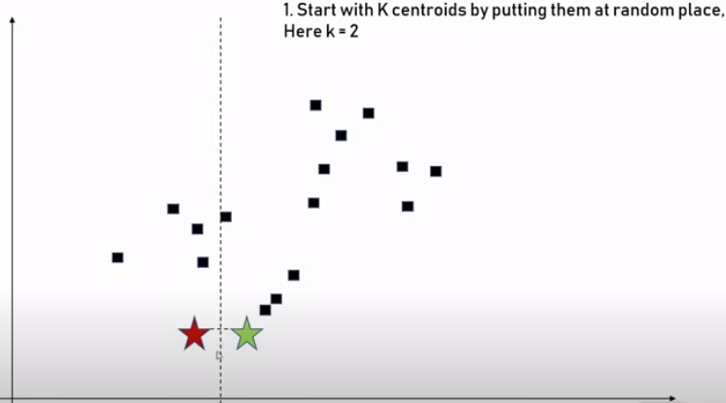
14.2 Step 2: Determine Cluster Centroid
https://www.youtube.com/watch?v=EItlUEPCIzM&list=PLeo1K3hjS3uvCeTYTeyfe0-rN5r8zn9rw&index=14
Step 2: Determine Cluster Centroid (2:31-3:00/25:14)
The simple way to determine the distance is to draw a perpendicular line between these two centroids. Any points on the left hand side is red cluster. Any points on the right hand side is green cluster.

Slide 11
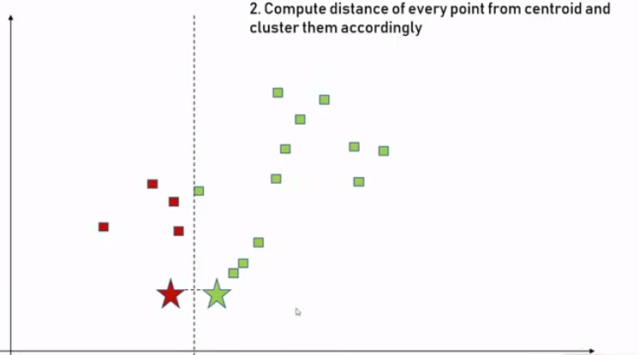
14.2 Step 2: Determine Cluster Centroid
https://www.youtube.com/watch?v=EItlUEPCIzM&list=PLeo1K3hjS3uvCeTYTeyfe0-rN5r8zn9rw&index=14
Step 2: Determine Cluster Centroid (3:01-3:30/25:14)
We have two imperfect clunky clusters.
Now, we improve these clusters to become better and better. We will adjust the centroid of these two clusters.
For example, we have 4 red point for the red cluster and 12 green points for green cluster.

Slide 12
14.3 Step 3: Adjust Centroid

Slide 13
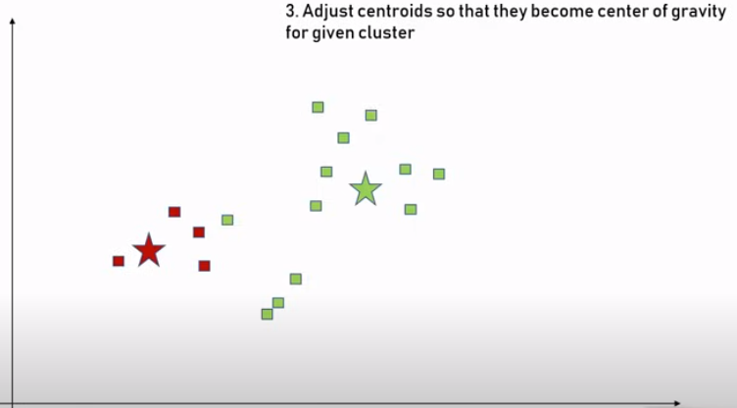
14.3 Step 3: Adjust Centroid
https://www.youtube.com/watch?v=EItlUEPCIzM&list=PLeo1K3hjS3uvCeTYTeyfe0-rN5r8zn9rw&index=14
Step 3: Adjust Centroid (3:31-3:50/25:14)
Now, we adjust the Centroids to become center of clusters.
And we repeat the same process again and again.

Slide 14
14.4 Step 4: Calculate Distance to Centroid

Slide 15
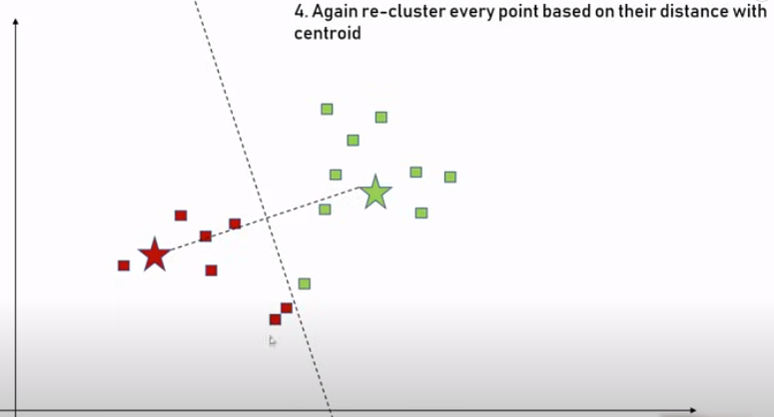
14.4 Step 4: Calculate Distance to Centroid
https://www.youtube.com/watch?v=EItlUEPCIzM&list=PLeo1K3hjS3uvCeTYTeyfe0-rN5r8zn9rw&index=14
Step 4: Calculate Distance to Centroid (3:51-4:00/25:14)
We re-cluster with selected two other points and draw a perpendicular line between the mid points of two selected points.
We keep selecting the new centroids and recalculate the distance of individual data points from these selected centroid and readjust the clusters.

Slide 16
14.5 Step 5: Adjust Centroid

Slide 17
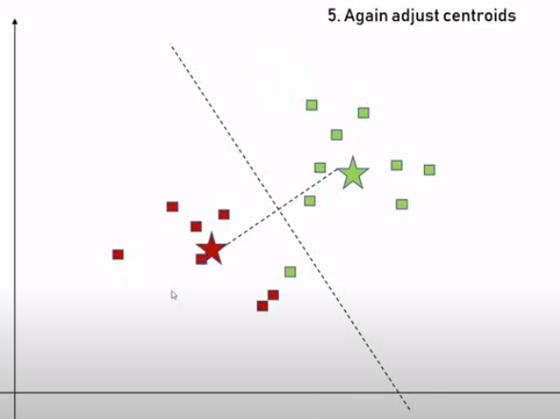
14.5 Step 5: Adjust Centroid
https://www.youtube.com/watch?v=EItlUEPCIzM&list=PLeo1K3hjS3uvCeTYTeyfe0-rN5r8zn9rw&index=14
Step 5: Adjust Centroid (4:01-4:20/25:14)
We Adjust the centroids.

Slide 18
14.6 Step 6: Re-Compute Distance

Slide 19
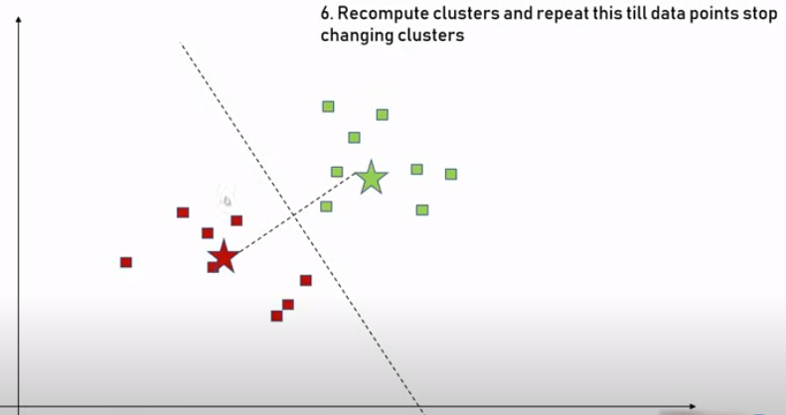
14.6 Step 6: Re-Compute Distance
https://www.youtube.com/watch?v=EItlUEPCIzM&list=PLeo1K3hjS3uvCeTYTeyfe0-rN5r8zn9rw&index=14
Step 6: Re-Compute Distance (4:21-4:30/25:14)
We rec-compute all the distances of data points for each cluster.

Slide 20
14.7 Final Cluster

Slide 21
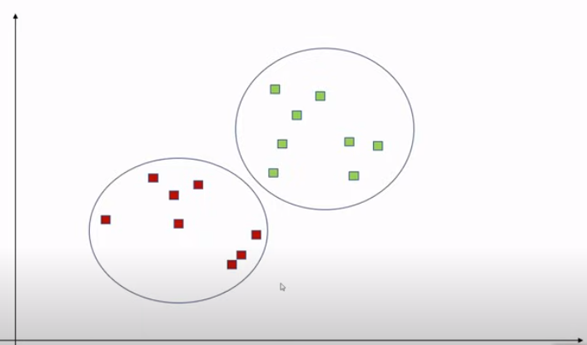
14.7 Final Cluster
https://www.youtube.com/watch?v=EItlUEPCIzM&list=PLeo1K3hjS3uvCeTYTeyfe0-rN5r8zn9rw&index=14
Final Cluster (4:31-4:50/25:14)
Now, we have the final clusters.
The most important thing here is we must supply K to K-Mean algorithm.

Slide 22
14.8 How to Determine K?

Slide 23
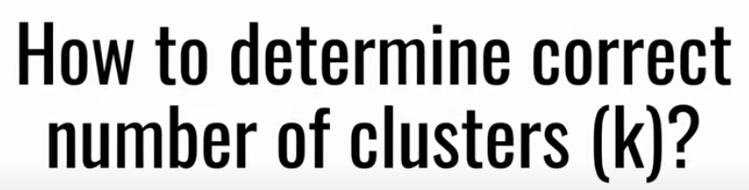
14.8 How to Determine K?
https://www.youtube.com/watch?v=EItlUEPCIzM&list=PLeo1K3hjS3uvCeTYTeyfe0-rN5r8zn9rw&index=14
How to Determine K? (4:51-5:00/25:14)
What is the good number of K? Here, we have only two dimensional features.
In practice, we have much more features. It is hard to visualize on a scatter plot.
There is a technique called Elbow Method.

Slide 24
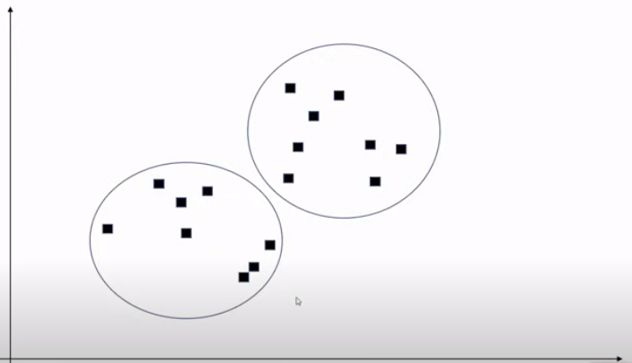
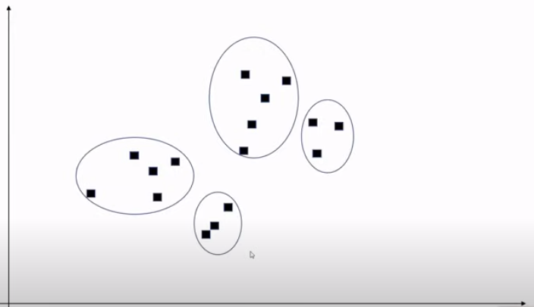
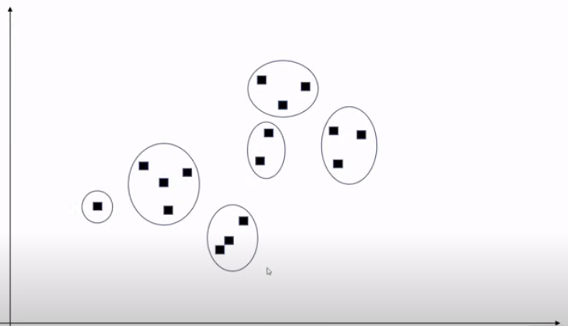
14.8 How to Determine K?
https://www.youtube.com/watch?v=EItlUEPCIzM&list=PLeo1K3hjS3uvCeTYTeyfe0-rN5r8zn9rw&index=14
How to Determine K? (5:01-5:20/25:14)
Below is the dataset.
We started with first person said, it is two Cluster. The second person may said, it is 4 clusters. The third person may said, it is 6 clusters.

Slide 25
14.9 Elbow Method

Slide 26
14.9 Elbow Method
https://www.youtube.com/watch?v=EItlUEPCIzM&list=PLeo1K3hjS3uvCeTYTeyfe0-rN5r8zn9rw&index=14
Elbow Method (5:21-5:30/25:14)
Different people interpret the cluster in different way.
Our job is to find the best possible K number. The method is called Elbow method.

Slide 27
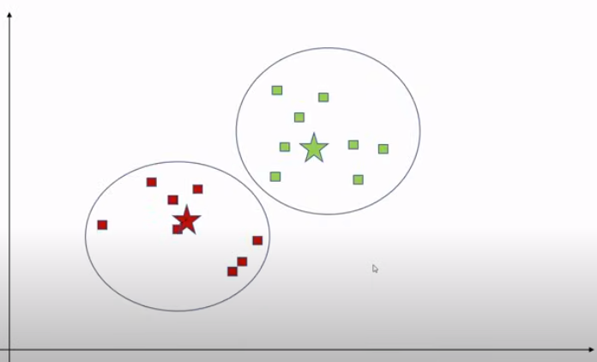

14.9 Elbow Method
https://www.youtube.com/watch?v=EItlUEPCIzM&list=PLeo1K3hjS3uvCeTYTeyfe0-rN5r8zn9rw&index=14
Elbow Method (5:31-5:50/25:14)
How the Elbow Method work?
We start with some K, for example, we start with K = 2.
We calculate the SSE (Sum of Square Error).

Slide 28
14.9 Elbow Method
https://www.youtube.com/watch?v=EItlUEPCIzM&list=PLeo1K3hjS3uvCeTYTeyfe0-rN5r8zn9rw&index=14
Elbow Method (5:31-5:50/25:14)
How the Elbow Method work?
We start with some K, for example, we start with K = 2.
We calculate the SSE (Sum of Square Error).

Slide 29
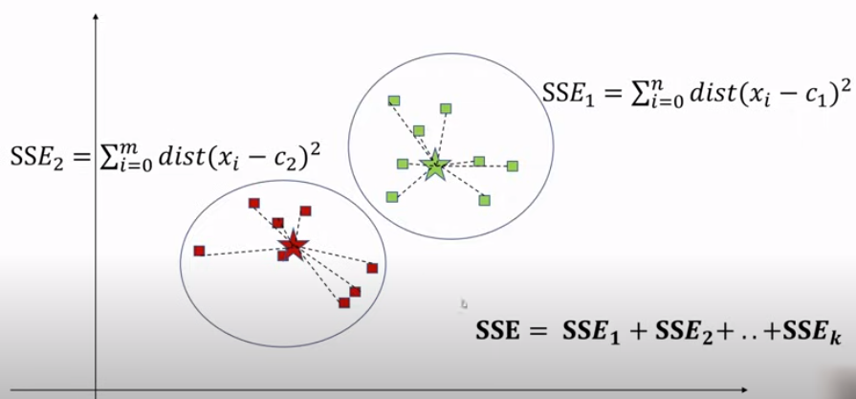
14.9 Elbow Method
https://www.youtube.com/watch?v=EItlUEPCIzM&list=PLeo1K3hjS3uvCeTYTeyfe0-rN5r8zn9rw&index=14
Elbow Method (5:31-6:10/25:14)
What is SSE (Sum of Square Error)?
First, we computer Sum of Square distance of all points to centroid of first cluster.
Second, we computer the SSE for the second cluster.
Similarly, we do that for all the clusters. We get SSE = SSE1 + SSE2 + … + SSEk.

Slide 30
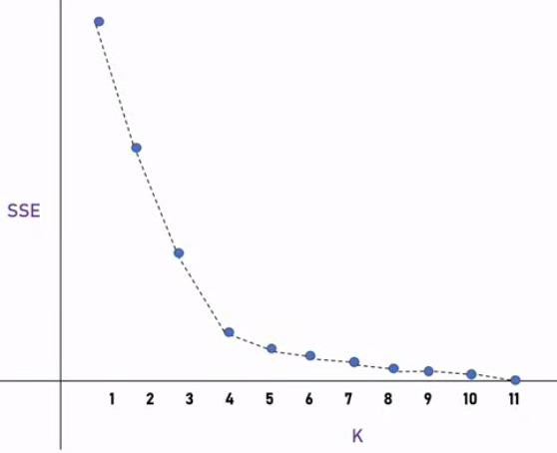
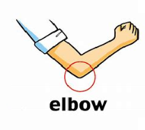
14.9 Elbow Method
https://www.youtube.com/watch?v=EItlUEPCIzM&list=PLeo1K3hjS3uvCeTYTeyfe0-rN5r8zn9rw&index=14
Elbow Method (5:31-7:30/25:14)
Here, we draw from K = 1 to K = 11. At K = 100, SSE (Sum of Square Error) = 0.
In the diagram, there is a point with big slope change called Elbow point. The Elbow point is a good cluster number, K = 4.

Slide 31
14.10 Dataset

Slide 32
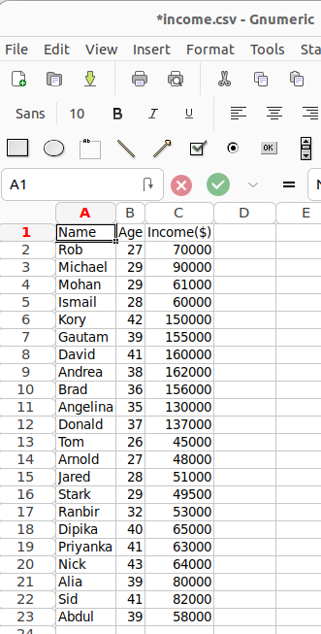
14.10 Dataset
https://www.youtube.com/watch?v=EItlUEPCIzM&list=PLeo1K3hjS3uvCeTYTeyfe0-rN5r8zn9rw&index=14
Dataset (7:31-8:00/25:14)
Here, we have dataset

Slide 33
14.11 Import Library and Load Dataset

Slide 34
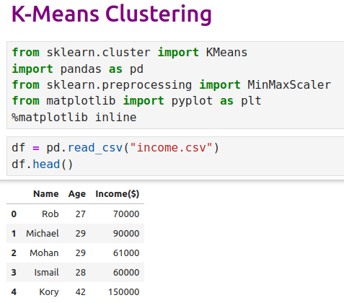
14.11 Import Library and Load Dataset
https://www.youtube.com/watch?v=EItlUEPCIzM&list=PLeo1K3hjS3uvCeTYTeyfe0-rN5r8zn9rw&index=14
Import Library and Load Dataset (8:01-9:00/25:14)

Slide 35
14.12 Plot Data

Slide 36
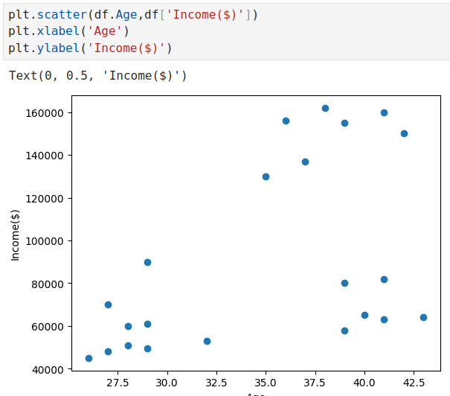
14.12 Plot Data
https://www.youtube.com/watch?v=EItlUEPCIzM&list=PLeo1K3hjS3uvCeTYTeyfe0-rN5r8zn9rw&index=14
Plot Data (9:01-10:00/25:14)

Slide 37
14.13 K = 3

Slide 38
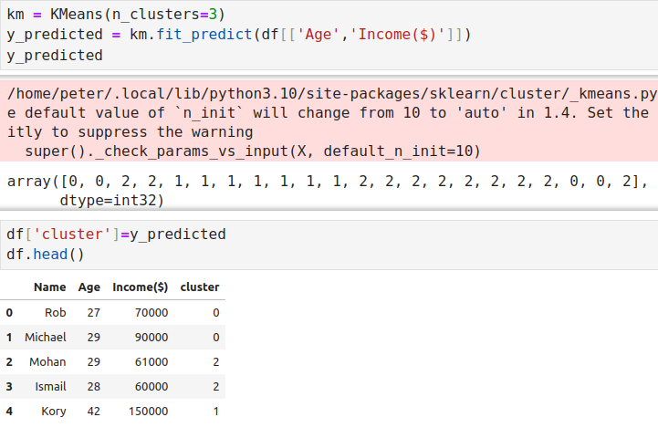
14.13 K = 3
https://www.youtube.com/watch?v=EItlUEPCIzM&list=PLeo1K3hjS3uvCeTYTeyfe0-rN5r8zn9rw&index=14
K = 3 (10:01-11:00/25:14)

Slide 39
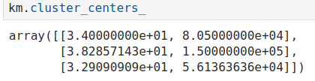
14.13 K = 3
https://www.youtube.com/watch?v=EItlUEPCIzM&list=PLeo1K3hjS3uvCeTYTeyfe0-rN5r8zn9rw&index=14
K = 3 (11:01-12:00/25:14)
Cluster Centroids.

Slide 40
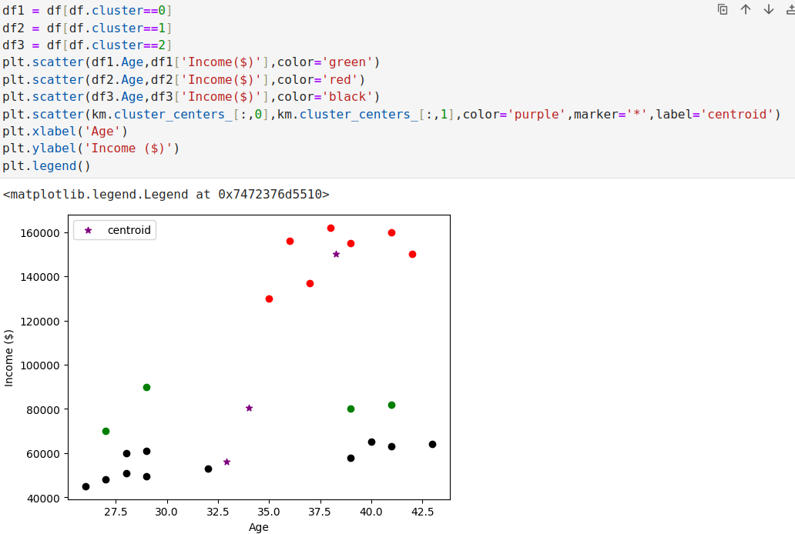
14.13 K = 3
https://www.youtube.com/watch?v=EItlUEPCIzM&list=PLeo1K3hjS3uvCeTYTeyfe0-rN5r8zn9rw&index=14
K = 3 (12:01-13:00/25:14)
Plot clusters and Centroids.

Slide 41
14.14 Min/Max Scaler

Slide 42
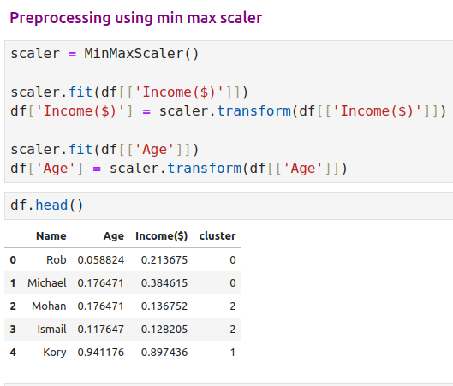
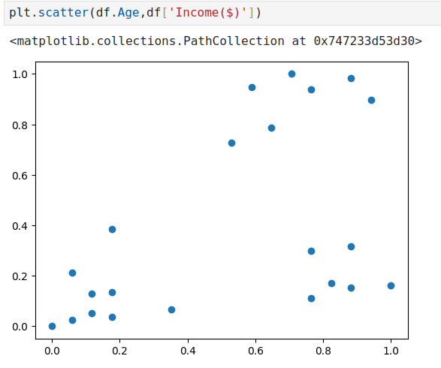
14.14 Min/Max Scaler
https://www.youtube.com/watch?v=EItlUEPCIzM&list=PLeo1K3hjS3uvCeTYTeyfe0-rN5r8zn9rw&index=14
Min/Max Scaler (13:01-15:00/25:14)
We use min/max scaler to scale age and income data between 0 and 1.

Slide 43
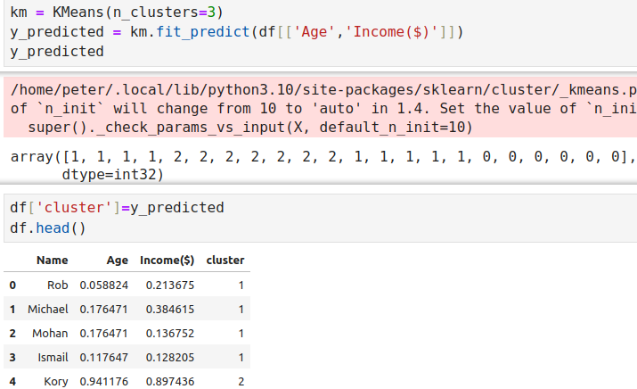
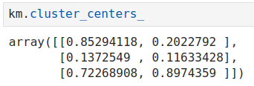
14.14 Min/Max Scaler
https://www.youtube.com/watch?v=EItlUEPCIzM&list=PLeo1K3hjS3uvCeTYTeyfe0-rN5r8zn9rw&index=14
Min/Max Scaler (15:01-17:00/25:14)

Slide 44
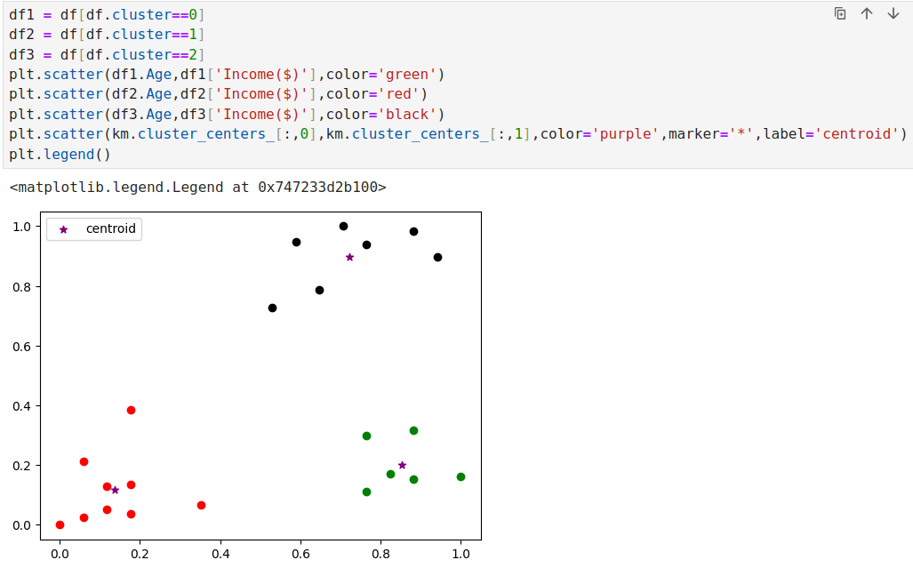
14.14 Min/Max Scaler
https://www.youtube.com/watch?v=EItlUEPCIzM&list=PLeo1K3hjS3uvCeTYTeyfe0-rN5r8zn9rw&index=14
Min/Max Scaler (17:01-19:00/25:14)

Slide 45
14.15 Elbow Plot

Slide 46
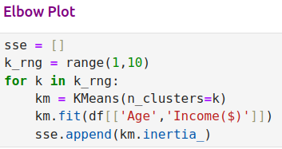
14.15 Elbow Plot
https://www.youtube.com/watch?v=EItlUEPCIzM&list=PLeo1K3hjS3uvCeTYTeyfe0-rN5r8zn9rw&index=14
Elbow Plot (19:01-21:00/25:14)
Create Elbow Data.

Slide 47
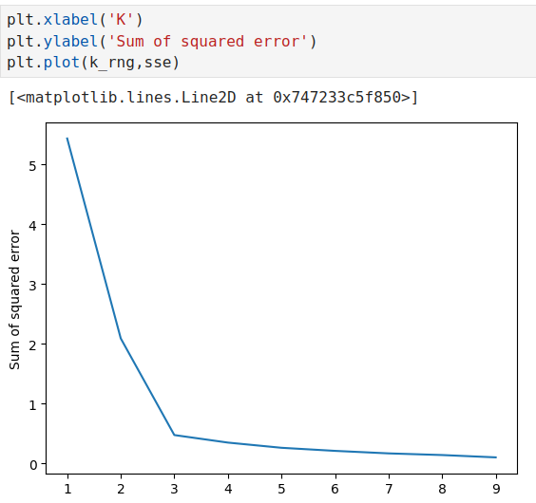
14.15 Elbow Plot
https://www.youtube.com/watch?v=EItlUEPCIzM&list=PLeo1K3hjS3uvCeTYTeyfe0-rN5r8zn9rw&index=14
Elbow Plot (21:01-23:00/25:14)
Plot Elbow Data.

Slide 48
14.16 Exercise

Slide 49
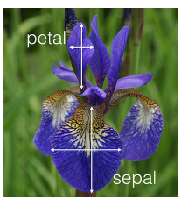
14.16 Exercise
https://www.youtube.com/watch?v=EItlUEPCIzM&list=PLeo1K3hjS3uvCeTYTeyfe0-rN5r8zn9rw&index=14
Exercise (23:01-25:14/25:14)
1. Use iris flower dataset from sklearn library and try to form clusters of flowers using petal width and length features. Drop other two features for simplicity.
2. Figure out if any preprocessing such as scaling would help here
3.Draw elbow plot and from that figure out optimal value of k.

Slide 50
End

