Slide 1

24 CNN Classify
Peter H. Chen

Slide 2
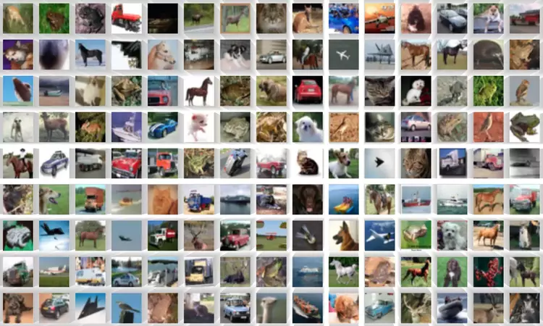
24 CNN Classify
https://www.youtube.com/watch?v=7HPwo4wnJeA&list=PLeo1K3hjS3uu7CxAacxVndI4bE_o3BDtO&index=24
CNN Classify (0:00-0:30/28:11)
We will do 65,000 small images classification.
Tensorflow Framework uses CIFAR-10 (Canadian Institute For Advanced Research, pronounced as “See-Far”) dataset. CIFAR-10 dataset has various objects, such as, airplane, Cars, Bird, Car, Deer, Dog, frog, Horse, Ship, truck, etc.
We can use CIFAR-10 images for classification using CNN (Convolutional Neural Network).

Slide 3
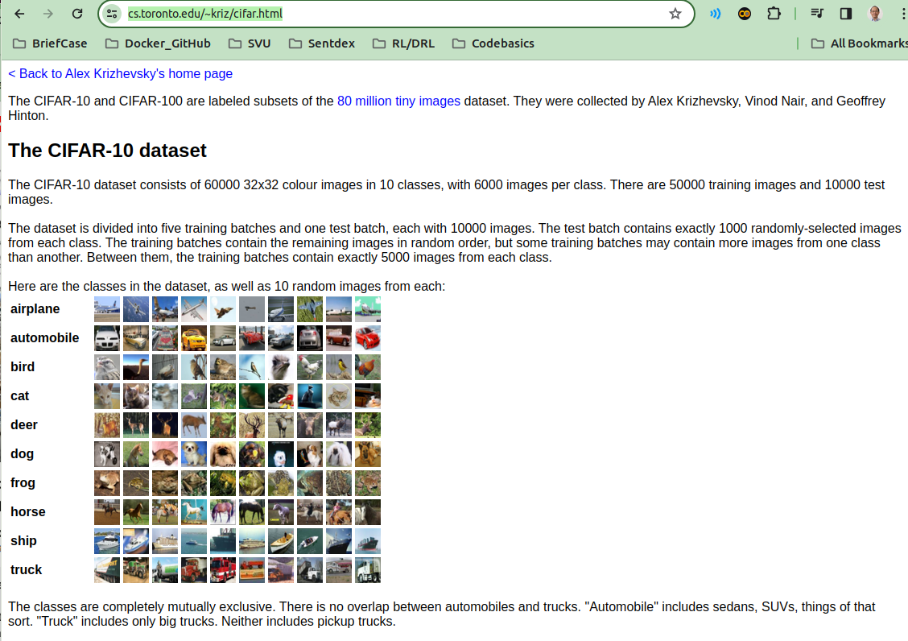
24 CNN Classify
https://www.youtube.com/watch?v=7HPwo4wnJeA&list=PLeo1K3hjS3uu7CxAacxVndI4bE_o3BDtO&index=24
CNN Classify (0:43-0:50/28:11)
https://www.cs.toronto.edu/~kriz/cifar.html
CIFAR-10 dataset consists of 60,000 images, each image is 32 x 32 color image with RGB channels. We will do image classification for 10 classes of images (1. Airplane, 2. Automobile, 3. Bird, 4. Cat, 5, Deer, 6. Dog, 7. Frog, 8. Horse, 9. Ship, 10. Truck). Each class have 6000 images. It contains 50000 training images and 10000 test images.

Slide 4
24.1 ANN: Coding

Slide 5
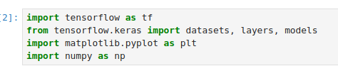
24.1 ANN: Coding
https://www.youtube.com/watch?v=7HPwo4wnJeA&list=PLeo1K3hjS3uu7CxAacxVndI4bE_o3BDtO&index=24
ANN: Coding (0:50-1:00/28:11)
We import the libraries.

Slide 6
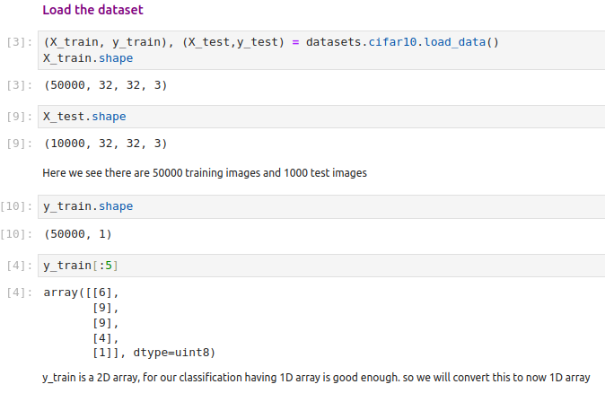
24.1 ANN: Coding
https://www.youtube.com/watch?v=7HPwo4wnJeA&list=PLeo1K3hjS3uu7CxAacxVndI4bE_o3BDtO&index=24
ANN: Coding (1:05-2:00/28:11)
Load the dataset into the jupyter notebook.
We have training samples 50000. size is 32 x 32 x 3.

Slide 7
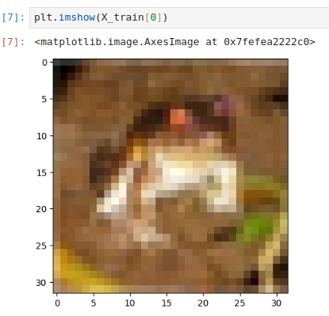
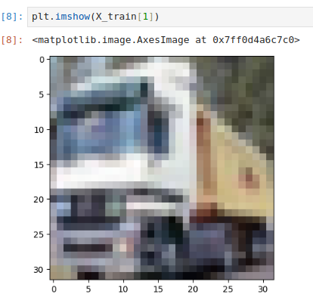
24.1 ANN: Coding
https://www.youtube.com/watch?v=7HPwo4wnJeA&list=PLeo1K3hjS3uu7CxAacxVndI4bE_o3BDtO&index=24
ANN: Coding (2:01-2:50/28:11)
Plot image X_train[0].
Plot image X_train[1].

Slide 8
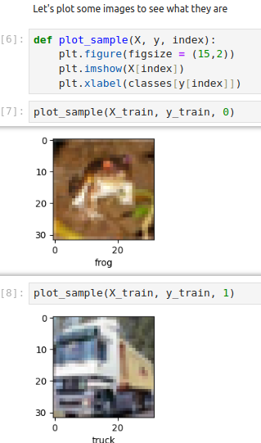
24.1 ANN: Coding
https://www.youtube.com/watch?v=7HPwo4wnJeA&list=PLeo1K3hjS3uu7CxAacxVndI4bE_o3BDtO&index=24
ANN: Coding (2:30-2:51/28:11)
Define plot_sample to plot: X_trian, y_train, classes (0, …, 9)
Class = [“airplane”, “automobile”, …, “truck”]
classes[y[index]]

Slide 9
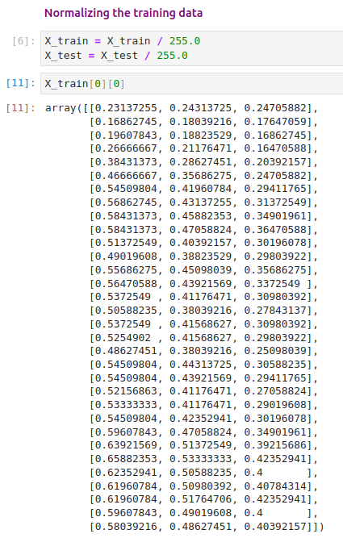
24.1 ANN: Coding
https://www.youtube.com/watch?v=7HPwo4wnJeA&list=PLeo1K3hjS3uu7CxAacxVndI4bE_o3BDtO&index=24
ANN: Coding (4:30-9:00/28:11)
We normalize the data.

Slide 10
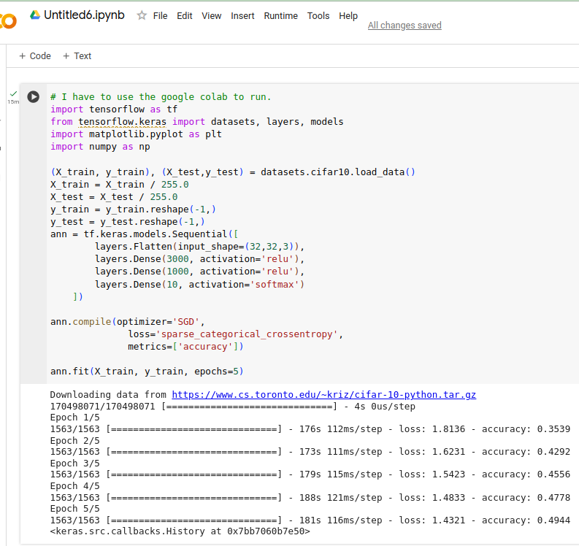
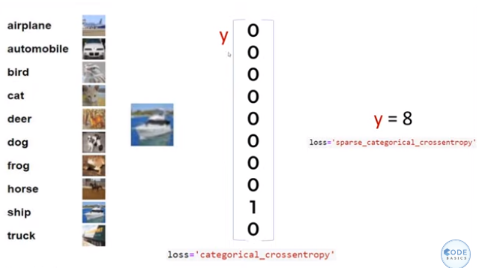
24.1 ANN: Coding
https://www.youtube.com/watch?v=7HPwo4wnJeA&list=PLeo1K3hjS3uu7CxAacxVndI4bE_o3BDtO&index=24
ANN: Coding (9:01-9:30/28:11)
We do the ANN first before CNN.
Note:
My computer does not have enough GPU VRAM to run CIFAR-10 Image training ANN.
I used Colab to run.

Slide 11
24.1 ANN: Coding
https://www.youtube.com/watch?v=7HPwo4wnJeA&list=PLeo1K3hjS3uu7CxAacxVndI4bE_o3BDtO&index=24
ANN: Coding (12:01-12:30/28:11)
The classification accuracy = 49% It is really bad in ANN.

Slide 12
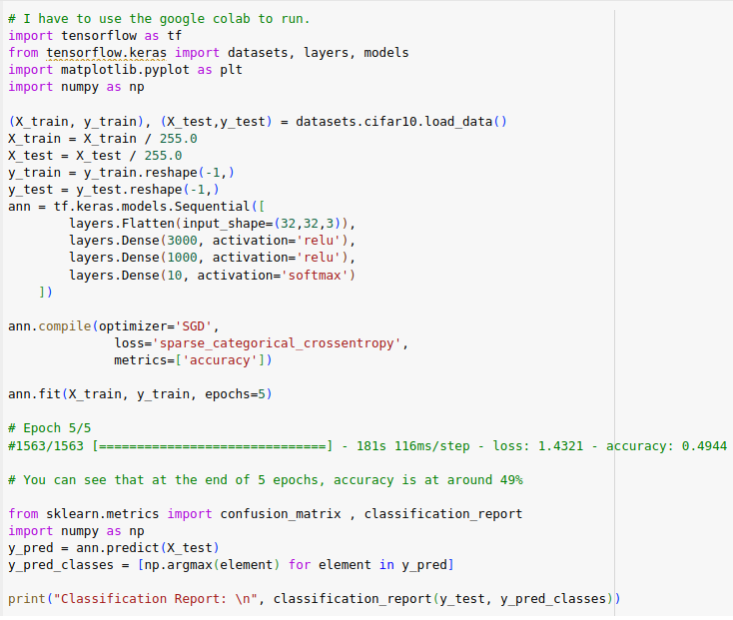
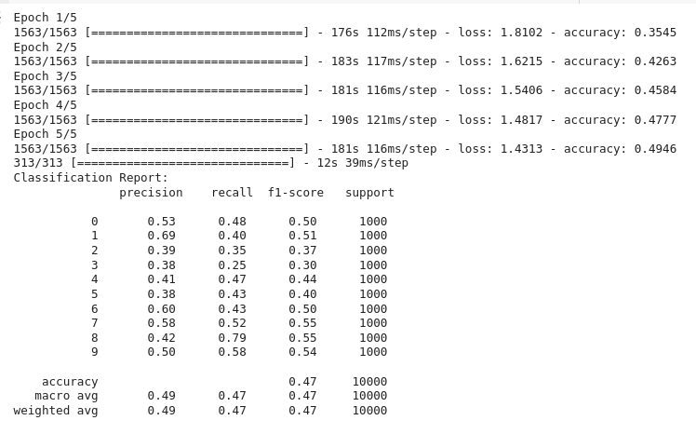
24.1 ANN: Coding
https://www.youtube.com/watch?v=7HPwo4wnJeA&list=PLeo1K3hjS3uu7CxAacxVndI4bE_o3BDtO&index=24
ANN: Coding (12:01-12:30/28:11)
We re-run with complete metrics. We have only 49% accuracy.

Slide 13
24.2 CNN: Coding

Slide 14
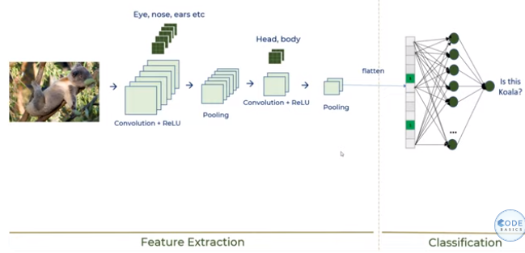
24.2 CNN: Coding
https://www.youtube.com/watch?v=7HPwo4wnJeA&list=PLeo1K3hjS3uu7CxAacxVndI4bE_o3BDtO&index=24
CNN Coding (12:31-13:49/28:11)
In the last discussion, we have CNN in several layers. We have
Feature extraction:
1. Convolutional layers (for Eye, Nose, ears, hands, legs, etc), ReLU activation, and Pooling
2. Convolution (for Head and Body), ReLU activation, and Pooling.
Then we flatten the convolution result and feed into Dense neural network.
So, we need to add the several layers for feature extraction before we input to neural network for classification.

Slide 15
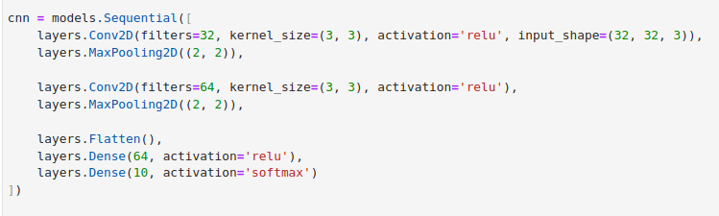
24.2 CNN: Coding
https://www.youtube.com/watch?v=7HPwo4wnJeA&list=PLeo1K3hjS3uu7CxAacxVndI4bE_o3BDtO&index=24
CNN Coding (14:01-14:30/28:11)
Copy copy ANN Network, we will add CNN code.
In CNN, Dense layer, we do not need 1000 neurons, we just need about 64.
We add the convolution layer.

Slide 16
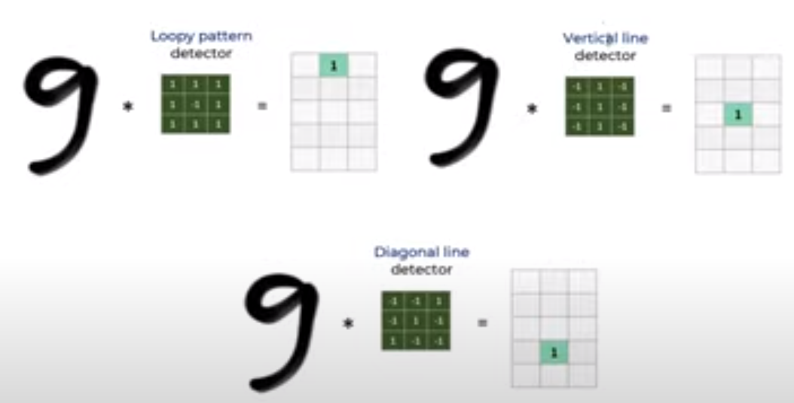
24.2 CNN: Coding
https://www.youtube.com/watch?v=7HPwo4wnJeA&list=PLeo1K3hjS3uu7CxAacxVndI4bE_o3BDtO&index=24
CNN Coding (14:31-18:45/28:11)
We add the convolution layer (Conv2D), kernel filter 3 x 3, activation function ReLU, input image shape 32 x 32 x 3, and Max Pooling 2D layers (2, 2).
Below is the digit “9” with loopy pattern detector, vertical line detector, and Diagonal line detector.
In Tensorflow, we just need to specify how many filters we want. Tool will figure out the pattern for you.

Slide 17
24.2 CNN: Coding
https://www.youtube.com/watch?v=7HPwo4wnJeA&list=PLeo1K3hjS3uu7CxAacxVndI4bE_o3BDtO&index=24
CNN Coding (14:31-18:30/28:11)
How many Conv2D you need. You try and error.
Here, we just use 2 Convolutional layers (2 Conv2D)

Slide 18

24.2 CNN: Coding
https://www.youtube.com/watch?v=7HPwo4wnJeA&list=PLeo1K3hjS3uu7CxAacxVndI4bE_o3BDtO&index=24
CNN Coding (18:31-19:30/28:11)
The rests are straight forward, we specify
1. optimizer: adam
2. loss function: sparse categorical cross entropy.
3. measurement metrics: accuracy for the error measurement.

Slide 19
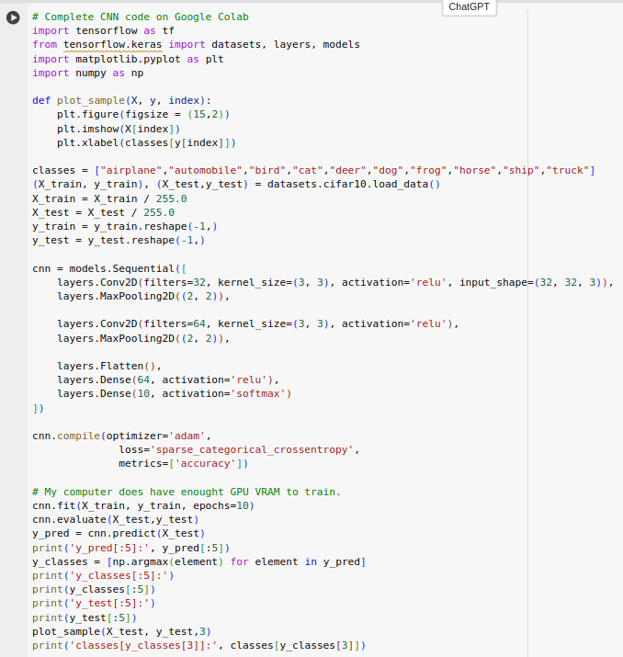
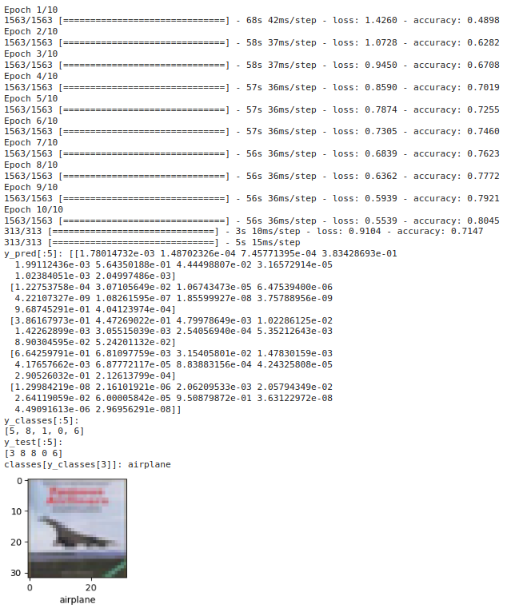
24.2 CNN: Coding
https://www.youtube.com/watch?v=7HPwo4wnJeA&list=PLeo1K3hjS3uu7CxAacxVndI4bE_o3BDtO&index=24
CNN Coding (19:31-20:10/28:11)
Now, we run CNN.
Below code run on Google Colab.

Slide 20
24.2 CNN: Coding
https://www.youtube.com/watch?v=7HPwo4wnJeA&list=PLeo1K3hjS3uu7CxAacxVndI4bE_o3BDtO&index=24
CNN Coding (20:11-20:30/28:11)
In ANN, after 5 epochs, we have 49%.
In CNN, after 5 epochs, we have 72.5%. We run more epochs, we have 80%.

Slide 21
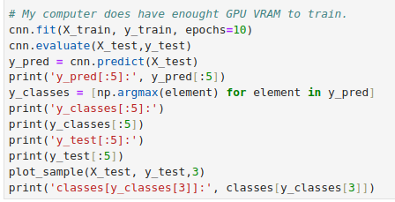
24.2 CNN: Coding
https://www.youtube.com/watch?v=7HPwo4wnJeA&list=PLeo1K3hjS3uu7CxAacxVndI4bE_o3BDtO&index=24
CNN Coding (20:31-21:30/28:11)
We evaluate the accuracy: 71%

Slide 22
24.2 CNN: Coding
https://www.youtube.com/watch?v=7HPwo4wnJeA&list=PLeo1K3hjS3uu7CxAacxVndI4bE_o3BDtO&index=24
CNN Coding (20:31-21:30/28:11)
We make some prediction
> cnn.predit()

Slide 23
24.2 CNN: Coding
https://www.youtube.com/watch?v=7HPwo4wnJeA&list=PLeo1K3hjS3uu7CxAacxVndI4bE_o3BDtO&index=24
CNN Coding (21:31-22:30/28:11)
We input the test data and find the max: arg_max()

Slide 24
24.2 CNN: Coding
https://www.youtube.com/watch?v=7HPwo4wnJeA&list=PLeo1K3hjS3uu7CxAacxVndI4bE_o3BDtO&index=24
CNN Coding (22:31-24:30/28:11)
We plot some sample data, “airplane”.
https://www.cs.toronto.edu/~kriz/cifar.html

Slide 25
24.3 Exercise: Handwritten Digit CNN

Slide 26
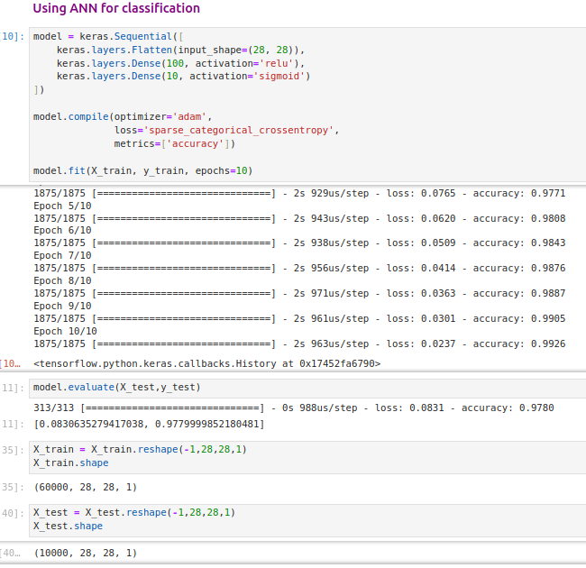
24.3 Exercise: Handwritten Digit CNN
https://www.youtube.com/watch?v=7HPwo4wnJeA&list=PLeo1K3hjS3uu7CxAacxVndI4bE_o3BDtO&index=24
Exercise: Hand-Written Digit CNN (24:31-28:11/28:11)
ANN: 97%
CNN: 98%.

Slide 27
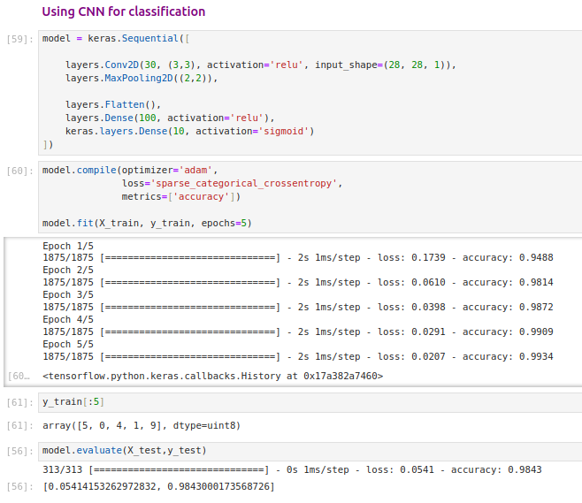
24.3 Exercise: Handwritten Digit CNN
https://www.youtube.com/watch?v=7HPwo4wnJeA&list=PLeo1K3hjS3uu7CxAacxVndI4bE_o3BDtO&index=24
Exercise: Hand-Written Digit CNN (24:31-28:11/28:11)
ANN: 97%
CNN: 98%.

Slide 28
End

