Slide 1

19 Confusion Matrix
Peter H. Chen

Slide 2
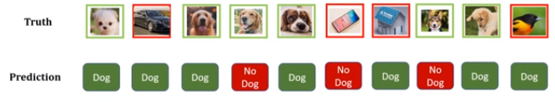
19 Confusion Matrix
https://www.youtube.com/watch?v=2osIZ-dSPGE&list=PLeo1K3hjS3uu7CxAacxVndI4bE_o3BDtO&index=19
Confusion Matrix (1:01-1:00/11:45)
We go over Confusion Matrix, i.e., F1-Score, Precision, Recall, True Positive, True negative, etc. In Machine Learning and Deep Learning, all these terms are very important.
We have dataset of dog images. Below, there are 6 dos images then four images are not dog images.
This is binary classification, dog vs. not a dog.
We build a machine learning model and ask the images are dog or not dog.
Below is the the model prediction. The prediction may not correct. It makes some mistakes.

Slide 3
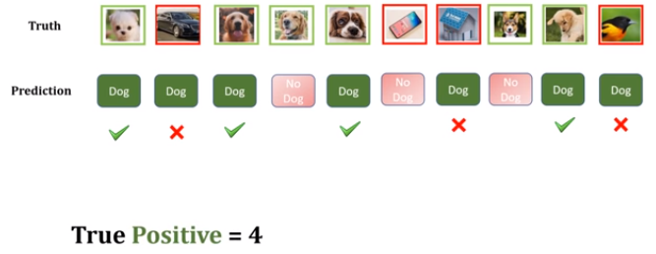

19 Confusion Matrix
https://www.youtube.com/watch?v=2osIZ-dSPGE&list=PLeo1K3hjS3uu7CxAacxVndI4bE_o3BDtO&index=19
Confusion Matrix (1:01-1:30/11:45)
Let’s think about the positive prediction (Dog).
First, let’s gray out the Negative Prediction (“No Dog” predictions).
Forget about those “No Dog” prediction.
We have total 7 dog predictions.
Out of those seven, how many of them are correct?
We have four are correct and three are not correct.
For the positive class which is correct (dog), we have True Positive = 4 (gree marks).
And three of the positive class which is incorrect (not dog), we have False Positive = 3 (red marks).

Slide 4
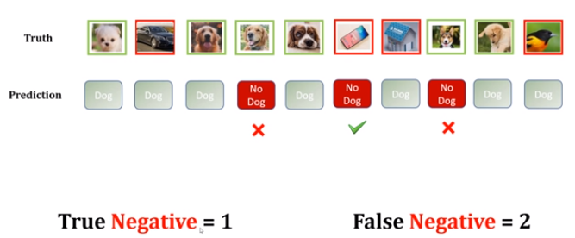
19 Confusion Matrix
https://www.youtube.com/watch?v=2osIZ-dSPGE&list=PLeo1K3hjS3uu7CxAacxVndI4bE_o3BDtO&index=19
Confusion Matrix (2:01-3:30/11:45)
Now, think about the prediction of Negative (“No Dog”).
Forget about green (Positive prediction).
We have True Negative is 1 (correct Negative prediction). False Negative = 2 (False Negative Prediction).

Slide 5
19.1 Accuracy

Slide 6
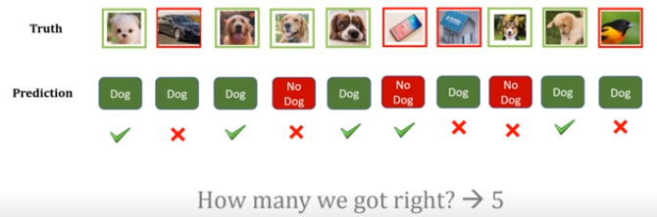

19.1 Accuracy
https://www.youtube.com/watch?v=2osIZ-dSPGE&list=PLeo1K3hjS3uu7CxAacxVndI4bE_o3BDtO&index=19
Accuracy (3:35-4:00/11:45)
Now, we turn on all of the predictions.
Which predictions are correct and which predictions are wrong.
We got total five rights. We have accuracy = 5/10 = 0.5.
No matter “Positive” or “Negative”, we got five out of ten is right.
And the accuracy is 0.5.

Slide 7
19.2 Precision

Slide 8
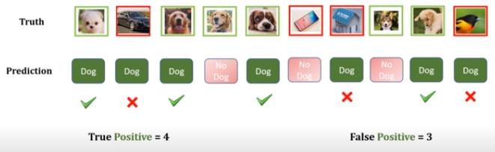

19.2 Precision
https://www.youtube.com/watch?v=2osIZ-dSPGE&list=PLeo1K3hjS3uu7CxAacxVndI4bE_o3BDtO&index=19
Precision (4:01-4:50/11:45)
In this diagram, we only consider the Positive Prediction.
Here, we have True Positive = 4 and False Positive = 3.
Precision is out of Positive (Dog) Prediction. How many of you got right?
We have Precision = 4/7 = 0.57.
Precision = TP / (TP + FP).
TP: True Positive, FP: False Positive.

Slide 9
19.3 Recall

Slide 10
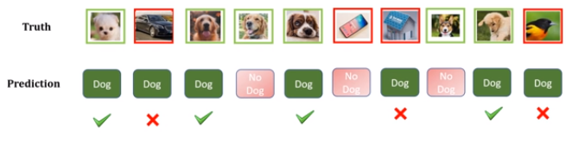
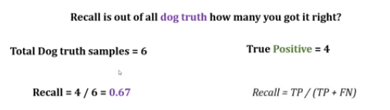
19.3 Recall
https://www.youtube.com/watch?v=2osIZ-dSPGE&list=PLeo1K3hjS3uu7CxAacxVndI4bE_o3BDtO&index=19
Recall (5:01-5:50/11:45)
Now, we talk about recall.
We have truth as the baseline. What is the truth?
We have truth, total 6 samples are dog.
When I predicted, only 4 of them are correct prediction: True Positive = 4.
We have total 6 dog samples, how many of them are correct prediction? Only 4.
Recall = 4/6 = 0.67 or Recall = TP/(TP + FN)
TP: True Prediction, FN: False Negative

Slide 11
19.4 Prediction vs. Recall

Slide 12
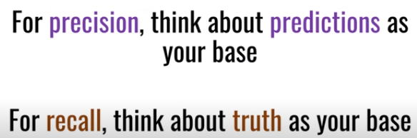
19.4 Prediction vs. Recall
https://www.youtube.com/watch?v=2osIZ-dSPGE&list=PLeo1K3hjS3uu7CxAacxVndI4bE_o3BDtO&index=19
Prediction vs. Recall (5:56-6:00/11:45)
1. Precision: base on Positive Prediction (Prediction Dog)
2. Recall: Base on Truth (How many Dog is in samples)

Slide 13
19.5 Negative Class: Prediction/Recall

Slide 14
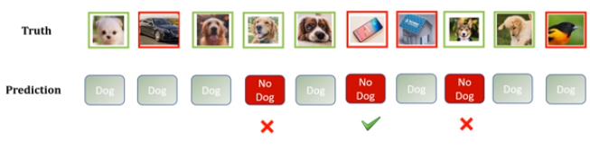
19.5 Negative Class: Prediction/Recall
https://www.youtube.com/watch?v=2osIZ-dSPGE&list=PLeo1K3hjS3uu7CxAacxVndI4bE_o3BDtO&index=19
Negative Class: Prediction and Recall (6:01-6:30/11:45)
Now, let talk about negative class.
Before, we have precision and Recall for Positive (Dog) Class.
Now, we have precision and Recall for Negative (“No Dog”) Class.
Precision: We have Negative (No Dog) Prediction = 3. How many of them is True Negative?
True Negative = 1
Precision = 1/3.

Slide 15
19.5 Negative Class: Prediction/Recall
https://www.youtube.com/watch?v=2osIZ-dSPGE&list=PLeo1K3hjS3uu7CxAacxVndI4bE_o3BDtO&index=19
Negative Class: Prediction and Recall (6:01-7:20/11:45)
Now, we have Truth baseline of Negative Class (No Dog).
How many of the samples are No Dog?
We have 4 samples are “No Dog”.
How many of them got right? Only 1.
So, Recall of Negative Class = 1/4 = 0.25

Slide 16
19.6 F1-Score

Slide 17
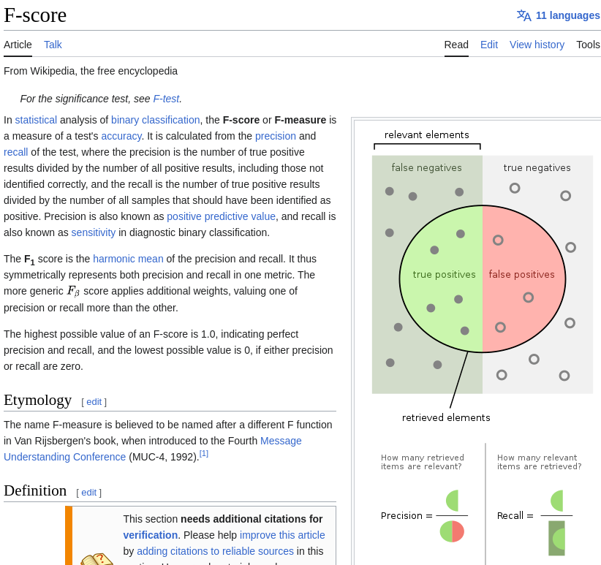
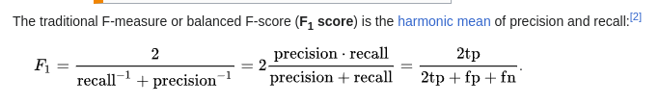
19.6 F1-Score
https://www.youtube.com/watch?v=2osIZ-dSPGE&list=PLeo1K3hjS3uu7CxAacxVndI4bE_o3BDtO&index=19
F1-Score (7:01-7:30/11:45)
Now, We talk F1-Score.
F1-Score is the harmonic mean of precision and recall: F1 = 2 /(1/Recall + 1/Precision).
F1-Score is overall performance of your model.

Slide 18
19.7 Confusion Matrix: Coding

Slide 19
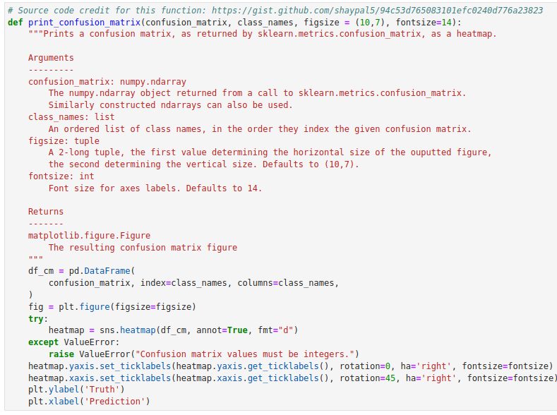
19.7 Confusion Matrix: Coding
https://www.youtube.com/watch?v=2osIZ-dSPGE&list=PLeo1K3hjS3uu7CxAacxVndI4bE_o3BDtO&index=19
Confusion Matrix: Coding (7:59-8:20/11:45)
We define print_confusion_matrix ():
Import libraries
Inputs:
1. confusion_matrix:
2. class_names: index given to confusion matrix:
3. fig-size:
4. font-size:

Slide 20
19.7 Confusion Matrix: Coding
https://www.youtube.com/watch?v=2osIZ-dSPGE&list=PLeo1K3hjS3uu7CxAacxVndI4bE_o3BDtO&index=19
Confusion Matrix: Coding (8:35-8:20/11:45)
What is confusion matrix?
We have
Truth array: [“Dog”, “Not a dog”, “Dog”, “Dog”, “Dog”, …]
Prediction array = [“Dog”, “Dog”, “Dog”, “Not a dog”, ...]

Slide 21
19.7 Confusion Matrix: Coding
https://www.youtube.com/watch?v=2osIZ-dSPGE&list=PLeo1K3hjS3uu7CxAacxVndI4bE_o3BDtO&index=19
Confusion Matrix: Coding (8:35-8:50/11:45)
When we construct the confusion matrix, we need “truth” array and “prediction” array.
> cm = confusion_matrix (truth, prediction)

Slide 22
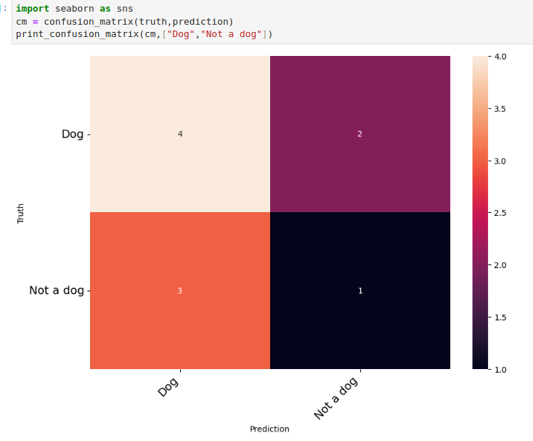
19.7 Confusion Matrix: Coding
https://www.youtube.com/watch?v=2osIZ-dSPGE&list=PLeo1K3hjS3uu7CxAacxVndI4bE_o3BDtO&index=19
Confusion Matrix: Coding (8:35-10:00/11:45)
> print_confusion_matrix (cm, {“Dog”, “Not a dog”].
4: True Positive: Truth os Dog = 4, Prediction is positive (Dog) is 4.
2: True Negative: Truth is Dog = 2, but prediction is negative = 2
3: False Negative: Truth is not a Dog, but prediction is a Dog.
1: False Negative: Truth is not a dog, prediction is not a Dog.

Slide 23
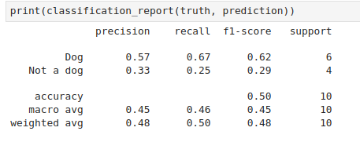
19.7 Confusion Matrix: Coding
https://www.youtube.com/watch?v=2osIZ-dSPGE&list=PLeo1K3hjS3uu7CxAacxVndI4bE_o3BDtO&index=19
Confusion Matrix: Coding (10:01-11:00/11:45)
> print_confusion_matrix (cm, {“Dog”, “Not a dog”].

Slide 24
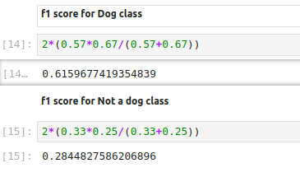
19.7 Confusion Matrix: Coding
https://www.youtube.com/watch?v=2osIZ-dSPGE&list=PLeo1K3hjS3uu7CxAacxVndI4bE_o3BDtO&index=19
Confusion Matrix: Coding (11:01-11:45/11:45)
> print_confusion_matrix (cm, {“Dog”, “Not a dog”].

Slide 25
End

