Slide 1

21 Imbalanced Data
Peter H. Chen

Slide 2
21 Imbalanced Data
https://www.youtube.com/watch?v=JnlM4yLFNuo&list=PLeo1K3hjS3uu7CxAacxVndI4bE_o3BDtO&index=21
Imbalanced Data (0:00-1:00/38:25)
In the fraud training dataset, such as, dataset for fraud detection.
The dataset may contain 1,000 good data and only 1 fraud data, i.e., there are a lot of non-fraud data but few is fraud data. This data is imbalanced.
If you write the prediction function, you may get 99% accuracy but in reality. Because of 99% is non-fraud data, we cannot use imbalanced data for training and prediction.
We implement various techniques to handle imbalanced data in machine learning.

Slide 3

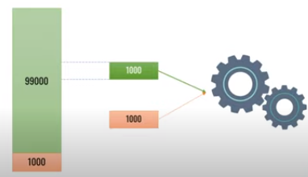
21 Imbalanced Data
https://www.youtube.com/watch?v=JnlM4yLFNuo&list=PLeo1K3hjS3uu7CxAacxVndI4bE_o3BDtO&index=21
Imbalanced Data (1:10-2:00/38:25)
The first technique is called “Under Sampling Major Class”.
If we have 99,000 samples belong one class (green class) and 1,000 belong another class (red class).
This is the fraud detection classification. 99% is non-fraud sample and only 1% is fraud sample.
To tackle this problem, we randomly select 1,000 samples from 99,000 samples and discard the remaining samples, then, we combine this 1,000 samples with red samples.
We keep both samples with 1,000 samples. Totally, we have 2,000 samples.
This may not the best choice, because we only select 1% samples and sacrifice too 99% samples in the 99,000 samples.

Slide 4
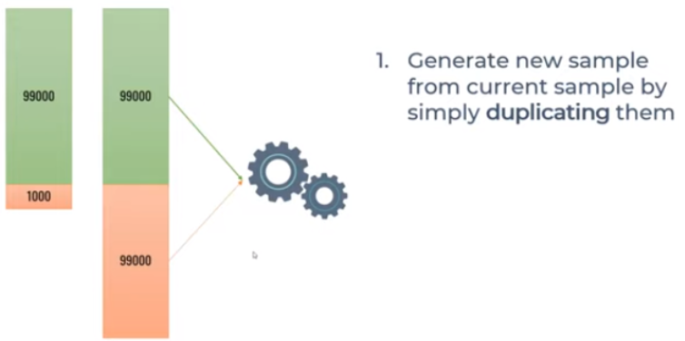
21 Imbalanced Data
https://www.youtube.com/watch?v=JnlM4yLFNuo&list=PLeo1K3hjS3uu7CxAacxVndI4bE_o3BDtO&index=21
Imbalanced Data (2:05-2:30/38:25)
The second technique is “Over sampling minority class by duplication”.
How do we over sample the minor class?
We duplicate 99 times of the minority samples.
Do we have the better option?

Slide 5

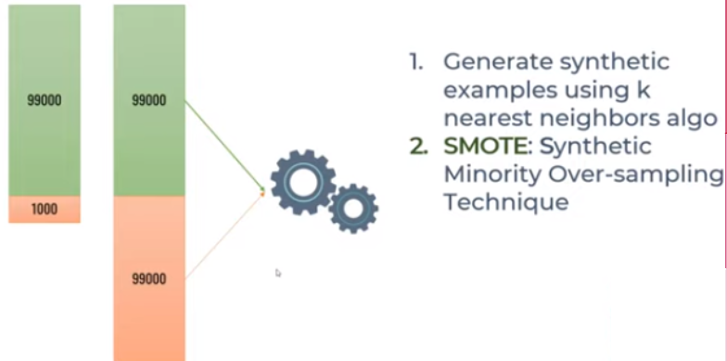
21 Imbalanced Data
https://www.youtube.com/watch?v=JnlM4yLFNuo&list=PLeo1K3hjS3uu7CxAacxVndI4bE_o3BDtO&index=21
Imbalanced Data (2:33-3:00/38:25)
The third technique is “Over sampling minority class using SMOTE”.
SMOTE uses near K-neighborhood algorithm and try to produce Synthetic samples from your thousand samples. That is why we called this is SMOTE.
What is SMOTE (Synthetic Minority Oversampling Technique) do?
SMOTE is one of the most commonly used oversampling methods to solve the imbalance problem. SMOTE aims to balance class distribution by randomly increasing minority class examples by replicating them. SMOTE synthesizes new minority instances between existing minority instances.

Slide 6

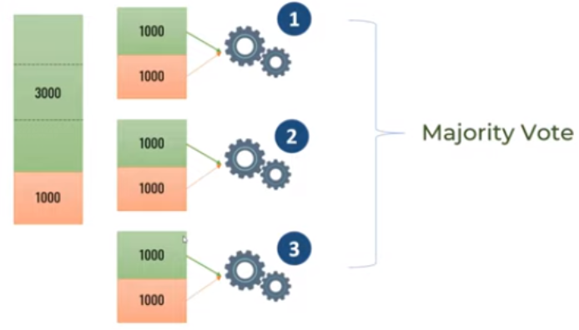
21 Imbalanced Data
https://www.youtube.com/watch?v=JnlM4yLFNuo&list=PLeo1K3hjS3uu7CxAacxVndI4bE_o3BDtO&index=21
Imbalanced Data (3:01-3:30/38:25)
The fourth technique is “Ensemble Method”.
We have 3 thousand samples in first class and 1 thousand samples in second class.
We can divide 3 thousand samples into three batches.
Take each batch with the second class to train the model 1, model 2, and model 3.
Now, we have three models, we use the majority vote.
This is similar to random forests. We have a bunch of tress and we take the majority of vote.

Slide 7
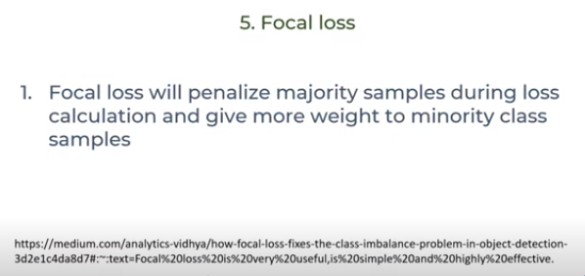
21 Imbalanced Data
https://www.youtube.com/watch?v=JnlM4yLFNuo&list=PLeo1K3hjS3uu7CxAacxVndI4bE_o3BDtO&index=21
Imbalanced Data (3:40-3:00/38:25)
The fifth technique is “Focal Loss”.
https://medium.com/analytics-vidhya/how-focal-loss-fixes-the-class-imbalance-problem-in-object-detection-3d2e1c4da8d7
This method penalize the majority samples and give more weight to minority class samples.

Slide 8

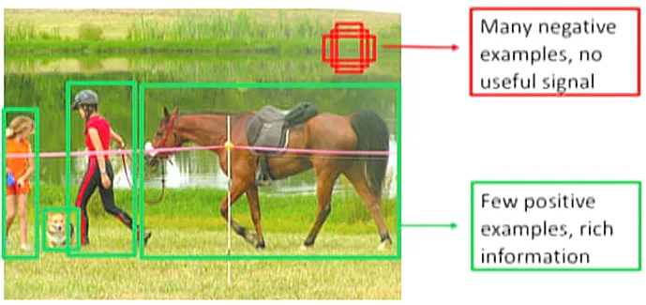
21 Imbalanced Data
https://www.youtube.com/watch?v=JnlM4yLFNuo&list=PLeo1K3hjS3uu7CxAacxVndI4bE_o3BDtO&index=21
Imbalanced Data (3:40-4:00/38:25)
The fifth technique is “Focal Loss”.
https://medium.com/analytics-vidhya/how-focal-loss-fixes-the-class-imbalance-problem-in-object-detection-3d2e1c4da8d7
The above article describe the imbalanced data. The foreground is more important but few samples. The background have more samples but not important.

Slide 9
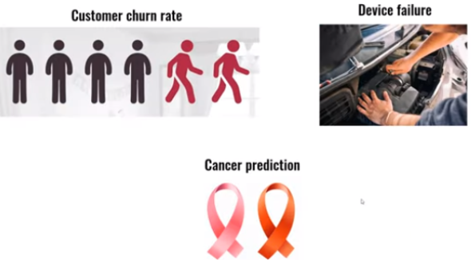
21 Imbalanced Data
https://www.youtube.com/watch?v=JnlM4yLFNuo&list=PLeo1K3hjS3uu7CxAacxVndI4bE_o3BDtO&index=21
Imbalanced Data (4:01-4:30/38:25)
We have some imbalanced datasets for customer churn rate, device failure, and cancer prediction.
1. For customer churn, most customer stay. Only few customer leave.
2. device failure: most device are good device. Only very few device are failed.
3. for cancer prediction, only very few patients have cancer.

Slide 10
21.1 Imbalanced Churn Data: Coding

Slide 11
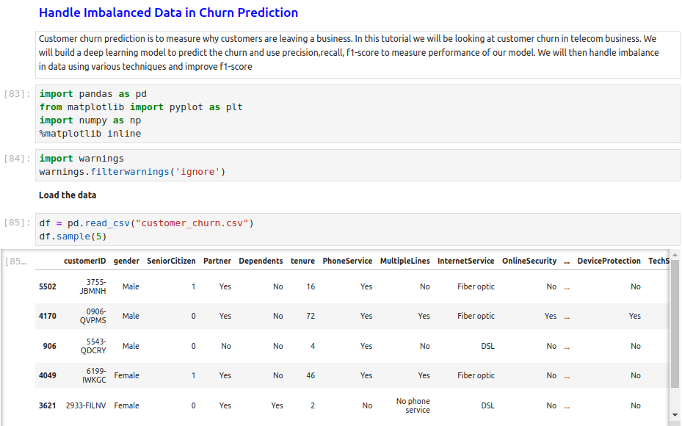
21.1 Imbalanced Churn Data: Coding
https://www.youtube.com/watch?v=JnlM4yLFNuo&list=PLeo1K3hjS3uu7CxAacxVndI4bE_o3BDtO&index=21
Imbalanced Churn Data: Coding (4:01-6:00/38:25)
Read in imbalanced Dataset of Customer Churn.

Slide 12
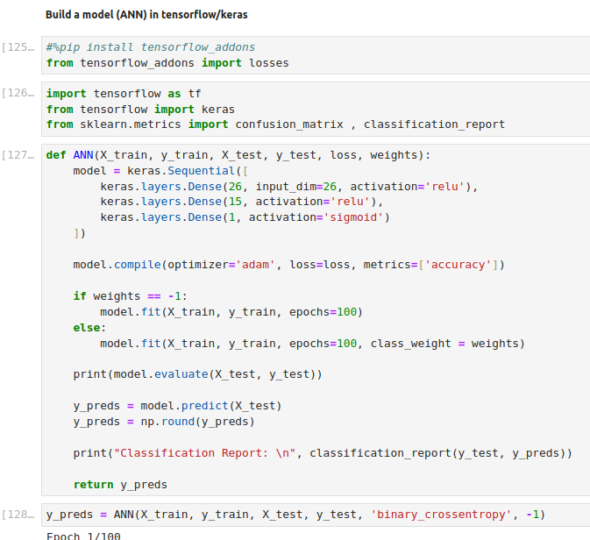
21.1 Imbalanced Churn Data: Coding
https://www.youtube.com/watch?v=JnlM4yLFNuo&list=PLeo1K3hjS3uu7CxAacxVndI4bE_o3BDtO&index=21
Imbalanced Churn Data: Coding (4:01-7:16/38:25)
Train churn customer with ANN.

Slide 13
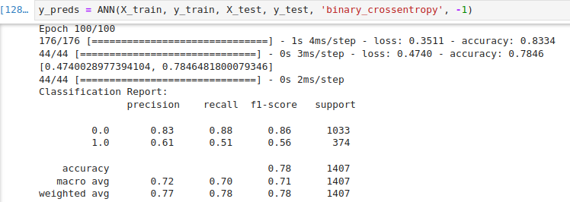
21.1 Imbalanced Churn Data: Coding
https://www.youtube.com/watch?v=JnlM4yLFNuo&list=PLeo1K3hjS3uu7CxAacxVndI4bE_o3BDtO&index=21
Imbalanced Churn Data: Coding (7:10-7:30/38:25)
Here, Our goal is too improve the f1-score for both Yes (Leave) and No (Stay) classes of Churn Customers.
So, model can predict equally well for precision and recall of both classes (Yes/No).

Slide 14
21.2 Method 1: Under-Sampling

Slide 15
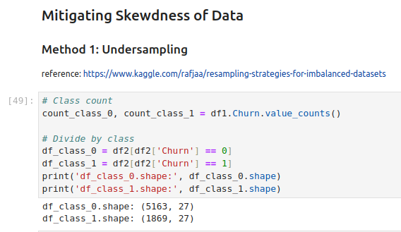

21.2 Method 1: Under-Sampling
https://www.youtube.com/watch?v=JnlM4yLFNuo&list=PLeo1K3hjS3uu7CxAacxVndI4bE_o3BDtO&index=21
Method 1: Under-Sampling (7:10-7:30/38:25)
The first method we are going to do is method 1: Under-Sampling.
We can see y_test.value_counts()
No (0) Stay: 1033
Yes (1) Leave: 374
The data is imbalanced. Most (1033) customer stay. 374 customer leaves.
We have 5163 stay customers and 1869 leave customers. We can the imbalanced samples.

Slide 16
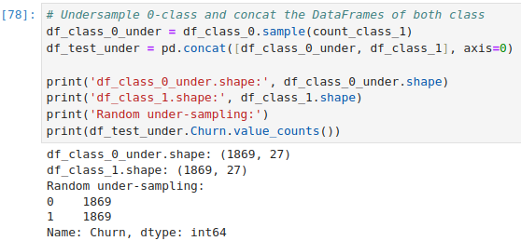
21.2 Method 1: Under-Sampling
https://www.youtube.com/watch?v=JnlM4yLFNuo&list=PLeo1K3hjS3uu7CxAacxVndI4bE_o3BDtO&index=21
Method 1: Under-Sampling (8:01-11:30/38:25)
We can randomly select samples from majority class 0 (with the number of minority class 1).
Now, under sampling class 0 and class 1 are the same size now.

Slide 17
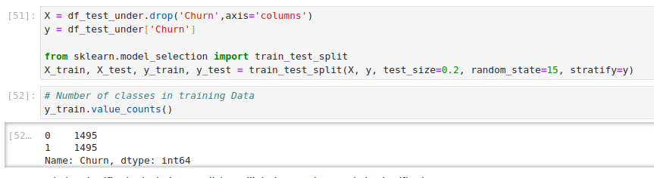
21.2 Method 1: Under-Sampling
https://www.youtube.com/watch?v=JnlM4yLFNuo&list=PLeo1K3hjS3uu7CxAacxVndI4bE_o3BDtO&index=21
Method 1: Under-Sampling (11:01-11:45/38:25)
We drop the churn of X and move churn into y.

Slide 18
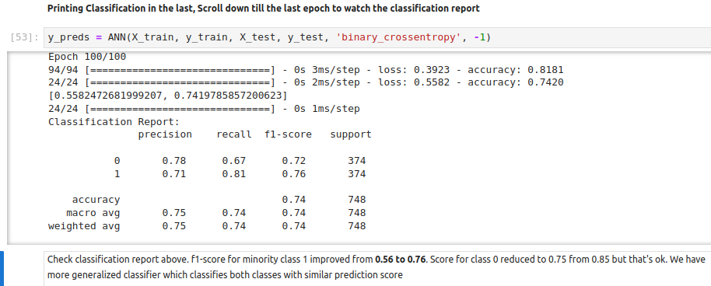
21.2 Method 1: Under-Sampling
https://www.youtube.com/watch?v=JnlM4yLFNuo&list=PLeo1K3hjS3uu7CxAacxVndI4bE_o3BDtO&index=21
Method 1: Under-Sampling (11:01-14:00/38:25)
We improve the class (0 = Stay customer, 1 = Leave customer) from (0.86, 0.56) to (0.72, 0.76)

Slide 19
21.3 Method 2: Over-Sampling

Slide 20
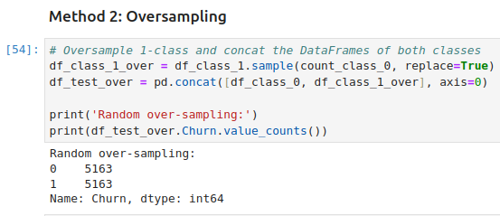
21.3 Method 2: Over-Sampling
https://www.youtube.com/watch?v=JnlM4yLFNuo&list=PLeo1K3hjS3uu7CxAacxVndI4bE_o3BDtO&index=21
Method 2: Over-Sampling (14:01-17:30/38:25)
Now, we do the over-sampling for class 1.

Slide 21
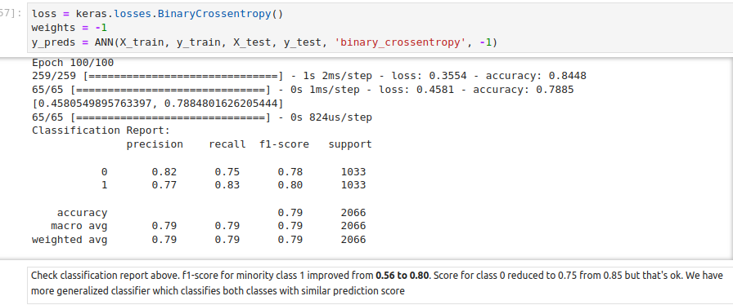
21.3 Method 2: Over-Sampling
https://www.youtube.com/watch?v=JnlM4yLFNuo&list=PLeo1K3hjS3uu7CxAacxVndI4bE_o3BDtO&index=21
Method 2: Over-Sampling (17:31-20:45/38:25)
We improve class 1 from 0.56 60 0.80.

Slide 22
21.4 Method 3: SMOTE

Slide 23
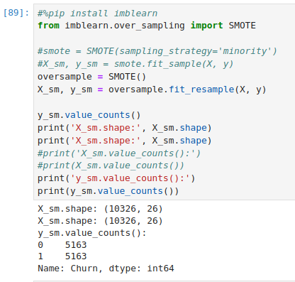
21.4 Method 3: SMOTE
https://www.youtube.com/watch?v=JnlM4yLFNuo&list=PLeo1K3hjS3uu7CxAacxVndI4bE_o3BDtO&index=21
Method 3: SMOTE (21:01-22:45/38:25)
Google the SMOTE to check how to install SMOTE.
> pip install imblearn
Now, we move to SMOTE (Synthetic Minority Over-Sampling Technique).
We use SMOTE() to over-sample the new samples: X_sm and y_sm.
We y_sm have same samples in class 0 and class 1.

Slide 24
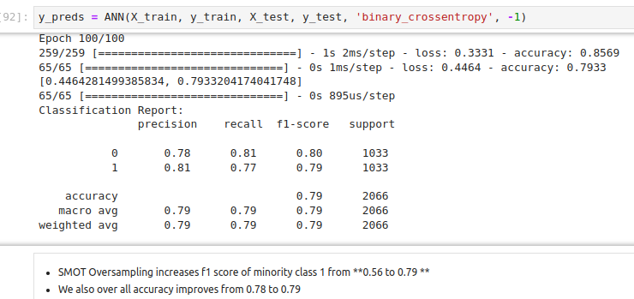
21.4 Method 3: SMOTE
https://www.youtube.com/watch?v=JnlM4yLFNuo&list=PLeo1K3hjS3uu7CxAacxVndI4bE_o3BDtO&index=21
Method 3: SMOTE (23:01-24:15/38:25)
We have improvement in f1-score of class 1 and accuracy improvement.

Slide 25
21.5 Method 4: Ensemble with Under-Sampling

Slide 26
21.5 Method 4: Ensemble with Under-Sampling
https://www.youtube.com/watch?v=JnlM4yLFNuo&list=PLeo1K3hjS3uu7CxAacxVndI4bE_o3BDtO&index=21
Method 4: Ensemble with Under-Sampling (23:01-27:15/38:25)
We will divide the dataset into several smaller datasets.

Slide 27
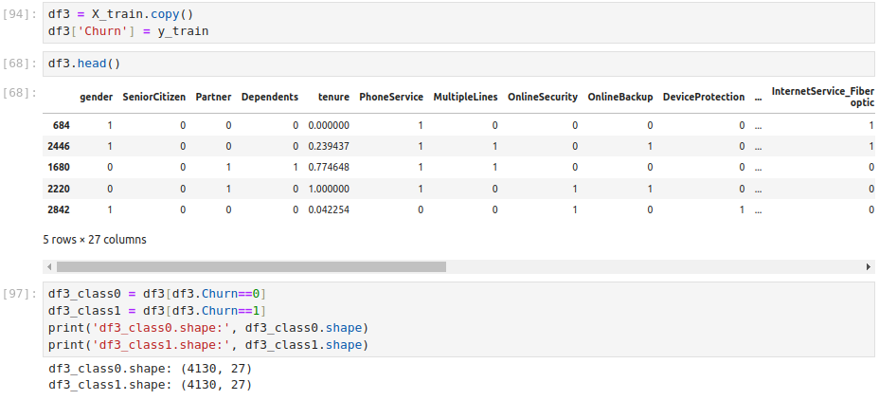
21.5 Method 4: Ensemble with Under-Sampling
https://www.youtube.com/watch?v=JnlM4yLFNuo&list=PLeo1K3hjS3uu7CxAacxVndI4bE_o3BDtO&index=21
Method 4: Ensemble with Under-Sampling (28:01-29:00/38:25)
We copy data into df3.

Slide 28
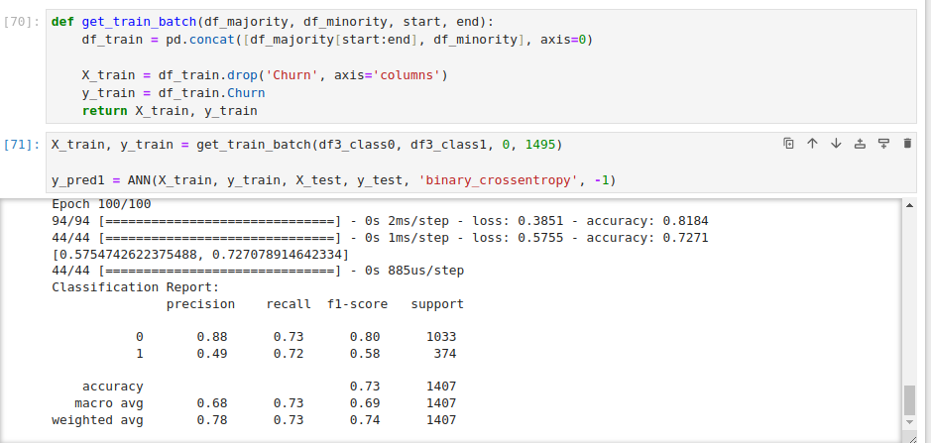
21.5 Method 4: Ensemble with Under-Sampling
https://www.youtube.com/watch?v=JnlM4yLFNuo&list=PLeo1K3hjS3uu7CxAacxVndI4bE_o3BDtO&index=21
Method 4: Ensemble with Under-Sampling (29:01-30:00/38:25)
We separate into three batches 0 to 1495)

Slide 29
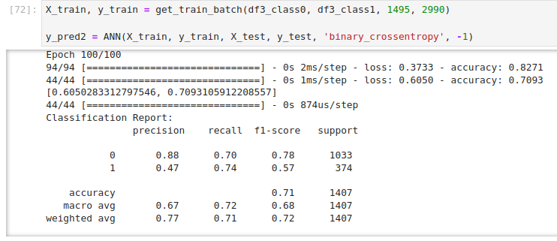
21.5 Method 4: Ensemble with Under-Sampling
https://www.youtube.com/watch?v=JnlM4yLFNuo&list=PLeo1K3hjS3uu7CxAacxVndI4bE_o3BDtO&index=21
Method 4: Ensemble with Under-Sampling (30:01-31:00/38:25)
We separate into three batches 1495 to 2999)

Slide 30
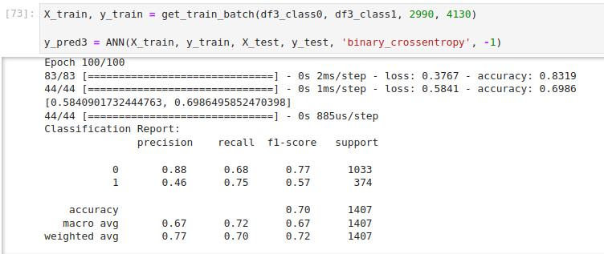
21.5 Method 4: Ensemble with Under-Sampling
https://www.youtube.com/watch?v=JnlM4yLFNuo&list=PLeo1K3hjS3uu7CxAacxVndI4bE_o3BDtO&index=21
Method 4: Ensemble with Under-Sampling (31:01-32:00/38:25)
We separate into three batches 2999 to 4130)

Slide 31
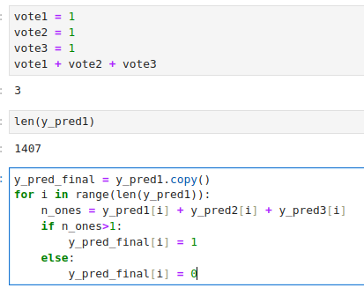
21.5 Method 4: Ensemble with Under-Sampling
https://www.youtube.com/watch?v=JnlM4yLFNuo&list=PLeo1K3hjS3uu7CxAacxVndI4bE_o3BDtO&index=21
Method 4: Ensemble with Under-Sampling (33:01-34:00/38:25)
We pick up the majority vote. Any one predict 1 (leave), then we set to 1.

Slide 32
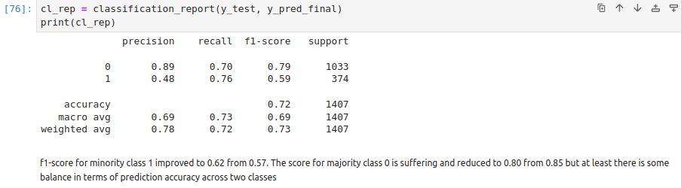
21.5 Method 4: Ensemble with Under-Sampling
https://www.youtube.com/watch?v=JnlM4yLFNuo&list=PLeo1K3hjS3uu7CxAacxVndI4bE_o3BDtO&index=21
Method 4: Ensemble with Under-Sampling (34:01-35:15/38:25)
We the result for Ensemble with Under-Sampling

Slide 33
21.6 Exercise

Slide 34
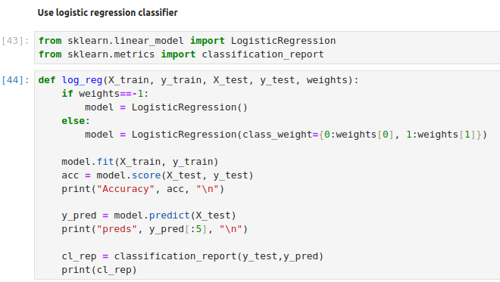
21.6 Exercise
https://www.youtube.com/watch?v=JnlM4yLFNuo&list=PLeo1K3hjS3uu7CxAacxVndI4bE_o3BDtO&index=21
Exercise (36:01-37:00/38:25)
Do the same example with Logistic Regression.

Slide 35
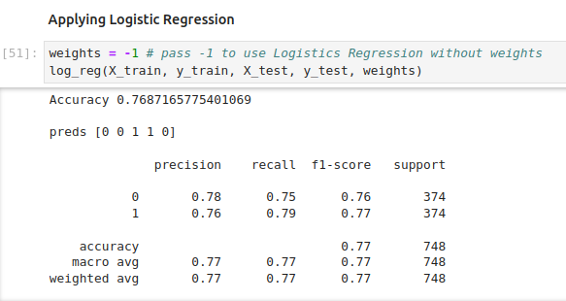
21.6 Exercise
https://www.youtube.com/watch?v=JnlM4yLFNuo&list=PLeo1K3hjS3uu7CxAacxVndI4bE_o3BDtO&index=21
Exercise (37:01-38:25/38:25)
Do the same example with Logistic Regression.

Slide 36
End

