Slide 1

30 Slide Window Object Detection
Peter H. Chen

Slide 2
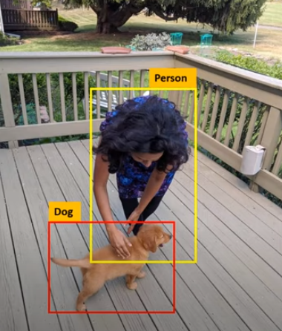
30 Slide Window Object Detection
https://www.youtube.com/watch?v=AimW3j7M2Uw&list=PLeo1K3hjS3uu7CxAacxVndI4bE_o3BDtO&index=30
Slide Window Object Detection (0:00-0:15/4:57)
We discuss the Sliding Window Object Detection.
It detects the objects, such as, Dog and Person, etc.
We get the bounding box in the pictures.

Slide 3

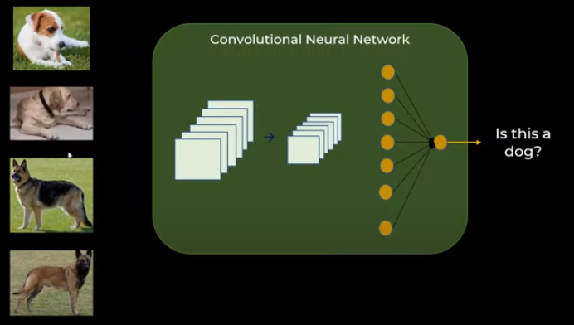
30 Slide Window Object Detection
https://www.youtube.com/watch?v=AimW3j7M2Uw&list=PLeo1K3hjS3uu7CxAacxVndI4bE_o3BDtO&index=30
Slide Window Object Detection (0:20-0:22/4:57)
Let’s detect dog first.
We can have cropped (裁剪过的) of dog images and we can train the CNN (Convolutional Neural Network) and we can predict there is a dog or not.

Slide 4
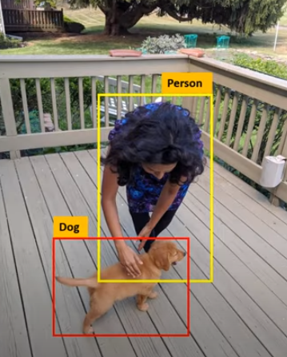
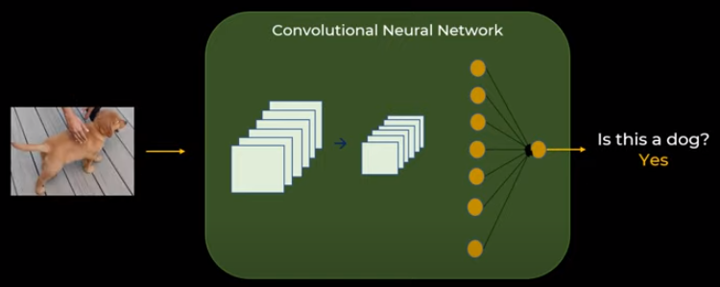
30 Slide Window Object Detection
https://www.youtube.com/watch?v=AimW3j7M2Uw&list=PLeo1K3hjS3uu7CxAacxVndI4bE_o3BDtO&index=30
Slide Window Object Detection (0:45-0:55/4:57)
We can input a cropped dog image to predict there is a dog not?

Slide 5
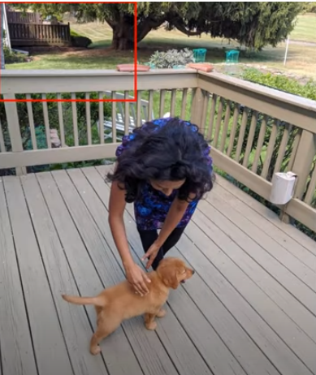
30 Slide Window Object Detection
https://www.youtube.com/watch?v=AimW3j7M2Uw&list=PLeo1K3hjS3uu7CxAacxVndI4bE_o3BDtO&index=30
Slide Window Object Detection (1:00-2:30/4:57)
Now, we can slide the windows in any image.
We can start with any window size.
We have Convolutional result inside the window,
We know inside the window has the Dog or not.
We keep on moving the window until there is a convolutional match.
We can trial and err

Slide 6
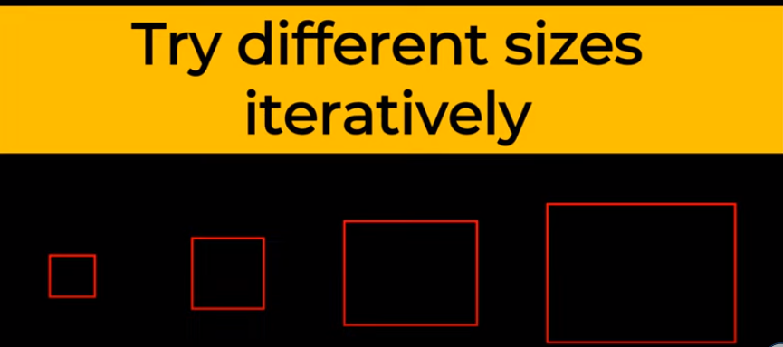
30 Slide Window Object Detection
https://www.youtube.com/watch?v=AimW3j7M2Uw&list=PLeo1K3hjS3uu7CxAacxVndI4bE_o3BDtO&index=30
Slide Window Object Detection (2:36-3:00/4:57)
We can trial and err.
So, we start with a small window and slide the window. Then, we try bigger window and slide again until we find the object.

Slide 7
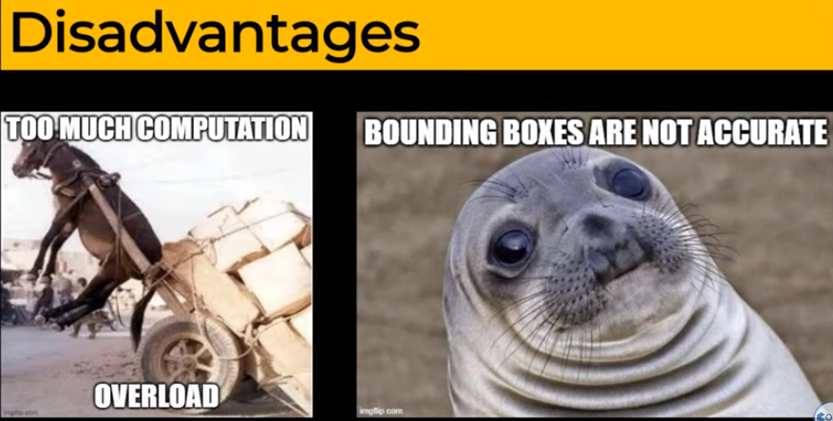
30 Slide Window Object Detection
https://www.youtube.com/watch?v=AimW3j7M2Uw&list=PLeo1K3hjS3uu7CxAacxVndI4bE_o3BDtO&index=30
Slide Window Object Detection (3:03-3:20/4:57)
The disadvantage is too much computation.

Slide 8
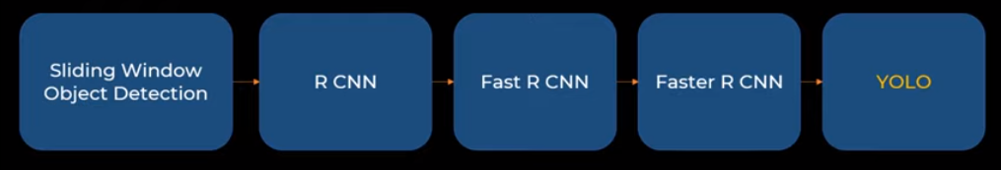
30 Slide Window Object Detection
https://www.youtube.com/watch?v=AimW3j7M2Uw&list=PLeo1K3hjS3uu7CxAacxVndI4bE_o3BDtO&index=30
Slide Window Object Detection (3:30-4:20/4:57)
The are R-CNN (Region based Convolutional Neural Network).
There is a YOLO (You Only Look Once) algorithm.
YOLO is the industry standard for sliding window.

Slide 9
End

