Slide 1

25 CNN Padding and Stride
Peter H. Chen

Slide 2

25 CNN Padding and Stride
https://www.youtube.com/watch?v=oDAPkZ53zKk&list=PLeo1K3hjS3uu7CxAacxVndI4bE_o3BDtO&index=25
CNN Padding and Stride (0:00-0:05/6:34)
We discuss the convolution padding and stride.

Slide 3
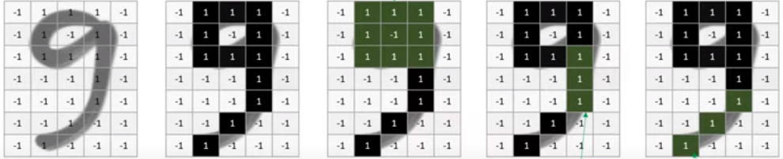
25 CNN Padding and Stride
https://www.youtube.com/watch?v=oDAPkZ53zKk&list=PLeo1K3hjS3uu7CxAacxVndI4bE_o3BDtO&index=25
CNN Padding and Stride (0:07-0:30/6:34)
In the digit recognition, we come up with three different filters or feature detectors.
These filters are
1. Loopy Pattern detector,
2. Vertical Line detector, and
3. Diagonal line detector.
These detectors detect the head, middle part, and tail part of digit “9”.
3
1
Loopy Pattern Filter
2
Vertical Line Filter
Diagonal Line Filter

Slide 4
25.1 Valid vs. Same Convolution

Slide 5
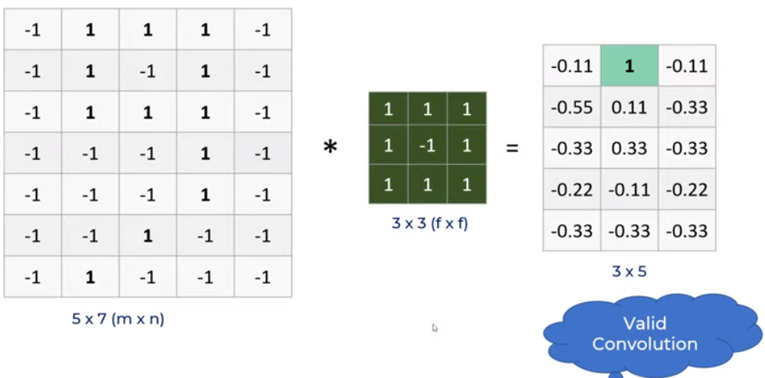
25.1 Valid vs. Same Convolution
https://www.youtube.com/watch?v=oDAPkZ53zKk&list=PLeo1K3hjS3uu7CxAacxVndI4bE_o3BDtO&index=25
Valid vs. Same Convolution (0:40-1:00/6:34)
When we apply these filters,
We have 5 x 7 (m x n) image, 3 x 3 (f x f) filters, and feature map 3 x 5.
How do we get the feature map size?
(m – f + 1) x (n – f + 1) = (5 - 3 + 1) x (7 – 3 + 1) = 3 x 5.

Slide 6
25.1 Valid vs. Same Convolution
https://www.youtube.com/watch?v=oDAPkZ53zKk&list=PLeo1K3hjS3uu7CxAacxVndI4bE_o3BDtO&index=25
Valid vs. Same Convolution (1:01-1:20/6:34)
The convolution with the original image (without padding) is called “Valid Convolution.”
What is valid convolution?
1. A valid convolution is a type of convolution operation that does not use any padding on the input.
2. For an m×n input matrix and an f × f filter, a valid convolution will return an output matrix of dimensions. ⌊m - f + 1⌋ × ⌊n – f + 1⌋

Slide 7
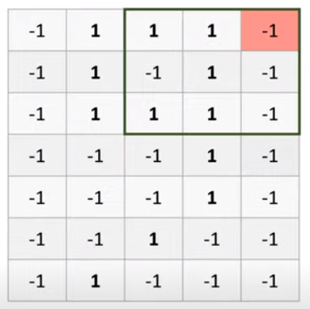
25.1 Valid vs. Same Convolution
https://www.youtube.com/watch?v=oDAPkZ53zKk&list=PLeo1K3hjS3uu7CxAacxVndI4bE_o3BDtO&index=25
Valid vs. Same Convolution (1:25-1:40/6:34)
For example, the color high-lite on the corner does not participate well in the convolution convolution operation. The filter cannot move well at the corner of image.

Slide 8
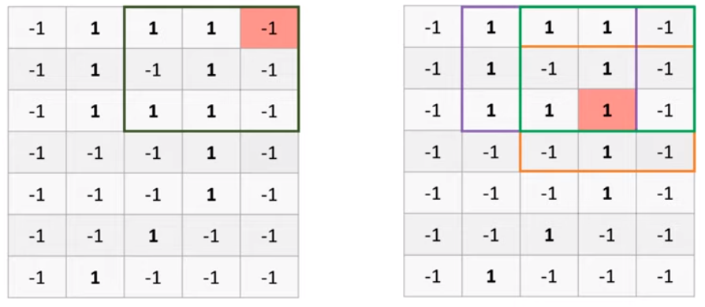
25.1 Valid vs. Same Convolution
https://www.youtube.com/watch?v=oDAPkZ53zKk&list=PLeo1K3hjS3uu7CxAacxVndI4bE_o3BDtO&index=25
Valid vs. Same Convolution (1:25-1:55/6:34)
There is a problem at the corner of image.
In the left below example, the corner pixel do not participate well in feature detection. The corner pixel only convolve by filter one time only.
In the right below example, the color pixel fully participate the convolution operation. The pixel is convolved by filters at least three times (or more).

Slide 9
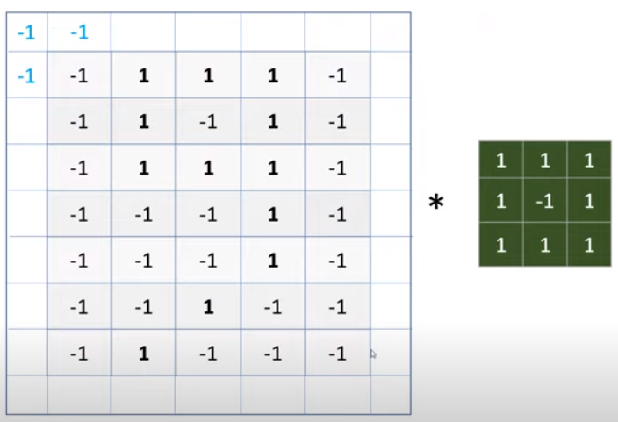
25.1 Valid vs. Same Convolution
https://www.youtube.com/watch?v=oDAPkZ53zKk&list=PLeo1K3hjS3uu7CxAacxVndI4bE_o3BDtO&index=25
Valid vs. Same Convolution (1:56-2:50/6:34)
To solve this problem, we can pad the original image with more pixels.
Below example, we pad one pixel with value -1 at the image boundary.
Orignal Image: 5 x 7 => Pad Image : 7 x 9

Slide 10
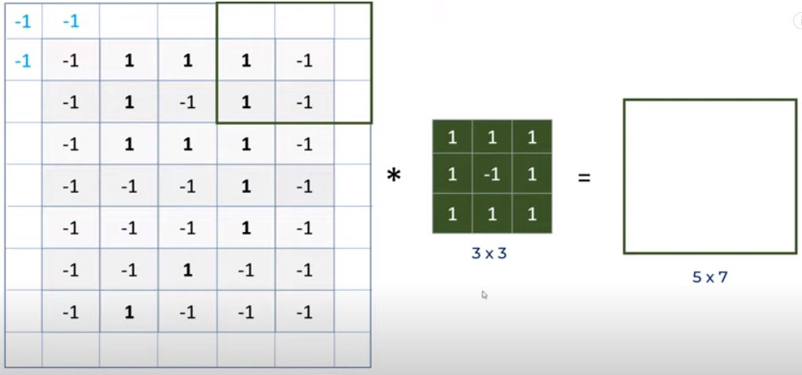
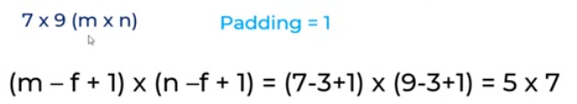
25.1 Valid vs. Same Convolution
https://www.youtube.com/watch?v=oDAPkZ53zKk&list=PLeo1K3hjS3uu7CxAacxVndI4bE_o3BDtO&index=25
Valid vs. Same Convolution (2:25-4:00/6:34)
Below, we put some value on the boundary. We get the original image (5 x 7) size back.
The pad padding convolution is called “Same Convolution”.
What does "same convolution" mean?
Same convolution means when you pad, the output size is the same as the input size.

Slide 11
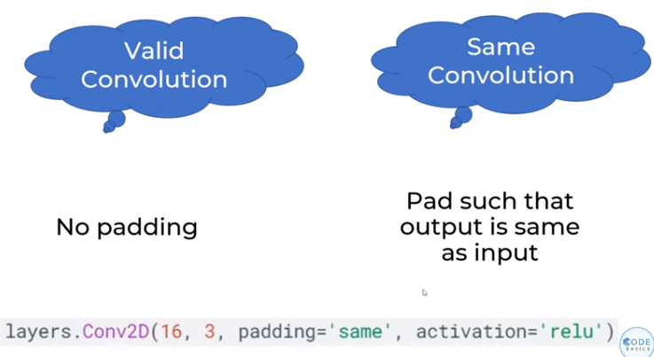
25.1 Valid vs. Same Convolution
https://www.youtube.com/watch?v=oDAPkZ53zKk&list=PLeo1K3hjS3uu7CxAacxVndI4bE_o3BDtO&index=25
Valid vs. Same Convolution (4:01-5:00/6:34)
Valid Convolution: No Padding convolution.
Same Convolution: Pad the input, such that the output is the same dimension as input.
In tensorflow, the padding parameters can be “same” or “valid”.

Slide 12
25.2 Stride

Slide 13
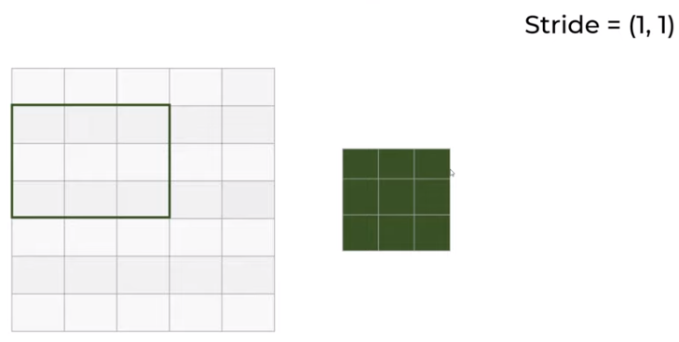
25.2 Stride
https://www.youtube.com/watch?v=oDAPkZ53zKk&list=PLeo1K3hjS3uu7CxAacxVndI4bE_o3BDtO&index=25
Stride (4:42-5:00/6:34)
When we have stride = (1, 1), stride one 1 by 1.
The window move right 1 step horizontally and then move down 1 in vertical.

Slide 14
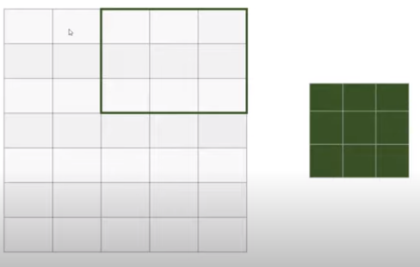
25.2 Stride
https://www.youtube.com/watch?v=oDAPkZ53zKk&list=PLeo1K3hjS3uu7CxAacxVndI4bE_o3BDtO&index=25
Stride (5:01-5:20/6:34)
When we have stride = (2, 1), stride one 2 by 1.
The window move right 2 steps horizontally and then move down 1 step in vertical.

Slide 15
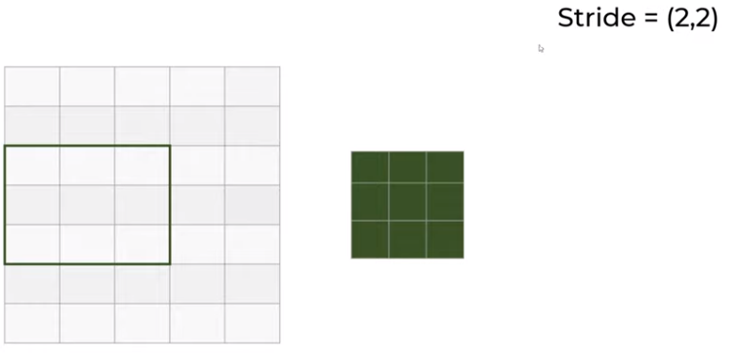
25.2 Stride
https://www.youtube.com/watch?v=oDAPkZ53zKk&list=PLeo1K3hjS3uu7CxAacxVndI4bE_o3BDtO&index=25
Stride (5:21-5:30/6:34)
When we have stride = (2, 2), stride one 2 by 2.
The window move right 2 steps horizontally and then move down 2 steps in vertical.

Slide 16
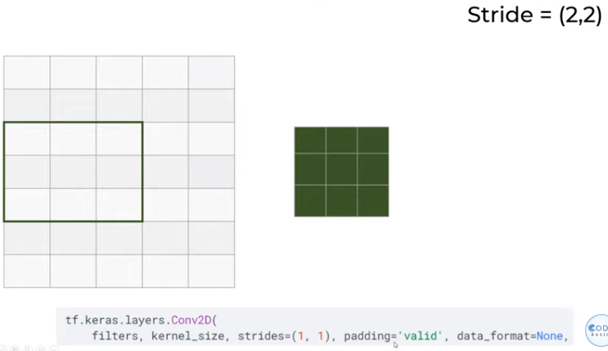
25.2 Stride
https://www.youtube.com/watch?v=oDAPkZ53zKk&list=PLeo1K3hjS3uu7CxAacxVndI4bE_o3BDtO&index=25
Stride (5:31-6:34/6:34)
In TensorFlow, specify stride = (2, 2), padding = ‘valid’
(2, 2)

Slide 17
End

