Slide 1
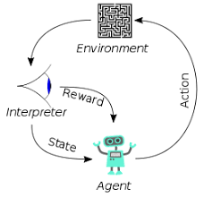
002 DL: Why Deep Learning?
Peter H. Chen

Slide 2
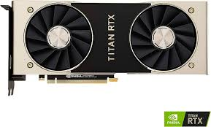
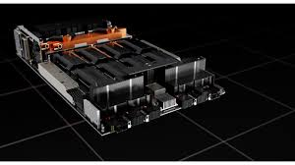
002 DL: Why Deep Learning?
https://www.youtube.com/watch?v=yfsTZbwgMSE&list=PLeo1K3hjS3uu7CxAacxVndI4bE_o3BDtO&index=2
DL: Why Deep Learning? (0:00-1:24/5:24)
It is very difficult to implement the back propagation algorithm using Cpp.
The neural network concept is there for many years.
Now, why the PyTorch packages and Tensorflow frameworks become popular?.
Because:
1. Data growth: The volume of data, e.g., business data for analysis, social media data for like/dislike, twitter semantic analysis
2. hardware advancement: in 2000s, we have CPU/Cores and MB/GB DRAM takes months to run jobs, now the computer with CPU/Cores DRAM in hours. With NVIDIA Titan RTX GPU 10GB VRAM to run in minutes. With NVIDIA HGX H100, we run in seconds.
Nvidia/Titan RTX
Nvidia/HGX H100

Slide 3
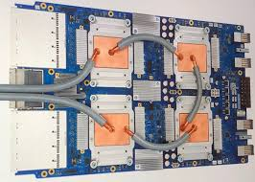
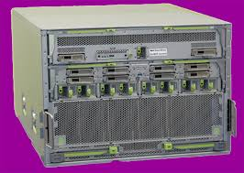
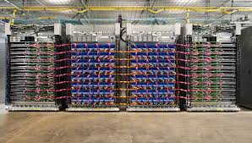
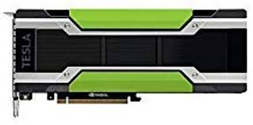
002 DL: Why Deep Learning?
https://www.youtube.com/watch?v=yfsTZbwgMSE&list=PLeo1K3hjS3uu7CxAacxVndI4bE_o3BDtO&index=2
DL: Why Deep Learning? (1:30-2:00/5:24)
Google has built TPU (Tensorflow Processor Unit), Meta has Grand Teton Platform, and Tesla K10/M40 based on Nvidia GPU.
You can run job with them on computer or cloud.
Google TPU
Meta Grand Teton Platform
Tesla M40 based on Nvidia GPU

Slide 4
002 DL: Why Deep Learning?
https://www.youtube.com/watch?v=yfsTZbwgMSE&list=PLeo1K3hjS3uu7CxAacxVndI4bE_o3BDtO&index=2
DL: Why Deep Learning? (2:40-5:24/5:24)
3. Python and Open-source ecosystem: this is the most important. Before, we can only use C++ with Computer science background. Now, with Python, non-CS majors, math, statistical major, EE, etc can develop program easily. We have meta PyTorch and google tensorflow.
4. Cloud: If yo don’t have GPU on your computer, you can run GPU on cloud. You don’t have to buy the GPU and TPU hardware. You just rent a computer on the cloud.
5. AI Boom: LLM (Large Language Model) for Google PaLM (Pathway Language Model), Meta Llama (Large Language Model by Meta AI), FAISS (Facebook AI Similarity Search), chatGPT by OpenAI, HuggingFace LangChain, etc.

Slide 5
End

