Slide 1
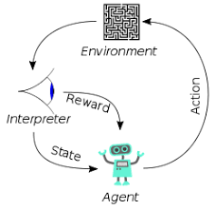
005 Install Tensorflow
Peter H. Chen

Slide 2
005 Install Tensorflow
https://www.youtube.com/watch?v=VC-EliTgMEM&list=PLeo1K3hjS3uu7CxAacxVndI4bE_o3BDtO&index=5
Install Tensorflow (0:00-2:36/2:36)
We install Tensorflow in anaconda under Linux/Ubuntu Operating system.
Anaconda come with Python installation.

Slide 3
001 DL in Python, TF, Keras
https://www.youtube.com/watch?v=wQ8BIBpya2k&list=PLQVvvaa0QuDfhTox0AjmQ6tvTgMBZBEXN&index=1
Install Tensorflow (0:00-2:36/2:36)
> conda create -name tf
> conda activate tf
> pip install tensorflow

Slide 4
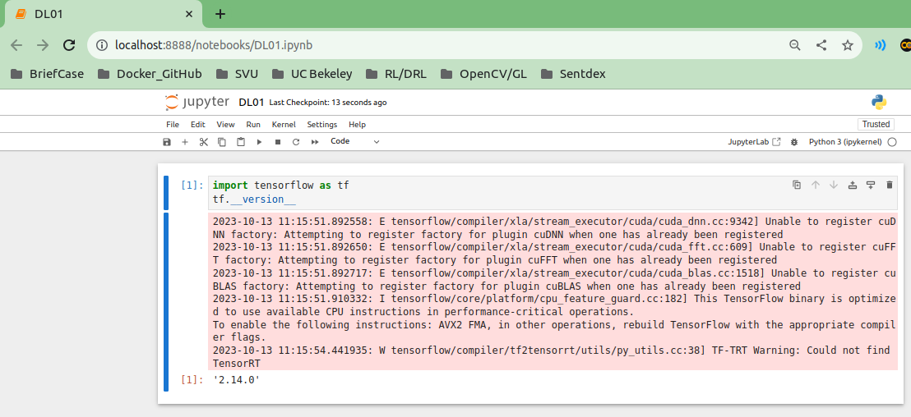
001 DL in Python, TF, Keras
https://www.youtube.com/watch?v=wQ8BIBpya2k&list=PLQVvvaa0QuDfhTox0AjmQ6tvTgMBZBEXN&index=1
Install Tensorflow (0:00-2:36/2:36)
https://tecadmin.net/installing-tensorflow-on-ubuntu/
Install Jupyter notebook on Ubuntu:
> pip install jupyter
> jupyter notebook DL01.ipynb
Select jupyter cell and “Control-<Return>”

Slide 5
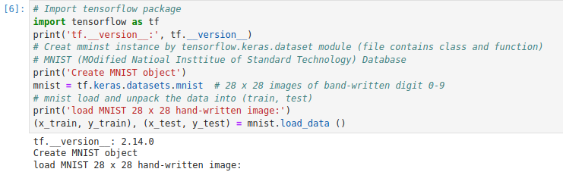
001 DL in Python, TF, Keras
https://www.youtube.com/watch?v=wQ8BIBpya2k&list=PLQVvvaa0QuDfhTox0AjmQ6tvTgMBZBEXN&index=1
Install Tensorflow (0:00-2:36/2:36)

Slide 6
End

