Slide 1
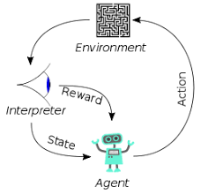
006 PT, TF, and Keras
Peter H. Chen

Slide 2
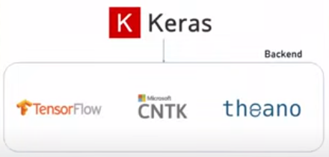
006 PyTorch, Tensorflow, and Keras
https://www.youtube.com/watch?v=z-ZR_8BZ1wQ&list=PLeo1K3hjS3uu7CxAacxVndI4bE_o3BDtO&index=6
PyTorch, Tensorflow, and Keras (0:00-1:00/2:16)
Meta PyTorch and Goggle Tensorflow are two most popular deep learning Frameworks.
Microsoft CNTK (Cognitive Toolkit) is not as popular as Meta PyTorch and Google Tensorflow.
PyTorch is GPU version of Numpy, i.e., PyTorch = Numpy (used in machine learning) + run GPU (for Deep Learning).
Keras is not a full-fledged (complete) deep learning framework.
Keras is a nice wrapper around Google Tensorflow, Microsoft CNTK, and Theano.
People program Tensorflow, CNTK, and Theano is not easy. Keras creates a nice wrapper (easy API interface) around these libraries.
Keras provides a convenient way to program these libraries. Keras is not a full-fledged framework.

Slide 3
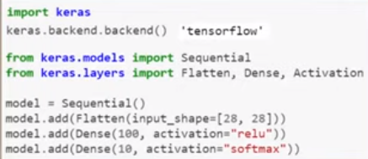
006 PyTorch, Tensorflow, and Keras
https://www.youtube.com/watch?v=z-ZR_8BZ1wQ&list=PLeo1K3hjS3uu7CxAacxVndI4bE_o3BDtO&index=6
PyTorch, Tensorflow, and Keras (1:04-1:25/2:16)
Below is the code snippet.
You can see Keras is very easy for tensorflow programming.
In Tensorflow 1.0, we use Keras as the backend of Tensorflow as below.

Slide 4
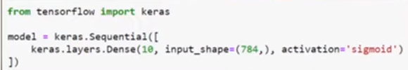
006 PyTorch, Tensorflow, and Keras
https://www.youtube.com/watch?v=z-ZR_8BZ1wQ&list=PLeo1K3hjS3uu7CxAacxVndI4bE_o3BDtO&index=6
PyTorch, Tensorflow, and Keras (1:26-2:16/2:16)
In Tensorflow 2.0, Keras is made part of Tensorflow API library.
When we install Tensorflow 2.0, we will get Keras automatically.
We will not install Keras separately. Keras are built into the Tensorflow 2.0.
Keras become the Tensorflow API.
We no longer see the Tensorflow as the backend of Tensorflow in the tensorflow 2.0.

Slide 5
End

