Slide 1

32 YOLO Object Detection
Peter H. Chen

Slide 2
32 YOLO Object Detection
https://www.youtube.com/watch?v=IfRMV2MY9n0&list=PLeo1K3hjS3uu7CxAacxVndI4bE_o3BDtO&index=32
YOLO Object Detection (0:00-0:30/14:52)
I already looked at the basic theory of YOLO (You Only Look Once) algorithm.
In this discussion, we do the real object detection using YOLO.
We will go over some important history of YOLO version (v1, v2, v3, v4, etc).
As for January 2021, there are totally five versions of YOLO. Now, YOLO come to version 9.
We go over the important versions of YOLO history.
Training YOLO is big task. We use the Pre-Trained Weights for doing object detection.
We do not take any custom object image dataset for object detection.
We take the COCO (Common Object Context) Dataset from Microsoft for object detection.
We then, use Pre-Trained Weights and doing object-detection for those COCO Dataset. The COCO Dataset are labeled by Microsoft.
The COCO Dataset labeled with classification (for example, Dog, Cat, Person, etc), bounding box locations (Object location in the image), and segmentation (for example, Dog1, Dog2, Cat1, Cat 2, Person 1, Person 2, etc.).
We also can train the YOLO weights with custom Dataset.

Slide 3
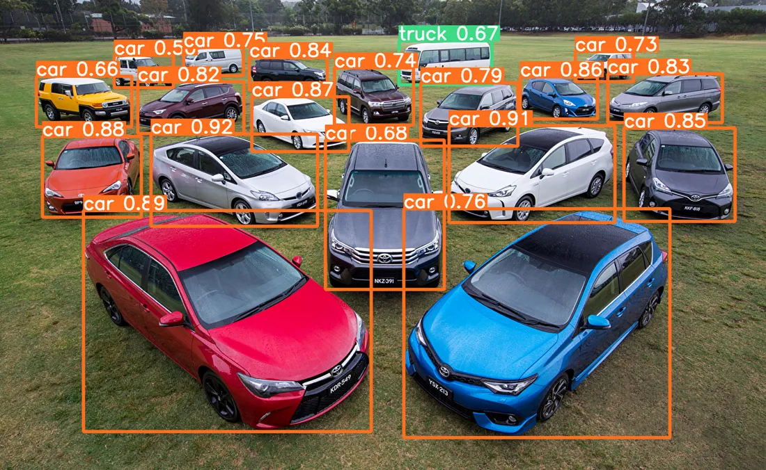
32 YOLO Object Detection
https://www.youtube.com/watch?v=IfRMV2MY9n0&list=PLeo1K3hjS3uu7CxAacxVndI4bE_o3BDtO&index=32
YOLO Object Detection (0:31-0:40/14:52)
The YOLO algorithm:
1. divides the image into a grid and
2. predicts bounding boxes and class probabilities inside each grid cell.
3. Perform the merge of grid cells or cleanup into the bounding
box.https://medium.com/@tejasdalvi927/object-detection-with-yolo-and-opencv-a-practical-guide-cf7773481d11

Slide 4
32 YOLO Object Detection
https://www.youtube.com/watch?v=IfRMV2MY9n0&list=PLeo1K3hjS3uu7CxAacxVndI4bE_o3BDtO&index=32
YOLO Object Detection (0:41-1:00/14:52)
Unlike other algorithms that rely on sliding windows or region proposals, YOLO performs detection in a single pass, resulting in faster and more efficient processing.
YOLO Key features:
1. Real-Time Performance:
  Architecture enables it to achieve real-time object detection
  Fits quick and accurate object detection.
2. Simple and Efficient:
  Single-pass simplifies the detection pipeline
  Computationally efficient compared to other algorithms.
3. Flexibility:
  Image with Multiple objects in image
  Image with different size of objects of different sizes.
box.https://medium.com/@tejasdalvi927/object-detection-with-yolo-and-opencv-a-practical-guide-cf7773481d11

Slide 5
32.01 YOLO Algorithm History

Slide 6
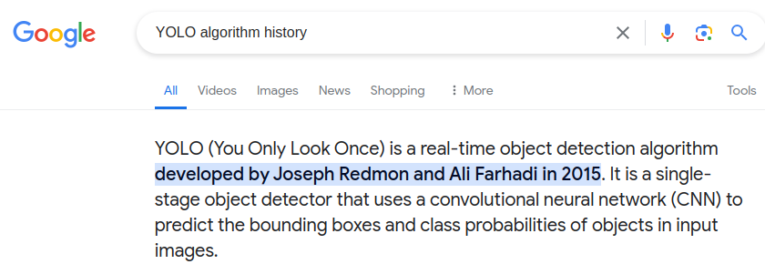
32.01 YOLO Algorithm History
https://www.youtube.com/watch?v=IfRMV2MY9n0&list=PLeo1K3hjS3uu7CxAacxVndI4bE_o3BDtO&index=32
YOLO Algorithm History (1:01-1:05/14:52)
We can find it by google search “YOLO Algorithm History”
We will find Joseph Redmon from Washington University is the original creator of YOLO.

Slide 7
32.01.01 YOLO V1

Slide 8
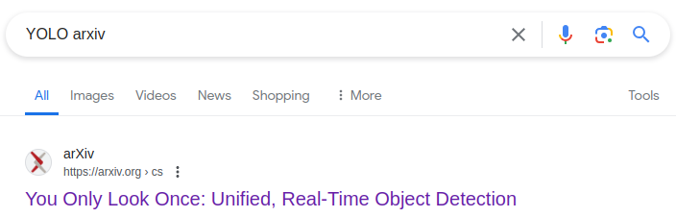
32.01.01 YOLO V1
https://www.youtube.com/watch?v=IfRMV2MY9n0&list=PLeo1K3hjS3uu7CxAacxVndI4bE_o3BDtO&index=32
YOLO V1 (1:01-1:05/14:52)
You can find it by google search “YOLO V1 arXiv”.
https://arxiv.org/abs/1506.02640

Slide 9
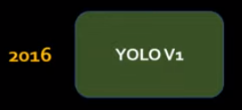
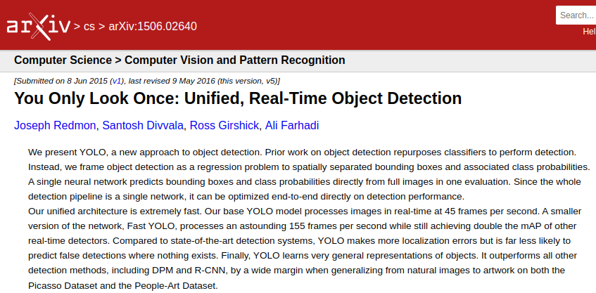
32.01.01 YOLO V1
https://www.youtube.com/watch?v=IfRMV2MY9n0&list=PLeo1K3hjS3uu7CxAacxVndI4bE_o3BDtO&index=32
YOLO V1 (1:06-1:15/14:52)
In 2016, “You Only Look Once: Unified, Real-Time Object Detection”, by Joseph Redmon (University of Washington), Santosh Divvala (Allen Institute of AI), Ross Girshick (Facebook).
In YOLO V1, the real-time rate is 45 frames per second.

Slide 10
32.01.02 YOLO V2

Slide 11
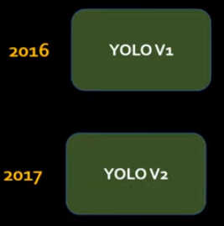
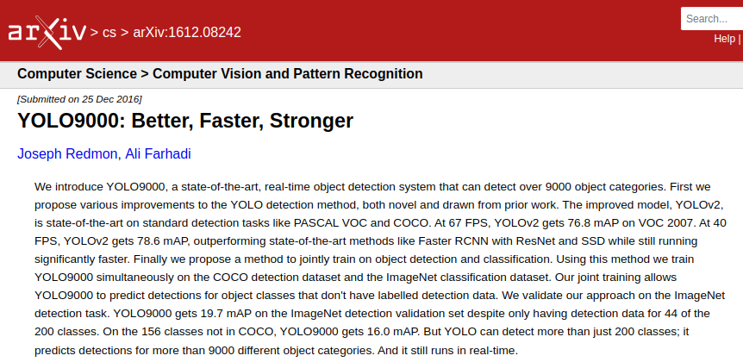
32.01.02 YOLO V2
https://www.youtube.com/watch?v=IfRMV2MY9n0&list=PLeo1K3hjS3uu7CxAacxVndI4bE_o3BDtO&index=32
YOLO V2 (1:16-1:30/14:52)
In 2017, the YOLO V2 come out, “YOLO9000: Better, Faster, Strong”, by Joseph Redmon (University of Washington) and Ali Farhadi (Allen Institute of AI).
In YOLO V2, they improve the speed to support the rate of 67 FPS (frames per second) with 76.8 mAP (Mean Average Prevision).

Slide 12
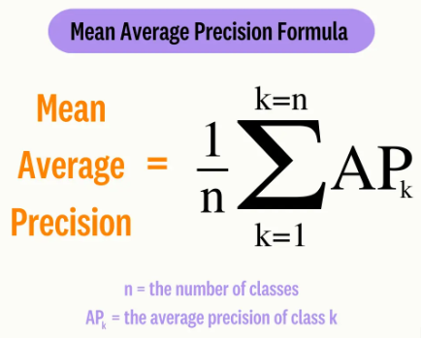
32.01.02 YOLO V2
https://www.youtube.com/watch?v=IfRMV2MY9n0&list=PLeo1K3hjS3uu7CxAacxVndI4bE_o3BDtO&index=32
YOLO V2 (1:31-1:35/14:52)
What is mAP (Mean Average Precision)?
1. Mean Average Precision is a metric used to measure the performance of a model for tasks such as object detection tasks and information retrieval.
2. mAP leverages these sub-metrics: Confused Matrix, Intersection over Union(IoU), Recall, and Precision.

Slide 13
32.01.02 YOLO V2
https://www.youtube.com/watch?v=IfRMV2MY9n0&list=PLeo1K3hjS3uu7CxAacxVndI4bE_o3BDtO&index=32
YOLO V2 (1:46-1:40/14:52)
The YOLO algorithm is very fast. Normal Video play at 24 FPS (Frames Per Second). YOLO detect objects at 67 FPS (Frames Per Second) is about 2-3 times fast for normal video play.
YOLO Fast FPS are very useful in:
1. Detect image in Video play.
2. Autonomous cars
  Tesla Autopilot: Improve the drive safety and reliability on the street
  Tesla Full Self-Driving: Given start point and destination, help long distance drive from, e.g., form Sunnyvale, California to Seattle, Washington.

Slide 14
32.01.03 YOLO V3

Slide 15
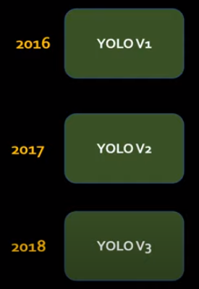
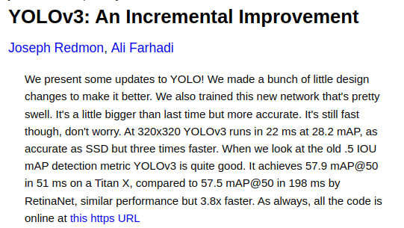
32.01.03 YOLO V3
https://www.youtube.com/watch?v=IfRMV2MY9n0&list=PLeo1K3hjS3uu7CxAacxVndI4bE_o3BDtO&index=32
YOLO V3 (1:41-1:50/14:52)
In 2018, “YOLO V3: An Incremental Improvement” was created.
Again, Joseph Redmon and Ali Farhadi from University of Washington.
They are the pioneers of YOLO incremental improvement.
They improve speed to 3 times faster and pre-train Model become bigger.

Slide 16
32.01.04 YOLO V4

Slide 17
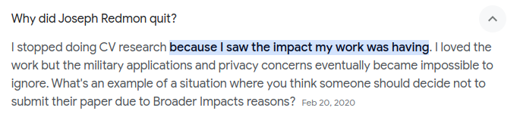
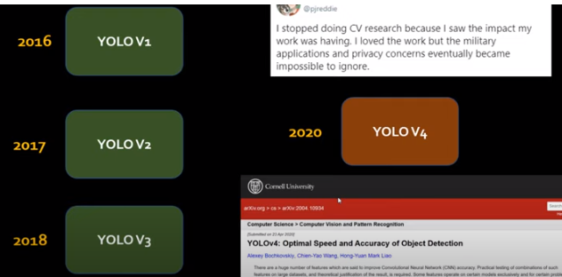
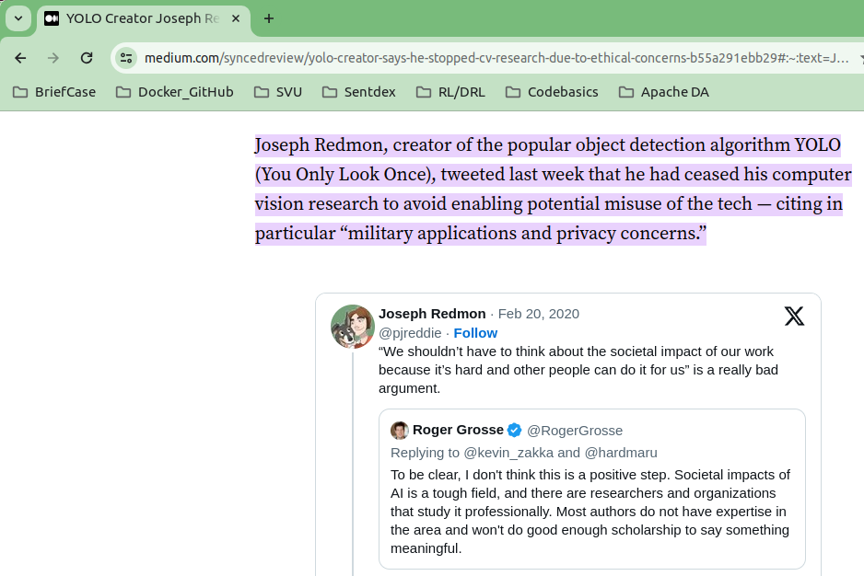
32.01.04 YOLO V4
https://www.youtube.com/watch?v=IfRMV2MY9n0&list=PLeo1K3hjS3uu7CxAacxVndI4bE_o3BDtO&index=32
YOLO V4 (1:51-2:20/14:52)
After YOLO V3, Joseph Redmon stopped working on YOLO due “Privacy concern”.
He has some personal value concern and conflict because YOLO is used in miliary purpose.

Slide 18
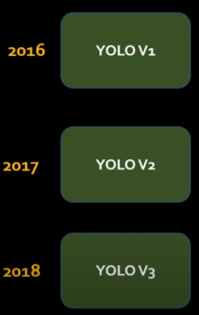
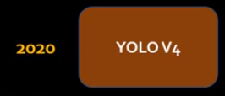
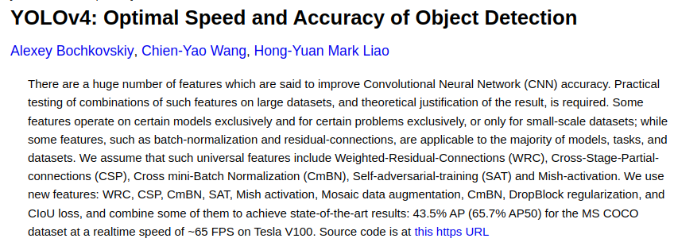
32.01.04 YOLO V4
https://www.youtube.com/watch?v=IfRMV2MY9n0&list=PLeo1K3hjS3uu7CxAacxVndI4bE_o3BDtO&index=32
YOLO V4 (2:21-2:40/14:52)
In 2020, YOLO V4 was created.
We use different color because the YOLO creator Joseph Redmon is no longer part of YOLO developer.
Alexey Bochkovskiy created a fork of YOLO repository.
Both Chien-Yao Wang and Hon-Yuan Liao are from Taiwan Sinica (中央研究院).
They created a separate branch for YOLO V4 algorithm.

Slide 19
32.01.05 YOLO Post Versions

Slide 20
32.01.05 YOLO Post Versions
https://www.youtube.com/watch?v=IfRMV2MY9n0&list=PLeo1K3hjS3uu7CxAacxVndI4bE_o3BDtO&index=32
YOLO Post Versions (2:41-2:50/14:52)
Nowadays, there are still controversy of privacy and milliary application still going on.
1. YOLO (You Only Look Once) has YOLO V1 (2016), V2 (2017), V3 (2018), V4-V5 (2020), V6 (Qualcomm Model, 2022), V7 (2022), V8 (2023), V9 (2024), and etc.
2. Each version builds on the previous version with new features, such as better accuracy, faster processing, and better handling of small objects.
3. The latest version, YOLO8, was launched on January 10, 2023, and includes new features like anchor-free detection, new convolutional layers, and structural and architectural changes.
4. YOLO8 also has a new API that makes training and inference easier on CPU and GPU devices
5. Google/Kaggle Object Detection with YOLO V3:
Has Tensorflow compatibility issues, but not stable yet.
https://www.kaggle.com/code/aruchomu/yolo-v3-object-detection-in-tensorflow
6. We will use Stable Code example from TF-Hub Module from Google Tensorflow Hub.
https://www.tensorflow.org/hub/tutorials/object_detection
Google has plan to implementation plant for YOLO.
https://discuss.tensorflow.org/t/why-there-is-no-yolo-models-at-tensorflow-hub-or-model-garden/829

Slide 21
End

