Slide 1

42 Word2Vec: Tensorflow Gensim
Peter H. Chen

Slide 2
42 Word2Vec: Tensorflow Gensim
https://www.youtube.com/watch?v=Q2NtCcqmIww&list=PLeo1K3hjS3uu7CxAacxVndI4bE_o3BDtO&index=42
Word2Vec: Tensorflow Gensim (0:00-0:40/18:27)
We discuss the Word2Vec implement by Tensorflow Gensim library.
Gensim library is an NLP library for Python and syntax is very easy.

Slide 3
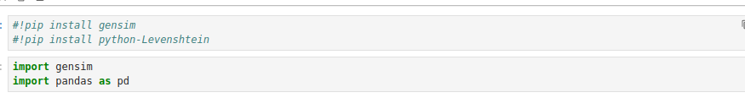
42 Word2Vec: Tensorflow Gensim
https://www.youtube.com/watch?v=Q2NtCcqmIww&list=PLeo1K3hjS3uu7CxAacxVndI4bE_o3BDtO&index=42
Word2Vec: Tensorflow Gensim (0:41-1:30/18:27)
Install Gensim and Pandas.

Slide 4
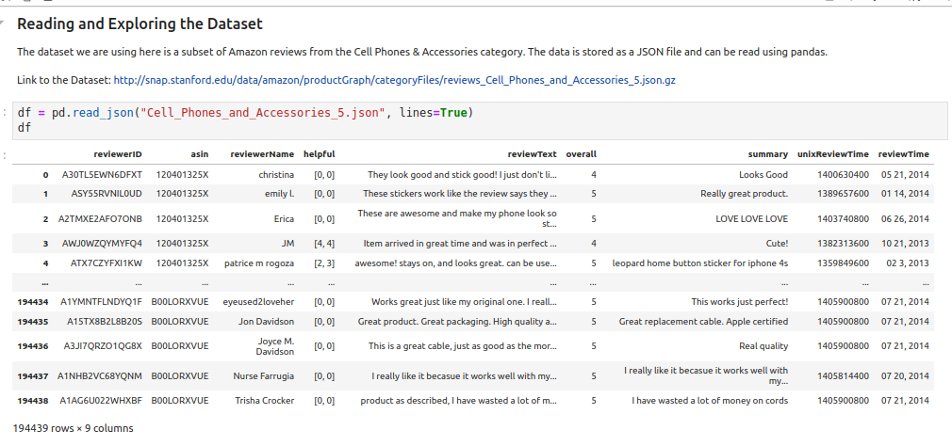
42 Word2Vec: Tensorflow Gensim
https://www.youtube.com/watch?v=Q2NtCcqmIww&list=PLeo1K3hjS3uu7CxAacxVndI4bE_o3BDtO&index=42
Word2Vec: Tensorflow Gensim (2:01-3:30/18:27)
Download ans unzip the json file and read the file.
Note: If you have security issue on chrome, use “wget “….gz” to dowload.

Slide 5
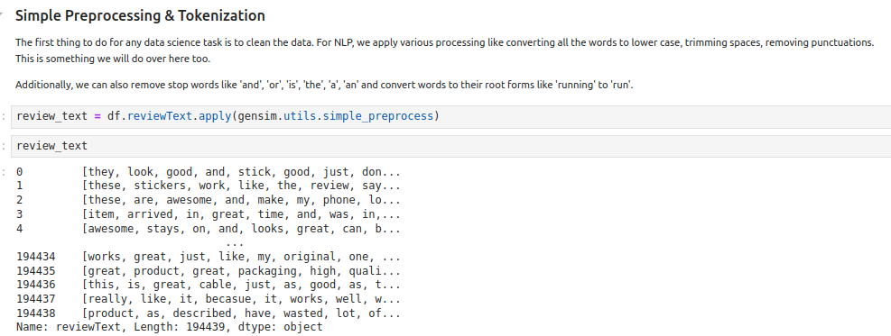
42 Word2Vec: Tensorflow Gensim
https://www.youtube.com/watch?v=Q2NtCcqmIww&list=PLeo1K3hjS3uu7CxAacxVndI4bE_o3BDtO&index=42
Word2Vec: Tensorflow Gensim (5:01-3:30/18:27)
simple.processes() function will process for vector

Slide 6
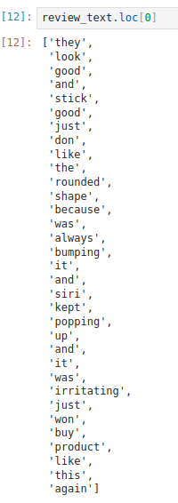
42 Word2Vec: Tensorflow Gensim
https://www.youtube.com/watch?v=Q2NtCcqmIww&list=PLeo1K3hjS3uu7CxAacxVndI4bE_o3BDtO&index=42
Word2Vec: Tensorflow Gensim (6:01-7:30/18:27)
Review_text.loc[0]

Slide 7
42 Word2Vec: Tensorflow Gensim
https://www.youtube.com/watch?v=Q2NtCcqmIww&list=PLeo1K3hjS3uu7CxAacxVndI4bE_o3BDtO&index=42
Word2Vec: Tensorflow Gensim (7:01-8:30/18:27)
df.reviewText.loc[0]:
View the first line of data.

Slide 8
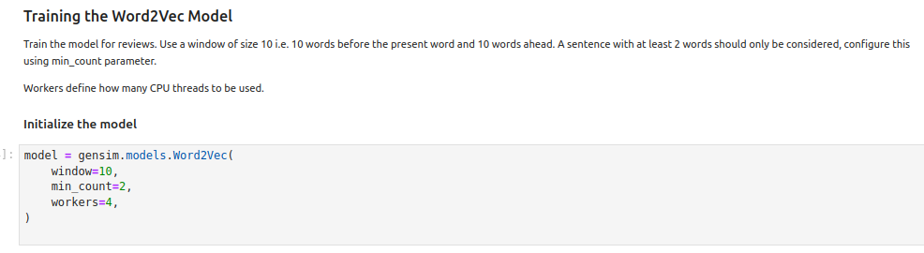
42 Word2Vec: Tensorflow Gensim
https://www.youtube.com/watch?v=Q2NtCcqmIww&list=PLeo1K3hjS3uu7CxAacxVndI4bE_o3BDtO&index=42
Word2Vec: Tensorflow Gensim (7:01-8:30/18:27)
Train the Word2Vec Model:
https://radimrehurek.com/gensim/models/word2vec.html
Window = 10: (optional) Maximum distance between the current and predicted word within a sentence
min_count = 2: (optional) Ignores all words with total frequency lower than this.
Workers = 4: (optional) How many threads we want to use. Faster training with multi-core machines.

Slide 9

42 Word2Vec: Tensorflow Gensim
https://www.youtube.com/watch?v=Q2NtCcqmIww&list=PLeo1K3hjS3uu7CxAacxVndI4bE_o3BDtO&index=42
Word2Vec: Tensorflow Gensim (11:01-12:30/18:27)
https://radimrehurek.com/gensim/models/doc2vec.html
Build_vocab()
progress_per=1000: How many words (1000) to process before showing/updating the progress.

Slide 10
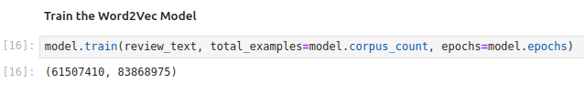
42 Word2Vec: Tensorflow Gensim
https://www.youtube.com/watch?v=Q2NtCcqmIww&list=PLeo1K3hjS3uu7CxAacxVndI4bE_o3BDtO&index=42
Word2Vec: Tensorflow Gensim (11:01-14:30/18:27)
Train Model
review_text: texts.
total_examples: Count of sentences. How many sentences? Here, model.copurs_count = 194439
model.epochs = 5

Slide 11
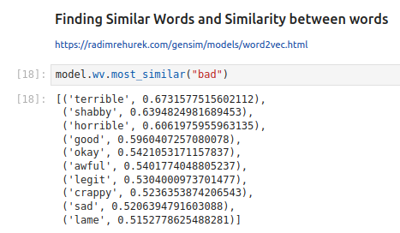
42 Word2Vec: Tensorflow Gensim
https://www.youtube.com/watch?v=Q2NtCcqmIww&list=PLeo1K3hjS3uu7CxAacxVndI4bE_o3BDtO&index=42
Word2Vec: Tensorflow Gensim (15:41-15:55/18:27)
Find the similar words and similarity between words.
What is words most similar? Find the “bad” words.

Slide 12
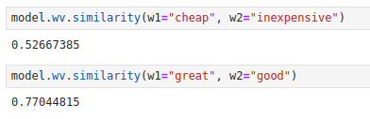
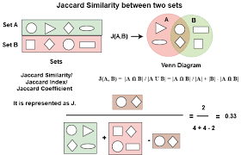
42 Word2Vec: Tensorflow Gensim
https://www.youtube.com/watch?v=Q2NtCcqmIww&list=PLeo1K3hjS3uu7CxAacxVndI4bE_o3BDtO&index=42
Word2Vec: Tensorflow Gensim (16:01-16:30/18:27)
We can find the how similar between words: word1 =”cheap” and word2=”inexpensive”.
How to measure the similarity between words?
It is the intersection of two sentences/texts between which the similarity is being calculated divided by the union of those two which refers to the number of common words over a total number of words.
The Jaccard Similarity score ranges from 0 to 1, where 1 represents most and 0 represents least similar.

Slide 13
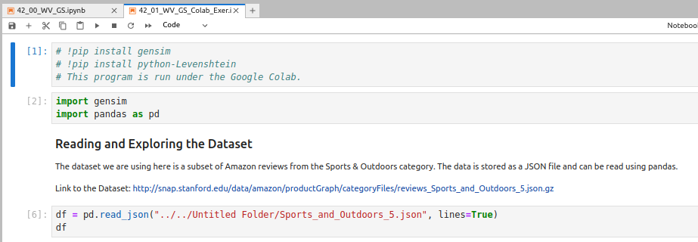
42 Word2Vec: Tensorflow Gensim
https://www.youtube.com/watch?v=Q2NtCcqmIww&list=PLeo1K3hjS3uu7CxAacxVndI4bE_o3BDtO&index=42
Word2Vec: Tensorflow Gensim (17:01-18:27/18:27)
Exercise:
http://snap.stanford.edu/data/amazon/productGraph/categoryFiles/reviews_Sports_and_Outdoors_5.json.gz
Train a word2vec model on the Sports & Outdoors Reviews Dataset Once you train a model on this, find the words most similar to 'awful' and find similarities between the following word tuples: ('good', 'great'), ('slow','steady')

Slide 14
End

