Slide 1

44 Input Pipeline
Peter H. Chen

Slide 2
44 Input Pipeline
https://www.youtube.com/watch?v=VFEOskzhhbc&list=PLeo1K3hjS3uu7CxAacxVndI4bE_o3BDtO&index=44
Input Pipeline (0:00-0:20/33:18)
We use Tensorflow pipeline for Deep Learning.
1. Theory
2. Python Coding

Slide 3
44.1 Input Pipeline: Theory

Slide 4
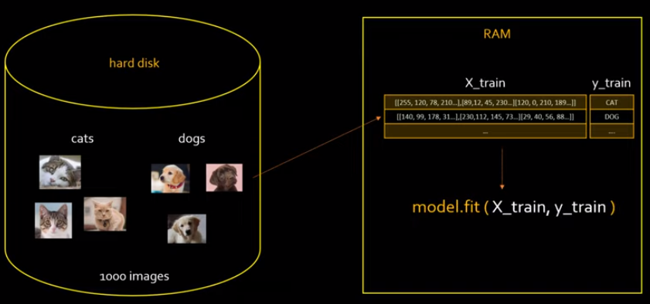
44.1 Input Pipeline: Theory
https://www.youtube.com/watch?v=VFEOskzhhbc&list=PLeo1K3hjS3uu7CxAacxVndI4bE_o3BDtO&index=44
Input Pipeline: Theory (0:21-0:40/33:18)
We have 1,000 images:
1. We load the image and
2. Convert image into numpy array
3. We use numpy array for training.

Slide 5
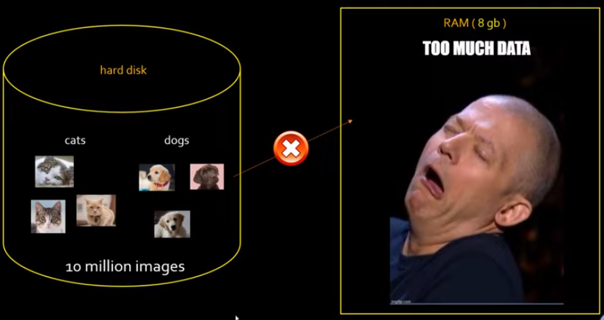
44.1 Input Pipeline: Theory
https://www.youtube.com/watch?v=VFEOskzhhbc&list=PLeo1K3hjS3uu7CxAacxVndI4bE_o3BDtO&index=44
Input Pipeline: Theory (0:41-1:10/33:18)
If we have 10M images, we only have 8GB memory.
It is too much data that 8GB memory cannot hold the data.

Slide 6
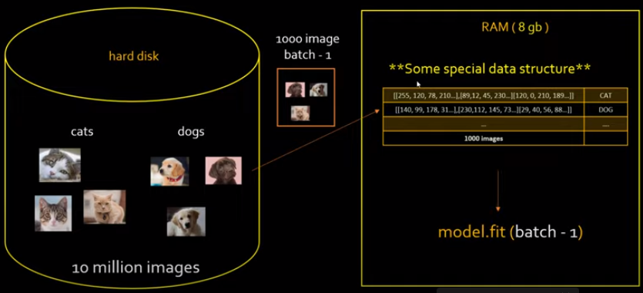
44.1 Input Pipeline: Theory
https://www.youtube.com/watch?v=VFEOskzhhbc&list=PLeo1K3hjS3uu7CxAacxVndI4bE_o3BDtO&index=44
Input Pipeline: Theory (1:18-1:30/33:18)
We split the 10M images into 1,000 image per batch. This is called Streaming approach.
This table is a special data structure, it is not numpy array or pandas data frame.
We do the batch-1 image training.

Slide 7
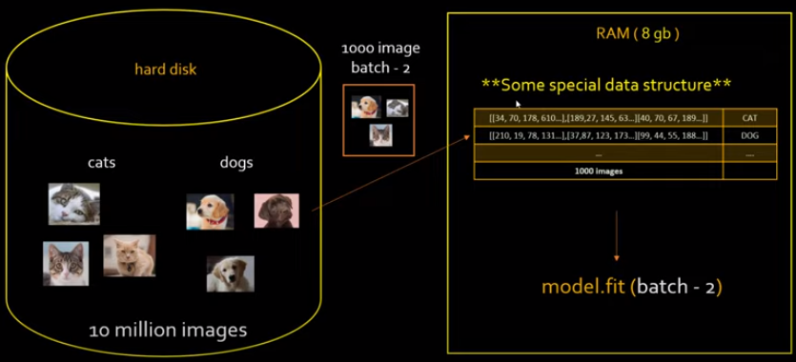
44.1 Input Pipeline: Theory
https://www.youtube.com/watch?v=VFEOskzhhbc&list=PLeo1K3hjS3uu7CxAacxVndI4bE_o3BDtO&index=44
Input Pipeline: Theory (1:48-2:20/33:18)
We continue to to the batch-2, batch-3, batch-4, etc.
What is the special data structure?
The data structure is: tf.data.dataset. This tf.data.dataset helps you to build the tensorflow input pipeline.
In order to build tensorflow pipeline, we have to use tf.data API framework.
The tf.data.dataset is the main class in the tf.data framework.

Slide 8
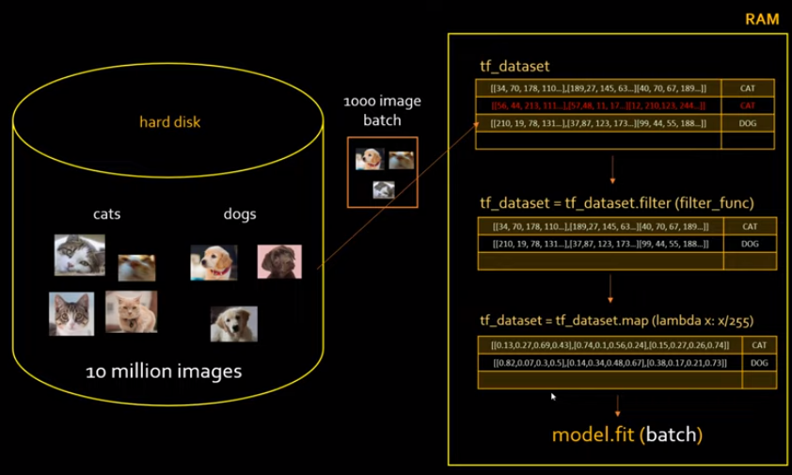
44.1 Input Pipeline: Theory
https://www.youtube.com/watch?v=VFEOskzhhbc&list=PLeo1K3hjS3uu7CxAacxVndI4bE_o3BDtO&index=44
Input Pipeline: Theory (3:35-4:20/33:18)
The images need to be scaled 255 before model fit.
We use map function with lambda function scaled and in parameters passing.
The tf.dataset framework can do mapping, filtering, shuffling, etc. A lot of different transformations.

Slide 9
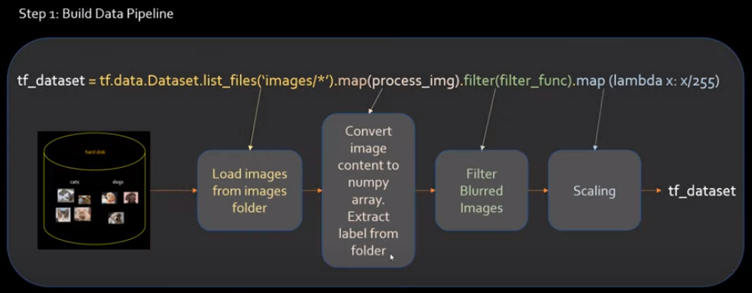
44.1 Input Pipeline: Theory
https://www.youtube.com/watch?v=VFEOskzhhbc&list=PLeo1K3hjS3uu7CxAacxVndI4bE_o3BDtO&index=44
Input Pipeline: Theory (4:40-6:00/33:18)
We can write all the transformation in a single line of code.
This single line of code does the data pipeline.
1. Load images
2. map: convert image content into numpy array of internal tf.dataset. Extract label from folder. The numpy array will be converted into tensor of tensorflow.
3. filter_func: Filter blurred images:
4. map: scaling the image by 255.
5. tf_dataset: built dataset.

Slide 10
44.1 Input Pipeline: Theory
https://www.youtube.com/watch?v=VFEOskzhhbc&list=PLeo1K3hjS3uu7CxAacxVndI4bE_o3BDtO&index=44
Input Pipeline: Theory (6:01-6:30/33:18)
In this data pipeline, we perform the ETL (Extract Transform Load).
We can do more transformation, such as, repeat, batching, etc.
We will see more in coding.
We get the idea of build a data input pipeline.
Look at the beauty of single line of code.

Slide 11
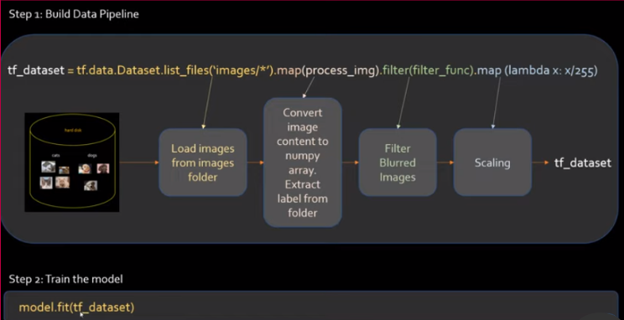
44.1 Input Pipeline: Theory
https://www.youtube.com/watch?v=VFEOskzhhbc&list=PLeo1K3hjS3uu7CxAacxVndI4bE_o3BDtO&index=44
Input Pipeline: Theory (6:40-6:50/33:18)
The second step is Train the model.
Before, we use input dataset to fit the data.
Now, we use numpy array or tf.dataset.

Slide 12
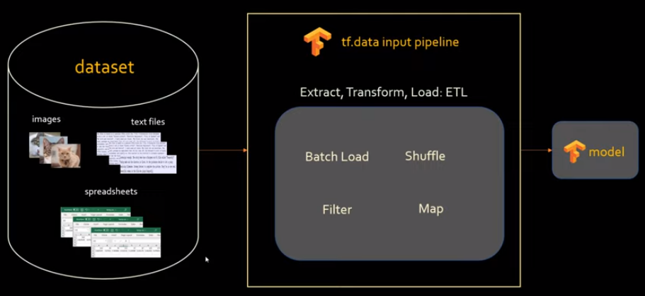
44.1 Input Pipeline: Theory
https://www.youtube.com/watch?v=VFEOskzhhbc&list=PLeo1K3hjS3uu7CxAacxVndI4bE_o3BDtO&index=44
Input Pipeline: Theory (7:01-7:30/33:18)
We can fit input dataset (images, text files, spreadsheets, etc.) from any data source.
We can process with tf.data for input pipeline to do ETL (Extract, Transform, and Load).
We get the model at the end.

Slide 13
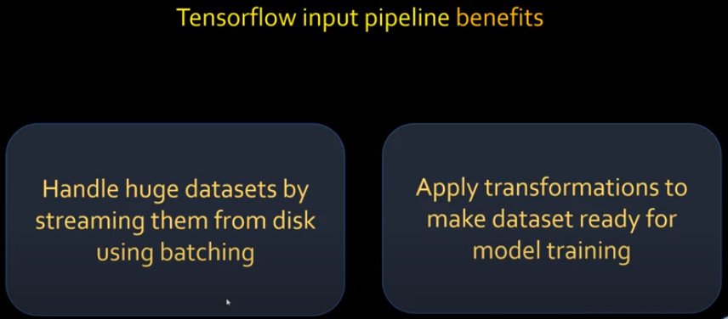
44.1 Input Pipeline: Theory
https://www.youtube.com/watch?v=VFEOskzhhbc&list=PLeo1K3hjS3uu7CxAacxVndI4bE_o3BDtO&index=44
Input Pipeline: Theory (7:35-7:50/33:18)
We summarize the benefit of Tensorflow input pipeline.
1. We can handle huge dataset by streaming them from disk, Amazon S3 (Simple, Storage, Service), or any other cloud storage.
2. We can apply transformation for deep learning model in one line of code.

Slide 14
44.2 Input Pipeline: Python Coding

Slide 15
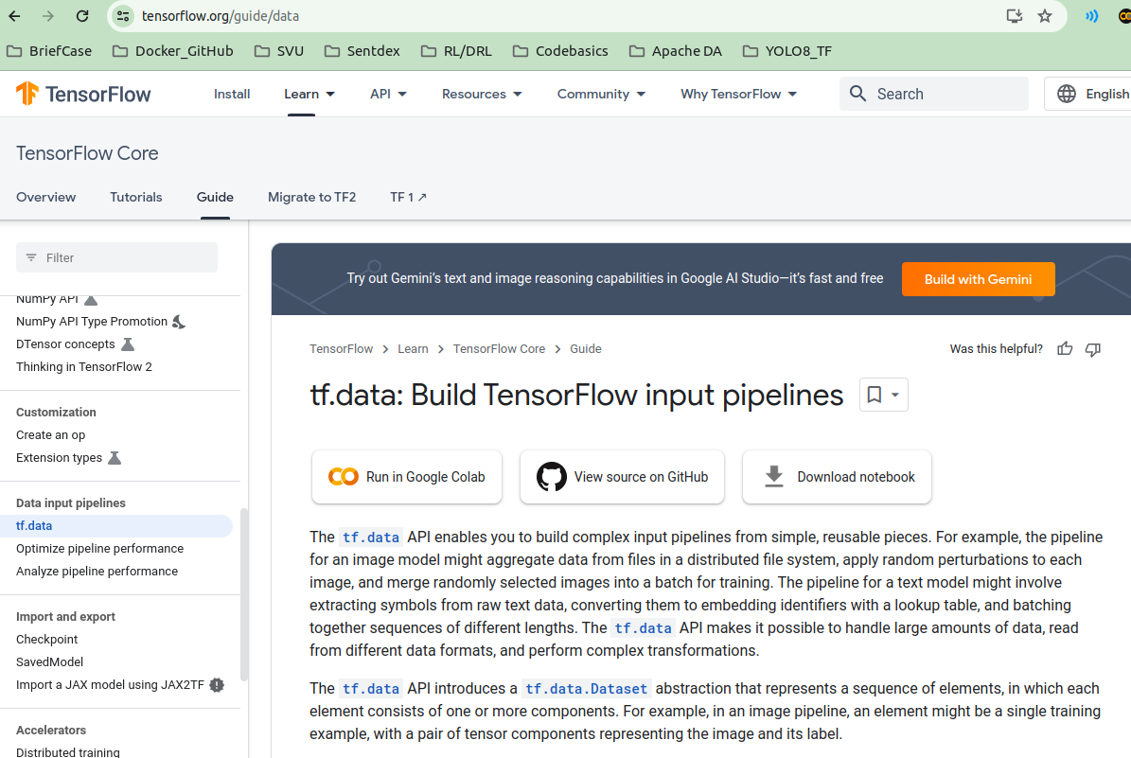
44.2 Input Pipeline: Python Coding
https://www.youtube.com/watch?v=VFEOskzhhbc&list=PLeo1K3hjS3uu7CxAacxVndI4bE_o3BDtO&index=44
Input Pipeline: Python Coding (8:11-8:20/33:18)
tf.data: Build TensorFlow Input Pipeline provides the information for data pipeline framework.
We will implement the code based on the information.

Slide 16
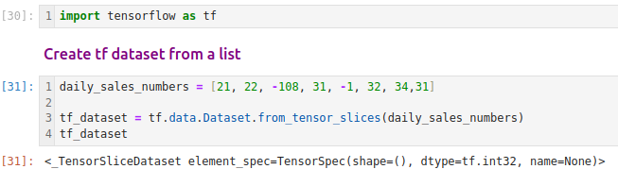
44.2 Input Pipeline: Python Coding
https://www.youtube.com/watch?v=VFEOskzhhbc&list=PLeo1K3hjS3uu7CxAacxVndI4bE_o3BDtO&index=44
Input Pipeline: Python Coding (7:59-9:00/33:18)
1. Import tensorflow framework.
2. Create simple tensorflow dataset object:
We have a list of daily sales number = [ … ]
We transform the dataset object.

Slide 17
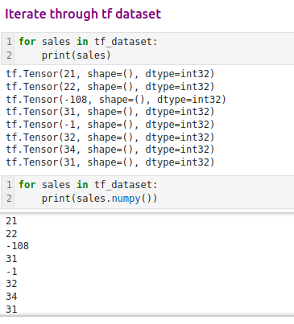
44.2 Input Pipeline: Python Coding
https://www.youtube.com/watch?v=VFEOskzhhbc&list=PLeo1K3hjS3uu7CxAacxVndI4bE_o3BDtO&index=44
Input Pipeline: Python Coding (9:01-10:00/33:18)
We iterate the individual elements.
Each element is a tensor.
It is a numpy() object.

Slide 18
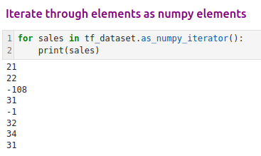
44.2 Input Pipeline: Python Coding
https://www.youtube.com/watch?v=VFEOskzhhbc&list=PLeo1K3hjS3uu7CxAacxVndI4bE_o3BDtO&index=44
Input Pipeline: Python Coding (10:01-10:26/33:18)
Iterate through numpy iterator.

Slide 19
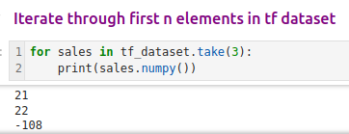
44.2 Input Pipeline: Python Coding
https://www.youtube.com/watch?v=VFEOskzhhbc&list=PLeo1K3hjS3uu7CxAacxVndI4bE_o3BDtO&index=44
Input Pipeline: Python Coding (10:30-10:40/33:18)
Iterate through tf_dataset.

Slide 20
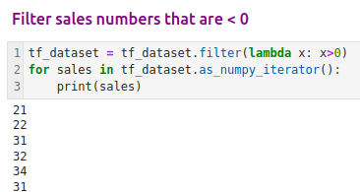
44.2 Input Pipeline: Python Coding
https://www.youtube.com/watch?v=VFEOskzhhbc&list=PLeo1K3hjS3uu7CxAacxVndI4bE_o3BDtO&index=44
Input Pipeline: Python Coding (10:41-11:40/33:18)
Filter by lambda function

Slide 21
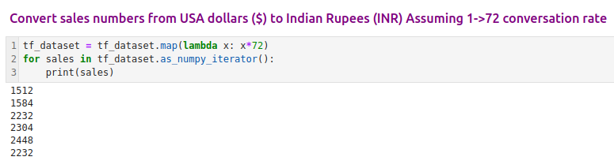
44.2 Input Pipeline: Python Coding
https://www.youtube.com/watch?v=VFEOskzhhbc&list=PLeo1K3hjS3uu7CxAacxVndI4bE_o3BDtO&index=44
Input Pipeline: Python Coding (10:51-12:20/33:18)
Multiple number.

Slide 22
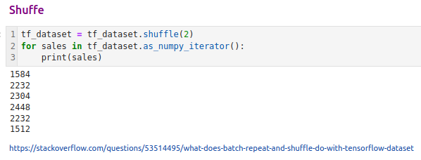
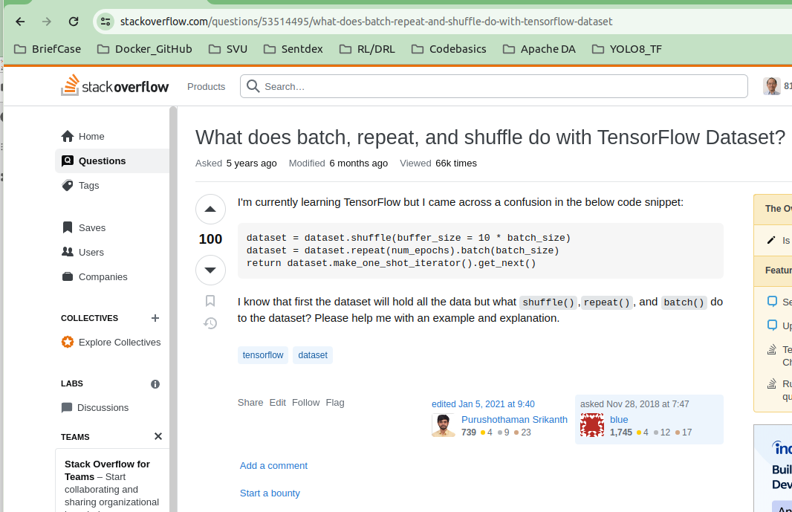
44.2 Input Pipeline: Python Coding
https://www.youtube.com/watch?v=VFEOskzhhbc&list=PLeo1K3hjS3uu7CxAacxVndI4bE_o3BDtO&index=44
Input Pipeline: Python Coding (12:21-14:00/33:18)
Shuffle element

Slide 23
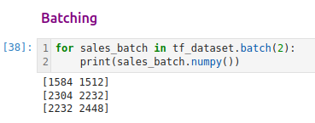
44.2 Input Pipeline: Python Coding
https://www.youtube.com/watch?v=VFEOskzhhbc&list=PLeo1K3hjS3uu7CxAacxVndI4bE_o3BDtO&index=44
Input Pipeline: Python Coding (14:01-15:10/33:18)
Batch

Slide 24
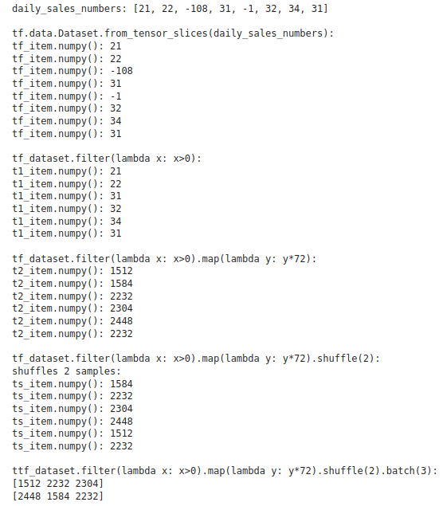
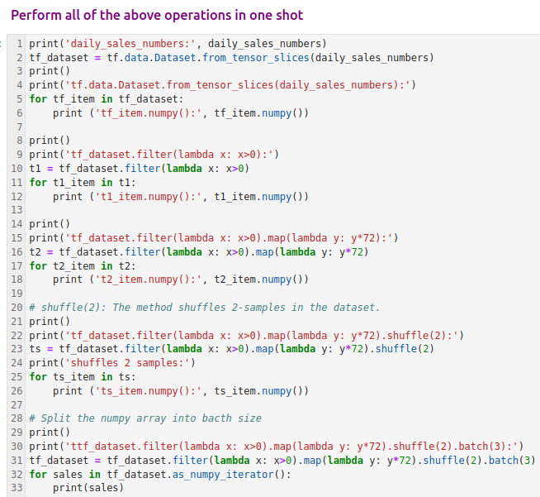
44.2 Input Pipeline: Python Coding
https://www.youtube.com/watch?v=VFEOskzhhbc&list=PLeo1K3hjS3uu7CxAacxVndI4bE_o3BDtO&index=44
Input Pipeline: Python Coding (15:14-17:00/33:18)
How to do all these operations in one line?
Shuffle with buffer 2.
Take batch = 2

Slide 25
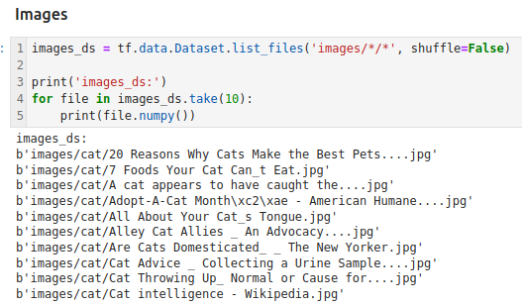
44.2 Input Pipeline: Python Coding
https://www.youtube.com/watch?v=VFEOskzhhbc&list=PLeo1K3hjS3uu7CxAacxVndI4bE_o3BDtO&index=44
Input Pipeline: Python Coding (17:01-19:00/33:18)
1. We load the images and
2. Print 10 samples.

Slide 26
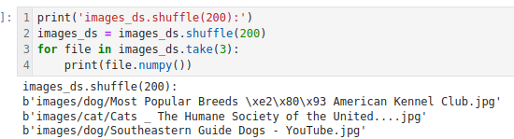
44.2 Input Pipeline: Python Coding
https://www.youtube.com/watch?v=VFEOskzhhbc&list=PLeo1K3hjS3uu7CxAacxVndI4bE_o3BDtO&index=44
Input Pipeline: Python Coding (19:01-19:30/33:18)
Shuffle(200) images.

Slide 27
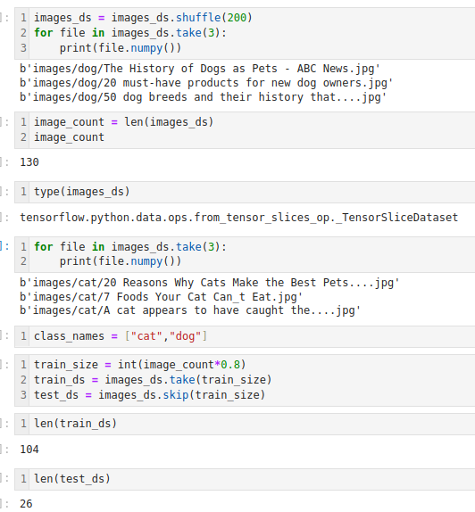
44.2 Input Pipeline: Python Coding
https://www.youtube.com/watch?v=VFEOskzhhbc&list=PLeo1K3hjS3uu7CxAacxVndI4bE_o3BDtO&index=44
Input Pipeline: Python Coding (19:31-22:30/33:18)
Size operation

Slide 28
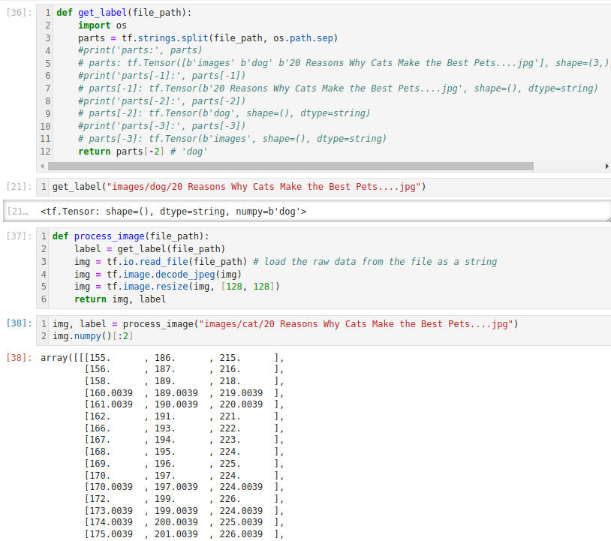
44.2 Input Pipeline: Python Coding
https://www.youtube.com/watch?v=VFEOskzhhbc&list=PLeo1K3hjS3uu7CxAacxVndI4bE_o3BDtO&index=44
Input Pipeline: Python Coding (22:31-29:30/33:18)
Get label

Slide 29
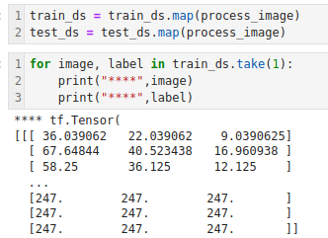
44.2 Input Pipeline: Python Coding
https://www.youtube.com/watch?v=VFEOskzhhbc&list=PLeo1K3hjS3uu7CxAacxVndI4bE_o3BDtO&index=44
Input Pipeline: Python Coding (29:31-31:30/33:18)
Map with custom function.

Slide 30
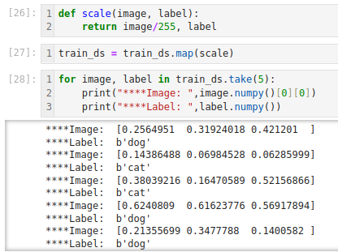
44.2 Input Pipeline: Python Coding
https://www.youtube.com/watch?v=VFEOskzhhbc&list=PLeo1K3hjS3uu7CxAacxVndI4bE_o3BDtO&index=44
Input Pipeline: Python Coding (31:31-33:18/33:18)
Scale and take some samples.

Slide 31
End

