Slide 1

27.05 Transfer Learning with TF Hub
Peter H. Chen

Slide 2
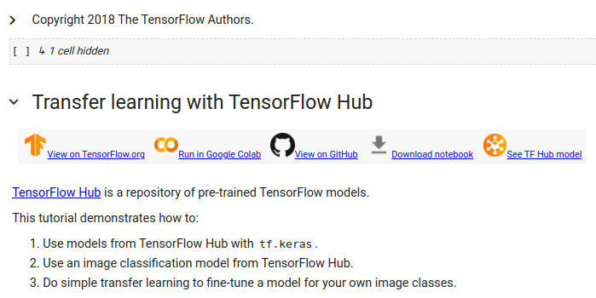
27.05 Transfer Learning with TF Hub
https://www.youtube.com/watch?v=LsdxvjLWkIY&list=PLeo1K3hjS3uu7CxAacxVndI4bE_o3BDtO&index=27
Transfer Learning with TF (Tensorflow) Hub (6:21-7:30/25:54)
We discussed the code example (as link below) hosted on Tensorflow Hub.
Tensorflow Hub provide the model hosting, code example, and space for developers.
1. Here, we use pre-trained model downloaded from Tensorflow Hub.
2. We do the Image classification with pre-trained Model.
3. We use Transfer Learning technique, i.e., fine-tune the pre-trained model with custom images.
https://colab.research.google.com/github/tensorflow/docs/blob/master/site/en/tutorials/images/transfer_learning_with_hub.ipynb#scrollTo=crU-iluJIEzw

Slide 3
27.05 Transfer Learning with TF Hub
https://www.youtube.com/watch?v=LsdxvjLWkIY&list=PLeo1K3hjS3uu7CxAacxVndI4bE_o3BDtO&index=27
Transfer Learning with TF (Tensorflow) Hub (6:21-7:30/25:54)
Click “Run with Google Colab”
https://colab.research.google.com/github/tensorflow/docs/blob/master/site/en/tutorials/images/transfer_learning_with_hub.ipynb#scrollTo=crU-iluJIEzw

Slide 4
27.06 Select Colab Runtime

Slide 5
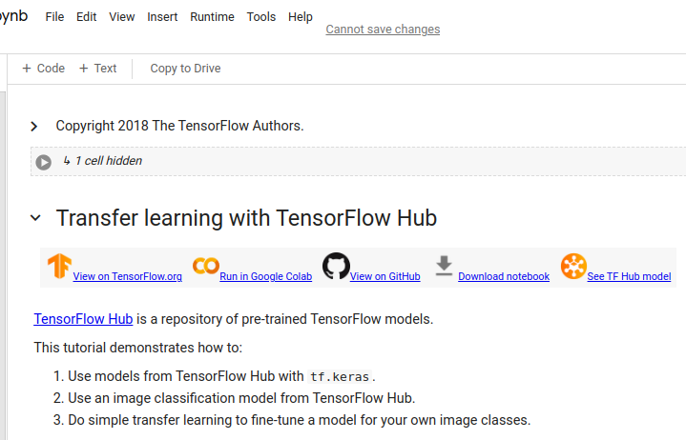
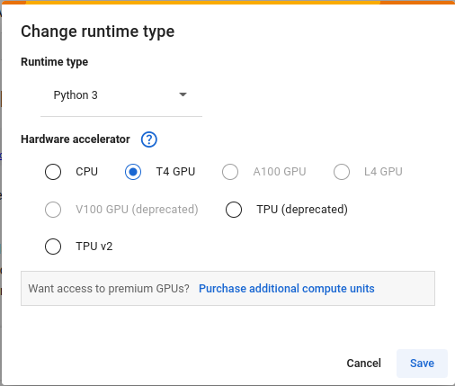
27.06 Select Colab Runtime
https://www.youtube.com/watch?v=LsdxvjLWkIY&list=PLeo1K3hjS3uu7CxAacxVndI4bE_o3BDtO&index=27
Select Colab Runtime (8:31-9:30/25:54)
Runtime > Change runtime type > Select “T4 CPU”.
https://colab.research.google.com/github/tensorflow/docs/blob/master/site/en/tutorials/images/transfer_learning_with_hub.ipynb#scrollTo=feiXojVXAbI9

Slide 6
27.07 Import Library

Slide 7
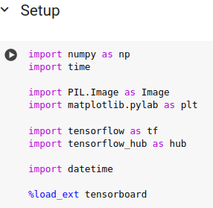
27.07 Import Library
https://www.youtube.com/watch?v=LsdxvjLWkIY&list=PLeo1K3hjS3uu7CxAacxVndI4bE_o3BDtO&index=27
Import Library (9:31-10:30/25:54)
Runtime > Change runtime type > Select “T4 CPU”.
https://colab.research.google.com/github/tensorflow/docs/blob/master/site/en/tutorials/images/transfer_learning_with_hub.ipynb#scrollTo=feiXojVXAbI9

Slide 8
27.08 Select Pre-trained CNN Model MobileNet V2

Slide 9
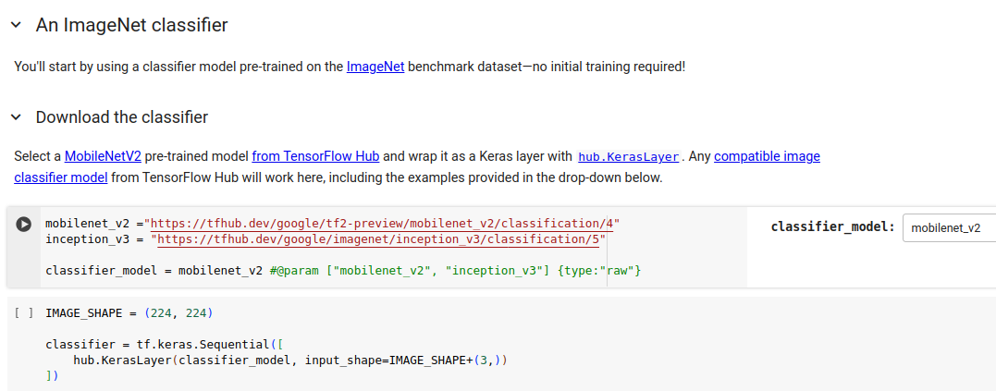
27.08 Select Pre-trained CNN Model MobileNet V2
https://www.youtube.com/watch?v=LsdxvjLWkIY&list=PLeo1K3hjS3uu7CxAacxVndI4bE_o3BDtO&index=27
Select Pre-trained CNN Model MobileNet V2 (10:31-11:30/25:54)
There are two pre-trained model: “mobilenet_v2” model and “inception_v3 Model.
Here, we select the “mobilenet_v2”.
We then get the classifier_model = moblienet_v2
Note:
Colab JupyterLab provide the system command “#@param” for user to select the Model.
https://colab.research.google.com/github/tensorflow/docs/blob/master/site/en/tutorials/images/transfer_learning_with_hub.ipynb#scrollTo=feiXojVXAbI9

Slide 10
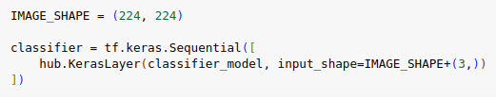
27.08 Select Pre-trained CNN Model MobileNet V2
https://www.youtube.com/watch?v=LsdxvjLWkIY&list=PLeo1K3hjS3uu7CxAacxVndI4bE_o3BDtO&index=27
Select Pre-trained CNN Model MobileNet V2 (11:31-12:30/25:54)
Here, for classification, we use “mobilenet_v2” as the classifier_model.

Slide 11
27.09 Download Image To Classify with MobileNet

Slide 12
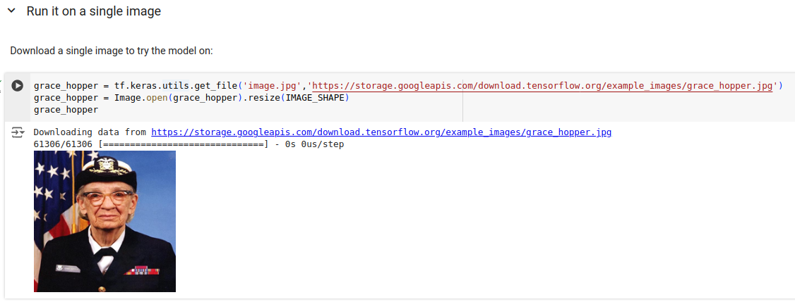
27.09 Download Image To Classify with MobileNet
https://www.youtube.com/watch?v=LsdxvjLWkIY&list=PLeo1K3hjS3uu7CxAacxVndI4bE_o3BDtO&index=27
Download Image to Classify with MobileNet (12:31-13:30/25:54)
Download an Image to test.
https://colab.research.google.com/github/tensorflow/docs/blob/master/site/en/tutorials/images/transfer_learning_with_hub.ipynb#scrollTo=feiXojVXAbI9

Slide 13
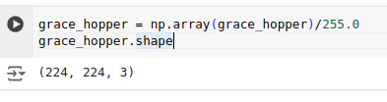
27.09 Download Image To Classify with MobileNet
https://www.youtube.com/watch?v=LsdxvjLWkIY&list=PLeo1K3hjS3uu7CxAacxVndI4bE_o3BDtO&index=27
Download Image to Classify with MobileNet (12:31-13:30/25:54)
Check download image dimension: (224, 224, 3)
https://colab.research.google.com/github/tensorflow/docs/blob/master/site/en/tutorials/images/transfer_learning_with_hub.ipynb#scrollTo=feiXojVXAbI9

Slide 14
27.11 Pre-Trained Model MobileNet Prediction

Slide 15
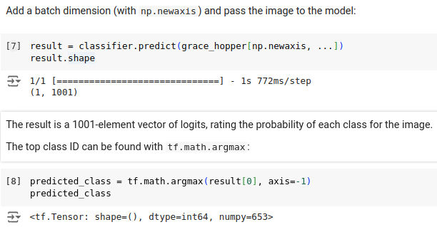
27.11 Pre-Trained Model MobileNet Prediction
https://www.youtube.com/watch?v=LsdxvjLWkIY&list=PLeo1K3hjS3uu7CxAacxVndI4bE_o3BDtO&index=27
Pre-Trained Model MobileNet Prediction (13:31-14:30/25:54)
1. Add one extra dimension to the original image.
2. Perform Prediction with pre-trained Model MobileNet.
https://colab.research.google.com/github/tensorflow/docs/blob/master/site/en/tutorials/images/transfer_learning_with_hub.ipynb#scrollTo=feiXojVXAbI9

Slide 16
27.09 Image Classification with MobileNet v2
https://www.youtube.com/watch?v=LsdxvjLWkIY&list=PLeo1K3hjS3uu7CxAacxVndI4bE_o3BDtO&index=27
Image Classification with MobileNet V2 (12:31-13:30/25:54)
Check download image dimension: (224, 224, 3)
https://colab.research.google.com/github/tensorflow/docs/blob/master/site/en/tutorials/images/transfer_learning_with_hub.ipynb#scrollTo=feiXojVXAbI9

Slide 17
27.12 MobileNet V2 Prediction

Slide 18
27.12 MobileNet V2 Prediction
https://www.youtube.com/watch?v=LsdxvjLWkIY&list=PLeo1K3hjS3uu7CxAacxVndI4bE_o3BDtO&index=27
MobileNet V2 Prediction (13:31-14:30/25:54)
1. Add one extra dimension to the original image.
2. Perform Prediction with pre-trained Model MobileNet.
https://colab.research.google.com/github/tensorflow/docs/blob/master/site/en/tutorials/images/transfer_learning_with_hub.ipynb#scrollTo=feiXojVXAbI9

Slide 19
27.12 MobileNet V2 Prediction
https://www.youtube.com/watch?v=LsdxvjLWkIY&list=PLeo1K3hjS3uu7CxAacxVndI4bE_o3BDtO&index=27
MobileNet V2 Prediction (12:31-13:30/25:54)
Check download image dimension: (224, 224, 3)
https://colab.research.google.com/github/tensorflow/docs/blob/master/site/en/tutorials/images/transfer_learning_with_hub.ipynb#scrollTo=feiXojVXAbI9

Slide 20
27.13 Display Input Image with Label Prediction

Slide 21
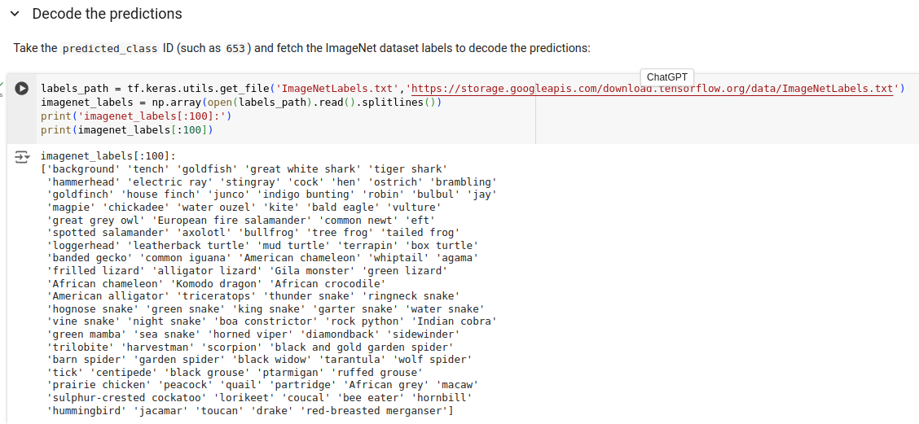
27.13 Display Input Image with Label Prediction
https://www.youtube.com/watch?v=LsdxvjLWkIY&list=PLeo1K3hjS3uu7CxAacxVndI4bE_o3BDtO&index=27
Display Input Image with Label Prediction (13:31-14:30/25:54)
Print MobileNet V2 (ImageNet) Labels.
https://colab.research.google.com/github/tensorflow/docs/blob/master/site/en/tutorials/images/transfer_learning_with_hub.ipynb#scrollTo=feiXojVXAbI9

Slide 22
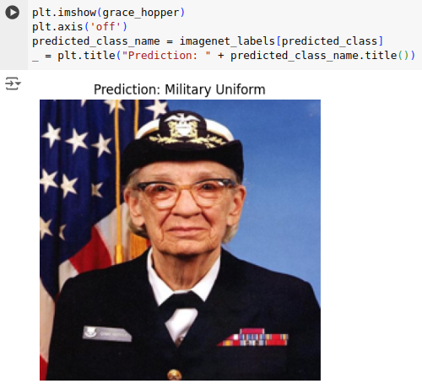
27.13 Display Input Image with Label Prediction
https://www.youtube.com/watch?v=LsdxvjLWkIY&list=PLeo1K3hjS3uu7CxAacxVndI4bE_o3BDtO&index=27
Display Input Image with Label Prediction (14:31-15:30/25:54)
Display the Prediction labels “Military Uniform” with input Image (an Woman with “Military Uniform”).
https://colab.research.google.com/github/tensorflow/docs/blob/master/site/en/tutorials/images/transfer_learning_with_hub.ipynb#scrollTo=feiXojVXAbI9

Slide 23
27.14 Simple Transfer Learning

Slide 24
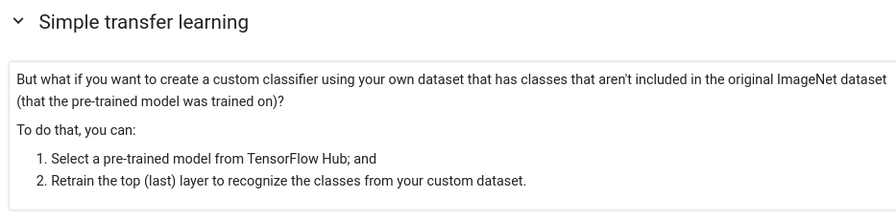
27.14 Simple Transfer Learning
https://www.youtube.com/watch?v=LsdxvjLWkIY&list=PLeo1K3hjS3uu7CxAacxVndI4bE_o3BDtO&index=27
Simple Transfer Learning (15:31-16:30/25:54)
We create another classifier
1. Pretrained Model (MobileNet V2)
2. Re-train the top layer (last year) with custom dataset.
https://colab.research.google.com/github/tensorflow/docs/blob/master/site/en/tutorials/images/transfer_learning_with_hub.ipynb#scrollTo=feiXojVXAbI9

Slide 25
27.15 Custom Dataset

Slide 26
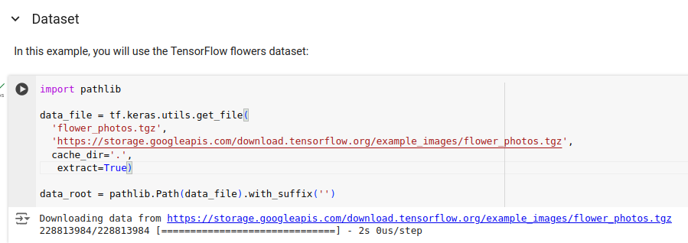
27.15 Custom Dataset
https://www.youtube.com/watch?v=LsdxvjLWkIY&list=PLeo1K3hjS3uu7CxAacxVndI4bE_o3BDtO&index=27
Custom Dataset (16:31-17:30/25:54)
We load the flowers dataset as our custom dataset.
https://colab.research.google.com/github/tensorflow/docs/blob/master/site/en/tutorials/images/transfer_learning_with_hub.ipynb#scrollTo=feiXojVXAbI9

Slide 27
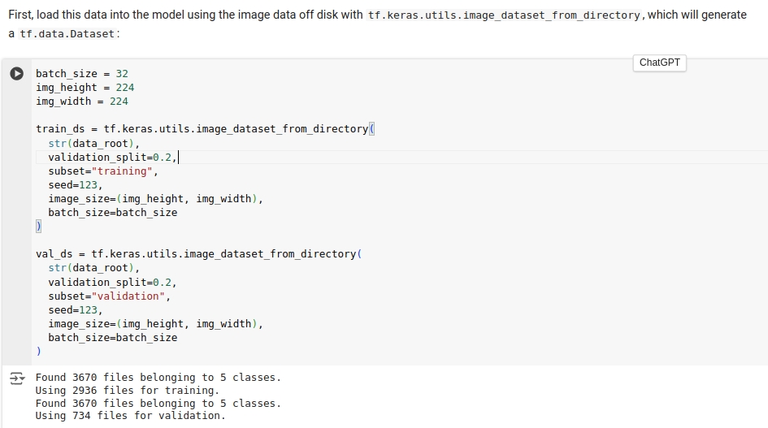
27.15 Custom Dataset
https://www.youtube.com/watch?v=LsdxvjLWkIY&list=PLeo1K3hjS3uu7CxAacxVndI4bE_o3BDtO&index=27
Custom Dataset (16:31-17:30/25:54)
We split the flowers dataset into the training dataset (train_ds) and validation dataset (valid_ds).
https://colab.research.google.com/github/tensorflow/docs/blob/master/site/en/tutorials/images/transfer_learning_with_hub.ipynb#scrollTo=feiXojVXAbI9

Slide 28
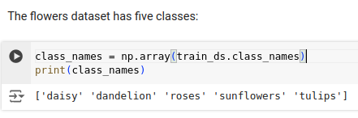
27.15 Custom Dataset
https://www.youtube.com/watch?v=LsdxvjLWkIY&list=PLeo1K3hjS3uu7CxAacxVndI4bE_o3BDtO&index=27
Custom Dataset (16:31-17:30/25:54)
First, we print out the classes:
The flowers dataset have five classes, i.e., five target labels:
1. daisy
2. dandelion
3. roses
4. sunflowers
5. tulips
https://colab.research.google.com/github/tensorflow/docs/blob/master/site/en/tutorials/images/transfer_learning_with_hub.ipynb#scrollTo=feiXojVXAbI9

Slide 29
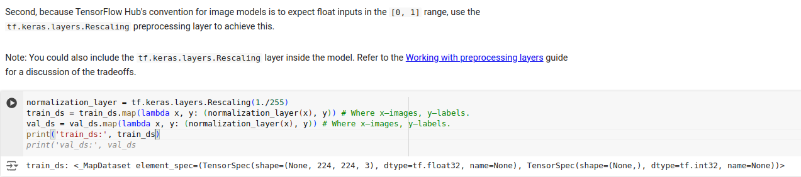
27.15 Custom Dataset
https://www.youtube.com/watch?v=LsdxvjLWkIY&list=PLeo1K3hjS3uu7CxAacxVndI4bE_o3BDtO&index=27
Custom Dataset (17:31-18:30/25:54)
Second, we Normalize/rescale the dataset.
https://colab.research.google.com/github/tensorflow/docs/blob/master/site/en/tutorials/images/transfer_learning_with_hub.ipynb#scrollTo=feiXojVXAbI9

Slide 30
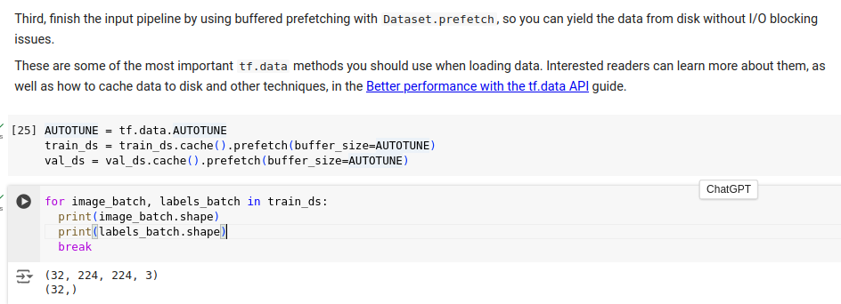
27.15 Custom Dataset
https://www.youtube.com/watch?v=LsdxvjLWkIY&list=PLeo1K3hjS3uu7CxAacxVndI4bE_o3BDtO&index=27
Custom Dataset (18:31-19:30/25:54)
Third, we pipeline (Google use function name “prefetch”)
1. dataset reading with CPU
2. model training with multiple GPUs, e.g, 8 GPUs for H100 and A100.
https://colab.research.google.com/github/tensorflow/docs/blob/master/site/en/tutorials/images/transfer_learning_with_hub.ipynb#scrollTo=feiXojVXAbI9

Slide 31
27.16 Predict Flowers with Model MobileNet V2

Slide 32
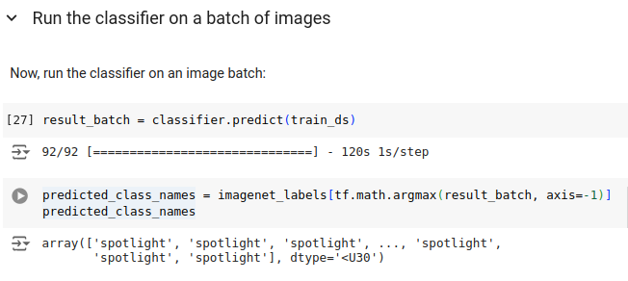
27.16 Predict Flowers with Model MobileNet V2
https://www.youtube.com/watch?v=LsdxvjLWkIY&list=PLeo1K3hjS3uu7CxAacxVndI4bE_o3BDtO&index=27
Predict Flowers with MobileNet V2 (19:31-20:30/25:54)
We use flower Dataset (train_ds) and ask Model MobileNet V2 to predict.
https://colab.research.google.com/github/tensorflow/docs/blob/master/site/en/tutorials/images/transfer_learning_with_hub.ipynb#scrollTo=feiXojVXAbI9

Slide 33
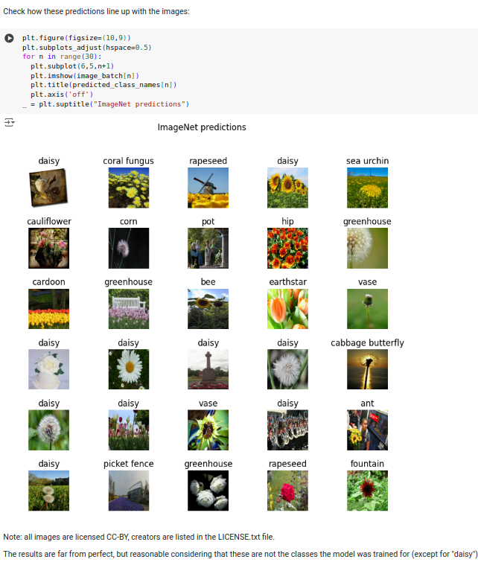
27.16 Predict Flowers with Model MobileNet V2
https://www.youtube.com/watch?v=LsdxvjLWkIY&list=PLeo1K3hjS3uu7CxAacxVndI4bE_o3BDtO&index=27
Predict Flowers with MobileNet V2 (20:31-21:30/25:54)
All flowers label as “spotlight”.
The MobileNet V2 does not know the Flower Dataset very well. The predictions are very poor.
https://colab.research.google.com/github/tensorflow/docs/blob/master/site/en/tutorials/images/transfer_learning_with_hub.ipynb#scrollTo=feiXojVXAbI9

Slide 34
27.17 TL (Transfer Learning): Select MobileNet

Slide 35
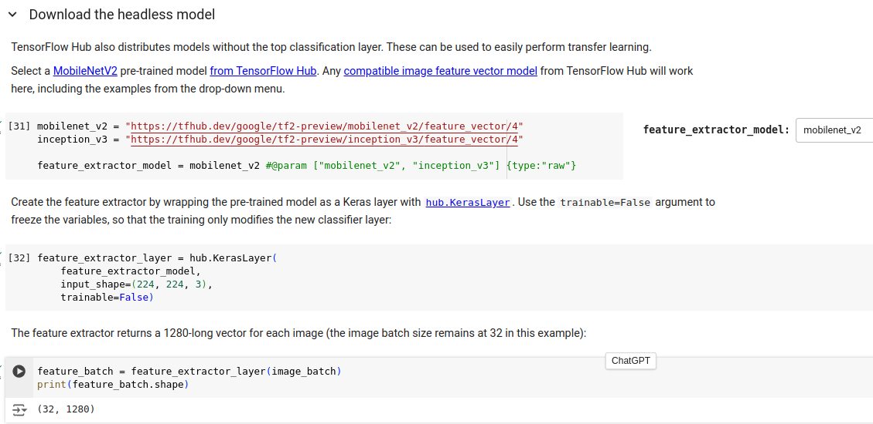
27.17 TL (Transfer Learning): Select MobileNet
https://www.youtube.com/watch?v=LsdxvjLWkIY&list=PLeo1K3hjS3uu7CxAacxVndI4bE_o3BDtO&index=27
TL (Transfer Learning): Select MobileNet (20:31-21:30/25:54)
Now, we
1. Select MobileNet V2 for Model (same as before)
2. Prepare Transfer Knowledge: We create extract layer with MobileNet V2 Model.
https://colab.research.google.com/github/tensorflow/docs/blob/master/site/en/tutorials/images/transfer_learning_with_hub.ipynb#scrollTo=feiXojVXAbI9

Slide 36
27.18 TL: Model MobileNet + Dense Layer

Slide 37
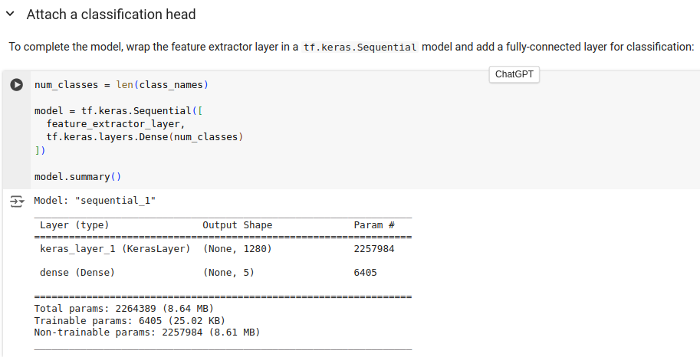
27.18 TL: Model MobileNet + Dense Layer
https://www.youtube.com/watch?v=LsdxvjLWkIY&list=PLeo1K3hjS3uu7CxAacxVndI4bE_o3BDtO&index=27
TL: Model MobileNet + Dense Layer (20:31-21:30/25:54)
We create new model with:
1. Layer feature_extractor_layer with MobileNet V2 and flower2 (batch_image is selected from trains_ds).
2. Create extra Dense Layer for Transfer Learning.
https://colab.research.google.com/github/tensorflow/docs/blob/master/site/en/tutorials/images/transfer_learning_with_hub.ipynb#scrollTo=feiXojVXAbI9

Slide 38
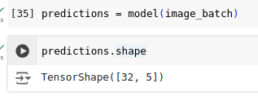
27.18 Add Layer to Selected Model
https://www.youtube.com/watch?v=LsdxvjLWkIY&list=PLeo1K3hjS3uu7CxAacxVndI4bE_o3BDtO&index=27
Select Layer to Selected Model (20:31-21:00/25:54)
We can train the new Model and then to do prediction.
https://colab.research.google.com/github/tensorflow/docs/blob/master/site/en/tutorials/images/transfer_learning_with_hub.ipynb#scrollTo=feiXojVXAbI9

Slide 39
27.18 Train New Model: MobileNet + Dense Layer

Slide 40
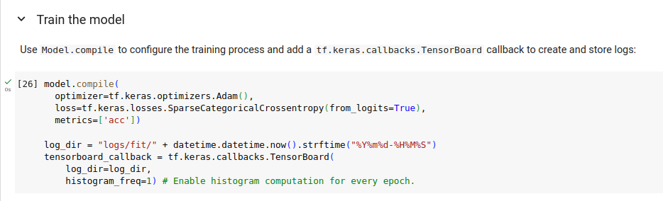
27.18 Train New Model: MobileNet + Dense Layer
https://www.youtube.com/watch?v=LsdxvjLWkIY&list=PLeo1K3hjS3uu7CxAacxVndI4bE_o3BDtO&index=27
Train New Model: Mobile Net + Dense Layer (21:01-21:10/25:54)
Compile New Model with Mobile Net and Dense Layer

Slide 41
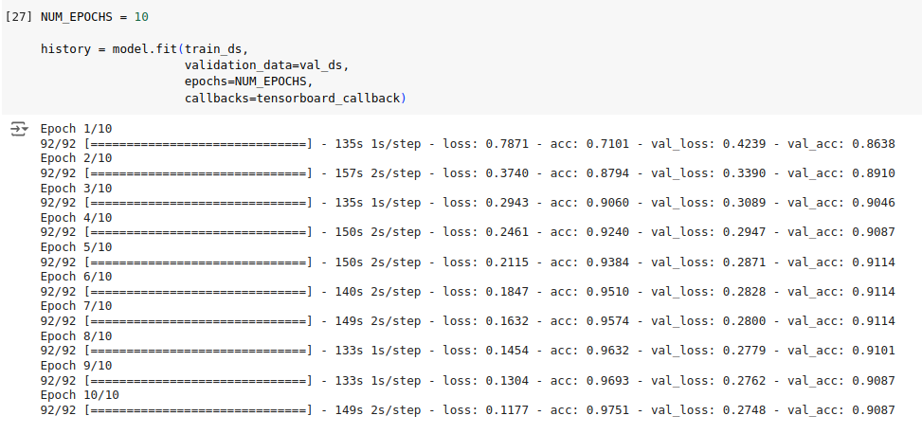
27.18 Train New Model: MobileNet + Dense Layer
https://www.youtube.com/watch?v=LsdxvjLWkIY&list=PLeo1K3hjS3uu7CxAacxVndI4bE_o3BDtO&index=27
Train New Model: MobileNet + Dense Layer (21:11-21:20/25:54)
1. Input the flowers knowledge (train data and validation data) to new Model with MobileNet and Dense Layer.
2. Train New Mode with MobileNet and Dense Layer.
Since New Model learn the Flower knowledge, the new model should able to predict the flowers now.
This will take hours to train and Dense Layer.

Slide 42
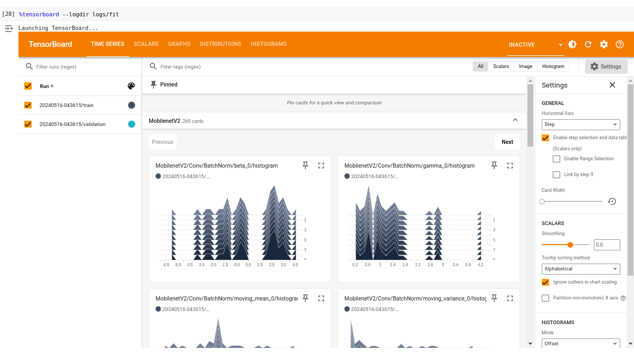
27.18 Train New Model: MobileNet + Dense Layer
https://www.youtube.com/watch?v=LsdxvjLWkIY&list=PLeo1K3hjS3uu7CxAacxVndI4bE_o3BDtO&index=27
Train New Model: MobileNet + Dense Layer (21:21-21:30/25:54)
%tensorboard --logdir logs/dir
Click “-> V” to see the tensorboard results.

Slide 43
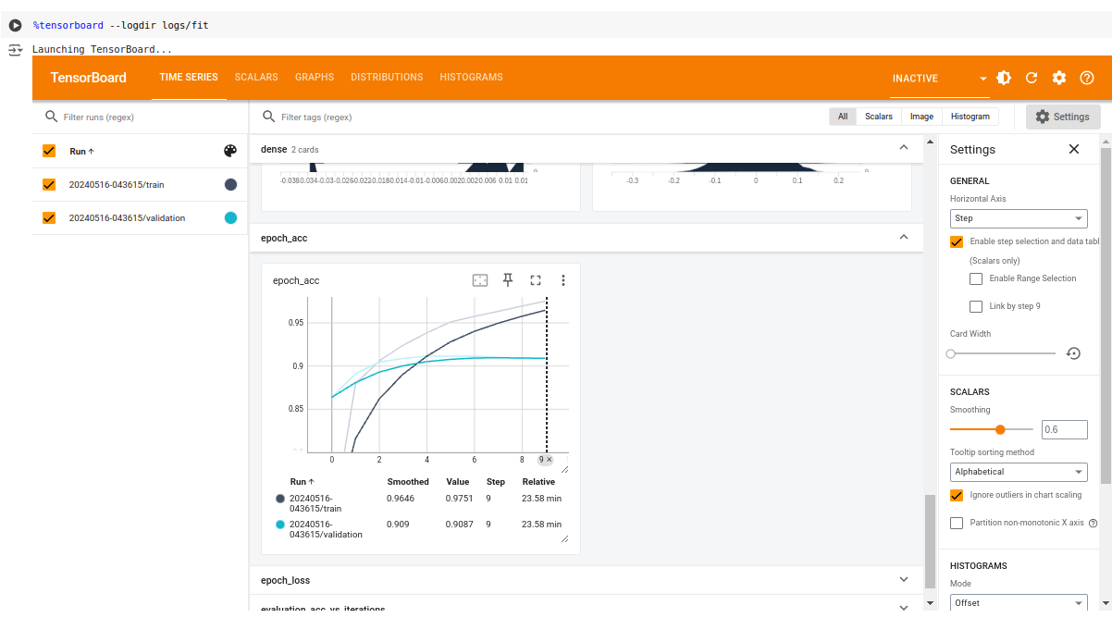
27.18 Train New Model: MobileNet + Dense Layer
https://www.youtube.com/watch?v=LsdxvjLWkIY&list=PLeo1K3hjS3uu7CxAacxVndI4bE_o3BDtO&index=27
Train New Model: MobileNet + Dense Layer (21:31-21:50/25:54)
Scroll down to Accuracy information.

Slide 44
27.19 Check TL Prediction

Slide 45
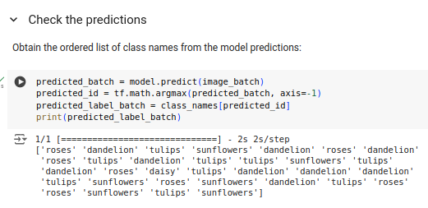
27.19 Check TL Prediction
https://www.youtube.com/watch?v=LsdxvjLWkIY&list=PLeo1K3hjS3uu7CxAacxVndI4bE_o3BDtO&index=27
Check TL (MobileNet + Dense Layer) Prediction (22:01-22:30/25:54)
Get the prediction Labels.

Slide 46
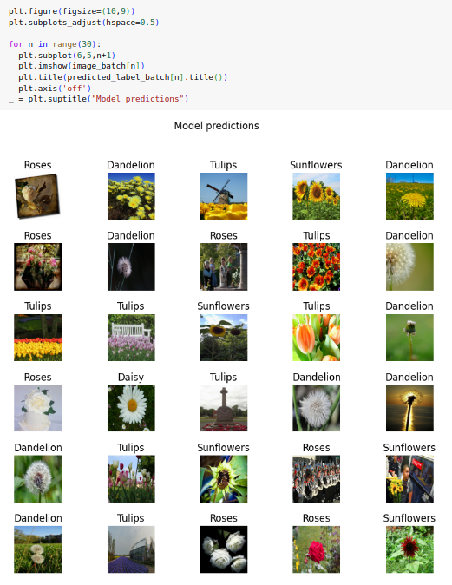
27.19 Check TL Prediction
https://www.youtube.com/watch?v=LsdxvjLWkIY&list=PLeo1K3hjS3uu7CxAacxVndI4bE_o3BDtO&index=27
Check TL (MobileNet + Dense Layer) Prediction (22:31-23:00/25:54)
Plot Model Predictions.

Slide 47
27.20 Export/Reload New Model

Slide 48
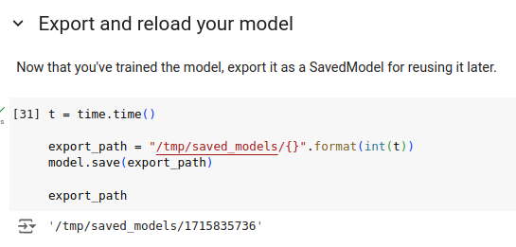
27.20 Export/Reload New Model
https://www.youtube.com/watch?v=LsdxvjLWkIY&list=PLeo1K3hjS3uu7CxAacxVndI4bE_o3BDtO&index=27
Export/Reload New Model (23:01-23:30/25:54)
Export Model

Slide 49
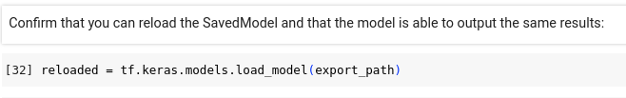
27.20 Export/Reload New Model
https://www.youtube.com/watch?v=LsdxvjLWkIY&list=PLeo1K3hjS3uu7CxAacxVndI4bE_o3BDtO&index=27
Export/Reload New Model (23:31-24:00/25:54)
Reload Model

Slide 50
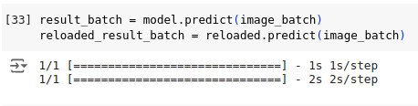
27.20 Export/Reload New Model
https://www.youtube.com/watch?v=LsdxvjLWkIY&list=PLeo1K3hjS3uu7CxAacxVndI4bE_o3BDtO&index=27
Export/Reload New Model (24:01-24:30/25:54)
Prediction with reload model.

Slide 51

27.20 Export/Reload New Model
https://www.youtube.com/watch?v=LsdxvjLWkIY&list=PLeo1K3hjS3uu7CxAacxVndI4bE_o3BDtO&index=27
Export/Reload New Model (24:31-25:00/25:54)
Check prediction of before save and save/reload model.
Error is zero. It is good.

Slide 52
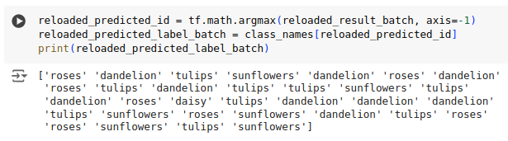
27.20 Export/Reload New Model
https://www.youtube.com/watch?v=LsdxvjLWkIY&list=PLeo1K3hjS3uu7CxAacxVndI4bE_o3BDtO&index=27
Export/Reload New Model (25:01-25:30/25:54)
Check prediction ID and labels of reloaded Model.

Slide 53
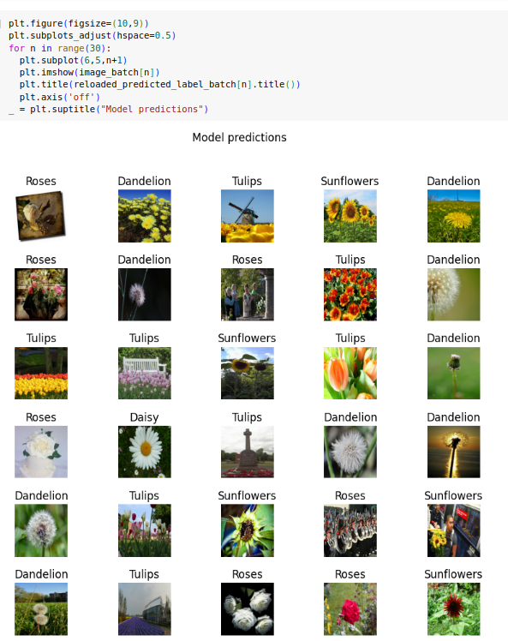
27.20 Export/Reload New Model
https://www.youtube.com/watch?v=LsdxvjLWkIY&list=PLeo1K3hjS3uu7CxAacxVndI4bE_o3BDtO&index=27
Export/Reload New Model (25:31-25:54/25:54)
Plot Reloaded Prediction

Slide 54
End

