Slide 1
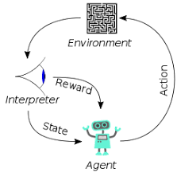
001 RNN Model
Peter H. Chen

Slide 2
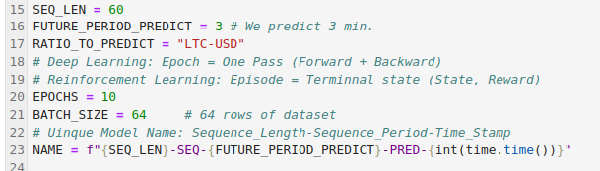
001 RNN Model
https://www.youtube.com/watch?v=yWkpRdpOiPY&list=PLQVvvaa0QuDfhTox0AjmQ6tvTgMBZBEXN&index=11
RNN Model (0:00-2:00/23:05)
1. Define EPOCH = 10 for deep learning epoch (forward pass and backward pass).
Note:
In Game (Reinforcement learning), we have Episode defined for terminal state of game (for state and reward)
2. Define batch size = 64 rows of training dataset.
3. Define unique name: Name contains sequence length, sequence period, and time stamp.

Slide 3
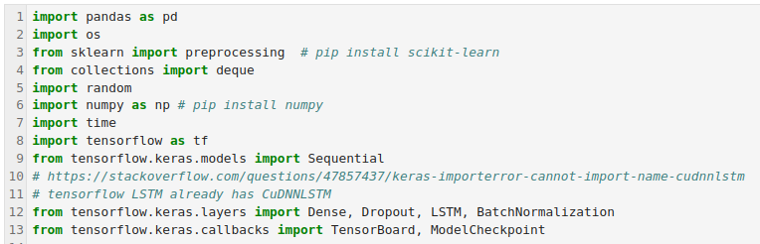
001 RNN Model
https://www.youtube.com/watch?v=yWkpRdpOiPY&list=PLQVvvaa0QuDfhTox0AjmQ6tvTgMBZBEXN&index=11
RNN Model (2:01-4:40/23:05)
Import
1. import time library package
2. Tensorflow library package (framework)
3. import class/function: Sequential from tensorflow models module
4. Import class/function: Dense, Dropout, LSTM, BatchNormalization from tensorflow layer modules.
5. Import Class/function: TensorBoard and ModelCheckpoint from tensorflow model callbacks.

Slide 4
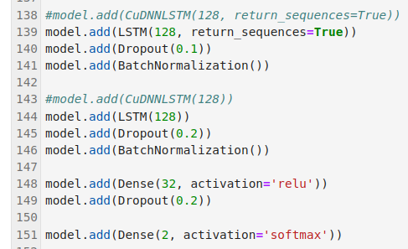
001 RNN Model
https://www.youtube.com/watch?v=yWkpRdpOiPY&list=PLQVvvaa0QuDfhTox0AjmQ6tvTgMBZBEXN&index=11
RNN Model (4:46-8:46/23:05)
Setup LSTM and Neural Network Model
train_x
(60, 8)
LSTM
(128)
O1
LSTM
(128)
O2
LSTM
(128)
O3
Dense
(32)
Dense
(2)

Slide 5
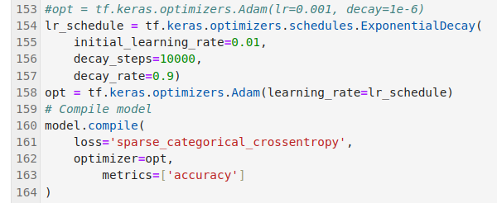
001 RNN Model
https://www.youtube.com/watch?v=yWkpRdpOiPY&list=PLQVvvaa0QuDfhTox0AjmQ6tvTgMBZBEXN&index=11
RNN Model (8:50-10:46/23:05)
Setup parameters for optimizer

Slide 6
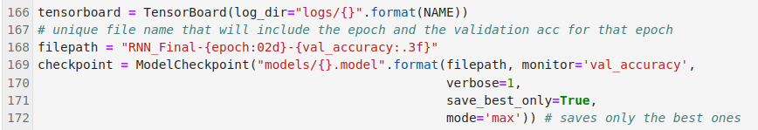
001 RNN Model
https://www.youtube.com/watch?v=yWkpRdpOiPY&list=PLQVvvaa0QuDfhTox0AjmQ6tvTgMBZBEXN&index=11
RNN Model (10:50-11:46/23:05)
Setup tensorboard

Slide 7
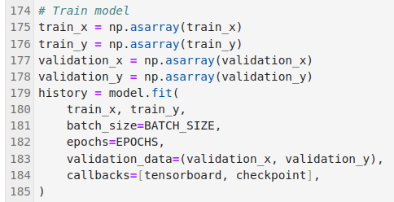
001 RNN Model
https://www.youtube.com/watch?v=yWkpRdpOiPY&list=PLQVvvaa0QuDfhTox0AjmQ6tvTgMBZBEXN&index=11
RNN Model (11:50-12:46/23:05)
Setup train.

Slide 8
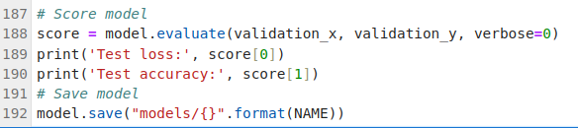
001 RNN Model
https://www.youtube.com/watch?v=yWkpRdpOiPY&list=PLQVvvaa0QuDfhTox0AjmQ6tvTgMBZBEXN&index=11
RNN Model (12:50-13:46/23:05)
1. Evaluate the Score
2. Save Model.

Slide 9
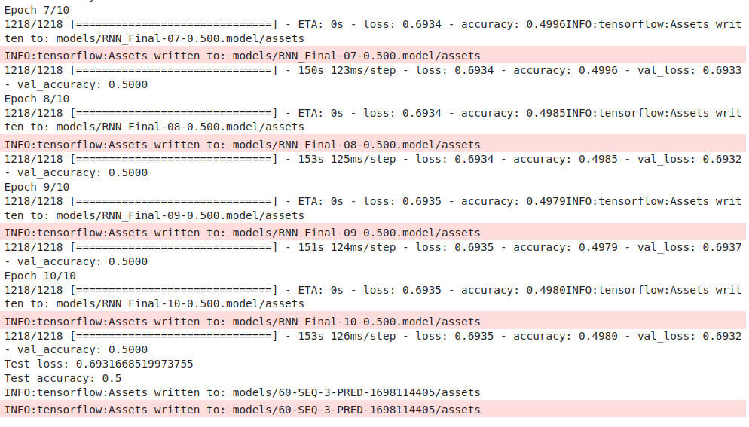
001 RNN Model
https://www.youtube.com/watch?v=yWkpRdpOiPY&list=PLQVvvaa0QuDfhTox0AjmQ6tvTgMBZBEXN&index=11
RNN Model (13:50-23:05/23:05)
Train RNN Model.
When learning rate = 0.01 and decay = 0.9E-4, we have training accuracy = 49% and validation 50%.

Slide 10
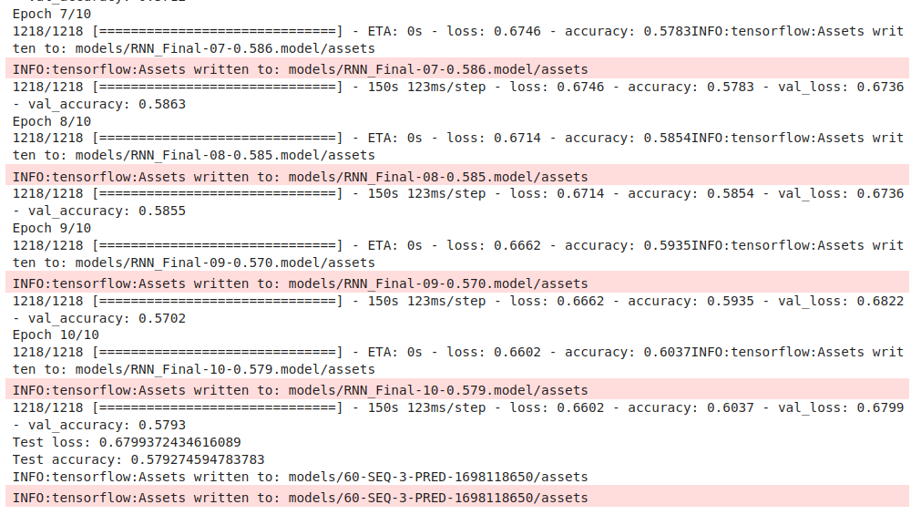
001 RNN Model
https://www.youtube.com/watch?v=yWkpRdpOiPY&list=PLQVvvaa0QuDfhTox0AjmQ6tvTgMBZBEXN&index=11
RNN Model (20:50-23:05/23:05)
Right now, our initialized learning rate = 0.01 and decay = 0.9/10000 = 0.9E-4 with "LTC-USD".
We reset the initialized learning rate to = 0.001 and decay = 0.9/1000000 = 0.9E-6.
Review tensorboard again.

Slide 11
001 RNN Model
https://www.youtube.com/watch?v=yWkpRdpOiPY&list=PLQVvvaa0QuDfhTox0AjmQ6tvTgMBZBEXN&index=11
RNN Model (13:50-20:05/23:05)
Review Tensorboard
> tensordboard –logdir=logs/

Slide 12
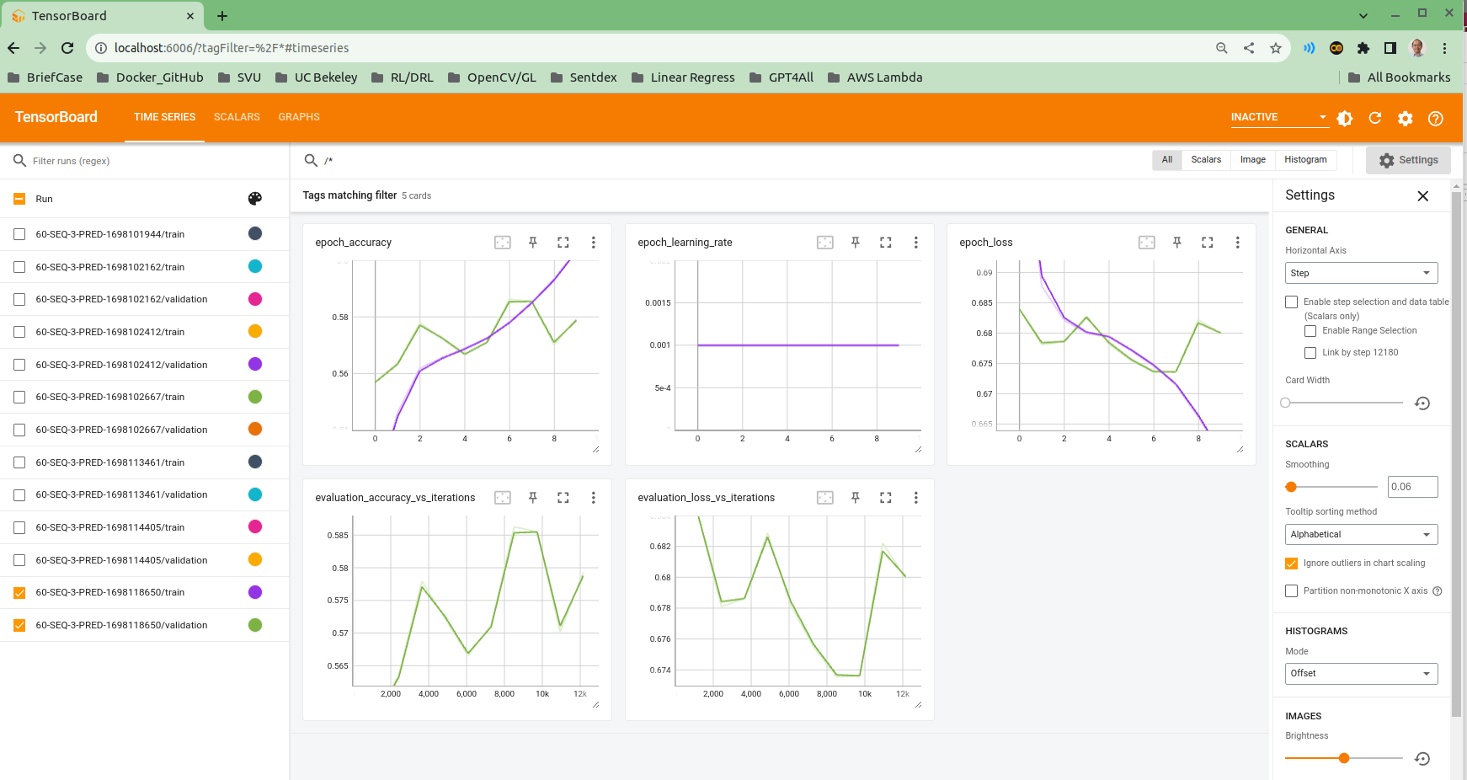
001 RNN Model
https://www.youtube.com/watch?v=yWkpRdpOiPY&list=PLQVvvaa0QuDfhTox0AjmQ6tvTgMBZBEXN&index=11
RNN Model (20:50-23:05/23:05)
>> http://localhost:6006
When initial learning rate = 0.01 and decay = 0.9E-4, we have training accuracy = 49% and validation 50%.
When we change initial learning rate = 0.001 and decay to 1.0E-6, we imprve train accuracy: 60% and validation accuracy 57%.

Slide 13
End

