Slide 1

21.13 Python Imbalanced: Exercise
Peter H. Chen

Slide 2
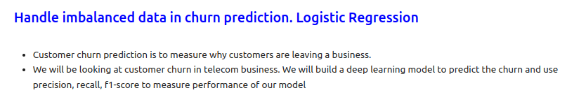
21.13 Python Imbalanced: Exercise
https://www.youtube.com/watch?v=JnlM4yLFNuo&list=PLeo1K3hjS3uu7CxAacxVndI4bE_o3BDtO&index=21
Python Imbalanced: Exercise (36:01-36:10/38:25)
Do the same example with Logistic Regression.

Slide 3
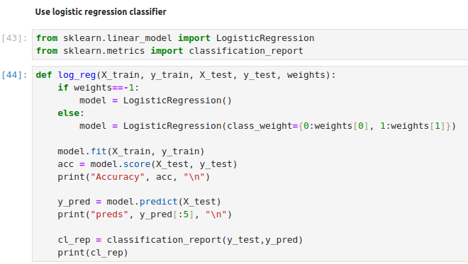
21.13 Python Imbalanced: Exercise
https://www.youtube.com/watch?v=JnlM4yLFNuo&list=PLeo1K3hjS3uu7CxAacxVndI4bE_o3BDtO&index=21
Python Imbalanced: Exercise (36:11-36:20/38:25)
Do the same example with Logistic Regression.

Slide 4
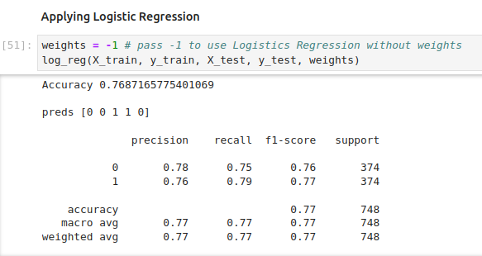
21.13 Python Imbalanced: Exercise
https://www.youtube.com/watch?v=JnlM4yLFNuo&list=PLeo1K3hjS3uu7CxAacxVndI4bE_o3BDtO&index=21
Python Imbalanced: Exercise (36:21-36:30/38:25)
Do the same example with Logistic Regression.

Slide 5
21.14 Import Libraries

Slide 6
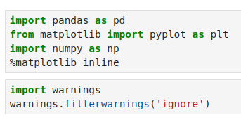
21.14 Import Libraries
https://www.youtube.com/watch?v=JnlM4yLFNuo&list=PLeo1K3hjS3uu7CxAacxVndI4bE_o3BDtO&index=21
Import Libraries (36:31-36:40/38:25)

Slide 7
21.15 Read Data

Slide 8
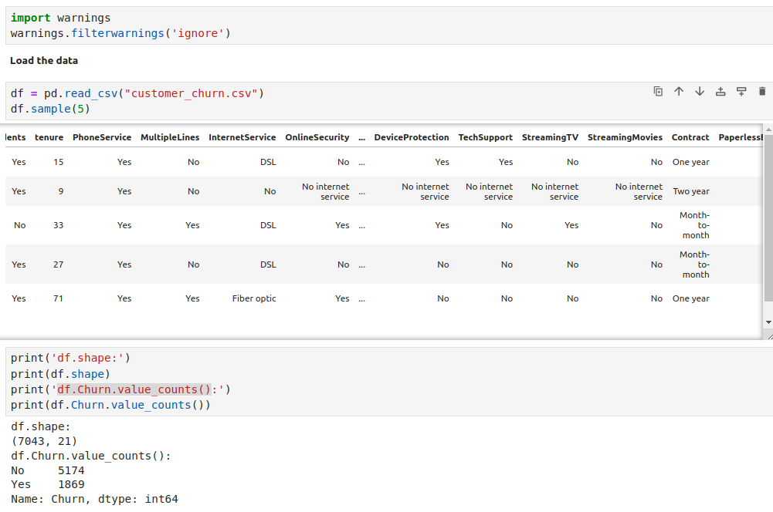
21.15 Read Data
https://www.youtube.com/watch?v=JnlM4yLFNuo&list=PLeo1K3hjS3uu7CxAacxVndI4bE_o3BDtO&index=21
Read Data (36:41-36:50/38:25)
Read Data: 7043 (rows) x 21 (columns)

Slide 9
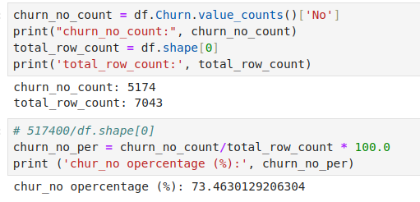
21.15 Read Data
https://www.youtube.com/watch?v=JnlM4yLFNuo&list=PLeo1K3hjS3uu7CxAacxVndI4bE_o3BDtO&index=21
Read Data (36:51-37:00/38:25)
We have majority (no) in churn: 73.46%

Slide 10
21.16 Cleanup Data

Slide 11
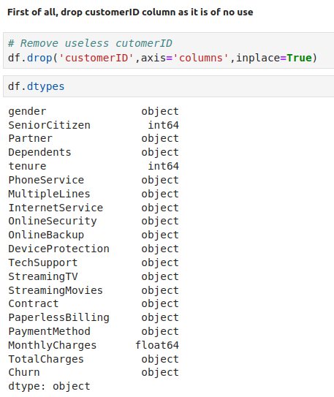
21.16 Cleanup Data
https://www.youtube.com/watch?v=JnlM4yLFNuo&list=PLeo1K3hjS3uu7CxAacxVndI4bE_o3BDtO&index=21
Cleanup Data (37:01-37:10/38:25)
Remove useless column: CustomerID

Slide 12
21.17 Check Valid/Invalid Data

Slide 13
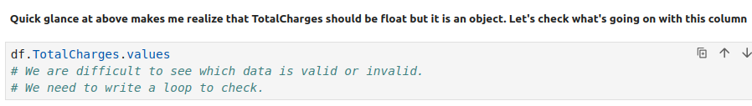
21.17 Check Valid/Invalid Data
https://www.youtube.com/watch?v=JnlM4yLFNuo&list=PLeo1K3hjS3uu7CxAacxVndI4bE_o3BDtO&index=21
Check Valid/Invalid Data (37:11-37:20/38:25)
There are invalid value (empty ‘ ’) in TotalCharges column.
They are difficult to see is valid or invalid (‘’) data.
We need to write a loop to check how many of them are valid and invlaid.

Slide 14
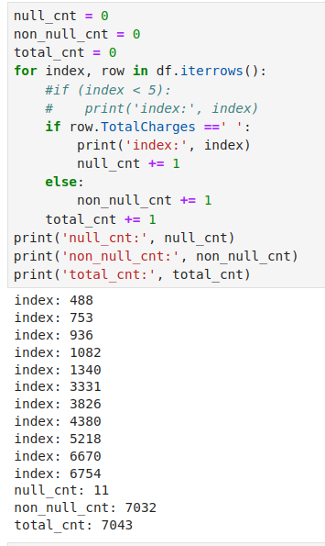
21.17 Check Valid/Invalid Data
https://www.youtube.com/watch?v=JnlM4yLFNuo&list=PLeo1K3hjS3uu7CxAacxVndI4bE_o3BDtO&index=21
Check Valid/Invalid Data (37:21-37:30/38:25)
There are invalid value (empty ‘ ’) in TotalCharges column.
1. Totally, we have 7043 rows (samples)
2. We have 11 invalid data, i.e., empty (‘ ‘) data.
3. We have 7032 valid data.

Slide 15
21.18 Covert Rows with Valid Data

Slide 16
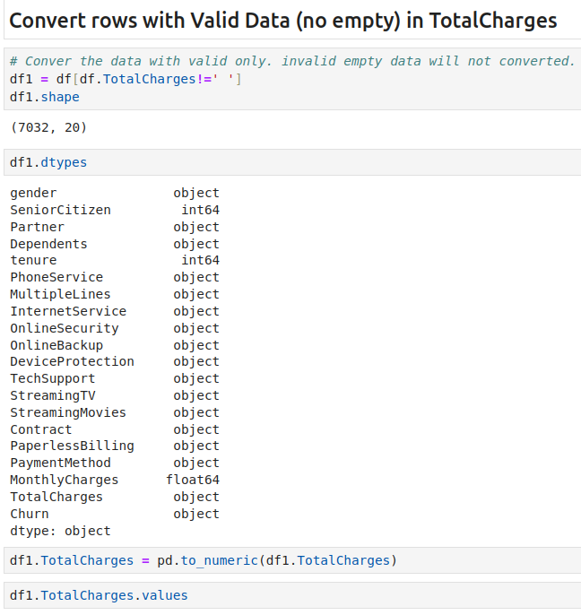
21.18 Covert Rows with Valid Data
https://www.youtube.com/watch?v=JnlM4yLFNuo&list=PLeo1K3hjS3uu7CxAacxVndI4bE_o3BDtO&index=21
Convert Row with Valid Data (37:31-37:40/38:25)

Slide 17
21.19 Plot Churn Data

Slide 18
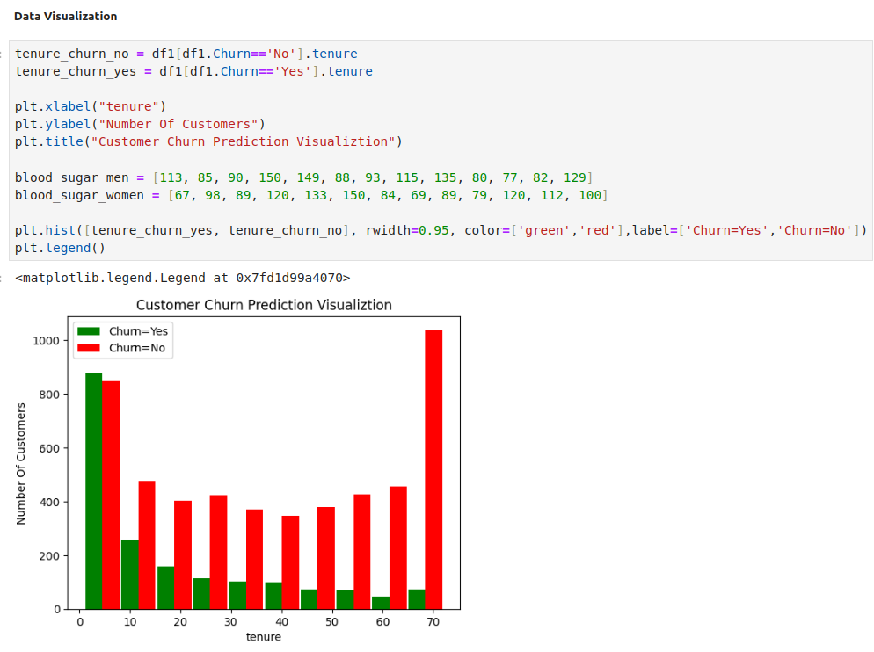
21.19 Plot Churn Data
https://www.youtube.com/watch?v=JnlM4yLFNuo&list=PLeo1K3hjS3uu7CxAacxVndI4bE_o3BDtO&index=21
Plot Churn Data (37:41-37:42/38:25)

Slide 19
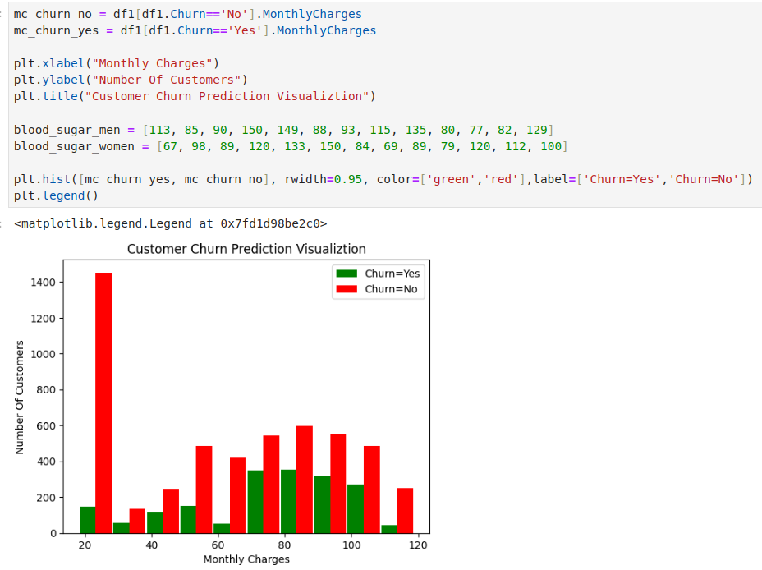
21.19 Plot Churn Data
https://www.youtube.com/watch?v=JnlM4yLFNuo&list=PLeo1K3hjS3uu7CxAacxVndI4bE_o3BDtO&index=21
Plot Churn Data (37:42-37:50/38:25)

Slide 20
21.20 Replace Text Data to 0/1

Slide 21
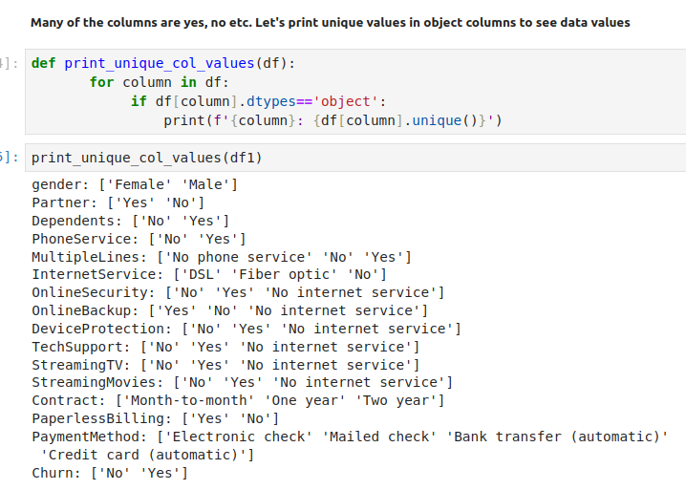
21.20 Replace Text Data to 0/1
https://www.youtube.com/watch?v=JnlM4yLFNuo&list=PLeo1K3hjS3uu7CxAacxVndI4bE_o3BDtO&index=21
Replace Text Data to 0/1 (37:51-38:00/38:25)
Replace Yes/No into 1/0.

Slide 22
21.21 One-Hot-Encoding

Slide 23
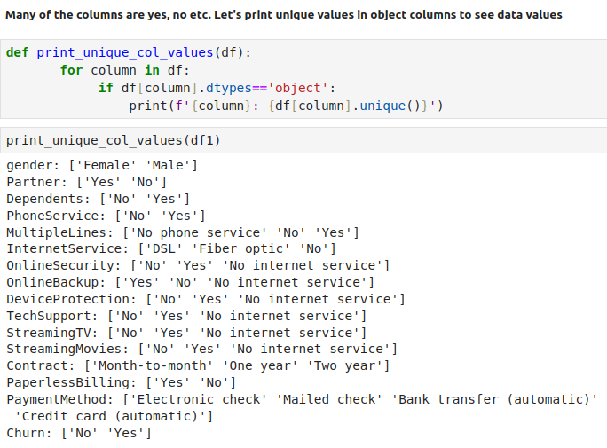
21.21 One-Hot-Encoding
https://www.youtube.com/watch?v=JnlM4yLFNuo&list=PLeo1K3hjS3uu7CxAacxVndI4bE_o3BDtO&index=21
One-Hot-Encoding (38:01-38:02/38:25)
Some columns has more than 0/1. Need to uniquefy them with one-hot-encoding.

Slide 24
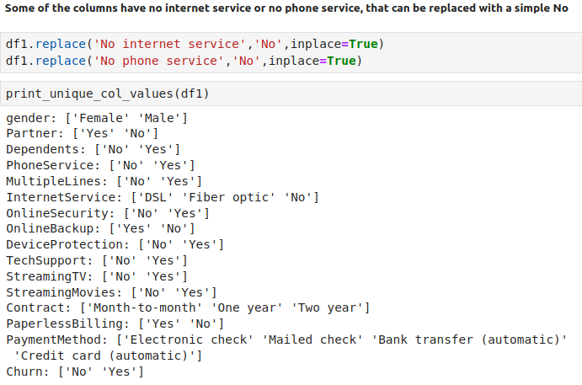
21.21 One-Hot-Encoding
https://www.youtube.com/watch?v=JnlM4yLFNuo&list=PLeo1K3hjS3uu7CxAacxVndI4bE_o3BDtO&index=21
One-Hot-Encoding (38:03-38:04/38:25)

Slide 25
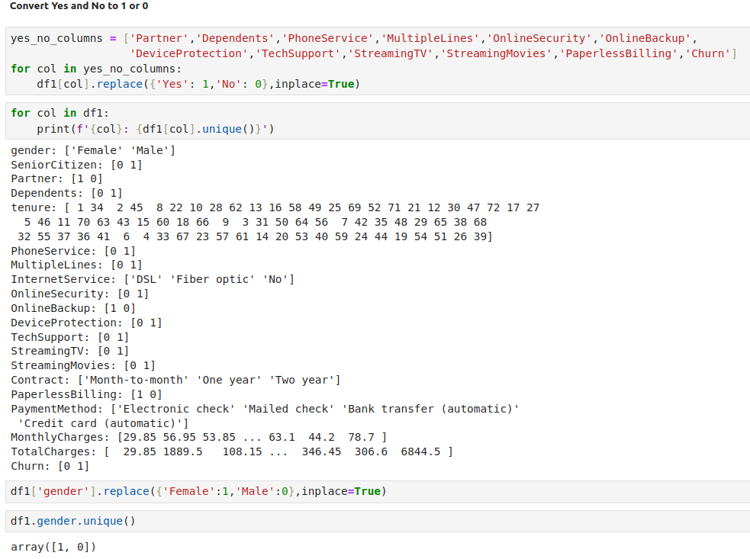
21.21 One-Hot-Encoding
https://www.youtube.com/watch?v=JnlM4yLFNuo&list=PLeo1K3hjS3uu7CxAacxVndI4bE_o3BDtO&index=21
One-Hot-Encoding (38:05-38:06/38:25)

Slide 26
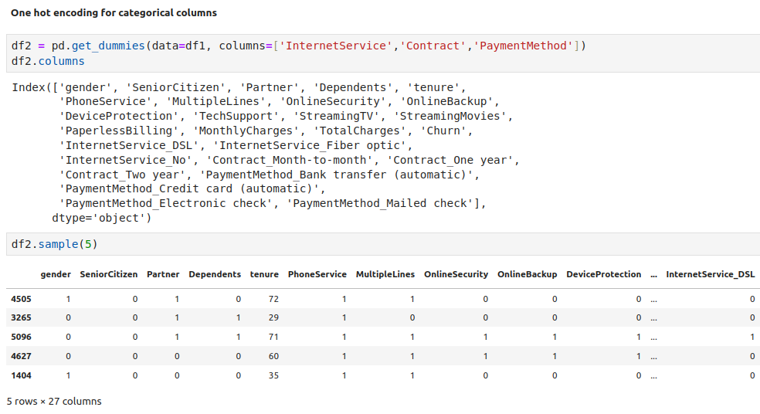
21.21 One-Hot-Encoding
https://www.youtube.com/watch?v=JnlM4yLFNuo&list=PLeo1K3hjS3uu7CxAacxVndI4bE_o3BDtO&index=21
One-Hot-Encoding (38:07-38:08/38:25)

Slide 27
21.22 Use Logic Regression Classifier

Slide 28
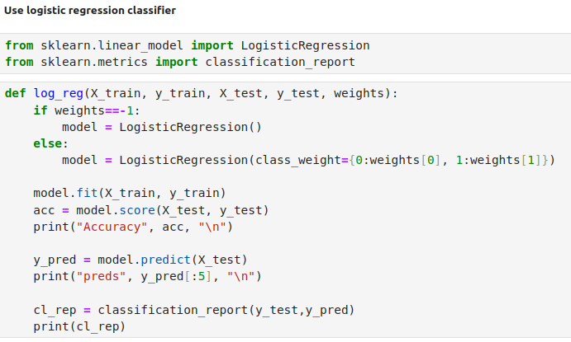
21.22 Use Logic Regression Classifier
https://www.youtube.com/watch?v=JnlM4yLFNuo&list=PLeo1K3hjS3uu7CxAacxVndI4bE_o3BDtO&index=21
Use Logic Regression Classifier (38:09-38:10/38:25)

Slide 29
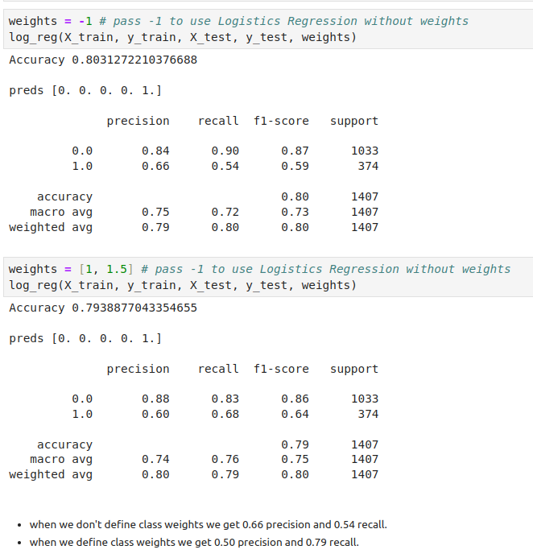
21.22 Use Logic Regression Classifier
https://www.youtube.com/watch?v=JnlM4yLFNuo&list=PLeo1K3hjS3uu7CxAacxVndI4bE_o3BDtO&index=21
Use Logic Regression Classifier (38:11-38:12/38:25)

Slide 30
21.23 Under Sampling

Slide 31
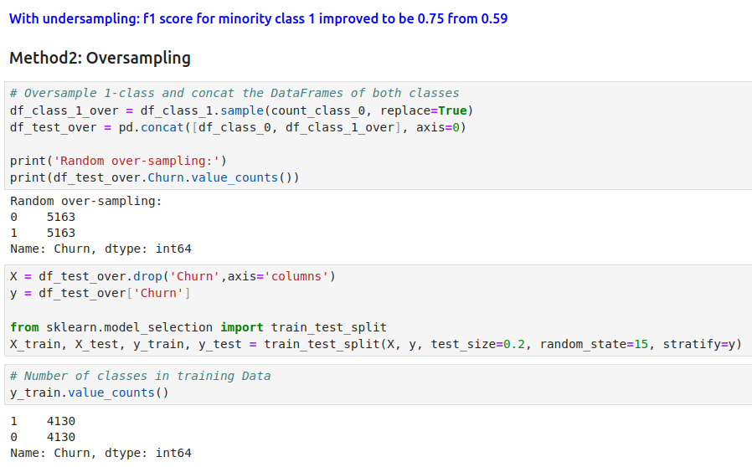
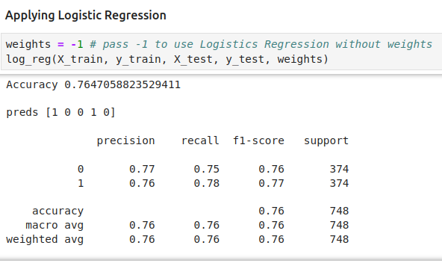
21.23 Under Sampling
https://www.youtube.com/watch?v=JnlM4yLFNuo&list=PLeo1K3hjS3uu7CxAacxVndI4bE_o3BDtO&index=21
Under Sampling (38:13-38:14/38:25)

Slide 32
21.24 Over Sampling

Slide 33
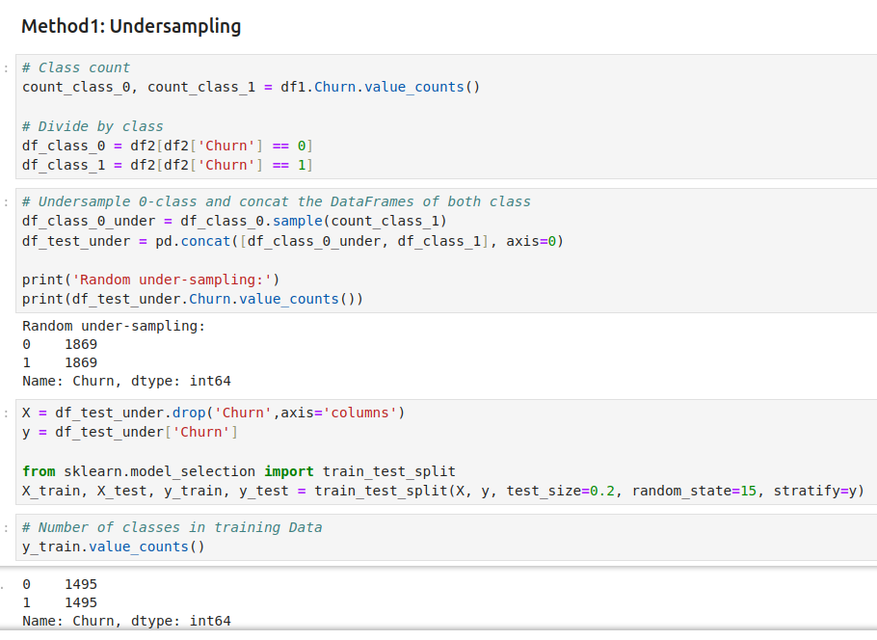
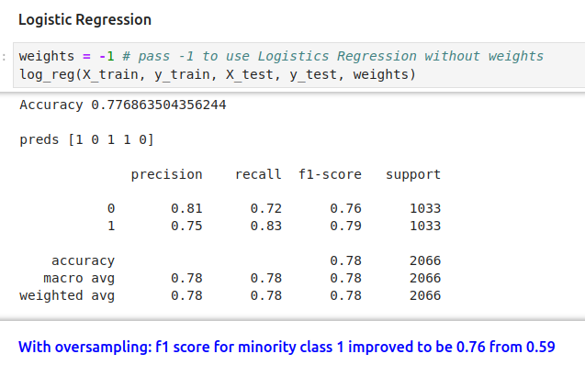
21.24 Over Sampling
https://www.youtube.com/watch?v=JnlM4yLFNuo&list=PLeo1K3hjS3uu7CxAacxVndI4bE_o3BDtO&index=21
Over Sampling (38:15-38:16/38:25)

Slide 34
21.25 SMOTE Sampling

Slide 35
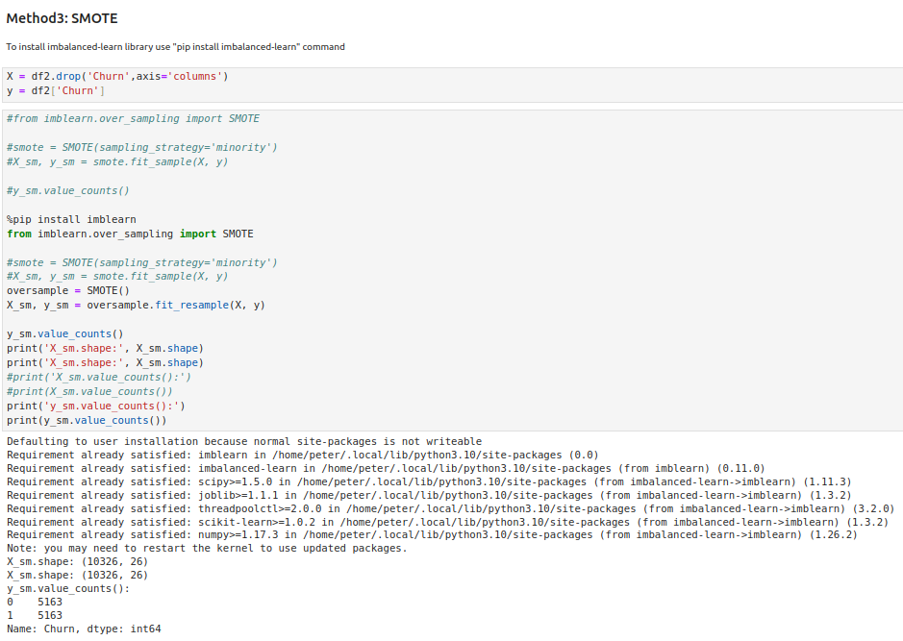
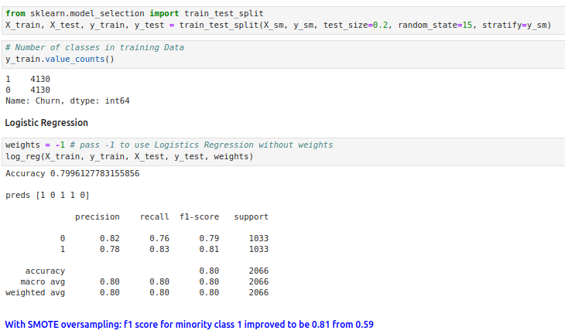
21.25 SMOTE Sampling
https://www.youtube.com/watch?v=JnlM4yLFNuo&list=PLeo1K3hjS3uu7CxAacxVndI4bE_o3BDtO&index=21
SMOTE Sampling (38:15-38:16/38:25)

Slide 36
21.26 Ensemble Sampling

Slide 37
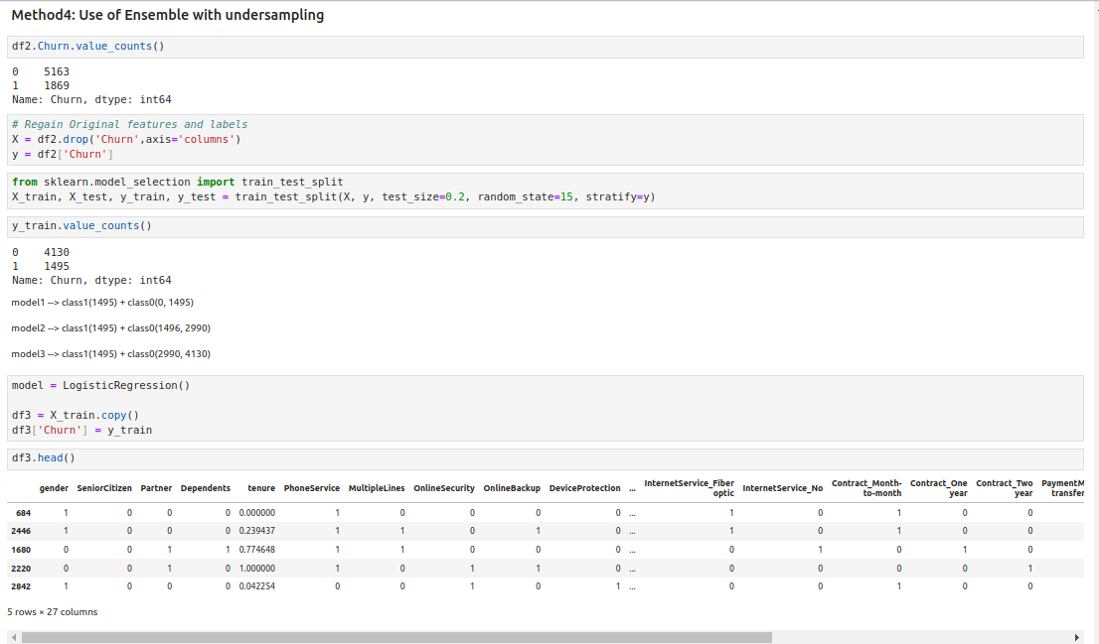
21.26 Ensemble Sampling
https://www.youtube.com/watch?v=JnlM4yLFNuo&list=PLeo1K3hjS3uu7CxAacxVndI4bE_o3BDtO&index=21
Ensemble Sampling (38:17-38:20/38:25)

Slide 38
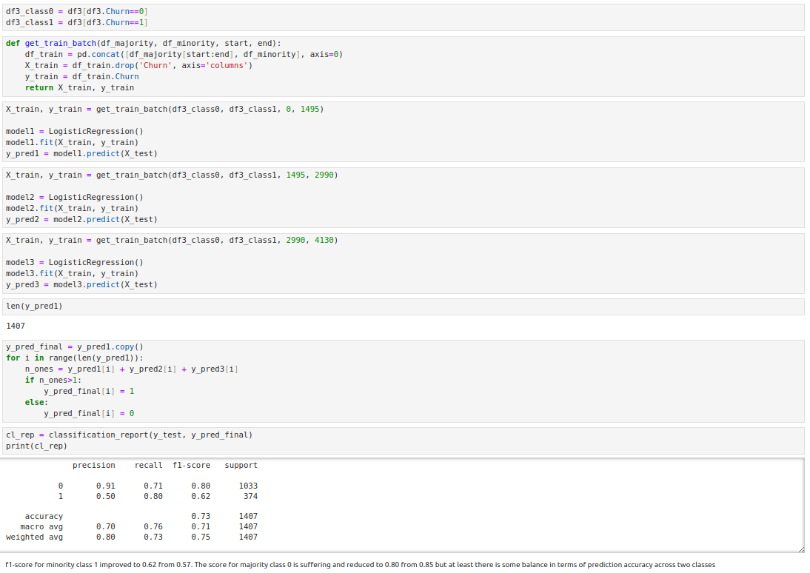
21.26 Ensemble Sampling
https://www.youtube.com/watch?v=JnlM4yLFNuo&list=PLeo1K3hjS3uu7CxAacxVndI4bE_o3BDtO&index=21
Ensemble Sampling (38:21-38:25/38:25)

Slide 39
End

