Slide 1

21.00 Review Week 10: Dropout
Peter H. Chen

Slide 2
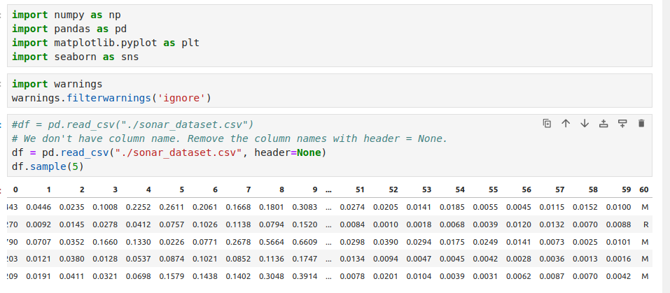
21.00 Review Week 10: Dropout
https://www.youtube.com/watch?v=lcI8ukTUEbo&list=PLeo1K3hjS3uu7CxAacxVndI4bE_o3BDtO&index=20
Review Week 10: Dropout
In the Sonar database, the last column is R (Rock) or M (Mines).
These are non-numeric (not integer or not float). We need to convert them into integer or one-hot-encoding.

Slide 3
21.01 Review Week 10: Convert Text into Numeric

Slide 4
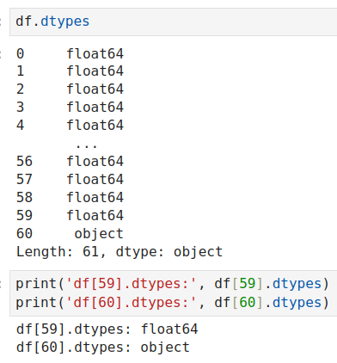
21.01 Review Week 10: Convert Text into Numeric
https://www.youtube.com/watch?v=lcI8ukTUEbo&list=PLeo1K3hjS3uu7CxAacxVndI4bE_o3BDtO&index=20
Review Week 10: Convert Text into Numeric
We have column 60 which is object (Text: not integer and not float).

Slide 5
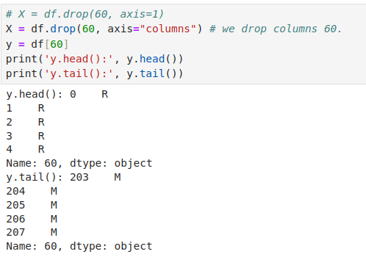
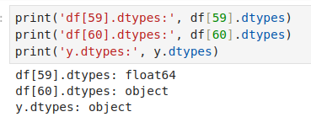
21.01 Review Week 10: Convert Text into Numeric
https://www.youtube.com/watch?v=lcI8ukTUEbo&list=PLeo1K3hjS3uu7CxAacxVndI4bE_o3BDtO&index=20
Review Week 10: Convert Text into Numeric
We drop column 60 in X and put column 60 in y. Now, y.dtypes is object. We need to convert text into integer or one-hot-encoding.

Slide 6
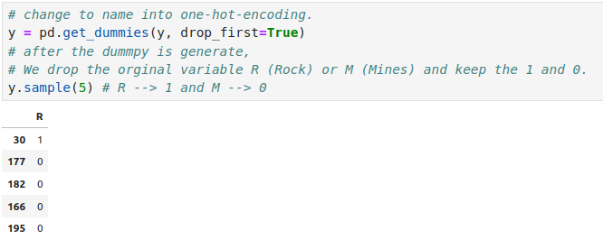
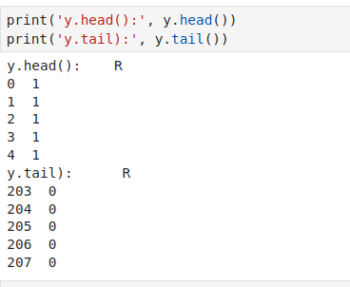
21.01 Review Week 10: Convert Text into Numeric
https://www.youtube.com/watch?v=lcI8ukTUEbo&list=PLeo1K3hjS3uu7CxAacxVndI4bE_o3BDtO&index=20
Review Week 10: Convert Text into Numeric
We use pandas get_dummies (y) to convert into integers.
What is pandas get_dummies() do?
1. Convert categorical variable into dummy/indicator variables. Each variable is converted in as many 0/1 variables as there are different values.
2. Columns in the output are each named after a value. If the input is a DataFrame, the name of the original variable is prepended to the value.

Slide 7
21.02 Dropout Input Layers

Slide 8
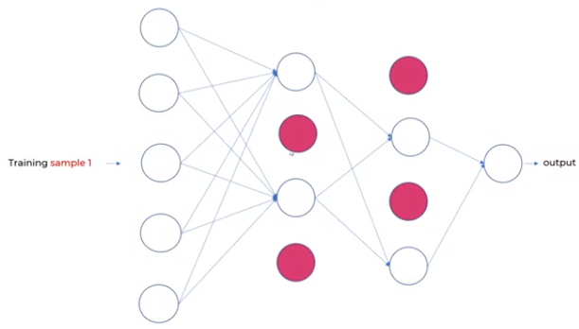
21.0 Dropout Input Layer
https://www.youtube.com/watch?v=lcI8ukTUEbo&list=PLeo1K3hjS3uu7CxAacxVndI4bE_o3BDtO&index=20
Dropout Input Layer
Can we dropout the input layer?
1. Dropout can be applied to input neurons called the visible layer.
If the number of drop neurons is round into intger number., e.g., 2.5 neurons will be round into 2 neurons.
https://machinelearningmastery.com/dropout-regularization-deep-learning-models-keras/#:~:text=Dropout%20can%20be%20applied%20to,excluded%20from%20each%20update%20cycle.

Slide 9
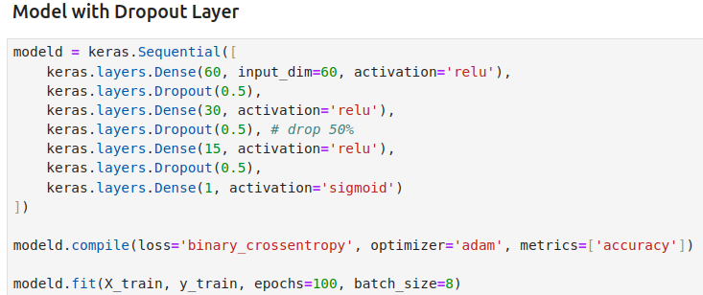
21.0 Dropout Input Layer
https://www.youtube.com/watch?v=lcI8ukTUEbo&list=PLeo1K3hjS3uu7CxAacxVndI4bE_o3BDtO&index=20
Dropout Overfitting (3:34-4:00/19:01)
Dropout input layer.

Slide 10
End

