Slide 1

24.9 Exercise: Handwritten Digit from ANN to CNN
Peter H. Chen

Slide 2
24.9 Exercise: Handwritten Digit from ANN to CNN
https://www.youtube.com/watch?v=7HPwo4wnJeA&list=PLeo1K3hjS3uu7CxAacxVndI4bE_o3BDtO&index=24
Exercise: Hand-Written Digit from ANN to CNN (24:31-24:50/28:11)
Use CNN instead of ANN to do handwritten digits classification using MNIST dataset.
ANN Code is below:
https://github.com/peterhchen/AIU_CS512_DL/tree/main/000_Lecture_Project/week12/02_Code
Above we used ANN for digits classification.
You need to modify this code to use CNN instead.
Check how accuracy improves fast with CNN and figure out how CNN can be a better choice for doing image classification compared to ANN.
Once you have worked on this problem on your own, you can check my solution by clicking on this link:

Slide 3
24.10 Handwriting Digit with ANN

Slide 4
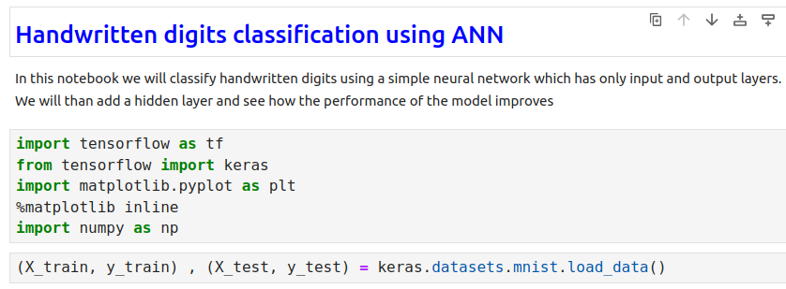
24.10 Handwriting Digit with ANN
https://www.youtube.com/watch?v=7HPwo4wnJeA&list=PLeo1K3hjS3uu7CxAacxVndI4bE_o3BDtO&index=24
Handwriting Digit with ANN (24:51-25:00/28:11)

Slide 5
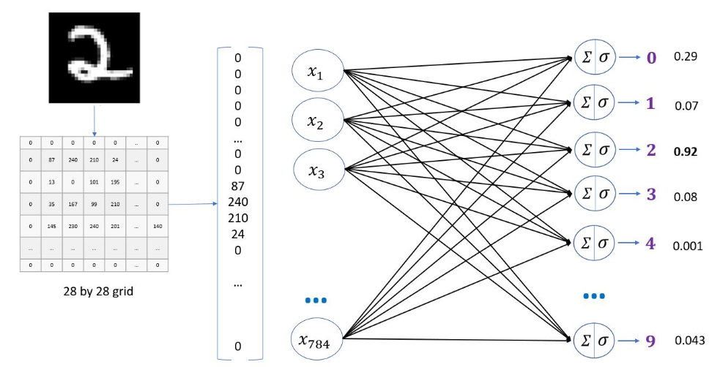
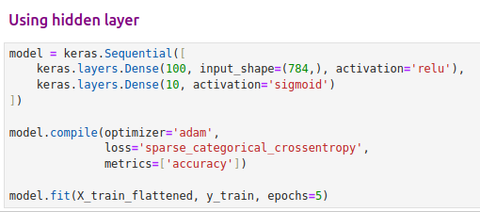

24.10 Handwriting Digit with ANN
https://www.youtube.com/watch?v=7HPwo4wnJeA&list=PLeo1K3hjS3uu7CxAacxVndI4bE_o3BDtO&index=24
Handwriting Digit with ANN (25:01-25:10/28:11)
We have accuracy 97%.
Now, we want to remove some neurons and add extraction layers.

Slide 6
End

