Slide 1

24.11 Handwriting Digit with CNN
Peter H. Chen

Slide 2
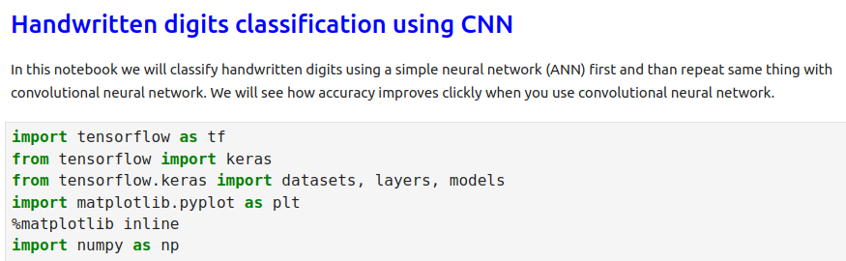
24.11 Handwriting with CNN
https://www.youtube.com/watch?v=7HPwo4wnJeA&list=PLeo1K3hjS3uu7CxAacxVndI4bE_o3BDtO&index=24
Handwriting Digit with CNN (25:11-25:20/28:11)
Import Libraries

Slide 3
24.12 Previous ANN Code

Slide 4
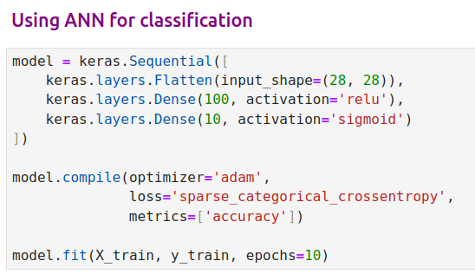
24.12 Previous ANN Code
https://www.youtube.com/watch?v=7HPwo4wnJeA&list=PLeo1K3hjS3uu7CxAacxVndI4bE_o3BDtO&index=24
Previous ANN Code (25:21-25:30/28:11)

Slide 5
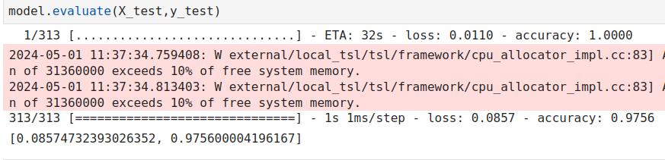
24.12 Previous ANN Code
https://www.youtube.com/watch?v=7HPwo4wnJeA&list=PLeo1K3hjS3uu7CxAacxVndI4bE_o3BDtO&index=24
Previous ANN Code (25:31-26:00/28:11)

Slide 6
24.13 Exercise: Handwriting Digit CNN Code

Slide 7
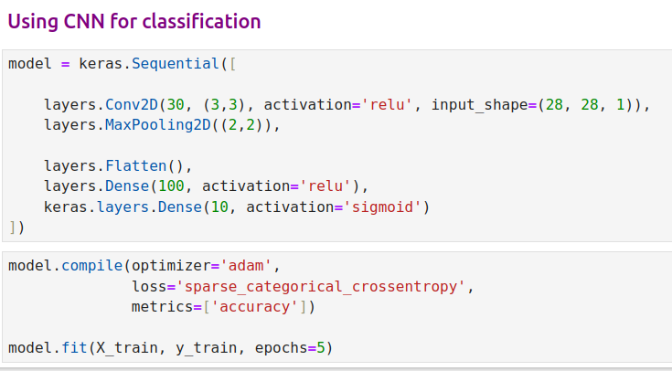
24.13 Exercise: Handwriting Digit CNN Code
https://www.youtube.com/watch?v=7HPwo4wnJeA&list=PLeo1K3hjS3uu7CxAacxVndI4bE_o3BDtO&index=24
Exercise: Handwriting Digit CNN (26:01-27:00/28:11)
Here, we reduce the input shape from 28 x 28 into 3 x 3.
We still keep the neuron 100. We can reduce the Dense neurons to any number by trial and error.

Slide 8
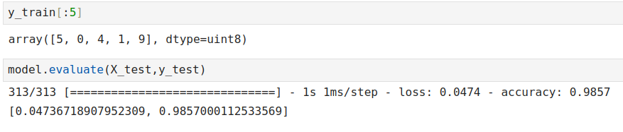
24.13 Exercise: Handwriting Digit CNN Code
https://www.youtube.com/watch?v=7HPwo4wnJeA&list=PLeo1K3hjS3uu7CxAacxVndI4bE_o3BDtO&index=24
Exercise: Handwriting Digit CNN (27:01-28:11/28:11)
We reduce input layer neurons to improve the overfitting and speed.
The accuracy still better.
ANN: 97%
CNN: 98%.

Slide 9
End

